Slide 1
UN Battery Classification Test Method Development
Steve Rehn, Joe Sica

Slide 2
Introduction
Informal Working Group (IWG) responsible for creating a hazard-based classification system for batteries and cells
Hazards based on batteries ability to catch fire and propagate from cell to cell
Meeting held on August 27 – 29 in Washington D.C.
Three labs presented test data
Lots of discussion on heating rates and the arrangement of the classification decision tree

Slide 3
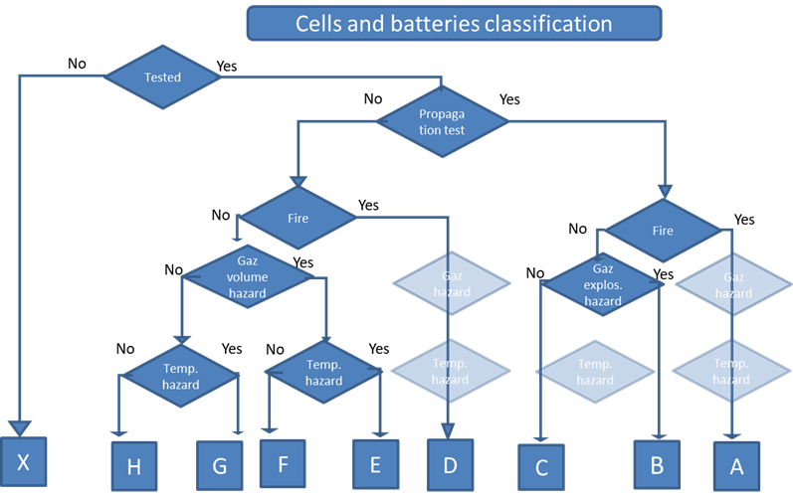
Current Decision Tree
Current Decision tree has separate category for fire and gas explosion hazard
Fire: cell self-ignites
Gas explosion hazard: Cell releases flammable gas, but does not self-ignite
Test procedure requires you to test battery 3 times to determine if it propagates and catches on fire
3 tests with no self-ignition is not enough to prove that the cell will never self ignite

Slide 4
Recent Flammability Testing
FAA conducted same propagation test 5 times with no ignitor
Four 2.59Wh pouch cells placed in line

Slide 6
Recent Flammability Testing
2 out of 5 tests had self ignition
Ignition occurred after the 4th cell went into thermal runaway on both of those tests
Batteries like this could potentially lead to a situation where it gets a lower classification because it does not self-ignite in lab testing
Propagation test is less repeatable without ignitor

Slide 7
Simplified Decision Tree
At the previous UN Dangerous Goods Committee meeting in summer 2024, the IWG was told there were too many categories
FAA also presented a simplified decision tree to the IWG in December 2023.

Slide 8
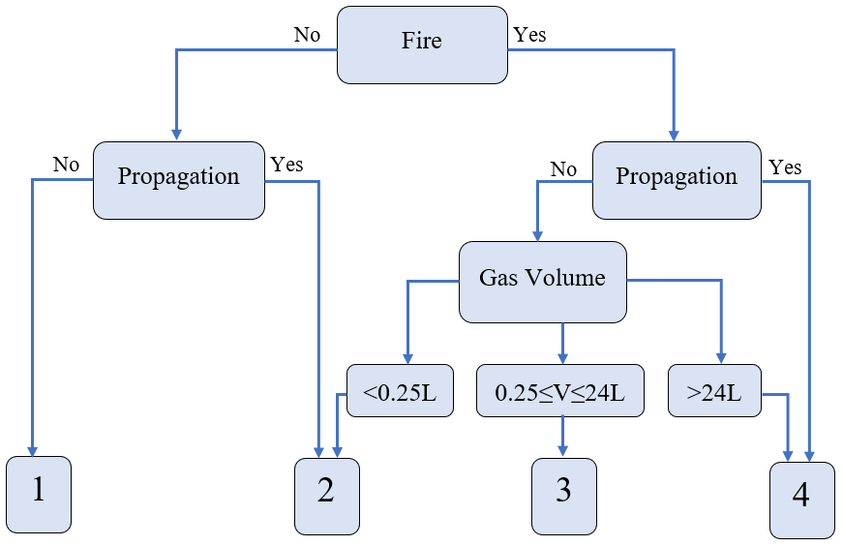
FAA Simplified Decision Tree
Places fire as the top level threat
Category 1: Minimal threat level
Category 2: Temperature hazard
Category 3: Fire hazard, but limited in size, also fuel source for external fire
Category 4: Fire and propagation hazard, or large fire hazard from single cell

Slide 9
Additional Options

Slide 10
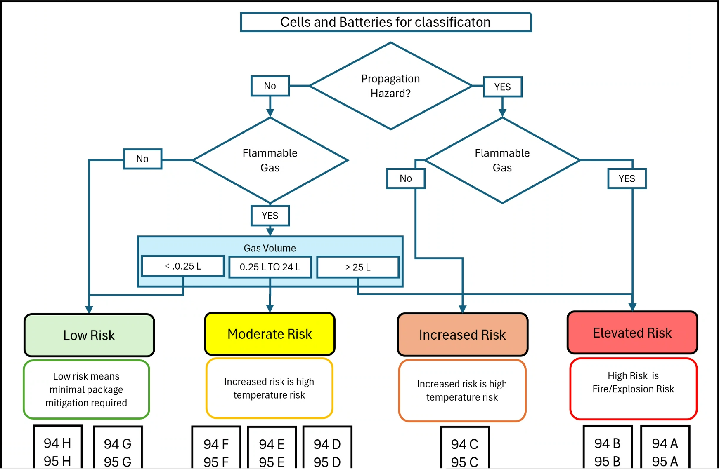
Additional Options

Slide 11
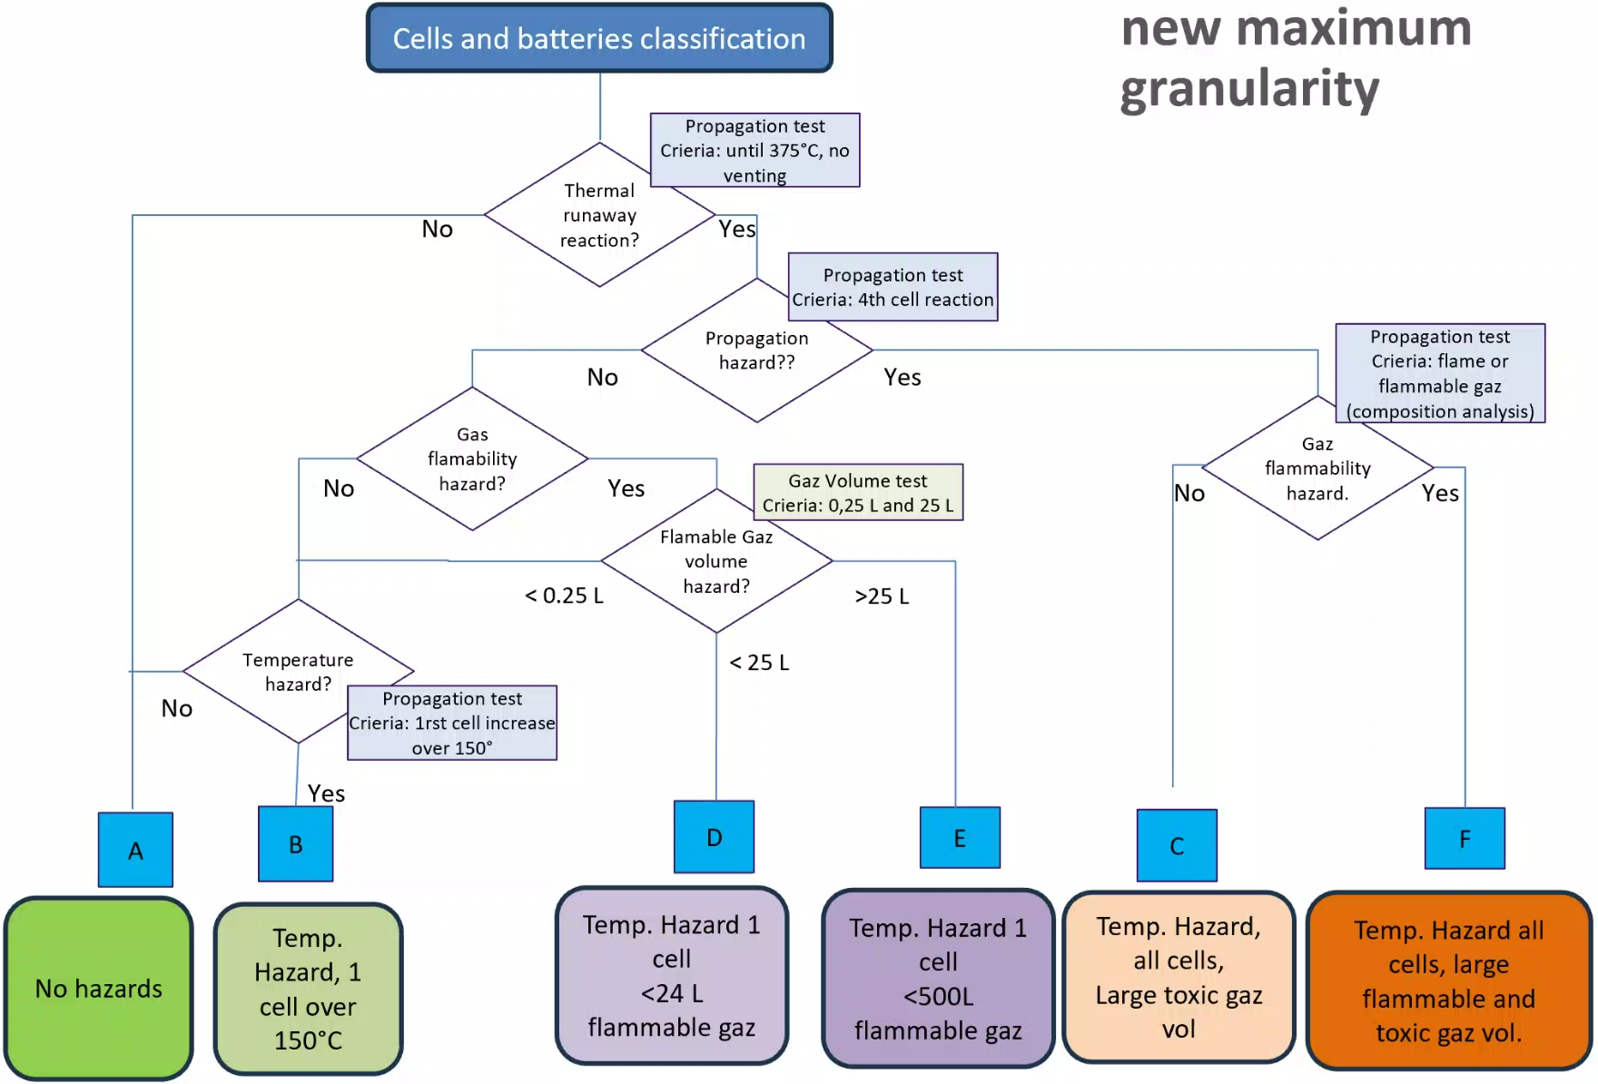
Additional Options

Slide 12
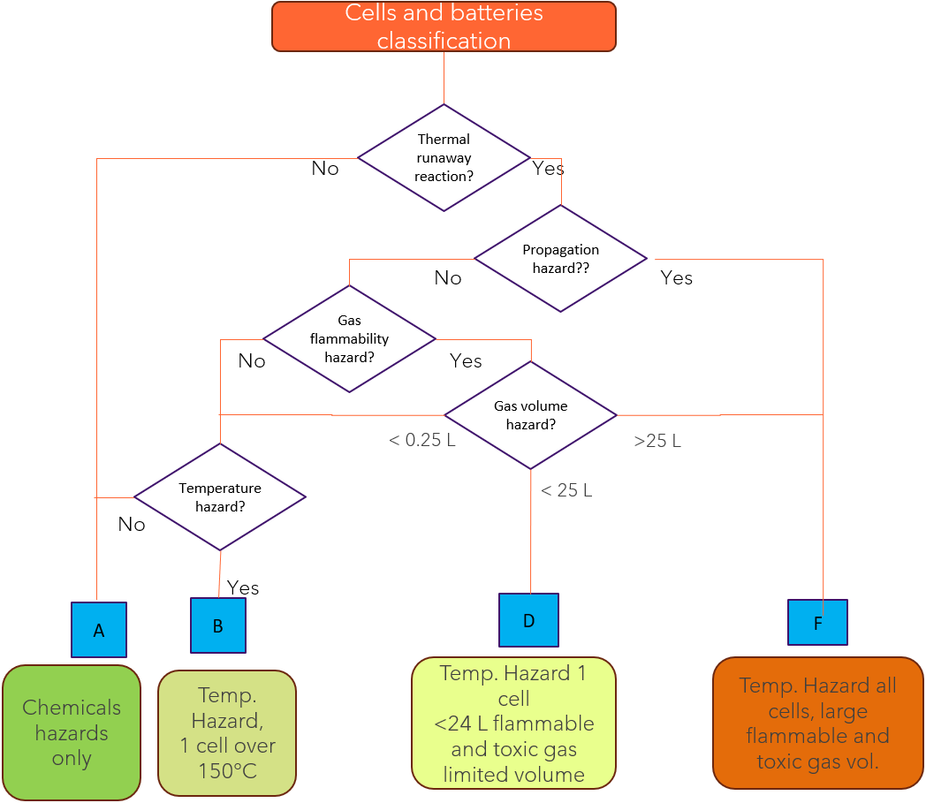
Additional Options

Slide 13
Conclusion and Future Work
Decision Tree will be simplified
Four categories seemed to be the most popular choice
Next IWG meeting is February – March 2025 in Shanghai, China
Test procedures for battery propagation test and gas volume test need more detail
Round Robin for those test procedures

Slide 14
State of Charge Round Robin
FAA has batteries ready to ship out to labs for a state-of-charge round robin.
Originally set up for G-27 group
FAA will send out two specimens each of five cells of different size and chemistries, each lab will charge to 30% and 70% SOC
Each lab reports charging method and other details and sends them back to FAA
FAA checks SOC of all cells using the same charger and method to determine variability in setting the state of charge
Need labs to participate

Slide 15
Questions?
Contact:
Steven Rehn
Federal Aviation Administration
William J. Hughes Technical Center
Fire Safety Branch, Bldg. 203
Atlantic City Int’l Airport, NJ 08405
(609) 485-5587
steven.rehn@faa.gov

