Slide 1
Handheld Extinguisher Toxicity Update
International Aircraft Materials and Systems Forum Meeting
Natallia Safronava, Robert Morrison, Timothy Marker
April 16-18, 2024, Bremen, Germany

Slide 2
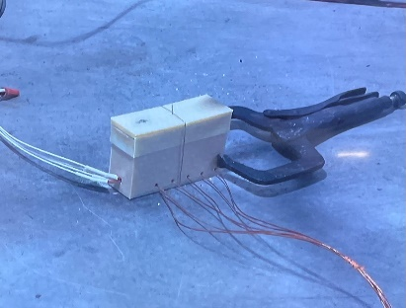
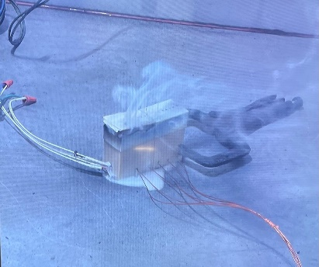
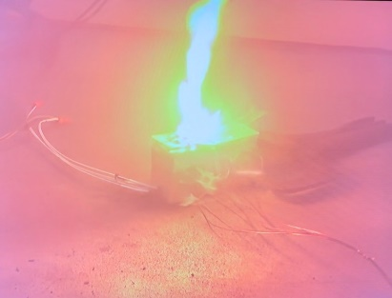
Outline
Project motivation
Timeline
Instrumentation and test compartment setup
Test details
Test results
Summary

Slide 3
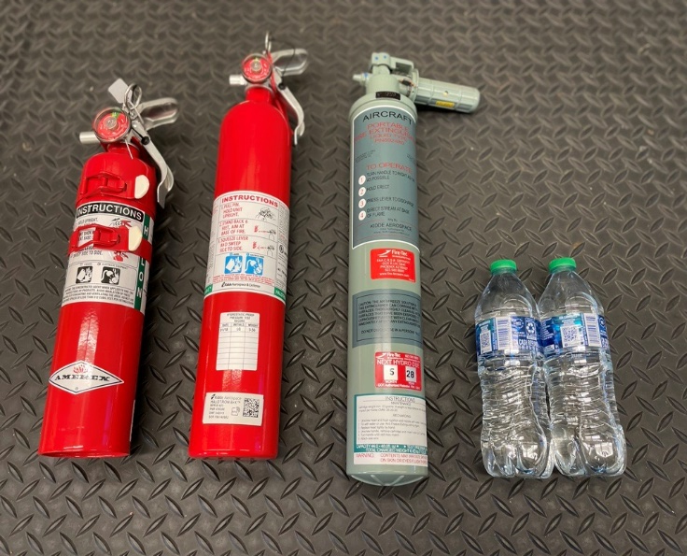
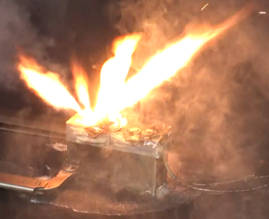
Motivation
Evaluate the difference in thermal and toxic hazards of handheld extinguishing agents used on Lithium-Ion battery fires in small compartments.
Agents:
Halon 1211
Halotron BrX (stabilized 2-BTP)
Water (2 x 0.5L bottles)
Water Extinguisher
Batteries:
18650
Pouch cells

Slide 4
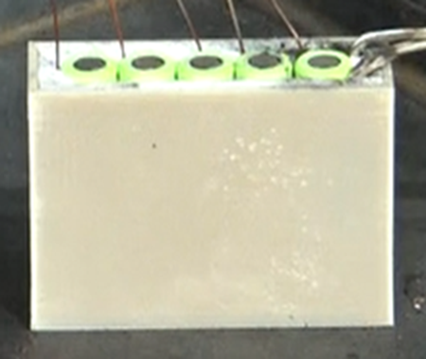
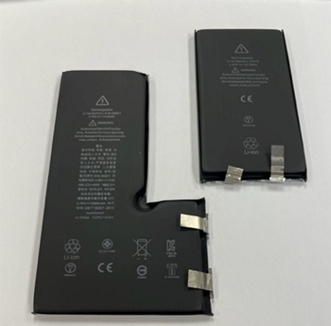
Testing timeline
Testing started summer 2022 with 18650 5 cells pack and two agents.
Pouch cells were added in December 2022 ( two agents).
Additional agents were added to 18650 and pouch cells testing matrixes in summer 2023.
Total number of tests was 41 for two types of cells and 4 agents.

Slide 5
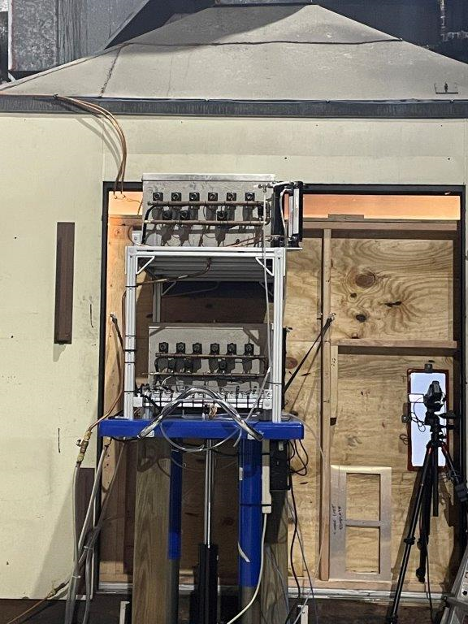
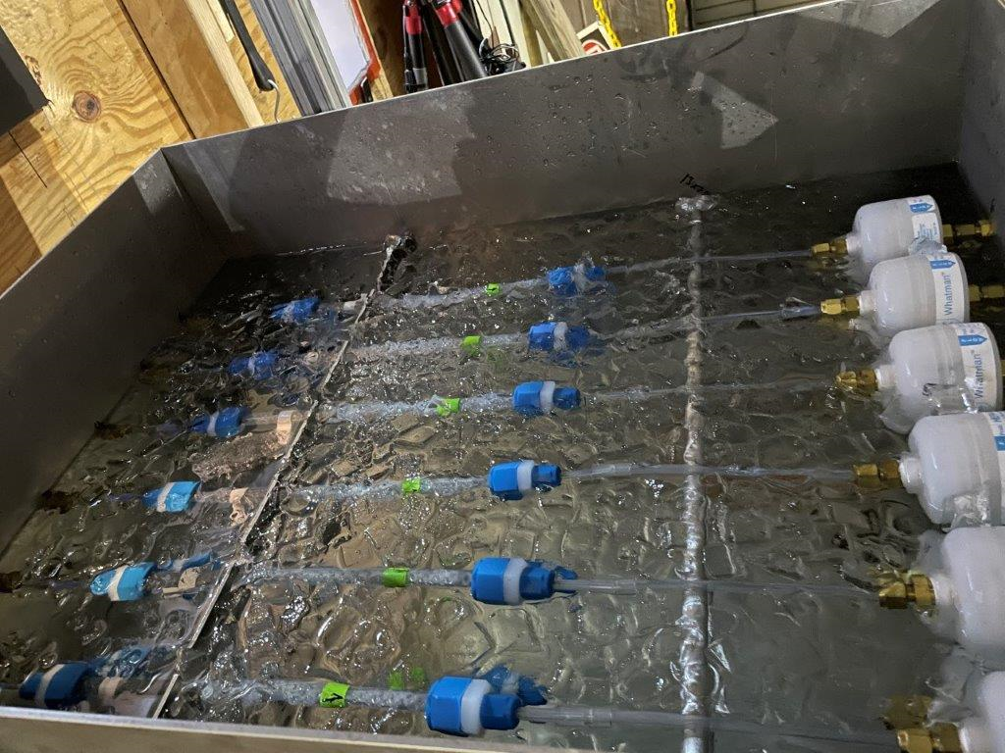
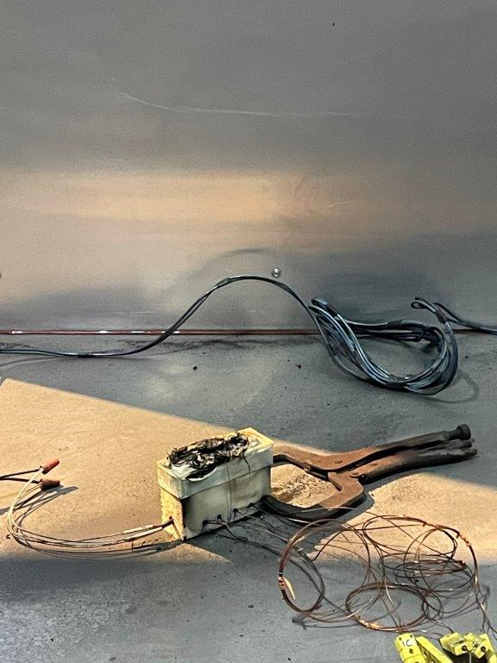
Instrumentation
Multiple TC
NDIR gas analyzers: CO, CO₂, O₂ and Halocarbon.
Acid gas sampling assembly
Dionex Integrion Ion Chromatograph (IC) with AS15 column. Ion chromatography (IC) method described in FAA report https://www.fire.tc.faa.gov/pdf/dot_66039_DS1.pdf

Slide 6
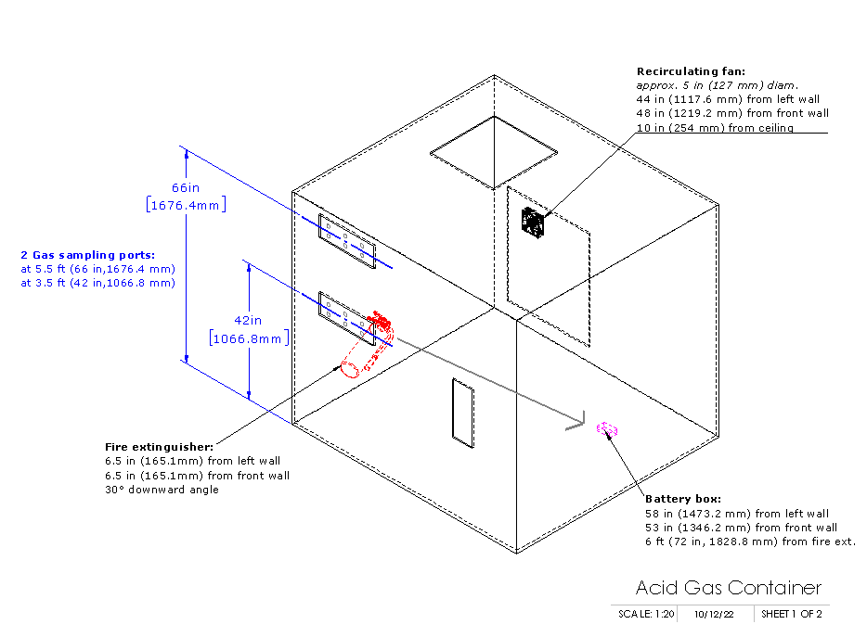
Test Compartment
240 ft³ volume (flight deck)
NO air exchange
Battery box on the floor
Fire extinguisher 5 feet away from battery box
Small fan on the ceiling
Two (2) heights form gas sampling/ Temp
Temp, CO, CO₂, Agent data collection started @ heater initiation
Acid gases data collection @ fire extinguisher discharge

Slide 7
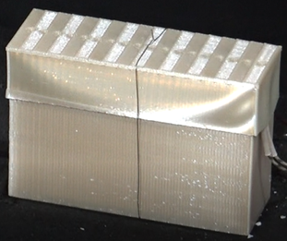
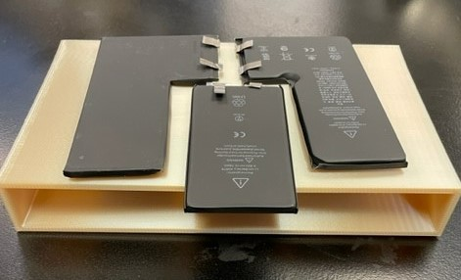
Test details
3D printed battery case + lid using thermoplastic material
Five (5) 18650 Li-ion batteries were each fitted with a type-K thermocouple.
The right most cell was fitted with the cartridge heater, rate 15°C/minute
Agent introduced after thermal runaway propagated to the 3rd cell.
3D printed battery case using thermoplastic material
Three (3) pouch Li-ion batteries were each fitted with a type-K thermocouple.
The right most cell was fitted with the cartridge heater, rate 15°C/minute.
Agent introduced when the 1st cell ignited.

Slide 8
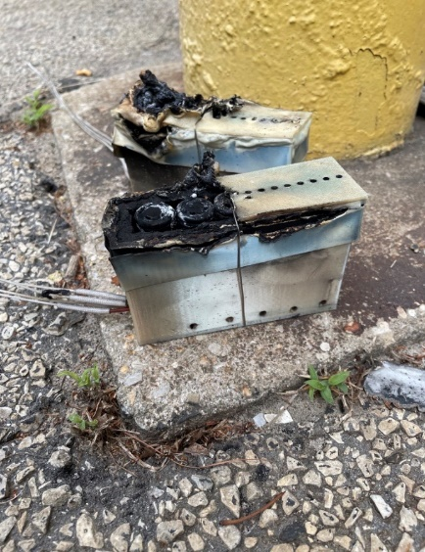
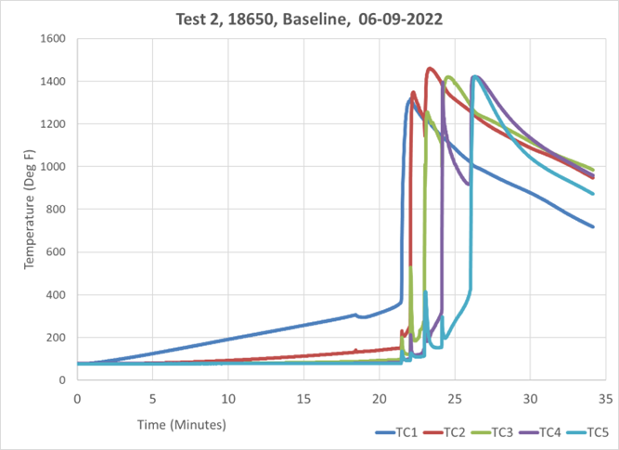
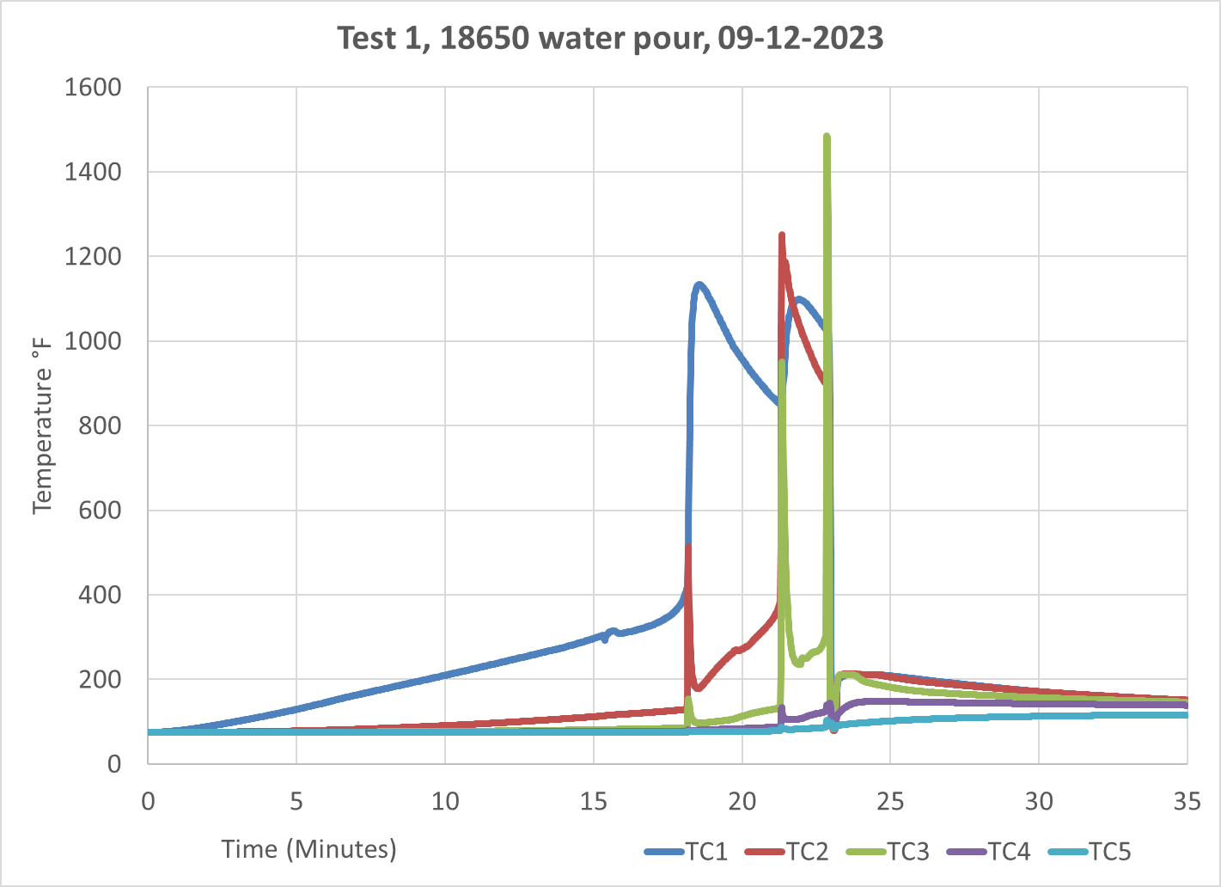
Test results
Water pours and water extinguishers were effective in stopping thermal propagation of the cells.

Slide 9
Toxicity assessment, previous approach
Acute Exposure Guideline Levels (AEGLs) 10 minute (CO, HF, HBr, HCl)
Cardiac Arrhythmias: (Halon 1211 & 2-BTP) 5-minute exposures.

Slide 10
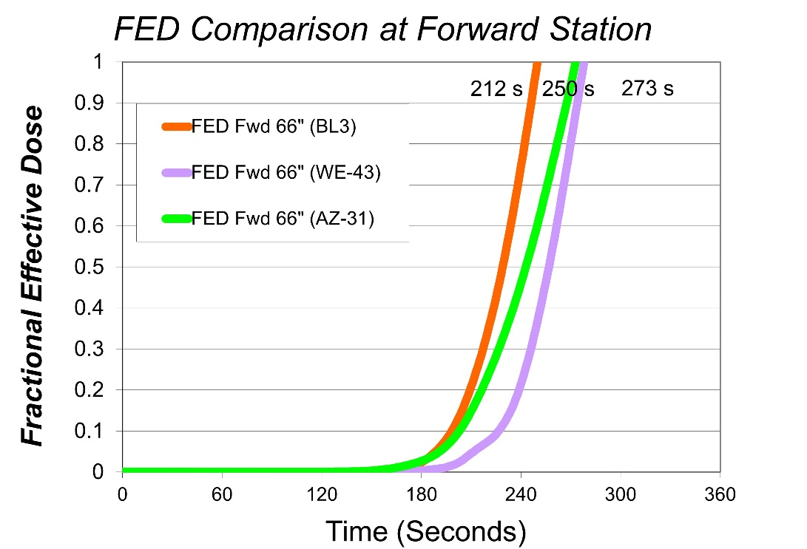
Toxicity assessment, new approach
Survival model uses incapacitation data to obtain a fractional effective dose for incapacitation (FED_{i}).
The time when FED_{i} reaches 1 determines the exposure time available to escape from an aircraft cabin fire. The model combines toxic and thermal hazards.
FED_{I} = FED_{I Gases} + FED_{I Heat}
FED_{I} =
FED_{I CO} + FED_{I HCN} + FED_{I HCl} + FED_{I HF} +
FED_{I Acrolein} + FED_{I HBr} + FED_{I CO2} + FED_{I NO2} +
FED_{I O2} + FED_{I Heat}
Full-scale test, different seat materials
*Toxicity Assessment of Combustion Gases and Development of a Survival Model, Louise C. Speitel, DOT/FAA/AR-95-5

Slide 11
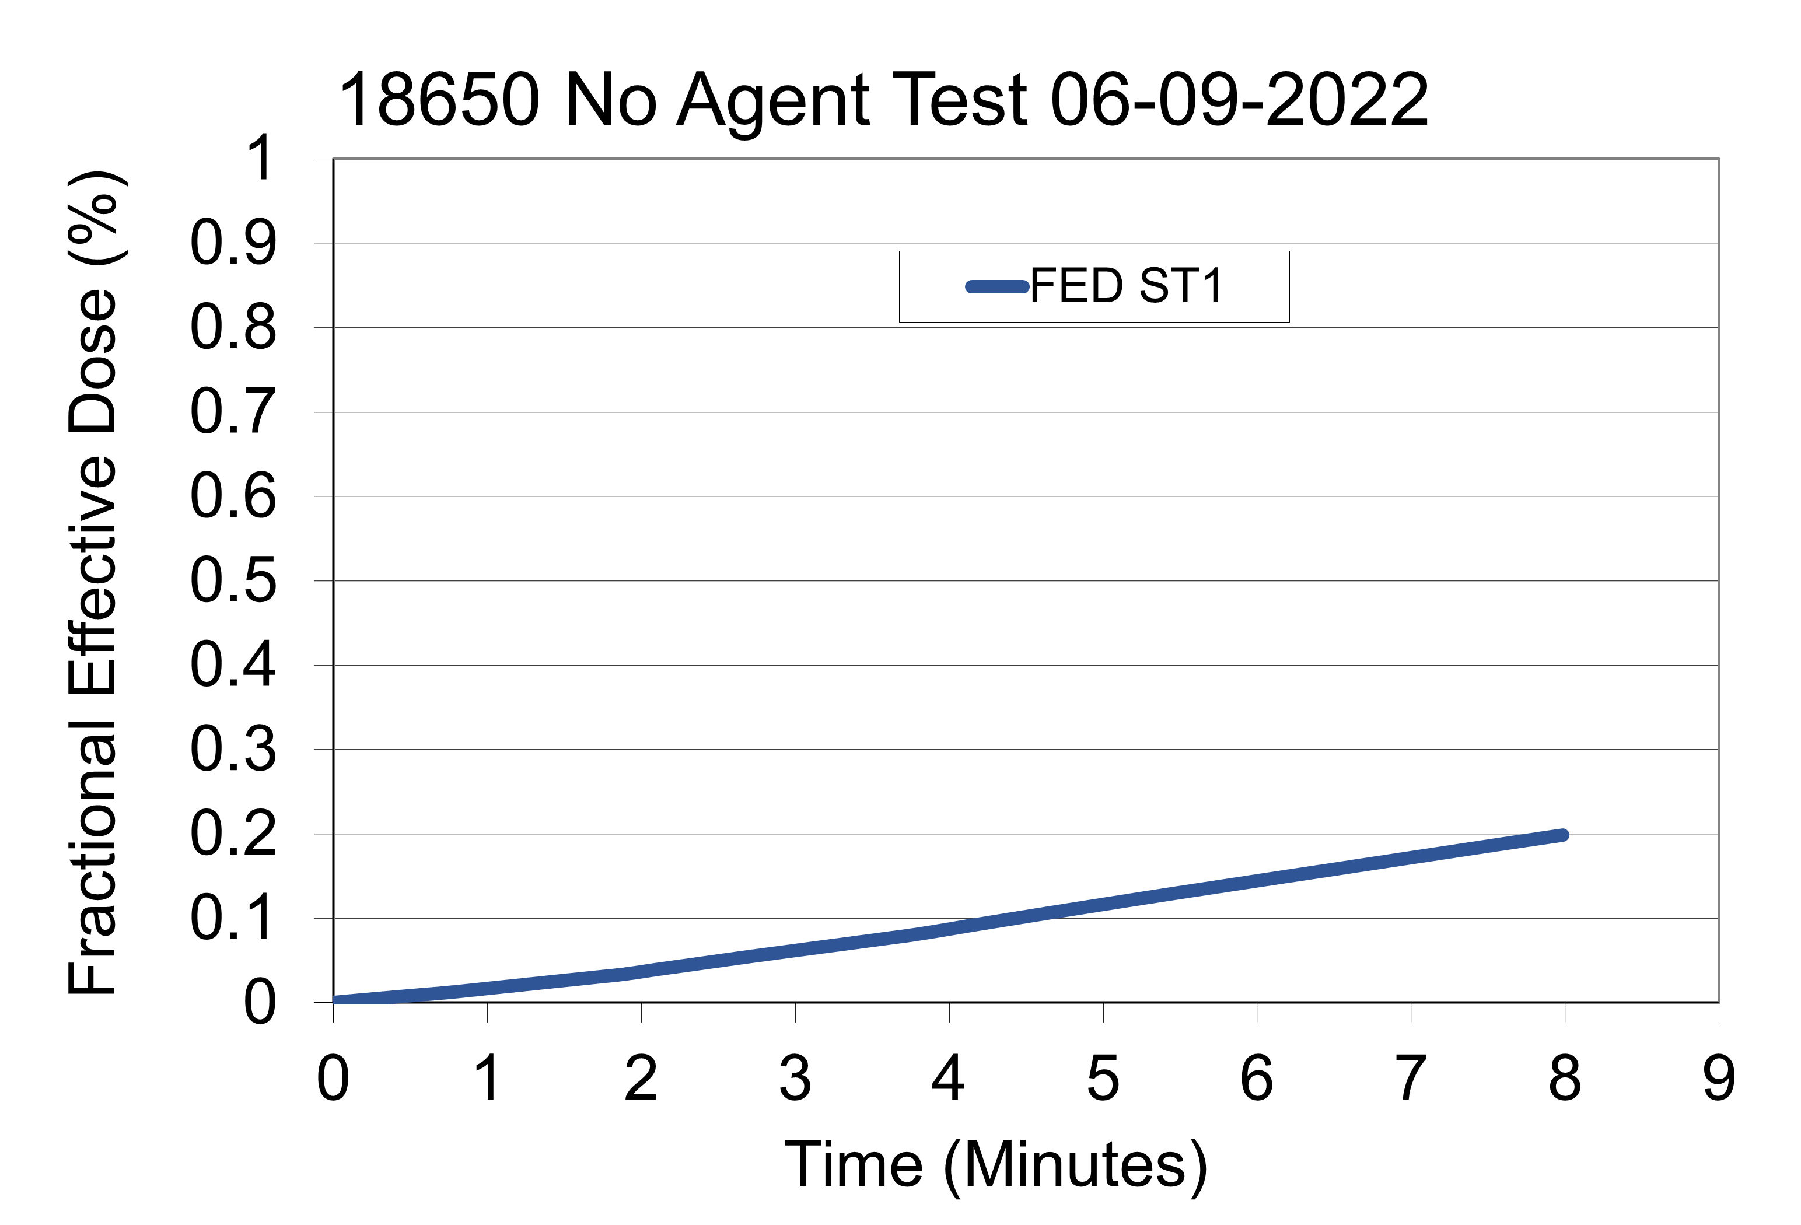
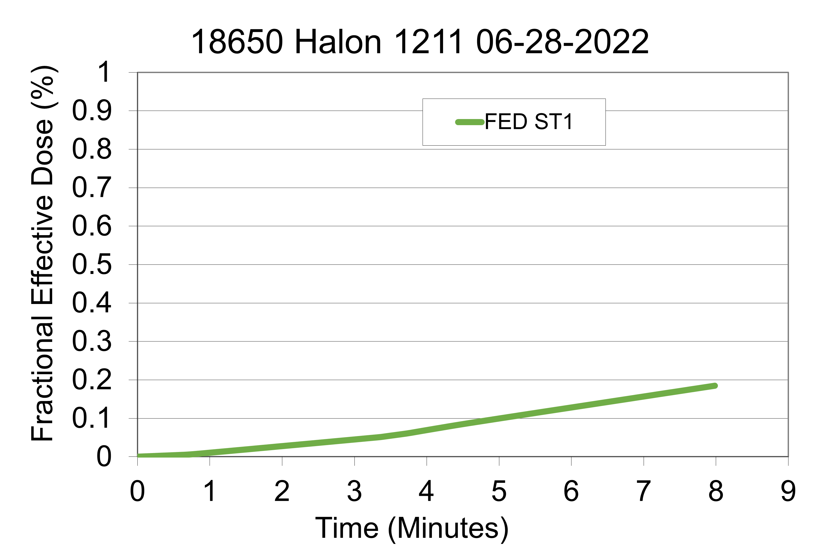
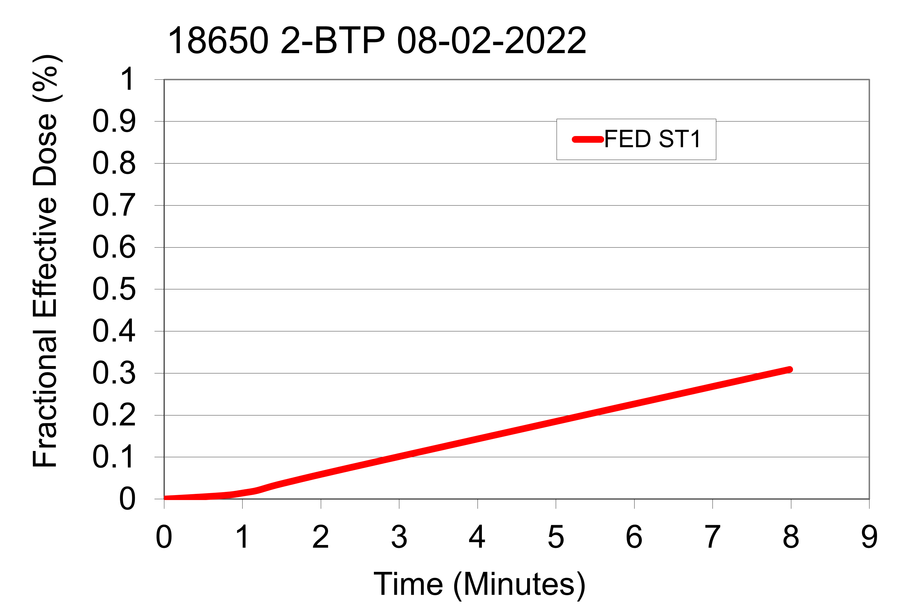
FED_{I} results
CO was the main contributor to FED_{I}. HF contributed insignificantly only for 2-BTP scenario.

Slide 12
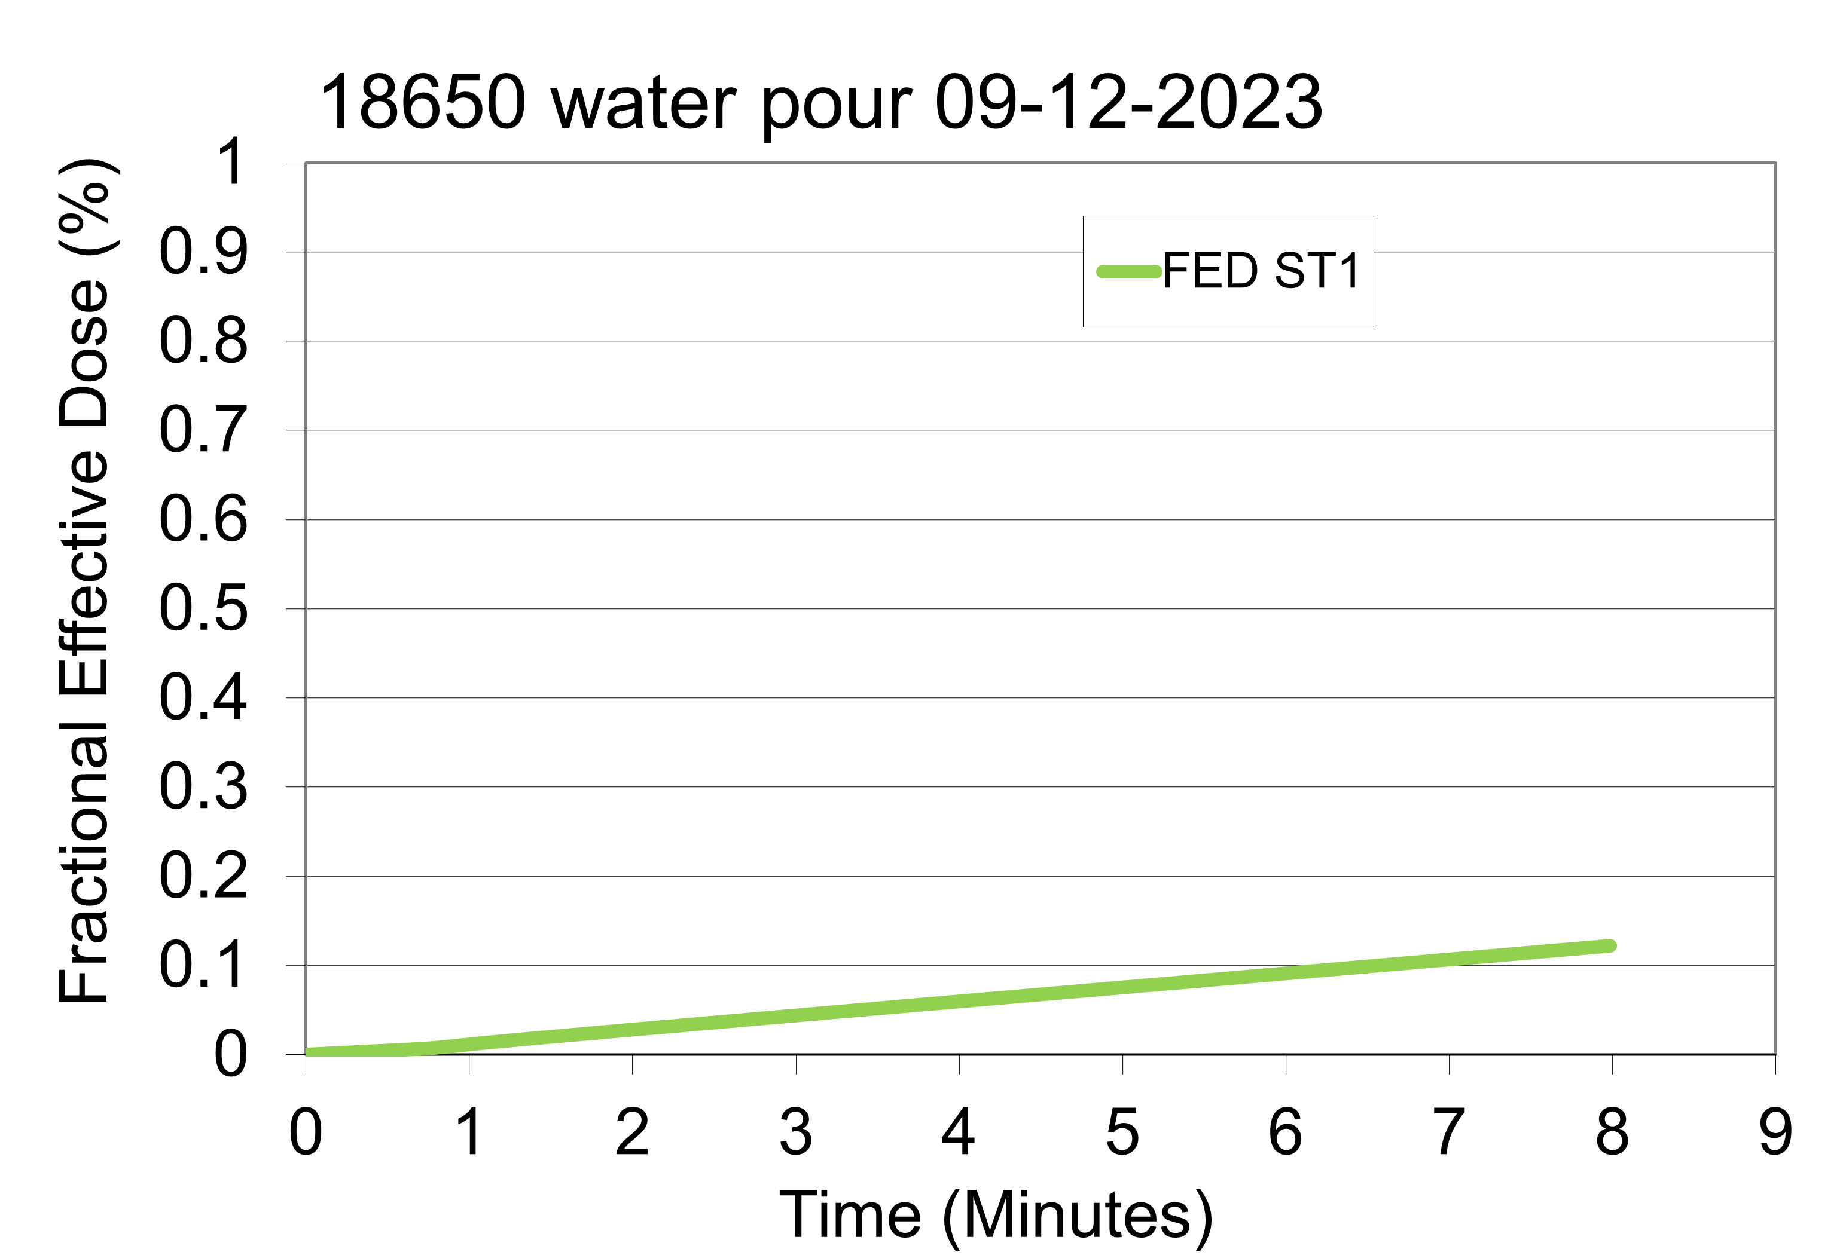
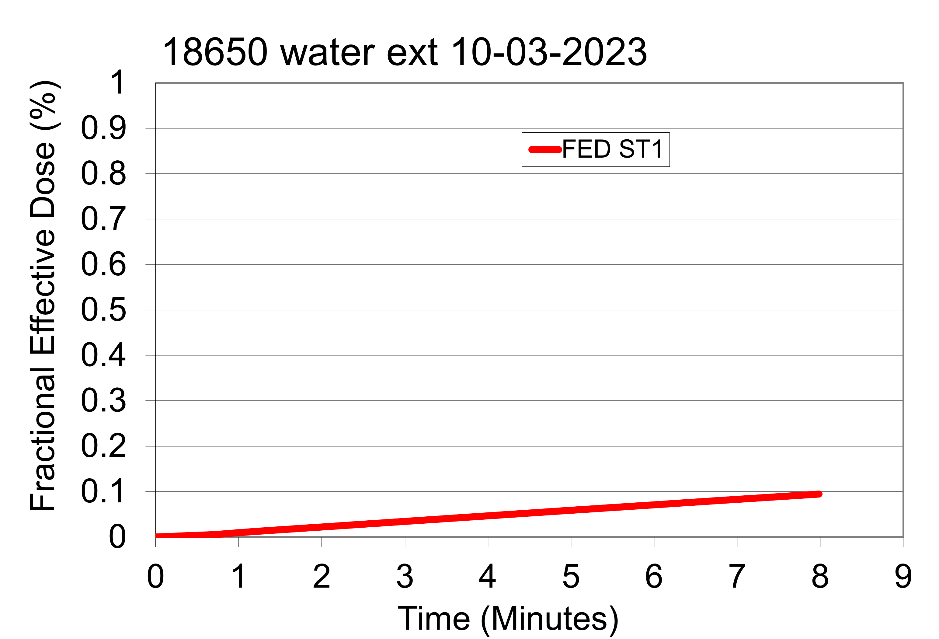
FED_{I} results cont.
CO was the main contributor to FED_{I}.
FED_{I} overall number was lower due to stopped thermal propagation in these 2 test-subseries.

Slide 13
Summary
Project motivation was to evaluate the difference in thermal and toxic hazards of handheld extinguishing agents ( 4 agents) used on Lithium-Ion battery ( 2 types) fires in small compartments.
Water and water extinguisher were effective in stopping the cells propagation.
FED_{I} model was applied to assess the toxicity of combustion gases. No significant differences were noticed for different agents.

Slide 14
Contact info
Natallia Safronava
Natallia.i.safronava@faa.gov
FAATC reports: https://www.fire.tc.faa.gov/Reports/reports.asp

