Slide 1
UN Battery Classification Test Method Development

Slide 2
Introduction
Previous meeting held in Geneva, Switzerland on December 6 – 8, 2023
Monthly online meetings between in-person meetings
Introduction of the “draft hazard-based classification” document which will be formally submitted to the UN Dangerous Goods subcommittee
Details how this classification system fits in with UN 38.3 regulations
Draft was submitted in March of the general framework, but the working group is still making edits to the details
FAA and other labs presented test results

Slide 3
Lithium Battery Classification
By Default, no testing will be required, all hazards would be considered worst case
Purpose of this testing is to determine worst case as well as developing test methods for individual batteries to be classified on their own
Propagation Test
Gas Volume Test (all gas emitted is assumed to be toxic)
Flammability and temperature hazard determined through propagation test
If a battery shipper/seller can prove their battery is inherently safer, then they may be able to ship with fewer restrictions

Slide 4
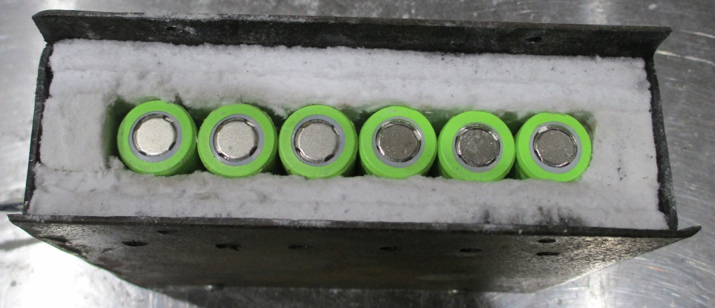
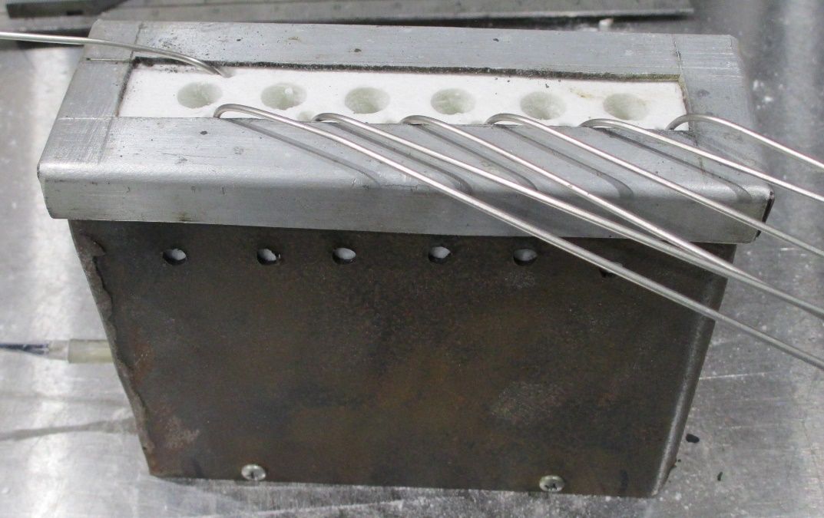
Battery Propagation Testing
6 cells placed in a line in an insulated box to determine if thermal runaway will propagate down the line (recently reduced to 4 cells)
All cells at 100% SOC
Cell #1 heated at 20°C/min until thermal runaway occurs, then heater is turned off
Thermocouple placed on each cell to measure temperature
Top of box is vented to allow gas to escape
Spark ignitor placed 2 inches above the box
To determine if gas is flammable
Some batteries self-ignite only some of the time, so ignitor increases repeatability
Tested 38 different batteries so far

Slide 5
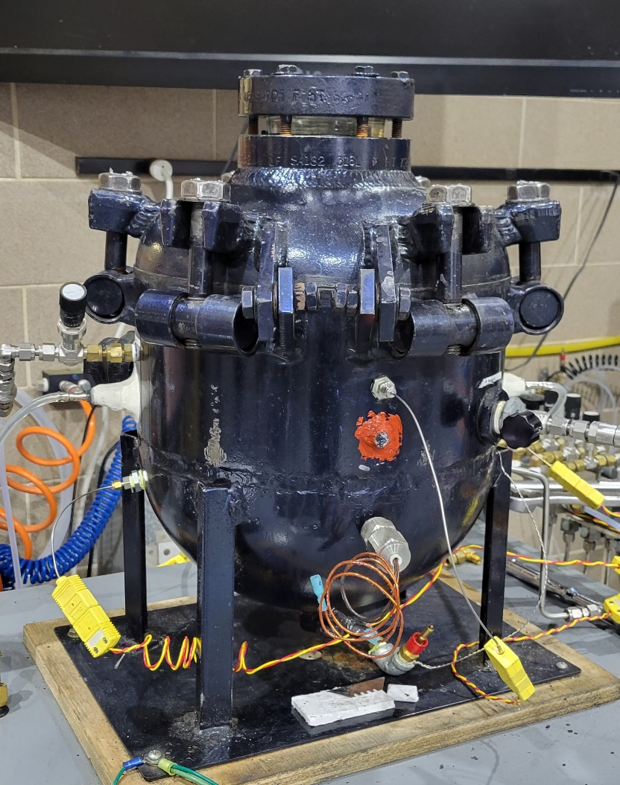
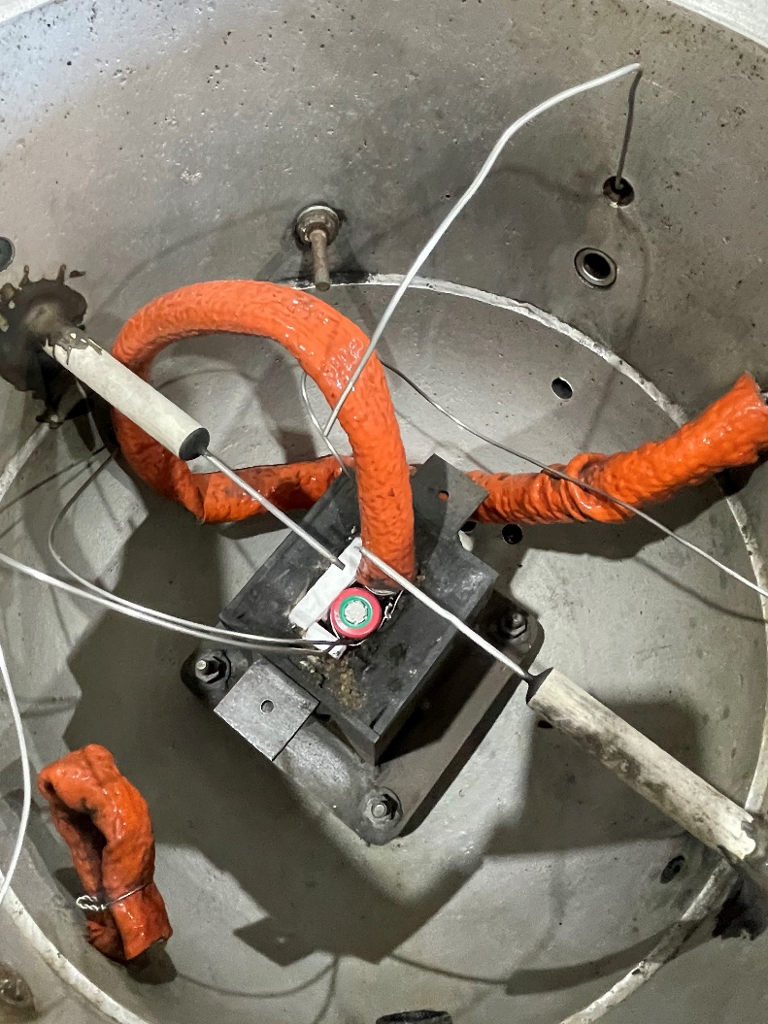
Battery Gas Volume Measurements
Single cell placed in 21.7L pressure vessel and heated until thermal runaway
Instrumented with pressure transducers and thermocouples for heater, battery, and ambient air
Chamber is evacuated with vacuum pump, then filled with nitrogen at atmospheric pressure
Battery gas volume is calculated from temperature and pressure measurements
Have tested 38 different batteries at 3 heating rates each

Slide 6
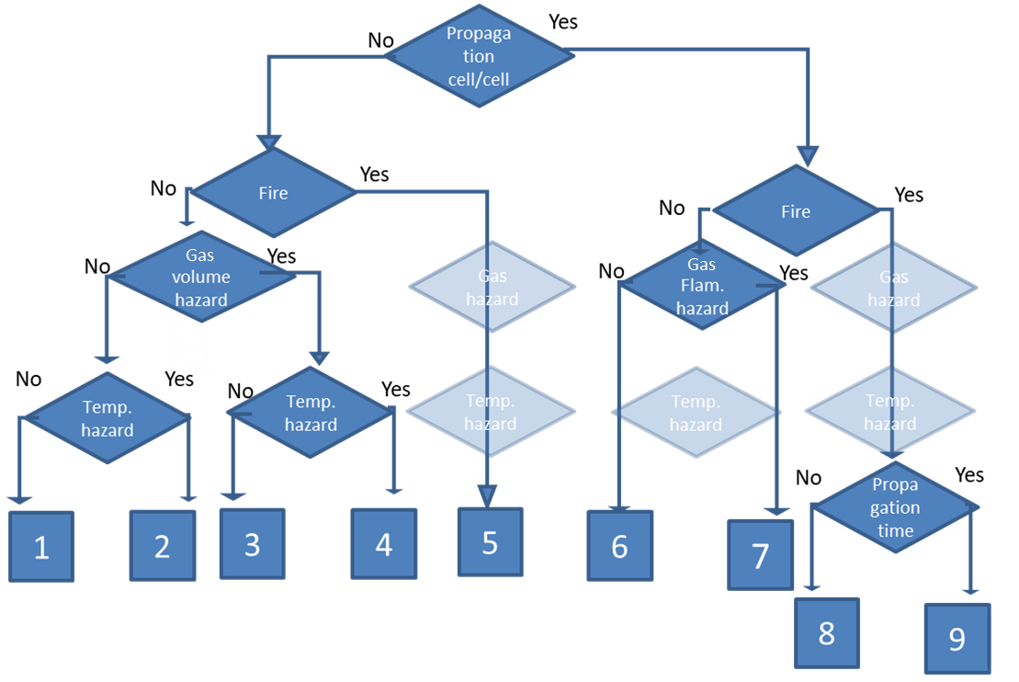
Previous Decision Tree
Previous draft of decision tree separated batteries into 9 divisions based on their hazards
Propagation
Fire
Gas flammability Hazard
Temperature Hazard
Propagation Time
FAA conducted tests on ~45 different batteries to determine range of hazards

Slide 7
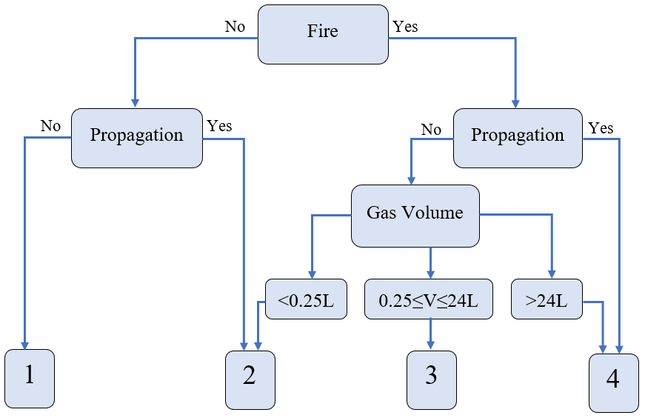
FAA Proposed Decision Tree
In December 2023 we presented a simplified decision tree to the UN working group based on our test results

Slide 8
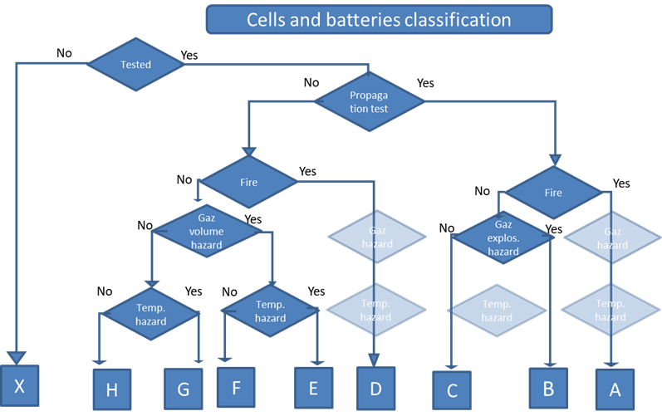
Current Decision Tree
Removes category for propagation time
Adds category for untested battery
Untested would be treated the same as Category A
Position of the working group is that it’s better to have too many categories that may overlap, than not enough

Slide 9
Recent Flammability Testing
Decision tree still has separate category for fire and gas explosion hazard
Batteries are not always consistent in when they ignite
Could be possible for a lab to run the propagation test three times without any flames, even though the cells are able to self-ignite
This would also require running a separate test to determine if the gas is flammable if it doesn’t self-ignite
FAA conducted same propagation test 5 times with no ignitor
Four 2.59Wh pouch cells placed in line

Slide 11
Recent Flammability Testing
2 out of 5 tests had self ignition
Ignition occurred after the 4th cell went into thermal runaway on both of those tests
Batteries like this could potentially lead to a situation where it gets a lower classification because it does not self-ignite in lab testing
Propagation test is less repeatable without ignitor

Slide 12
Conclusion and Future Work
FAA has conducted ~200 tests in support of the UN battery classification working group over the last 2 years
Battery self-ignition is not consistent for many cells
Future work is to help the working group design a round robin study and participate in testing

Slide 13
Questions?
Contact:
Steven Rehn
Federal Aviation Administration
William J. Hughes Technical Center
Fire Safety Branch, Bldg. 203
Atlantic City Int’l Airport, NJ 08405
(609) 485-5587
steven.rehn@faa.gov

