Slide 1
FAA G-27 Round Robin Testing
International Aircraft Materials & Systems Fire Test Forum
Steve Rehn
4/17/2024

Slide 2
Introduction
Round robin with 6 labs running 9 tests each
Tested 18650 cells at states of charge (SOC) of 33%, 44%, and 55% in cardboard packaging
All cells, thermocouples, and heaters were purchased at once and sent out to the test labs
All cells were set to their test SOC on the same charger before being sent out
Test results received from 3 out of 6 labs so far

Slide 3
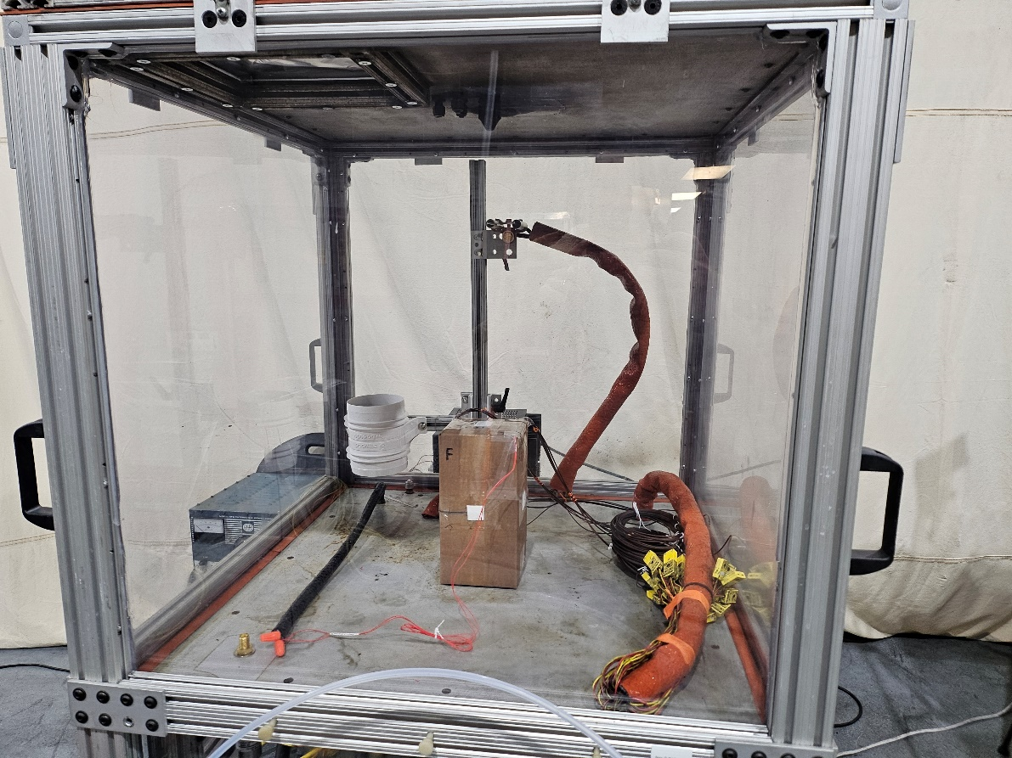
FAA G-27 Chamber
Chamber completely overhauled prior to testing
New polycarbonate, blow out panel, and seals
4 inch, 12V, 200 CFM fan ran at 3V, 38 CFM measured
26.75 × 26.75 × 25.5 to 34 in. chamber size
Calibration conducted
Leak Test
Methane Test

Slide 4
Leak Rate Calibration
Leak Test conducted at two chamber sizes: 322.5L (27.5” height) and 302.5L (25.8” height)
Flow Rate into chamber to maintain 24.9 Pa pressure: 453 L/hr
Same results for both chamber volumes
Air Changes per Hour (ACPH) (6 ACPH Limit)
322.5L chamber: 1.405 ACPH
302.5L chamber: 1.498 ACPH

Slide 5
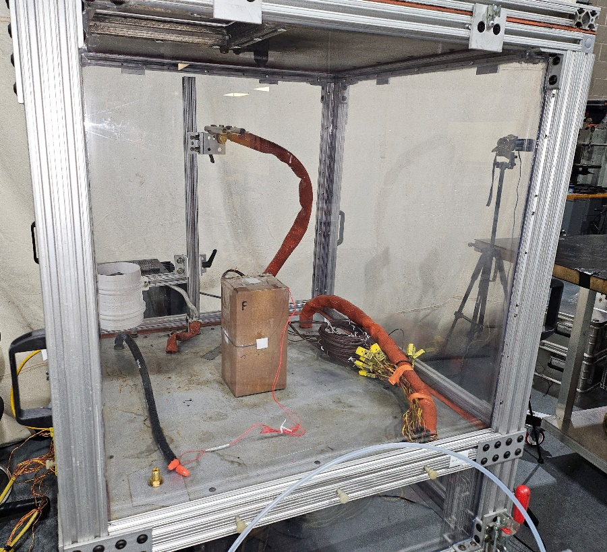
Ignition Point Calibration
Methane entrance point
Methane flowed into chamber at 2 L/min
Tested with spark ignitor at three positions
High location concentration is 5.4% less than low location
Under 10% Limit
 | Height (in) | Depth from front (in) | Time to Ignition | Concentration
Test 1 | 19.75 | 16.25 | 7:23 | ~4.88%
Test 2 | 9.75 | 16.25 | 7:45 | ~5.12%
Test 3 | 9.75 | 4 | 7:48 | ~5.16%

Slide 6
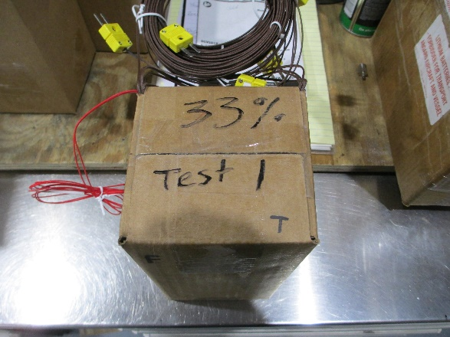
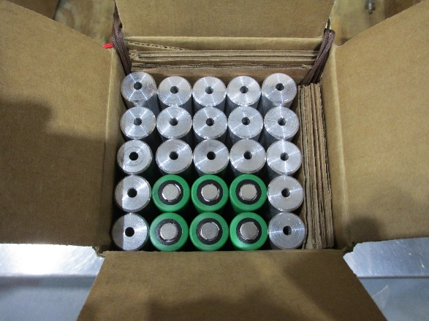
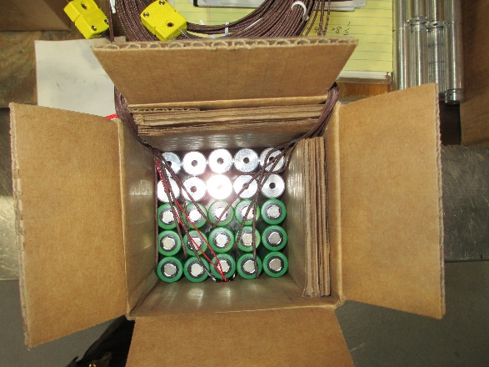
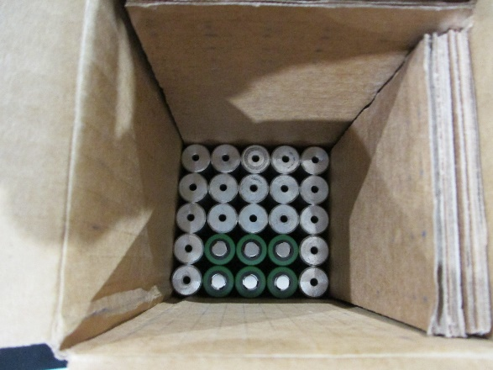
Round Robin Testing
2.5L box, chamber set to 302.5L
18650 cells rated at 3.7V, 2100 mAh, 7.77 Wh, LiNiMnCoO₂ chemistry
Three levels of batteries in 5x5 configuration
Surrogate cells placed where cells are less likely to propagate
Three tests each at 33%, 44%, and 55% SOC
All tests had set heating rate of 10°C/min
Initiating Cell

Slide 7
Pass-Fail Criteria
Material shall not ignite in any location
Gas accumulating in chamber shall not ignite
Temperature thresholds for external surfaces of packaging material (increase of 150°C for 3 min)
Walls of test article shall have no perforations
Test article must contain its contents
When periphery zones are defined, cells in the periphery zone shall have no vent opening and shall maintain at least 90% of the pre-test open circuit voltage.

Slide 8
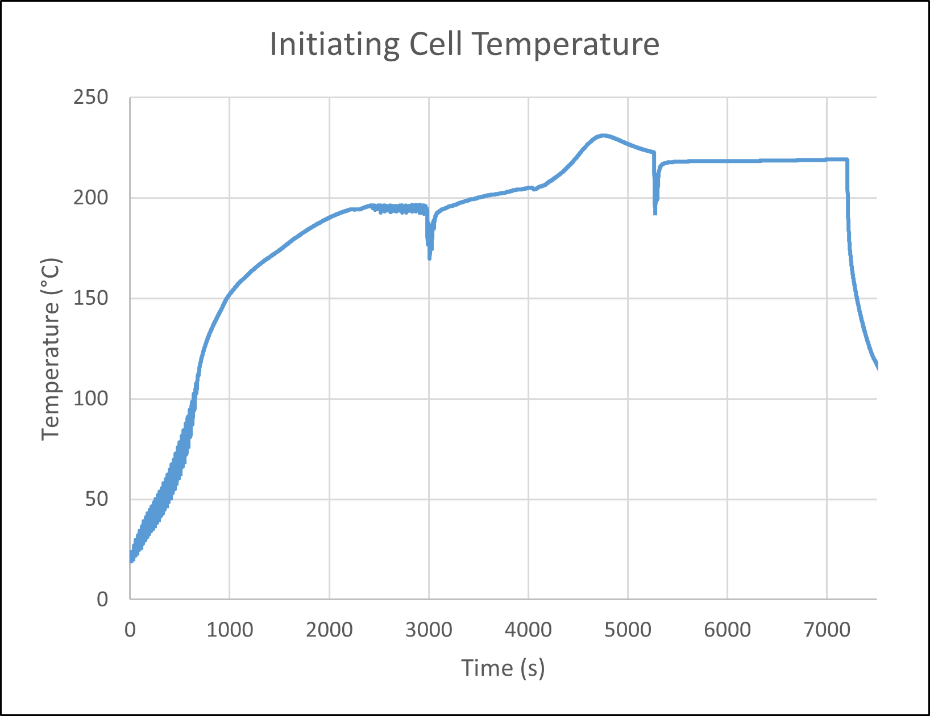
33% SOC Test 1
Heater rated for 56V, tested with a 30V power supply
Max battery temp of 231°C with no thermal runaway
Held above 200°C for 62 min with no thermal runaway

Slide 9
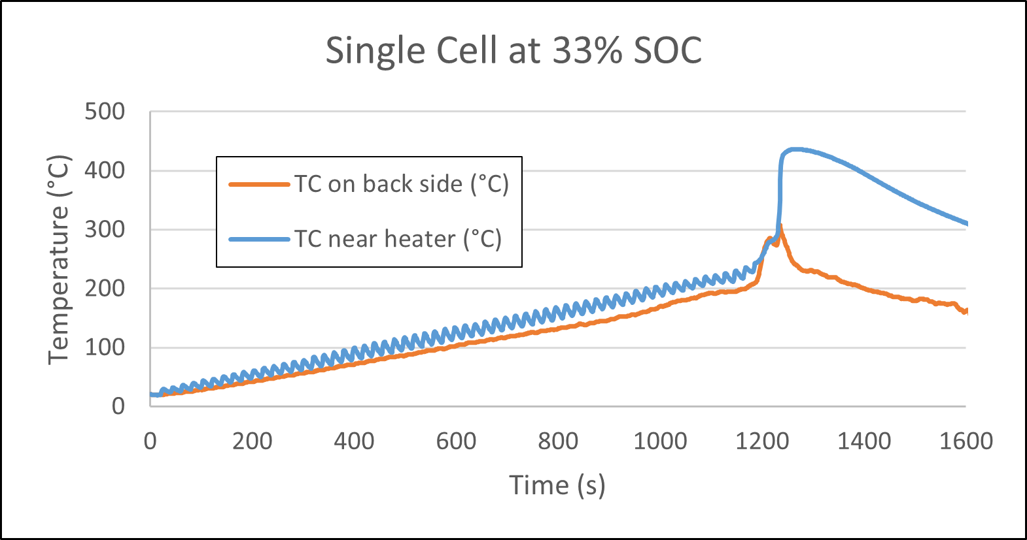
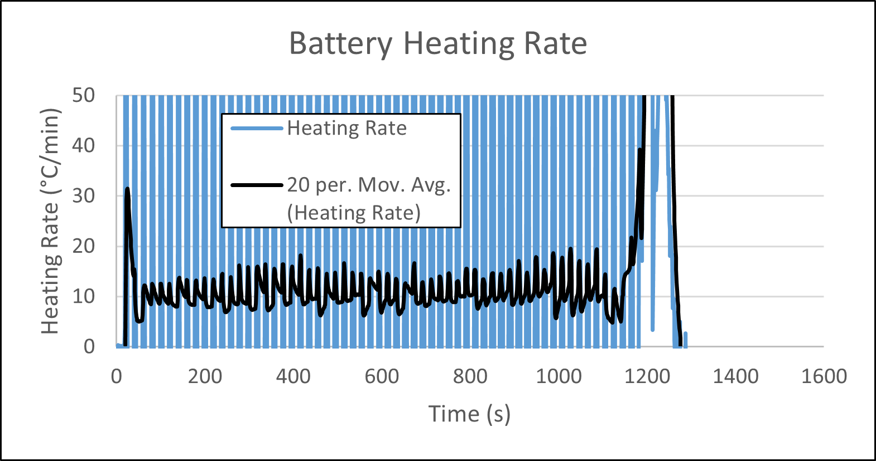
Additional Testing
Switched to a power supply running at 50V
Auto-tuned temperature controller
Tested single cell at 33% SOC
Measured temperature ~3 mm from heater and on the back side
TC near heater was placed on bare metal, backside TC was placed on battery cover
Average heating rate = 11.0°C/min
Temperature was more consistent on back side but read lower

Slide 10
33% SOC Test 2

Slide 11
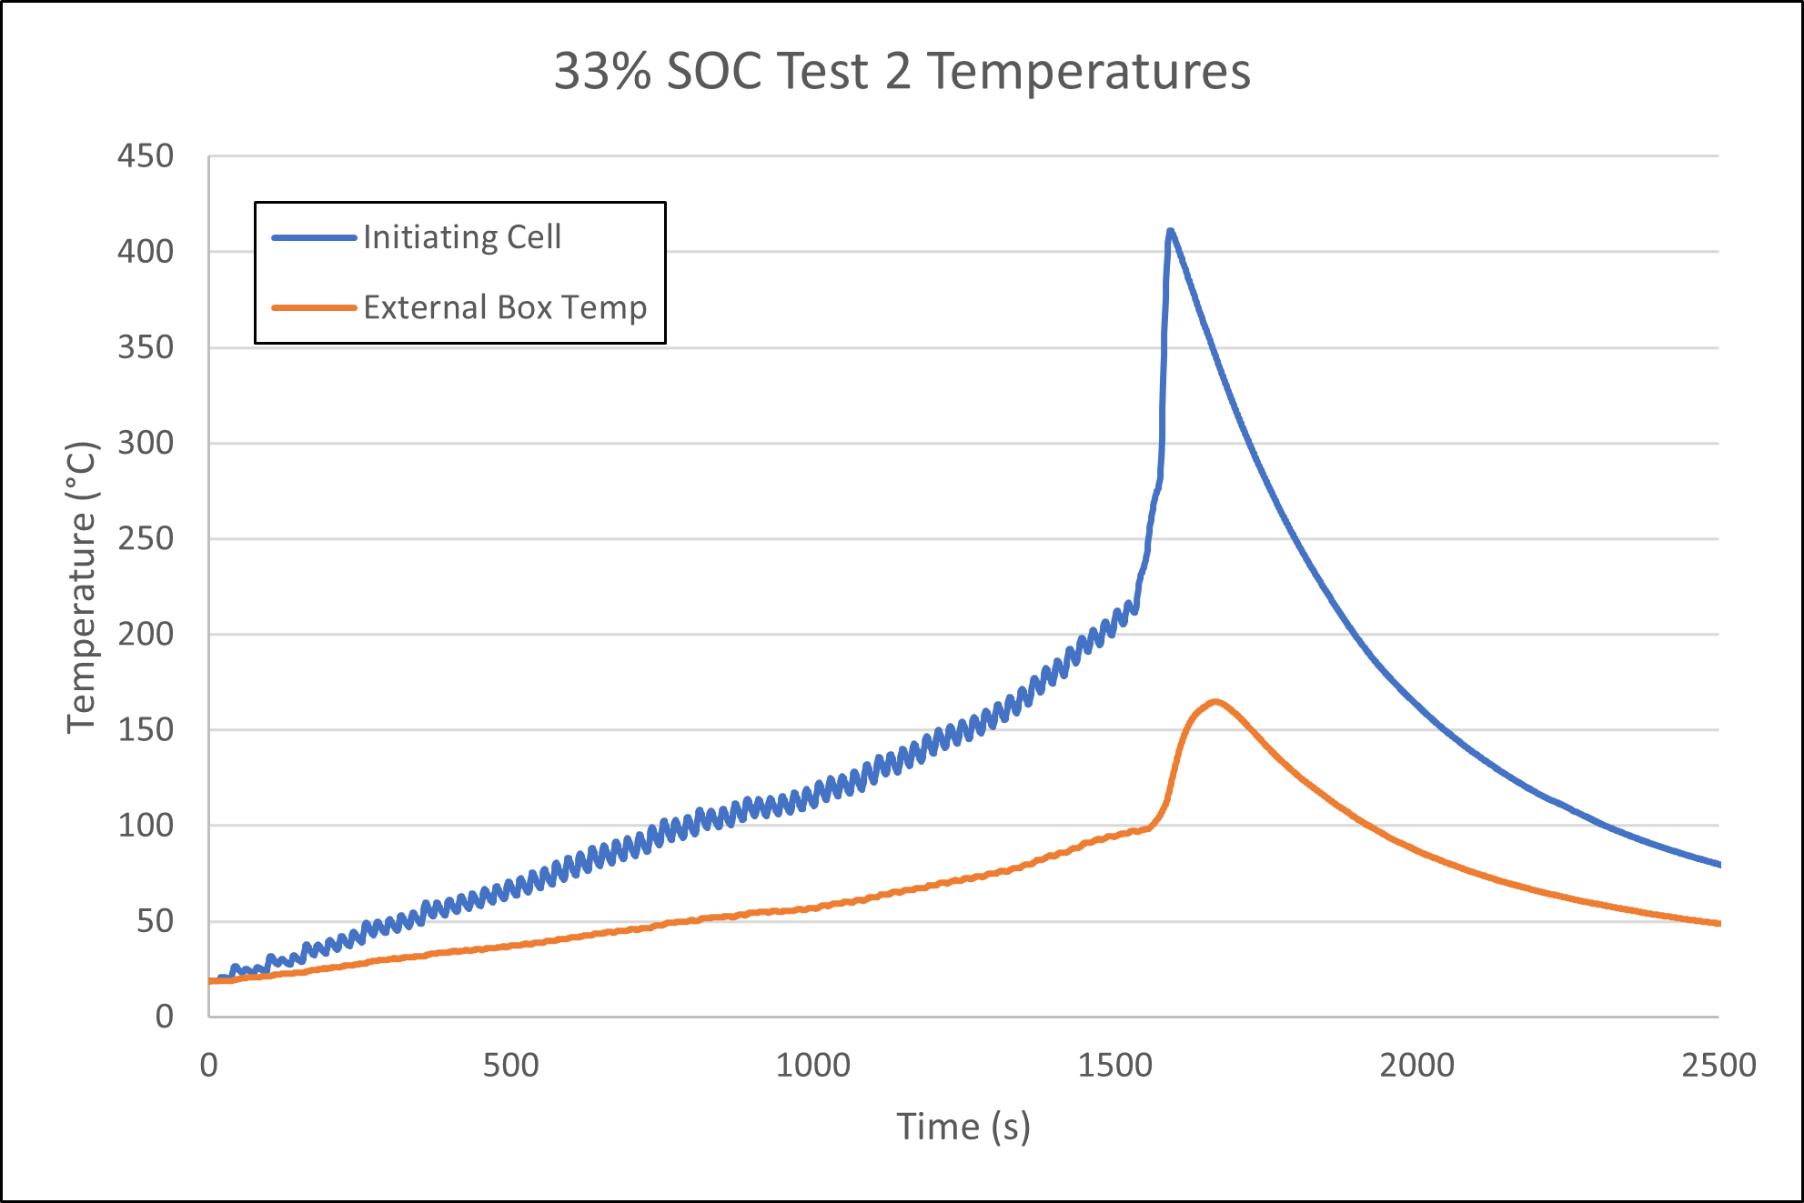
33% SOC Test 2
Average Heating Rate: 7.7°C
Pass/Fail Criteria
Box did not ignite
Gas did not ignite
Box temp increase <150°C for <3 min
Max external temp: 164.9°C

Slide 12
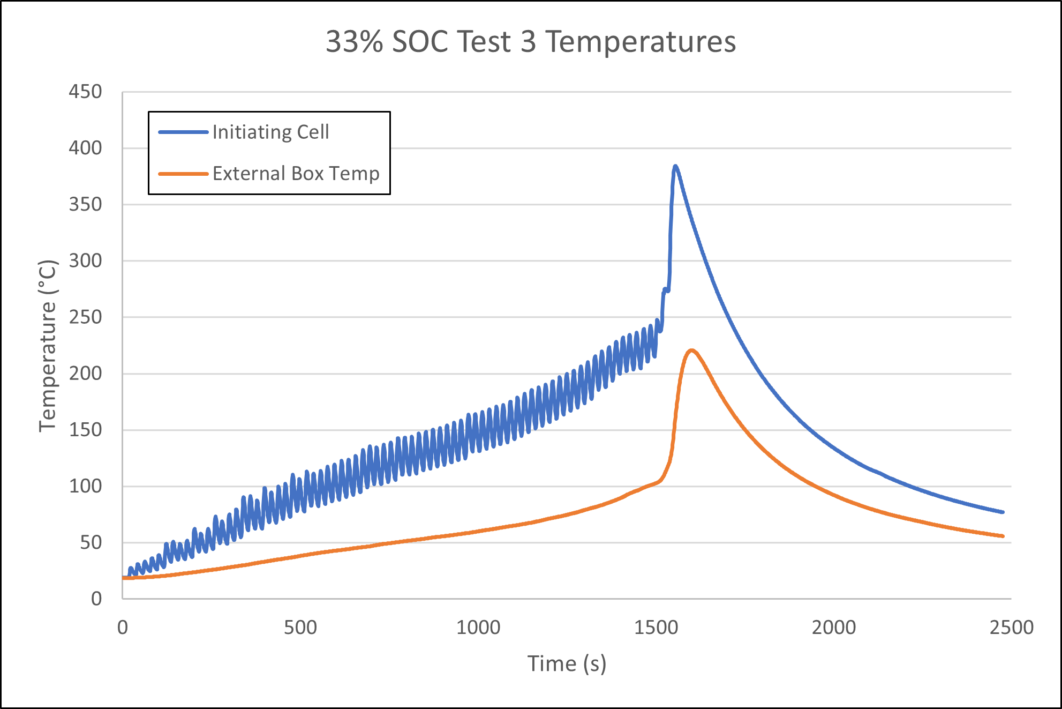
33% SOC Test 3
Average Heating Rate: 8.9°C
Pass/Fail Criteria
Box did not ignite
Gas did not ignite
Box temp increase <150°C for <3 min
Max external temp: 220.6°C

Slide 13
44% SOC Test 1

Slide 14
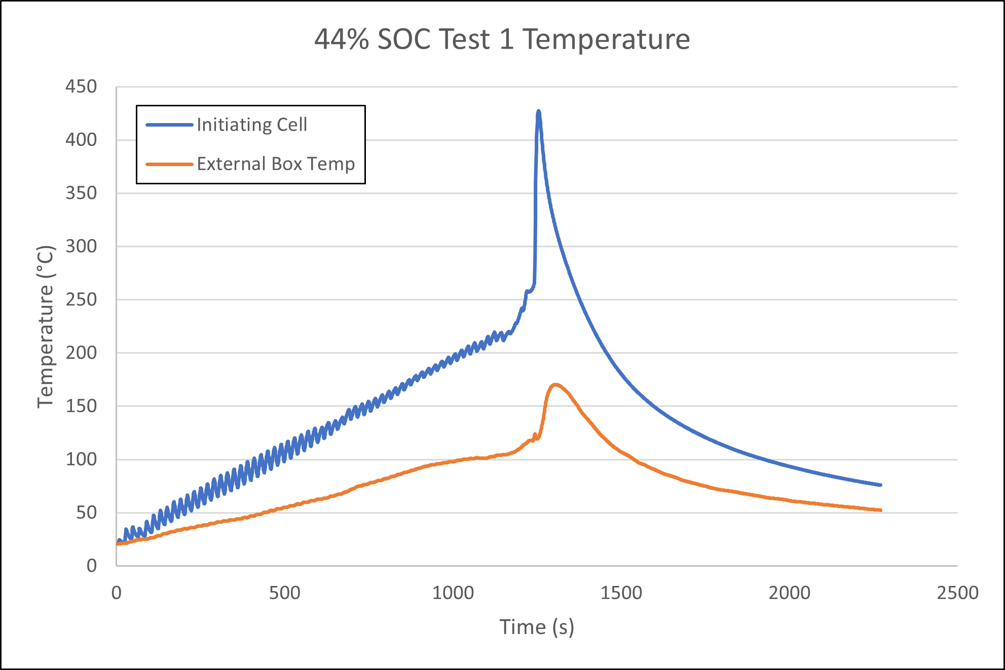
44% SOC Test 1
Average Heating Rate: 10.4°C
Pass/Fail Criteria
Box did not ignite
Gas did not ignite
Box temp increase <150°C for <3 min
Max external temp: 170.4°C

Slide 15
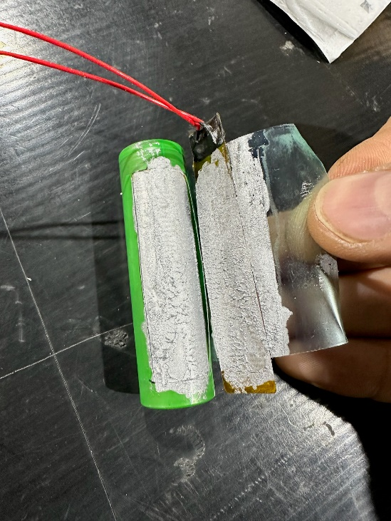
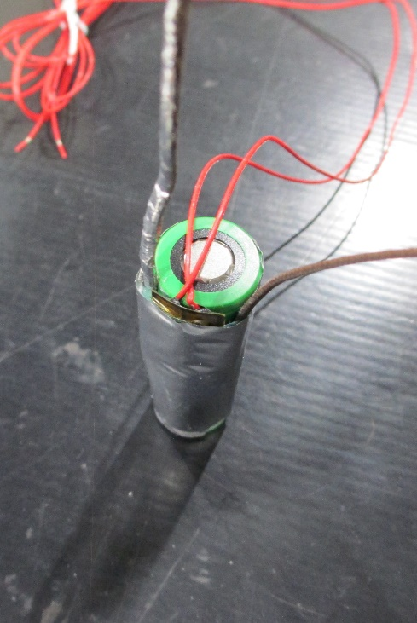
Test Setup Problems
Initiating cell as received had too much thermal grease which caused the thermocouple and tape to not stay in place
Heater and TC setup was redone for all tests except 44% SOC Tests 2 and 3
This caused heating rates to be more variable in those tests
Initiating cell as received
Initiating cell fixed

Slide 16
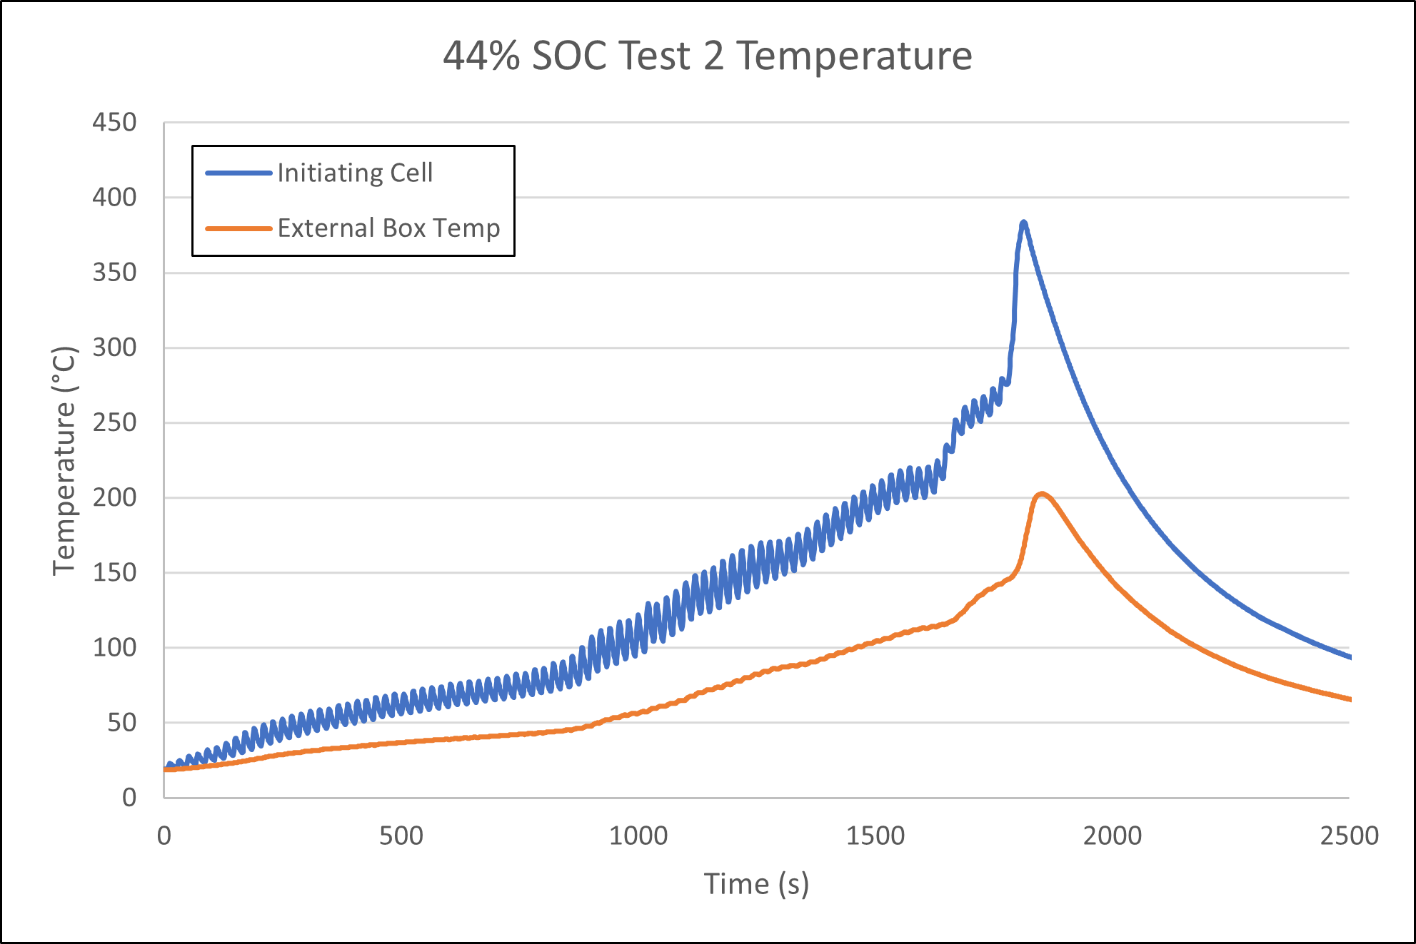
44% SOC Test 2
Average Heating Rate: 7.5°C*
Pass/Fail Criteria
Box did not ignite
Gas did not ignite
Box temp increase <150°C for <3 min
Max external temp: 202.7°C
*Left heater and TC as received

Slide 17
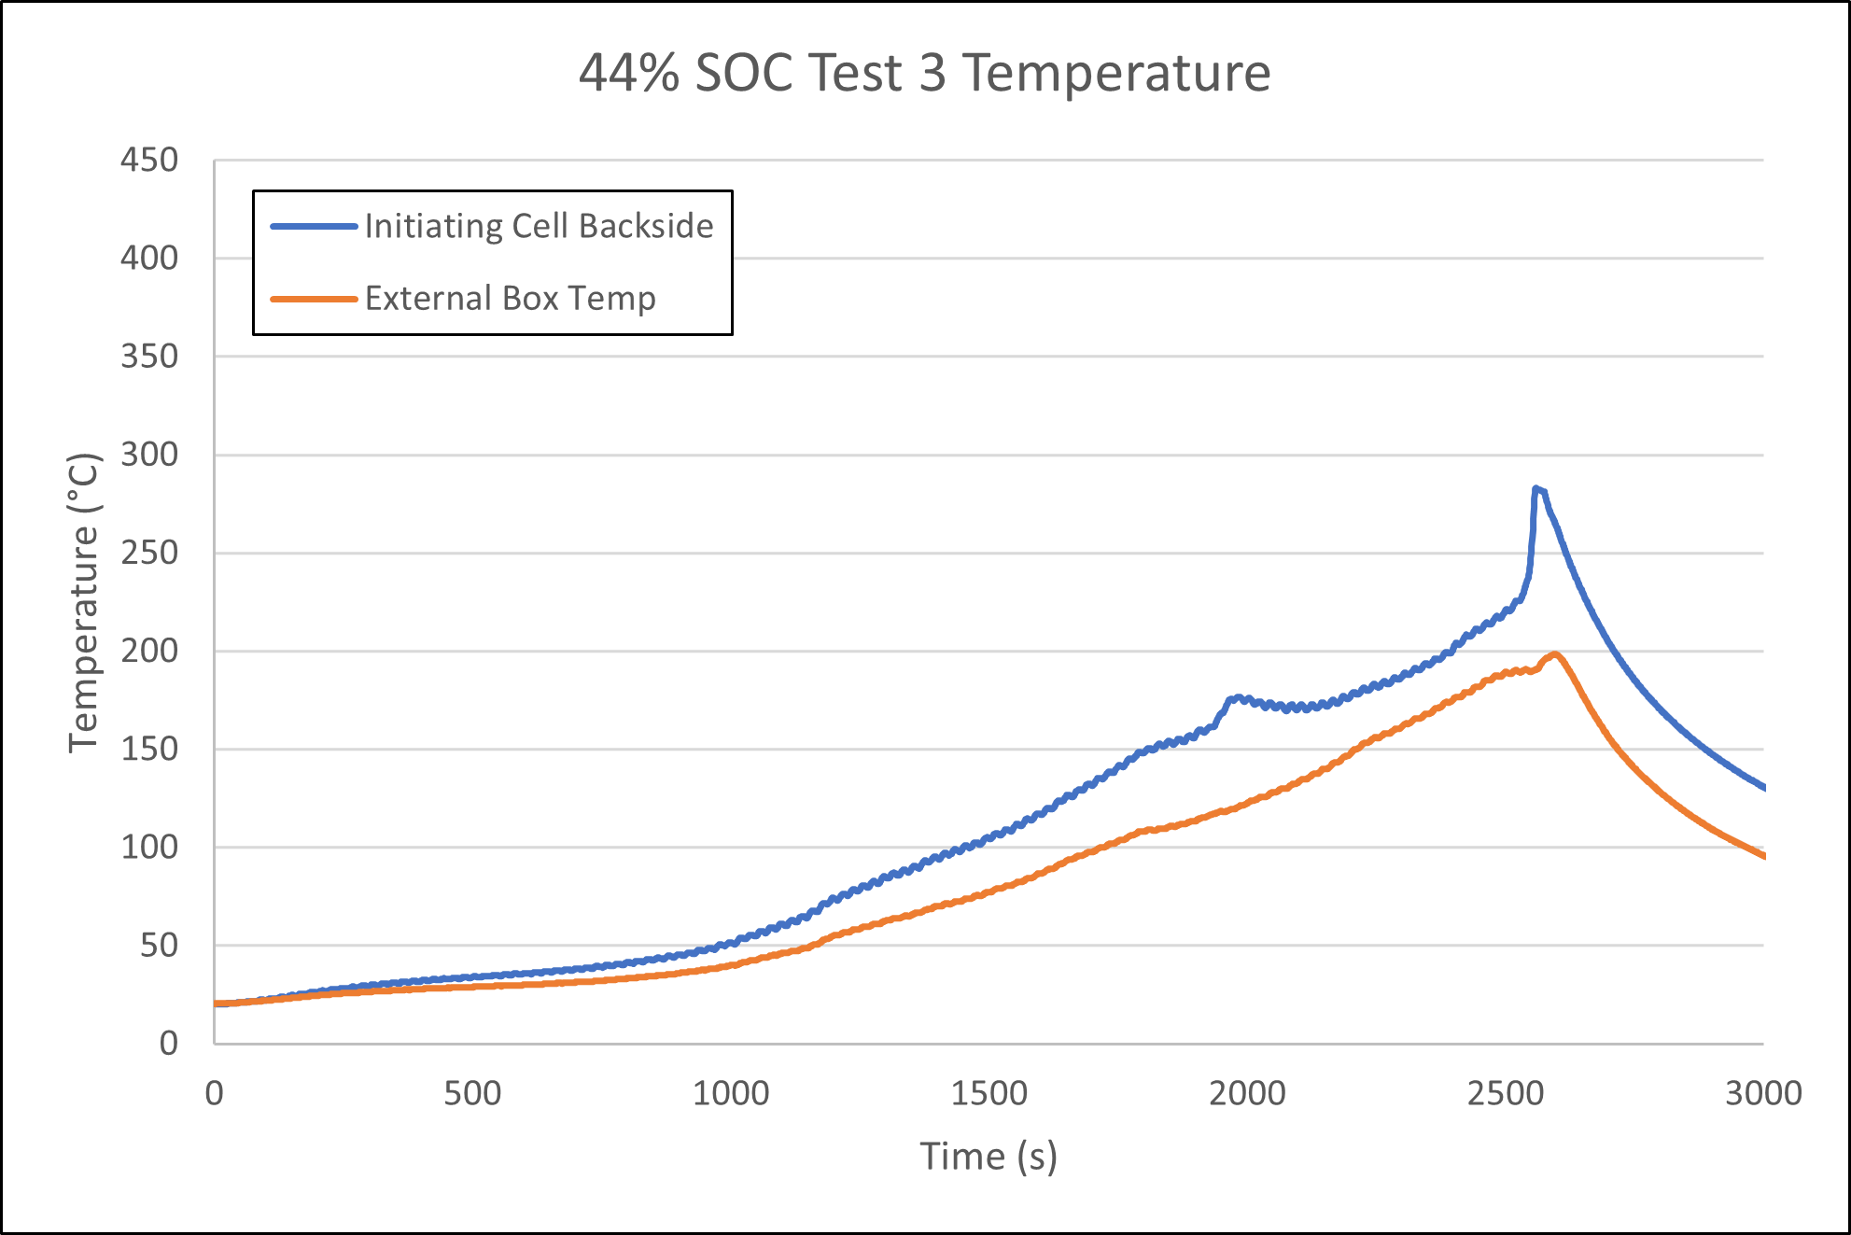
44% SOC Test 3
Average Heating Rate: TC failed*
Pass/Fail Criteria
Box did not ignite
Gas did not ignite
Box temp increase <150°C for <3 min
Max external temp: 198.4°C
*Left heater and TC as received
**Initiating cell thermocouple short-circuited. TC for temperature controller and backside TC continued to function

Slide 18
55% SOC Test 1

Slide 19
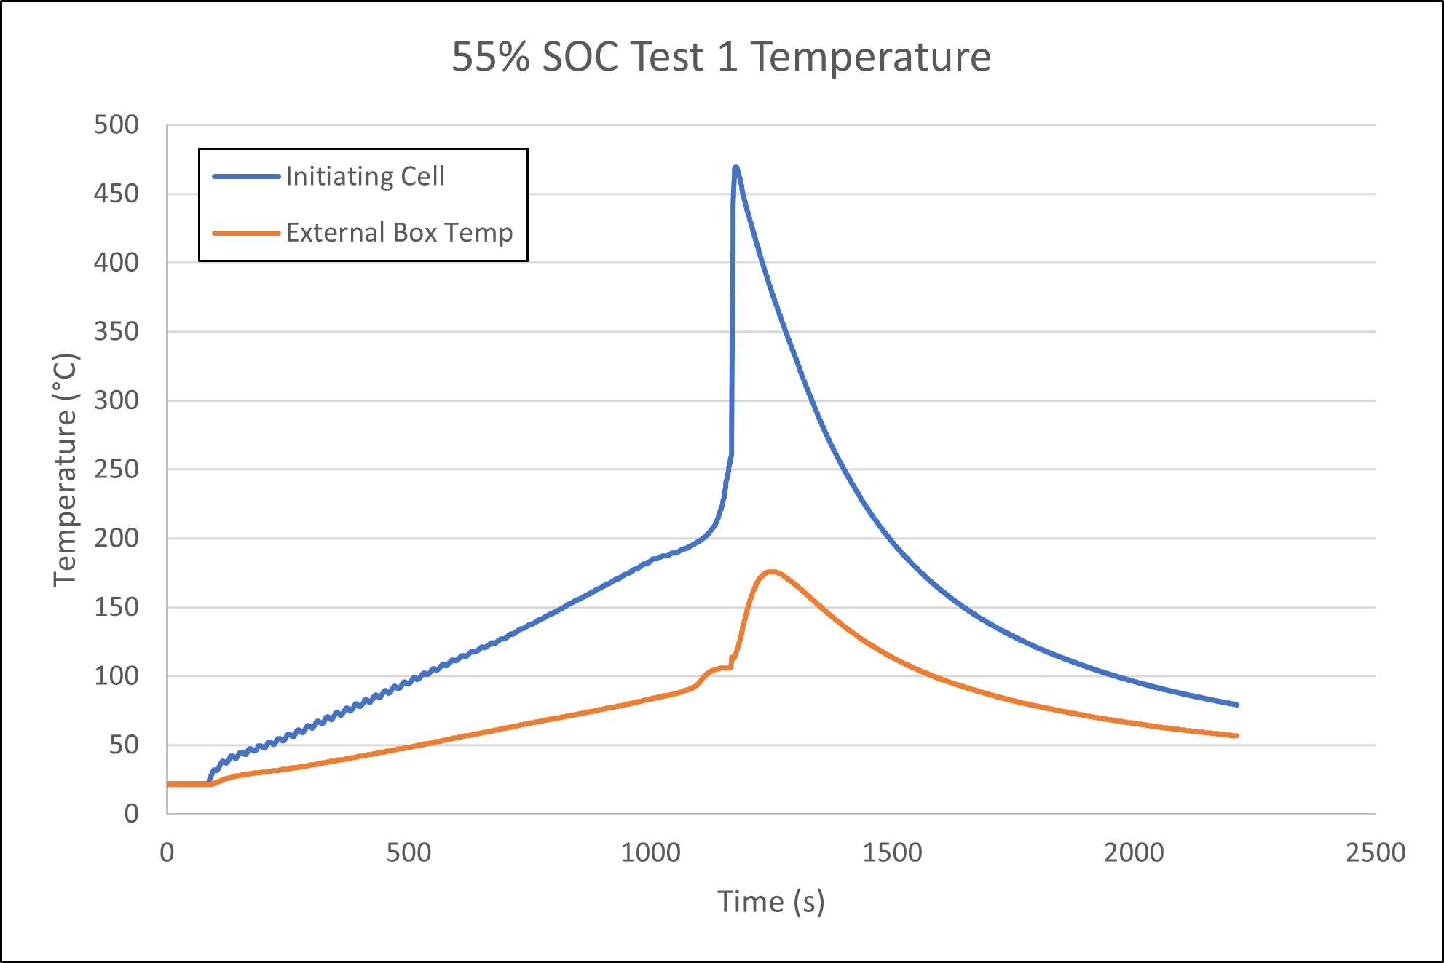
55% SOC Test 1
Average Heating Rate: 10.5°C
Pass/Fail Criteria
Box did not ignite
Gas did not ignite
Box temp increase <150°C for <3 min
Max external temp: 176.0°C
*Heater failed on first attempt, redid test with 30W, 28V heater running at 30V

Slide 20
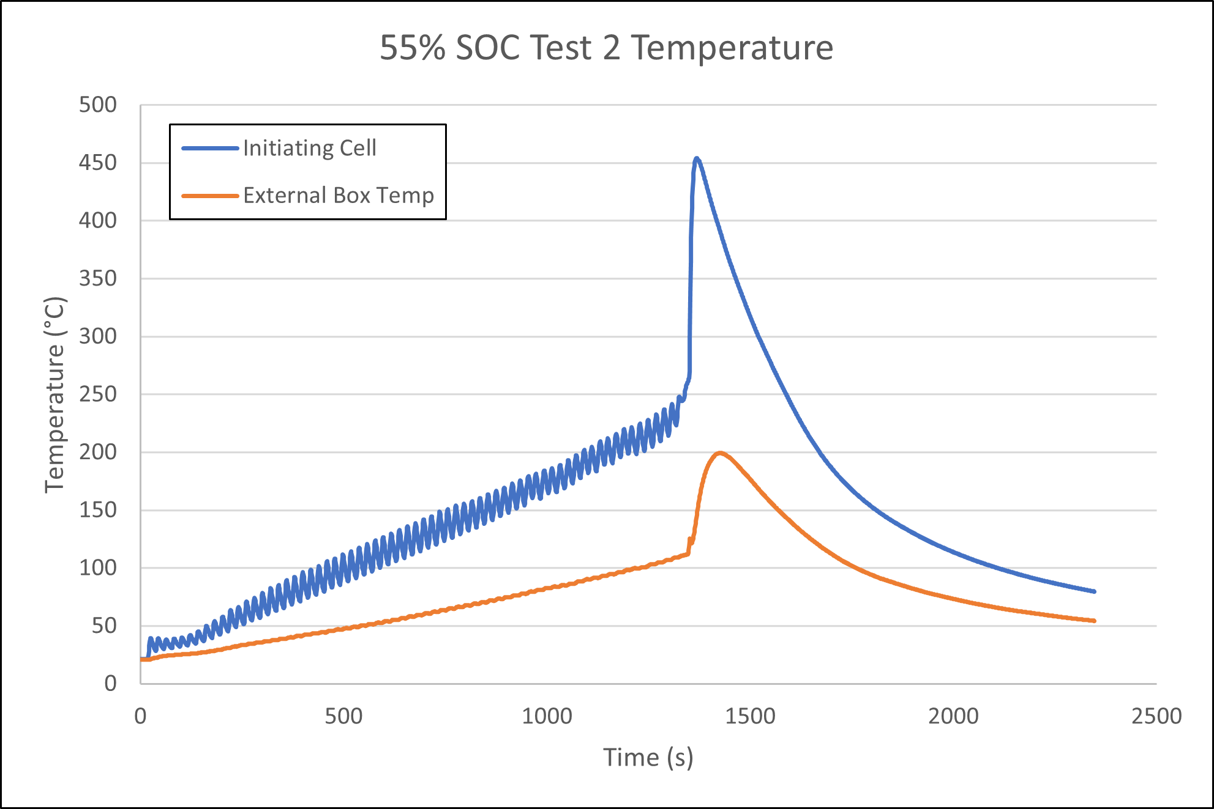
55% SOC Test 2
Average Heating Rate: 10.2°C
Pass/Fail Criteria
Box did not ignite
Gas did not ignite
Box temp increase <150°C for <3 min
Max external temp: 199.3°C

Slide 21
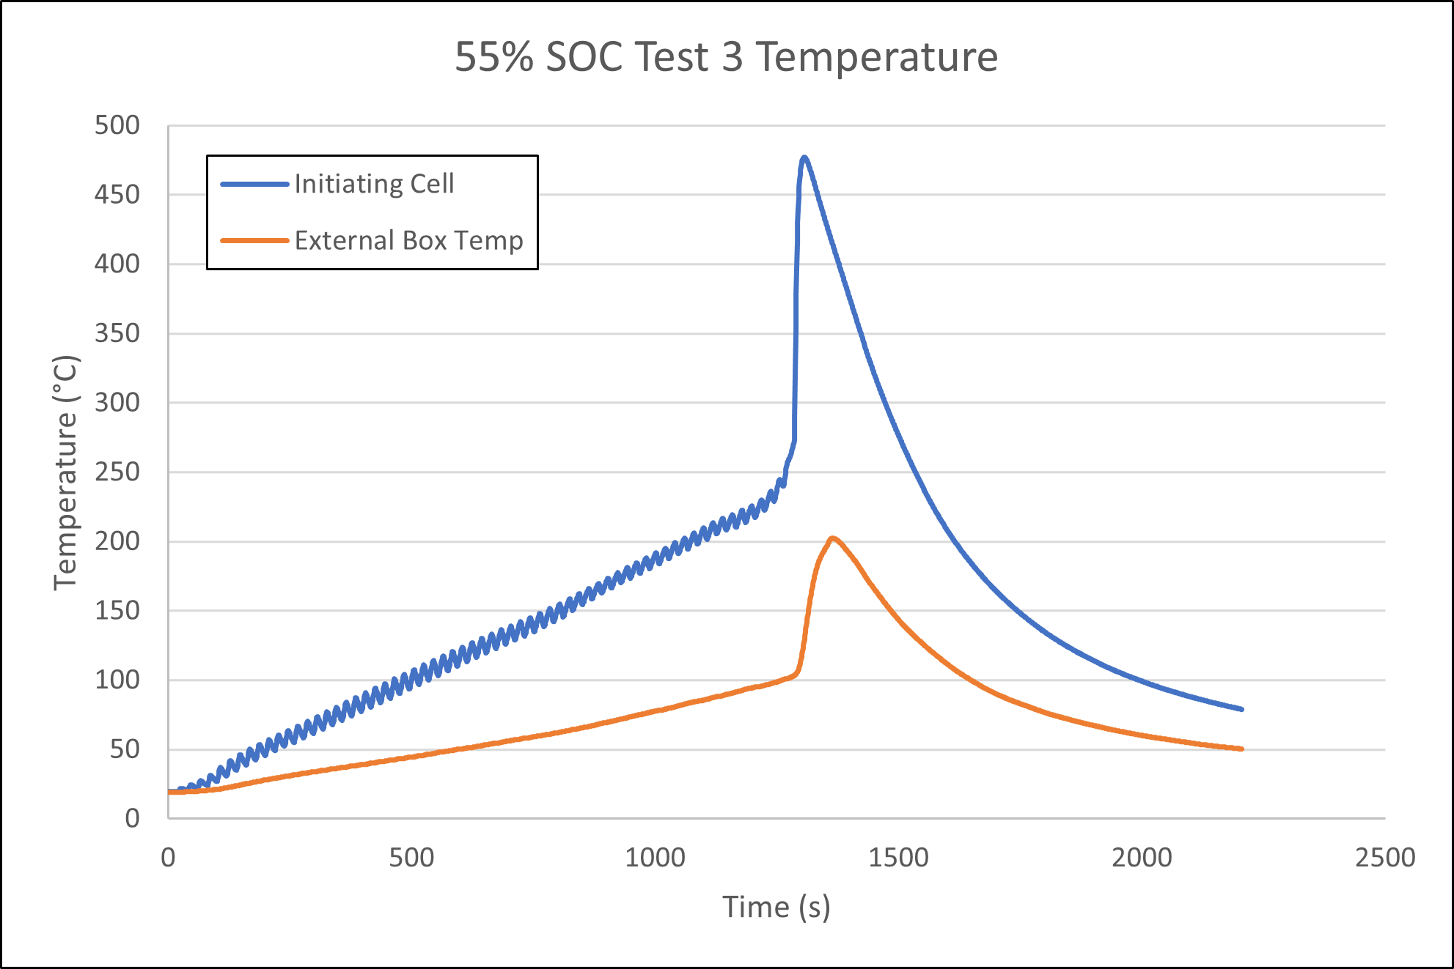
55% SOC Test 3
Average Heating Rate: 10.7°C
Pass/Fail Criteria
Box did not ignite
Gas did not ignite
Box temp increase <150°C for <3 min
Max external temp: 202.2°C

Slide 22
Post-Test Calibration
At 302.5 L chamber size, leak test was performed again after round robin tests
Pre-test Leak Rate: 453 L/hr (1.498 ACPH)
Post-test Leak Rate: 283 L/hr (0.936 ACPH)
Leak rate improved after testing
May not be the case if there were many test failures

Slide 23
Conclusion
Procedure generally worked well
Similar test results from the three labs that conducted round robin tests
Since the SOC was too low to allow for propagation, it will be difficult to learn much without a failing case
Holding cell at 200°C for one hour is likely inadequate to drive many cells into thermal runaway
Tests will be repeated at a higher SOC that will lead to failures

Slide 24
Questions?
Contact:
Steven Rehn
Federal Aviation Administration
William J. Hughes Technical Center
Fire Safety Branch, Bldg. 203
Atlantic City Int’l Airport, NJ 08405
(609) 485-5587
steven.rehn@faa.gov

