Slide 1
High-Fidelity Modeling and Simulation of the NexGen Burner
Manu Kamin, Ryan Hasselbeck, San-Mou Jeng & Prashant Khare
Department of Aerospace Engineering
University of Cincinnati
Presented at
International Aircraft Systems Fire Protection Forum Meeting
Bremen, Germany
April 16, 2024
This work is supported by FAA.

Slide 2
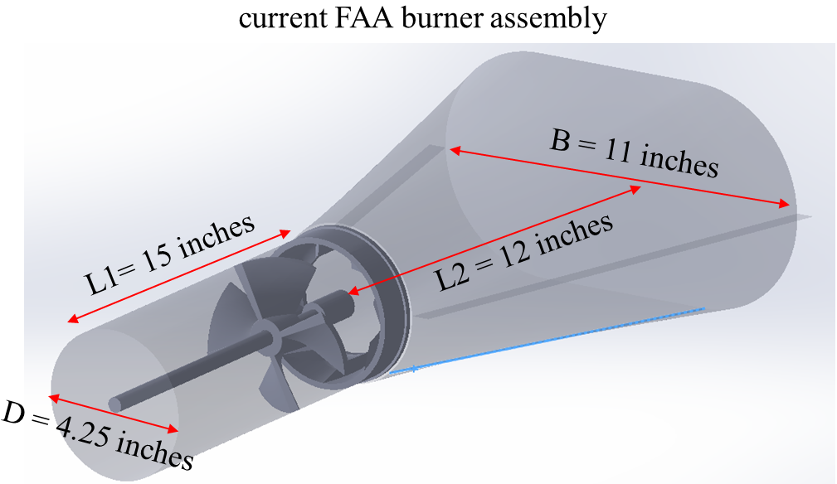
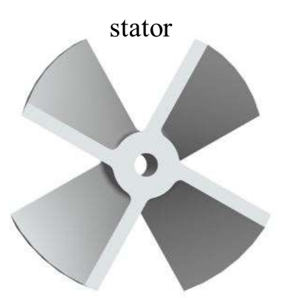
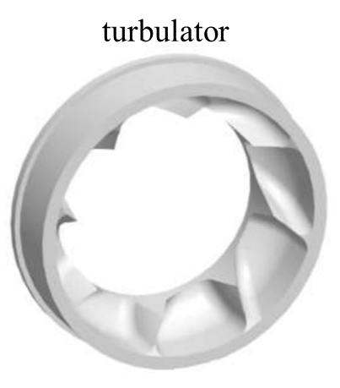
Computations: Overall Goals
Identify the detailed flow physics in the current and modified FAA NexGen burner systematically using high-fidelity LES computations
  cold flow without fuel spray
  cold flow with fuel spray
  “hot flow” with vaporizing fuel spray
  reacting flow
Establish a reference database developed using high-fidelity LES simulations for the above conditions
* geometry dimensions source - https://www.fire.tc.faa.gov/pdf/materials/NexGenPlans_4_2016.pdf

Slide 3
Approach: Large Eddy Simulation (LES)
Salient features of the in-house LES framework:
Compressible finite volume solver
Multi-block structured grid based solver with Message Passing Interface (MPI) for inter-process communication
LES with dynamic Smagorinsky model for sub-grid scale modeling
Up to fourth order accurate in space and third order in time
Scalar or matrix artificial dissipation to assure numerical stability
All Mach number with preconditioning schemes for steady and unsteady flows
Gridding strategy: at least 80% of turbulent kinetic energy is resolved
3

Slide 4
LES: Gas Phase Formulation
Favre-filtered conservation equations for gas-phase flowfield
mass
momentum
energy
species
Closure requirements
- Subgrid-scale (sgs) turbulence interaction
- Chemical reaction source and thermophysical properties & constitutive laws

Slide 5
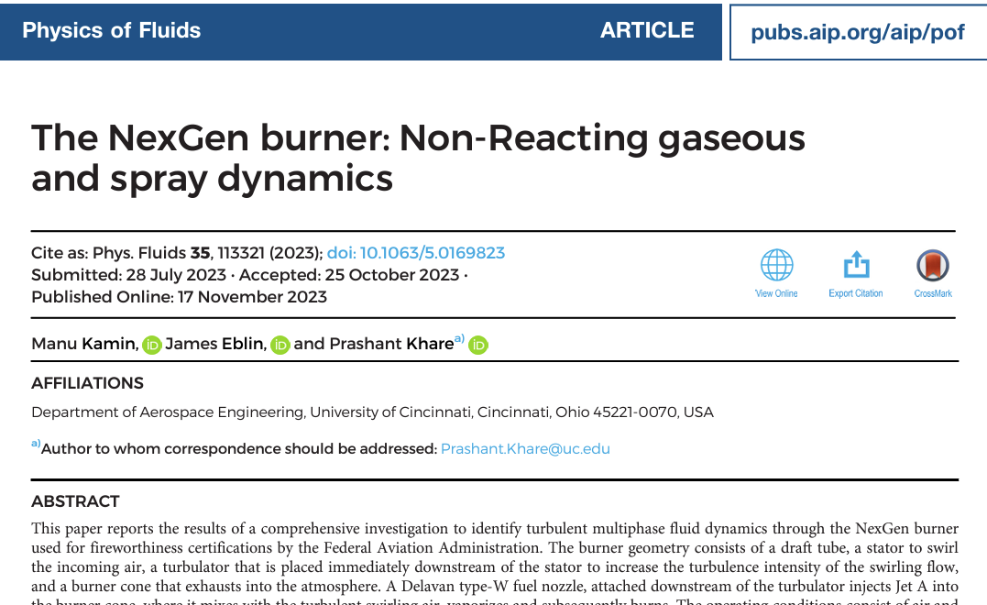
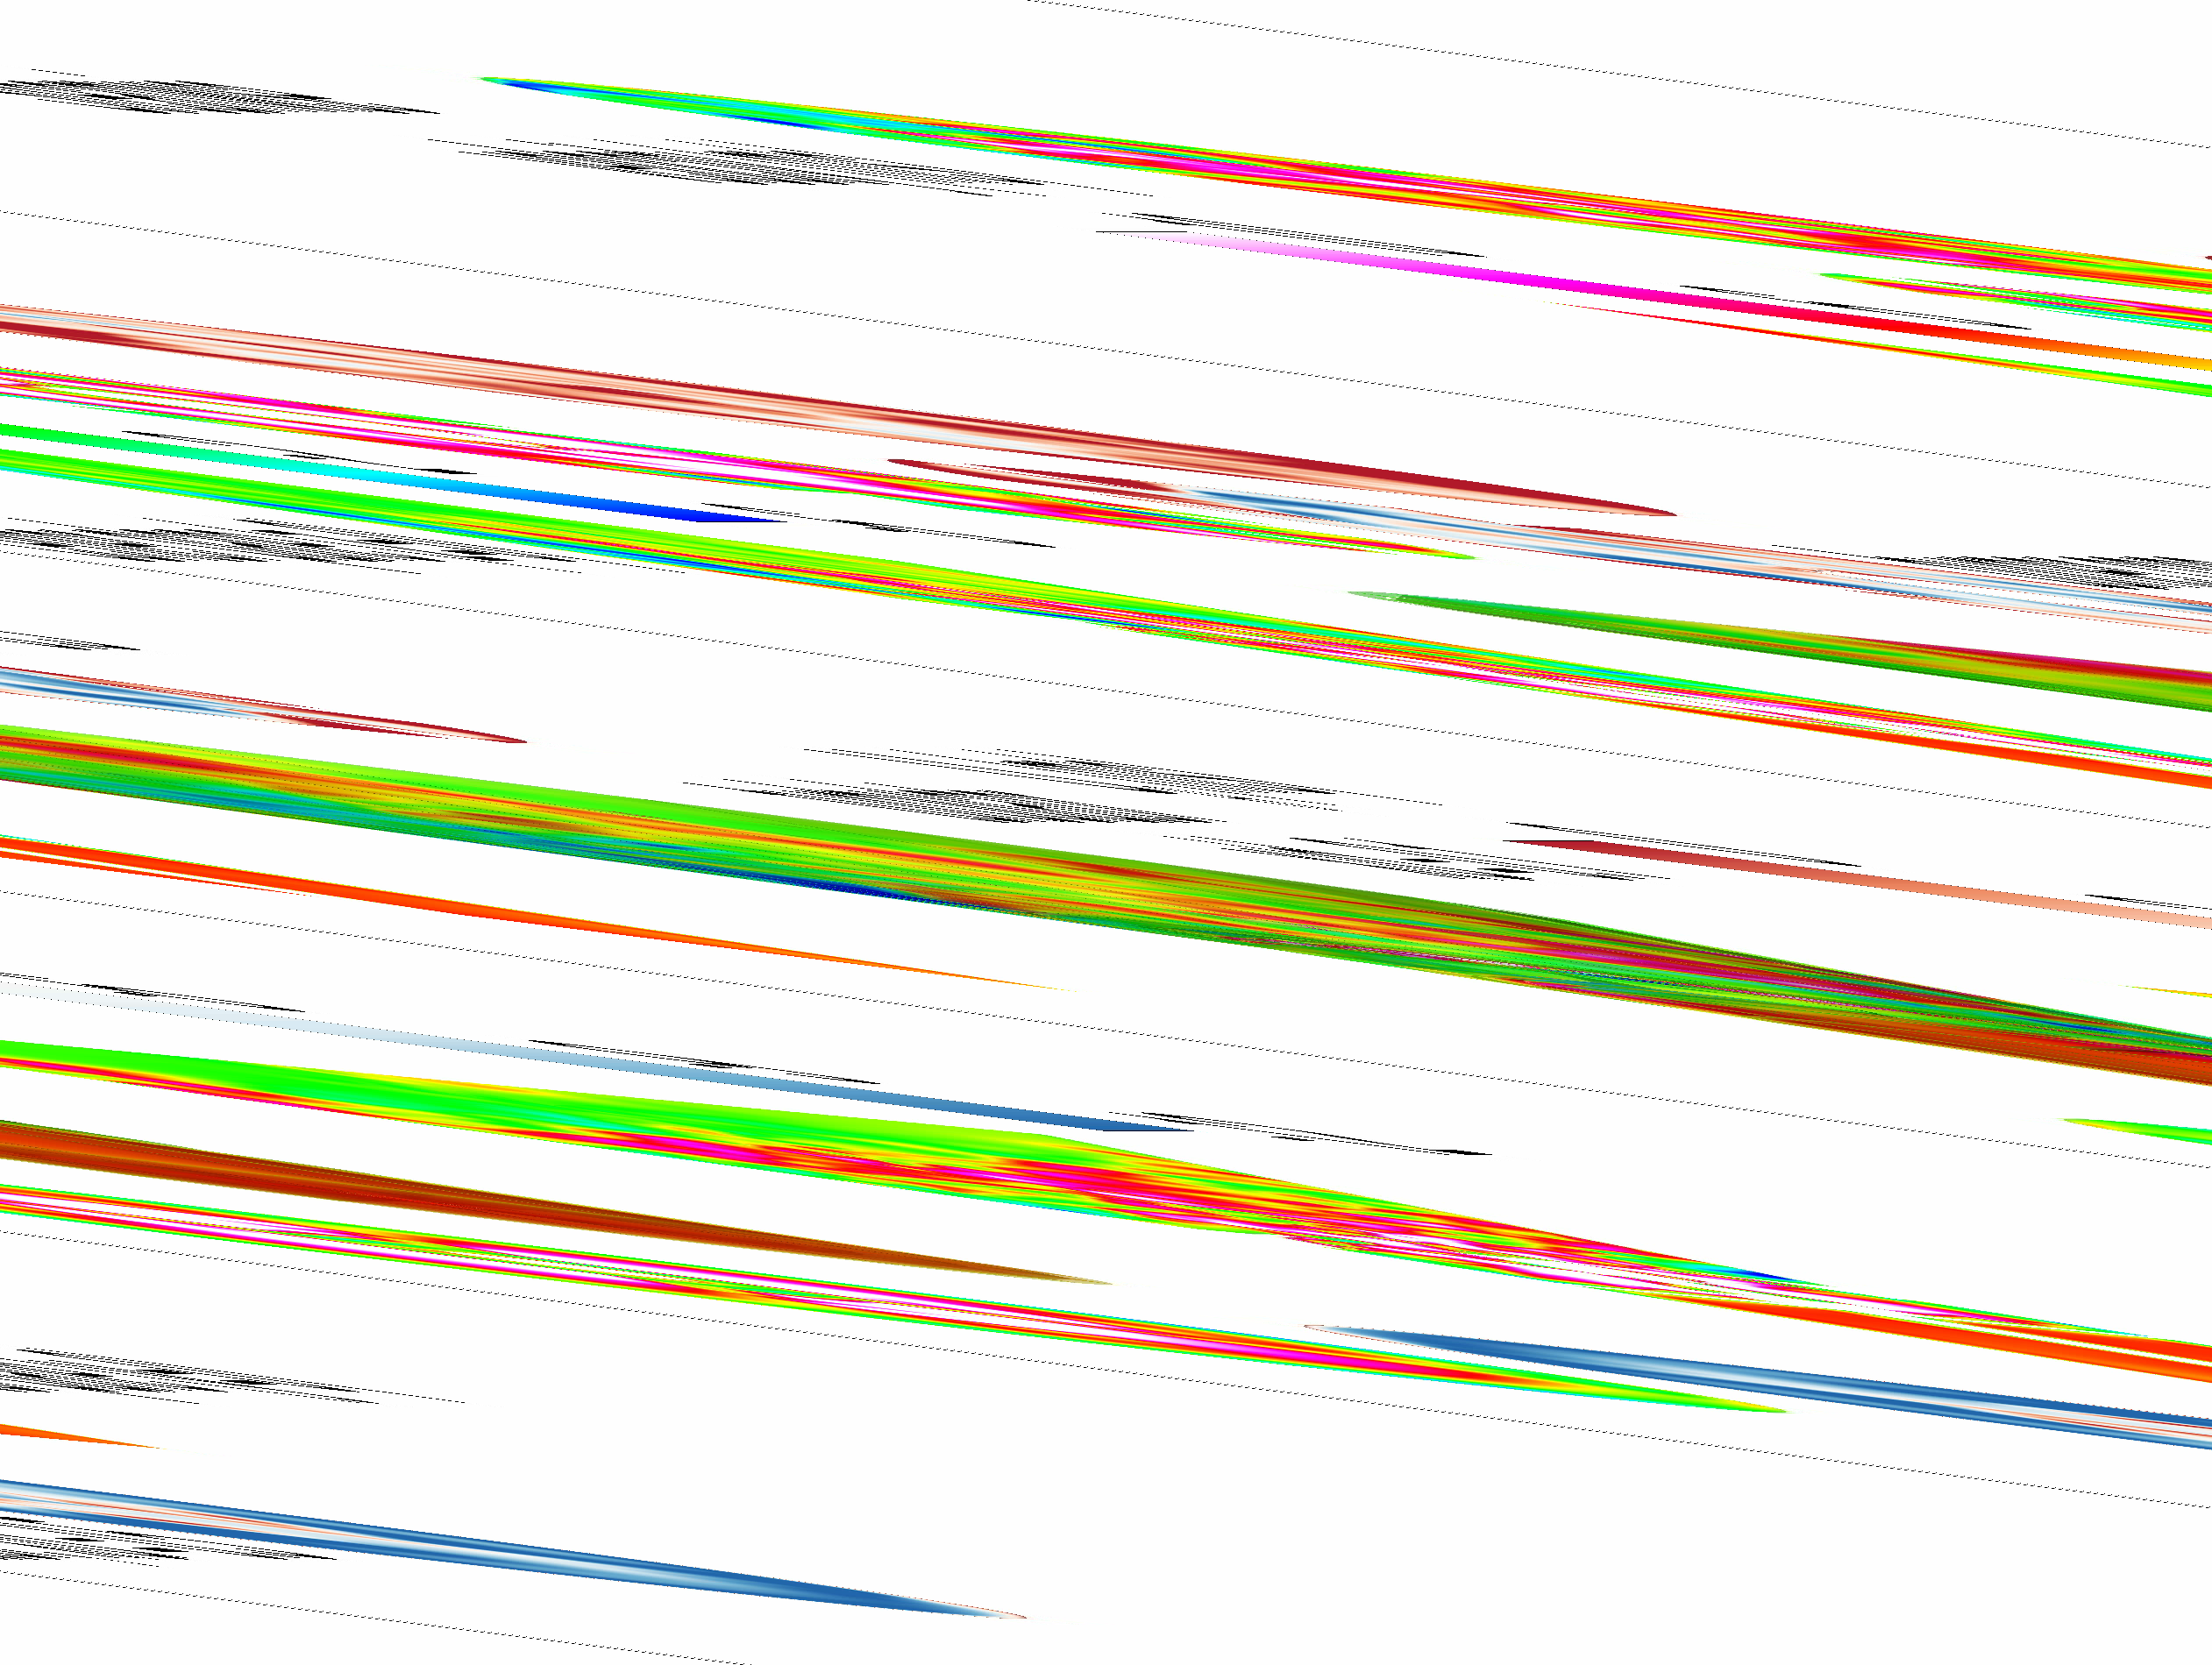
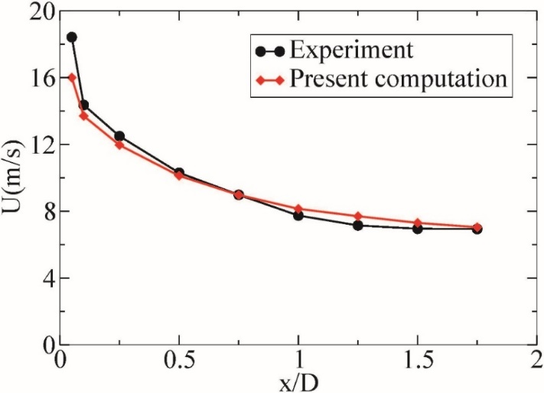
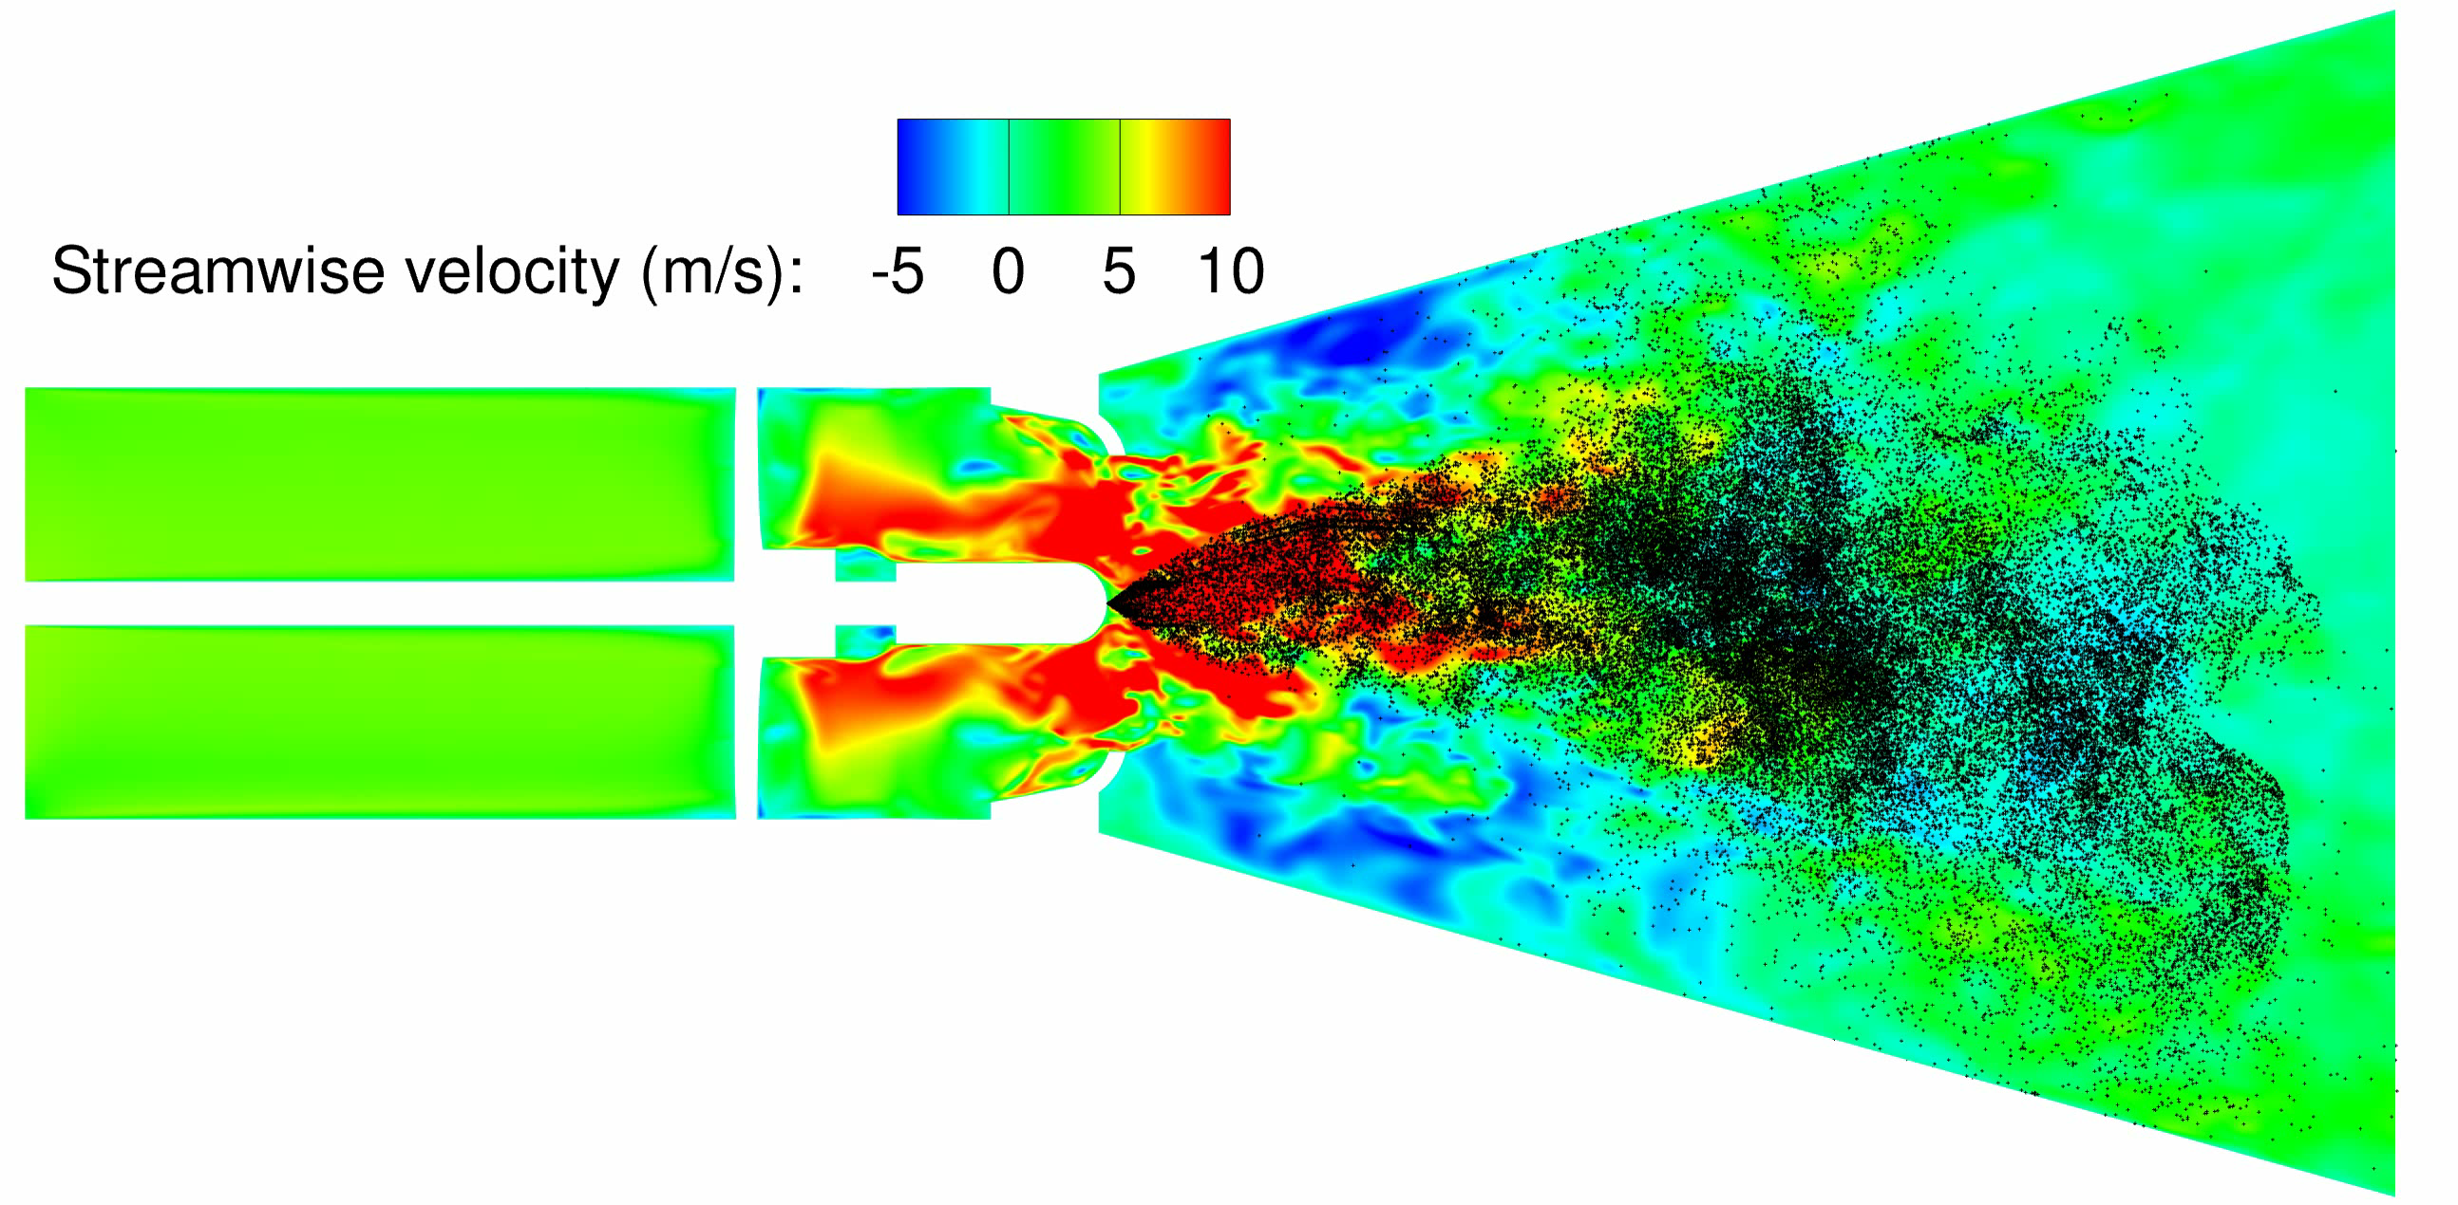
Non-Reacting Flow Analysis

Slide 6
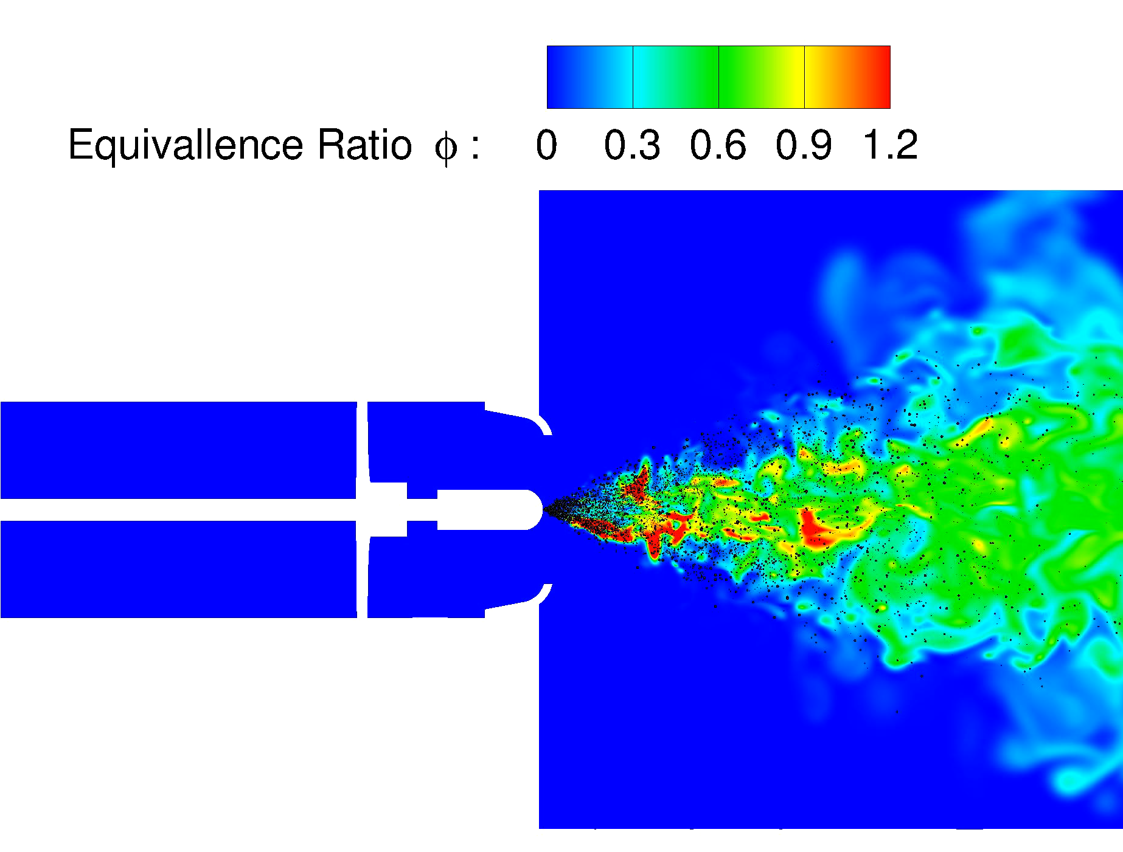
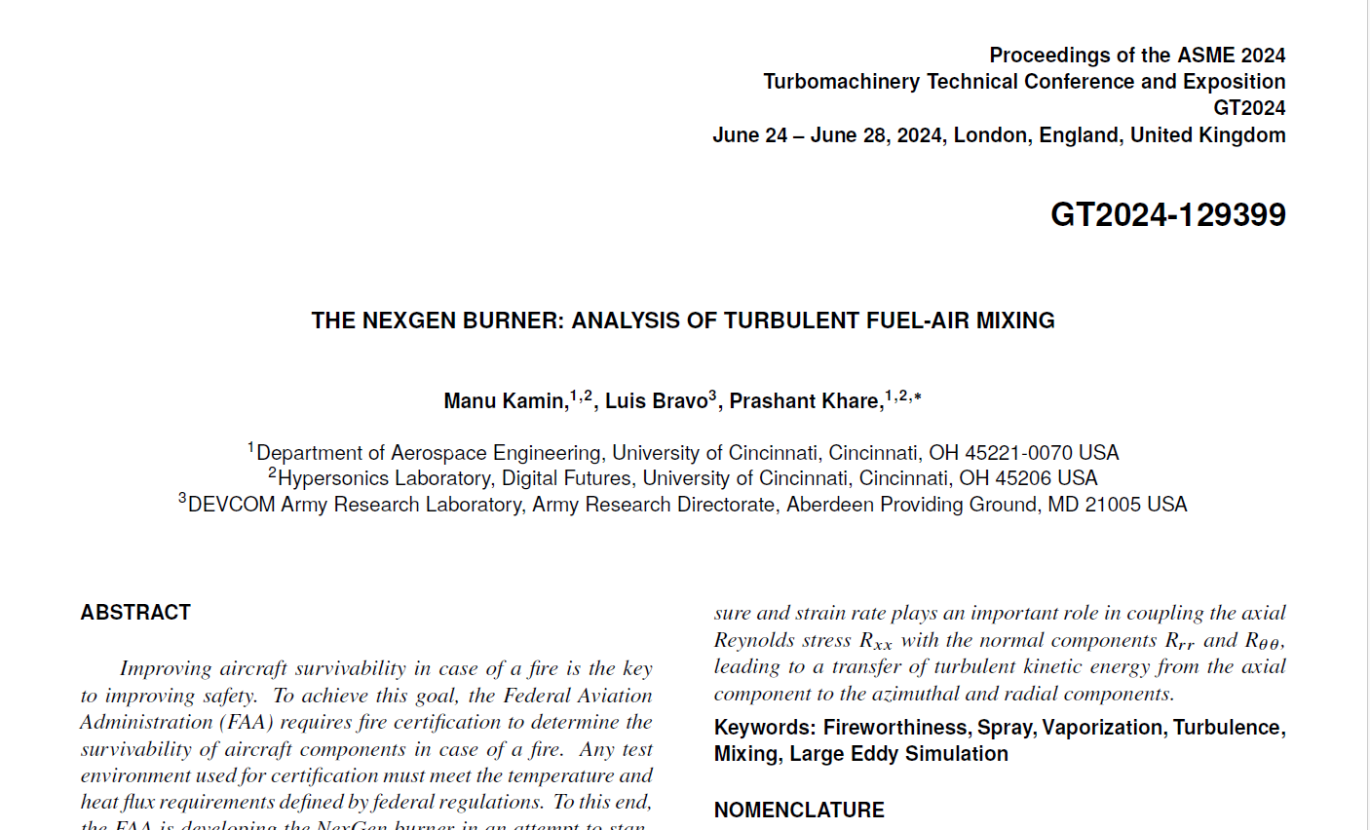
Vaporization and Mixing Analysis
Accepted for publication

Slide 7
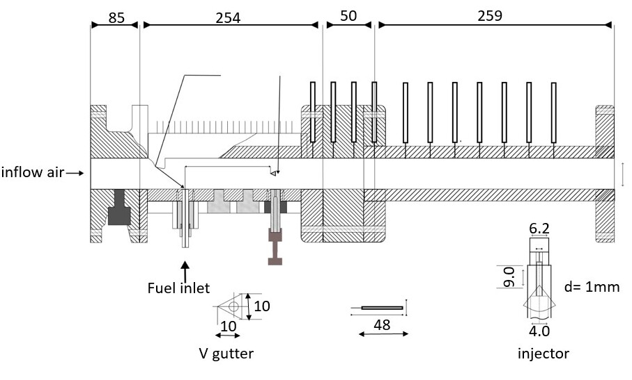
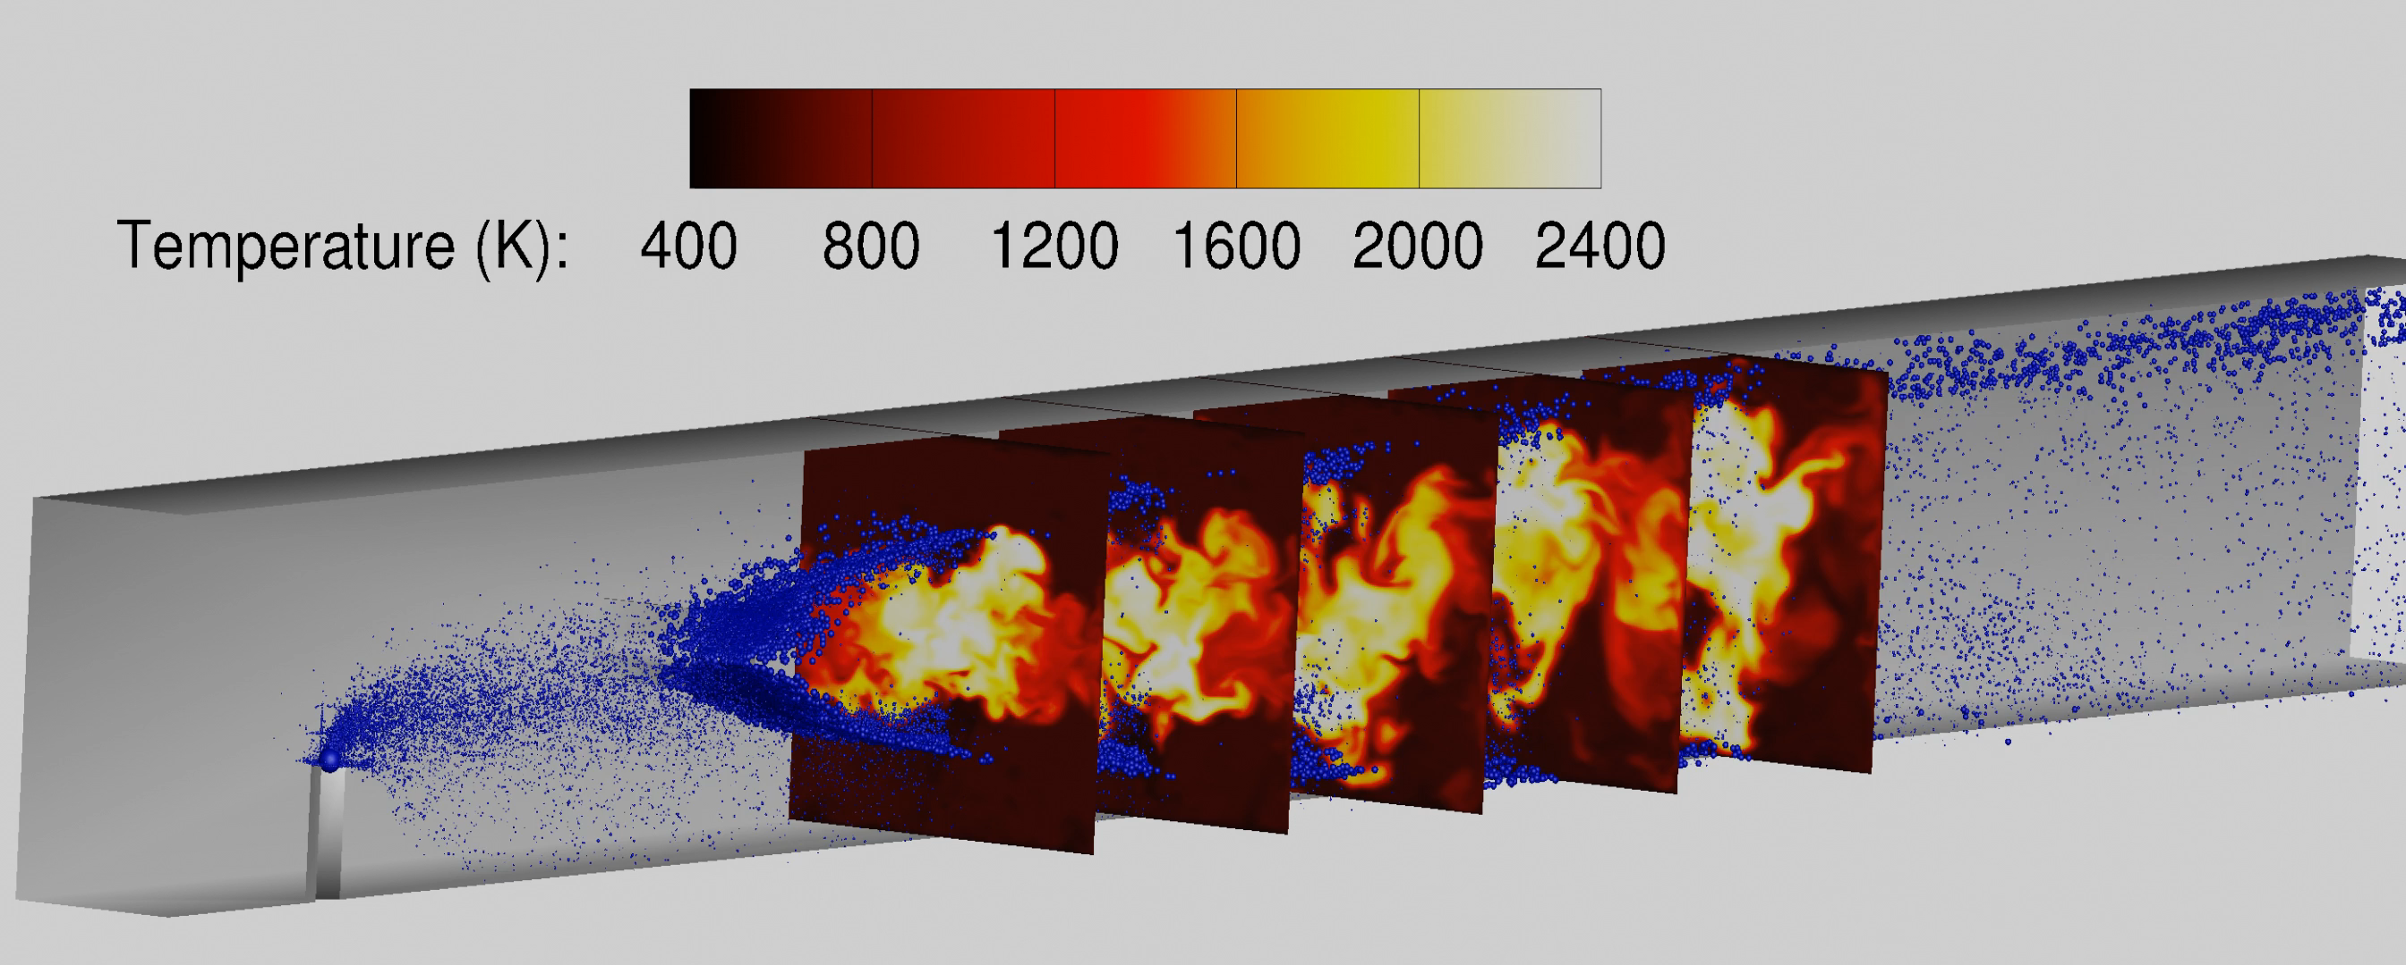
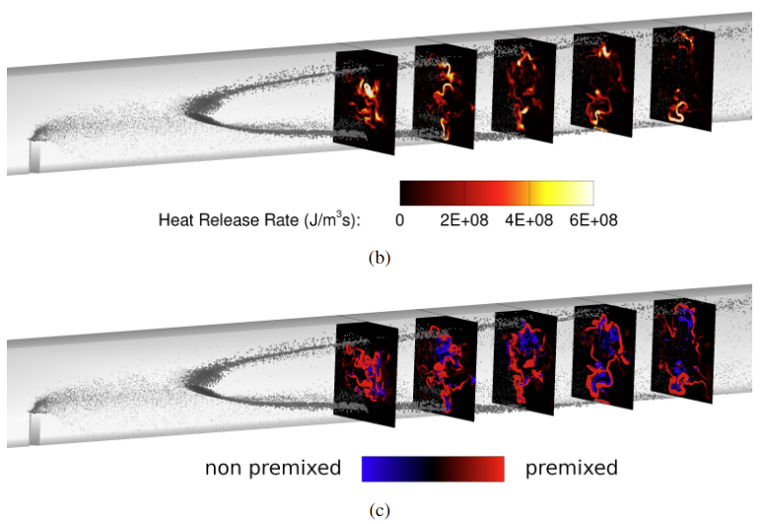
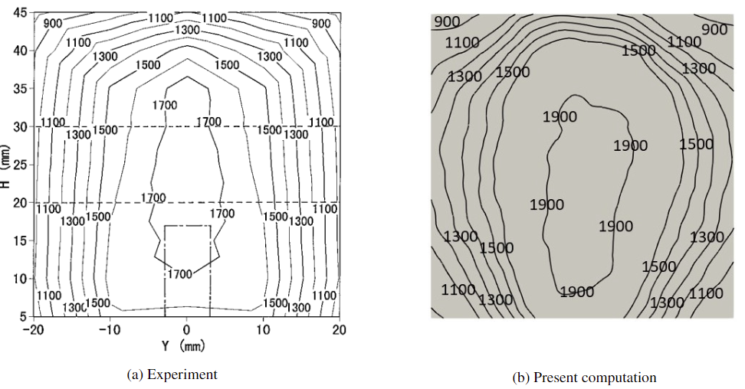
Development and Validation of Thickened Flame Combustion Model
Inamura, Takahashi and Kumakawa, JPP 2001, 17(4)

Slide 8
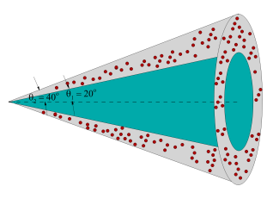
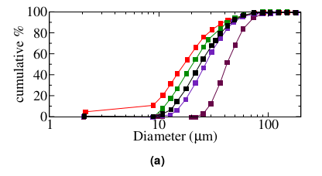
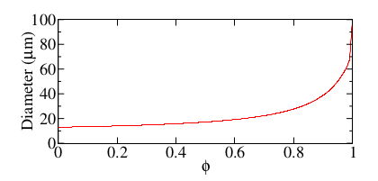
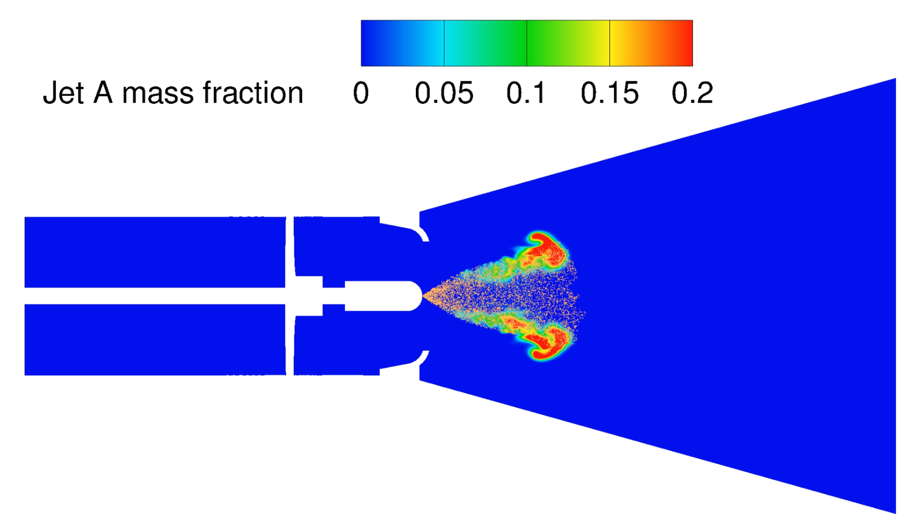
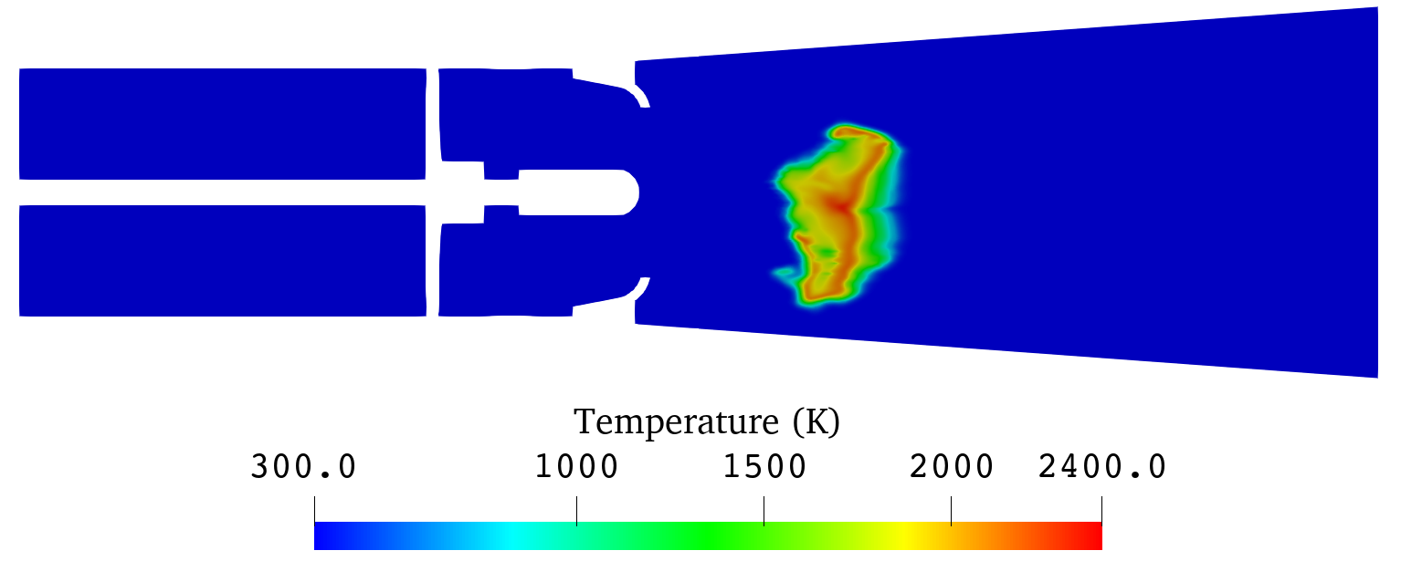
Flowchart of Upcoming Research
NexGen Burner: Combustion Analysis
A schematic of the injected cone
Droplet size distribution from experiment
Cumulative droplet size distribution : computation
Ignite the mixture
Self sustained combustion achieved (instantaneous temperature field at 12 ms – front view)

Slide 9
Thank you for your attention
Prashant Khare, PhD
Associate Professor and Associate Department Head
Department of Aerospace Engineering
University of Cincinnati
Tel: (513) 556-5248
Email: Prashant.Khare@uc.edu
Web: https://khare.uc.edu

