Slide 1
Battery Fire Simulator
International Aircraft Materials & Systems Forum Meeting
Dhaval Dadia
April 16-18, 2024

Slide 2
Objective
Develop a test method to simulate lithium-ion battery fires to replace physical testing of batteries in standardized tests.

Slide 3
Background
SAE is currently developing an additional fire load of lithium cells in addition to the Class-A fire load of cardboard boxes and shredded paper for the AS 8992 (Fire Resistant Containers (FRC))
The additional fire load will test the FRC’s capability to suppress or contain a specified quantity of lithium-ion cells
The testing will involve an open-air test to ensure the entire lithium-ion cell fire load will be consumed and an assembly test with the same lithium-ion cell fire load surrounded by a Class-A fire load.

Slide 4
Fire Loads
SAE Proposed Setup
FAA Proposed Setup

Slide 5
Benefits
Repeatable and Reproducible fire load for standardized tests
Fire load can be changed based on evolving variables such as cell chemistry, SOC, capacity, and quantity of cells
Lower cost to conduct standardized tests

Slide 6
Test Objective
Conduct a series of tests that will determine the amount of battery gases generated by lithium-ion cells in thermal runaway
Conduct a series of tests that will determine the rate at which thermal runaway propagates in large quantities of lithium-ion cells

Slide 7
Test Setup – Gas Generation
1 Cell, 4 Cell, and 9 Cell configurations placed within an inert pressure vessel
1 Cell initiated into thermal runaway via heater
Unignited battery gases are allowed to cool down
Battery gases are quantified using a Gas Chromatograph (GC) and other gas analyzers

Slide 8
Test Setup – Propagation Rate
25 Cell, 49 Cell, 100 Cell, 200 Cell configurations placed in the pressure vessel
1 cell initiated into thermal runaway via heater
Measured pressure, temperature, and heat flux.

Slide 9
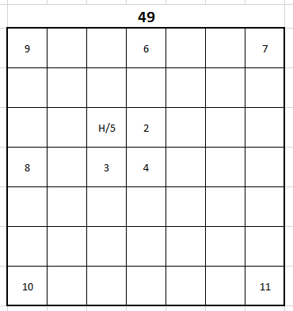
Test Setup – Propagation Rate

Slide 10
Test Results – Gas Generation

Slide 11
Test Results – Propagation Rate
Generated histogram profiles to determine a propagation rate
Determined thermal runaway events based on pressure data and validated with audio recording of tests.

Slide 12
Test Results – Propagation Rate

Slide 13
Test Results – Propagation Rate

Slide 14
Test Results – Propagation Rate

Slide 15
Test Results – Propagation Rate

Slide 16
Test Results – Propagation Rate

Slide 17
Test Results – Propagation Rate

Slide 18
Test Results – Propagation Rate

Slide 19
Test Results – Propagation Rate

Slide 20
Test Results – Propagation Rate

Slide 21
Test Results – Propagation Rate

Slide 22
Future Work
Conduct lithium-cell propagation tests in an inert pressure vessel.
Validate gas generation data.

Slide 23
Summary
Development of a test method to simulate lithium-ion fires is ongoing.
More tests need to be conducted to validate gas generation data.
Propagation tests present a trend, but more tests need to be conducted in an inert pressure vessel to generate accurate datasets.

Slide 24
Questions?
Dhaval Dadia
dhaval.dadia@faa.gov

