Slide 1
Revised Rate of Heat Release Test Method
(HR2)
April, 2024
Bremen, Germany
Michael Burns, FAA Technical Center

Slide 2
Talking Points
Diamond Mask Position Discussion (OSU)
Industry HR2 Updates
HR2 Airflow Control
New T-Burner Calibration & Testing
Smoke (SNPRM)
Next

Slide 3
Diamond Mask Position and Effect
Recent observation of vague or non-existent dimension called out in FAAFTHB
Sent a survey request out to Industry requesting the center dimension of the diamond mask measurement relative to the 120-hole air distribution plate
The following results show compiled data from 10 OSU manufacturers:
Atlas | Govmark
Concept equipment | Homebuilt
CSI | K.Svanks Co H.R.R Consulting
Deatak | M.E.
FTT | OSU

Slide 4
Diamond Mask Position and Effect

Slide 5
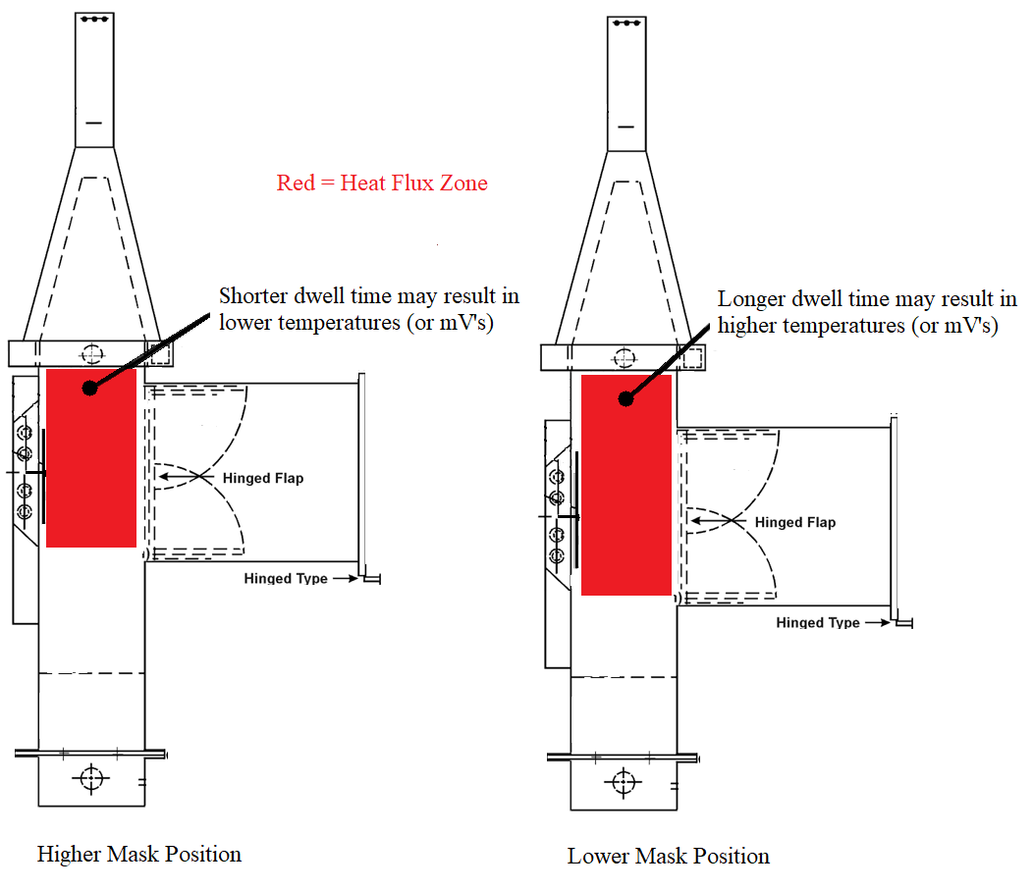
Diamond Mask Position and Effect

Slide 6
Diamond Mask Position and Effect
CF = 0.2407 (10.36)
CF = 0.3524 (15.17)

Slide 7
Diamond Mask Position and Effect
Observations from high mask/holding chamber position relative to 120-hole plate:
Shorter dwell time of passing gasses in the targeted heat flux zone
Lower gas temperatures (or mV’s)
Higher calibration factor
Potential for higher test results (result of CF)
inch cm
Max 15.75 40.00
Min 13.25 33.66
Delta 2.50 6.35

Slide 8
Industry HR2 Updates

Slide 9
Industry HR2 updates
Boeing HR2 update
Sierra Instruments MFC repaired
Alternative MFC comparative testing underway
Sonic choke procurement complete (but currently not installed)
Lower plenum pressure comparative testing underway with the FAATC and other HR2 units (validate system air flow similarity)
New radius type T-Burner testing underway

Slide 10
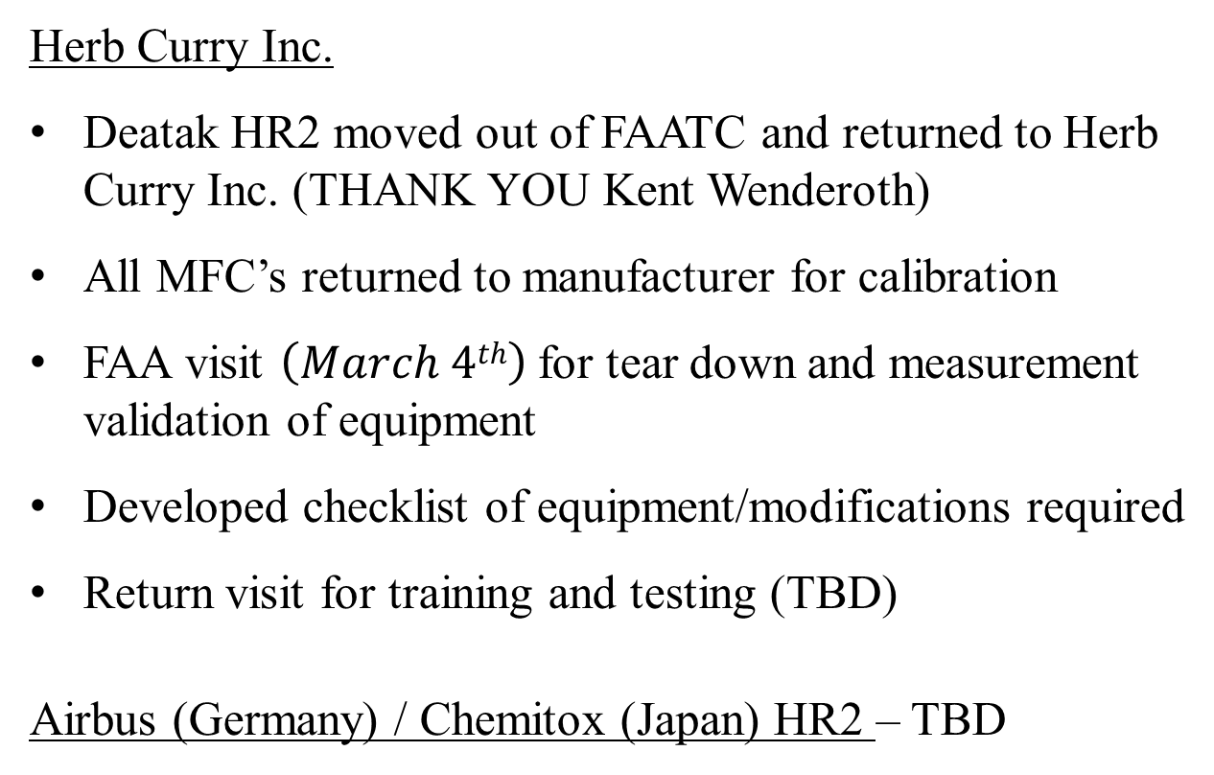
Industry HR2 updates
Herb Curry Inc.
Deatak HR2 moved out of FAATC and returned to Herb Curry Inc. (THANK YOU Kent Wenderoth)
All MFC’s returned to manufacturer for calibration
FAA visit $\left(March 4th\right)$for tear down and measurement validation of equipment
Developed checklist of equipment/modifications required
Return visit for training and testing (TBD)
Airbus (Germany) / Chemitox (Japan) HR2 – TBD

Slide 11
HR2 Airflow Control

Slide 12
HR2 MFC (Alternative Manufacturer)
Currently using a Sierra Instruments MFC
Manufacturer stated they would no longer support this device
Desire to find alternative replacement MFC
The use of sonic choke was added to the placeholder document as an alternative option

Slide 13
HR2 MFC (Alternative Manufacturer)
Alicat Mass Flow Controller: P/N MCR-500SLPM-D/5M
Length: 5IN
Gas selection: Air
Body and sensor engineered for 0-500 SLPM full scale range
Range: (20 SCFM) 0 - 650 SLPM (30% custom range added)
Tuned pressure: P₁ (In): 20 PSIG / P₂ (Out): 0.5 PSIG
Reference Temperature and Pressure: 0°C & 1 ATM
Display: LRV-67x51
Standard Accuracy: ±(0.8% of reading + 0.2% of full scale)
Backlit monochrome display
98 selectable gases

Slide 14
HR2 MFC (Alternative Manufacturer)
0-5 Vdc primary analog output of mass flow rate
0-5 Vdc analog setpoint input
ASCII and Modbus RTU over RS-232 communication
8-pin mini DIN (Cable P/N USB-MD8-232 @ $100)
2.1 mm barrel power jack
Power Requirements: 24 Vdc and 1 A (P/N PVPS24U @ $55)
Default FKM elastomers
3/4" NPT female process connections
NIST traceable calibration certificate included
RoHS compliant
MFC Cost: $2450

Slide 15
HR2 MFC (Alternative Manufacturer)
Alicat Scientific, Inc.
7641 N Business Park Dr
Tucson, AZ 85743 USA
ph: 1-520-290-6060
orders@alicat.com
alicat.com

Slide 16
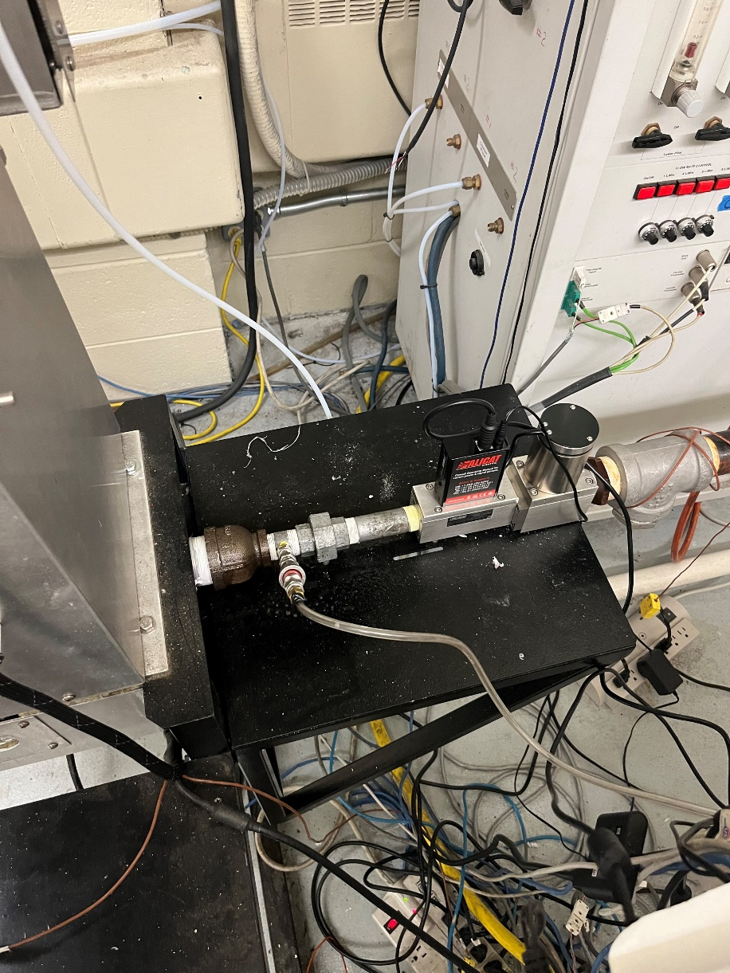
HR2 MFC (Alternative Manufacturer)

Slide 17
New T-Burner Calibration & Testing

Slide 18
Current Calibration Method
Unlike the OSU, the HR2 calibration captures steady state thermopile values at a ‘zero’ flow condition and a ‘span’ flow condition
The HR2 uses the upper pilot as the calibration burner while flowing 3 SLPM for 4 minutes averaging the final 20 seconds of thermopile signal.
Calibration factor range is 17 ± 2 W/°C

Slide 19
Calibration Method
In an effort to better correlate OSU HRR values experimental testing was conducted using a T-shaped burner during calibration
Slight differences were discovered due to the change in position of calibration gas entry (from upper pilot burner to lower pilot position)
HR2 calibration values increased approximately 10% to better correlate with OSU data
When T-burner is used in HR2, calibration factor range changes from 17 ± 2 W/°C to 18 ± 2 W/°C

Slide 20
Changes to consider:
Changes in plumbing to divert calibration gas from the upper burner to the lower burner position.
Calibration gas is lit immediately once gas is flowing.
Potential changes to software to account for this change (pop-up information or notices etc.).
The calibration procedure itself will not change.
Specify exact position of the T-burner within the chamber

Slide 21
T-Burner Calibration
Initial testing included installing the original OSU T-burner
Observation made indicating flames being drawn into globar pan as a result of the lower gas flow vs. OSU
    HR2 @ 3 slpm
    OSU @ 4, 6 & 8 slpm
Decision was made to modify vertical T-burner to one having a radius allowing the flames to be more centrally positioned
Research continues developing new operating parameters
  - Baseline, TST, CF

Slide 22
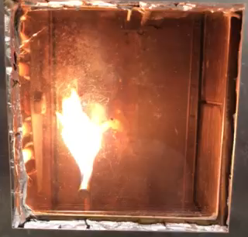
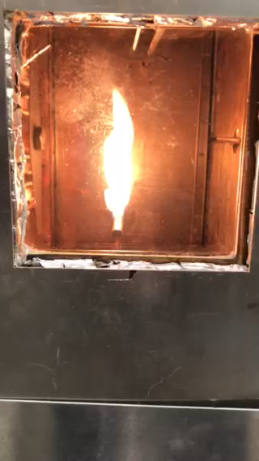
T-Burner Calibration
T-Vertical Post T-Burner @ LP outlet

Slide 23
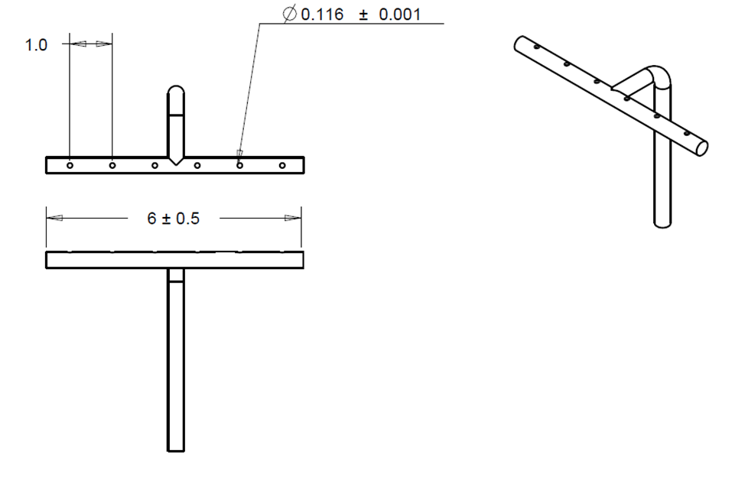
New T Burner Design & Position
Figure A4-8. Calibration Burner

Slide 24
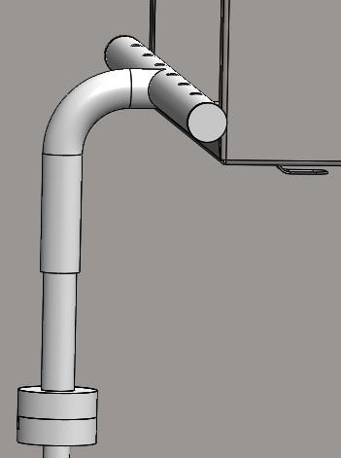
Changes to consider:

Slide 25
Smoke Monitoring (SNRPM)

Slide 26
Smoke Monitoring (SNRPM)
Initial system used single beam signal and thermopile type receiver
New system uses a flat-sheet signal and an optical power meter.
New System mounted on a platform that sits in the chimney area
Flat-sheet laser signal covers entire exhaust width (2”) at a height of 2” from outlet.
Purchased Edmund Optics calibrated ND filters to validate system (Optical density = 0.3, 0.5 and 1.0)

Slide 27
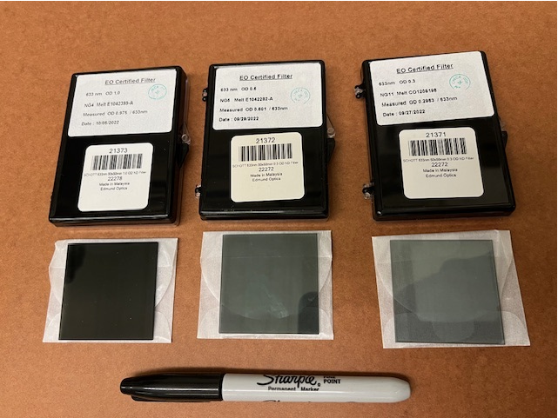
Smoke Monitoring (SNRPM)
Calibrated Optical Density

Slide 28
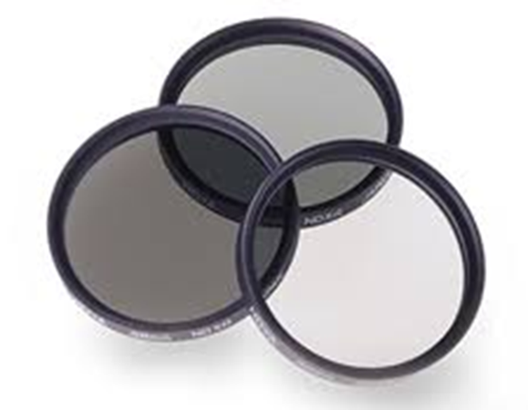
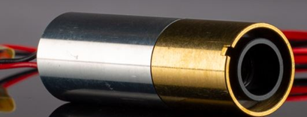
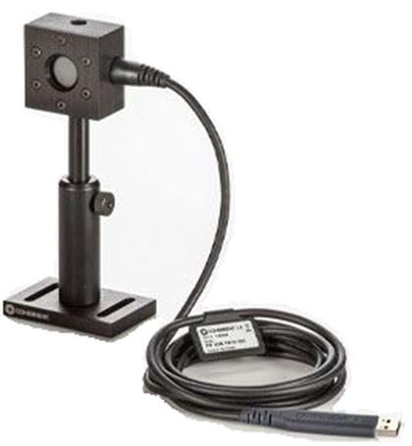
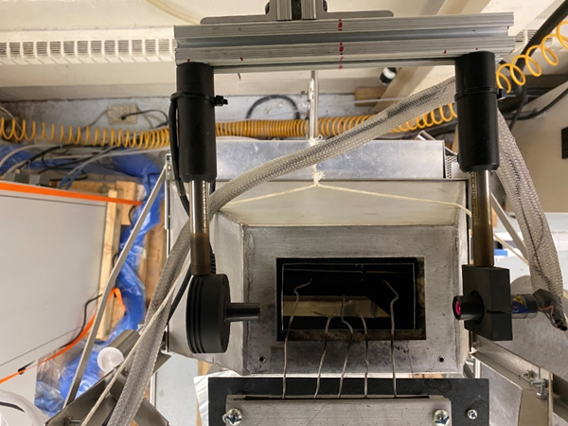
Smoke SNPRM

Slide 29
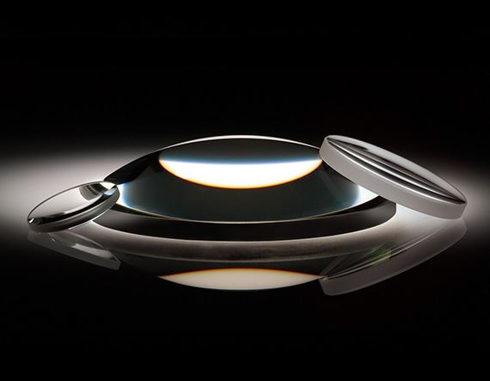
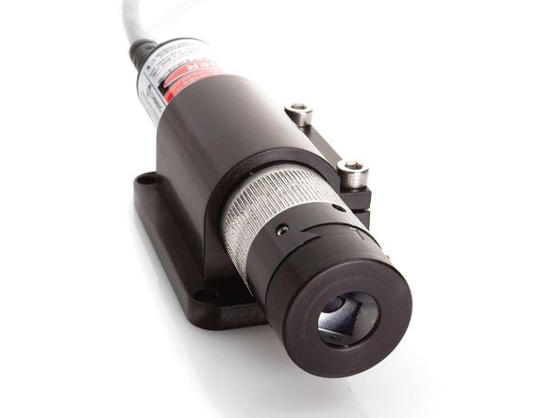
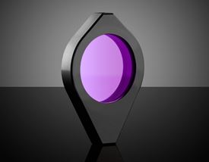
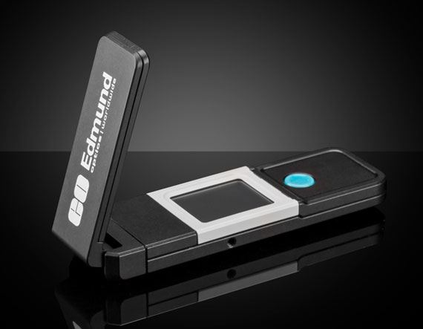
‘Flat Beam’ HR2 Smoke Monitoring
30° Fan Angle
Line Generator
Plano-Convex Lens (2)
660nm Bandpass Filter (1)
(Approx. total cost $3000)
Silicon Based Laser Power Meter

Slide 30
Edmund Optics: Laser Product List

Slide 31
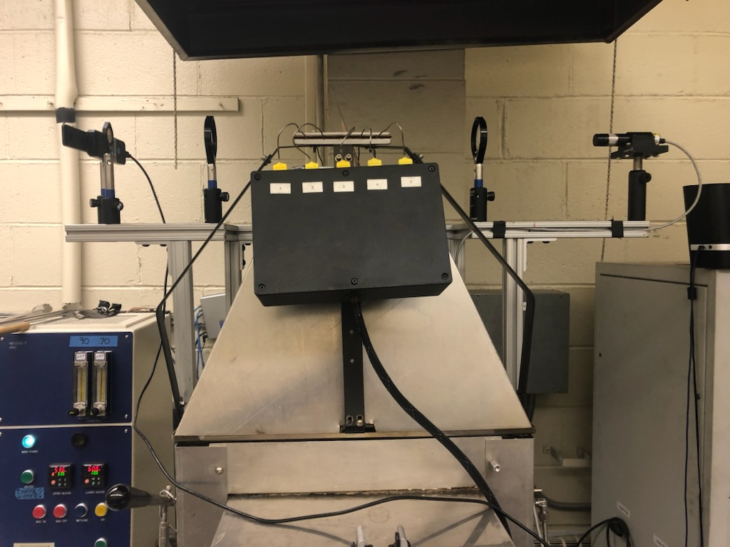
Edmund Optics: Laser System

Slide 32
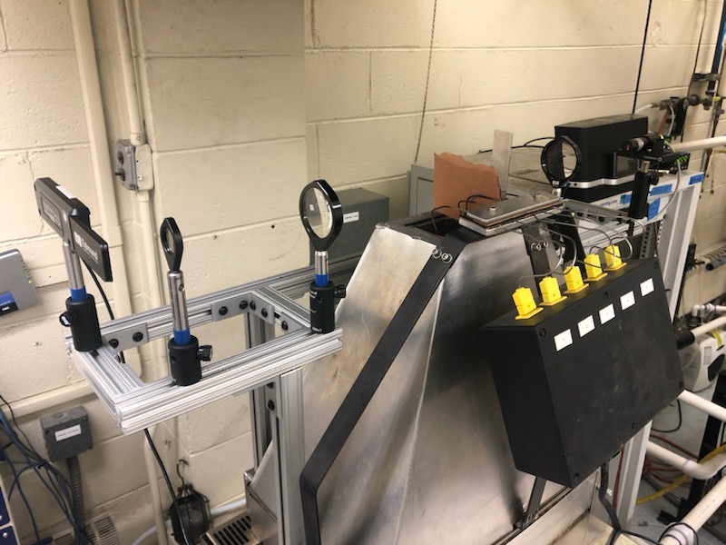
Edmund Optics: Laser System

Slide 33
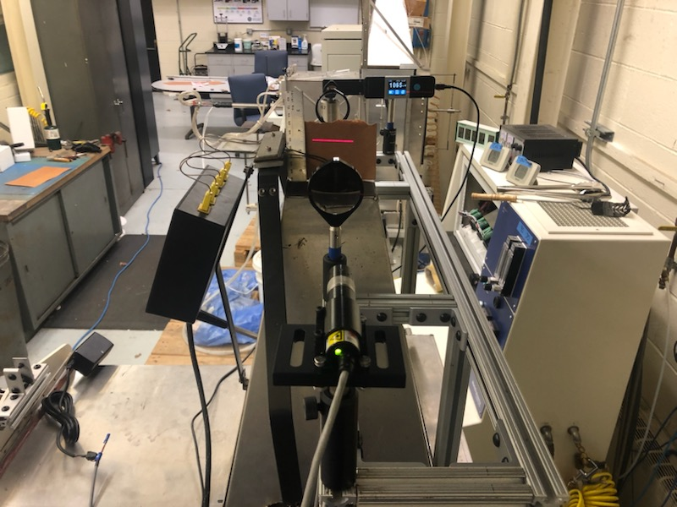
Edmund Optics: Laser System

Slide 34
Edmund Optics: Laser System (Initial)
Expected |  |  | Observed |  |  | % Delta
OD | Ds | % LT | OD | Ds | % LT | OD | Ds | % LT
0.3 | 39.6 | 0.50 | 0.4 | 49.8 | 0.42 | 25.7% |  | -16.2%
0.6 | 79.2 | 0.25 | 0.7 | 89.9 | 0.21 | 13.5% |  | -17.0%
0.9 | 118.8 | 0.13 | 0.8 | 108.1 | 0.15 | -9.0% |  | 20.5%
1.2 | 158.4 | 0.06 | 1.1 | 149.1 | 0.07 | -5.8% |  | 17.7%
1.5 | 198.0 | 0.03 | 1.4 | 190.2 | 0.04 | -3.9% |  | 13.2%

Slide 35
Edmund Optics: Laser System (New)
Stated | Calibrated |  | Calculated | Measured
O.D. | O.D | % Light Transmission | S.O.D | S.O.D | % Delta
0.30 | 0.298 | 50.32 | 39.4 | 41.6 | 5.6%
0.50 | 0.501 | 31.55 | 66.1 | 67.5 | 2.1%
0.80 | 0.799 | 15.87 | 105.5 | 112.2 | 6.3%
1.00 | 0.975 | 10.59 | 128.7 | 126.8 | -1.5%
1.30 | 1.273 | 5.33 | 168.1 | 172.1 | 2.4%
1.50 | 1.476 | 3.34 | 194.8 | 197.9 | 1.6%
1.80 | 1.774 | 1.68 | 234.2 | 247.1 | 5.5%

Slide 36
Edmund Optics: Laser System (New)
Lessons learned so far:
Power meter square aperture too large for signal beam (10mm x 10mm) allowing stray lighting to interfere
  Requirement states 70% to 90% of aperture to be covered
This requires square-to-round adapter and small orifice to be installed (purchased and awaiting arrival)
Bench scale testing to continue
THANK YOU to Boeing for providing ‘smokey’ test coupons to be tested soon (approach 200Ds but pass HRR)

Slide 37
Miscellaneous / Next
Validate new Alicat MFC and radius T-burner
Complete 100 calibration cycle as needed
  Define HR2 Nominal Operating Parameter Ranges (BL, TST, CF, lower plenum pressure)
Complete TRL6 testing as needed
TRL7 planning and acquisition of materials continues
Formalize endgame for TRL test series (define activities, goals etc.)
Continue Flat-sheet laser system testing
Update Rev3 placeholder document

Slide 38
QUESTIONS? FIRE AWAY!!!

