Slide 1

Detection of Signatures from Internal Contaminant Sources
FAA sponsored research grant with the University of Maryland
International Aircraft Materials & Systems Forum Meeting
Congress Center Bremen, Bremen, Germany
Lindsey Anaya, General Engineer
April 16, 2024
University of Maryland
PI: Dr. James Milke
Graduate Researcher: Saleel Anthrathodiyil

Slide 2
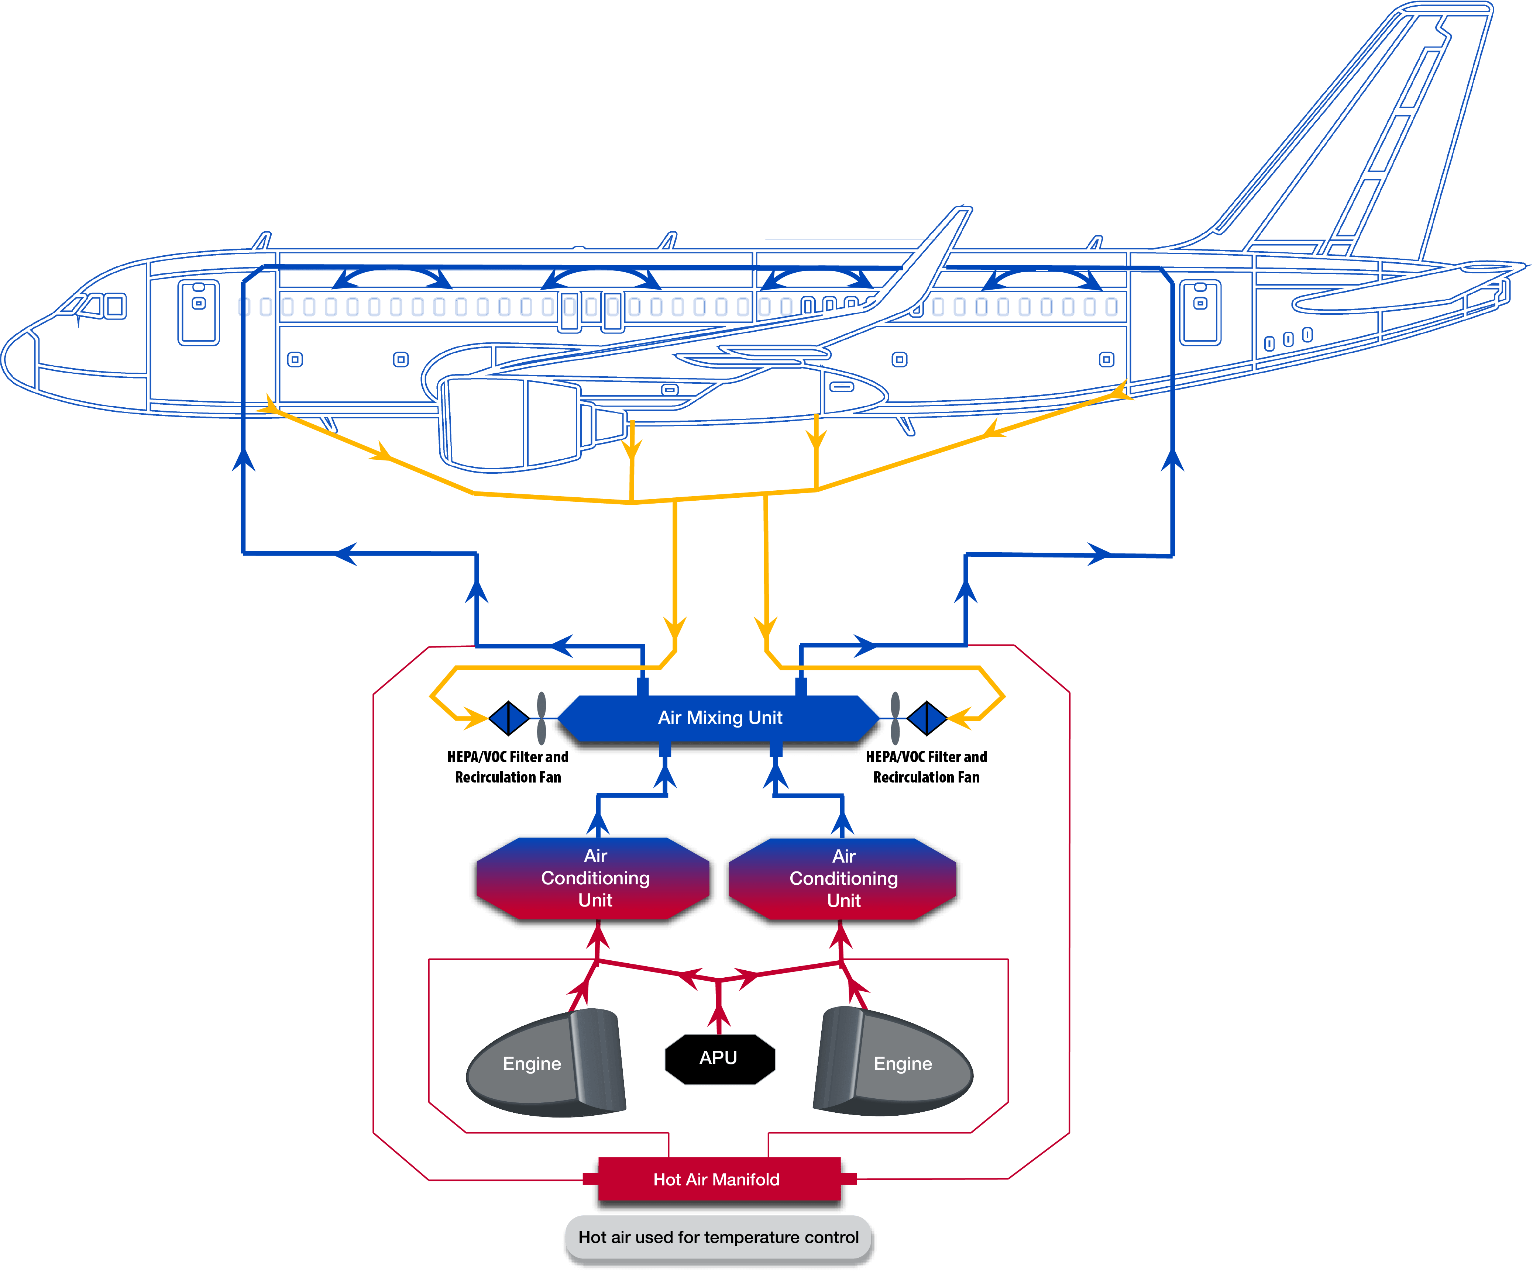
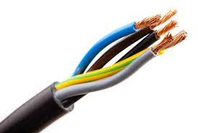
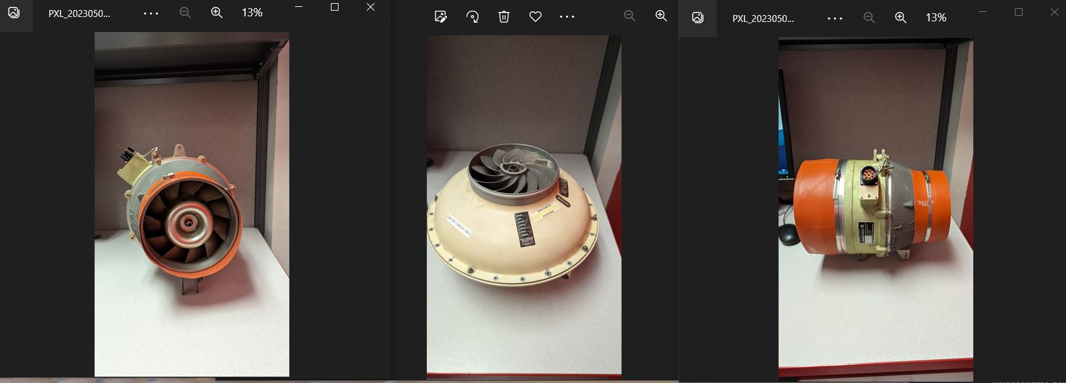
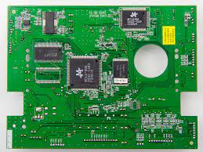
Internal Contaminant Sources
Wiring
Recirculation Fans
Printed Circuit Boards

Slide 3
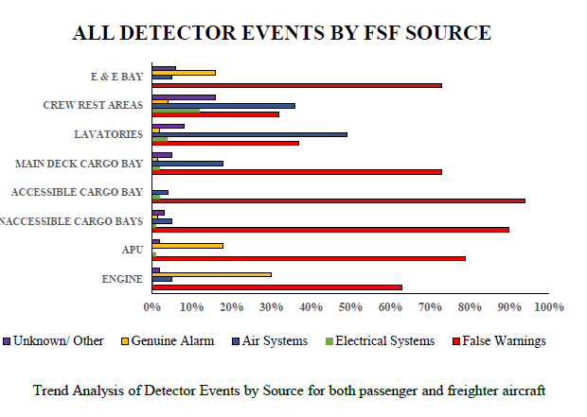
Research Motivation
Electrical odors and smoke incidents in aviation have become a pressing concern, with over half of the detector activations resulting in false alarms, leading to uncertainties for flight crews.
The escalating costs of diversions and growing awareness of associated health risks underscore the need for more reliable detection and discrimination from false alarms.
Data source:
Cherry, R.G.W. & Associates Limited. (2017). Research Into Fire, Smoke or Fumes Occurrences on Transport Airplanes (DOT/FAA/TC-16/49).

Slide 4
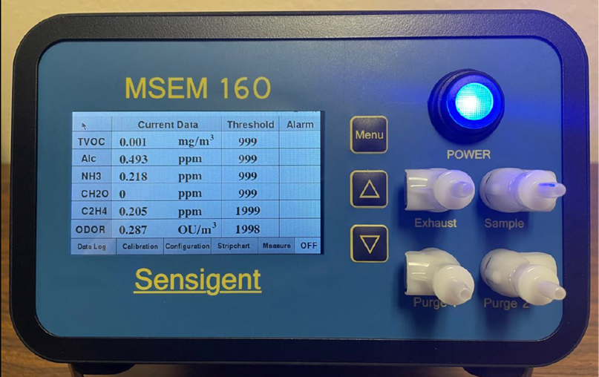
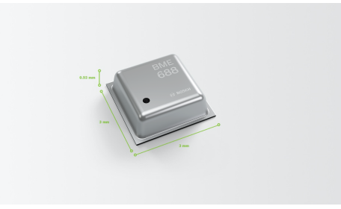
Research Goal
Identify sensor technology capable of:
Detecting signatures/significant markers from system and/or component failures in the Flight Deck
  e.g., certain classes of particulates and/or chemical species
Identifying signatures/markers that could potentially adversely affect other airplane systems or sensors
  i.e., masking a measurement or triggering a false warning
Sensigent MSEM 160 E-nose
Bosch BME 688
Enhance aircraft and passenger safety through early detection of fire precursors amidst nuisance sources.

Slide 5
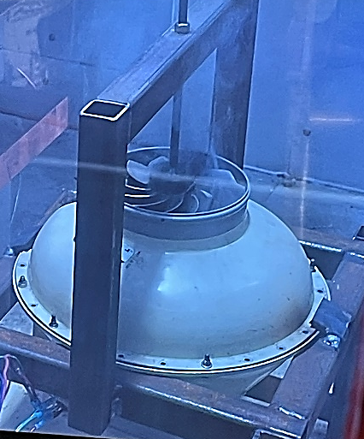
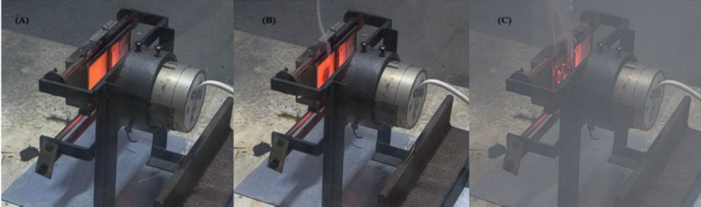
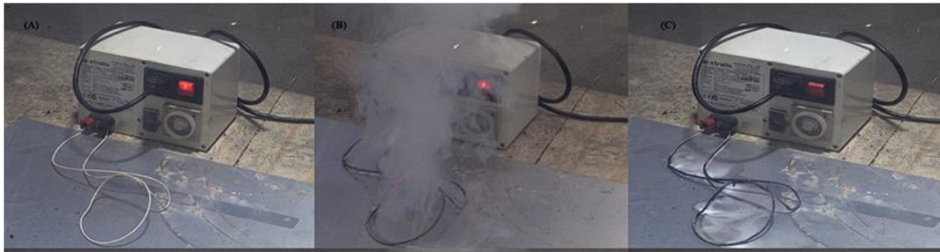
Approach
The focus was on the capability to distinguish between samples during the smoldering phase, leveraging a multivariate approach and gas analysis.
Advanced multi-sensor array technologies, intelligent algorithms, and Metal Oxide Sensors (MOS) equipped with AI capabilities to detect and analyze signatures from candidate internal contaminant sources located in the flight deck.
Printed circuit boards from avionics, various aviation cables, recirculation fans, as well as some external contaminant sources were put through failure testing to analyze the early fire signatures.
  PCB failure induced by radiant heat furnace (25 kW/m² heat flux)
  Wiring insulation failure induced by current-overload application with Xtralis transformer
  Recirculation fan failure induced by mechanical resistance mechanism (while operating normally via 400 Hz, 115 V external air start cart)
  Nuisance/External Contaminants:
    Jet oil & hydraulic Fluid heated on hot plate
    Wood & Bread heated via radiant heat furnace

Slide 6
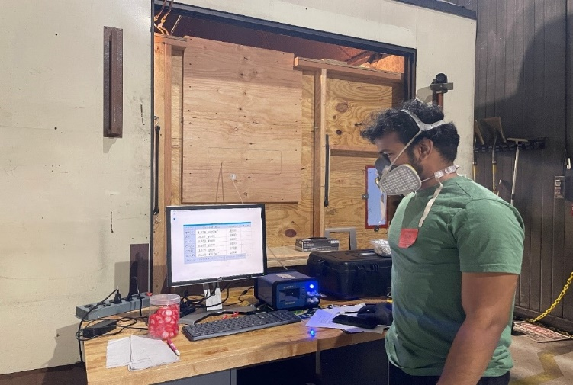
Test Chambers
MSEM 160
Exterior
Interior
BME688
Univ. MD NBS Smoke Chamber
0.52 m³
FAATC Simulated Flight Deck
6.6 m³
FAATC Reduced-Pressure Vessel
1.31 m³

Slide 7
Sensors
Sensigent MSEM 160 E-nose
Sensor Array: Up to 32 sensors (PCS, EC, MOS, PID), including temperature and humidity sensors.
Air sampling pump: Pre-Sample Purge; Sample Draw; Post-Sample Purge
Recording: Continuously logs TVOC, NH3, CH2O, C2H4, Alcohol & Odor
Bosch BME 688 Gas Sensor
Gas detection, humidity, pressure, temperature, and sensitivity to a wide range of VOCs.
Development Kit:
    Incorporates eight BME688 sensors.
    Connects to BME AI mobile app via Bluetooth for gas analysis.
Sensigent MSEM 160 E-nose
Bosch BME 688
TVOC = Total Volatile Organic Compound NH3 = Ammonia CH20 = Formaldehyde C2H4 = Ethylene

Slide 8
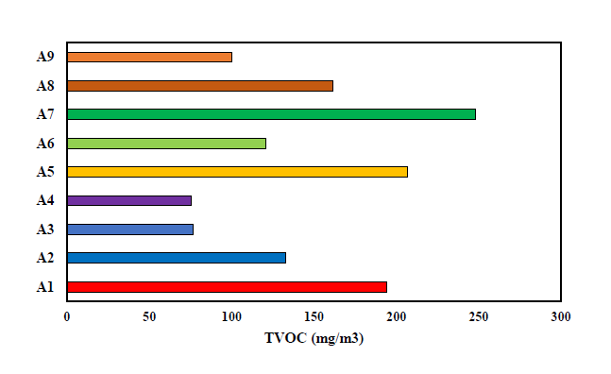
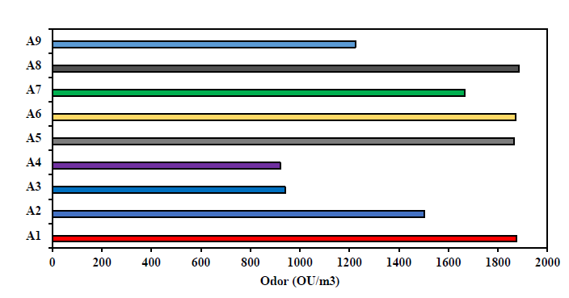


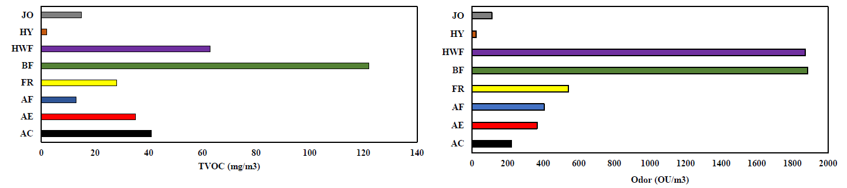
Sensigent E-Nose Data
Small-Scale UMD Chamber
All
PCBs
All
PCBs
Large-Scale FAATC Chamber
Jet/Hydraulic
Jet/Hydraulic
Fans
Fans
PCBs
PCBs
Consideration of Total Volatile Organic Compounds (TVOC) as a distinguishable marker
Consider the difference in graph scale, though PCB TVOC measurements are comparable when normalized for chamber volume
Notes:
Gases like NH3 (Ammonia), Alcohol, and CH2O (Formaldehyde) showed only minor reactions during the testing phase. But Ethylene(C2H4) stood out with slightly higher levels than the other gases tested.

Slide 9
Conclusions
Sensigent MSEM 160 E-nose
Gas Analysis
Elevated odor levels were observed across all samples compared to ambient conditions.
TVOC levels from PCBs exceeded Jet Oil and Hydraulic Oil but were lower than ‘burned bread’ and ‘hardwood’.
Gases like NH3 (Ammonia), Alcohol, and CH2O (Formaldehyde) showed only minor reactions during the testing phase. But Ethylene(C2H4) stood out with slightly higher levels than the other gases tested.
Overall Performance
Respectable performance even with limited aspirating capacity compared to VESDA (aux. smoke detector).
Faster response in reduced-pressure vessel tests when coupled with a higher sampling flow rate to overcome internal vacuum pressure.

Slide 10
Conclusions, cont’d.
Machine Learning Algorithms: Using all sensor responses may not be essential for fire detection and discrimination purposes.
8 MOS sensors yielded superior results compared to using all 32 sensors.
In small-scale tests: K-Means highest accuracy at 98%, followed by CDA, SIMCA, KNN, and SVM.
In large-scale tests: KNN led with 96.5% accuracy, with K-Means and SIMCA at 89.6% accuracy.
K-Means predicted samples best considering all diverse test conditions.
Bosch BME688 Gas Sensor:
Effective in categorizing distinct classes but faced challenges identifying samples within the classes.
AI capabilities of BME688 AI studio is beneficial for neural network training.
Small size is apt for aircraft application
Combustion-Related Gas Levels:
Minimal changes in CO, CO2, and O2 levels. Relying solely on these gases is inadequate for early detection.

Slide 11
Future Work
Integrating machine learning and AI capabilities with the sensors enriches the possibilities of early detection and identification. Future endeavors could focus on expanding the training set with even more diverse materials and conditions to enhance detection accuracy.
This thesis will soon be published as DOT/FAA/TCTT-24/10.
It can be found here upon publication:
https://www.fire.tc.faa.gov/Reports/reports.asp
Questions?
Contact Lindsey Anaya
Lindsey.p.anaya@faa.gov

