Slide 1
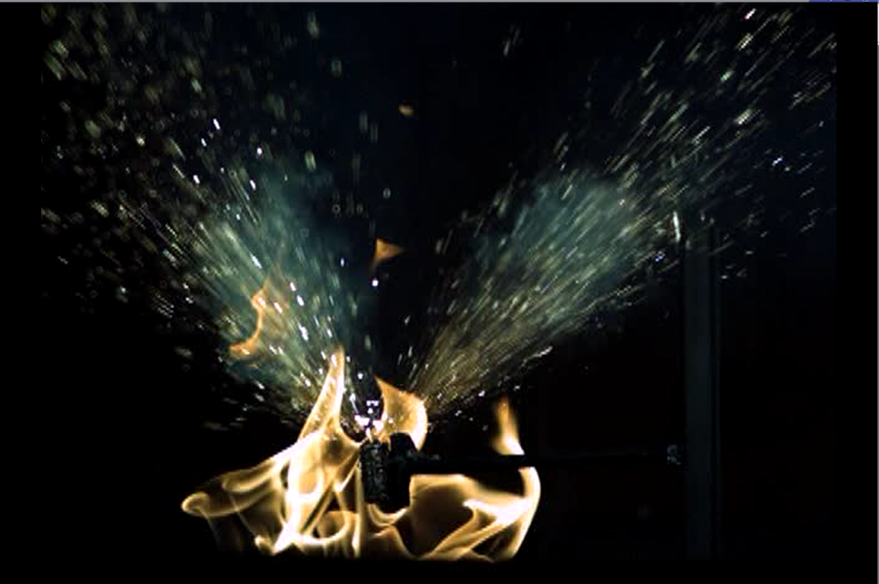
The aircraft hazards of flammable gasses produced by lithium batteries in thermal runaway
ICAO
FAA Fire Safety
07/2015

Slide 2
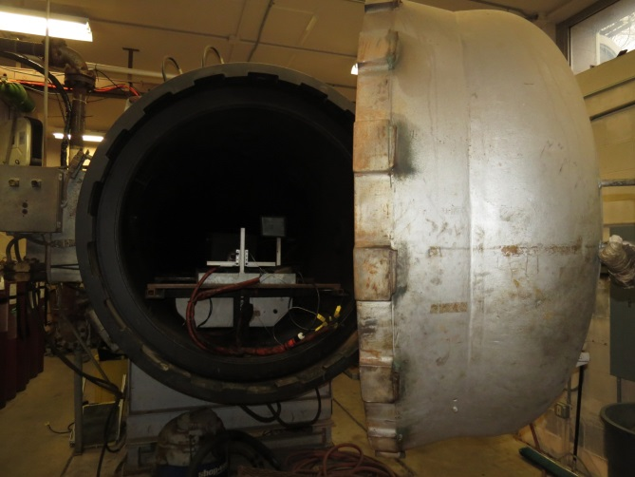
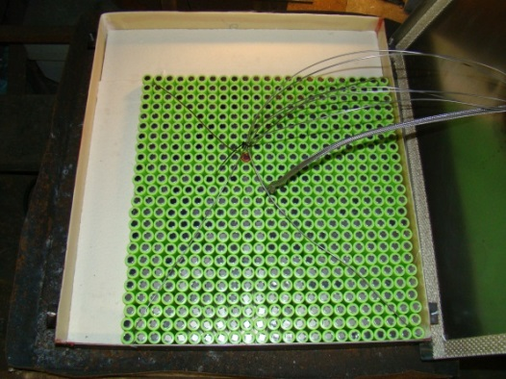
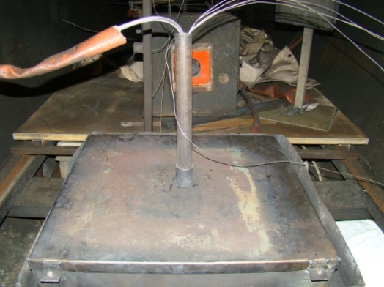
Halon Tests
Tests were performed in a 10.8m³ chamber to evaluate the effectiveness of Halon 1301 with vent gasses.
  Runaway was initiated => Halon was introduced => Spark was activated => Pressure was recorded

Slide 3
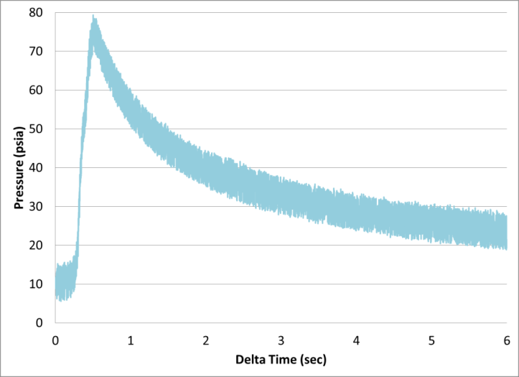
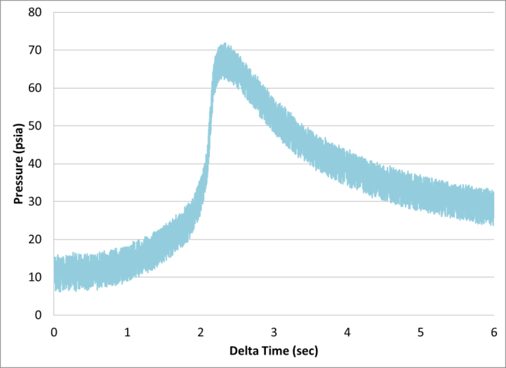
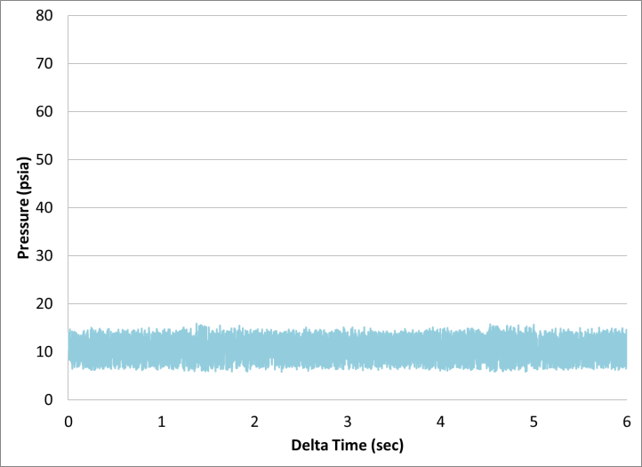
Halon Results
Test without suppression
Test with 5.28% Halon
Test with 10.43% Halon

Slide 4
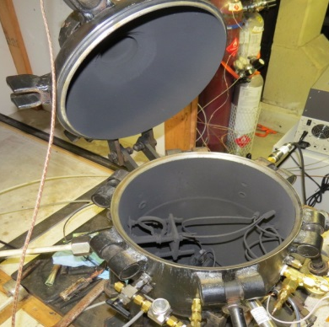
Gas Analysis from Cells
Tests were performed in a 21.7L combustion sphere to determine vent gas composition and quantity.
  Composition measured with GC, NDIR, Paramagnetic
  Volume measured with pressure calculations
Pressure Transducer (1Hz, 0-15psia)
Spark Igniter
Clamp-style cell holder (for cell and cartridge heater)
Gas collection port for sample bag.
Pressure Transducer (500Hz, 0-100psia)

Slide 5
Gas Analysis Results
Tests conducted at cabin pressure at altitude (10psia)

Slide 6
Bottled Gas
Rather than collect Li-Ion vent gasses for subsequent tests, a bottle of mixed gas was purchased that matched the composition from previous analysis.
  30.1% CO₂
  27.6% H₂
  22.9% CO
  6.37% CH₄
  4.48% C₃H₆
  2.21% C₂H₄
  1.57% C₄H₁₀
  1.17% C₂H₆
  .56% C₄H₈
  .268% C₃H₈

Slide 7
Bottled Gas
We then verified that pressure rise from bottled gas was identical to pressure rise from actual gas.
  Max pressure from actual gas at altitude: 70.1 psia
  Max pressure from bottled gas at altitude: 71.4 psia

Slide 8
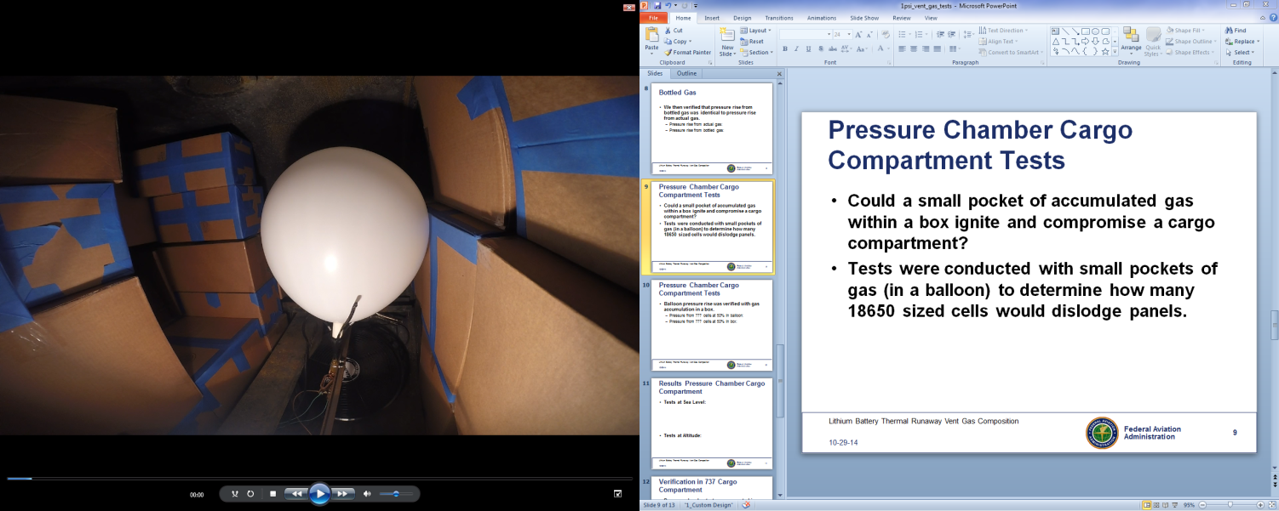
Pressure Chamber Cargo Compartment Tests
Tests were conducted with small pockets of gas (in a balloon) to determine how many 18650 sized cells would compromise fire suppression in cargo compartment.

Slide 9
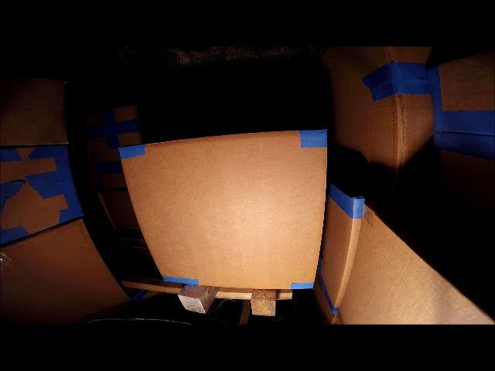
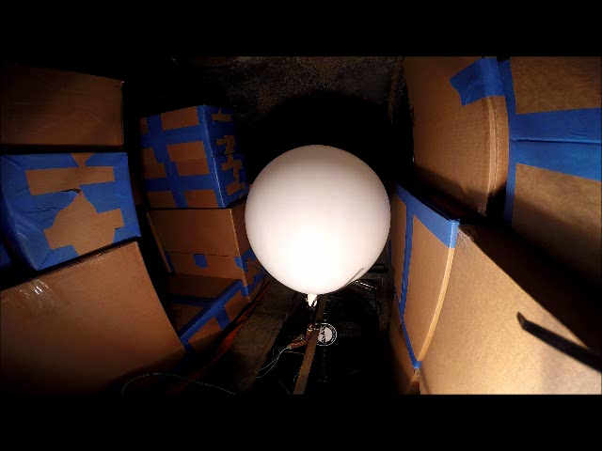
Pressure Chamber Cargo Compartment Tests
Balloon pressure rise was verified with gas accumulation in a box.
  Pressure from volume of gas corresponding to 5 cells at 50% SOC in balloon: .85 psi
  Pressure from volume of gas corresponding to 5 cells at 50% SOC in box: .97 psi

Slide 10
Results Pressure Chamber Cargo Compartment
Tests at Sea Level:
Tests at Altitude:

Slide 11
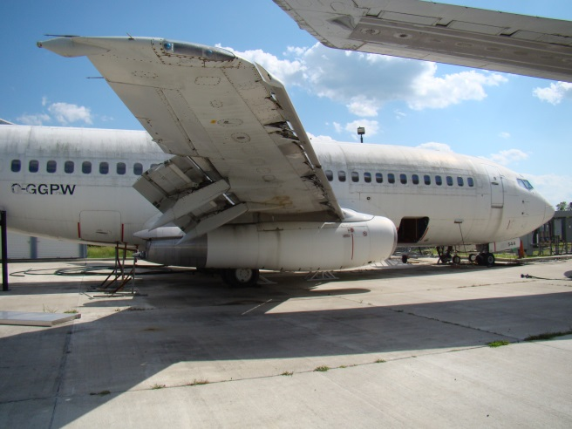
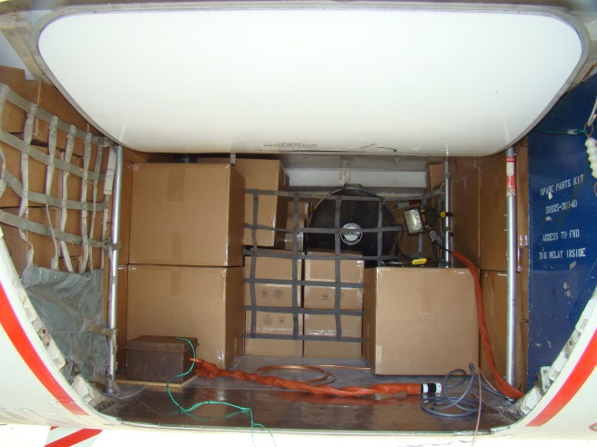
Verification in 737 Cargo Compartment
Pressure chamber tests were repeated in fwd. cargo compartment of 737 with 70% loading.
  Total volume of compartment (documented): 370ft³
  Volume of boxes based on 70% loading: 259ft³

Slide 12
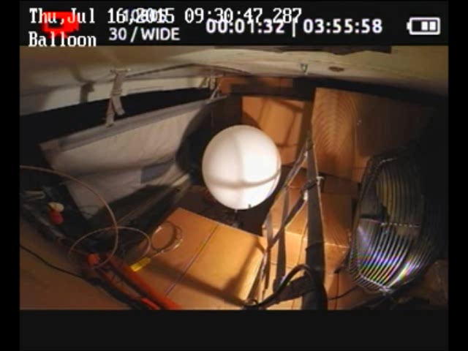
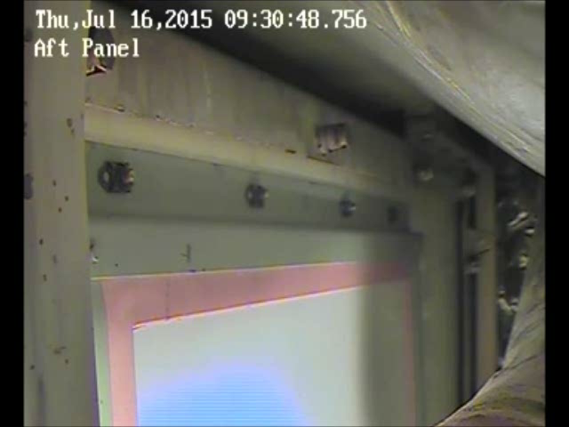
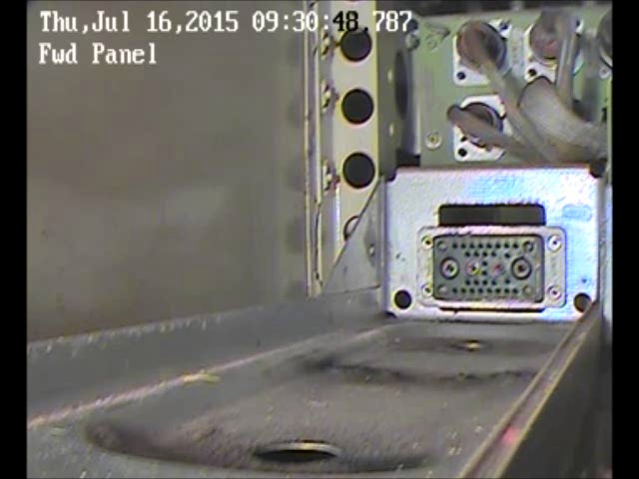
737 Cargo Compartment Results
5 cells at 50% SOC
1.61 cells at 100% SOC
.252 psi peak pressure

Slide 13
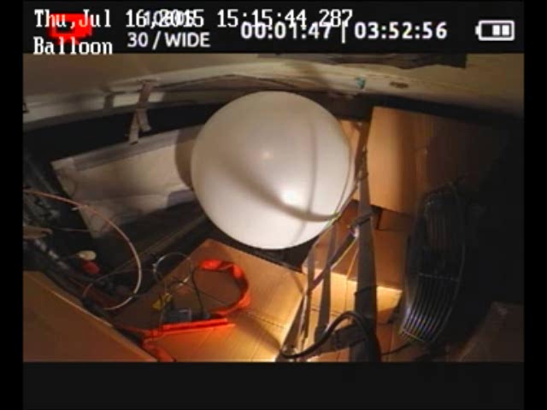


737 Cargo Compartment Results
20 cells at 50% SOC
6.44 cells at 100% SOC
1.22 psi peak pressure
Additional panel behind door (not shown) and panel on sidewall (not shown) were also compromised.

Slide 14
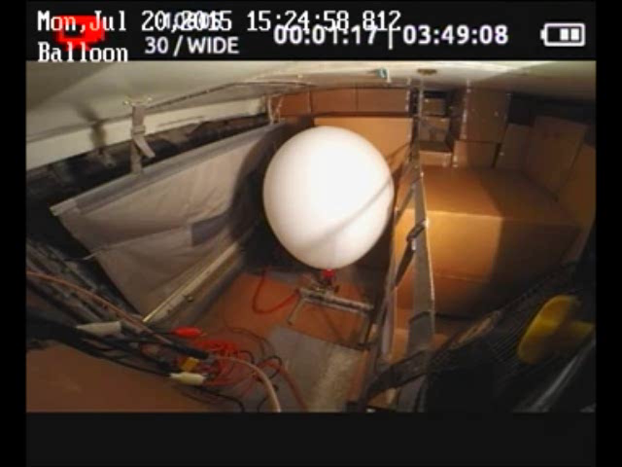
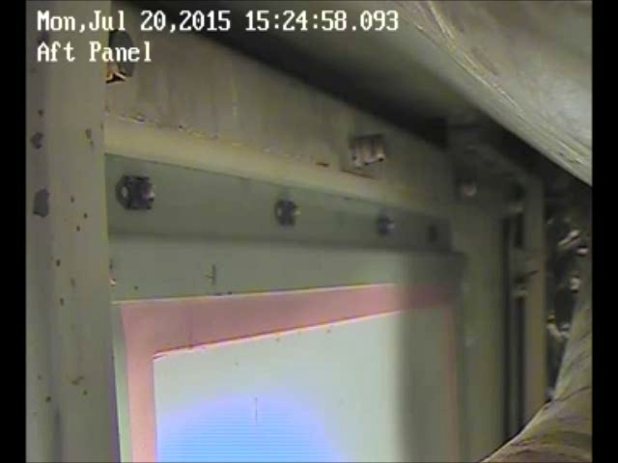
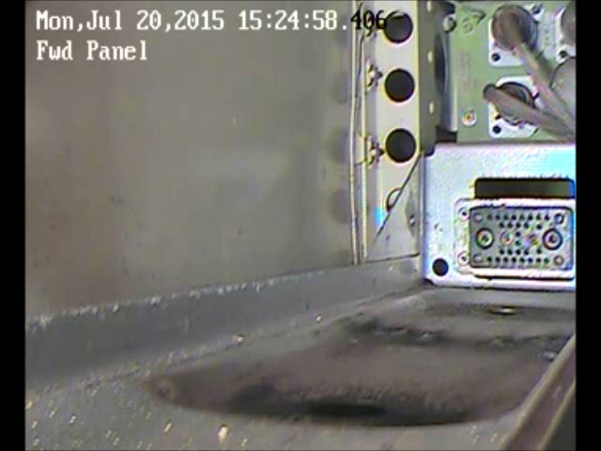
737 Cargo Compartment Results
8 cells at 50% SOC
2.6 cells at 100% SOC
.594 psi peak pressure

Slide 15
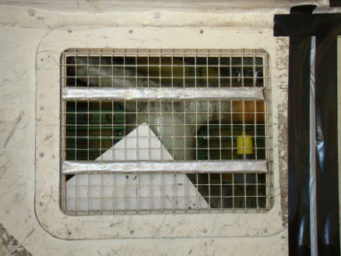
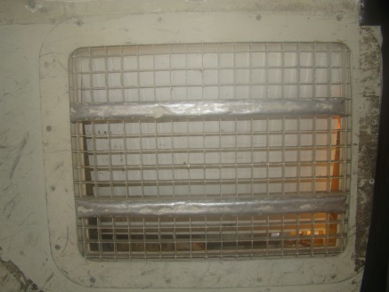
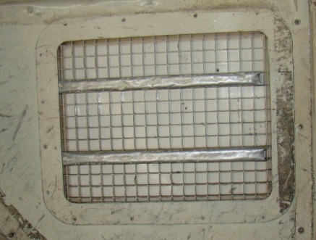
737 Cargo Compartment Results

Slide 16
Summary
If gasses from 8 18650 cells at 50% SOC
or
If gasses from 3 18650 cells at 100% SOC
accumulate in a loaded 737 fwd. cargo compartment and ignite, the halon suppression system would be compromised.

