Slide 1

Toxic Hazards of Handheld Extinguishing Agents Used on Lithium-Ion Battery Fires
International Aircraft Materials Fire Test Forum & International Aircraft Systems Fire Protection Forum Combined Meeting
Natallia Safronava, Timothy Marker, Robert Morrison
Cologne, Germany, June 13-15, 2023

Slide 2
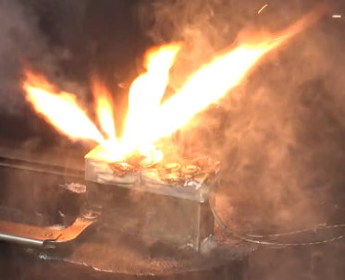
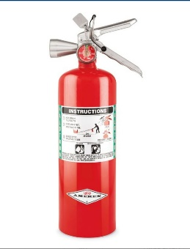
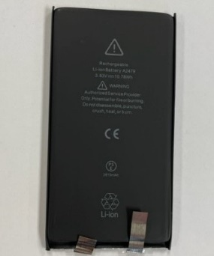
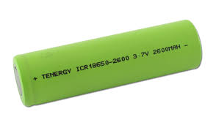
Motivation
  Evaluate the differences in thermal and toxic hazards of handheld extinguishing agents used on Lithium-ion battery fires in small compartments.
  Agents:
  Halon 1211
  Halotron BrX (stabilized 2-BTP)
  Batteries:
  18650
  Pouch cells
18650
Pouch

Slide 3
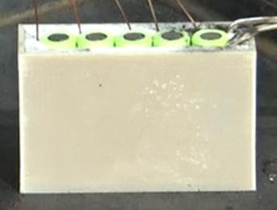
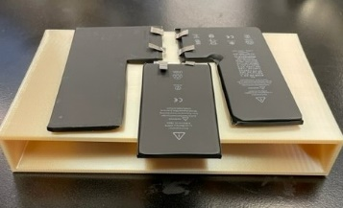
Test Plan Overview
Phase 1- Summer 2022, 18650 5 cells pack
Phase 2- December 2022, Pouch cells 3 pack
No agent (Baseline)
Halon 1211
2-BTP
No agent (Baseline)
Halon 1211
2-BTP
Temp
CO
CO₂
O₂
HF
Temp
CO
CO₂
O₂
Halon 1211
HF
HBr
HCl
Temp
CO
CO₂
O₂
2-BTP
HF
HBr
Temp
CO
CO₂
O₂
HF
Temp
CO
CO
O₂
Halon 1211
HF
HBr
HCl
Temp
CO
CO₂
O₂
2-BTP
HF
HBr
3 tests
3 tests
5 tests
3 tests
3 tests
7 tests

Slide 4
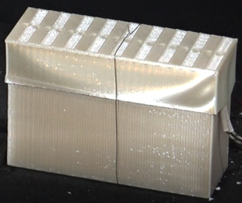
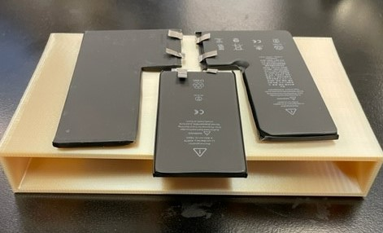
Test details
3D printed battery case +lid using thermoplastic material
Five (5) 18650 Li-ion batteries were each fitted with a type-K thermocouple.
The right most cell was fitted with the cartridge heater.
The first cell is heated at a rate of 15°C/minute
Agent introduced after 3rd cell went to the thermal runaway.
3D printed battery case using thermoplastic material
Three (3) pouch Li-ion batteries were each fitted with a type-K thermocouple.
The right most cell was fitted with the cartridge heater.
The first cell is heated at a rate of 15°C/minute.
Agent introduced when the 1st cell ignited.

Slide 5
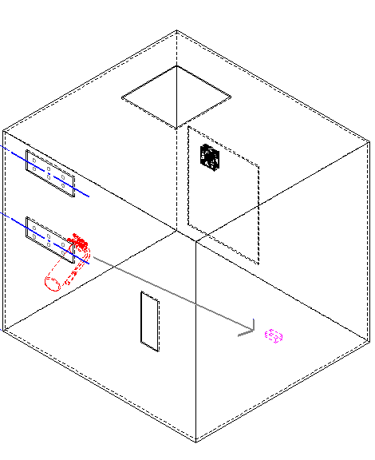
Test Compartment
Recirculating fan
Gas sampling ports: 3.5 ft. and 5.5 ft.
240 ft³ volume (flight deck)
NO air exchange
Battery box on the floor
Fire extinguisher 5 feet away from battery box
Small fan on the ceiling
Two (2) heights form gas sampling/ Temp
Temp, CO, CO₂, Agent data collection started @ heater initiation
Acid gases data collection @ fire extinguisher discharge
Fire extinguisher
Battery Box

Slide 6
Hazard Levels for Gases
  Acute Exposure Guideline Levels (AEGLs) 10 minute (CO, HF, HBr, HCl)
  AEGL 2: Irreversible or other serious, long-lasting adverse health effects or an impaired ability to escape.
  AEGL 3: Life-threatening health effects or death
  Cardiac Arrhythmias: (Halon 1211 & 2-BTP) 5 minute exposures.
  No Observable Adverse Effect Level (NOAEL)
  Safe-use concentrations
  Lowest Observable Adverse Effect Level (LOAEL)

Slide 7
Toxicity assessment
Hazard Level (10 min.) | HF (ppmv) | HCl (ppmv) | HBr (ppmv) | CO (ppmv) | Effect
AEGL2 | 95 | 100 | 250 | 400 | Irreversible or other serious, long-lasting adverse health effects or an impaired ability to escape.
AEGL3 | 170 | 620 | 740 | 1,700 | Life-threatening health effects or death
Hazard Level (5 min.) | Halon 1211 (percent) | 2-BTP (percent) | Effect: Atypical heartbeats
NOAEL | 0.5 | 0.5 | No dogs affected
Safe Use | ___ | 0.95 | No effect is predicted for humans
LOAEL | 1.0 | 1.0 | Lowest observed number of dogs affected

Slide 8
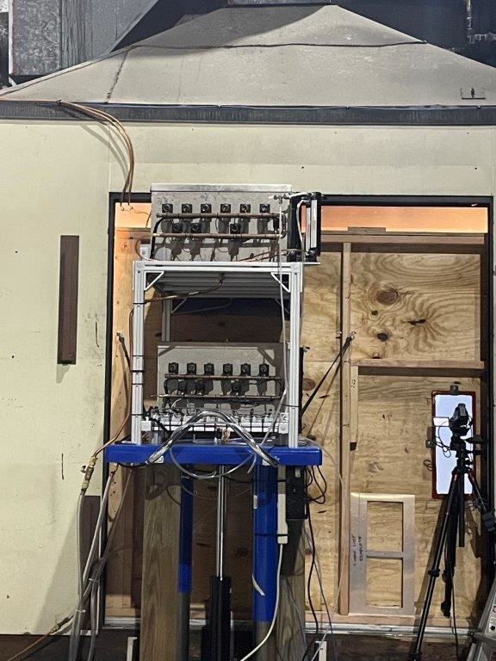
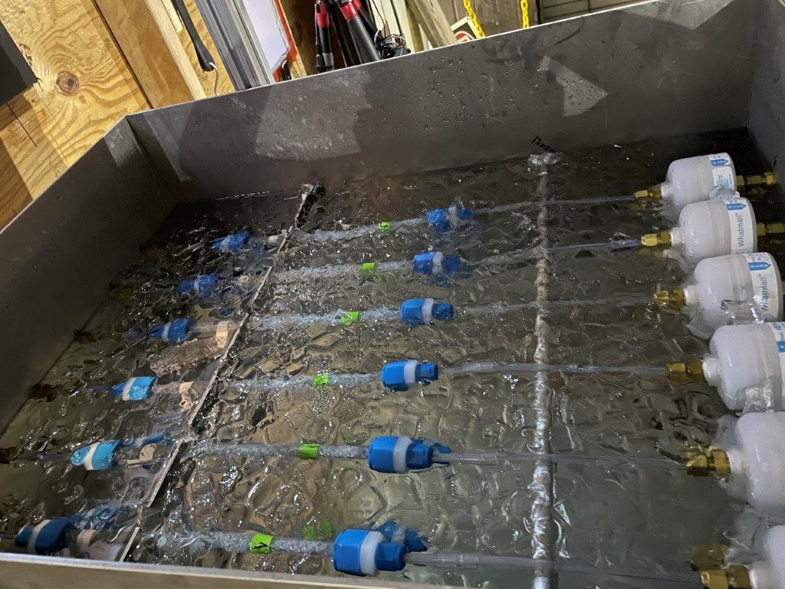
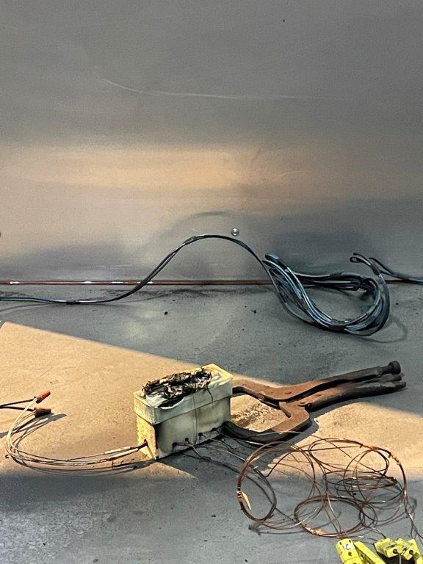
Instrumentation
  Multiple TC
  NDIR gas analyzers: CO, CO₂, O₂ and Halocarbon.
  Acid gas sampling assembly
  Dionex Integrion Ion Chromatograph (IC) with AS15 column. Ion chromatography (IC) method described in FAA report https://www.fire.tc.faa.gov/pdf/dot_66039_DS1.pdf

Slide 9
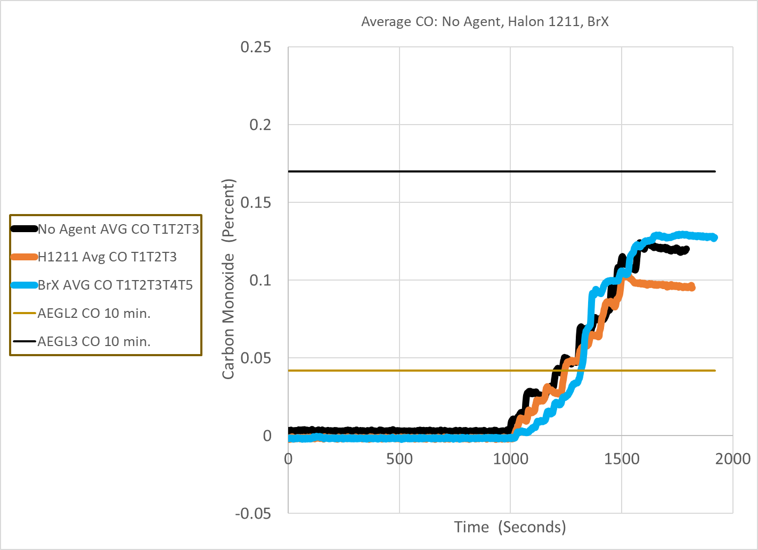
Results: CO concentrations
AEGL3
AEGL2

Slide 10
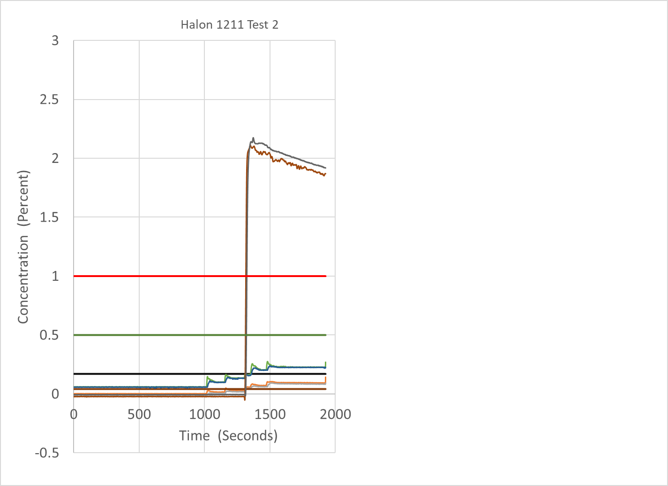
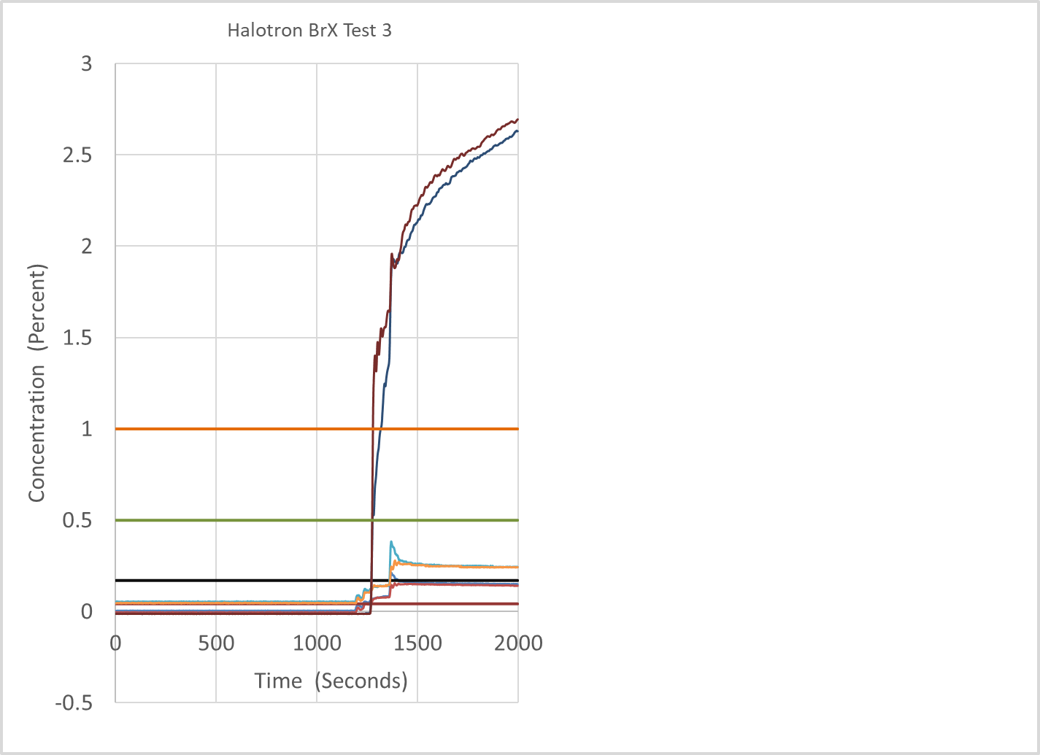
Results: Agent concentration profiles
Halon 1211
Halotron BrX
LOAEL
LOAEL
NOAEL
NOAEL

Slide 11
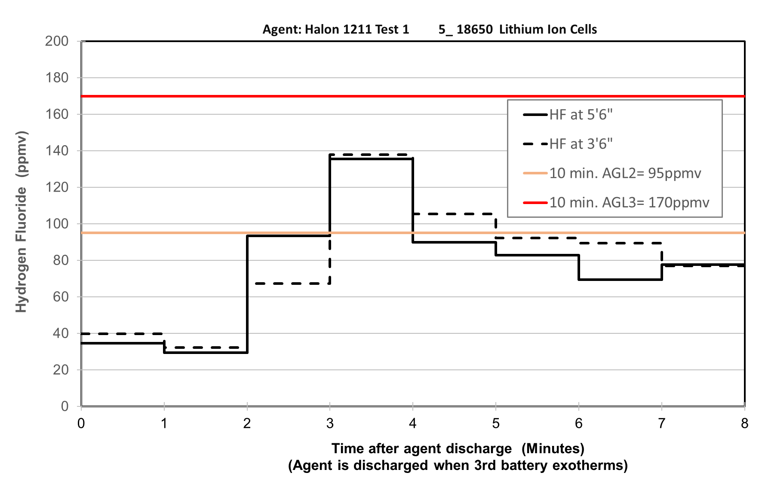
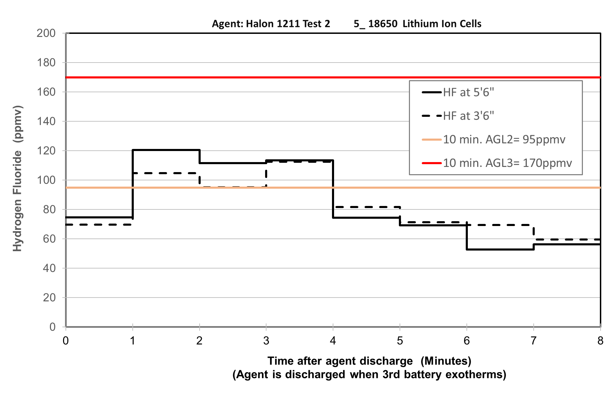
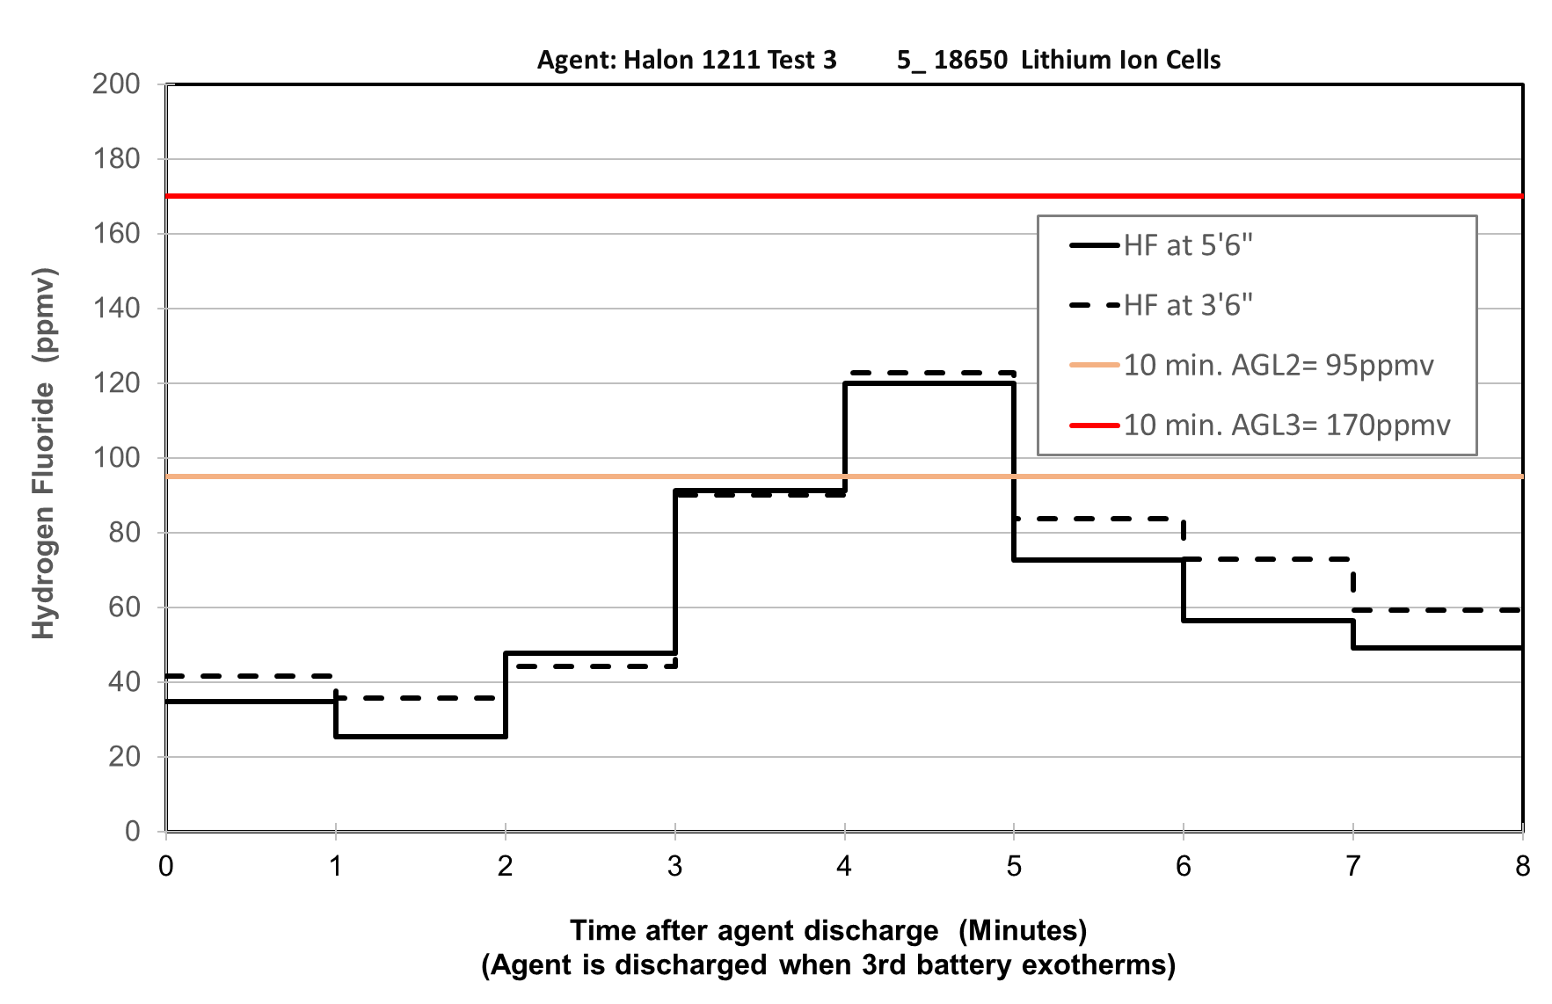
HF, Halon 1211
Peak concentrations HF exceed AEGL2 for a few minutes during the tests

Slide 12
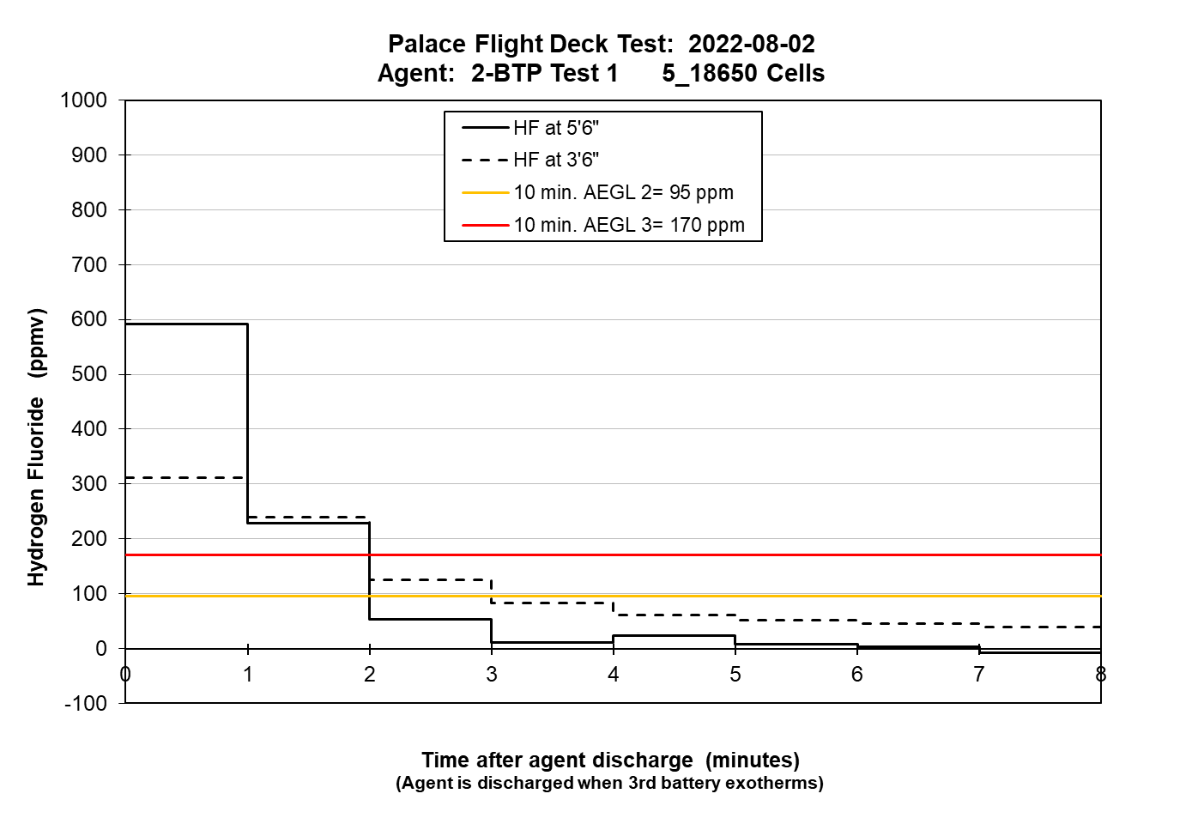
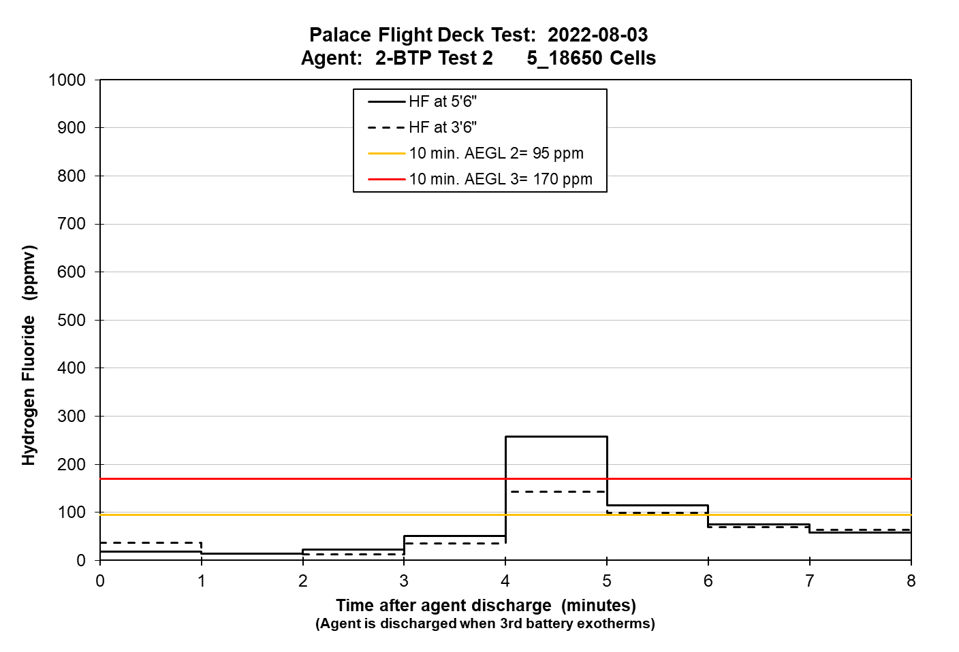
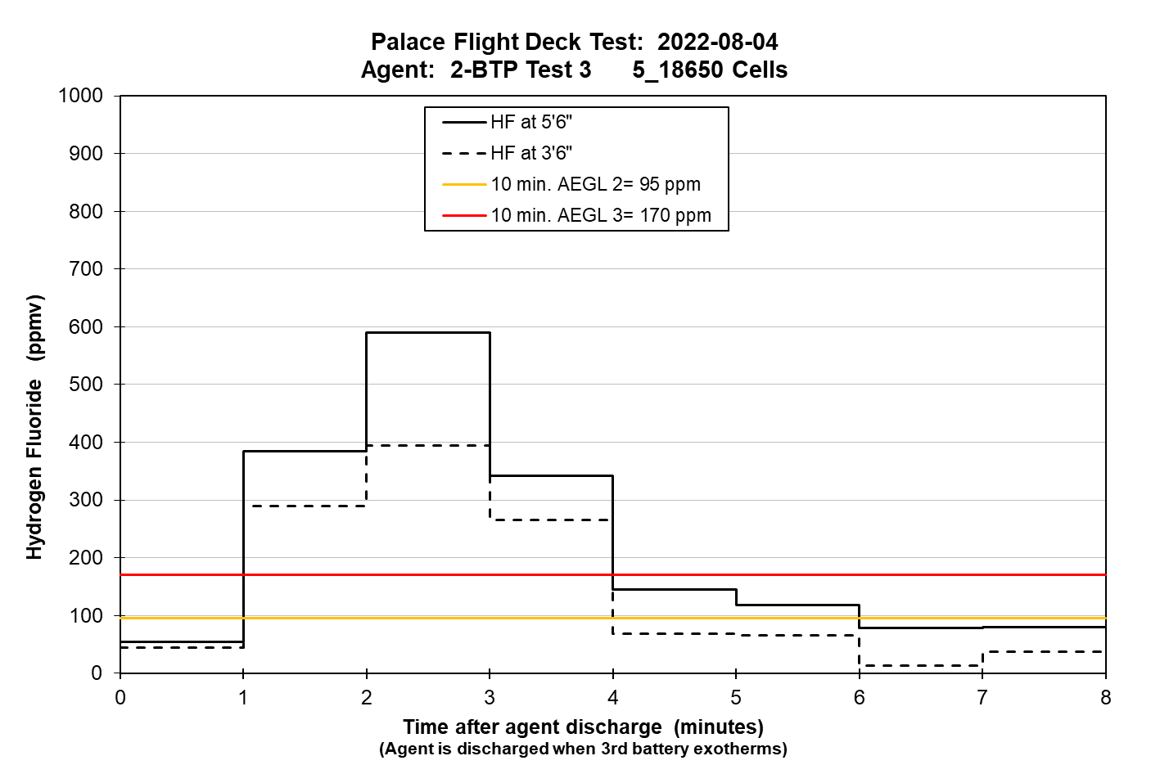
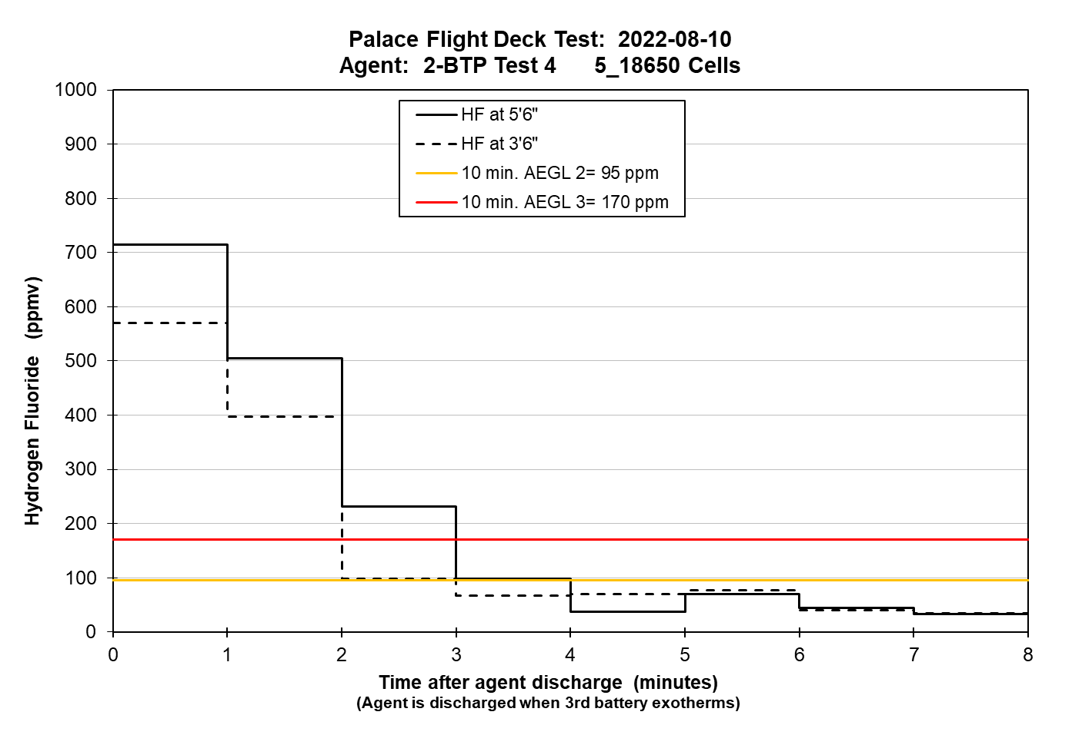
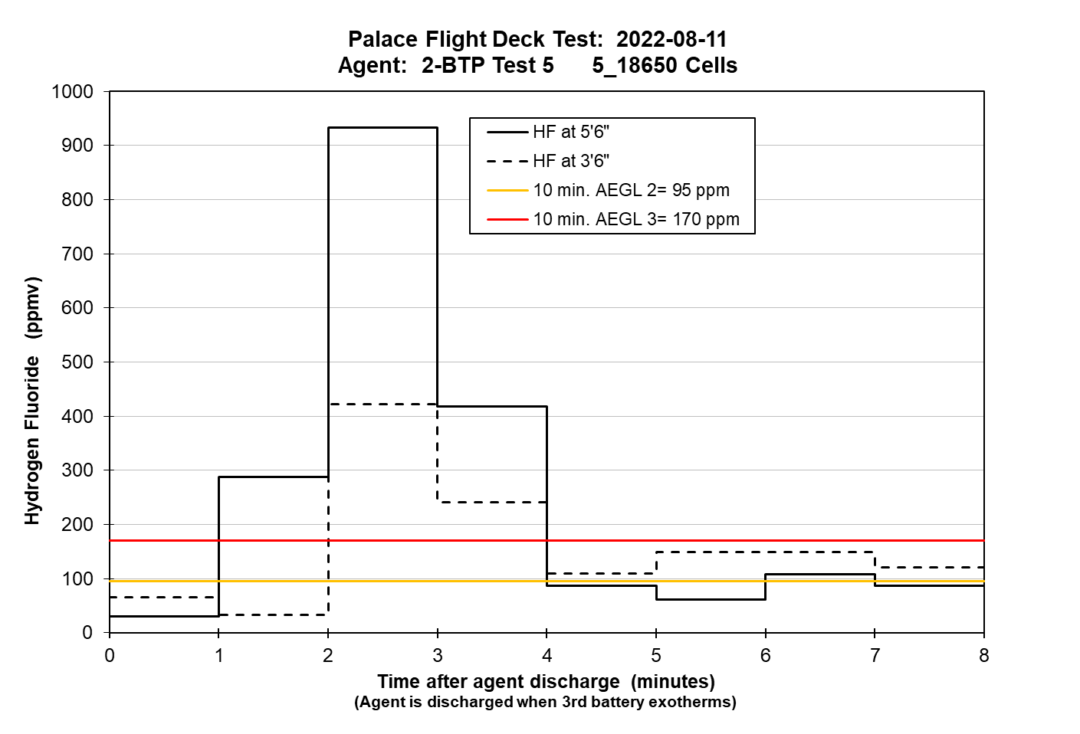
AEGL3
AEGL2
HF, 2-BTP
Note scale
Peak concentrations HF exceed AEGL3 for a few minutes

Slide 13
Conclusions
  Carbon Monoxide ( CO )
  Hazardous concentrations of CO were observed for the battery fires with no agent and both agents used.
  Agent ( Halon 1211/Halotron BrX)
  There is a slow buildup of Halotron BrX at both heights.
  Acid gases
  No HBr was observed for the Halon 1211 or Halotron BrX tests.
  HCl contributes to the toxicity of Halon 1211 use.
  Significant differences in HF concentrations profiles were observed within the same test series.
  Peak HF concentrations were significantly higher for Halotron BrX test series than for Halon 1211.

Slide 14
Next steps
  Expand the scope by including the water extinguisher to compare to Halon 1211 and Halotron BrX applied for 18650 and pouch cells.
  Complete Fractional Effective Dose (FED) model calculations to assess the total hazards for different agents.

Slide 15
Contact info
Natallia Safronava
Natallia.i.safronava@faa.gov
FAATC reports: https://www.fire.tc.faa.gov/Reports/reports.asp

