Slide 1
Relationship Between 3-D Printed Materials and Flammability
International Aircraft Materials Fire Test Forum
Dan Keslar and Steven Rehn
6/13/23

Slide 2
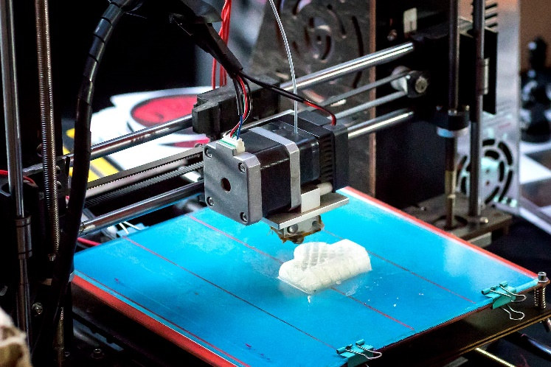
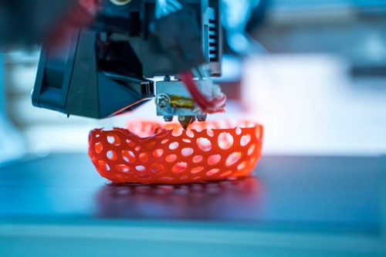
Introduction
Additive Manufacturing (AM), often referred to as “3-D Printing”, is a technology that introduces new variables during material construction
FAA has been researching how alterations in these variables impact an AM part’s flammability
Many different types of AM exist
All testing within this study were on samples produced via Fused Filament Fabrication (FFF)

Slide 3
Objective
Objective: Determine the worst case flammability scenario for each variable to simplify future testing and certification
Variables were tested according to the Vertical Bunsen Burner (VBB) test procedures
Three metrics are collected in this test:
Burn Length
Flame Time
Drip Flame Time

Slide 4
Previous Testing
Previous testing was conducted in which one (or a few) factors at a time were altered:
These variables included:
All variables found to have some impact on data
Material, thickness (# of inner layers), and infill percentage found to have the biggest impact on data
1. Material 2. Thickness(# of Inner Layers) 3. Infill Percentage 4. Infill Pattern 5. Raster Thickness 6. Raster Angle 7. Print Orientation (XY, YZ, ZX)

Slide 5
Infill Pattern
Infill %
Solid (100% Sparse infill)
Sparse
20%
60%
Sparse DD
Hexagram
Notes:
- Sparse DD (Sparse Double Dense)

Slide 6
Raster Angle
Raster Width
45°
0.016” Width
0.030” Width
- Width of inner extruded material
67.5°
90°

Slide 7
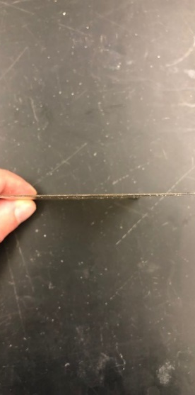
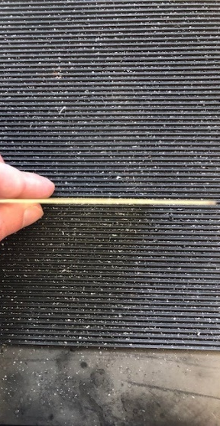
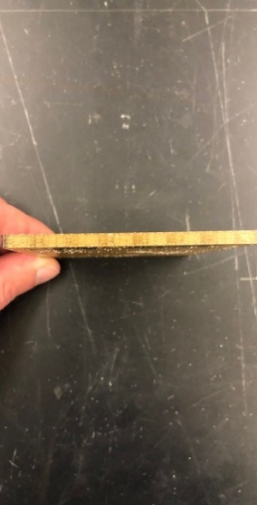
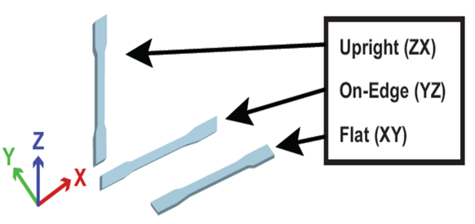
Print Orientation
Thickness
0.02”
0.08”
0.15”
- Extruded layer thickness can be altered, but for our testing layer thickness was kept constant at 0.01”
- Therefore, thickness is directly correlated with the number of extruded layers (i.e 15 layers = 0.15”)

Slide 8
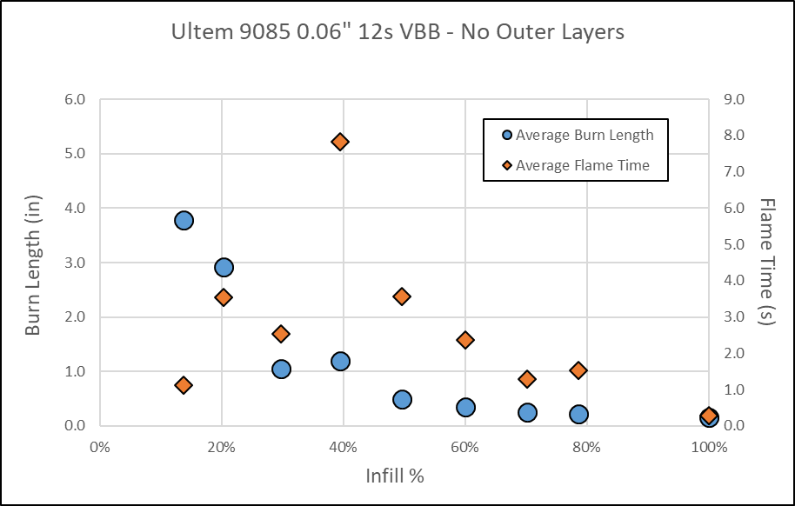
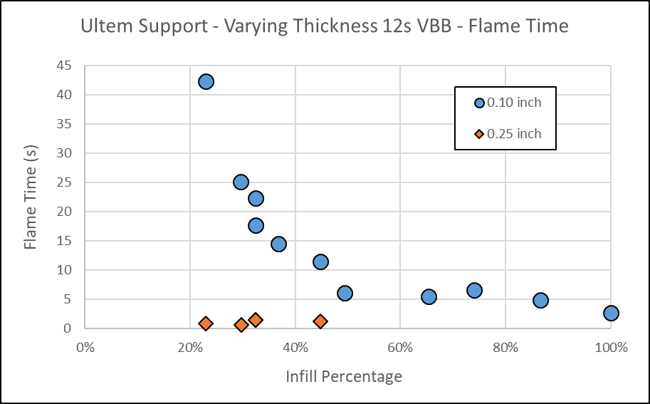
Examples of Infill % and Thickness Data
Infill % Comparisons
Thickness Comparisons
Thicker and higher infill % samples generally performed better
- As stated previously, material, infill % and thickness observed to have a much more significant impact on data…

Slide 9
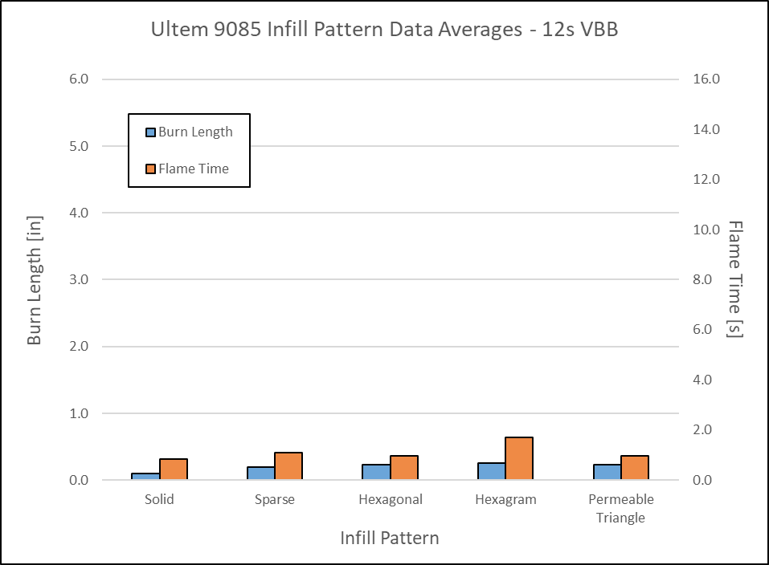
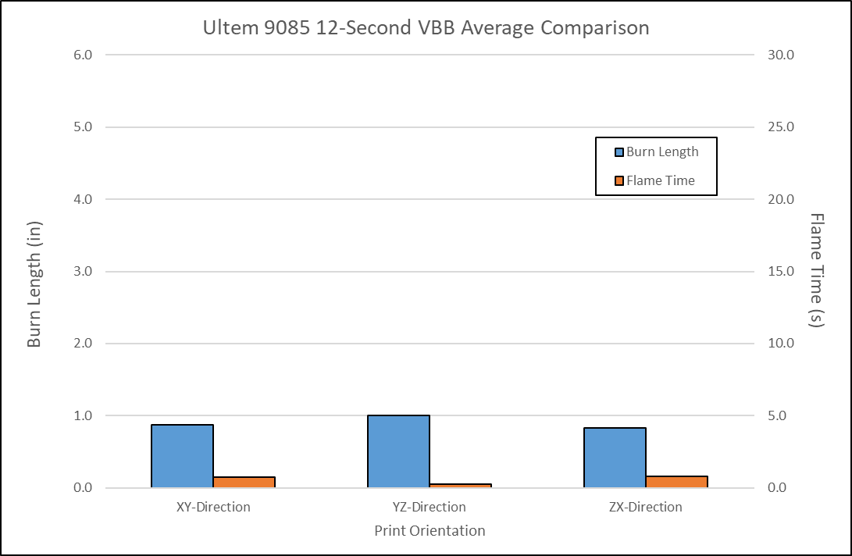
Examples of Infill Pattern and Print Orientation
Infill Pattern Comparisons
Print Orientation Comparisons
…As compared to other variables such as Infill Pattern and Print Orientation

Slide 10
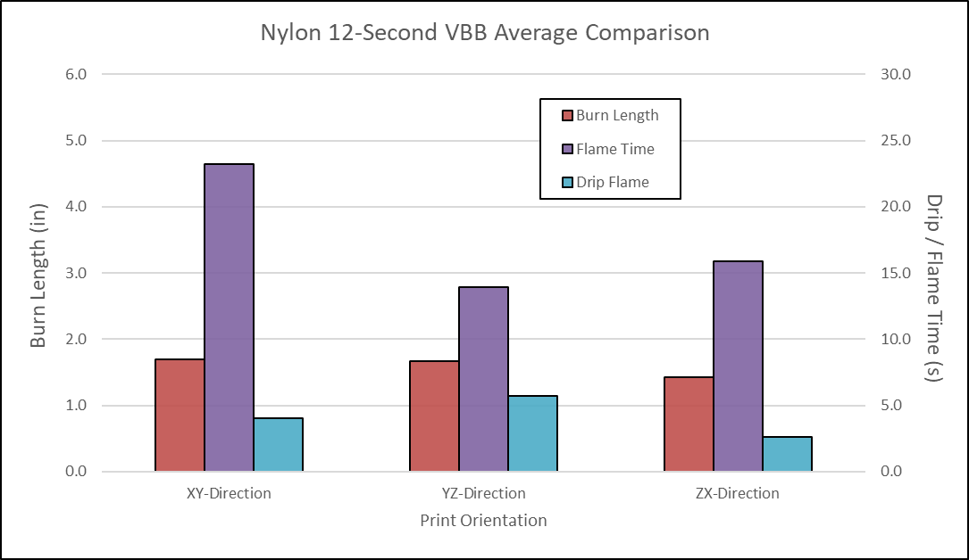
Print Orientation Material Comparisons
Ultem 9085
Nylon 12
*No Ultem 9085 samples recorded a Drip Flame Time
However, this observation changed depending on the evaluated material
Higher disparity between Print Orientations for Nylon 12, specifically in Flame/Drip Flame Time
This suggests that different combinations of variables may impact data

Slide 11
Design of Experiments (DOE) Testing
Although altering a few variables at a time provides a good comparisons between data, it does not take into account interaction effects between different variable combinations
A Design of Experiments (DOE) test setup was performed to account for this problem

Slide 12
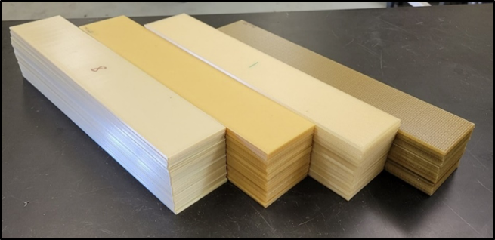
DOE Setup
120 16 x 3” samples were printed
Samples were cut into fourths, in which 480 4” x 3” samples were tested
Sample and factors were tested in a randomized sequence
Factors altered within the DOE include:
Material
Thickness (# of Inner Layers)
Infill %
Infill Pattern
Raster Angle
Raster Width
Print Orientation was not evaluated within this test series
Materials from left to right: Ultem 9085, Ultem 1010, Ultem Support, and Antero 800 NA
Ultem Support is not commonly used as a material in produced parts, rather it is the support material of Ultem 9085

Slide 13
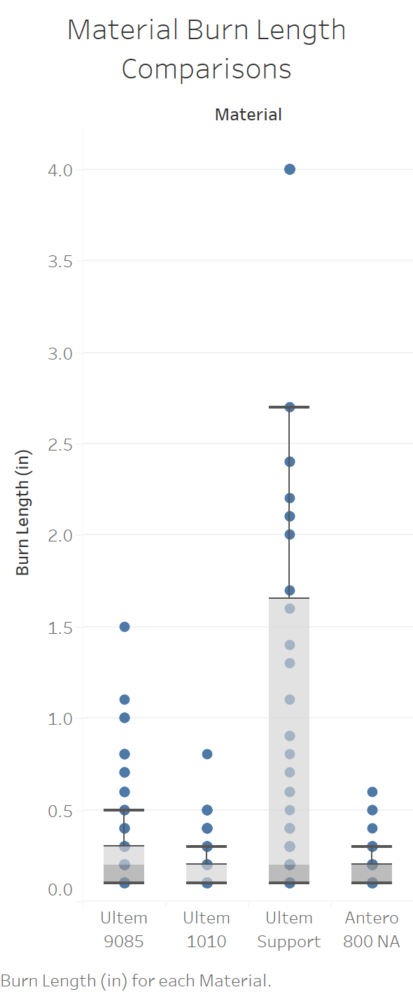
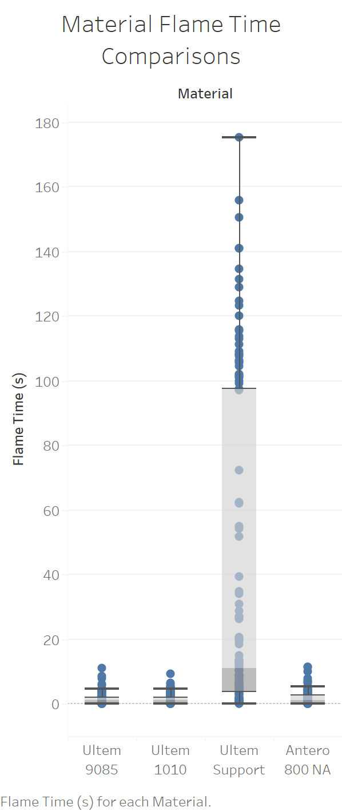
DOE Analysis
All evaluated variables found to have some impact on recorded data
Ultem Support material generally recorded highest burn length and flame times
Material is the most significant variable in the occurrence of drip flame times
Ultem Support was the only material to experience dripping

Slide 14
DOE Analysis
All variables significant as either main or interaction effect for predicting burn length
Material, thickness (# of inner layers), and infill percentage were the most significant main effect variables
Raster width and angle are significant as interaction effect variables
All variables except infill pattern were significant in predicting flame time
As raster angle increased, flame time was observed to increase quadratically (i.e 90° angles burned longer than 45° samples) in thinner samples

Slide 15
Generated Worst + Best Case Scenarios
From the DOE data, ten “worst” and “best” case scenarios were generated for each of the evaluated materials
Combinations with less inner layers were most common among “worst” case scenario
Combinations with higher inner layers and infill percentages as well as Sparse or Sparse DD patterns minimized burn length and flame time
Raster widths and angles depended on the material
However, validation of these generated scenarios was needed

Slide 16
Validation of DOE Model
Recorded data averages were observed to be close to generated data
Validates the accuracy of generated data

Slide 17
Summary
All DOE variables were pertinent in predicting either Burn Length or Flame Time
Material, infill percentage and thickness were the most significant main effect variables for Burn Length and Flame Time
Material is the most significant variable in the occurrence of drip flames
Of the ten “worst” case scenarios generated for each material:
Raster width and raster angle would vary based on the material
Thinner samples with a lower infill percentage were prominent

Slide 18
Next Steps
A technical note, which includes all collected data and test conclusions to this point is in the process of being edited and will be publicly released
An issue paper will be released (Transport Airplane Issue List) which will help provide guidance
Additional testing on other variables will need to be conducted
Within this study, layer thickness was kept constant at 0.01” per layer. Testing may be needed in which layer thickness is altered
Testing AM processes besides Fused Filament Fabrication (FFF) may be needed

