Slide 1

Combustion Potential​
Nature & Behavior Of Fire In A Compartment​
International Aircraft Material Fire Test Forum
Aeon Brown
06/14/2023

Slide 2
Objective​
To understand the effects that dimensions, fuel flow and air flow have on combustion inside of an engine nacelle type compartment. ​
The data acquired from this project will be used to provide an expeditious and small-scale validation method for CFD fire modeling.​
Notes:
This work is to investigate how significant of an effect the fuel flow, air flow, and dimensions inside an engine nacelle-type compartment have on combustion within the compartment.
The work also seeks to provide a foundation for quick and small-scale validation method for Computation Fluid Dynamic fire modeling.

Slide 3
Background​
The space between an aircraft’s engine and its nacelle houses many lines carrying fluids that are flammable. ​
These fluids include fuel, hydraulic fluid, and oil. ​
Engine nacelles are typically ventilated with forced airflow usually from free stream air outside the aircraft to limit the accumulation of flammable vapors.​
Fire tests are an integral part of the process of designing a fire safe environment​
Fire modeling allow the analysis of specific fire dynamics at a significantly reduced cost​
Notes:
The area between an aircraft's engine and its nacelle contains various fluid-carrying lines that are prone to flammability. These fluids consist of fuel, hydraulic fluid, and oil. To minimize the buildup of flammable vapors, engine nacelles are typically have forced airflow, often drawn from the external free stream air. This ventilation system helps maintain a safe environment. As part of the design process, fire tests are essential for ensuring the creation of an environment safe from combustion. Fire modeling allow the analysis of specific fire dynamics at a significantly reduced cost.
Computational fluid dynamics (CFD) model of fire-driven fluid flow numerically solves large simulations of low-speed, thermally-driven flow which takes into account heat transfer from fires that describes the evolution of fire.

Slide 4
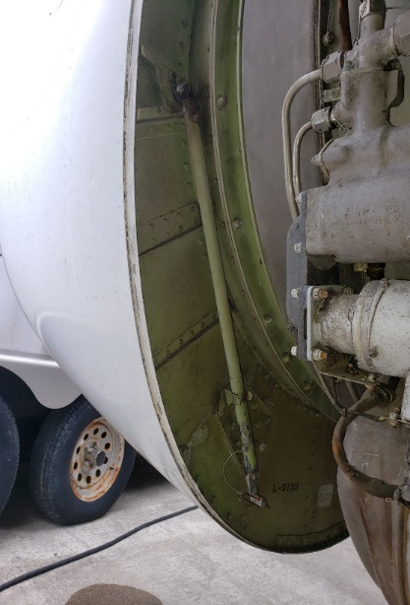
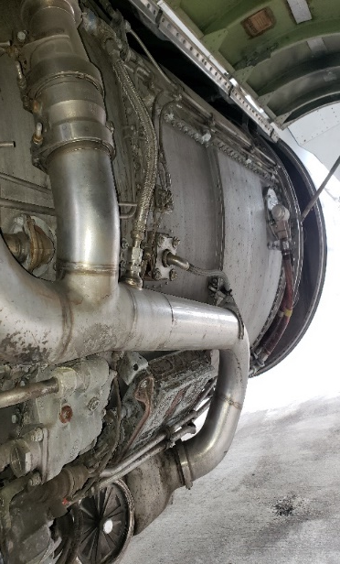
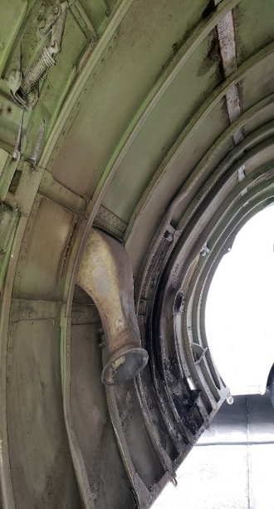
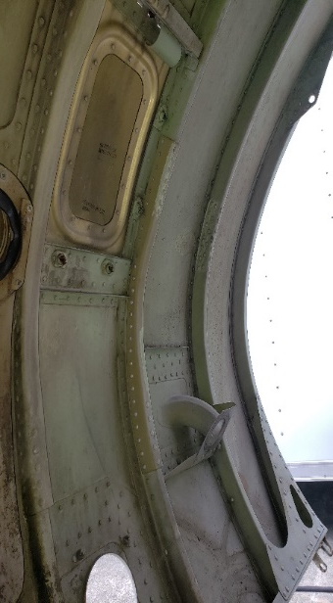
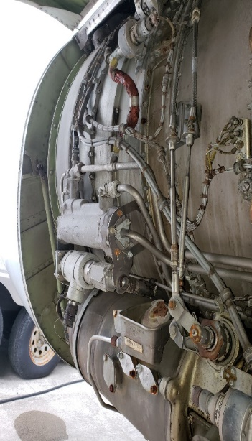
View Of Engine Components
Left Cowl Left side of engine
lines carrying flammable fluids
Notes:
The images shows the left cowling and left side of the engine of one of the FAA Tech Center’s test aircraft. The length of the engine from front to back was approximately 96 inches. The widest space between the aircraft’s engine and its cowling was approximately 12 inches. The narrowest space was approximately 6 inches.

Slide 5
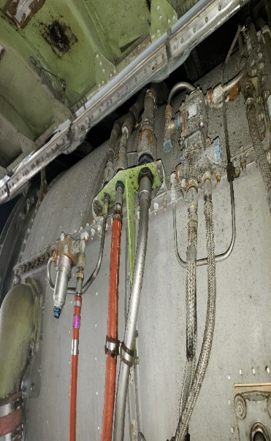
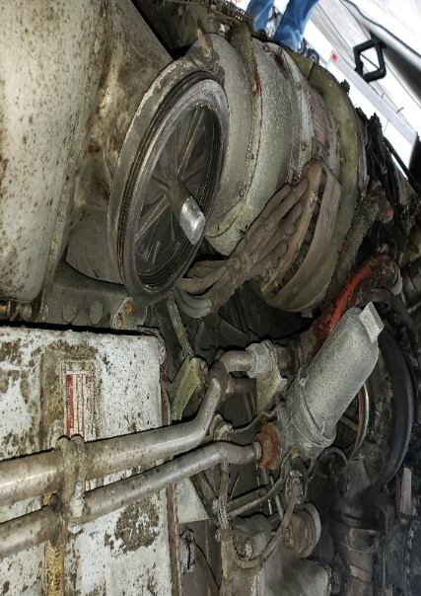
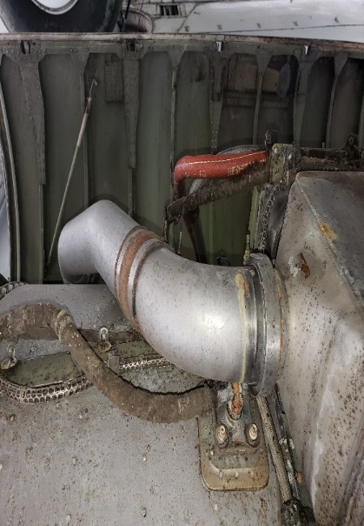
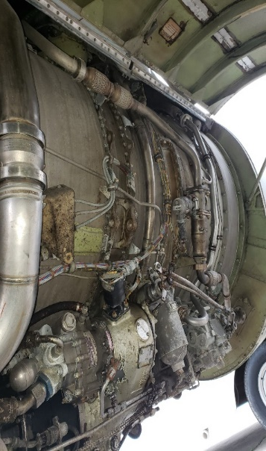
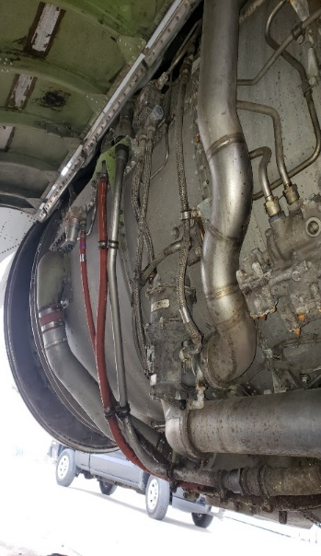
View Of Engine Components
Right side of engine Bottom of engine

Slide 6
Method
Fabricate a compartment that will mimic the space between an aircraft’s engine and the engine’s nacelle.
Assess the effect of fuel (JP-8) delivery in the compartment by varying the flow of fuel into the compartment.
An air flow will be chosen and kept constant through out the Iterations of the tests.
Assess the effects of the compartment dimensions by varying the distance between the upper and lower plate.

Slide 7
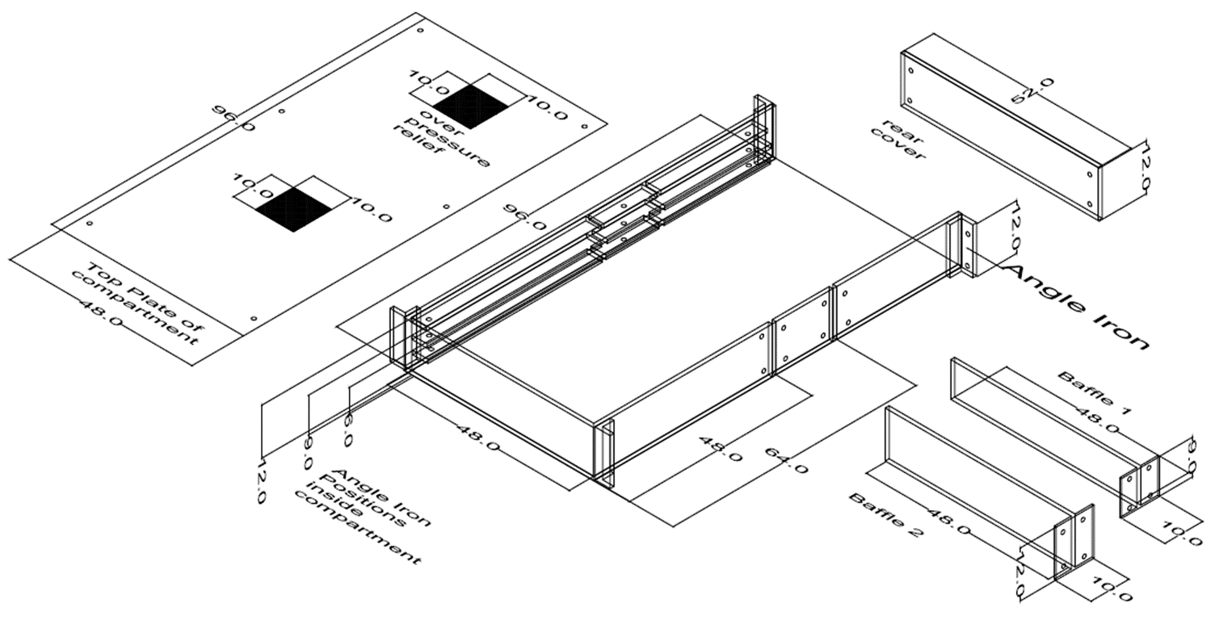
Compartment Design
Adjustable rectangular compartment to simulate the variable space in the engine’s nacelle
maximum dimensions of 96” x 48” X 12”
Minimum dimension of
48”X 48” X 6”
Pressure release panels at the top of the compartment
Notes:
The compartment was designed to be configured to 9 different dimensional settings. The maximum dimension is 48” in width, 96” in length, and 12” in height. The minimum dimension that the compartment can be adjusted to is 48” wide by 48” long by 6” high. The adjustments are made possible by the use of baffles and angled irons. The Cover of the compartment has two blow out panels in the event over pressure occurs in the compartment.

Slide 8
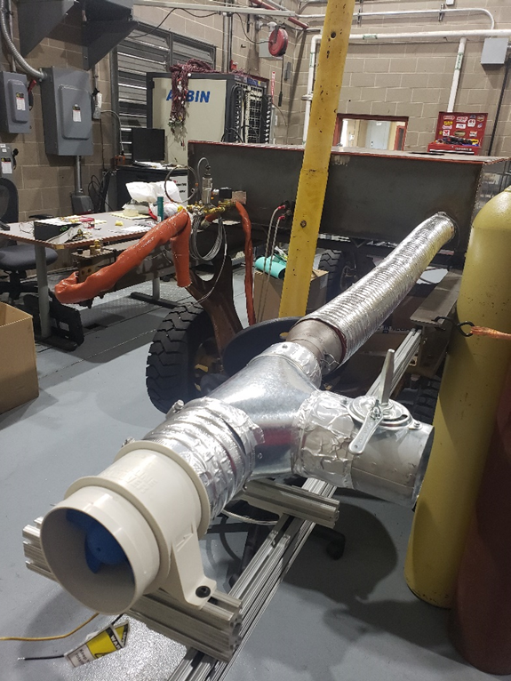
Compartment Design
Fabricated compartment
A blower is connected to the compartment.
An igniter is centered inside the front panel of the compartment.
The compartment is also outfitted with a fuel delivery system.
A vent is located on the side panel of the compartment.
Igniters
Air supply
Notes:
The compartment is accessorized with a blower that will provide air flow through the compartment.
An igniter is positioned on the inside of the front panel of the compartment.

Slide 9
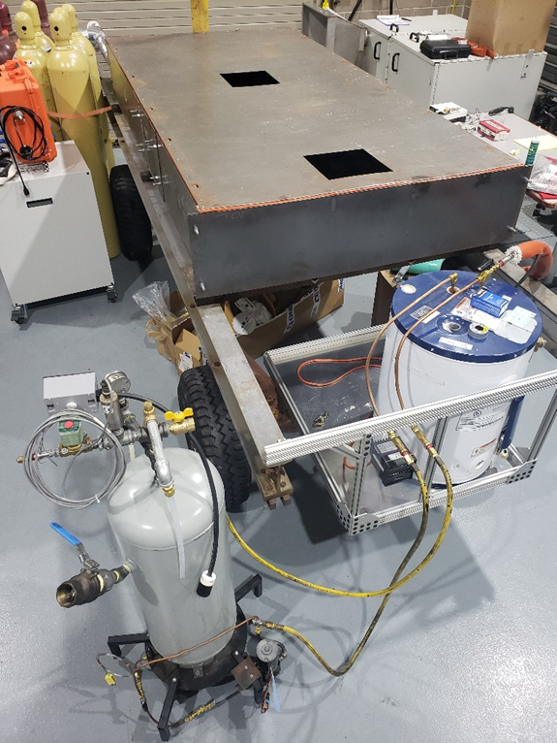
Compartment Design
Fabricated compartment
A blower is connected to the compartment.
An igniter is centered inside the front panel of the compartment.
The compartment is also outfitted with a fuel delivery system.
A vent is located on the side panel of the compartment.
Fuel heater
Fuel supply
Notes:
A fuel delivery system consisting of the fuel supply, fuel heater, and fuel lines to deliver fuel to the compartment will deliver fuel through a nozzle into to the compartment.

Slide 10
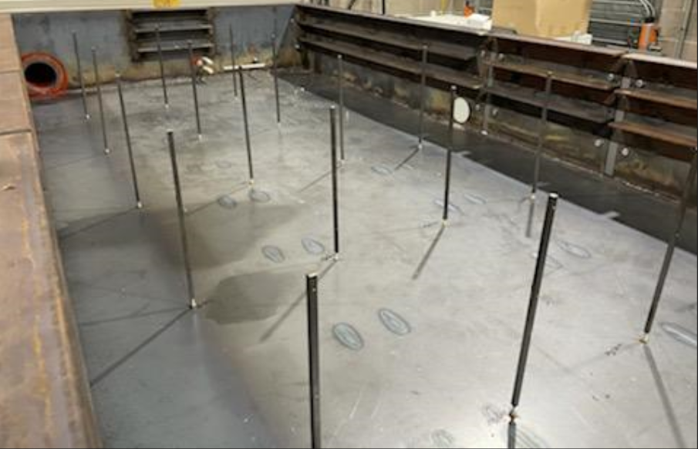
Observable Data
Temperature profile of thermocouples inside the compartment. °F
Oxygen levels in the compartment. % O2 concentration.
Flame localization during fuel delivery.
After Flame extinguishment time after fuel delivery has been stopped.
Notes:
Discuss PICTURE
4 columns X 5 rows grid of thermocouple trees each holding 3 thermocouples. The thermocouples will be placed six inches from the sides of the compartment. The columns are 10 inches apart and rows are 16 inches apart from each other.

Slide 11
Test Path
Heat Fuel To Flash Point Temperature
Set compartment dimensions
Initiate Forced Air Through Compartment
Turn on Igniter
Introduce Fuel into the Compartment
Collect data and record video of combustion event
Data acquired will be compared to CFD model
Notes:
The flash point of the fuel being used (JP-8) is about 38 degrees C or 100 degrees F.
The space between the Engine and its Nacelle being considered varies from 12 inches to 6 inches.
Other Required Data
DENSITY_LIQUID (kg/m3).
SPECIFIC_HEAT_LIQUID (kJ/(kg _ K)).
VAPORIZATION_TEMPERATURE Boiling temperature of the liquid, Tboil (degree C).
MELTING_TEMPERATURE Melting (solidification) temperature of the liquid (degree C). (not that important in your case, but it is better to get it right)
ENTHALPY_OF_FORMATION The heat of formation of the gas (kJ/mol).
HEAT_OF_VAPORIZATION Latent heat of vaporization of the liquid, hv (kJ/kg).
H_V_REFERENCE_TEMPERATURE The temperature corresponding to the HEAT_OF_VAPORIZATION (degree C).
HEAT_OF_COMBUSTION

Slide 12
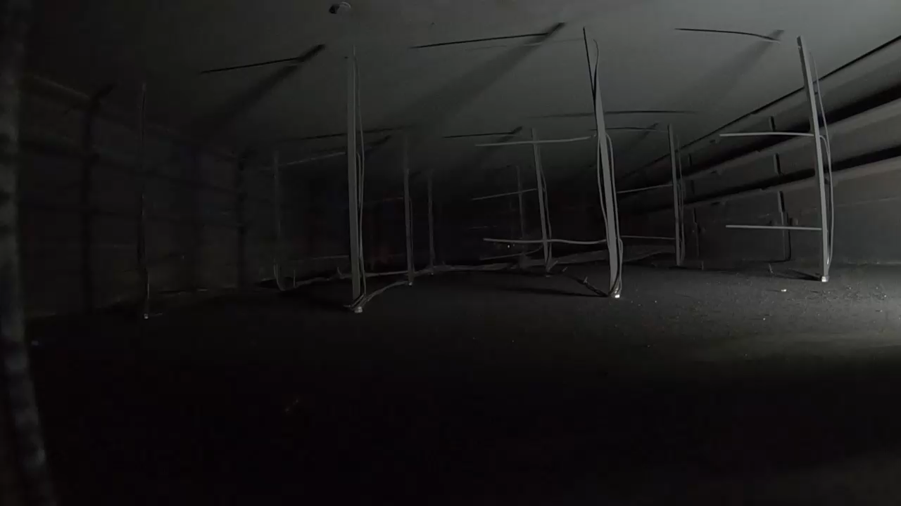
Real Test – 1.5GPH Fuel Flow
Notes:
This is video of a trial in a test series of a 1.5 GPH fuel flow into the compartment set at its maximum dimension
The air flow that was chosen for the iteration of tests was 300 CFMs
The flame favored the inlet side of the compartment
The highest temperature readings were from the first high thermocouples in column B and C
The oxygen concentration captured near the exhaust vent showed about 16% concentration.

Slide 13
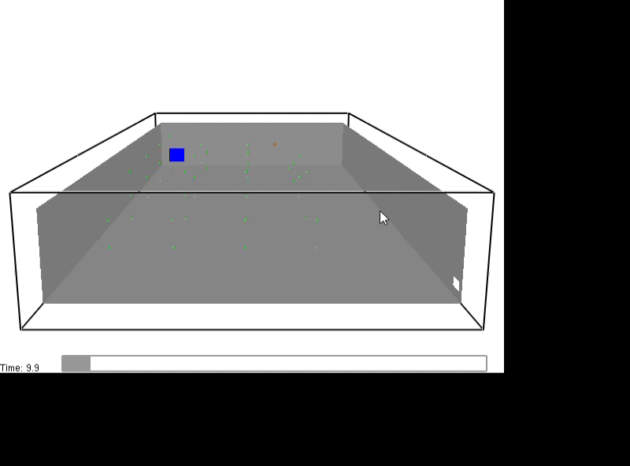
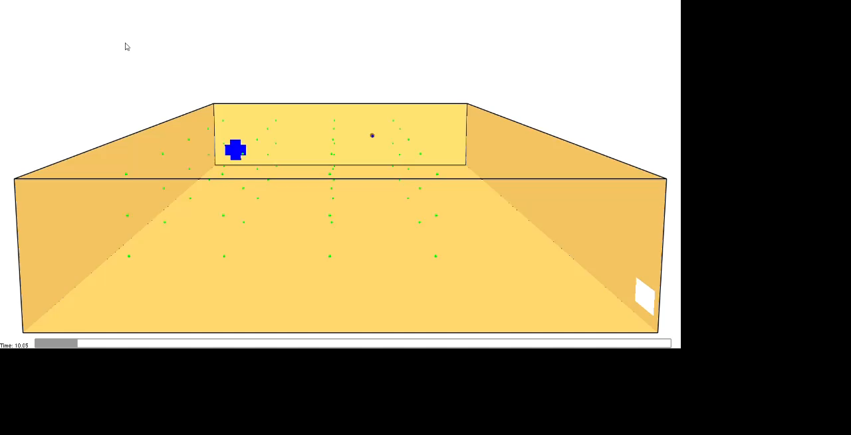
Simulated Test – 1.5GPH Fuel Flow
Adiabatic Boundary
Isothermal Boundary
Notes:
The heat release rate per unit volume view favored the inlet side of the compartment in both simulations
The highest temperature readings were from the first high thermocouples in column B and C
Based on the oxygen concentration slice of the simulation the oxygen concentration averaged around 16% during combustion event.

Slide 14

Acknowledgements

Slide 15
THANK YOU
Aeon Brown
ANG-E212 Fire Test
Phone: 609-485-4365
Email: Aeon.S.Brown@FAA.gov
Website: http://www.fire.tc.faa.gov

