Slide 1
Fire Testing of Bluetooth and GPS Tracking Devices

Slide 2
Introduction
On August 22, 2022, Alaska Airlines sent an email to the FAA pointing out media reports of passengers placing tracking devices in luggage to prevent them from getting lost or stolen
Code of Federal Regulations (CFR), Title 49 Part 175.10(a)(18) decrees that any portable electronic device (PED) powered by a lithium cell or battery and contained within checked baggage must be fully powered down
An inoperable smart tag won’t help travelers find their lost baggage

Slide 3
Test Plan
Determine if tracking devices contain enough energy to start a fire in a person’s luggage
Heat battery to thermal runaway and determine if flames are present outside of casing
Make as few modifications as possible to get heater inside tracking device
Use cotton mesh (cheesecloth) loosely wrapped around device as flame indicator

Slide 4
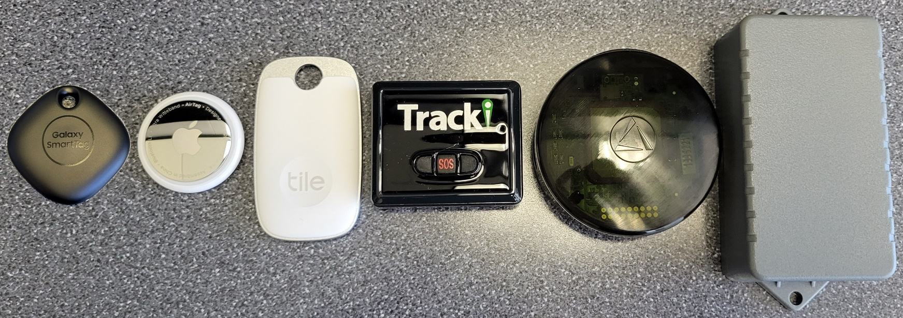
Devices Tested
Three Bluetooth-based tracking devices all used CR2032 LiMnO2 button cells (~0.675 Wh)
Three GPS-based tracking devices that use lithium-ion cells rated at 2.22 Wh, 5.55 Wh, and 17.02 Wh
Each device tested three times

Slide 5
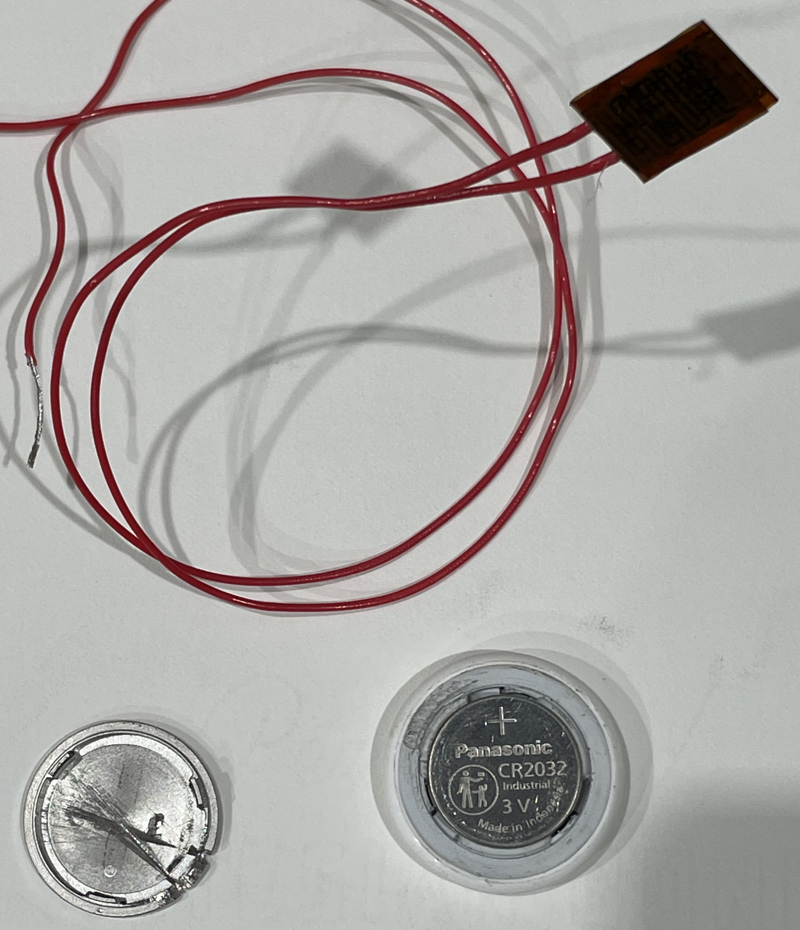
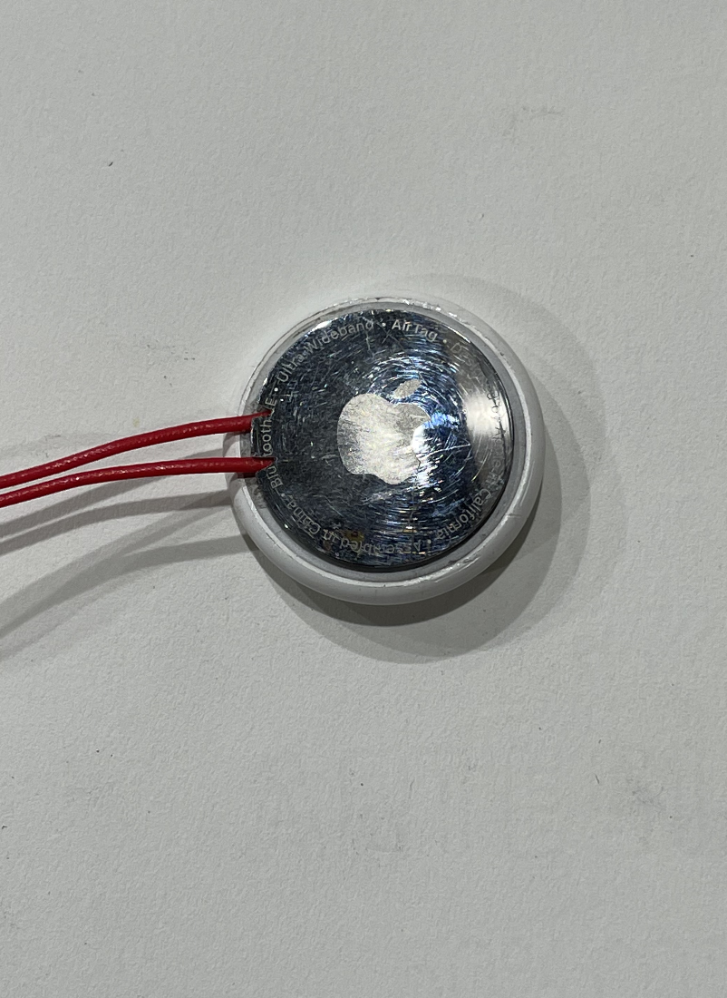
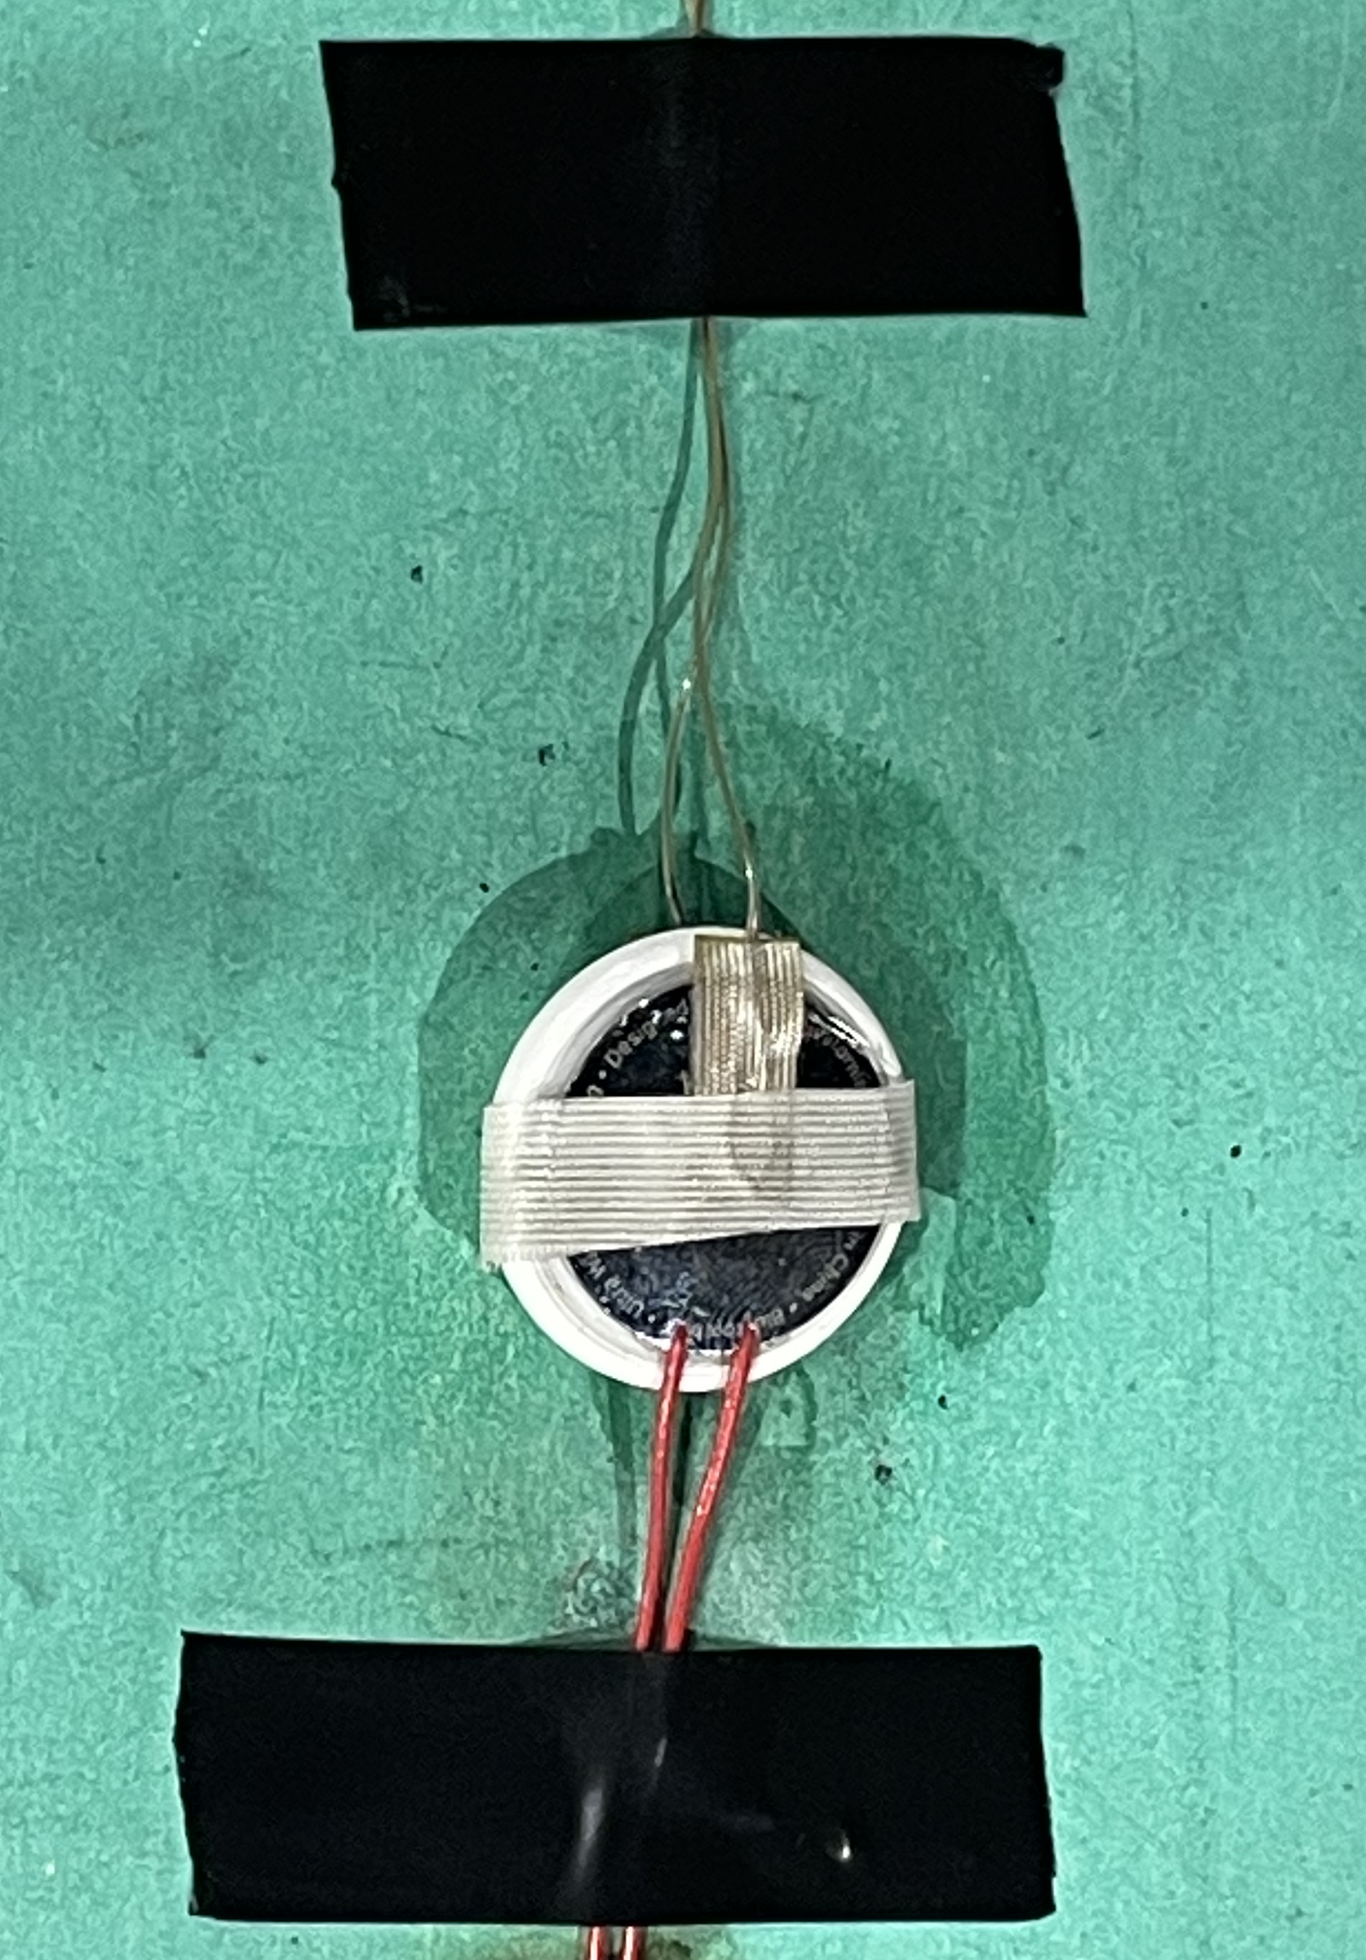
Bluetooth Trackers
Stick-on film heater placed on battery
Thermocouple placed on top and bottom

Slide 8
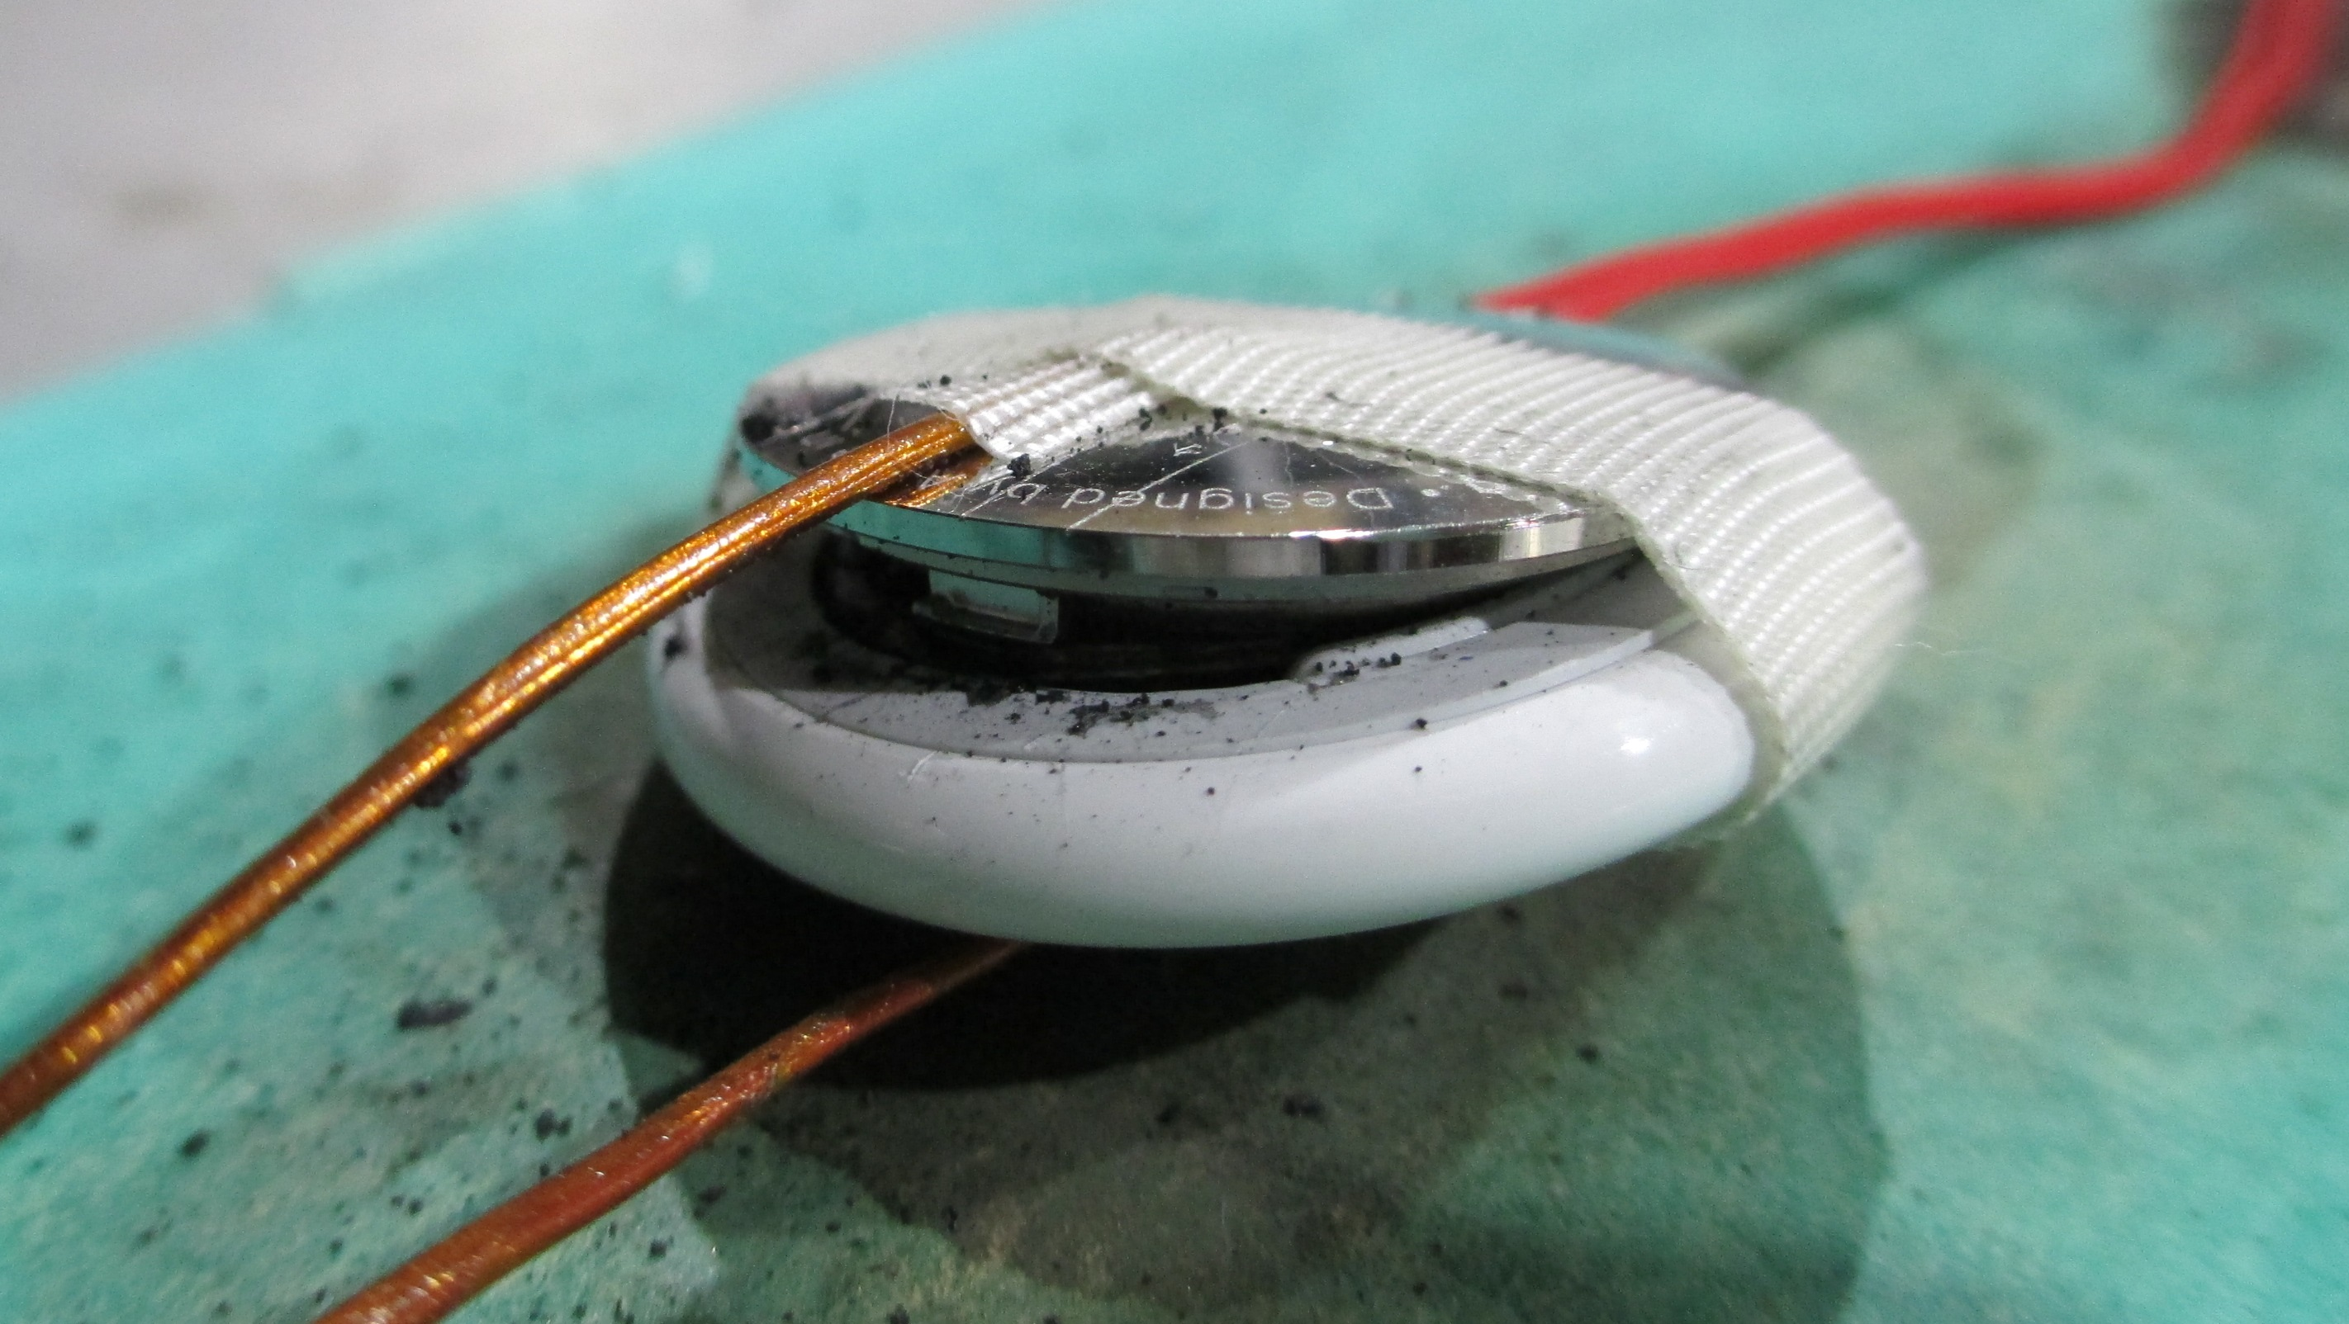
Bluetooth Trackers
Max Temperature: 356°F

Slide 9
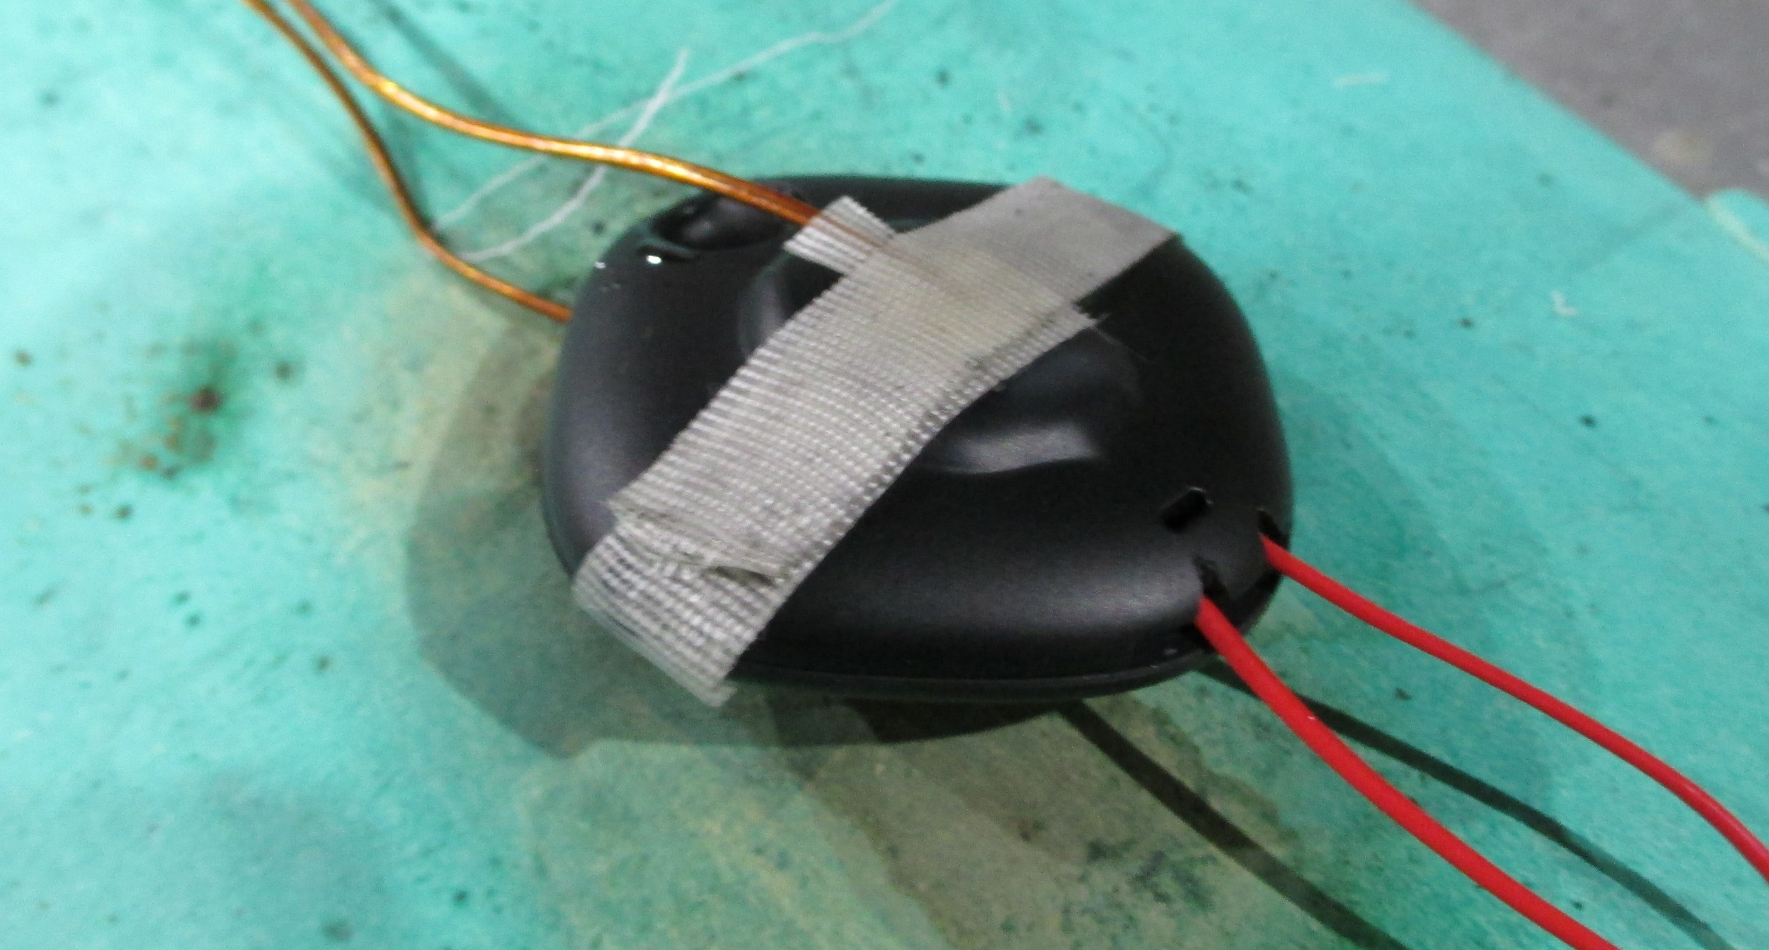
Bluetooth Trackers
Max Temperature: 420°F

Slide 10
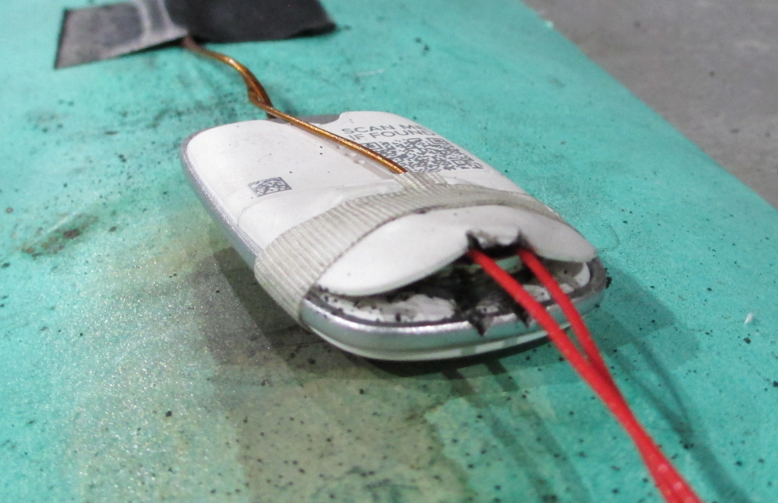
Bluetooth Trackers
Max Temperature: 486°F

Slide 11
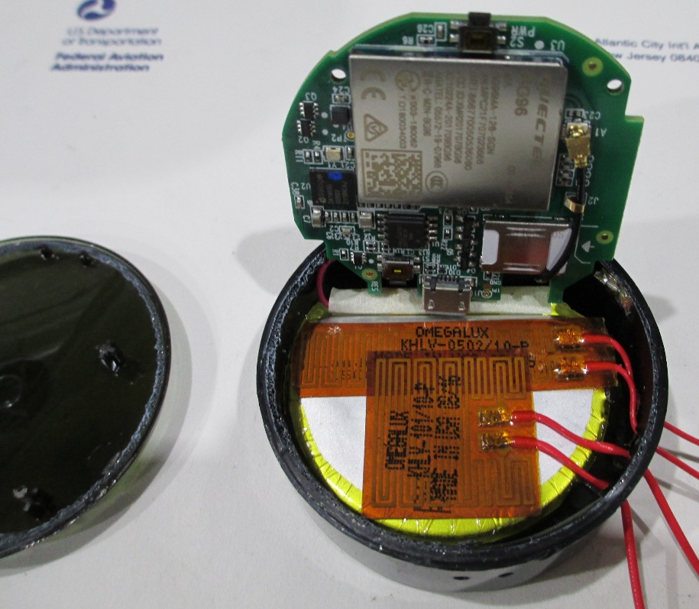
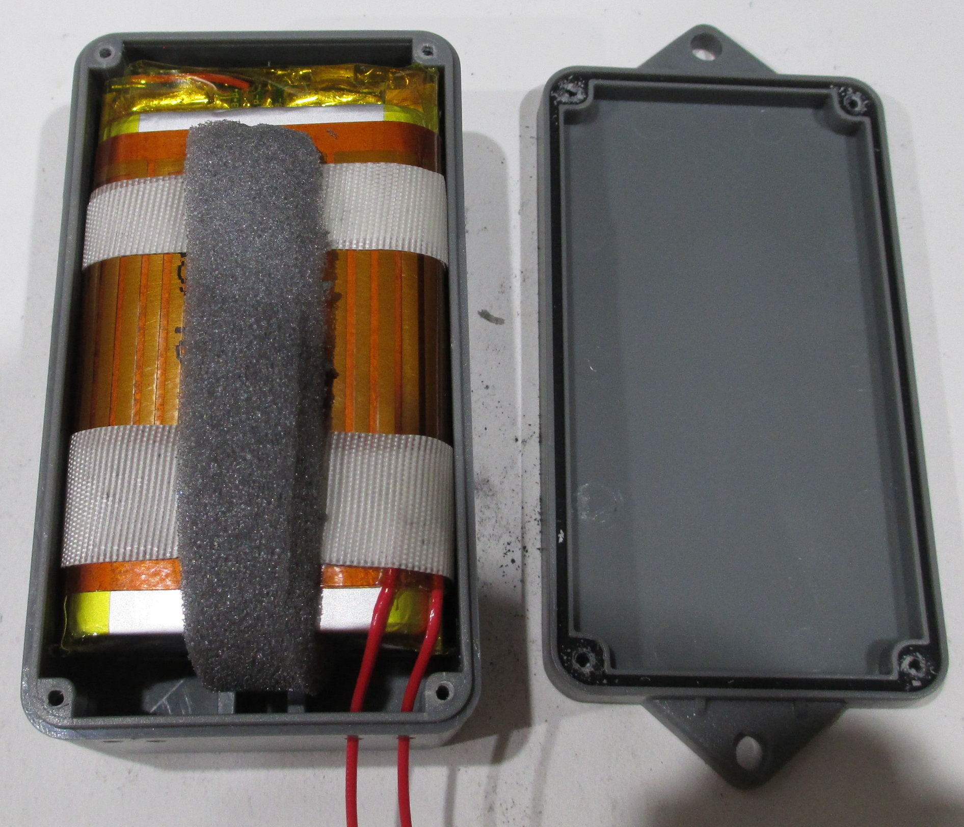
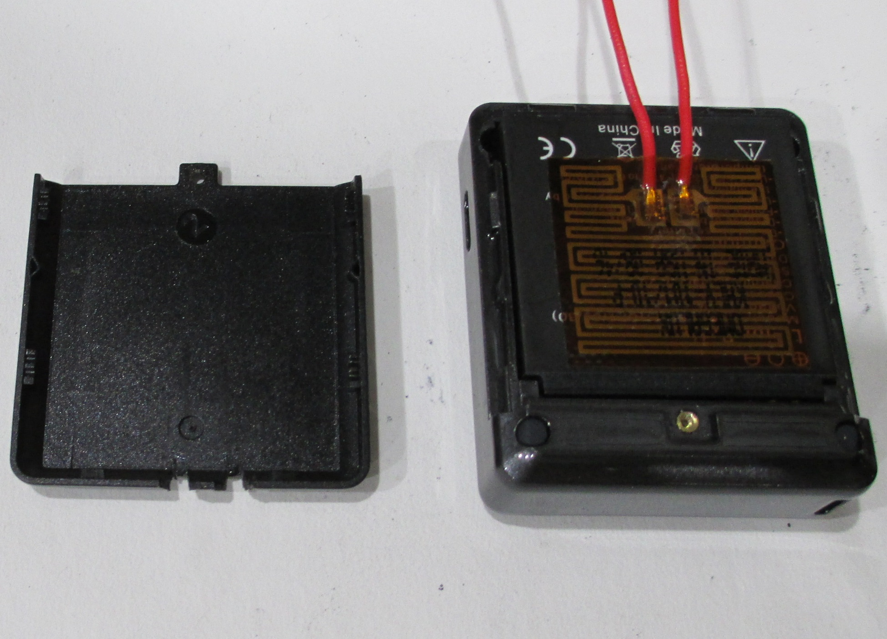
GPS Trackers
Contain larger lithium-ion cells
Fully charged before testing
2.22 Wh battery
5.55 Wh battery
17.02 Wh battery

Slide 12
Smallest GPS tracker

Slide 13
Largest GPS tracker
Burned for ~15 minutes

Slide 14
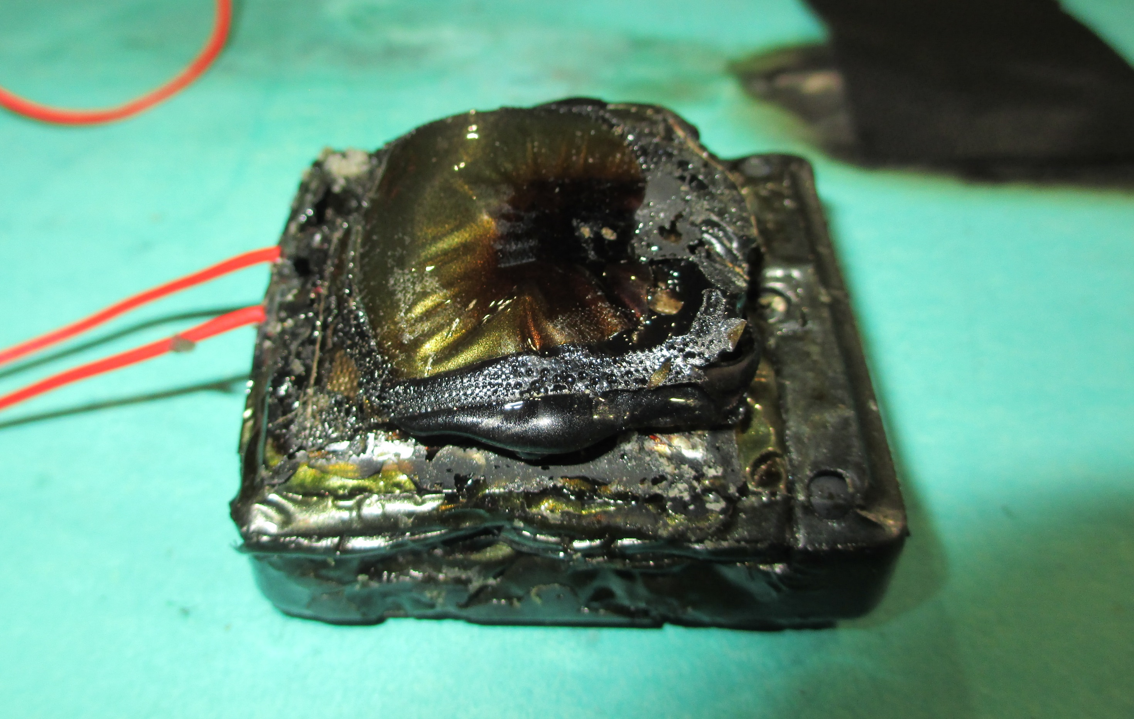
GPS Trackers
Max Temperature: 577°F

Slide 15
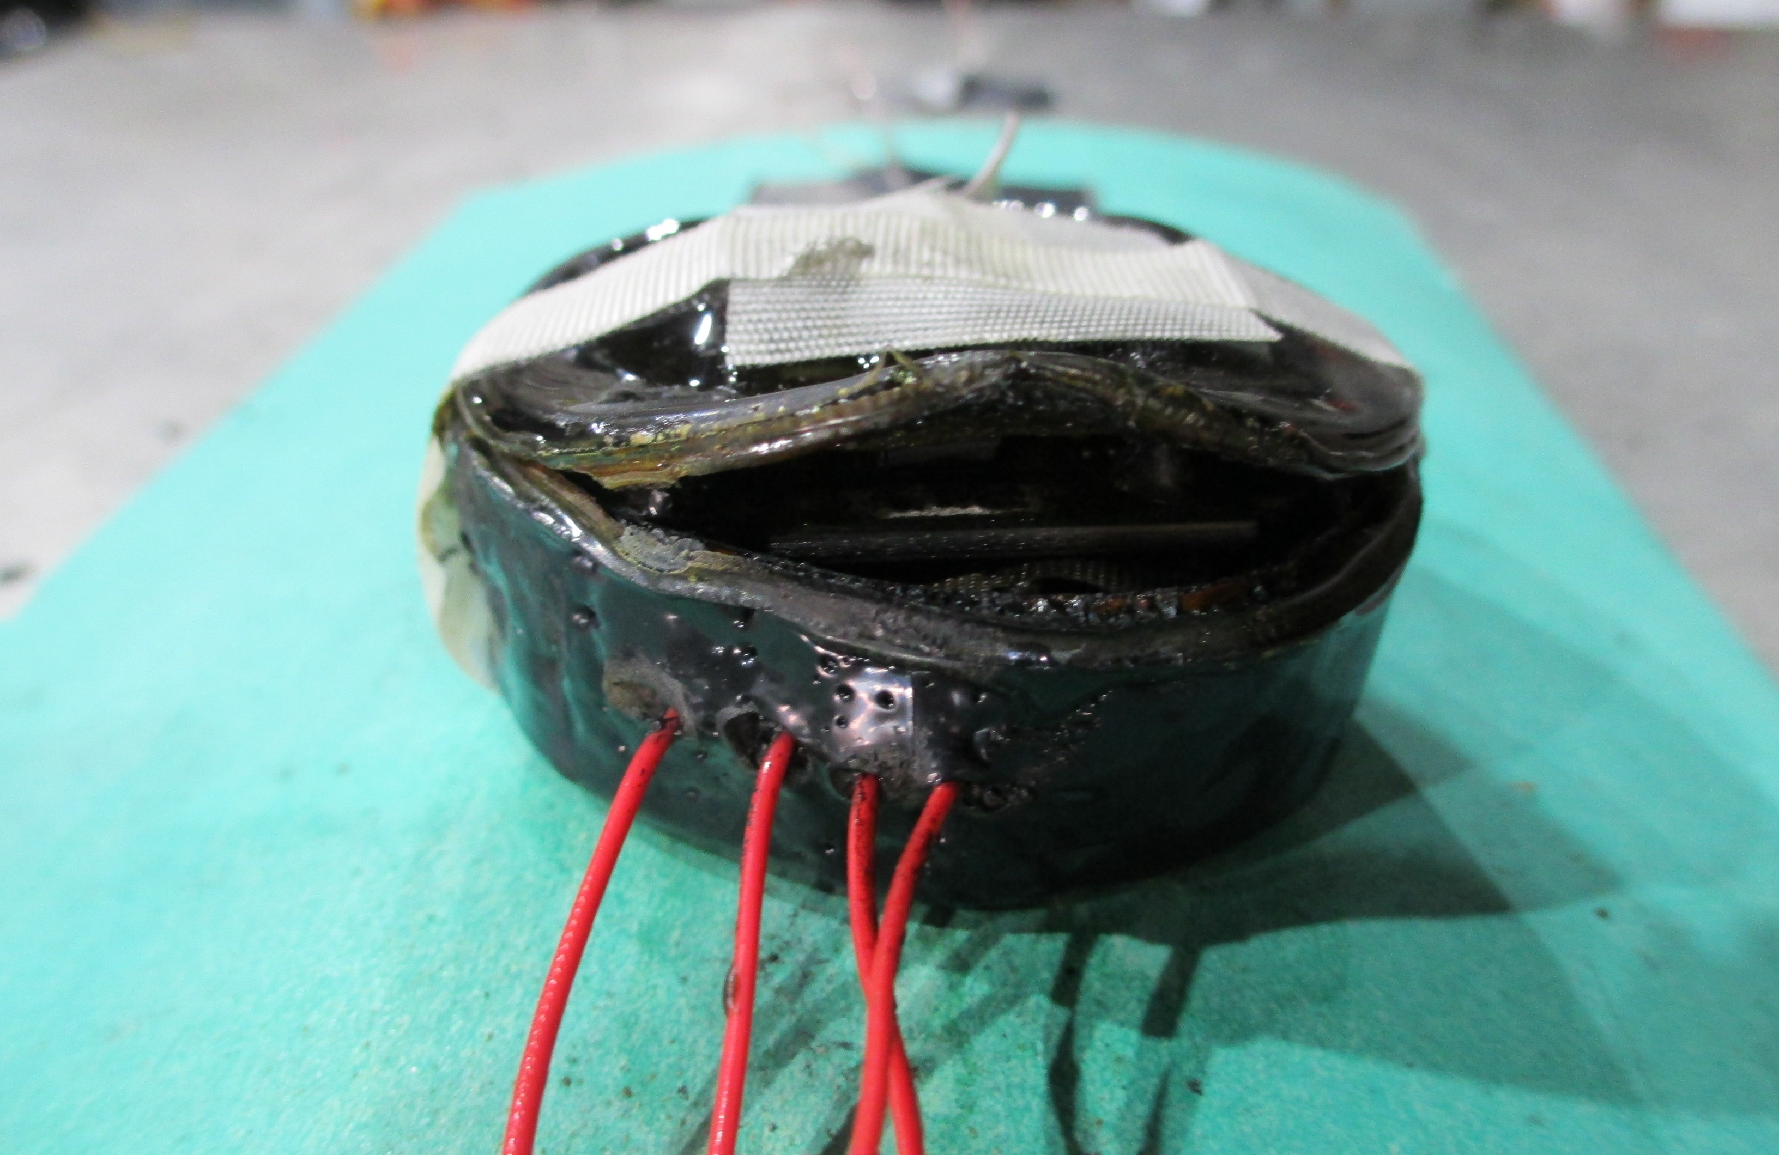
GPS Trackers
Max Temperature: 675°F

Slide 16
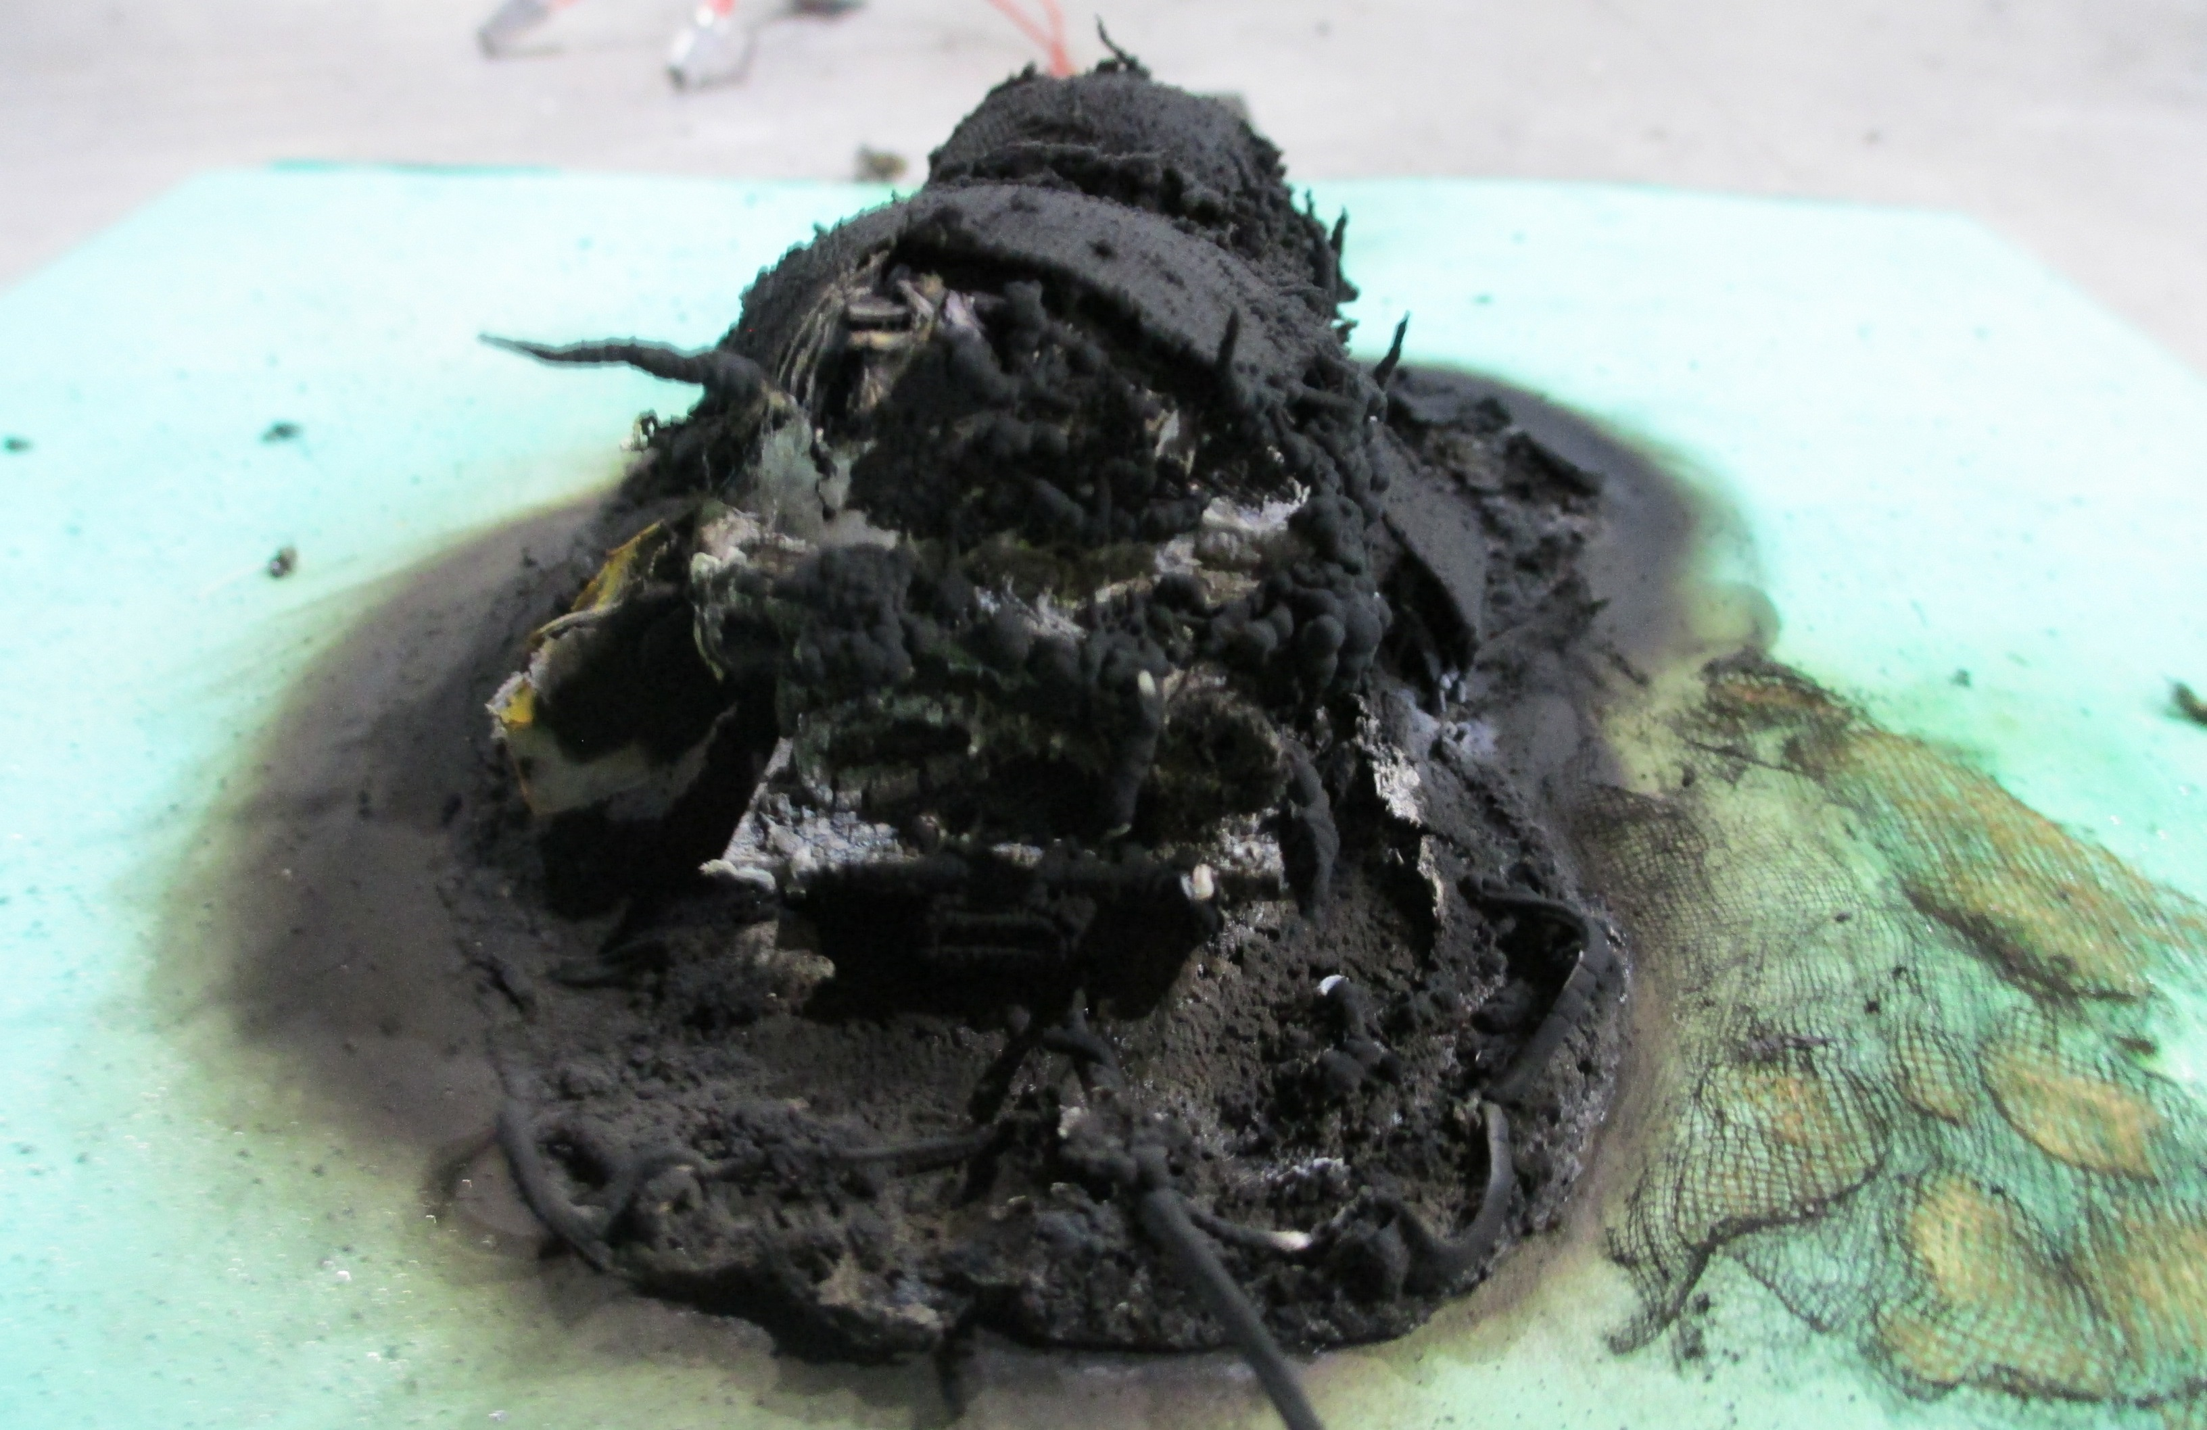
GPS Trackers
Max Temperature: 937°F (no fire)
TC failed on test with fire

Slide 17
Conclusion
Small tracking devices containing CR2032 batteries pose little to no threat to starting a fire on an aircraft
Devices with larger lithium batteries have a much higher chance of starting a fire if they go into thermal runaway

Slide 18
Conclusion
On October 6, 2022 this data was sent to FAA Hazardous Material sponsors
On October 8, 2022, Lufthansa posted on Twitter, “Lufthansa is banning activated AirTags from luggage as they are classified as dangerous and need to be turned off”
On October 12, 2022, Lufthansa reversed this with another post, “The German Aviation Authorities confirmed today, that they share our risk assessment, that tracking devices with very low battery and transmission power in checked luggage do not pose a safety risk. With that these devices are allowed on Lufthansa flights.”
On October 13, 2022, FAA released a statement saying “Luggage tracking devices powered by lithium metal cells that have 0.3 grams or less of lithium can be used on checked baggage. Apple AirTags meet this threshold; other luggage tracking devices may not.”

Slide 19
Questions?
Contact:
Steven Rehn
Federal Aviation Administration
William J. Hughes Technical Center
Fire Safety Branch, Bldg. 203
Atlantic City Int’l Airport, NJ 08405
(609) 485-5587
steven.rehn@faa.gov

