Slide 1
Smoke Generator Qualification Standardization
Status and Challenges
Dr. André Freiling, Jan Chen - Airbus Operations GmbH
Thorsten Schultze - University Duisburg-Essen
13 June 2023 - International Aircraft Systems Fire Protection Forum, Cologne

Slide 2
Smoke Task Group
Achieve Internationally standardized approach for smoke quantities to be used for showing of compliance to CS25.858a
Source: M. Karp, Development of a smoke Generator Handbook for Cargo Compartment Smoke Detection, The Tenth Triennial International Fire & Cabin Safety Research Conference, Oct 2022

Slide 3
Smoke Task Group - status
Last FAA Smoke task Group meeting before Covid-19
No FAA Technical Report published to date, draft for task group discussions available
Parameters for standardization and their values have been proposed by FAA and are agreed in the group
Several publications at conferences reflecting the actual status of the discussions
AUBE 21: M. Karp: Characterizing Smoke Generator Smoke Transport for Aircraft Cargo Smoke Detection Certification
Tenth Triennial Cabin Safety Conference 22: M. Karp: Development of a Smoke Generator Handbook for Cargo Smoke Detection

Slide 4
Horizontal Smoke Transport

Slide 5
Work performed
Source: M. Karp, Development of a smoke Generator Handbook for Cargo Compartment Smoke Detection, The Tenth Triennial International Fire & Cabin Safety Research Conference, Oct 2022

Slide 6
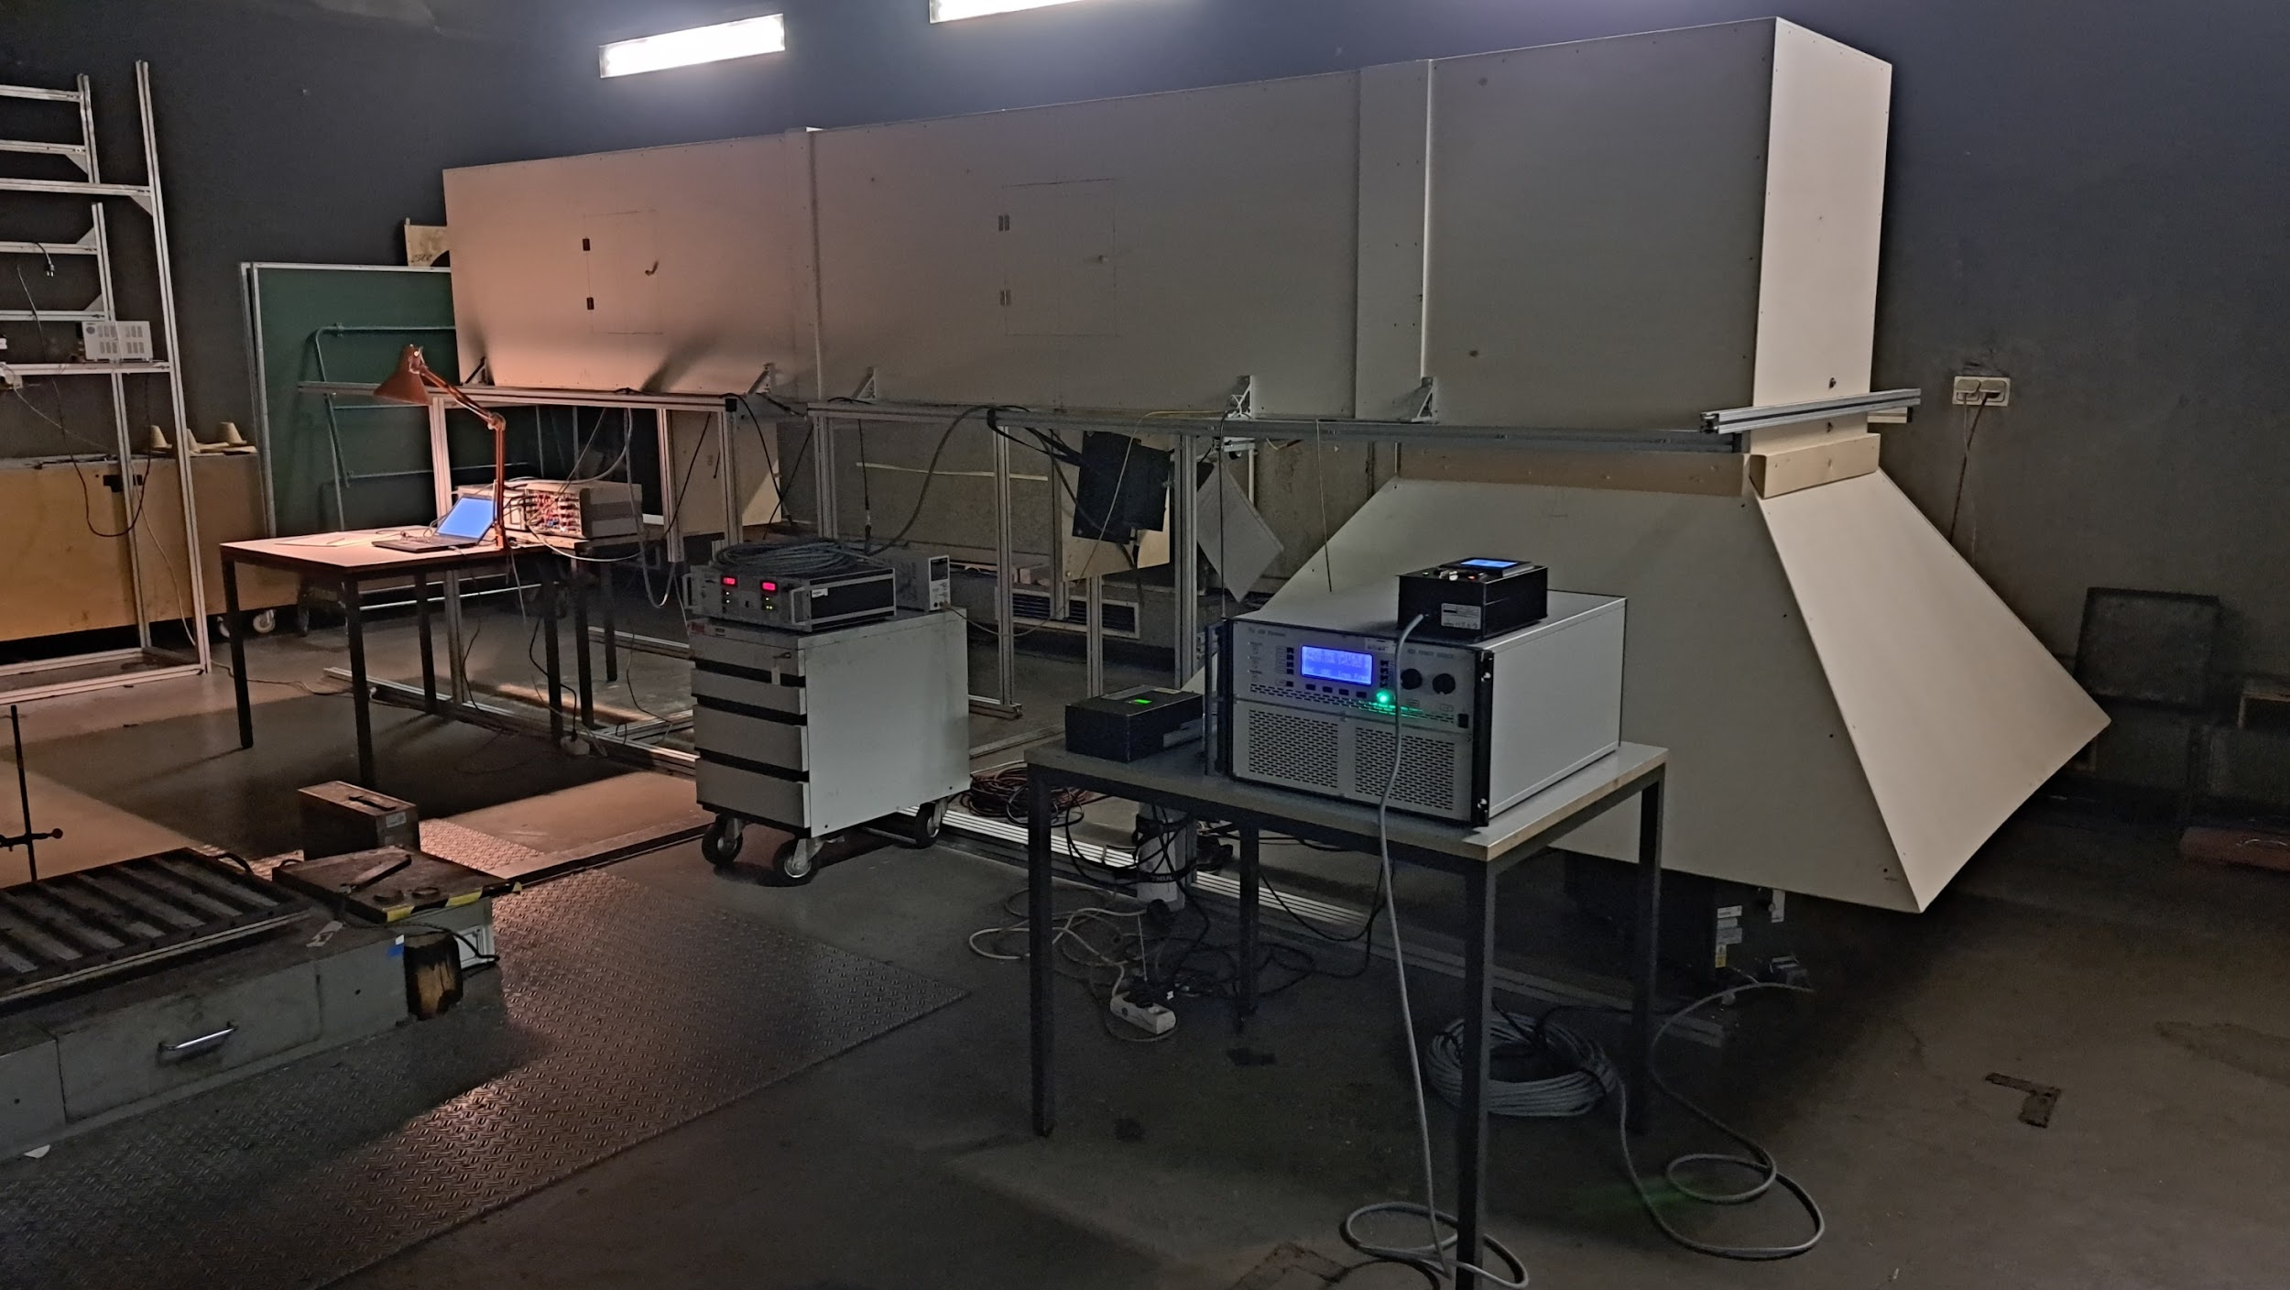
MIREX 2 (10°)
MIREX 1 (10°)
DAQ (10 Samples / sec, 16 Bit, 0-15V)
110 V
Aviator
CO₂, 2 bar

Slide 7
Horizontal smoke duct
Advantages:
Similar physical dimensions as in cargo compartment
Compact design (compared to EN fire detection laboratory)
Disadvantage:
Stratification and differences in flow velocities along the cross-section of the duct
→ Hardly any possibility to define standardized and reproducible reference measurement.
20 s after start
50 s after start
10 s smoke emission

Slide 8
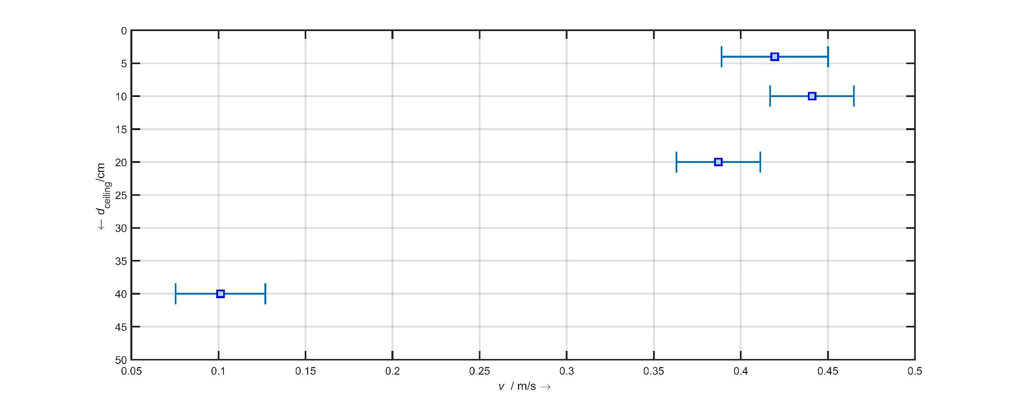
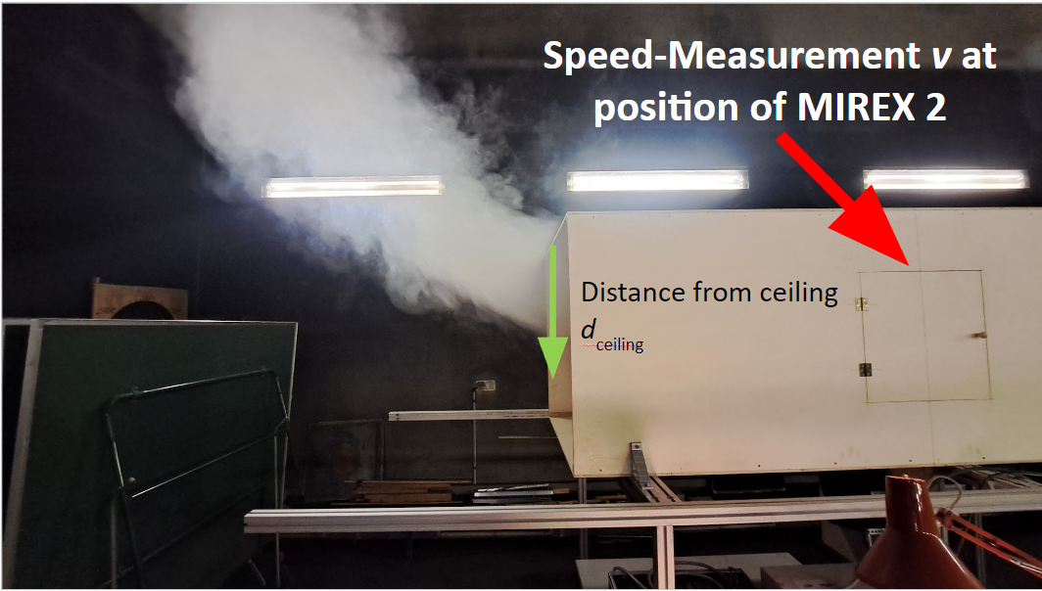
Horizontal Smoke Duct Velocities
45 samples/sec, 7 min Test duration per “distance from ceiling”
Concept Smoke UL, 6 heaters at 100%

Slide 9
Horizontal Smoke Dynamics
Conclusion:
Benefit of Horizontal Smoke Dynamics Characterization not justified

Slide 10
Vertical Smoke Dynamics

Slide 11
Alignment proposed
Source: M. Karp, Development of a smoke Generator Handbook for Cargo Compartment Smoke Detection, The Tenth Triennial International Fire & Cabin Safety Research Conference, Oct 2022

Slide 12
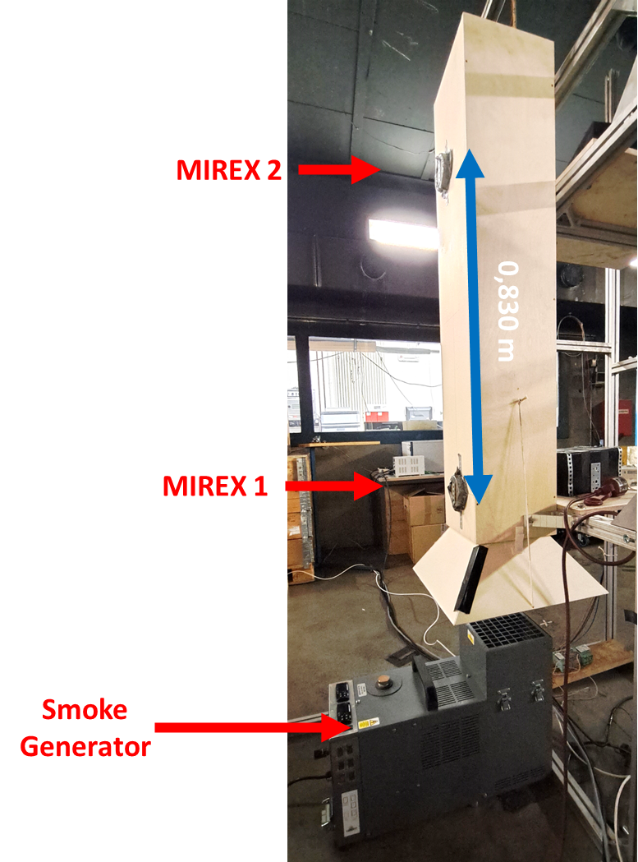
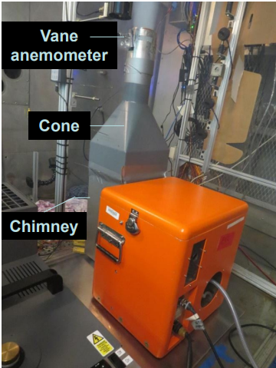
Vertical Velocity considerations
alternate setup 2022
Potential benefit: unobstructed smoke ingression
FAA setup 2018

Slide 13
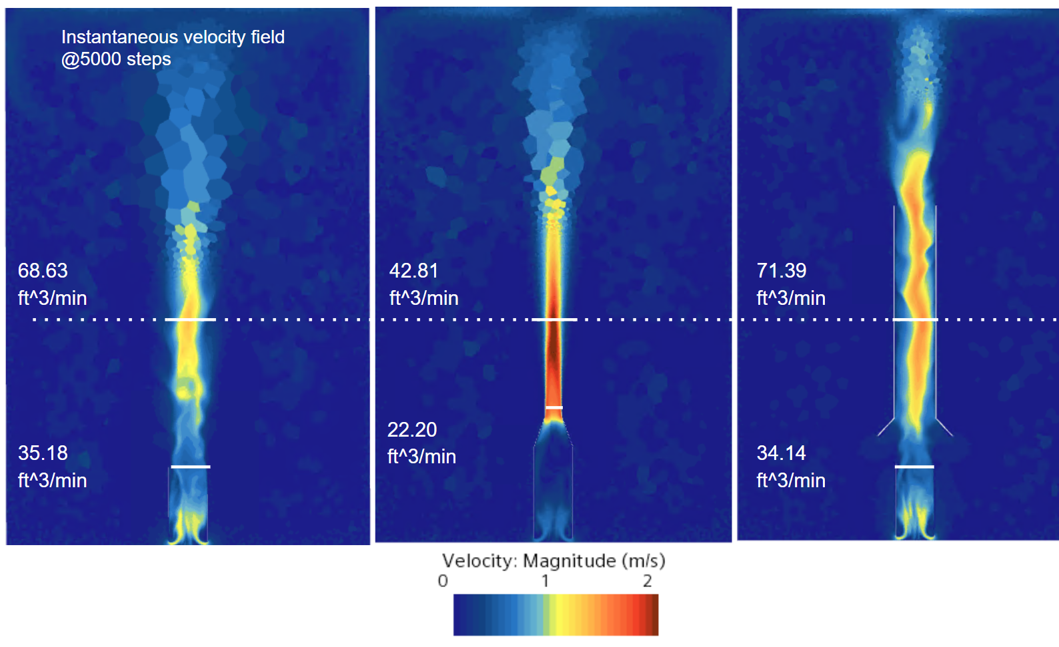
Simulation of Vertical Velocity Scenarios
Test setup influences the properties / dynamics of the smoke generator
Flow rates / speed are more realistic with open channel
71.05 ft^3/min
68.63 ft^3/min
42.81 ft^3/min
71.39 ft^3/min
35.18 ft^3/min
22.20 ft^3/min
Simulation parameters:
800W Heater power
Convection only

Slide 14
Vertical Smoke Dynamics
Conclusion:
Re-discuss vertical smoke dynamics standardization criteria in the task group

Slide 15
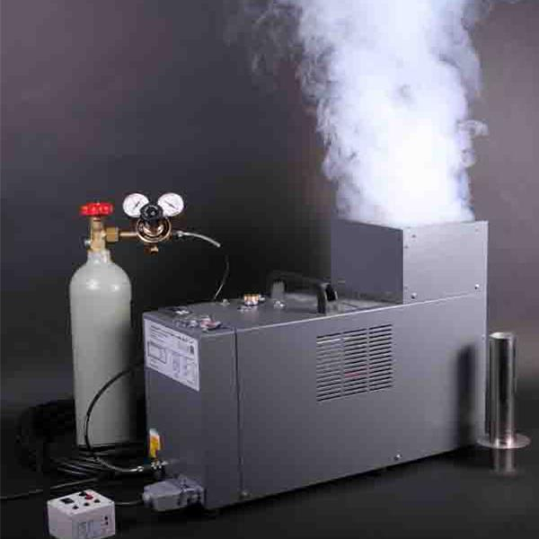
Cargo Compartment
Smoke Machines
Comparison
Siemens
Concept Smoke Aviator UL

Slide 16
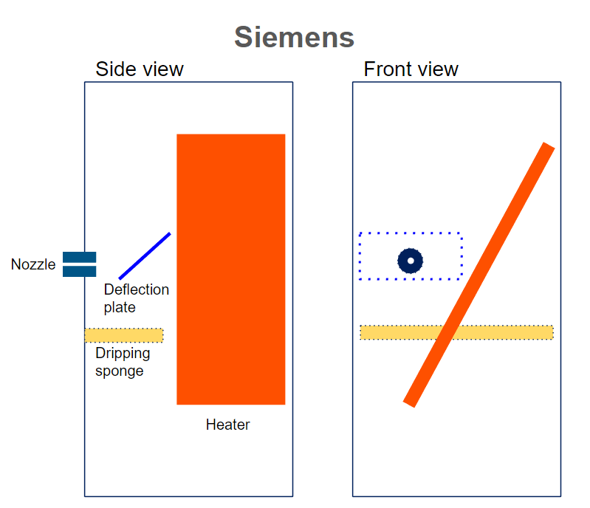
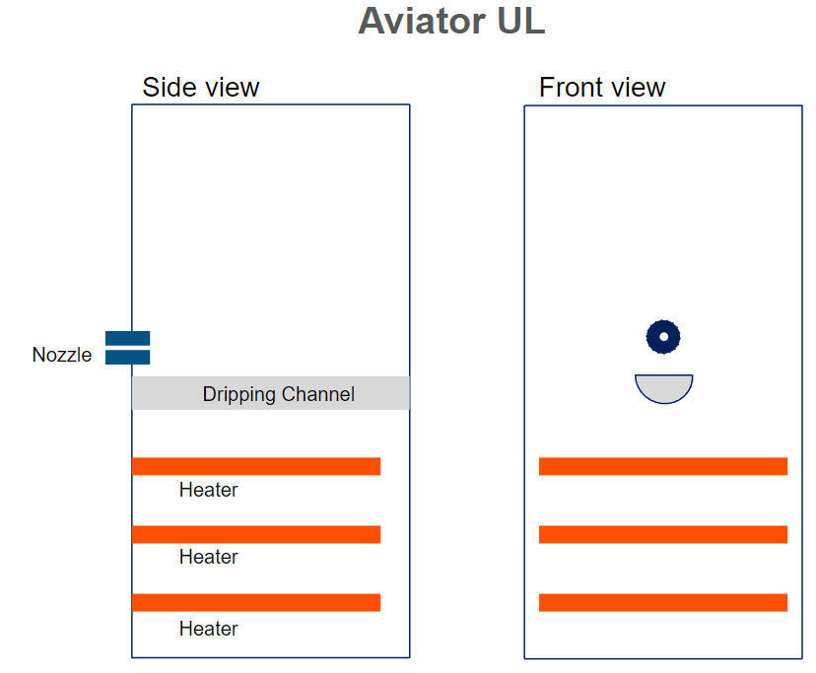
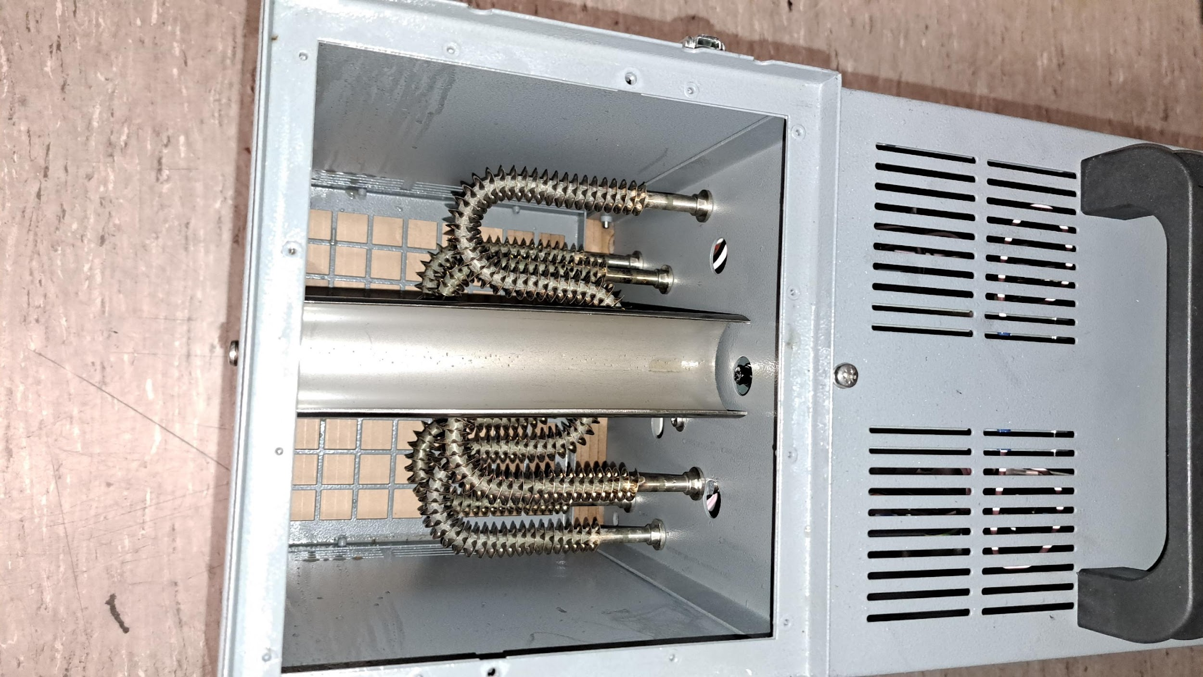
Smoke machine Design Details
Design differences
Deflection Plate
Handling of Paraffin dripping
Heater design
Oil reservoir temperature compensation
Micrometer Valve
Purge Button
Top view
Top view
Note: Aviator 440 and Mini Aviator not yet investigated

Slide 17
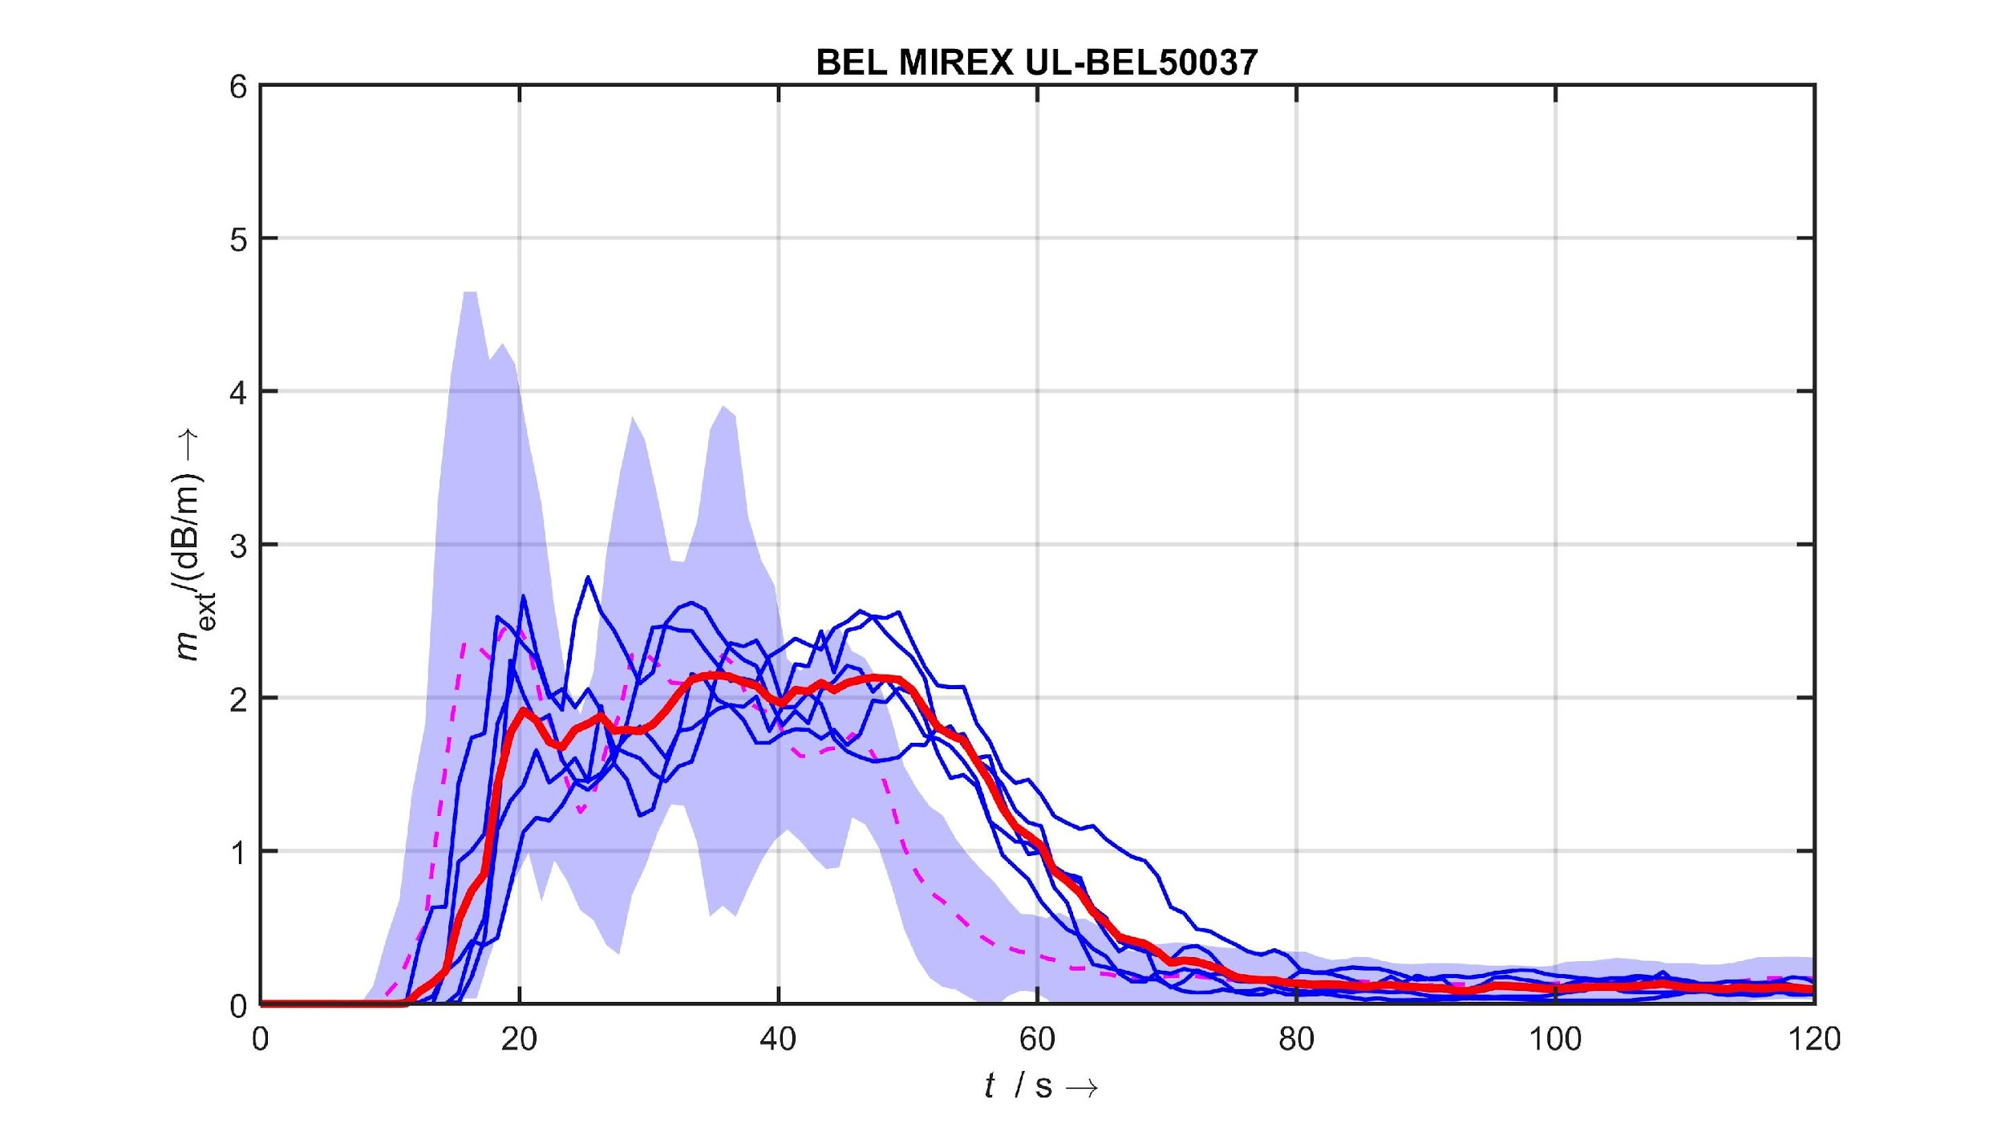
Alignment of settings
Siemens
Mean
Aviator
Mean
Aviator UL setting to replicate Siemens P5:
continuous smoke production
2.5 bar, 8 Turns, comparable pressure hose diameter

Slide 18
Conclusion
Re-discuss / consolidate in the Smoke Task Group:
Vertical velocity test procedure
Introduce Smoke rate of rise requirements: speed criterion in proposed open vertical channel
Steady state light obscuration discussion points:
Ventilation for homogenous smoke distribution
Introduction of test chamber scaling factor or tolerances in order to achieve flexibility in chamber dimensions
Repeatability
Particle size vs. optical effect (eventually easier to measure)
Discard Horizontal Velocity

Slide 19
Thank you
This document and all information contained herein is the sole property of Airbus. No intellectual property rights are granted by the delivery of this document or the disclosure of its content. This document shall not be reproduced or disclosed to a third party without the expressed written consent of Airbus. This document and its content shall not be used for any purpose other than that for which it is supplied.
Airbus, its logo and product names are registered trademarks.

