Slide 1
Joint EUROCAE/SAE Hydrogen Fuel Cells Standardization Group WG-80/AE-7AFC
AIR7765 / ER-020
Considerations for
Hydrogen Fuel Cells
in Airborne Applications

Slide 2
AIR 7765 / ER-020 Executive Summary
Objective
Introduction to Hydrogen
Hydrogen Usage
Hazards and Mitigations
Benefits for Airborne Applications
Conclusions

Slide 3
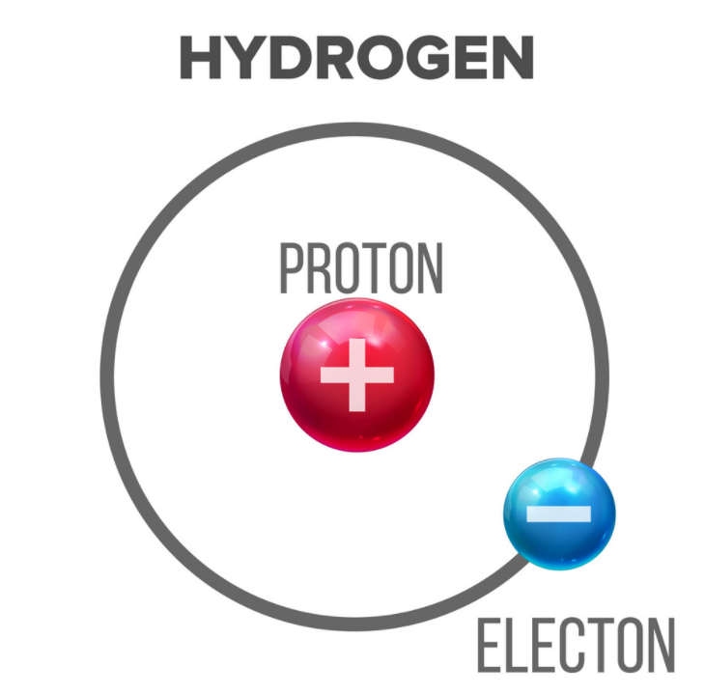
Objective
Why to use hydrogen as an energy carrier
Efficiently produce and store energy
Water emissions only
Key technology for energy security
Why and how to use hydrogen fuel cells in aviation
Aviation environmental targets
Efficient Hybrid-electric air vehicles
Experience with mobility sector transferable to aviation
Alleviate safety concerns
Demystify hydrogen for aviation

Slide 4
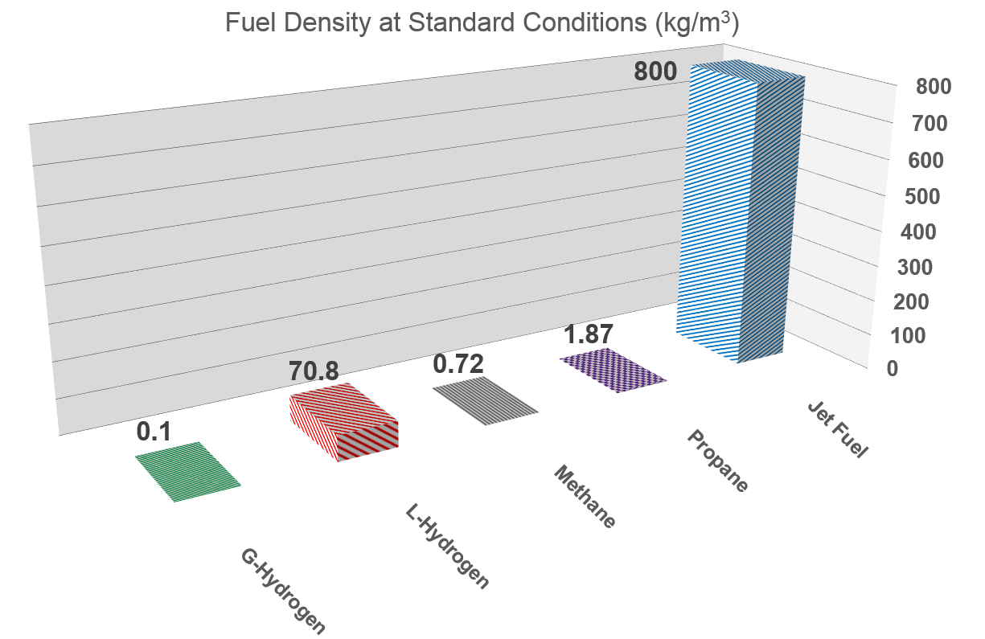
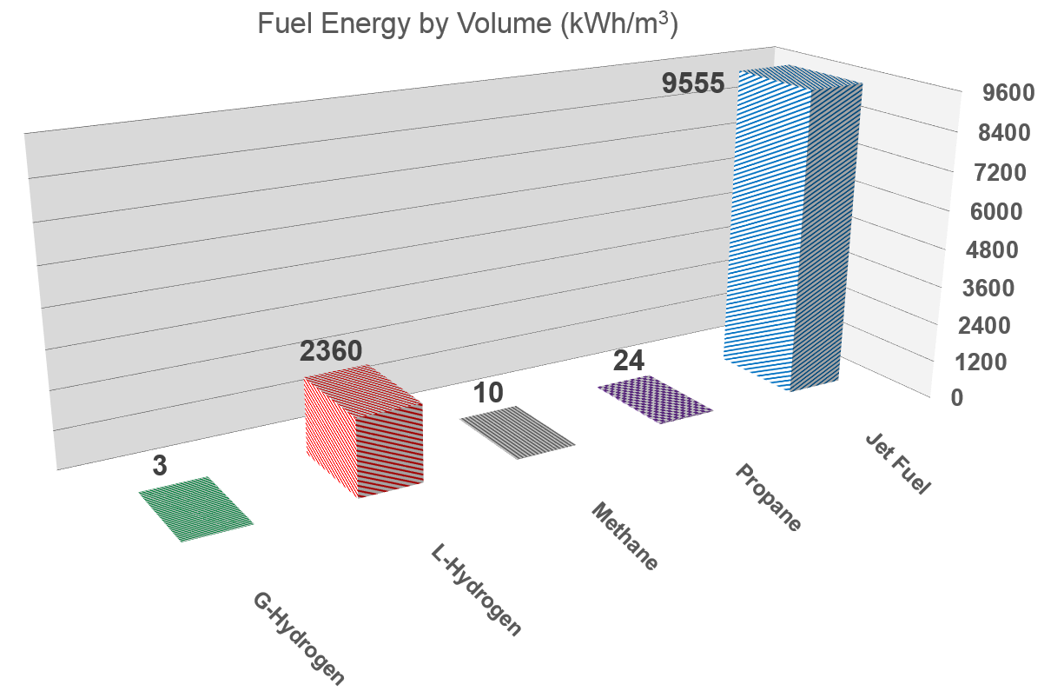
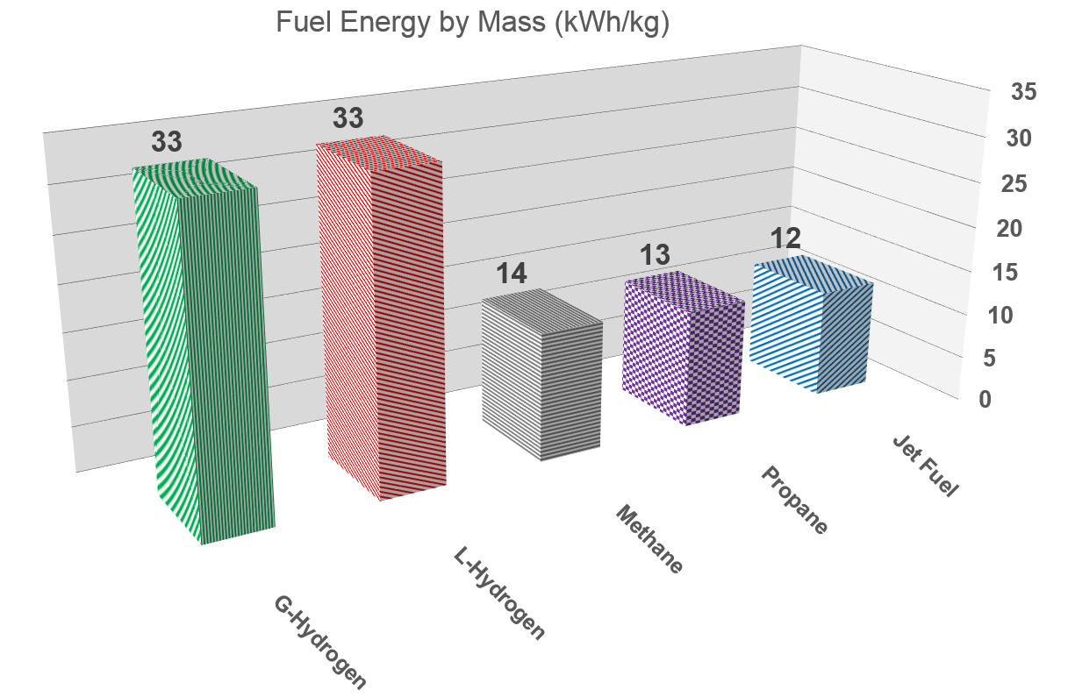
Introduction to Hydrogen
Hydrogen Properties
Gaseous in standard conditions
Liquid @ -253°C/-423°F
Colorless, odorless
Non-toxic, non-polluting, not radioactive
Lowest density gas with highest energy content by mass
Has wide flammability range
Has low ignition energy
Has high self-ignition temperature
Twice the jet fuel
Flame burning characteristics (adiabatic)
Different from jet fuel
Lower temperature
Lower radiation

Slide 5
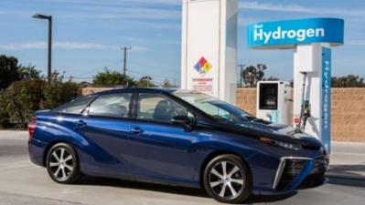
Introduction to Hydrogen
Production
Generated by hydrocarbon reforming
Mainly steam methane reforming
Also produced through water electrolysis
Transportation and Storage
Stored as gas in pressurized vessels or as liquid in cryo-tanks
Transported by pipeline, truck, rail and ship
Distribution
Daily distributed for various industries via dedicated and mature installations (e.g. refueling stations for cars, buses, forklifts, etc.)
Cost
Fuel cost to car owner by range same as gasoline with hydrogen un-taxed
More efficient fuel cells will balance future hydrogen taxes

Slide 6
Introduction to Hydrogen
Public Perception has Changed
Recognized safe use in industry processes (fertilizers, steel, electronics, etc.)
Chemical and petrochemical industries safely deal with reactions with hydrogen
This knowledge serves as base for safety in the hydrogen fuel cell sector
Increasing usage in mobility (cars, buses, forklifts, etc.) with direct involvement of the general public
Now seen as a key for low carbon energy systems to address climate change

Slide 7
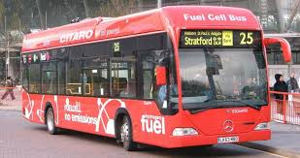
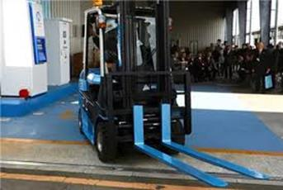
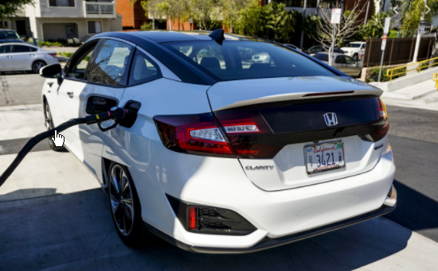
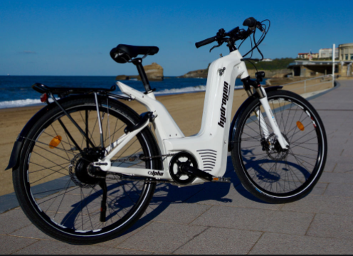
Hydrogen Usage
Hydrogen, known and used since 18th century
1783 in balloons and blimps as lighter-than-air gas
1830 for illumination and heating as city gas
1960s in fuel cells for electricity – terrestrial vehicles and Gemini and Apollo missions
In fuel cells for mobility sector
Bus, car, boat, train, tramway, truck, forklift, scooter, bicycle
30,000 vehicles by 2018
>80,000 expected by 2020
>300,000 expected by 2025
Civil drones

Slide 8
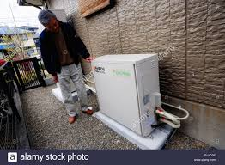
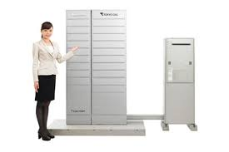
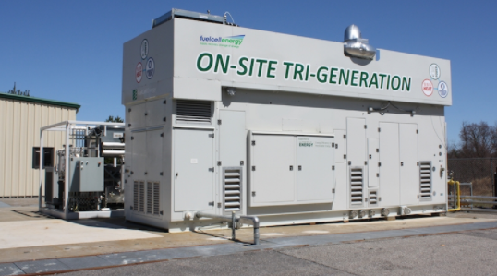
Hydrogen Usage
Green energy source for residential and industrial applications
Source of heat and electricity
Remote locations benefit from independency from normal grid
Government Programs:
EneFarm (Japan) : 250,000 units in 2018
Ene.field + PACE (Europe) : 3,500 units by 2021
Megawatts power source plants as primary and backup for whole neighborhoods, buildings and industries
South Korea and USA are major players

Slide 9
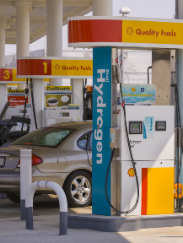
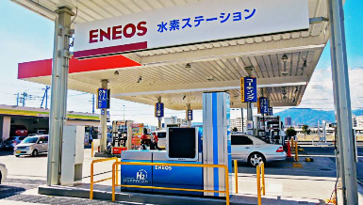
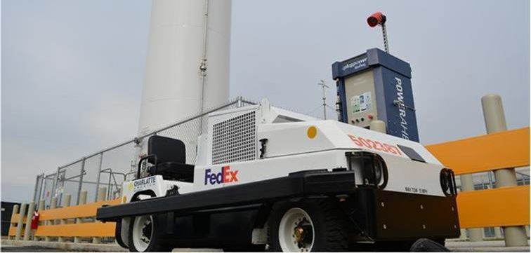
Hydrogen Usage
Hydrogen Refueling Stations (HRS)
325 HRS (for cars and buses) in operation worldwide in 2019
Expected > 1000 HRS by 2025
12,000 vehicles served daily
Near 10,000 forklifts fueled daily in storehouses
Introduction of HRS on airfields will be straightforward
Demonstration projects conducted in several airports

Slide 10
Hydrogen Usage
Hydrogen in the Energy Transition
Central component for energy transition
Proposed as the foundation of a sustainable low-carbon economy
Contribute to Paris Agreement objectives against global warming
May play 7 major roles*:
Enabling large-scale renewable energy integration and power generation
Distributing energy across sectors and regions
Acting as a buffer to increase energy system resilience
Decarbonizing transportation
Decarbonizing industrial energy use
Helping to decarbonize building heat and power
Providing clean feedstock for industry
Ambitious nation-wide initiatives already trigger Hydrogen economy
Japan, South Korea, Germany, USA
*Hydrogen Council (https://hydrogencouncil.com/en/)

Slide 11
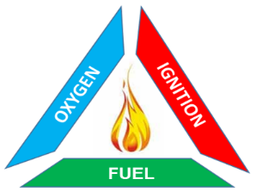
Hazards and Mitigations
Fire Hazard
Contrast with jet fuel storage
Segregated from air
No ignition risk inside the tank
No need for tank inerting
Overboard ventilation
Purging/inerting for plumbing
Centralized tanks
Reduced number of zones prone to leakages
Double wall for separation & segregation of leakages
Explosion proof qualification for electric equipment
Sensors
Hydrogen Concentration
Oxygen Concentration
Fire Detection
Optical
Thermal

Slide 12
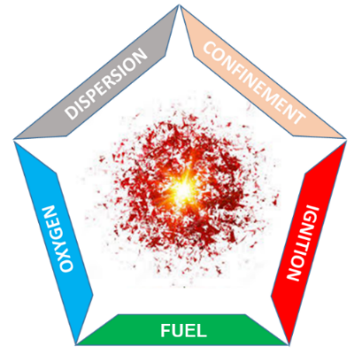
Hazards and Mitigations
Explosion Hazard
Prevent leakages
Double wall concept
Prevent accumulation
Provided ventilation, purging and dump valves
Pressure Hazard
Addressed as other pressurized vessels already used in airplanes
Such as Oxygen, fire extinguishing, hydraulic accumulators, etc.
Liquid Hydrogen cryogenic (-253°C/-423°F) hazard
Prevent leakages
Double wall concept
Insulation to mitigate contact with low temperatures surface
Prevent trapping of LH2/pressure build up
Overpressure relief devices
Prevent embrittlement with proper materials

Slide 13
Benefits for Airborne Applications
Benefits More Electric Airplanes (MEA)
Hydrogen as clean energy carrier
Better efficiency
Reduction of fuel consumption
Reduction of emissions
Fewer energy vectors on-board (electricity)
Usable by-products
Heat for cabin and galleys
Water for galleys and toilets
Oxygen Depleted Air (ODA) as inerting for cargo and fuel tanks

Slide 14
Conclusions
Proliferating electric vehicles
Fuel cell vehicles
Greater range than batteries
Refueling time comparable to regular fuels
#1 automotive trend
Significant benefits to fuel cells in aviation
Hydrogen is safe to use
Insights and lessons learned from other sectors will benefit aviation
Availability of hydrogen for ground mobility will reduce barriers for aviation
Key technology for upcoming more (and all) electric aircraft

Slide 15
THANK YOU

Slide 16
Joint EUROCAE/SAE Hydrogen Fuel Cells Standardization Group WG-80/AE-7AFC
Working Group Chairman
Olivier Savin
Dassault Aviation
olivier.savin@dassault-aviation.com

