Slide 1
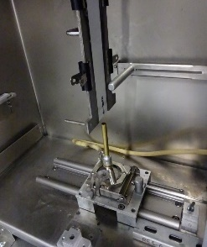
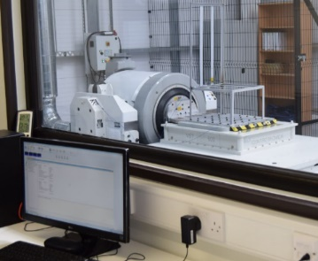
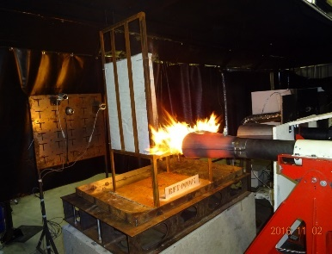
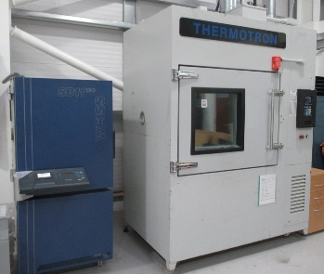
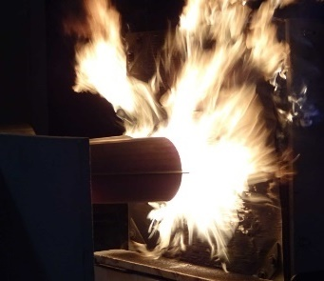
Assessment of Carlin 200 CRD and 201 CRD burners as approved Burners
2019-10-29
Presented by: TOM MALLON (Resonate)

Slide 2
Summary
The attached material highlights that Carlin burners remain obtainable.
Contrary to popular opinion the burners have not been discontinued, rather a simple mod rolled the 200CRD to the 201CRD. We shall review this within this presentation.
The 200 CRD and 201 CRD are almost entirely physically interchangeable.
Replacement parts for the 200 CRD (not fabricated since October 1986) may be sourced using 201 CRD parts.
Resonate Testing adopt a position of using modified 201 CRD burners and demonstrating that they are comparable to the modified 200 CRD burner approved by the FAA.
Please note that there is no financial or commercial links between the company or its employee’s with Carlin Burners or its agents.

Slide 3
Introduction and backdrop
Currently we are awaiting the introduction of the Sonic Burner; with the added development that the release of AC20-135 Change 1 removes the propane burner as an acceptable means of compliance for propulsions grade fire testing.
Furthermore the industry working groups are attempting to standardise best practice with the evaluation of the impact of hardware (TC’s, Copper tube etc) and standardise procedures.
The problem we face is how to use ‘approved burners’ (FAA Engineering report 3A, SAE AIR1377)
Contrary to popular opinion the burners have not been discontinued, rather a simple mod rolled the 200CRD to the 201CRD. We shall review this within this presentation.
The good news is that the burners are available, readily available – off the shelf, and available to the global community.

Slide 4
The Benefits
While what is presented is a means of compliance to the issue of ‘Approved Burners’ it is not the only means.
However if the industry moves to standardise on the Carlin burner then potentially we have moved closer to standardisation and removed variability. Resonate Testing position is that the impact of the turbulator is significant in the regularisation of the flame.
We could collectively benefit from reduced variability in the number of burners available and currently in use.
Help new entrants seeking to equip, and reassure witnesses of use approved burners.
Ensure spares are available. Thus hardware conformity for years to come.
Another point to note is that the FAA documentation always referred to a modified Carlin. The 200CRD was always to be modified.
Lets look at the burners….

Slide 5
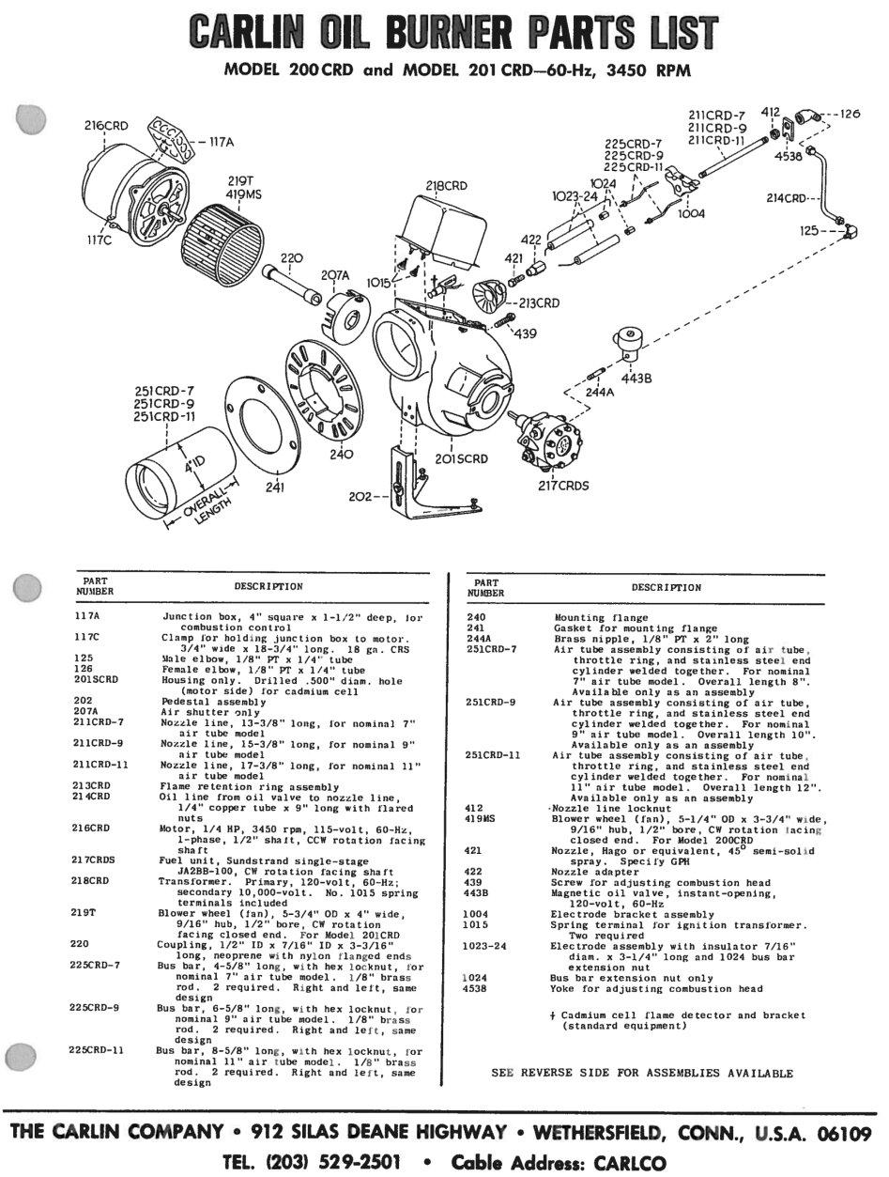
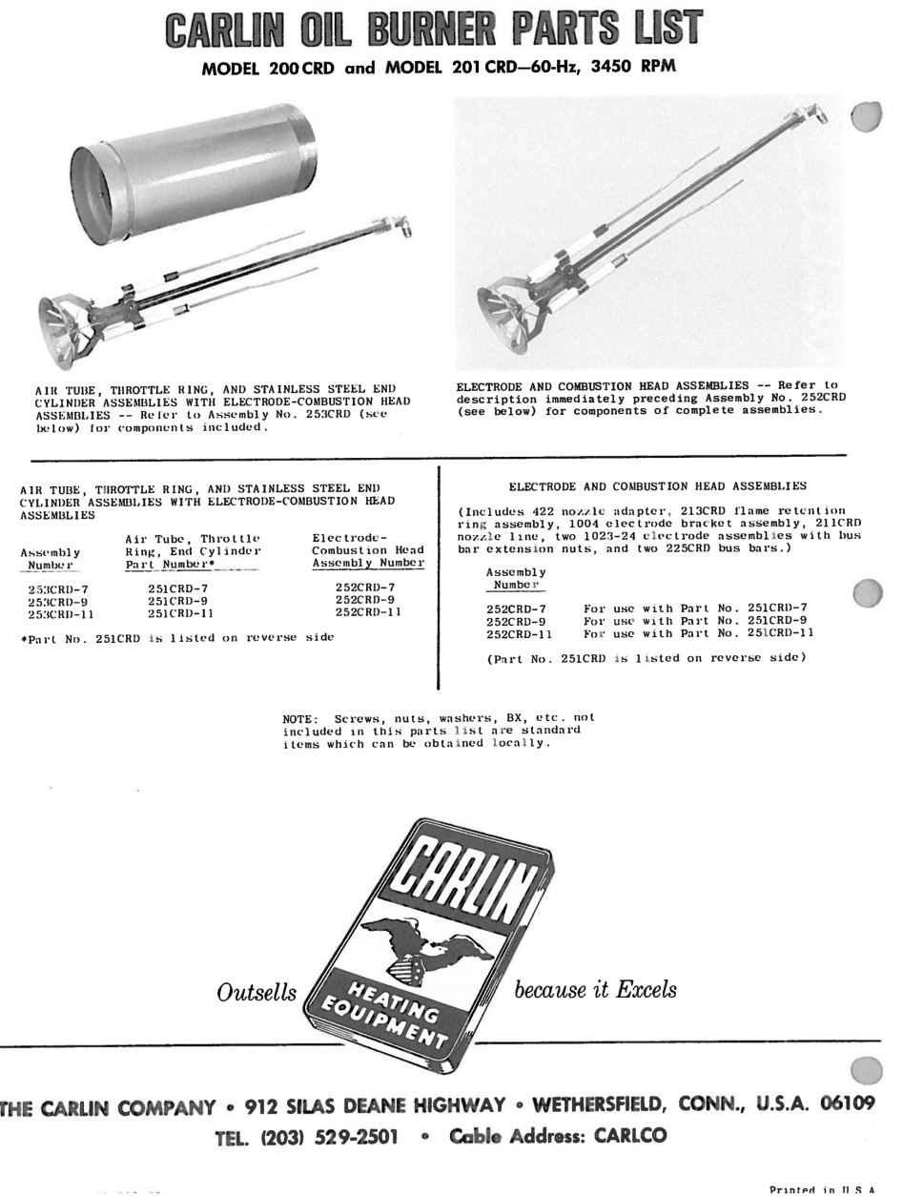
The Carlin 200 CRD and 201 CRD are interchangeable with one exception, the blower wheel (squirrel cage)

Slide 6
Reference documents
Carlin 201 CRD Instruction Manual Maintenance Instructions Included | Carlin 201 CRD Replacement Parts. | Carlin technical engineers have confirmed that the Carlin 200 CRD is unavailable since October 1986 (approximately 30 years) however the Carlin 201 CRD is physically interchangeable with one exception. The blower wheel (squirrel cage) differs between the 200 CRD and the 201 CRD 200 CRD 5 ¼” x3 ¾” ½” bore 201 CRD 5 ¾” x 4” ½” bore The conversion for Resonate requires the following motor conforming to 220/240 vac: 1/4 HP, 3450 rpm, Carlin PSC part number 99220 The blower wheel, is no longer available from Carlin, And would need to be sourced elsewhere
Carlin 200 CRD & 201 CRD Manual Maintenance Instructions Included | Carlin 201 CRD Parts Breakdown

Slide 7
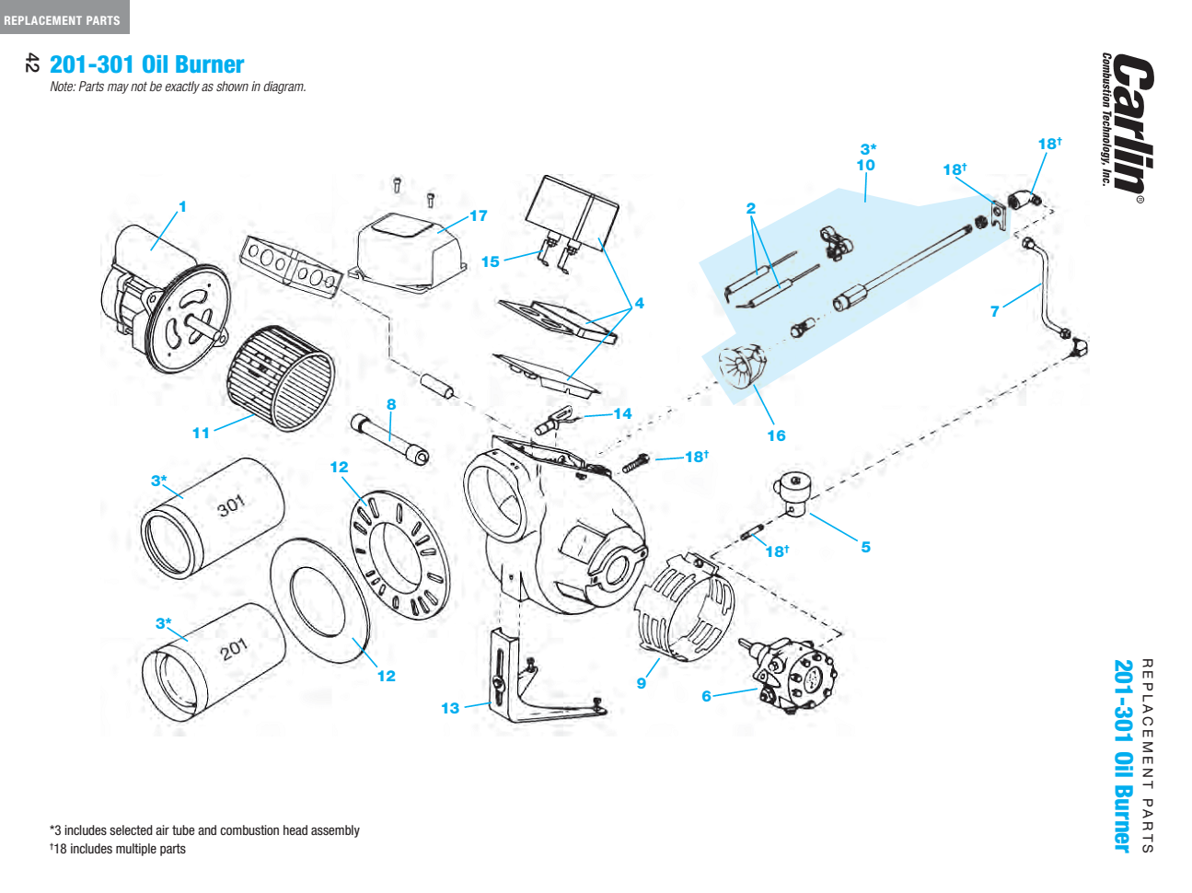
Burner illustrated parts catalogue
For the 200/201 CRD this is the only change, i.e. fan/ squirrel cage. Resonate Testing Note

Slide 8
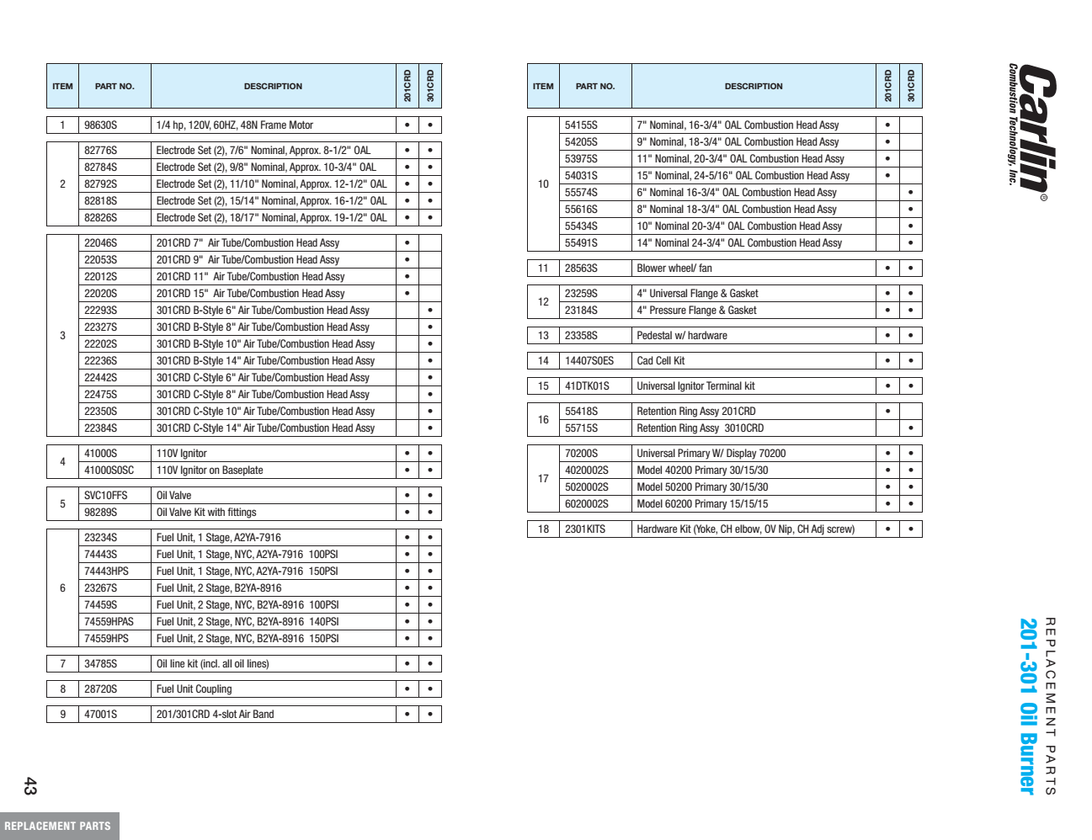
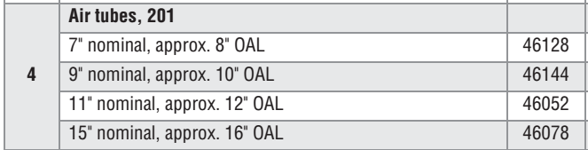

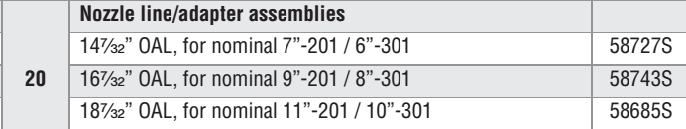

Slide 9
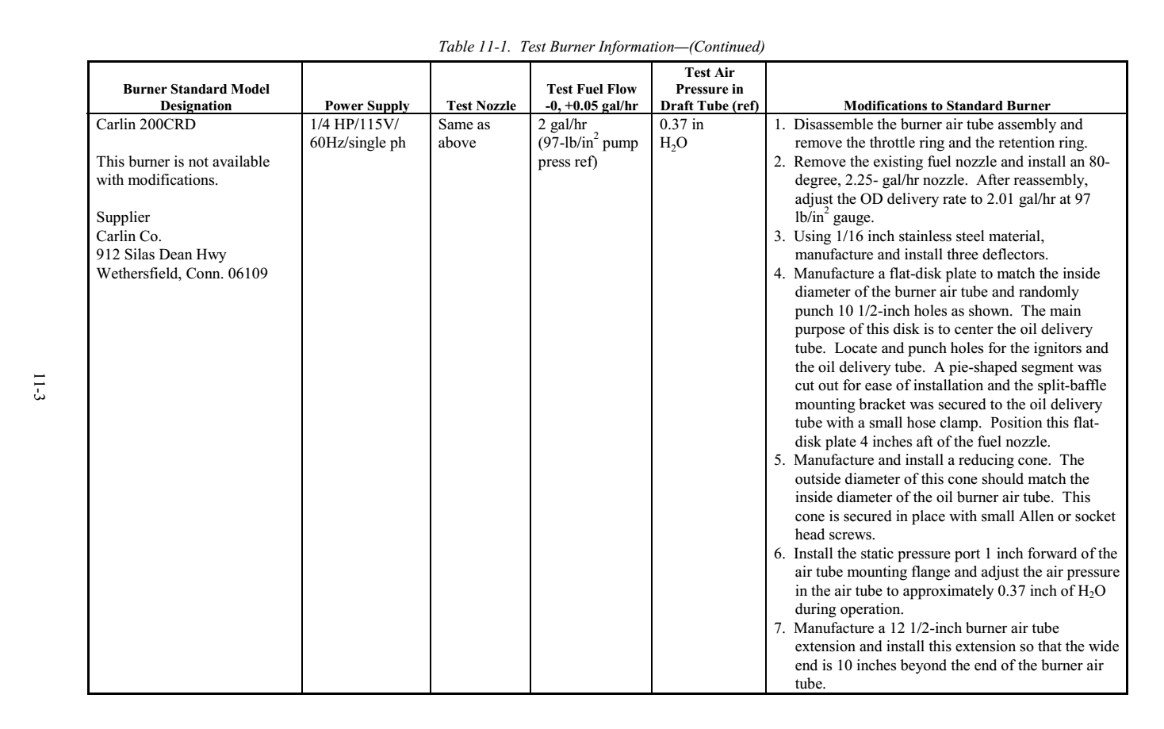
What the FAA say……….

Slide 10
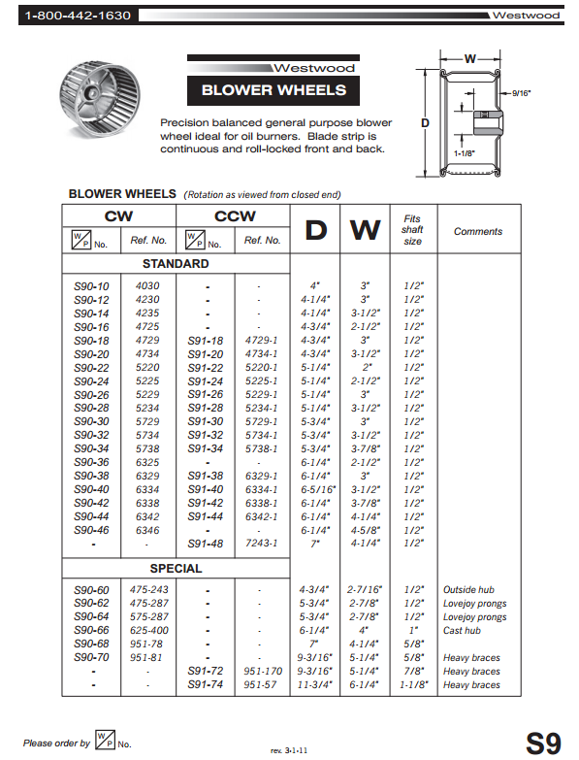
We want 5 ¼” x 3 ¾”

Slide 11
Engineering Report 3A :
Evaluation for Carlin Burner

Slide 12
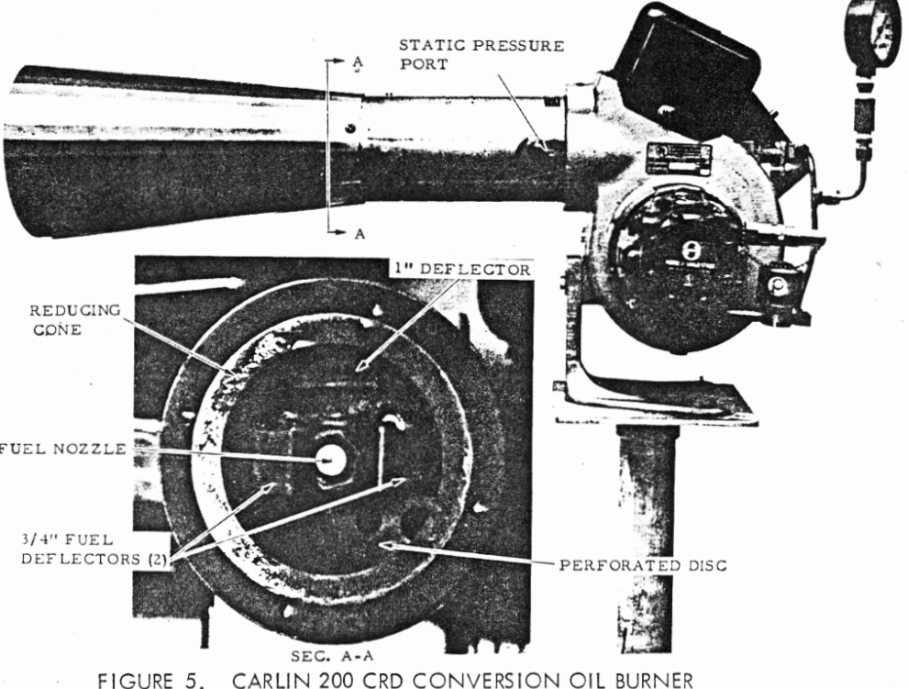

Slide 13
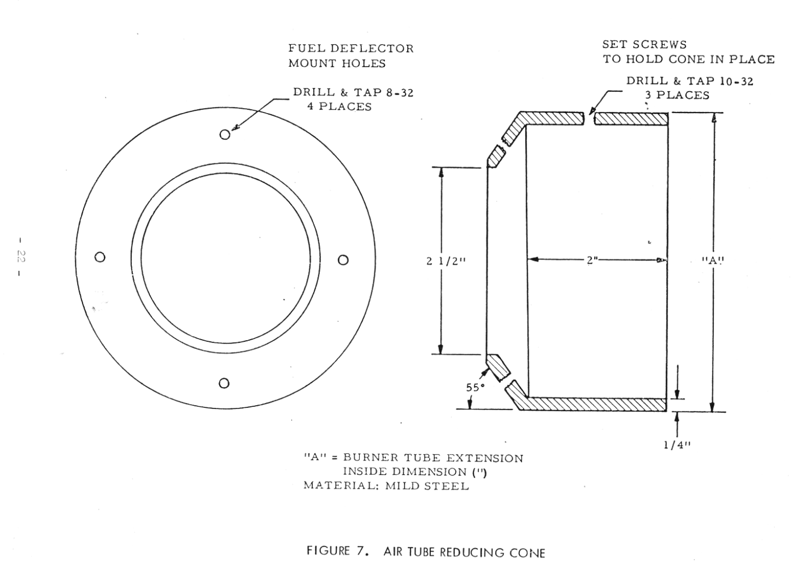

Slide 14
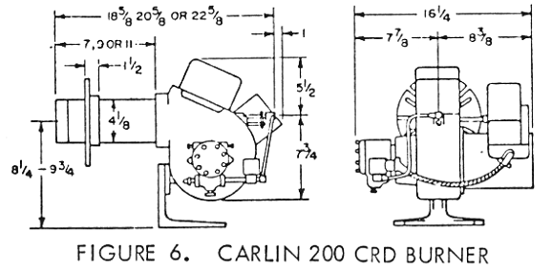

Slide 15
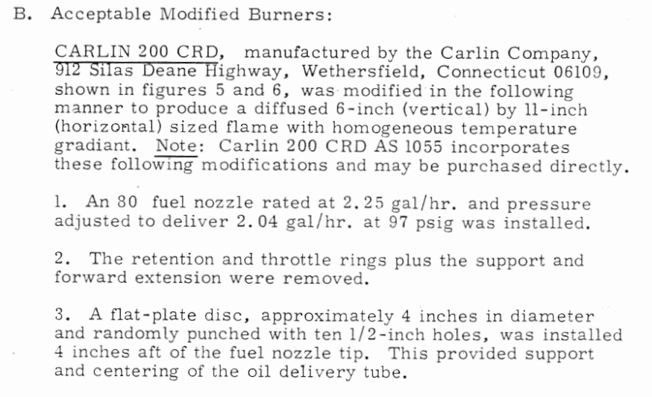
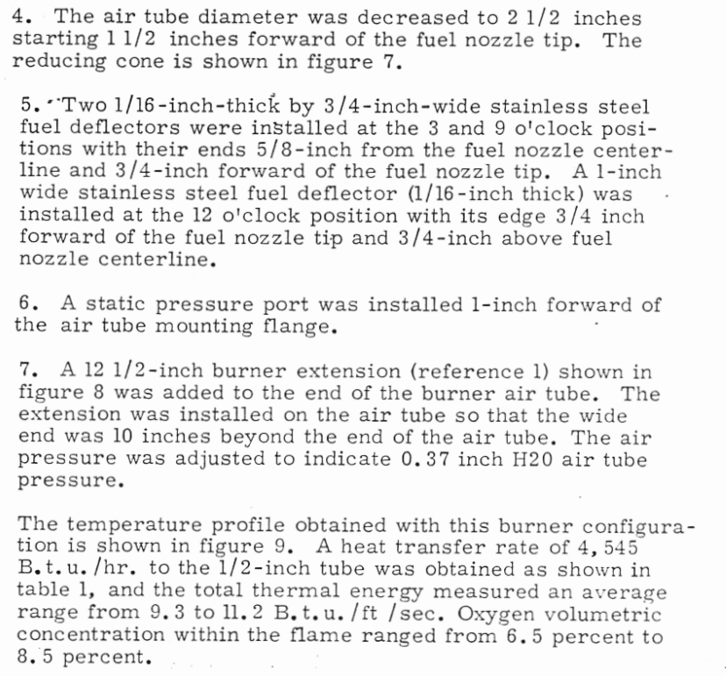
Engineering Report 3A Text:

Slide 16
Looking to the modern requirements
While we focus on ‘approved’ burners we should also consider other factors.
The motor frequency is 60Hz, most of the rest of the world us 50Hz (Japan use both).
We witness increasing international regularisation forward 2000F min average flame temperature.
The flame temperature mapping is attracting increasing attention and with that the requirement to demonstrate an area approximating to the min temperature requirements.
Post test calibration for Temperature and Heat Flux have driven test levels higher to ensure tests are not invalidated.
Therefore the question is raised are the approved burners , their definition and setup still appropriate for the modern requirements

Slide 17
Tom Mallon
Managing Director
tommallon@thenacellegroup.com
Notes:
Excel Data available on request
Contact details

