Slide 1

Research on the Flame Characteristics of the Oil Burner
FEI XIE
Test Center of CAAC

Slide 2
TOPICS
Configurations of Carlin 200 and FAA NexGen Burner
The Effect of Fuel on the Flame Characteristics
The Effect of Air on the Flame Characteristics
The Effect of Fuel/Air Ratio on the Flame Characteristics
The Effect of Typical Configurations on the Flame Characteristics

Slide 3
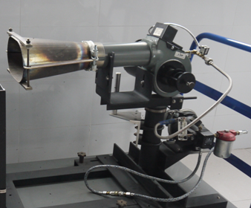
Oil Burner
NexGen
Carlin 200

Slide 4
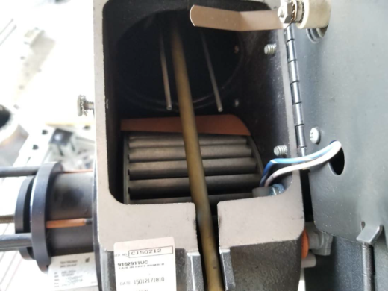
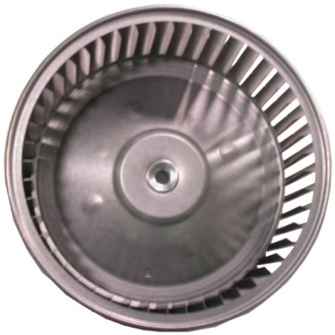
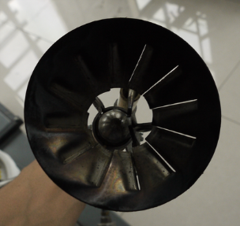
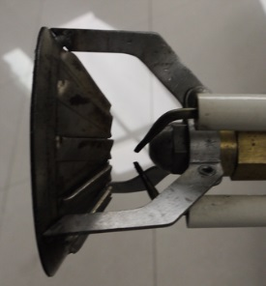
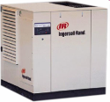
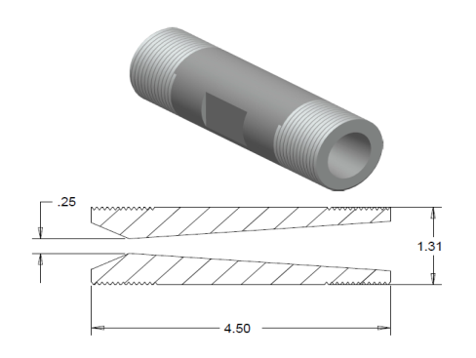
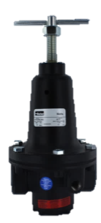
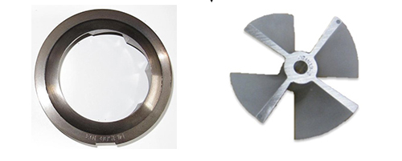
Oil Burner
(a) Airflow Path in the Carlin 200
(b) Airflow Path in the NexGen

Slide 5
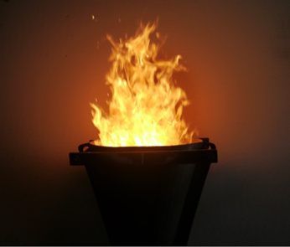
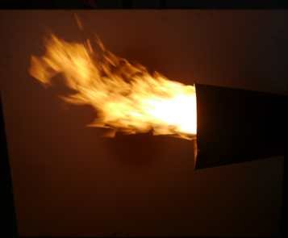
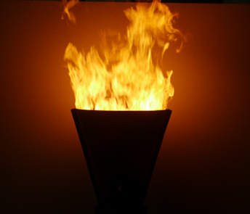
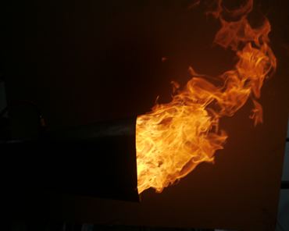
Flame Shape
Delavan 2.0 gallon/hour 80-degree solid spray pattern (WDB-type) spray nozzle
Carlin 200
NexGen

Slide 6
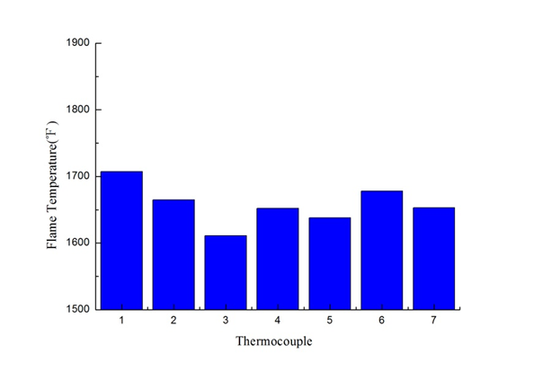
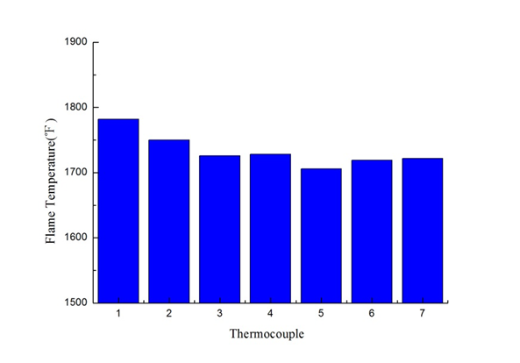
Oil Burner
Delavan 2.0 gallon/hour 80-degree solid spray pattern (WDB-type) spray nozzle
(a) Carlin 200, 2gal/h, 125Psi, 4inch
(b) NexGen, 2gal/h ,125Psi, 4inch

Slide 7
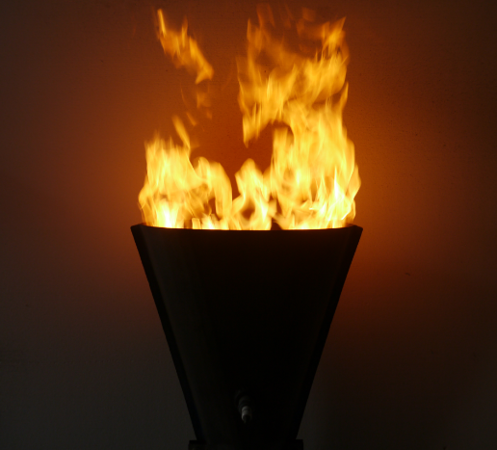
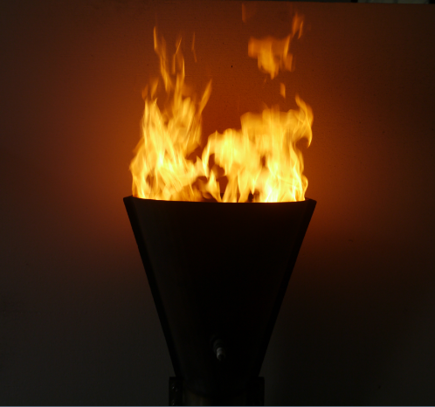
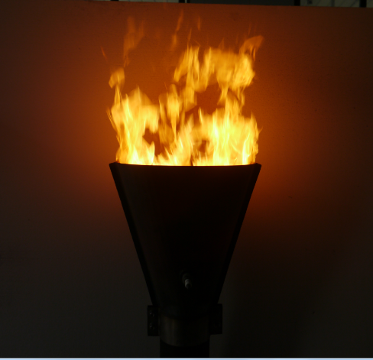
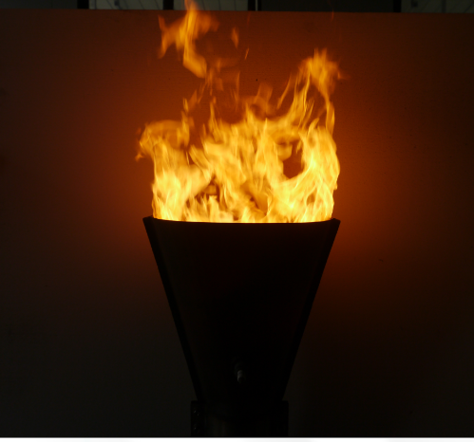
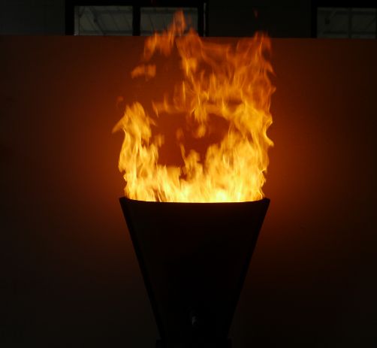
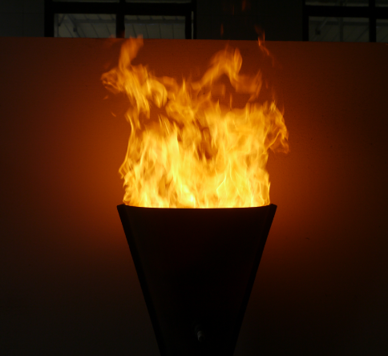
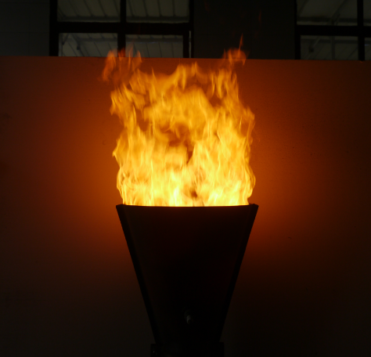
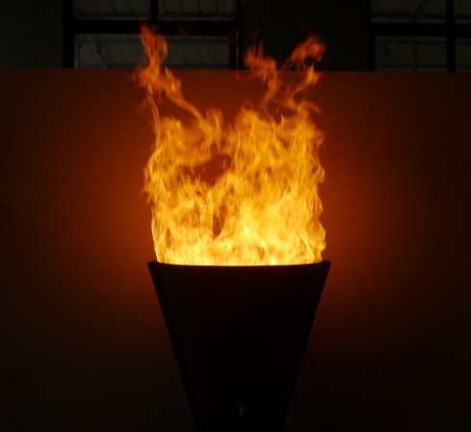
Fuel Pressure (NexGen, Air Pressure=45 Psi)
80psi
90psi
100psi
110psi
120psi
130psi
140psi
150psi

Slide 8
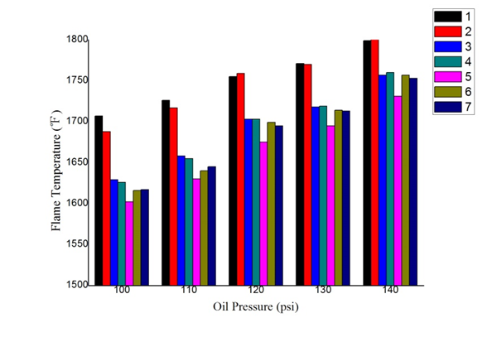
Fuel Pressure (NexGen, Air Pressure=45 Psi, 4 inch)

Slide 9
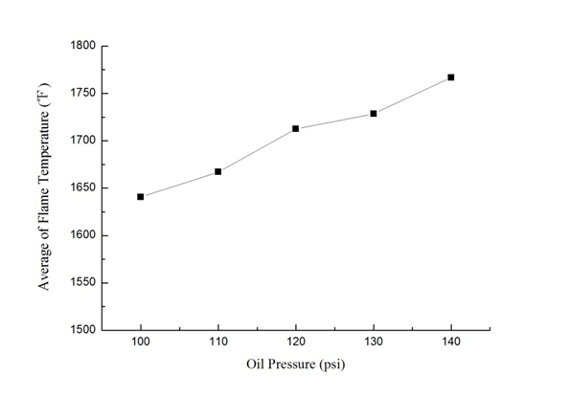
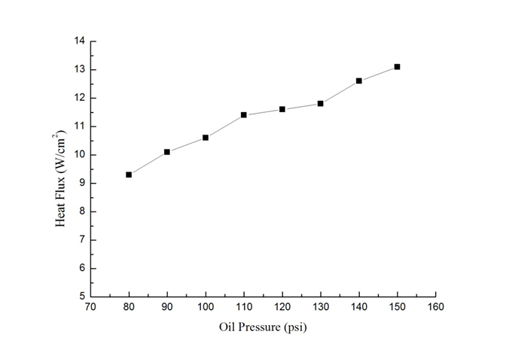
Fuel Pressure (NexGen, Air Pressure=45 Psi, 4inch, Horizontal)

Slide 10
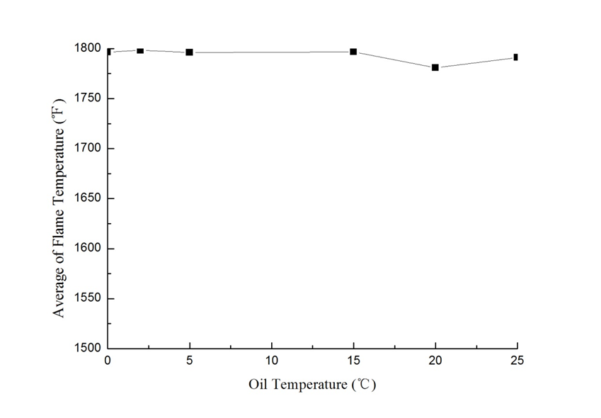
Fuel Pressure (NexGen, Air Pressure=45 Psi, 4 inch)
Air Temperature=5~15℃

Slide 11
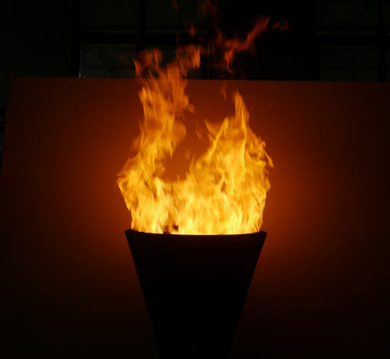
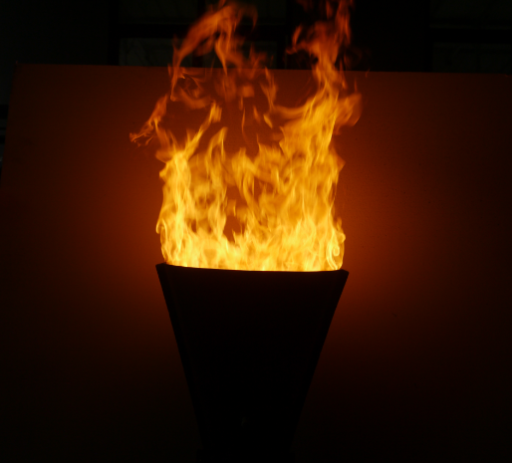
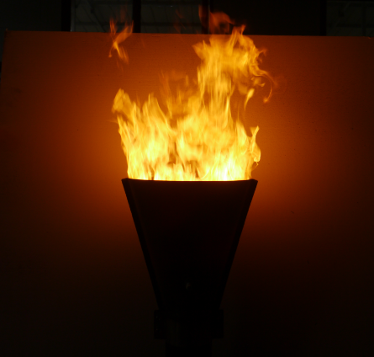
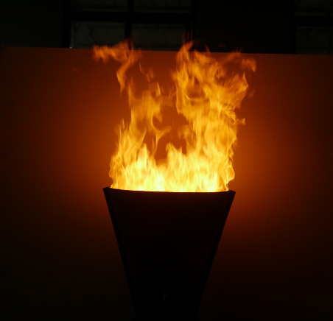
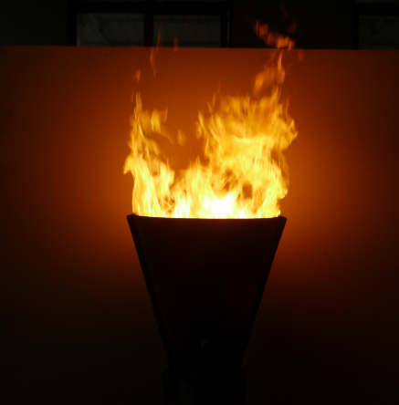
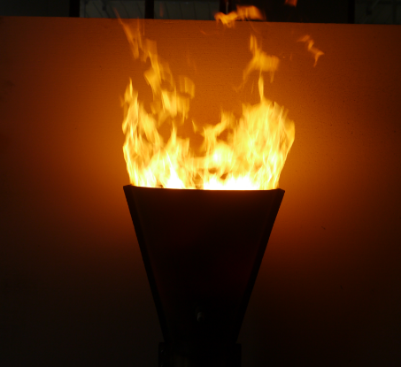
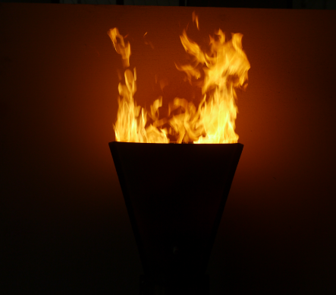
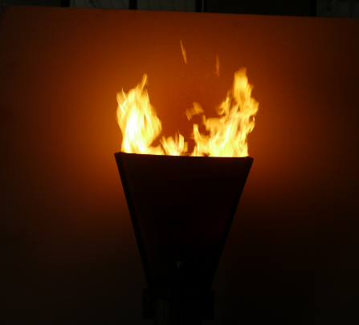
Air Pressure (NexGen, Fuel Pressure = 125 Psi, 4 inch)
40psi
42psi
45psi
48psi
50psi
52psi
55psi
60psi

Slide 12
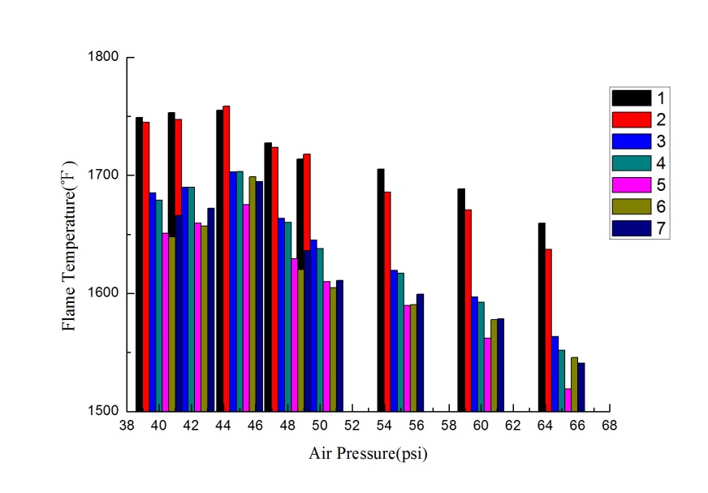
Air Pressure (NexGen, Fuel Pressure = 125 Psi, 4 inch)

Slide 13
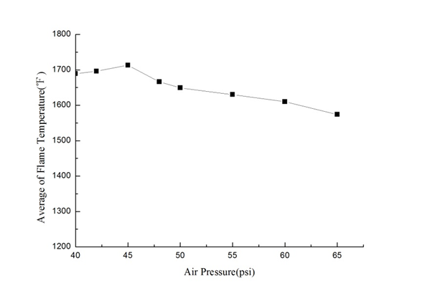
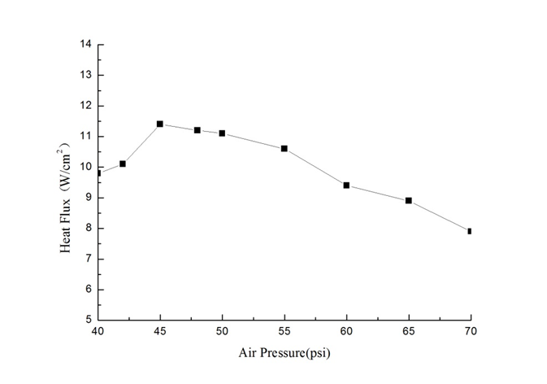
Air Pressure (NexGen, Fuel Pressure = 125 Psi, 4 inch)

Slide 14
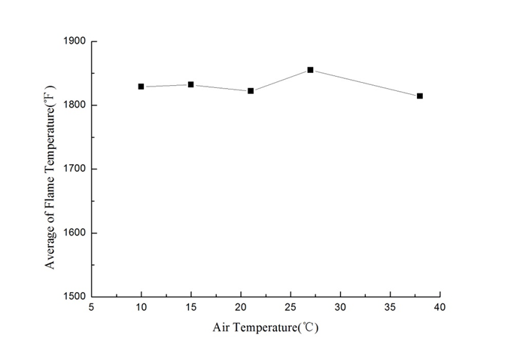
Air Pressure (NexGen, Fuel Pressure = 125 Psi, 4 inch)
Fuel Temperature=0~5℃

Slide 15
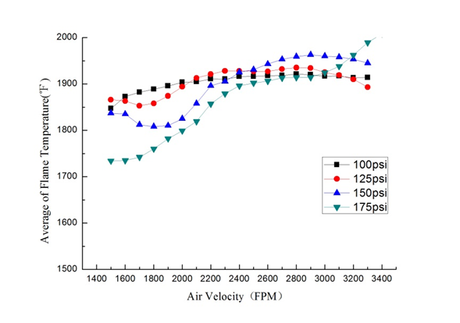
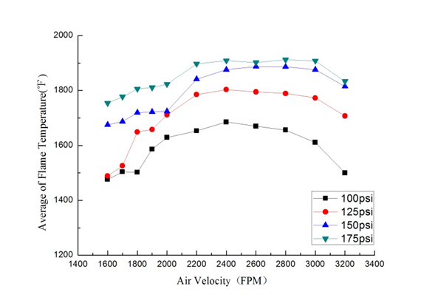
Fuel/Air Ratio (Carlin 200)
Horizontal
Vertical

Slide 16
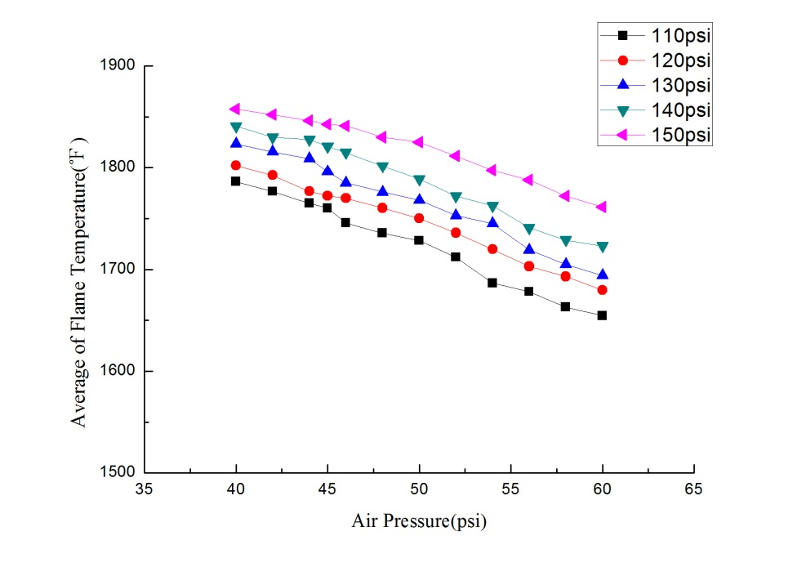
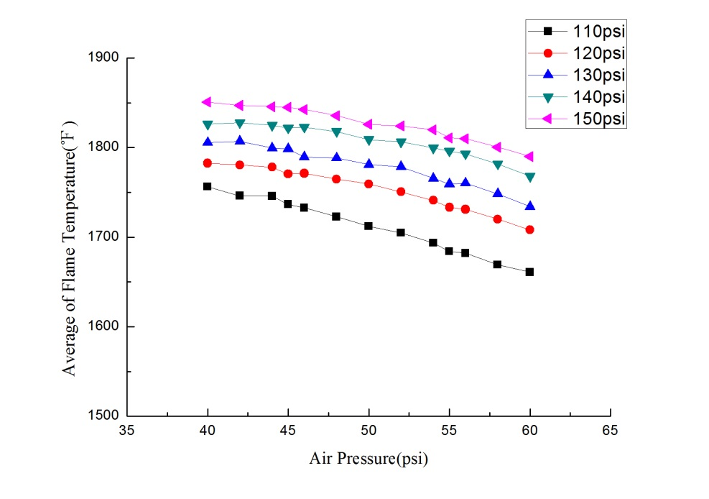
Fuel/Air Ratio (NexGen)
Horizontal
Vertical

Slide 17
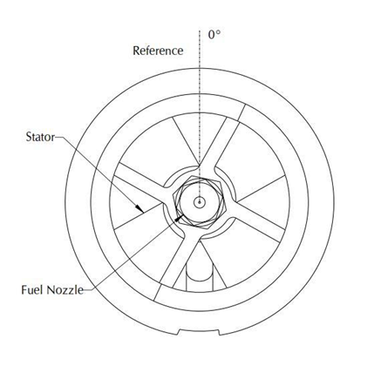
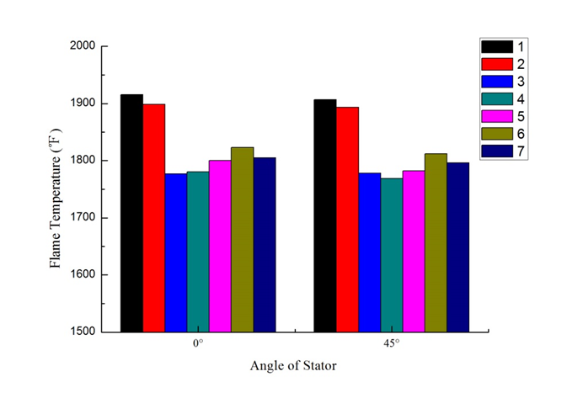
Configuration (NexGen, Stator Position)

Slide 18
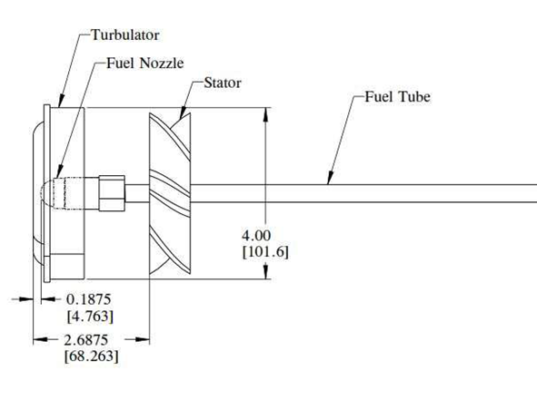
Configuration (NexGen, Stator Distance)

Slide 19
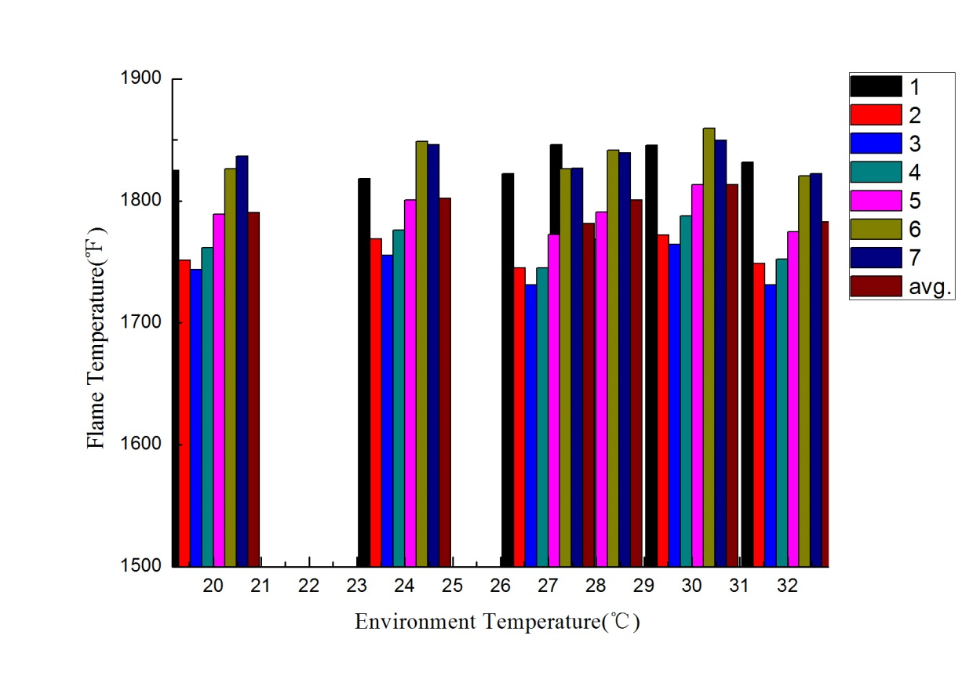
Enviroment (NexGen, Enviroment Temperature)

Slide 20
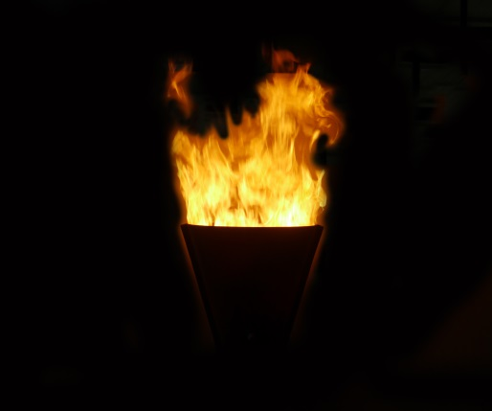
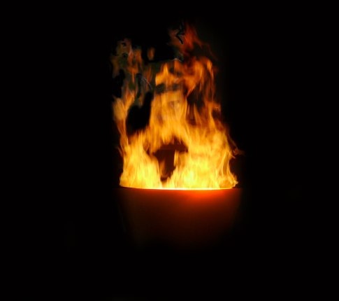

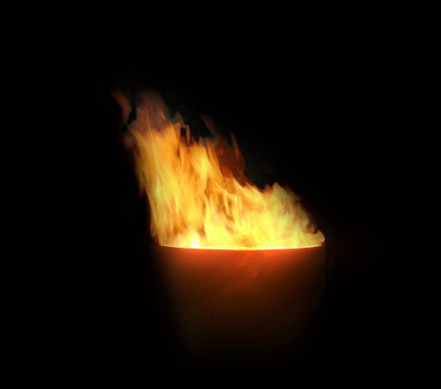

Enviroment (NexGen, Air Velocity, 0⁰ Flow, Vertical , 2GPH)
0 m/s
0.5 m/s
1.0 m/s
1.5 m/s
2.0 m/s

Slide 21




Enviroment (NexGen, Air Velocity, -30⁰ Flow, Vertical , 2GPH)
0 m/s
0.5 m/s
1.0 m/s
1.5 m/s
2.0 m/s

Slide 22



Enviroment (NexGen, Air Velocity, +30⁰ Flow, Vertical , 2GPH)
0 m/s
0.5 m/s
1.0 m/s
1.5 m/s

Slide 23




Enviroment (NexGen, Air Velocity, +60⁰ Flow, Vertical , 2GPH)
0 m/s
0.5 m/s
1.0 m/s
1.5 m/s
2.0 m/s

Slide 24


Enviroment (NexGen, Air Velocity)
0⁰
-30⁰

Slide 25


Enviroment (NexGen, Air Velocity)
+60⁰
+30⁰

Slide 26




Flame Temperature (NexGen, Horizontal, 2GPH)
2 inch
4 inch
6 inch

Slide 27

Flame Temperature (NexGen, Vertical, 2GPH)
2 inch
4 inch
6 inch

Slide 28
FEI XIE
ADD: No.765 Tengfei Rd, Southwest Airport Economic Development Zone, chengdu, Sichuan, P. R. China
Tel: 8628-64456018
Email: xiefei@fccc.org.cn

Slide 29
Thank you

