Slide 1
The Ninth Triennial International Fire & Cabin Safety Research Conference
Concerns with Baseline Fire Barrier Recommendations of FAA AC 20-135
28-31 October 2019
Greg Roberts
Northrop Grumman Corp.
Aerospace Systems

Slide 2
Fire Barrier Requirements

Slide 3
What Is A Fire Zone?
MIL-HDBK-221
Compartments which contain flammable fluid components with potential leakage, and, potential ignition sources, if the following applies:
One “single failure” can cause a fire or explosion. A combustor and turbine compartment is in this category if it contains external flammable fluid lines with leakage potential as well as an unprotected engine case hot enough to ignite the flammable fluid, or when a combustor burn through can cause leakage from the flammable fluid lines.
A dual failure is needed to cause ignition, but the flammable fluid components and potential ignition sources are not sufficient~ separated and shielded, or are present in high concentration, so that contact of flammable fluid and vapor with ignition sources by gravity, ventilation airflow or squirt is likely. Accessory sections of engines are, and hydraulic and fuel service centers may be in this category
Similar to Definitions in JSSG 2009 and AC 20-135

Slide 4
Where Is A Fire Zone
External fire zones
Hanging from wing
Engine Bays
Commercial jets
Fire barrier backside temperature cooled by surrounding airflow
Internal fire zones
Internal to fuselage
Engine Bays
Modern Military Jets
Conceptual Commercial Jets
Auxiliary Power Units
Commercial Jets
Military Jets
Fire barrier backside temperature transmitted to surrounding structure and adjacent bays
Internal Fire Zones Are Common On Military Aircraft

Slide 5
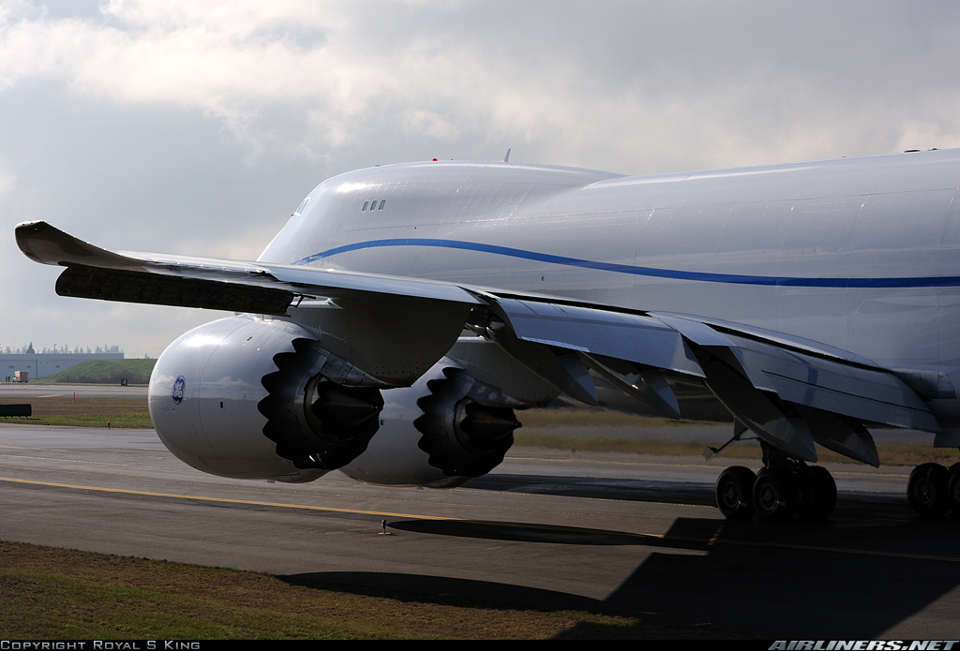
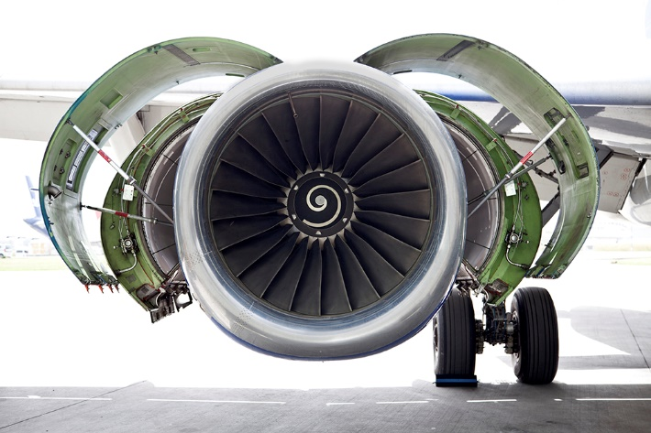
External Fire Zones
Photo: Airline world – WordPress.com
Photo: Honest Version – Global Engine Nacelle Market 2019: Industry Growth, Size, Share and Analysis 2025

Slide 6
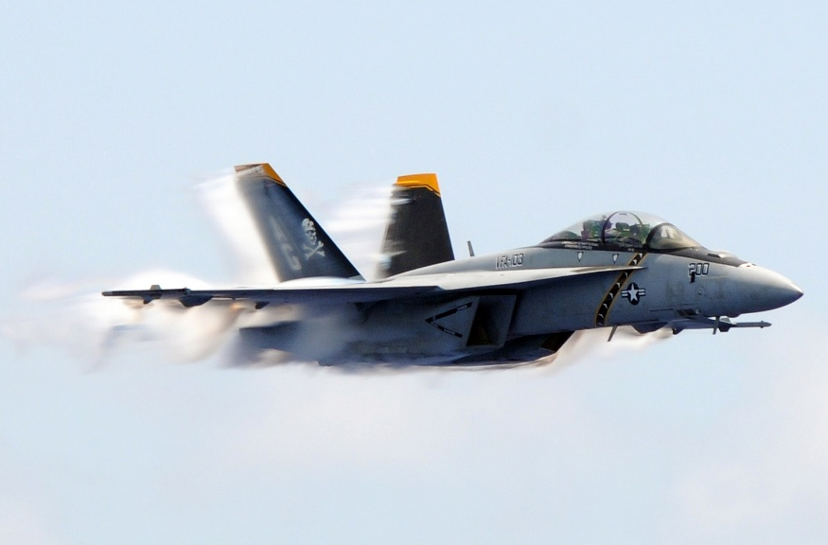
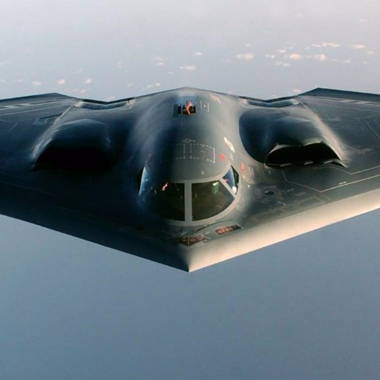
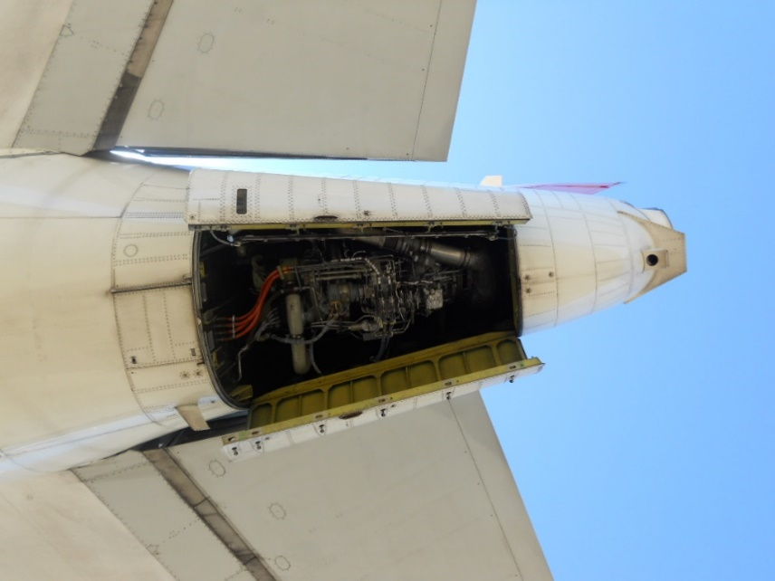
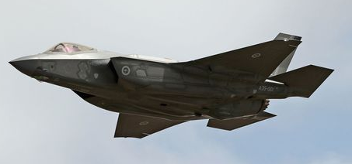
Internal Fire Zones
Photo US Navy - Released
Photo: B-2 Stealth Bomber (@Whiteman AFB) | Twitter
Photo: Popular Mechanics
Photo: uaminc.blogspot.com

Slide 7
Fire Barrier Requirements
Fire Barrier shall be fireproof
Temperature = 2000°F
Heat Flux Density > 9.3 BTU/ft² sec.
Time = 15 minutes
Previously Tested, Known Materials
Stainless steel sheet, .015 inch thick.
Mild steel sheet protected against corrosion, .018 inch thick.
Titanium sheet, .016 inch thick.
Monel metal sheet, .018 inch thick
Steel or copper base alloy firewall fittings/fasteners
Fire Zones Are Contained By Fire Barriers

Slide 8
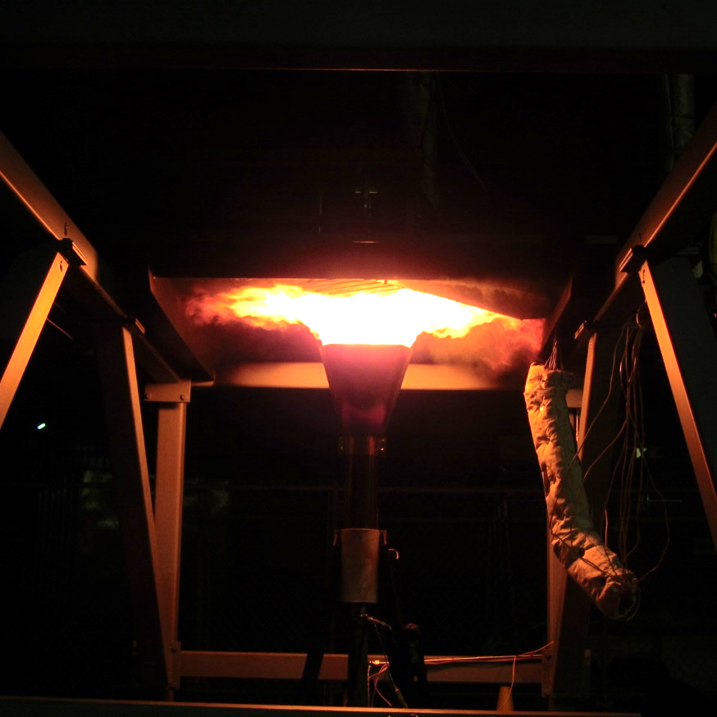
Fire Barrier Testing
Photo: NGC Fire Barrier Test Stand - Courtesy Area 67

Slide 9
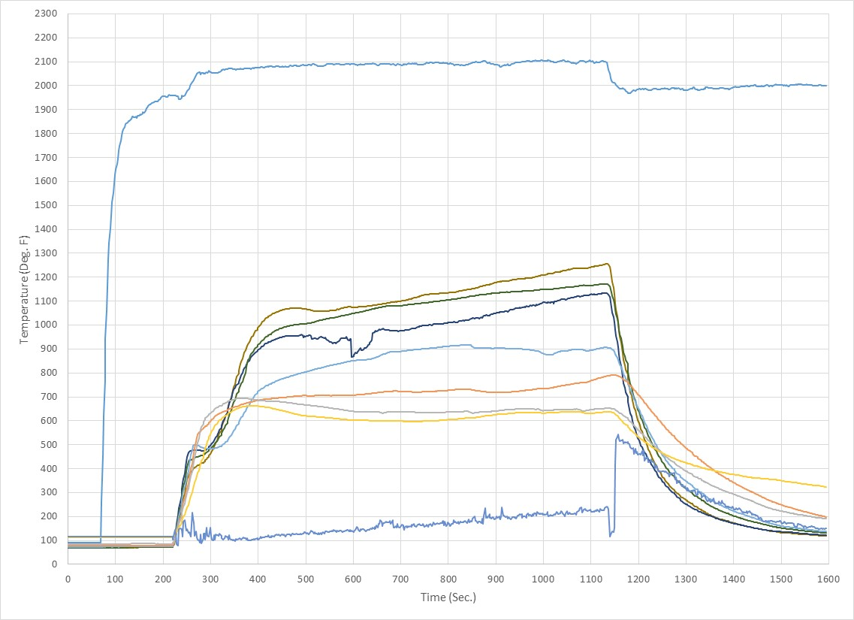
Backside Temperatures – Graphite/Epoxy 0.25”Thick
Flame Temp
Jet A MHSIT
Jet A AI

Slide 10
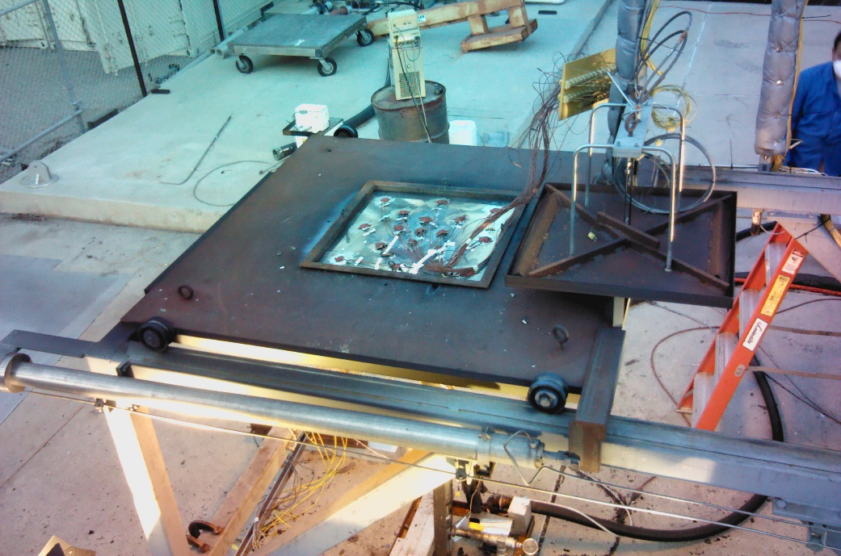
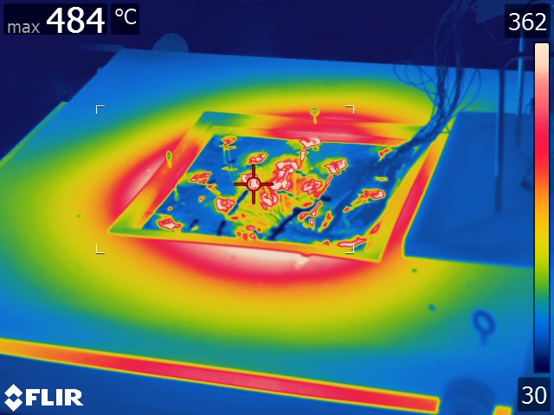
Backside Temperatures – 7075-T6 0.125” Thick
Photo: NGC Fire Barrier Test Stand - Courtesy Area 67
Photo: NGC Fire Barrier Test Stand - Courtesy Area 67

Slide 11
Fire Barrier Testing
Observations
The graphite/epoxy samples neither burned through nor experienced a backside fire resulting from a 15 minute exposure to the fire
In all cases, the backside thermocouple data exceeded the autoignition temperature of the fuel
In some cases, the backside thermocouple data exceed the minimum hot surface ignition temperature of the fuel

Slide 12
Recommendations
When updating AC 20-135, consider/examine effects of internal fire zone backside temperature on adjacent bays with:
Temperature sensitive primary structure
Graphite/Epoxy Composite
Flammable Contents (Flammable Zones)
Flammable Leakage (Flammable Leakage Zone)

