Slide 1
An Air Framer’s Pursuit of AC 20-135 Testing
Presented By:
Bryan Calungcagin
Greg Roberts
Approved for public release; NG19-1520
© 2019 Northrop Grumman Systems Corporation. All Rights Reserved.

Slide 2
Introduction
Northrop Grumman (NGC) is a prime military aircraft contactor. Not the type of company one would expect to do applied aircraft fire research. When presented with the opportunity to crate the capability to test materials for compliance to “fire resistant” or “fire-proof” requirements per the FAA’s AC 20-135, POWERPLANT INSTALLATION AND PROPULSION SYSTEM COMPONENT FIRE PROTECTION TEST METHODS, STANDARDS, AND CRITERIA, NGC took it. To execute this project, NGC Engineering turned to one of our more obscure test facilities at our Space Park Center of Excellence, “Area 67”. Once funding was secured, the team laid out a plan. With all of the readily accessible information on aircraft fire testing, including material from the FAA’s Next Generation Burner accumulated from the FAA’s Triennial International Fire & Cabin Safety Research Conference in hand, the team set off to work.
This presentation will describe the efforts and “adventures” that took Northrop Grumman from no fire test capability to operating a facility that would rival any specialty test house in the country. We offer this and our lessons learned so that anyone attempting to follow in our footsteps can avoid the hidden pitfalls (we managed to hit most of them) in setting up your test facility and join us in working to design aircraft fire protection systems that allow all of our military flight crews to make it home after every mission.
Approved for public release; NG19-1520
© 2019 Northrop Grumman Systems Corporation. All Rights Reserved.

Slide 3
Northrop Grumman’s Area 67
Aircraft design engineers needed a way to challenge fire barrier material against fire. They turned to a facility located at the Space Park Center of Excellence in Redondo Beach California known as Area 67. Area 67 is a Concept Development, Rapid Design and Testing Facility. Through extensive concept and design discussions, the panel comprised of aircraft design engineers and Area 67 engineers agreed that in order to truly evaluate a fire barrier material, the material had to be challenged against the worst case scenario.
Area 67: Concept Development, Rapid Design and Testing Facility
Approved for public release; NG19-1520
© 2019 Northrop Grumman Systems Corporation. All Rights Reserved.

Slide 4
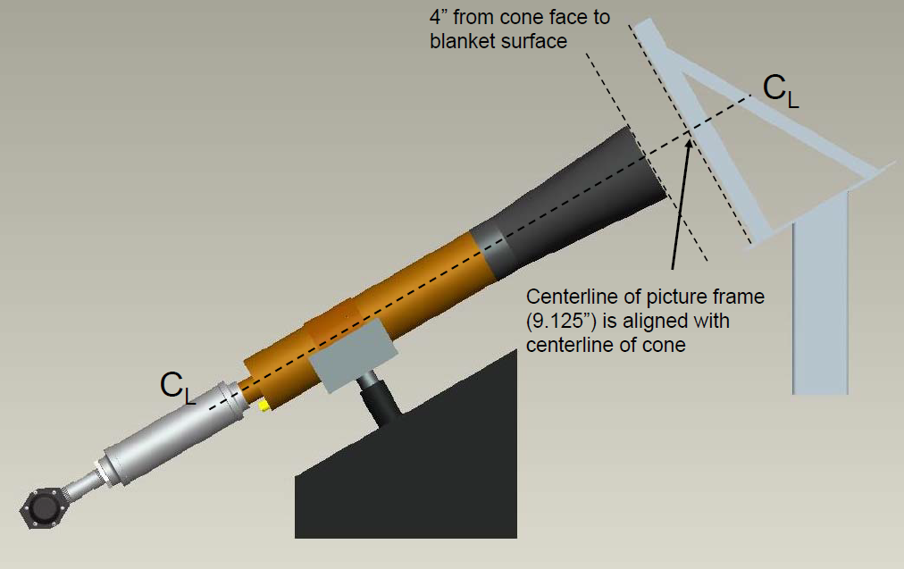
FAA AC20-135 Next Gen Fire Burner
Using the guidelines of the FAA AC20-135 and the Next Generation Fire Test Burner Plans, they procured the next generation burner.
The standard orientation of the burner was either mounted at 45° angle or an intermediate angle configuration. They believed that the worst case scenario was to subject the test articles in the vertical direction. This was the driving force behind the vertical orientation of the fire challenge test stand.
Approved for public release; NG19-1520
© 2019 Northrop Grumman Systems Corporation. All Rights Reserved.

Slide 5
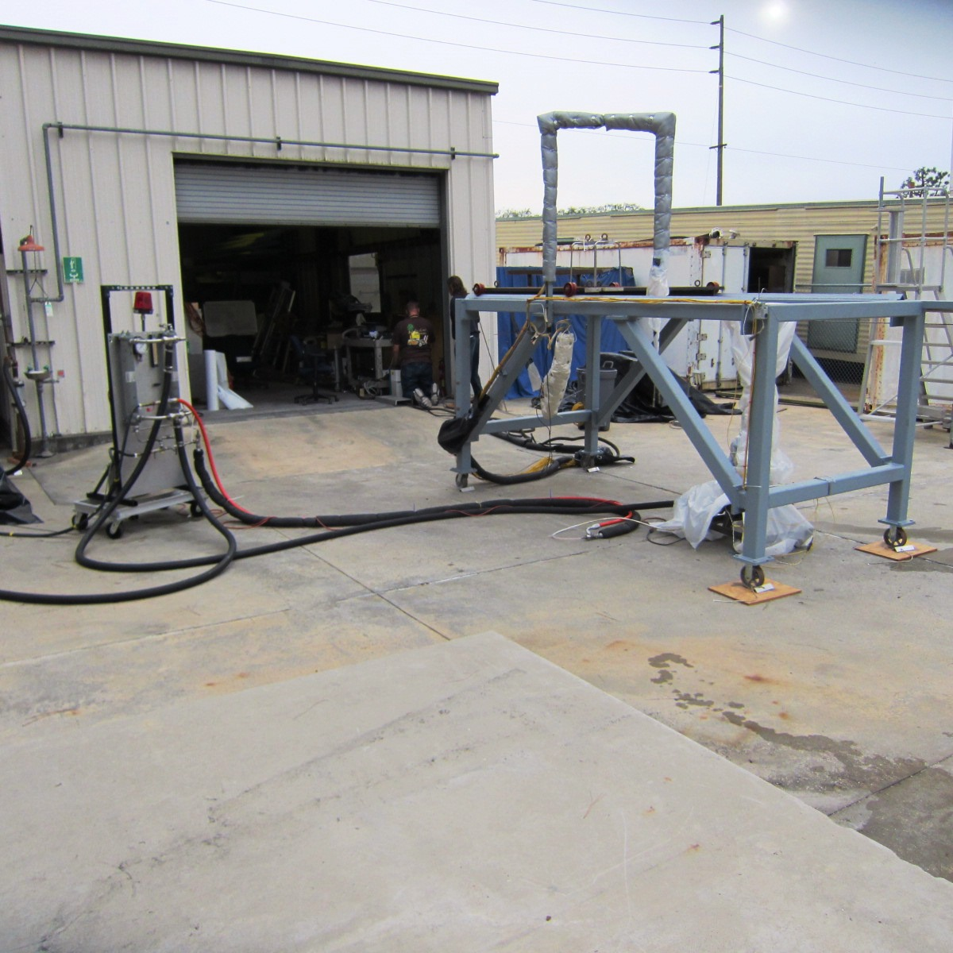
Fire Challenge Test Stand
The decision was made to do the fire challenge outdoors.
The test stand was made to be mobile for storage and quick refurbishment for test when needed.
All of the other test components carts are built on wheels and can be moved into test position easily.
Approved for public release; NG19-1520
© 2019 Northrop Grumman Systems Corporation. All Rights Reserved.

Slide 6
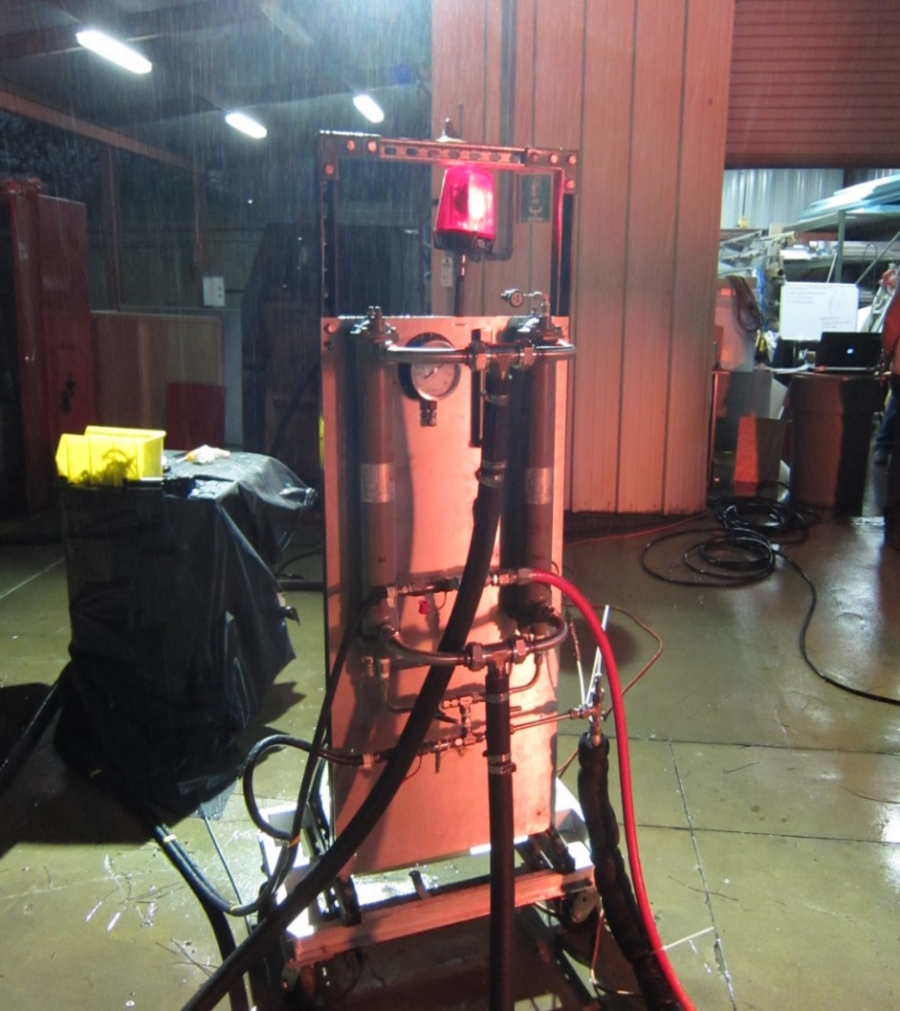
Air and Fuel Heat Exchanger Cart
The fuel line was special designed to control the temperature of the fuel coming into the burning using the cooling water jacket without contaminated the fuel supply.
On the cart were the safety shut offs for both the igniter and the fuel supply as well the red light notifying all personnel when in the system was active. The cart is located 20ft away which allows for safe operations in case of emergency.
Approved for public release; NG19-1520
© 2019 Northrop Grumman Systems Corporation. All Rights Reserved.

Slide 7
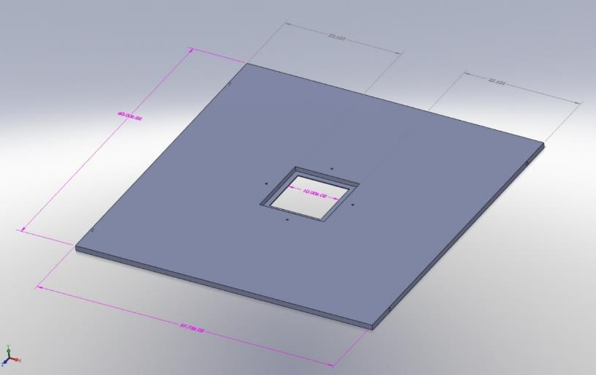
Burner Cart and Steel Plate
The fire challenge test stand centers around the burner with a test article mounted directly over it. To prevent fire from wrapping around the test article a steel plate 0.875” thick, 57.75” width by 60” length with a test article size hole cut out in the center was machined and angles were welded into place.
Burner Cart
Steel Plate
Approved for public release; NG19-1520
© 2019 Northrop Grumman Systems Corporation. All Rights Reserved.

Slide 8
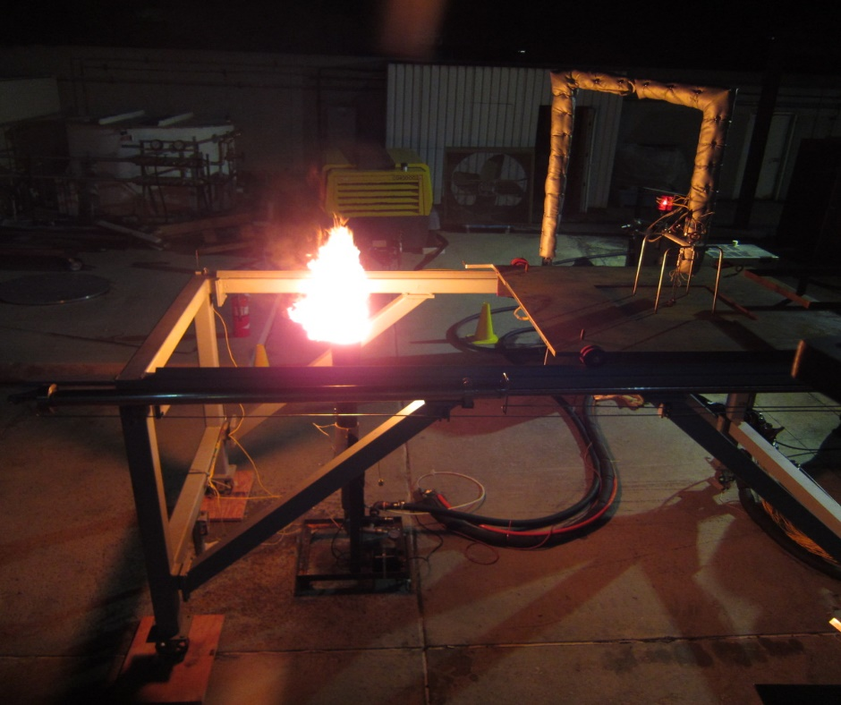
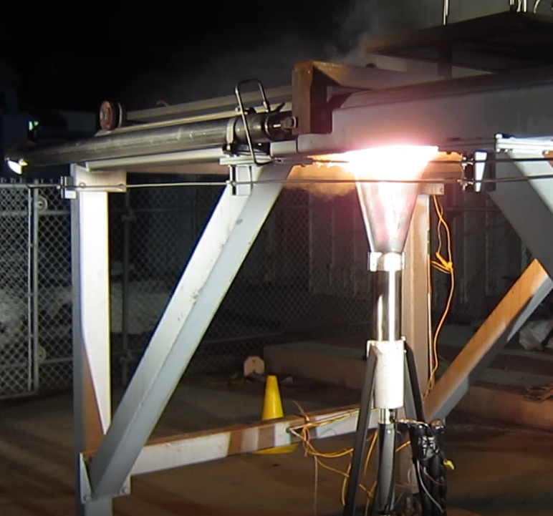
Moving the plate into position
The design engineers decided to move the test samples from a staging position to the test position by installing a railing system for the plate. To move the heavy plate, the engineers designed and fabricated an air ram cylinder. When the actuator was powered on the plate would deploy over the burner, when the off the system would return into the staging position.
Plate Staging Position
Plate Test Position
Approved for public release; NG19-1520
© 2019 Northrop Grumman Systems Corporation. All Rights Reserved.

Slide 9
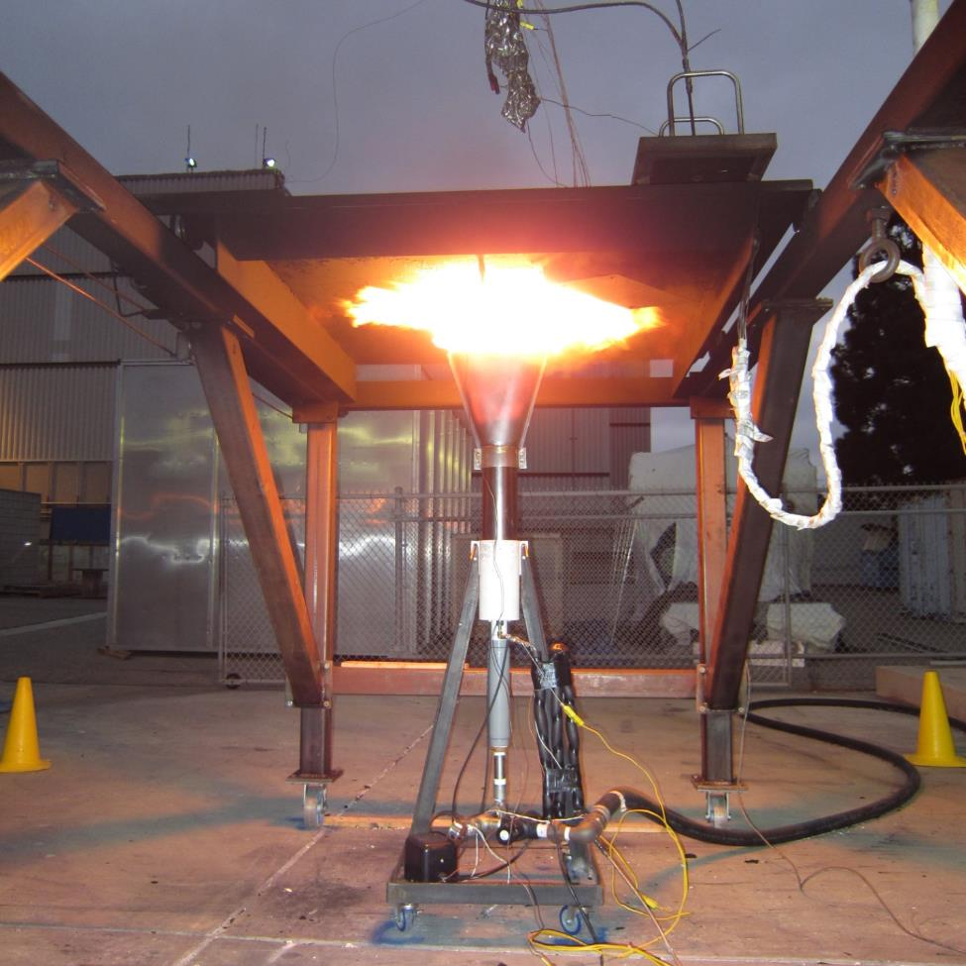
Testing with 12” panels
The first test campaign used 12” panels. Once the fire was started, the flame engulfed the sample and penetrated through the gaps of the sample plate and the steel plate cutout. The test team sealed the flame leak paths with fireproof felt to prevent flame penetration. But this led design engineers to questioning the size of the panel.
Approved for public release; NG19-1520
© 2019 Northrop Grumman Systems Corporation. All Rights Reserved.

Slide 10
JIB Boom Crane
Moving to a 24” panel configuration required a larger 24” calorimeter plate.
This posed an issue for the testing team to remove and install the heavy calorimeter plate. This led to led to the installation of the JIB BOOM crane system.
Approved for public release; NG19-1520
© 2019 Northrop Grumman Systems Corporation. All Rights Reserved.

Slide 11
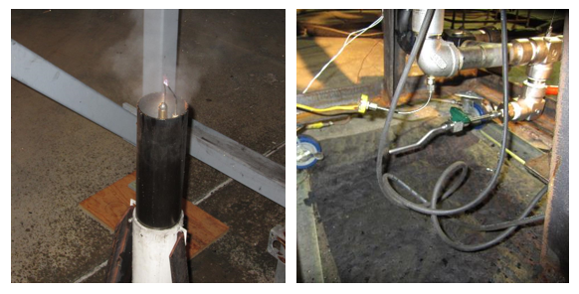
Water and Low Point Drains
Just like the previous test campaign, the burner was difficult to ignite.
The testing team discovered water buildup in the air lines from the both the facility air compressor and condensation while chilling the fuel.
This led to the installation of low point drains to purge the water build up from the system before and after testing. With this solved, we were able to return back to chilling the fuel per the AC-135.
Approved for public release; NG19-1520
© 2019 Northrop Grumman Systems Corporation. All Rights Reserved.

Slide 12
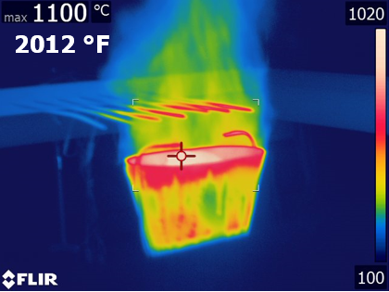
Thermal Imaging Camera
To provide additional data, a thermal imaging camera was introduced to the fire challenge test stand. This capability was able to show the thermal profile of the burner, the calorimeter plate and the test articles.
Approved for public release; NG19-1520
© 2019 Northrop Grumman Systems Corporation. All Rights Reserved.

Slide 13
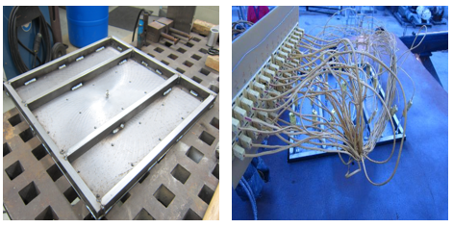
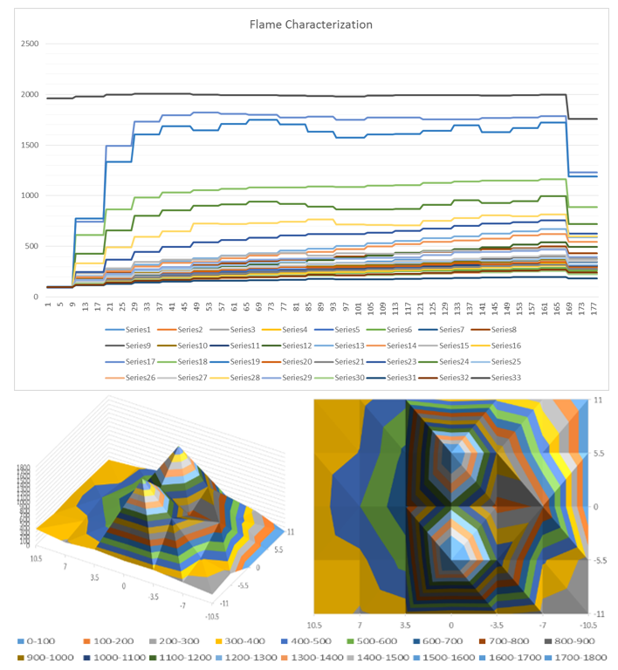
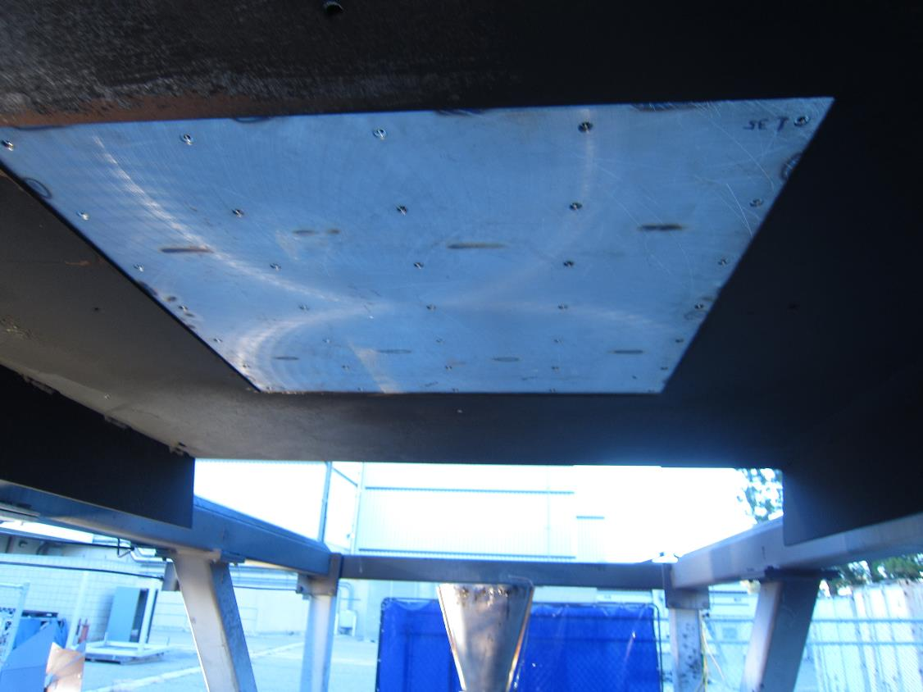
Flame Characterization Plate
The testing team assumed thought that the actual hottest flame temperature exposure was focused towards the middle of the sample test articles. But the data shows that the shape of the burner cone creates a flame with two lobes.
Approved for public release; NG19-1520
© 2019 Northrop Grumman Systems Corporation. All Rights Reserved.

Slide 14
Lessons Learned
From the early engineering design process, the Northrop Grumman Corporation Environmental, Health and Safety (EHS) organization had an active role.
pre-task and post-test briefing before each testing day
stay out zone during testing
trained fire extinguisher safe watch personnel and operational safety hardware shutoff systems in case of emergencies.
We learned a lot during testing.
A large sample holding plate reduces the wrap-around of the test flame that may skew the results.
A larger sample panel will also minimize the edge effects of the flame.
Vertically orienting the fire provides a worst-case test.
Air lines must be periodically drained to facilitate ignition of the fire.
The hottest place in the fire is the not the center of the test sample. It’s the peak of the two loads.
Having a safe and handy way to change out the calorimeter plate for the test samples saves a lot of time.
Given the design of the burner, once the burner has been adjusted to get the flame temperature to 2000°F, the heat flux density is fixed. Generally > 9.3.
Respecting safety keeps everyone safe
Approved for public release; NG19-1520
© 2019 Northrop Grumman Systems Corporation. All Rights Reserved.

