Slide 1
Revised Rate of Heat Release Test Method
(HR2)
October, 2019
Triennial Conference
Atlantic City, NJ
USA
Michael Burns, FAA Technical Center

Slide 2

AGENDA
HRR Test Method
Background for Revision
Improvements
Prototype Data
Next

Slide 3
Heat Release Rate Test Method
Required by Federal Aviation Administration (1988)
Qualify large surface area interior materials for use in commercial passenger aircraft
  Ceilings
  Stow bins
  Sidewalls
  Partitions
Federal Register 14 CFR parts 25 and 121
  Description
  Use
  Calibration
  Pass / Fail criteria

Slide 4
Revised Heat Release Rate Test Method
Goal: Simplify and Streamline
Multi-laboratory studies in which the same material was tested at different locations indicate reproducibility of test results can be improved.
Many factors can contribute to poor agreement between test laboratories.
This presentation describes a detailed revision of the test apparatus conducted by the International Aircraft Materials Fire Test Forum (IAMFTF) to better standardize components, procedures and calibration of equipment for this test method.

Slide 5
Areas Of Improvements
  Airflow (dual flow to single flow)
  Standardized construction
  Software / Thermopile
  Power control
  Calibration
  Equipment
  Detailed operation/procedures

Slide 6
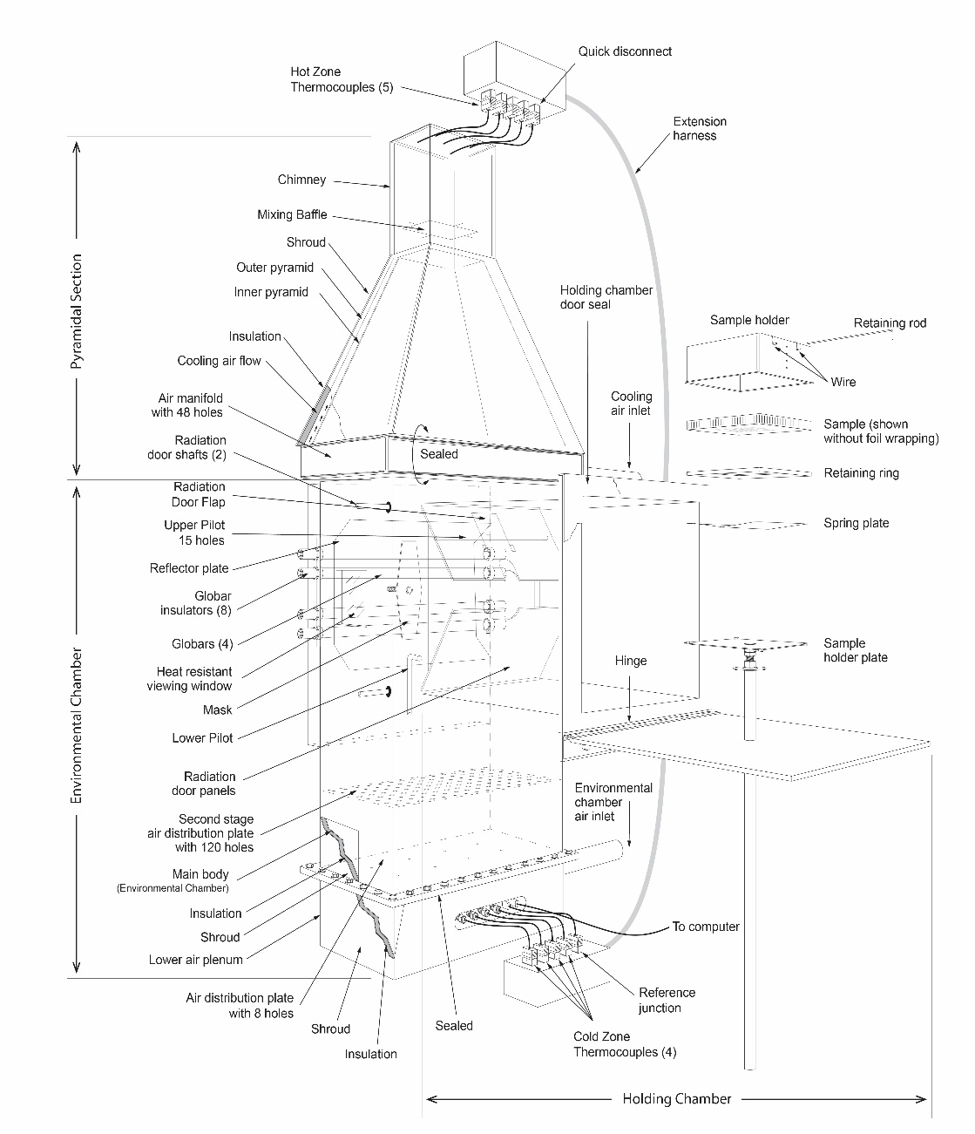
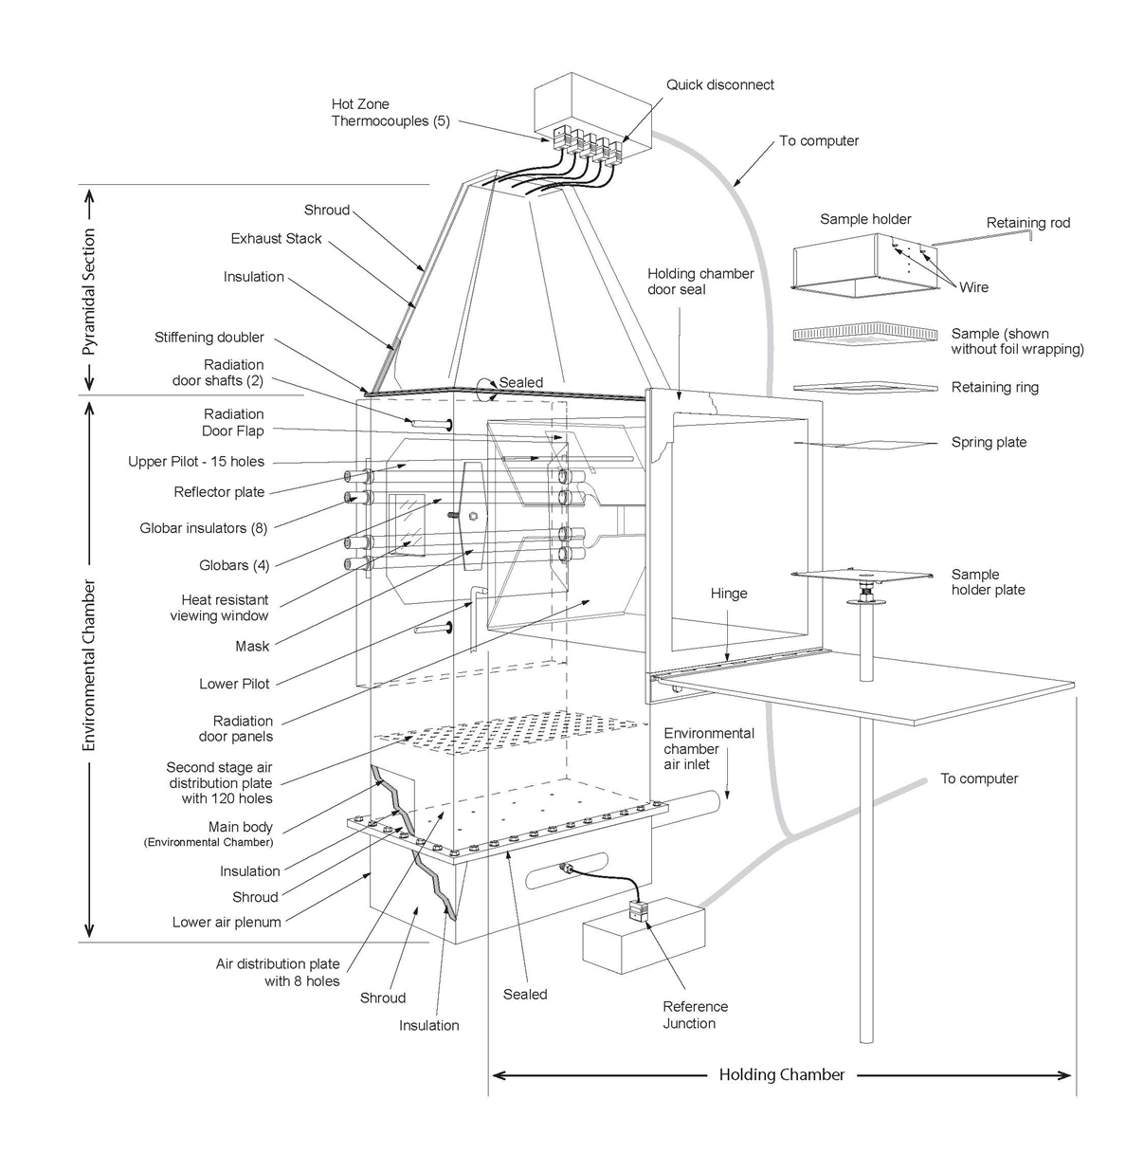
Airflow – Single Flow Design
OSU: Orifice Meter, Natural 3:1 Airflow Split
HR2: Mass Flow Controlled

Slide 7
Removal of Bypass Air and Components
  Chimney
  Baffle plate
  Outer pyramid
  Bypass air manifold
  Piping
  Surplus gasket material and hardware
  Orifice meter / Mercury manometer

Slide 8
Removal of Bypass Air and Components
PROS
  Single air source
    1 MFC req’d
    Smaller compressed air system req’d
  Easier to clean, inspect, maintain
  Fewer components
  Quieter system
  Thermocouples operating in a better performance range
CONS
  Higher exhaust gas temperatures (non-cooled exhaust)

Slide 9
Airflow
Defined air quality
  A well-regulated air supply is required. The supplied air shall be clean and free of oil mist, water (≤ 65% RH), and foreign particles.
Airflow
  Flow rate controlled using a MFC to replace orifice meter
  Calibrated to STP 0º C at 760 mmHg
  Accuracy: 2% full scale
  Flow Rate: 20 ± 0.4 SCFM
  Inlet air temperature: 72.5 ± 2.5 °F

Slide 10
Standardized Construction
Insulation - Thermal conductivity criteria specified
Overlap criteria specified
Component metal thickness & tolerances table
New Previous Component
¼ inch Aluminum | Unchanged | Holding Chamber Door
 | Unchanged | Air Distribution Plate
0.036 +/- 0.003 Alum. | Not Specified | Exhaust Stack Covering (New)
0.125 ± 0.005 | Not Specified | 1/8 inch Retaining Rod
0.048 ± 0.004 | (0.049 ± 0.002) | Main Body
 | Not Specified | Globar Pan
 | Not Specified | Holding Chamber
 | Not Specified | Second Stage Plate
 | Not Specified | Lower Air Plenum

Slide 11
Standardized Construction
New Previous Component
0.042 ± 0.004 | (0.042 ± 0.002) | Diamond Mask
0.036 ± 0.003 | (0.030 ± 0.008) | Reflector Plate
 | 24-Gauge Steal | Sample Holder Plate
0.030 ± 0.003 | (0.031 ± 0.002) | Outer Pyramid (Removed)
 | Not Specified | Radiation Doors (2)
0.018 ± 0.002 | Unchanged | Inner Pyramid (Modified)
 | Unchanged | Chimney (Removed)
 | Unchanged | Baffle Plate (Removed)
 | Unchanged | Sample Holders
 | Unchanged | Holder Spring
 | Unchanged | Retaining Ring

Slide 12
HR2 Exhaust Assembly
1” Stiffening Doubler
1” Flange

Slide 13
Standardized Construction
Exhaust stack mounting
  #10-32 x ¾” bolts / washers / nuts (28)
  Stiffening doubler and gasket
  Insulation
  0.036 +/- 0.003 Aluminum covering
  No substitutions permitted
Main body
  Dimensions
  Observation window
  Inner radiation doors
  Rear globar pan
  Reflector plate
  Diamond plate shaft
  Upper pilot / Calibration burner
  Second Stage Plate
    Hole pattern (centered in chamber)
    Perimeter sealed
    Removable

Slide 14
Standardized Construction
Holding chamber
  Dimensions
  Outer door
  Preheat sample position
Specimen holder / components
  Dimensions
  Retaining ring
  Spring plate
  Retaining rod
  Drip pan
HFG Mounting
  Corner HFG position
  Refractory board (thickness, density, HFG flush mount)

Slide 15
Standardized Thermopile / Globars
Thermopile System
  New thermocouples (5 hot zone; 1 cold zone)
  12 inch TC maximum length limit
  24 gauge, solid conductor, thermocouple grade wire
  Quick disconnects
  Cold junction centrally located in lower plenum
  Independent monitoring of all TC’s (Calculate T’Pile ΔT)
  Annual calibration of each thermocouple and temperature input is required. Accuracy must be within ± 1% of 380°C
Globars
  Construction: CHZ, length, diameter, resistance
  Power control of upper / lower globars
  Voltage fluctuation tolerance ± 1% (throughout day)

Slide 16
New: Upper Pilot Hot Surface Igniter (HSI)
A 0.125 ± 0.005 inch diameter ceramic rod 8.0 ± 0.0625 inches in length is positioned directly in the flames of the upper pilot burner.
The rod is continuously heated by the flamelets acting as a hot surface igniter to auto-ignite any upper pilot flames should they go out.
The distance from the centerline of the burner tube to the centerline of the HSI rod is 0.75 ± 0.125 inch.

Slide 17
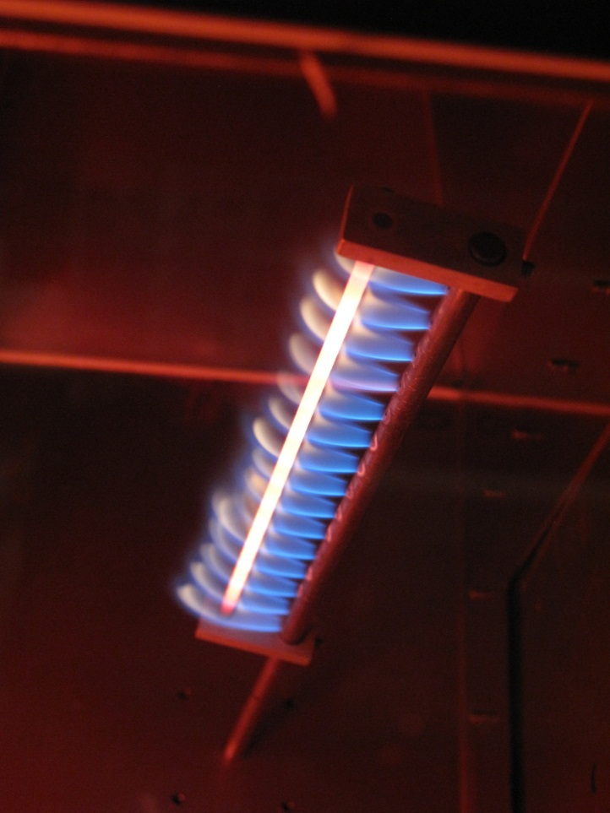
Upper pilot HSI
HSI / Upper Pilot Burner Operation

Slide 18

New Procedures: Heat Flux
HFG Type: Replaced Gardon with Schmidt-Boelter
HFG Guidance: Paint / Care / Mounting
New insitu method (Center)
  3.65 ± 0.05 W/cm²
New Uniformity Tolerance (4-Corners)
  3.65 +/- 0.10 W/cm²

Slide 19
New Procedures: Heat Flux
Stability criteria
The term “stable” as it relates to heat flux density and chamber equilibrium is calculated using a moving average and expressed in terms of % standard deviation over a defined time period. Typically, stable conditions can be achieved between 60 and 90 minutes after heating has begun.
Heat flux (60 second moving average)
Heat flux gauge millivolt signal that varies less than 1.0% standard deviation over the last 60 seconds and having a calculated heat flux density that is within range.
Chamber equilibrium (15 minute moving average)
Thermopile millivolt signal that varies less than 1.0% standard deviation over the last 15 minutes commencing no sooner than 30 minutes after turning the heating elements on.

Slide 20
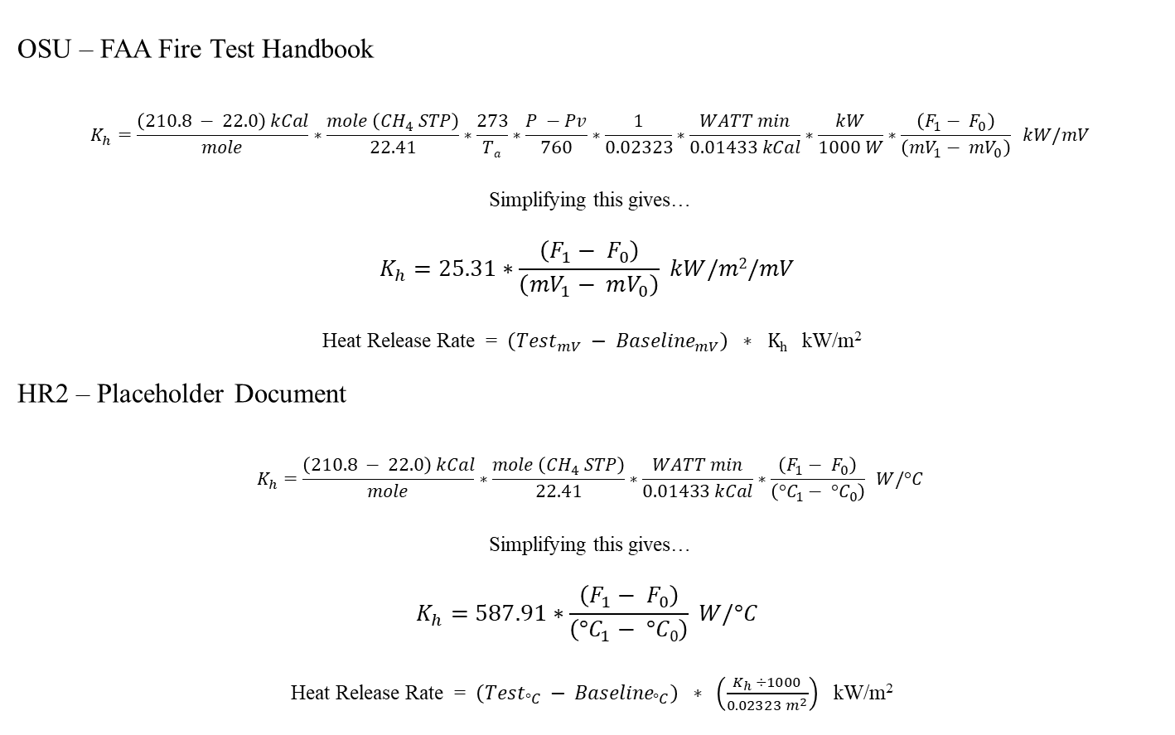
Calibration Factor / HRR Equation
Deleted
Sample Area Moved to HRR Calculation
OSU – FAA Fire Test Handbook
$$K_{h}=\frac{\left(210.8 − 22.0\right) kCal}{mole}∗\frac{mole \left({CH}_{4} STP\right)}{22.41}∗\frac{273}{Ta}∗\frac{P −Pv}{760}∗\frac{1}{0.02323}∗\frac{WATT min}{0.01433 kCal}∗\frac{kW}{1000 W}∗\frac{\left(F_{1}− F_{0}\right)}{\left({mV}_{1}− {mV}_{0}\right)} kW/mV$$
Simplifying this gives…
$$K_{h}=25.31∗\frac{\left(F_{1}− F_{0}\right)}{\left({mV}_{1}− mV_{0}\right)} kW/m2/mV$$
Heat Release Rate = $\left({Test}_{mV} − {Baseline}_{mV}\right) ∗ Kh$ kW/m²
HR2 – Placeholder Document
$$K_{h}=\frac{\left(210.8 − 22.0\right) kCal}{mole}∗\frac{mole \left({CH}_{4} STP\right)}{22.41}∗\frac{WATT min}{0.01433 kCal}∗\frac{\left(F_{1}− F_{0}\right)}{\left({°C}_{1}− {°C}_{0}\right)} W/°C$$
Simplifying this gives…
$$K_{h}=587.91∗\frac{\left(F_{1}− F_{0}\right)}{\left({°C}_{1}− °C0\right)} W/°C$$
Heat Release Rate = $\left({Test}_{°C} − {Baseline}_{°C}\right) ∗ \left(\frac{K_{h} ÷1000}{{0.02323 m}^{2}}\right)$ kW/m²
Moved to HRR Calculation
Units changed

Slide 21
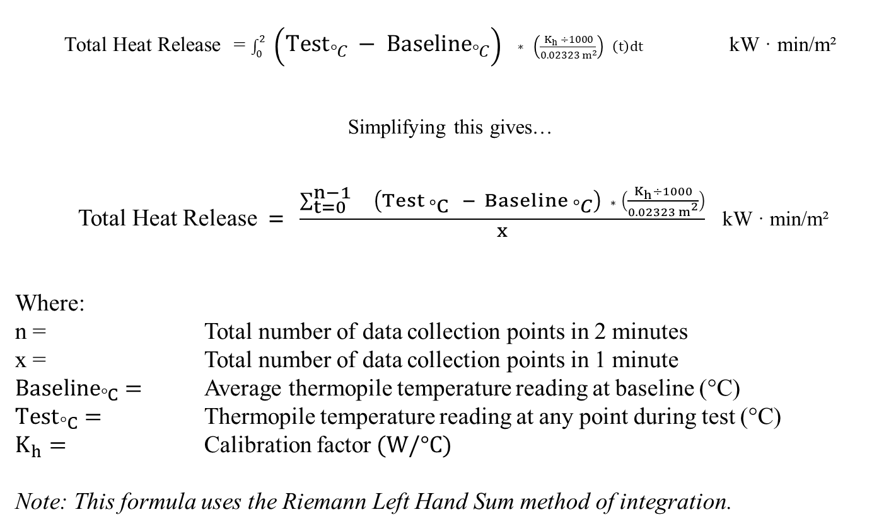
HR2: Total Heat Release Calculation
Total Heat Release = $\int_{0}^{2}{ \left({Test}_{°C} − {Baseline}_{°C}\right) ∗ \left(\frac{K_{h} ÷1000}{{0.02323 m}^{2}}\right) \left(t\right)dt}$ kW · min/m²
Simplifying this gives…
Total Heat Release$= \frac{\sum_{t=0}^{n−1}{ \left({Test}_{ °C} − {Baseline }_{°C}\right) ∗ \left(\frac{K_{h}÷1000}{{0.02323 m}^{2}}\right)}}{x}$ kW · min/m²
Where:
n = Total number of data collection points in 2 minutes
x = Total number of data collection points in 1 minute
${Baseline}_{°C}=$ Average thermopile temperature reading at baseline (°C)
${Test}_{°C}=$ Thermopile temperature reading at any point during test (°C)
$K_{h}=$ Calibration factor$(W/°C)$
Note: This formula uses the Riemann Left Hand Sum method of integration.

Slide 22
DOE Test Plan (approx. 2016)
Randomize 4 main parameters
Parameter | DESCRIPTION | Min. | Avg. | Max.
System Air Flow rates | SCFM | 19 | 20 | 21
Heat Flux (W/cm²) | Center | 3.60 | 3.65 | 3.70
Upper Pilot | Air (SLPM) | 0.98 | 1.0 | 1.2
 | Methane (SLPM) | 1.3 | 1.5 | 1.7

Slide 23
Changes as result of DOE Testing
  Chamber airflow:
  From: 20.0 ± 5% (19.0 – 21.0 SCFM)
  To: 20.0 ± 2% (19.6 – 20.4 SCFM)
  Upper pilot methane flow:
  From: 1.50 ± 13.3% (1.30 – 1.70 SLPM)
  To: 1.50 ± 2% (1.47 – 1.53 SLPM)
  Upper pilot air flow:
  From: 1.0 ± 20% (0.80 – 1.20 SLPM)
  To: 1.0 ± 5% (0.95 – 1.05 SLPM)
  Required inlet air be controlled by a MFC
  Replaced the panel mounted air flow meter (for upper pilot mixing air) with a MFC
  Changes to calibration method (from step to ramp)

Slide 24
Calibration
  Goals:
  Achieve better repeatability between successive calibrations
  Achieve good reproducibility between machines
  Reduce time req’d to complete the calibration process
  Reduced use of Methane gas
  Make it easier

Slide 25
Calibration
Replaced wet test meter with MFC
Upper pilot burner Methane MFC
  Thermal-based
  0.25 inch inlet/outlet fittings
  Calibrated annually with NIST traceability
  Calibrated for Methane gas
  Accuracy: 1% Full Scale
  STP 0ºC at 760 mmHg
  Signal output to data acquisition system
Dual purpose burner (upper)
  Calibration burner (replaces calibration T-burner)
  Upper pilot burner during testing - 1.5 SLPM Methane / 1.0 SLPM Air
  Note: Mixing air MFC has same specifications (calibrated for air)

Slide 26
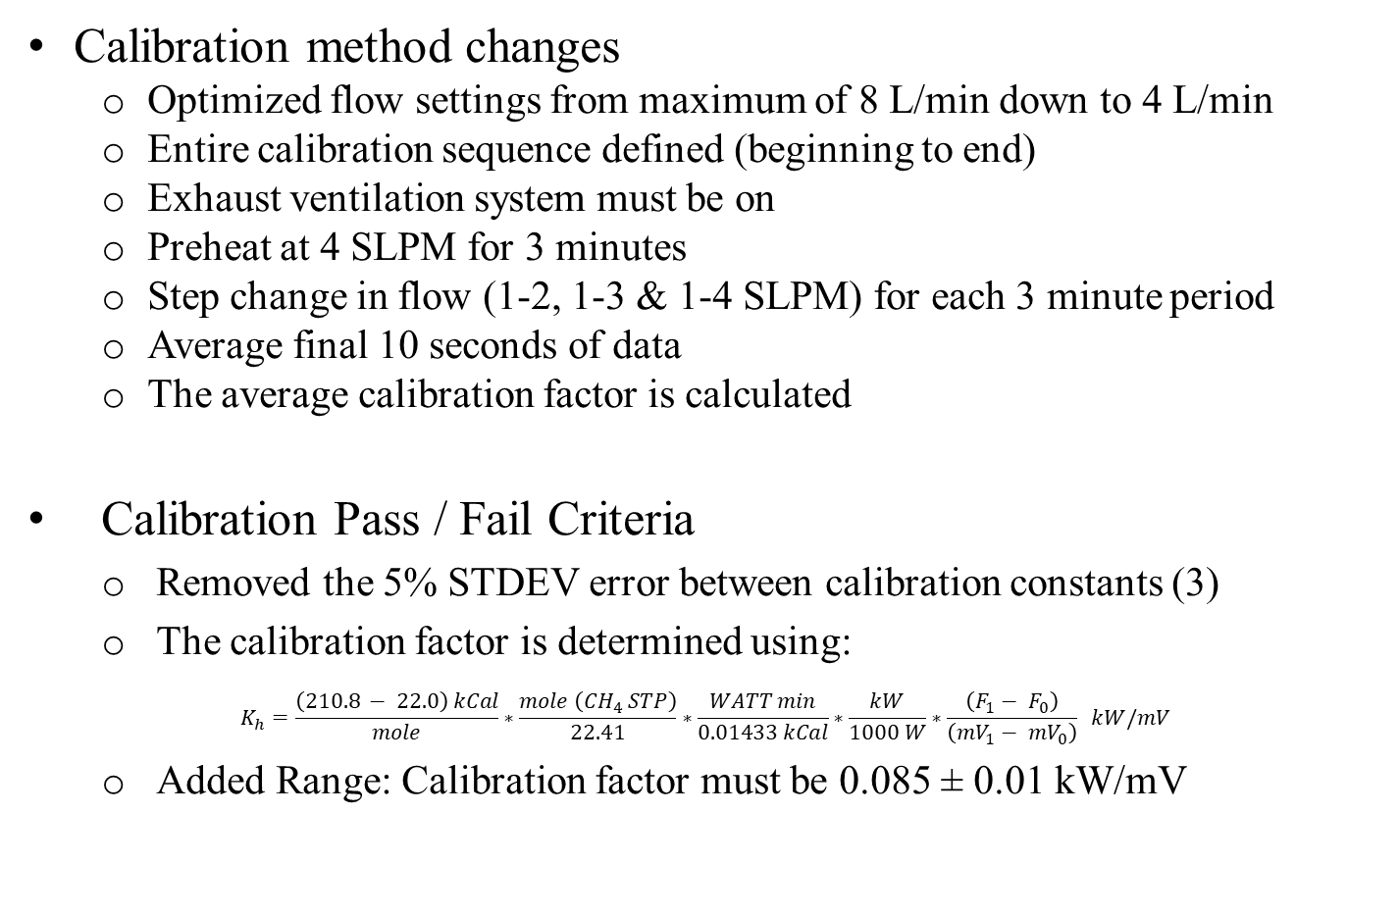
Initial Calibration (Step)
Calibration method changes
  Optimized flow settings from maximum of 8 L/min down to 4 L/min
  Entire calibration sequence defined (beginning to end)
  Exhaust ventilation system must be on
  Preheat at 4 SLPM for 3 minutes
  Step change in flow (1-2, 1-3 & 1-4 SLPM) for each 3 minute period
  Average final 10 seconds of data
  The average calibration factor is calculated
Calibration Pass / Fail Criteria
  Removed the 5% STDEV error between calibration constants (3)
  The calibration factor is determined using:
$$K_{h}=\frac{\left(210.8 − 22.0\right) kCal}{mole}∗\frac{mole \left({CH}_{4} STP\right)}{22.41}∗\frac{WATT min}{0.01433 kCal}∗\frac{kW}{1000 W}∗\frac{\left(F_{1}− F_{0}\right)}{\left({mV}_{1}− {mV}_{0}\right)} kW/mV$$
  Added Range: Calibration factor must be 0.085 ± 0.01 kW/mV

Slide 27
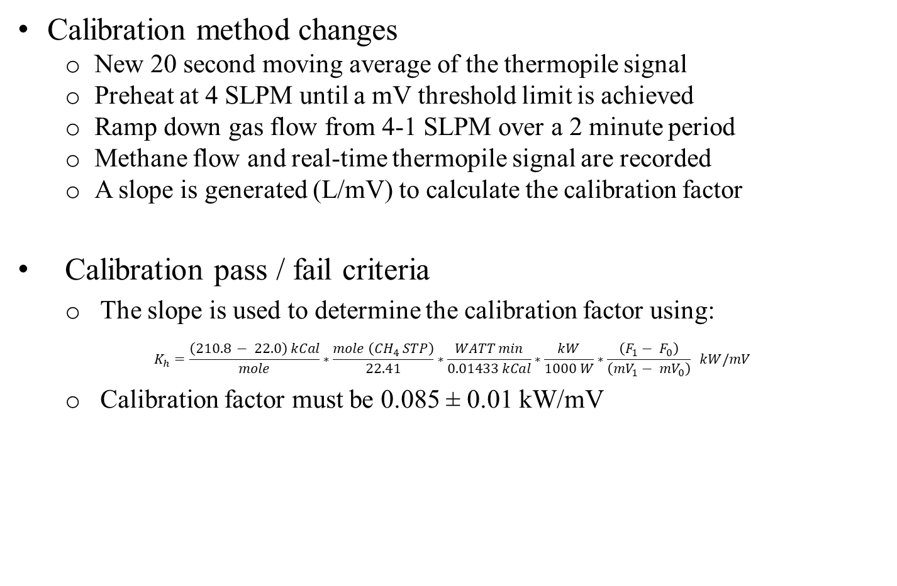
Amended Calibration (Ramp)
Calibration method changes
  New 20 second moving average of the thermopile signal
  Preheat at 4 SLPM until a mV threshold limit is achieved
  Ramp down gas flow from 4-1 SLPM over a 2 minute period
  Methane flow and real-time thermopile signal are recorded
  A slope is generated (L/mV) to calculate the calibration factor
Calibration pass / fail criteria
  The slope is used to determine the calibration factor using:
$$K_{h}=\frac{\left(210.8 − 22.0\right) kCal}{mole}∗\frac{mole \left({CH}_{4} STP\right)}{22.41}∗\frac{WATT min}{0.01433 kCal}∗\frac{kW}{1000 W}∗\frac{\left(F_{1}− F_{0}\right)}{\left({mV}_{1}− {mV}_{0}\right)} kW/mV$$
  Calibration factor must be 0.085 ± 0.01 kW/mV

Slide 28
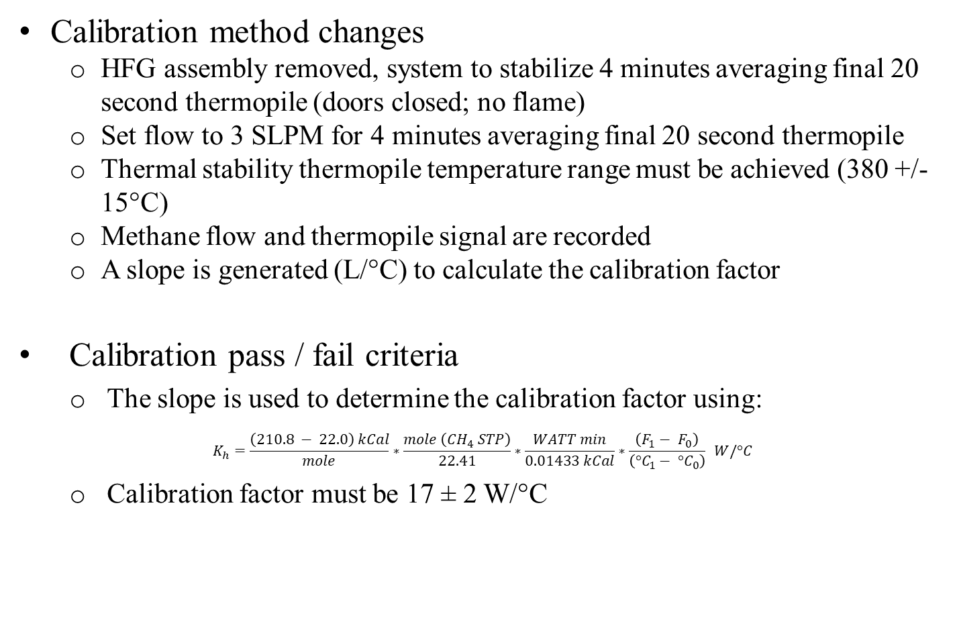
Current Calibration (Zero/Span)
Calibration method changes
  HFG assembly removed, system to stabilize 4 minutes averaging final 20 second thermopile (doors closed; no flame)
  Set flow to 3 SLPM for 4 minutes averaging final 20 second thermopile
  Thermal stability thermopile temperature range must be achieved (380 +/- 15°C)
  Methane flow and thermopile signal are recorded
  A slope is generated (L/°C) to calculate the calibration factor
Calibration pass / fail criteria
  The slope is used to determine the calibration factor using:
$$K_{h}=\frac{\left(210.8 − 22.0\right) kCal}{mole}∗\frac{mole \left({CH}_{4} STP\right)}{22.41}∗\frac{WATT min}{0.01433 kCal}∗\frac{\left(F_{1}− F_{0}\right)}{\left({°C}_{1}− {°C}_{0}\right)} W/°C$$
  Calibration factor must be 17 ± 2 W/°C

Slide 29
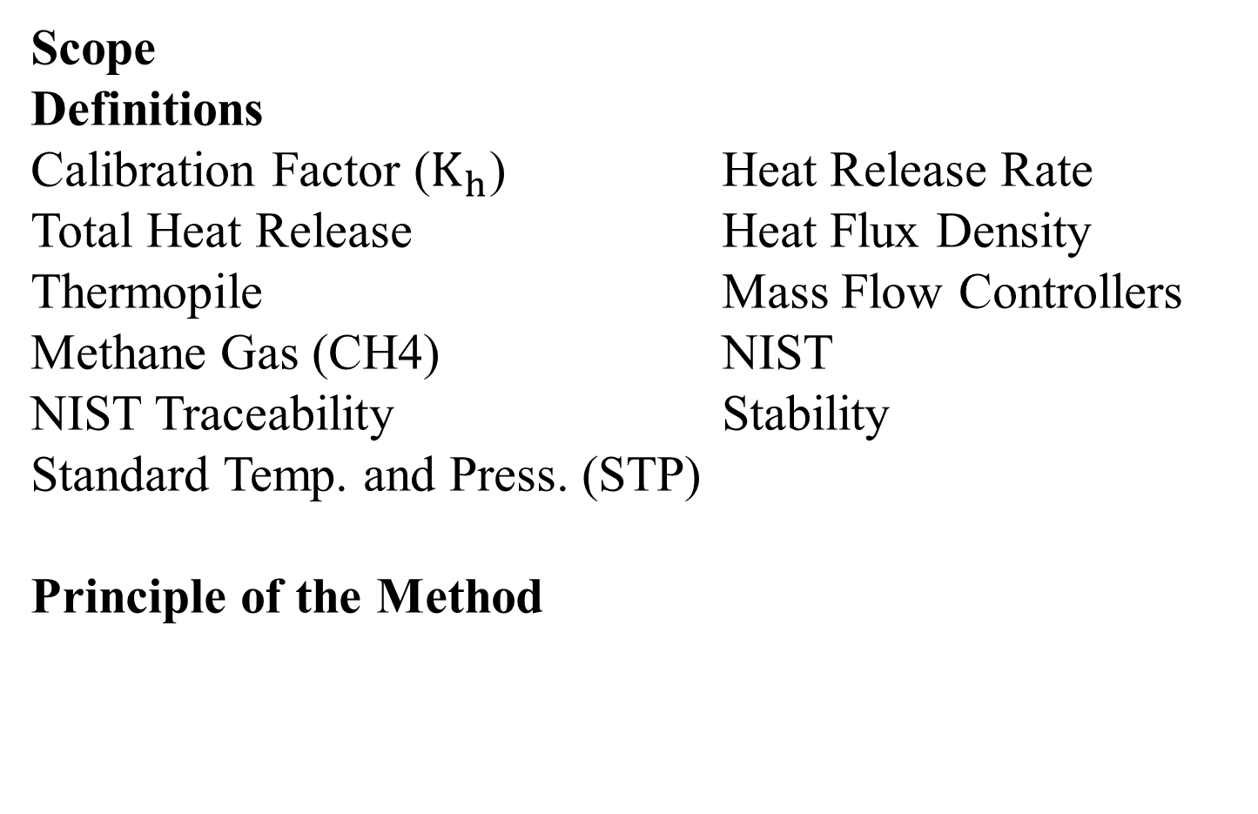
Placeholder Document
Scope
Definitions
Calibration Factor ($K_{h}$) Heat Release Rate
Total Heat Release Heat Flux Density
Thermopile Mass Flow Controllers
Methane Gas (CH4) NIST
NIST Traceability Stability
Standard Temp. and Press. (STP)
Principle of the Method

Slide 30
Placeholder Document
Apparatus
Heat Release Rate Apparatus
Holding Chamber
Environmental Chamber
Pyramidal Section
Apparatus Components
Thermopile
Pilot Burners
Hot Surface Igniter (HSI)
Electronic Igniter System
Air Distribution System
Specimen Holder
Calibration Equipment

Slide 31
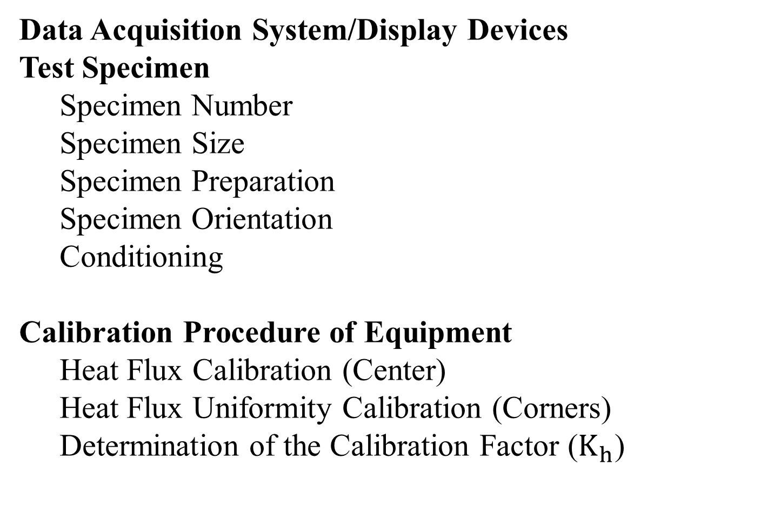
Placeholder Document
Data Acquisition System/Display Devices
Test Specimen
Specimen Number
Specimen Size
Specimen Preparation
Specimen Orientation
Conditioning
Calibration Procedure of Equipment
Heat Flux Calibration (Center)
Heat Flux Uniformity Calibration (Corners)
Determination of the Calibration Factor ($K_{h}$)

Slide 32
Placeholder Document
Preparation/Performance of Test
Preparation
Performance of Test
Preparation of Further Test Runs
Presentation of Results
Heat Release Rate
Total Heat Release
Accuracy, Units and Rounding
Requirements
Peak Heat Release Rate (65 kW/m²)
2-Minute Total Heat Release (65 kW · min/m²)
Quantity of Samples (80% must pass)
Test Report

Slide 33
Calibration Requirements and Frequency
Equipment (Annual calibration req’d)
  Heat flux gauges (center & corner)
  Data acquisition system/display devices
  Thermocouples (hot zone & cold zone)
  Main air supply MFC
  Methane / Mixing air MFC
  Sample conditioning equipment
Procedures
  System heat flux (daily)
  Heat flux 4-corner uniformity (daily)
  Thermopile gas calibration (weekly)

Slide 34
HR2 Appendix
  Contains information and supplemental material pertinent to referenced paragraphs.
Tolerance table
System overview drawing (assembled)
Individual components - 30 detailed drawings
  Methane gas (CH4) purity
  Heat release rate apparatus; insulation / gasket material
  Radiation source
  Thermopile / Thermocouples
  Lower & Upper pilot / calibration burner and hot surface igniter (HSI)
  Igniter System

Slide 35
HR2 Appendix
  Contains information and supplemental material pertinent to referenced paragraphs.
  Air distribution system; main distribution plate / second stage plate
  Specimen holder, drip pan, holding chamber/injection mechanism
  Heat flux gauges
  MFC’s
  Specimen preparation – Foil wrapping and general cleaning procedures
  Heat release rate / Total heat release calculations
  Nominal operating parameter table

Slide 36
HR2 Comparative Testing
Define a robust method to determine peak and total heat release that improves repeatability and reproducibility when compared with OSU
Status
NASA Technical Readiness Level (TRL) model adopted
TRL 4 -Robustness completed (2016) -DOE defined key parameters and variation
  Identification of Key Parameters influence levels
  Reduced variation in Calibration Factors
  Improved uniformity of Stability Runs

Slide 37
HR2 Comparative Testing
HR2 TRL phase 5 – Repeatability
  Phase I completed in Fall 2018 -inconclusive, indicated more work was needed
  Phase II completed in Spring 2019 – Significant repeatability improvements captured in current design and procedures.
HR2 TRL phase 6 – Reproducibility
  Start scheduled Spring 2020

Slide 38
Future work
Additional unit buildups for comparative testing (TRL 6)
New radiant heater design R&D
Sonic choke R&D (inlet air MFC replacement)

Slide 39
Questions?

