Slide 1
9Th Triennial International Aircraft Fire and Cabin Safety Research Conference, Atlantic City, October 28-31, 2019
Small Scale Fire Test for Component Substitutions in Aircraft Materials
Natallia Safronava ¹, Richard E. Lyon ², Richard Walters ²
¹ Technology and Management International, Toms River, NJ
² Fire Safety Branch, Federal Aviation Administration, William J. Hughes Technical Center, Atlantic City, NJ

Slide 2
Background/Motivation
2015: Industry petitioned FAA to use MCC as an alternative means of complying with 14 CFR 25 regulations for flammability of transport category aircraft cabin materials when a small change is made to certified design because of cost, performance, unavailability or environmental restrictions
Current requirements is to fabricate and fire test all cabin materials/constructions (e.g. storage bins) containing the changed component (e.g. flame retardant, resin, adhesive, film, fiber). This is expensive and time consuming.
2015-2019: FAA/Industry created task Group to determine best method to demonstrate equivalent bench scale fire performance (similarity) of cabin materials containing substitute components using Microscale Combustion Calorimeter (MCC).

Slide 3
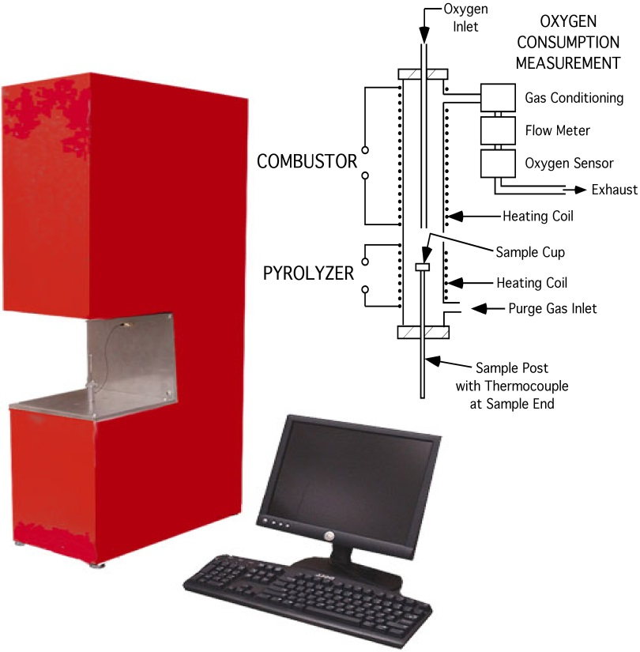
Microscale combustion Calorimeter
Develop guidance using the Microscale Combustion Calorimeter (MCC)
Utilize the MCC method to compare the flammability properties
Validate MCC similarity process
700
Peak HRR
600
500
T_{p}
400
Heat Release Rate Q/β (J/g-K)
T_{onset}
Heat of Combustion, Q∞
(Fire Load)
300
200
Pyrolysis Residue, μ
(Char Fraction)
100
0
450
500
550
600
650
700
750
Microscale Combustion Calorimeter
Temperature (°C)

Slide 4
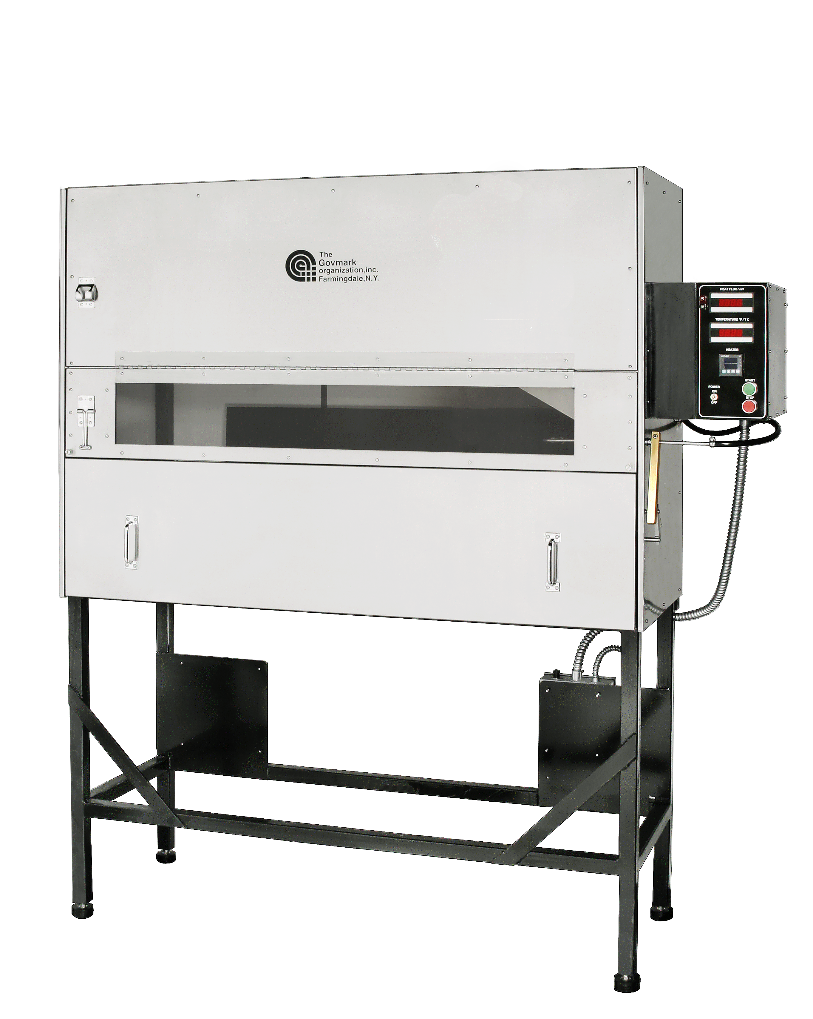
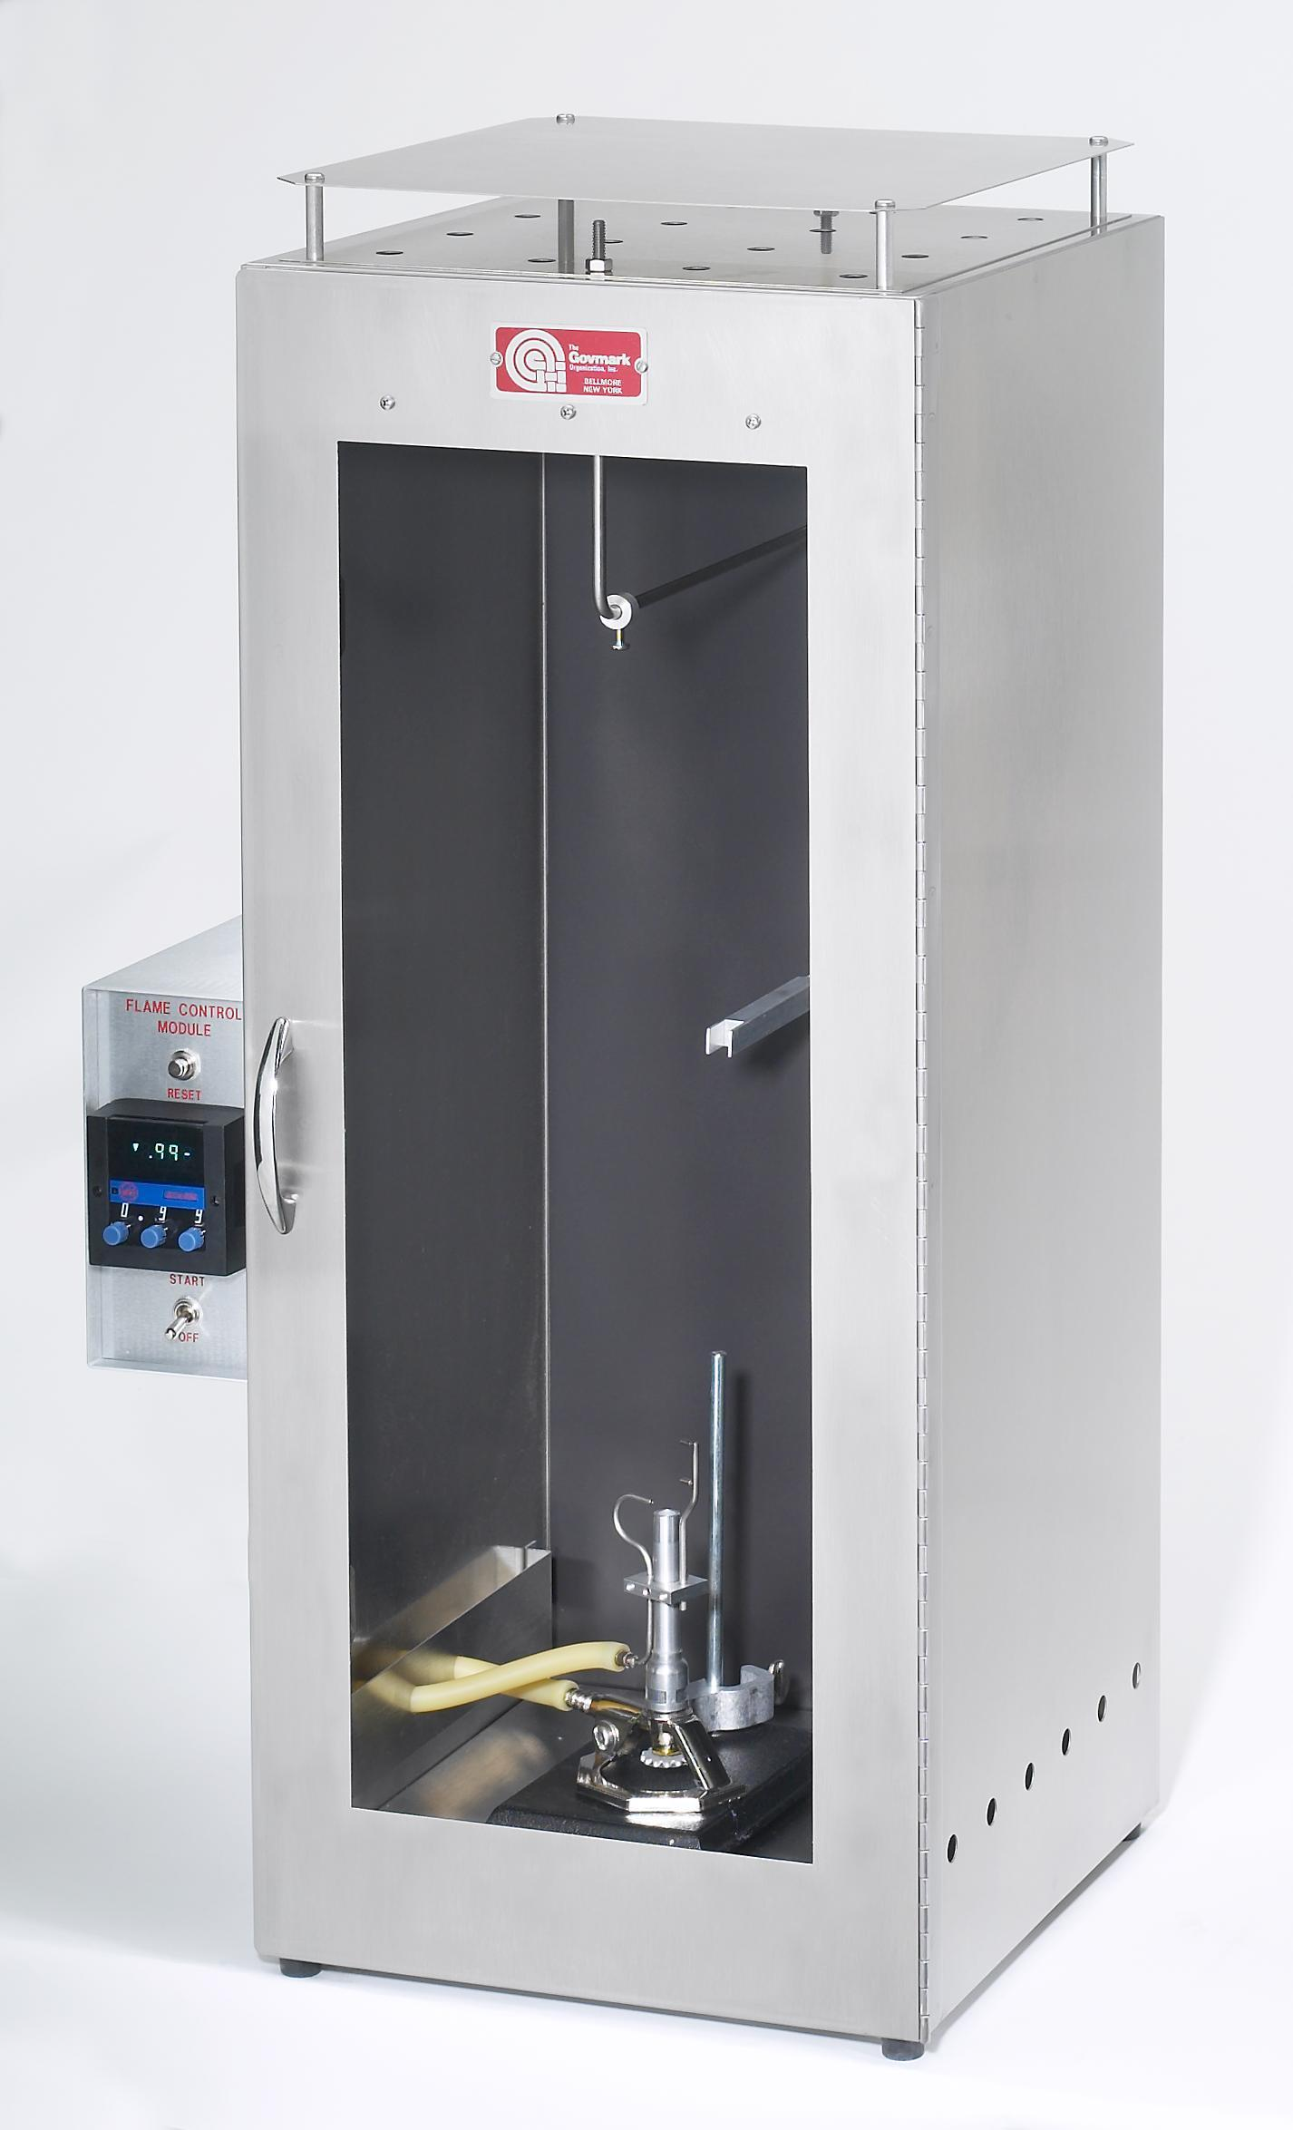
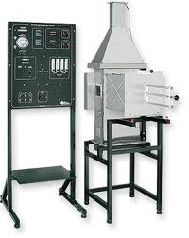
14 CFR Bench Scale Fire Tests (Pass/Fail)
OSU Rate of Heat Release Apparatus
(Large Area Materials)
Peak HRR
2-min HR
Radiant Panel
(Thermo-acoustic Insulation)
Flame propagation distance
After flame time
Vertical Bunsen Burner
(All other materials)
Flame time
Flame drip time
Burn length

Slide 5
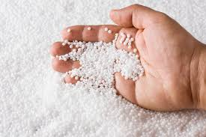
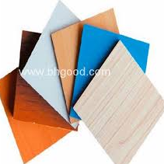
Proposed procedure to Determine if a Change to a Certified Cabin Material is Small with Regard of Fire Performance
ASTM D7309 (MCC)
Test and Criterion
Components
(mg)
Similar
Different
MCC
sufficient
FAR Test
of coupon
Coupons (g)
(self supporting components)
Similar
Different
Coupon
sufficient
FAR Test
of construction
(fabricated part)

Slide 6
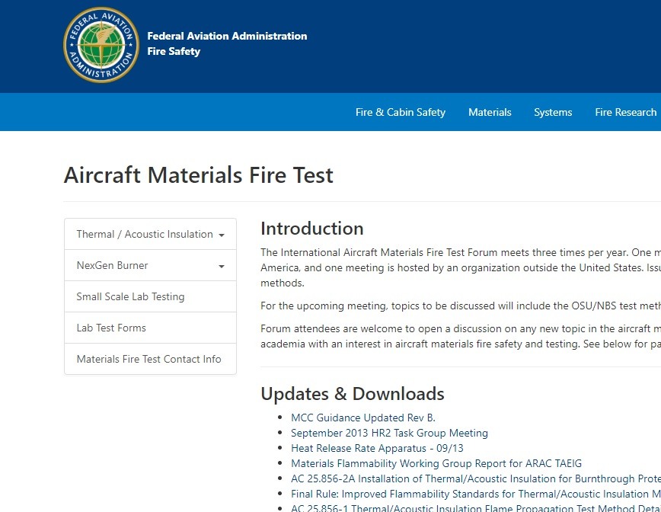
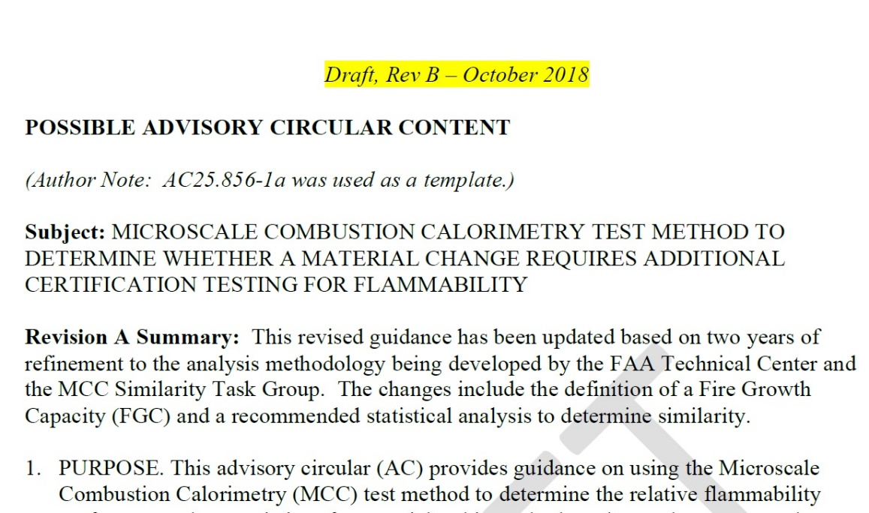
Current guidance
https://www.fire.tc.faa.gov/materials.asp

Slide 7
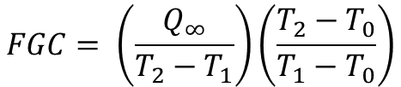
MCC procedure for FGC
Measure specific heat release rate Q′ versus temperature T as per ASTM D7309 (5 replicates)
Integrate Q′/β versus T to obtain Q versus T, i.e., Q(T )
Obtain total heat release
Q(T∞) = Q∞ = h_{c}(J/g)
Obtain T₁ at 5% deflection from Q(T) baseline, i.e., at 0.05Q∞
Obtain T₂ at Q∞-(0.05Q∞), i.e., 0.95Q∞.
Calculate Fire Growth capacity (FGC)
80
-5% Q∞
10
Q∞
70
60
8
T₂
50
6
Specific Heat Release Rate, Q′ (W/g)
Q (J/g)
40
+5%
Q∞
30
4
20
2
10
T₁
0
0
200
300
400
500
600
700
800
900
Temperature, T (°C)
T₀ = Standard Temperature = 25°C
T₁ ≈ Ignition temperature
T₂ = Burning temperature
$$FGC= \left(\frac{Q_{∞}}{T_{2}−T_{1}}\right)\left(\frac{T_{2}−T_{0}}{T_{1}−T_{0}}\right)$$

Slide 8
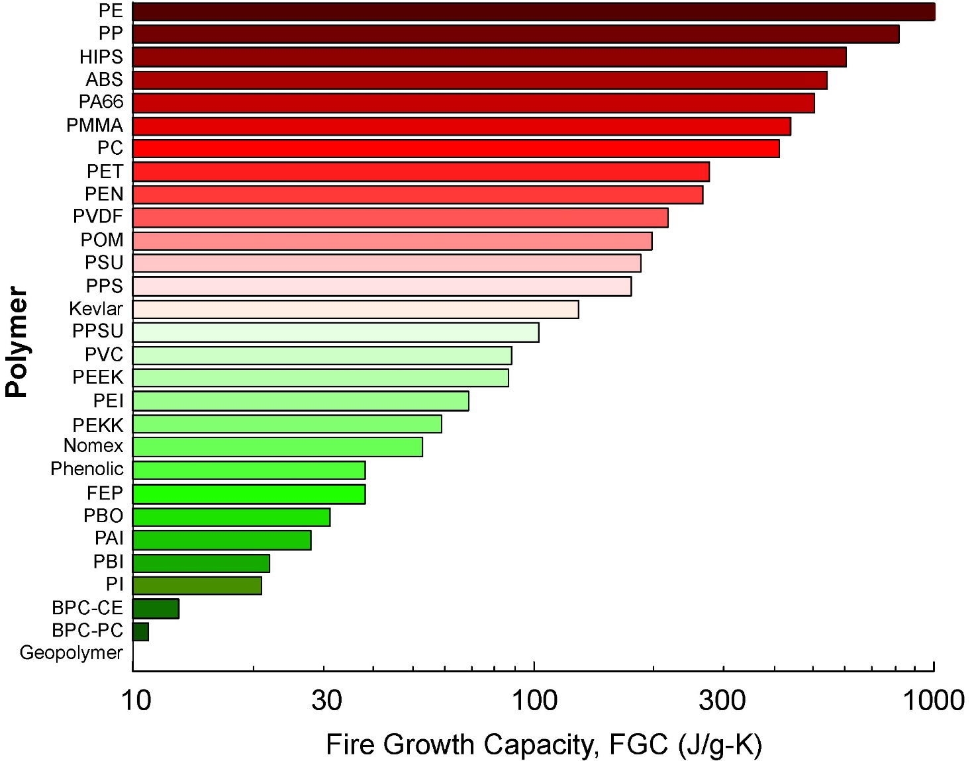
FGC of polymers
The motivation was to identify MCC parameter that captures the process of early growth and use it to compare the flammability of materials.

Slide 9
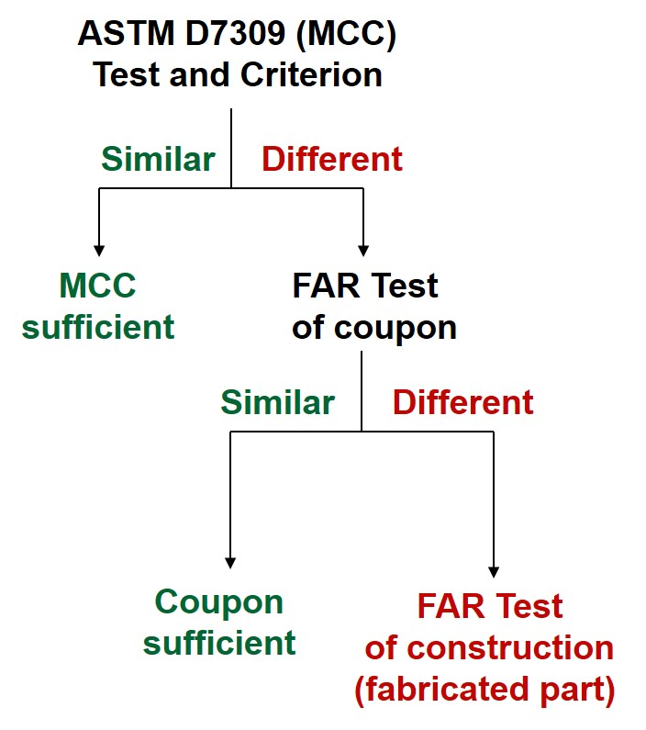
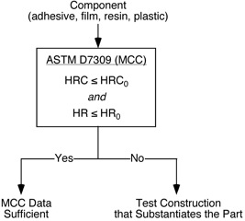
Iterations of the similarity approach
MCC guidance document was presented on FAA website on June 2016
Decision flow chart includes 2 MCC parameters HRC and HR
The basis for comparing HRC and HR is the reproducibility limit from ASTM D 7309 standard
Updated MCC guidance document was presented in 2018
HRC and IGC were used as the MCC parameters to generate new parameter FGC
FGC was compared between samples using t_{0.05} 95% confidence level

Slide 10
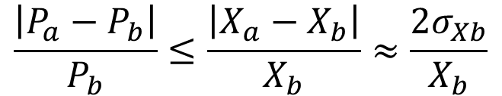
Current similarity approach (2019)
$$\frac{\left|P_{a}−P_{b}\right|}{P_{b}}≤\frac{\left|X_{a}−X_{b}\right|}{X_{b}}≈\frac{2σ_{Xb}}{X_{b}}$$
P_{a} and P_{b} are FGC from MCC experiments
X_{a} and X_{b} are bench-scale fire properties (e.g. peak HRR OSU, 2-minute total OSU, burn length, after time VBB); σ _{Xb} is the standard deviation for certified material B
If X_{a} is the flammability parameter of the substitute component in the FAR test, and X_{b} is the flammability parameter of the reference component in the certified cabin, it is expected with 95% confidence level that
X_{b}-2σ_{b} ≤ X_{a} ≤ X_{b}+2σ_{b}
Substituting X_{a}=X_{b}±2σ_{b}:
$$\frac{\left|P_{a}−P_{b}\right|}{P_{b}}≤\frac{\left|X_{a}−X_{b}\right|}{X_{b}}≈\frac{\left|{(X}_{b}±2σ_{b}\right)−X_{b}|}{X_{b}}≈\frac{2σ_{Xb}}{X_{b}}$$

Slide 11
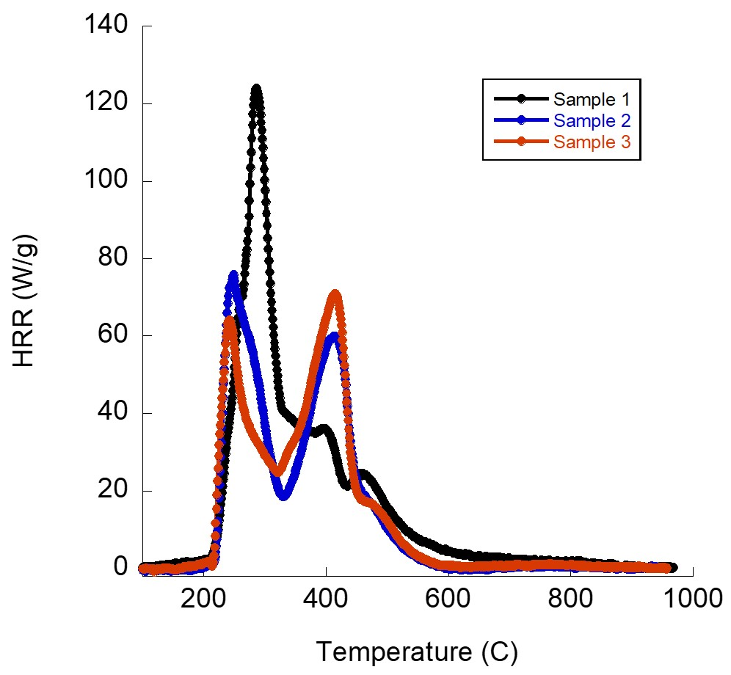
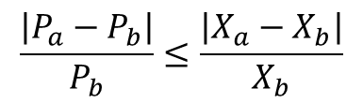
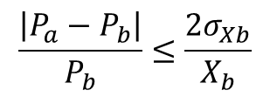
Case study example/adhesive film
Test results
Sample 1 is the certified material
The change is the flame retardant
OSU tests were done on a 2 ply phenolic laminate
Name | FGC (J/g-K) | pHRR (kW/m²) | 2 min HR (kW-min/m²)
Sample1* | 104 ± 2 | 45.5 ± 3.7 | 44.1 ± 1.1
Sample2 | 102 ± 3 | 44.4 ± 1.6 | 39.7 ± 1.1
Sample3 | 101 ± 7 | 41.3 ± 1.6 | 42.4 ± 1.0
$$\frac{\left|P_{a}−P_{b}\right|}{P_{b}}≤\frac{\left|X_{a}−X_{b}\right|}{X_{b}}$$
$$\frac{\left|P_{a}−P_{b}\right|}{P_{b}}≤\frac{2σ_{Xb}}{X_{b}}$$
Name | pHRR (kW/m²) | 2 min HR (kW-min/m²) | pHRR (kW/m²) | 2 min HR (kW-min/m²)
Sample 1 vs Sample2 | Yes | Yes | Yes | Yes
Sample1 vs Sample3 | Yes | Yes | Yes | Yes
Analysis

Slide 12
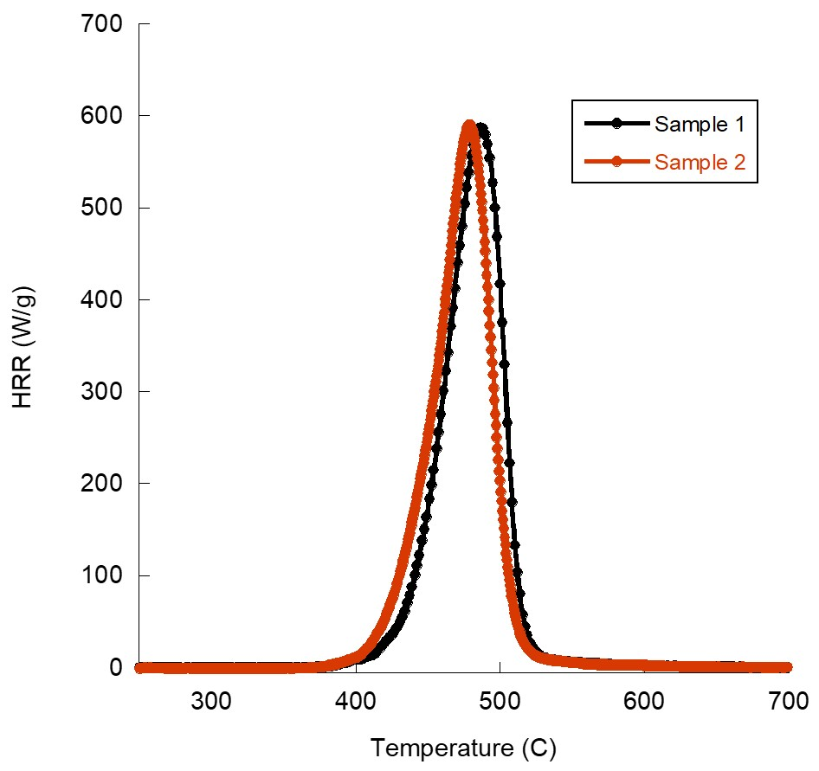
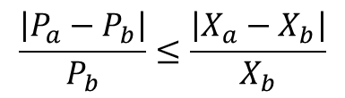
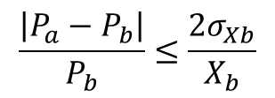
Case study example/Thermoplastic
Sample 1 is the certified material
Supplier change
VBB 12 sec, 3 mm samples
Test results
Name | FGC (J/g-K) | Burn length (mm) | Flame time (s)
Sample 1 | 499 ± 8 | 5 ± 0.5 | 1 ± 0.5
Samples 2 | 464 ± 3 | 3 ± 0.5 | 0.6 ± 0.7
$$\frac{\left|P_{a}−P_{b}\right|}{P_{b}}≤\frac{\left|X_{a}−X_{b}\right|}{X_{b}}$$
$$\frac{\left|P_{a}−P_{b}\right|}{P_{b}}≤\frac{2σ_{Xb}}{X_{b}}$$
Name | Burn length (mm) | Flame time (s) | Burn length (mm) | Flame time (s)
Sample1 vs Sample2 | Yes | Yes | Yes | Yes
Analysis

Slide 13
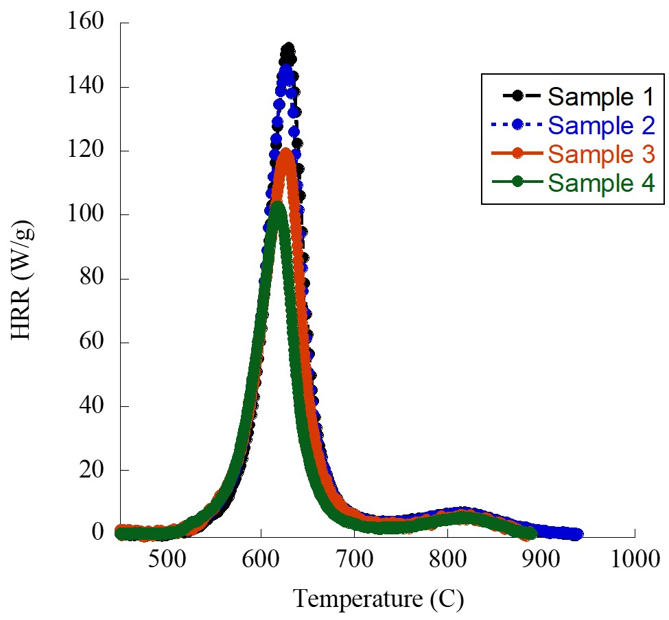
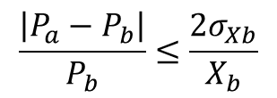
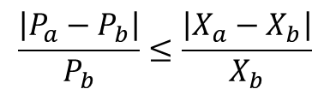
Case study example/Thermoplastic Lab A
Name | FGC (J/g-K) | pHRR (kW/m²) | 2 min HR (kW-min/m²)
Sample 1* | 59 ± 2 | 23 ± 6 | 2 ± 2
Sample 2 | 57 ± 1 | 28 ± 8 | 3 ± 2
Sample 3 | 50 ± 1 | 28 ± 6 | 5 ± 2
Sample 4 | 44 ± 4 | 23 ± 9 | 3 ± 3
$$\frac{\left|P_{a}−P_{b}\right|}{P_{b}}≤\frac{\left|X_{a}−X_{b}\right|}{X_{b}}$$
$$\frac{\left|P_{a}−P_{b}\right|}{P_{b}}≤\frac{2σ_{Xb}}{X_{b}}$$
Name | X =pHRR (kW/m²) | X= 2 min HR (kW-min/m²) | X = pHRR (kW/m²) | X =2 min HR (kW-min/m²)
1 vs 2 | [0.033≈0] ≤ 0.2 Yes | [0.033≈0] ≤ 0.5 Yes | [0.033≈0] ≤ 0.5 Yes | [0.033≈0] ≤ 2 Yes
1 vs 3 | 0.2 ≤ 0.2 Yes | 0.2 ≤ 1.5 Yes | 0.2 ≤ 0.5 Yes | 0.2 ≤ 2 Yes
1 vs 4 | 0.3 ≤ 0 No* | 0.3 ≤ 0.5 Yes | 0.3 ≤ 0.5 Yes | 0.3 ≤ 2 Yes

Slide 14
Case study example/Thermoplastic Lab B
Name | FGC (J/g-K) | pHRR (kW/m²) | 2 min HR (kW-min/m²)
Sample 1* | 59 ± 2 | 34 ± 2 | 4 ± 2
Sample 2 | 57 ± 1 | 43 ± 14 | 4 ± 1
Sample 3 | 50 ± 1 | 40 ± 6 | 9 ± 5
Sample 4 | 44 ± 4 | 48 ± 9 | 6 ± 3
$$\frac{\left|P_{a}−P_{b}\right|}{P_{b}}≤\frac{\left|X_{a}−X_{b}\right|}{X_{b}}$$
$$\frac{\left|P_{a}−P_{b}\right|}{P_{b}}≤\frac{2σ_{Xb}}{X_{b}}$$
Name | X =pHRR (kW/m²) | X= 2 min HR (kW-min/m²) | X = pHRR (kW/m²) | X =2 min HR (kW-min/m²)
1 vs 2 | [0.033≈0] ≤ 0.3 Yes | [0.033≈0] ≤ 0 Yes | [0.033≈0] ≤ 0.1 Yes | [0.033≈0] ≤ 1 Yes
1 vs 3 | 0.2 ≤ 0.2 Yes | 0.2 ≤ 1.3 Yes | 0.2 ≤ 0.1 No | 0.2 ≤ 1 Yes
1 vs 4 | 0.3 ≤ 0.4 Yes | 0.3 ≤ 0.5 Yes | 0.3 ≤ 0.1 No | 0.3 ≤ 1 Yes

Slide 15
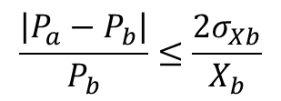
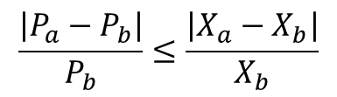
$$\frac{\left|P_{a}−P_{b}\right|}{P_{b}}≤\frac{\left|X_{a}−X_{b}\right|}{X_{b}}$$
$$\frac{\left|P_{a}−P_{b}\right|}{P_{b}}≤\frac{2σ_{Xb}}{X_{b}}$$
Summary of coupon level case studies
Case # | Changed Component | Coupon | pHRR (kW/m²) | 2min HR (kW-min/m²) | Burn length (mm) | pHRR (kW/m²) | 2min HR (kW-min/m²) | Burn length (mm)
1 | Decorative Laminate color (grey vs dark brown) | 1.1 Decorative laminate alone | Yes | Yes | Yes | Yes | Yes | Yes
 |  | 1.2 Decorative laminate on standard panel | Yes | Yes | Yes | Yes | Yes | Yes
2 | Decorative laminate adhesive film FR components | 2.1 Declam adhesive on fiberglass panel | No* | No* | Yes | Yes | Yes | Yes
 |  | 2.2 Declam adhesive on phenolic panel | Yes | Yes | Yes | Yes | Yes | Yes
 |  | 2.3 Declam adhesive on carbon fiber panel | No* | No* | Yes | Yes | Yes | Yes
 |  | 2.4 Declam adhesive on stow bin panel | No* | No* | Yes | Yes | Yes | No*
3.1 3.2 | Adhesive film FR components (Sample 1 vs sample 2 | Adhesive+ décor laminate + 2 ply phenolic | Yes | Yes | N/A | Yes | Yes | N/A
 | Adhesive film FR components (Sample 1 vs sample 3) | Adhesive+ décor laminate + 2 ply phenolic | Yes | Yes | N/A | Yes | Yes | N/A
4 | Resin systems for use in ECS ducting | Resin + 2 ply aramid fiber laminate | Yes | Yes | N/A | Yes | Yes | N/A
5 | Polymer supplier | Thermoplastic part | N/A | N/A | Yes | N/A | N/A | Yes
No* = anomalous result because ∆X or σ_{Xb} = 0

Slide 16
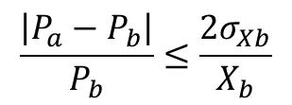
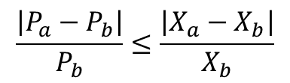
Summary of coupon level case studies
$$\frac{\left|P_{a}−P_{b}\right|}{P_{b}}≤\frac{\left|X_{a}−X_{b}\right|}{X_{b}}$$
$$\frac{\left|P_{a}−P_{b}\right|}{P_{b}}≤\frac{2σ_{Xb}}{X_{b}}$$
Case # | Changed component | Coupon | pHRR (kW/m²) | 2min HR (kW-min/m²) | Burn length (mm) | pHRR (kW/m²) | 2min HR (kW-min/m²) | Burn length (mm)
6 | Phenolic resin chemistry * Also tested 2 ply system in MCC | 6.1 2 ply laminates | Yes | Yes | N/A | Yes | Yes | N/A
 |  | 6.2 6 ply laminates | Yes | Yes | N/A | Yes | Yes | N/A
7 | Phenolic | 2 ply phenolic laminates | Yes | Yes | N/A | Yes | Yes | N/A
8 | Adhesive minor formulation change | 0.047 in Kydex 6565 + adhesive + 0.032 in Al | Yes | Yes | N/A | Yes | Yes | N/A
9 9.1 9.2 9.3 9.4 2 labs | Processing conditions Reference material along with recyclate and additional pigment in 2 concentrations | Thermoplastic specimen Lab A Sample 1 vs Sample 2 | Yes | Yes | N/A | Yes | Yes | N/A
 |  | Sample 1 vs Sample 3 | Yes | Yes | N/A | Yes | Yes | N/A
 |  | Sample 1 vs Sample 4 | No* | Yes | N/A | Yes | Yes | N/A
 |  | Lab B Sample 1 vs Sample 2 | Yes | Yes | N/A | Yes | Yes | N/A
 |  | Sample 1 vs Sample 3 | Yes | Yes | N/A | No | Yes | N/A
 |  | Sample 1 vs Sample 4 | Yes | Yes | N/A | No | Yes | N/A
No* = anomalous result because ∆X or σ_{Xb} = 0

Slide 17
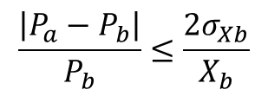
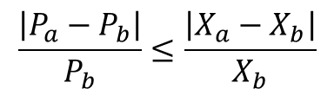
Summary of coupon level case studies
$$\frac{\left|P_{a}−P_{b}\right|}{P_{b}}≤\frac{\left|X_{a}−X_{b}\right|}{X_{b}}$$
$$\frac{\left|P_{a}−P_{b}\right|}{P_{b}}≤\frac{2σ_{Xb}}{X_{b}}$$
Case # | Changed component | Coupon | pHRR (kW/m²) | 2min HR (kW-min/m²) | Burn length (mm) | pHRR (kW/m²) | 2min HR (kW-min/m²) | Burn length (mm)
10 2 labs | Top coat added to phenolic | Laminate with and without varnish Lab A Lab B | Yes Yes | Yes Yes | N/A N/A | Yes Yes | Yes Yes | N/A N/A

Slide 18
Conclusions
FAA-industry working group has been developing a process to compare material formulations that underwent a small change
Current approach involves using Fire Growth Capacity (FGC) parameter in MCC to determine the similarity
Current similarity requirement: relative deviation of FGC for the changed component is less than the relative deviation of fire test results for coupons/cabin materials containing the changed component.
Proposed approach showed good agreement between MCC tests and coupon level tests (OSU, VBB) in numerous case studies
Next steps would be wrapping up case studies and releasing updated guidance
Review by FAA regulatory officials for approval

