Slide 1
The Effect of Phosphorus on Flame Retardancy of Plastics
9th Triennial International Fire & Cabin Safety Research Conference
Oct 29 – 31, 2019
Atlantic City, NJ
Haiqing Guo¹, Richard Lyon² ,
Richard Walters², Sean Crowley²
¹ C-FAR Services, Atlantic City, NJ
² Fire Safety Branch, Federal Aviation Administration Technical Center, Atlantic City, NJ

Slide 2
Background
A ban of highly effective bromine containing flame-retardant compounds that are widely used in aircraft cabins.
Increased interest in phosphorous containing flame-retardant compounds as bromine replacement.
MCC has been used for gas-phase combustion kinetics study of polymers under the premixed condition.
Bromine inhibits the chemical reaction whereas phosphorus does not have a noticeable effect on the rate of premixed homogeneous combustion.
Substantial amount of soot is observed in bench-scale diffusion flame system and the soot promotion mechanism by flame retardancy is not well understood.

Slide 3
Objectives
Examine the impact of phosphorous compound on soot formation in fire tests.
Perform detailed characterization of soot collected in the post-combustion gas stream.
Propose a possible soot formation path under the influence of phosphorus.

Slide 4
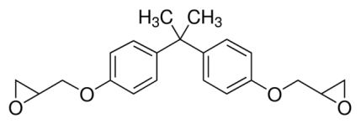
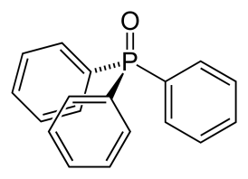
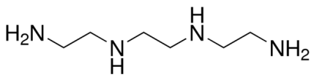
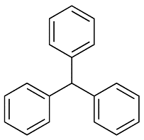
Materials
Sample | Structure | (FR) Additives | Structure | Concentrations
Epoxy (DER-332) + Triethylenetetramine (TETA) |  | Triphenylphosphine oxide (TPPO) |  | 0, 9, 18%
Epoxy (DER-332) + Triethylenetetramine (TETA) |  | Triphenylmethane (TPM) |  | 0, 9, 18%

Slide 5
Cone Calorimeter Results
Specific Extinction Coef. (gravimetric): 6.8 m²/g.
Previously used: 4.2 m²/g.

Slide 6
Cone Calorimeter Results
Carbon conversion efficiency η_{C} is introduced to quantify the incomplete combustion products’ impact.
Soot is the major incomplete combustion product.
Soot is collected at the exhaust.

Slide 7
TEM Results
JEOL JEM 2100 LaB6 at 200 kV.
Hough transform semi-automatic program.
More than 4000 particles examined each sample.
Blank epoxy
Epoxy + 2% P

Slide 8
Elemental Analysis
C, H, N: Combustion method with a TCD detector.
O: Pyrolysis Method.
P: Inductively coupled plasma atomic emission spectrometry.
Element | Char |  |  | Soot
 | blank | 1% P | 2% P | blank | 1% P | 2% P
C | 87.86 | 87.91 | 88.56 | 93.84 | 85.49 | 79.67
H | 2.21 | 2.22 | 2.05 | 1.60 | 2.12 | 2.88
O | 4.18 | 3.86 | 3.36 | 3.17 | 7.71 | 10.79
P | 0 | 0.01 | 0.02 | 0 | 2.84 | 4.82
N | 5.75 | 5.99 | 6.02 | 1.39 | 1.83 | 1.84

Slide 9
Soot Chemical Bonding
FTIR with a universal ATR sampling accessory.
P=O and P-Ar from TPPO.
Strong P-O-C peak.
More aromatic structures.

Slide 10
Soot Surface Reactivity
Soot surface reactivity is examined in air using TGA (40 L/min air flow, 10 °C/min).
A surface reaction model is implemented assuming soot is monodispersed particles, (g/m²-s).

Slide 11
Soot Surface Reactivity
Kinetics parameters were obtained assuming the following Arrhenius form:
 | diesel soot ^{[1]} | blank | 1% P | 2% P
E (kJ/mol) | 183.8 | 135.6 | 113.2 | 109.7
A (K^{0.5} s/m) | 1.6 | 2.1×10⁻² | 5.9×10⁻⁴ | 4.3×10⁻⁴
R² | 0.977 | 0.985 | 0.988 | 0.975
Mass Range (%) | 20 - 85 | 10 - 95 | 20 - 90 | 40 - 85
w_{ox}/w_{ox,diesel} @1600 K | NA | 0.5 | 0.08 | 0.07
^{[1]} Sharma et al., Energy Fuels 2012, 26, 5613-5625.

Slide 12
Summary
Phosphorus does not have a noticeable impact on the soot morphology.
Phosphorus from TPPO does not incorporate into the char, but instead directly participates in the gas phase reaction.
In large scale fires, the main flame retardancy mechanism of phosphorus is a heterogeneous reaction that promotes soot formation.
It is speculated that phosphorus promotes condensation of aromatic structures that form the precursor of soot particles.
Thermogravimetric analysis showed that the soot surface reactivity decreases when phosphorus is present, so its oxidation in flames is also suppressed.

Slide 13
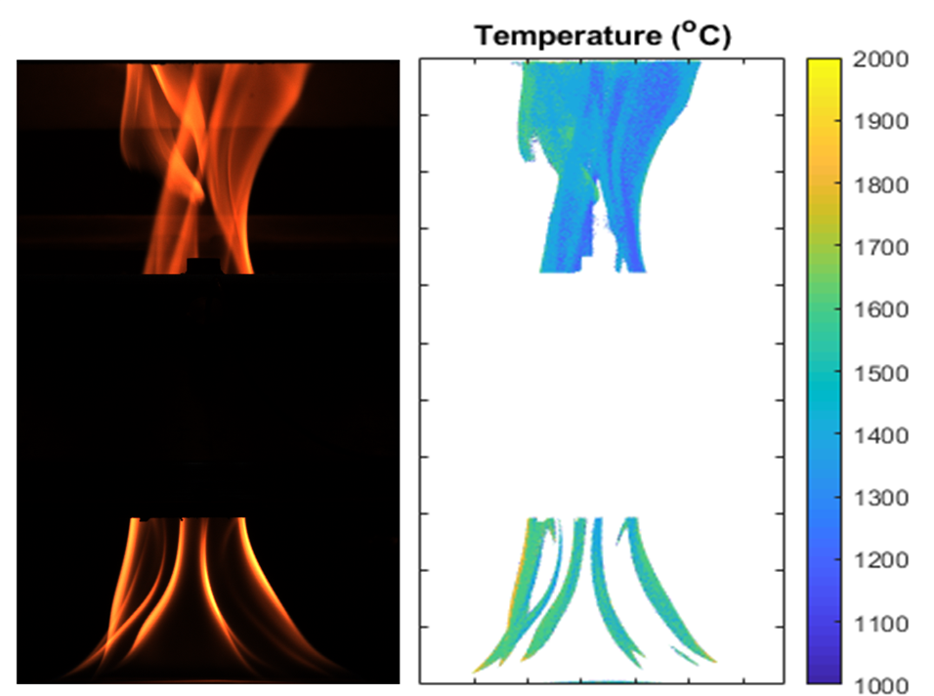
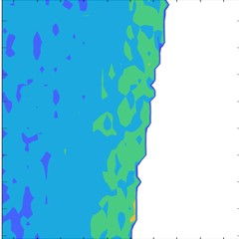
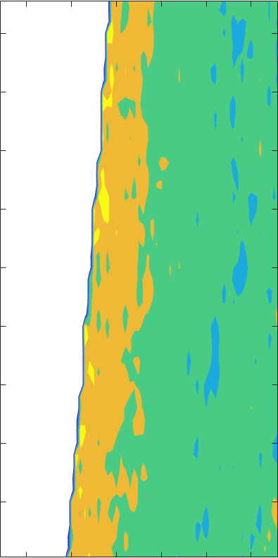
Future Work
Examine different flame retardant material’s impact on soot formation in burning PS. (TPPO, Polymeric FR, DBDPO, HBCD).
Measure flame retardant material’s impact on flame temperature.
Heptane Fire

