Slide 1
RECENT DEVELOPMENTS IN MICROSCALE COMBUSTION CALORIMETRY
Richard Walters, Richard Lyon, Louise Speitel, FAA
Natallia Safronava, TAMI
Haiqing Guo, CFar Services

Slide 2
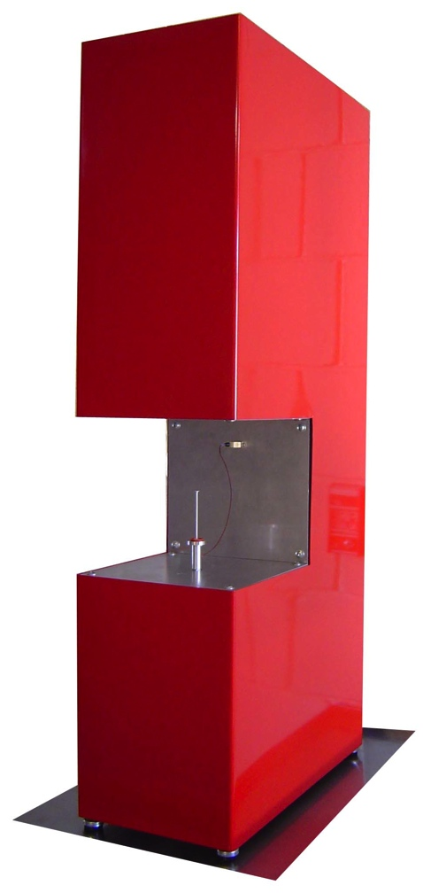
Microscale Combustion Calorimeter
Developed at FAA Technical Center
Measures Material Properties
Sample Size 5-20 mg
Temperature Resolved Data
Repeatable & Reproducible Results
PMMA
Burning Rate
Area = Heat of Combustion
Ignition Temperature

Slide 3
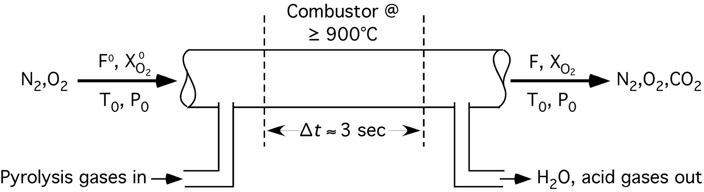
Heat Release Rate Calculation

Slide 4
Heat Release Rate Calculation
Case 1: ASTM Calculation Case 7: New Calculation
- - - - Literature Value

Slide 5
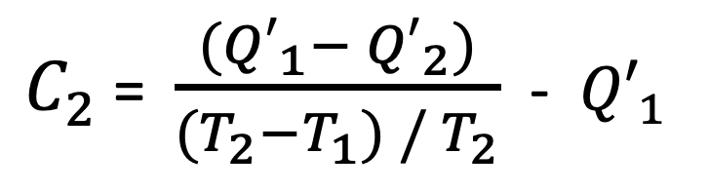
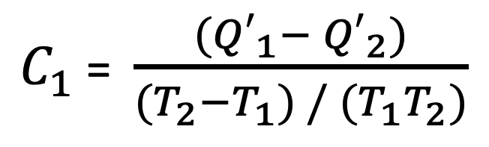
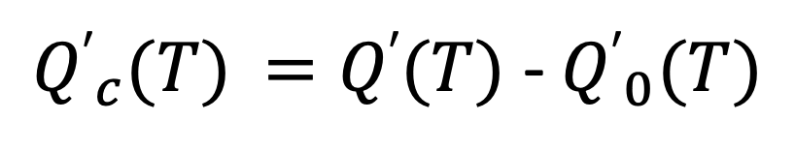
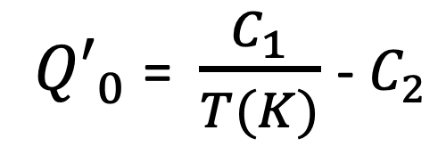
Baseline Correction Method
Coefficients for Thermal Baseline Drift
$C_{1}$ = $\frac{{(Q′}_{1}− {Q′}_{2})}{{(T}_{2}−T_{1}) / (T_{1}T_{2})}$
$C_{2}$ = $\frac{{(Q′}_{1}− {Q′}_{2})}{{(T}_{2}−T_{1}) / T_{2}}$ - ${Q′}_{1}$
Baseline Correction
${Q′}_{0}$ = $\frac{C_{1}}{T(K)}$ - $C_{2}$
Baseline Corrected Heat Release Rate
${Q′}_{c}(T)$ $=Q′(T)$ - ${Q′}_{0}(T)$

Slide 6
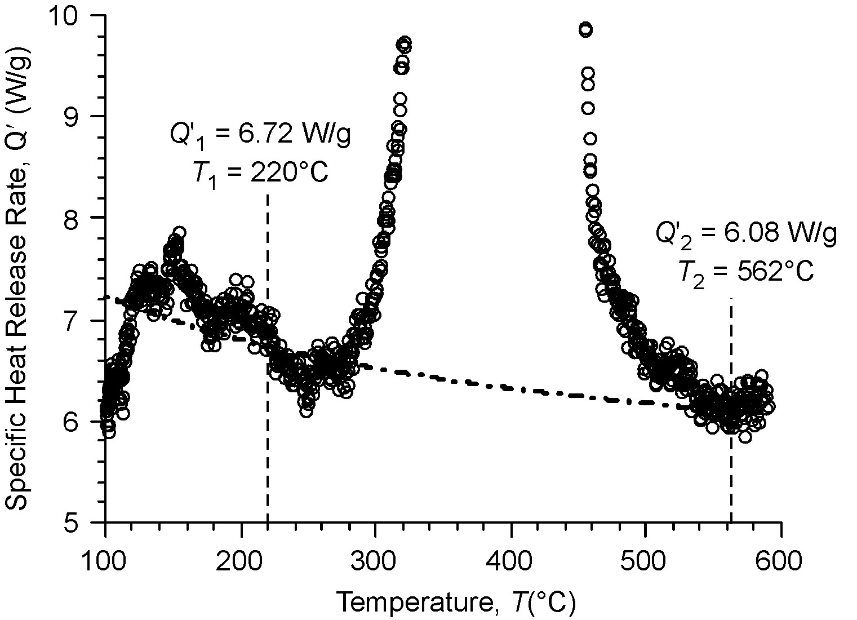
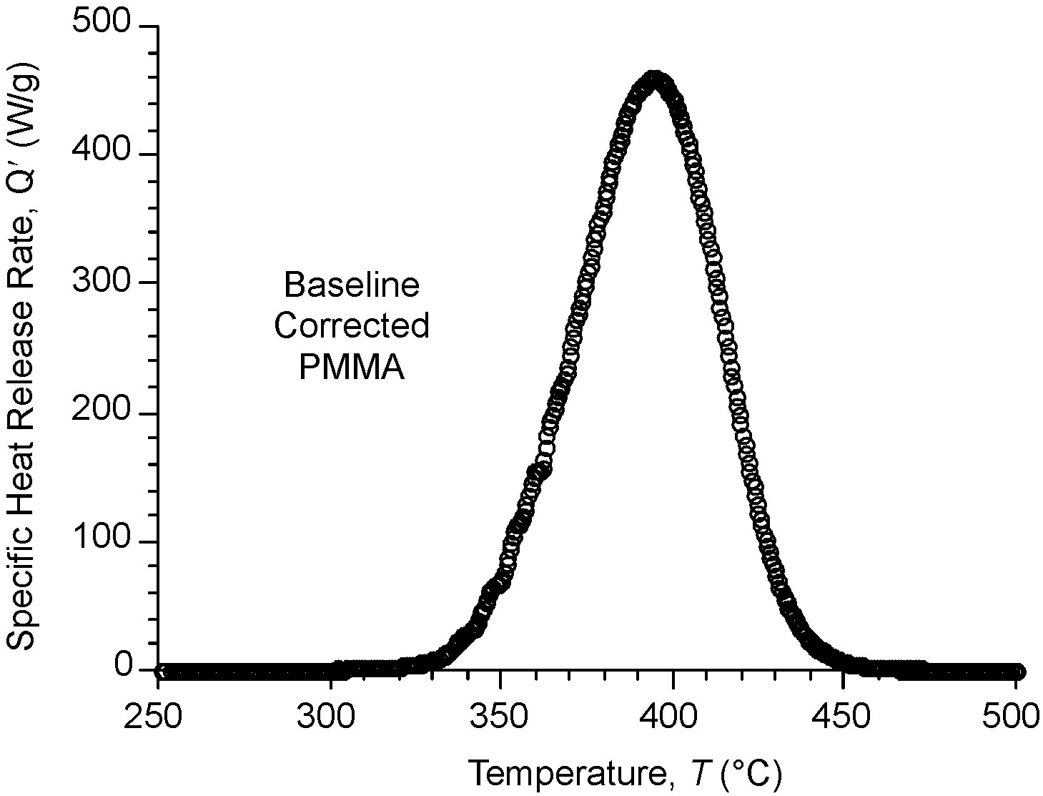
Baseline Correction Method

Slide 7
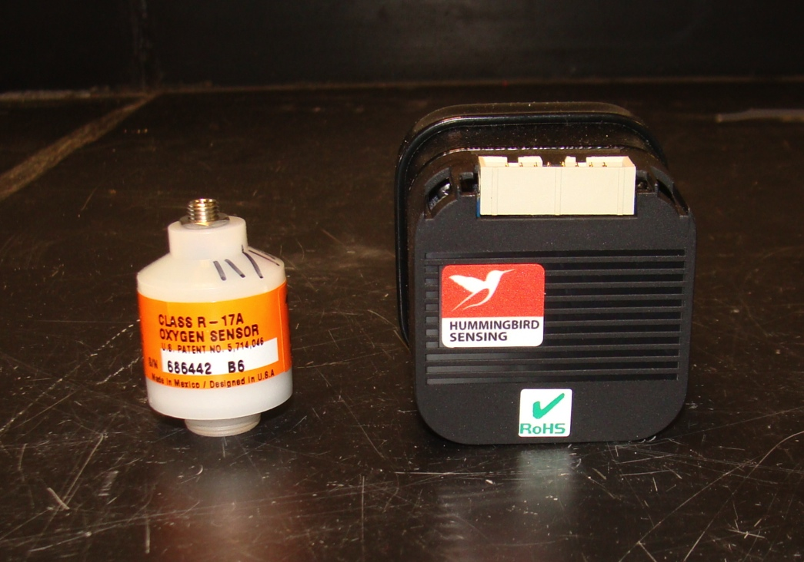
High Precision O2 Measurement
Paramagnetic Oxygen Sensor
  Less noise
  Eliminates baseline drift
  Longer lifespan
  More expensive

Slide 8
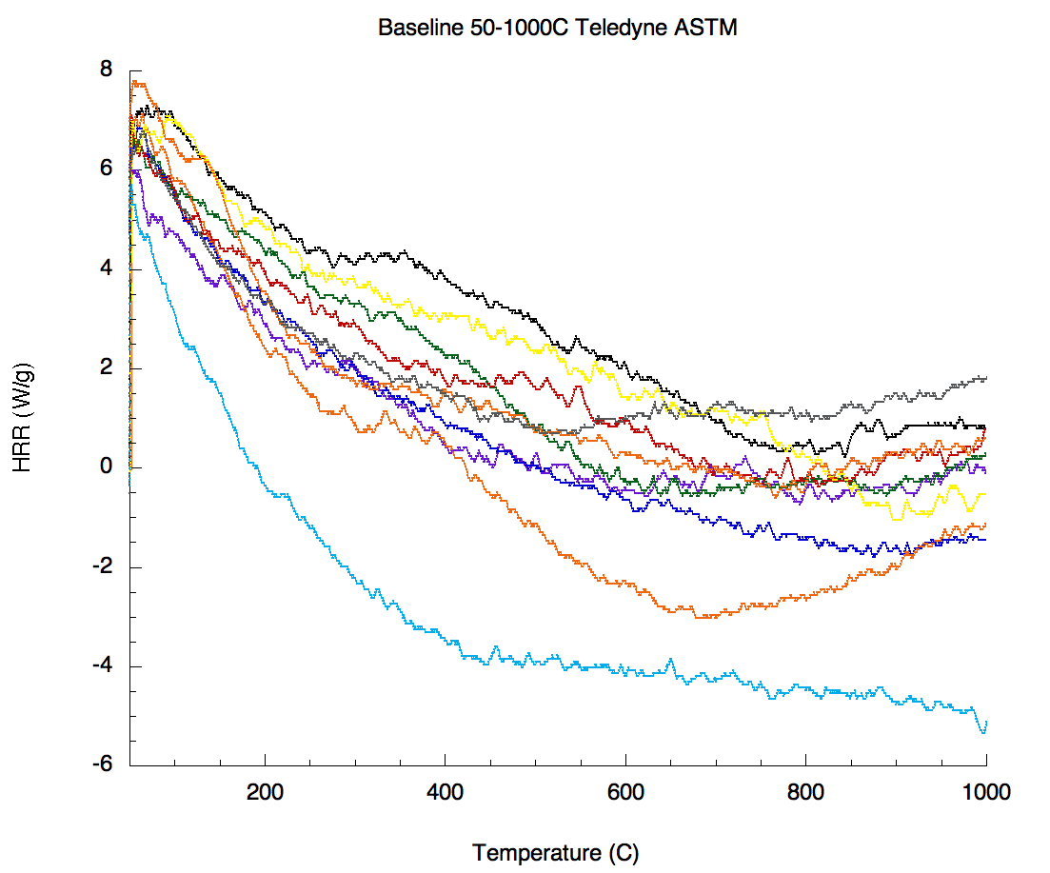
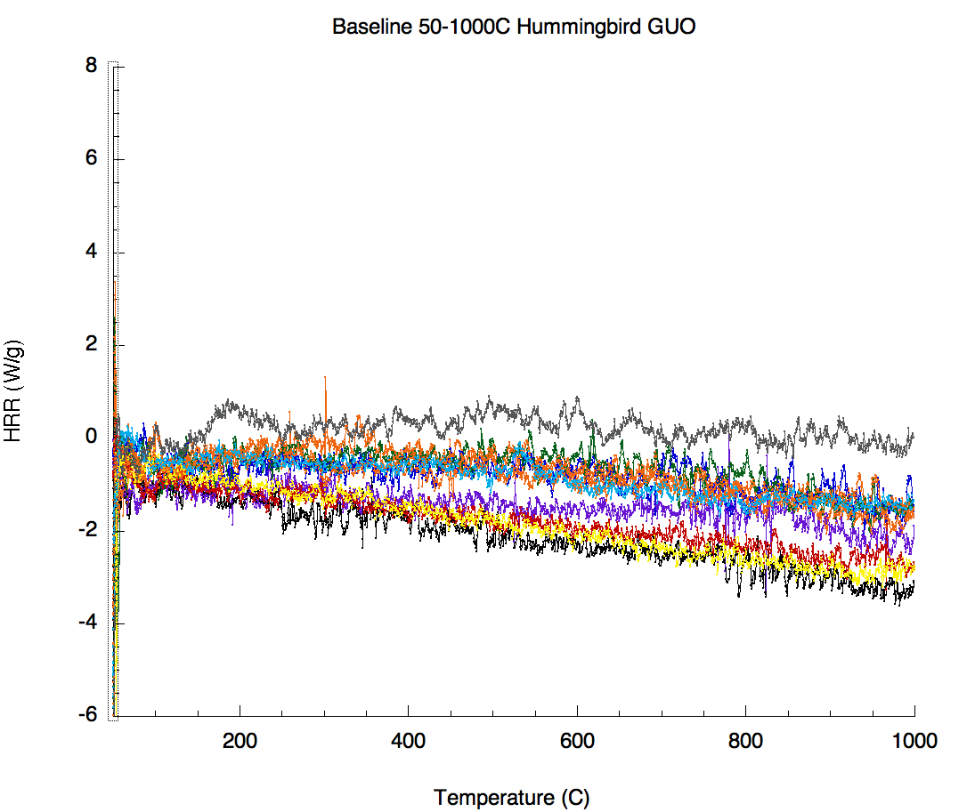
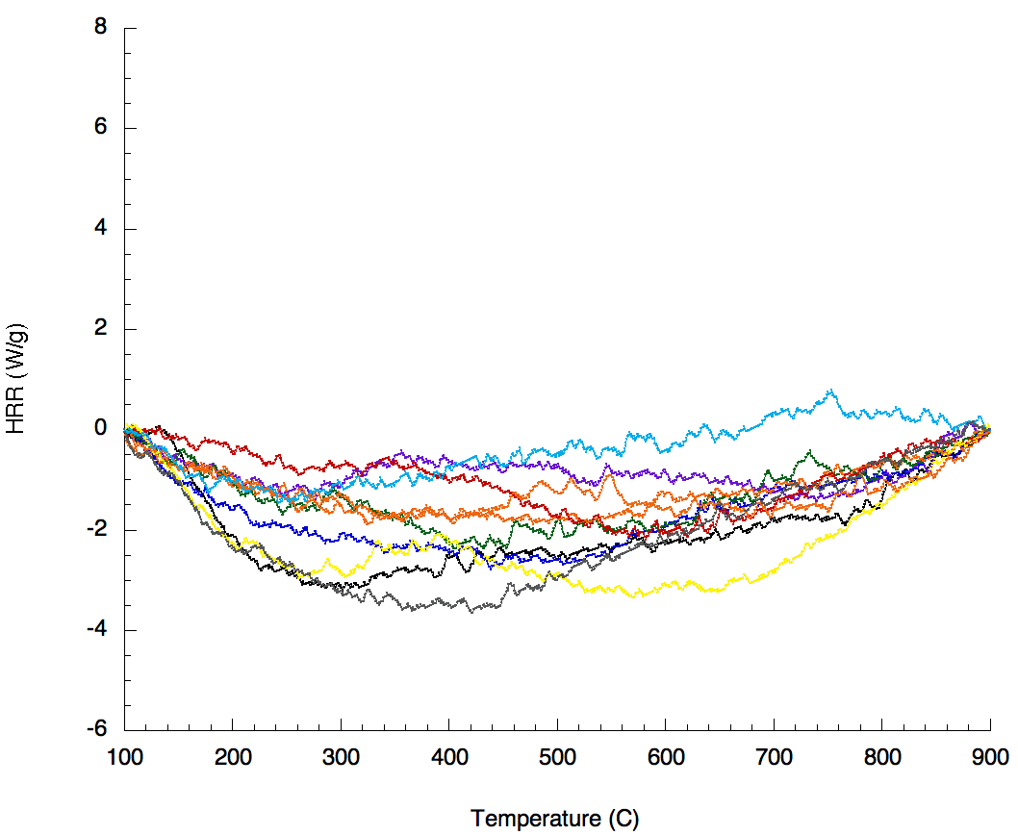
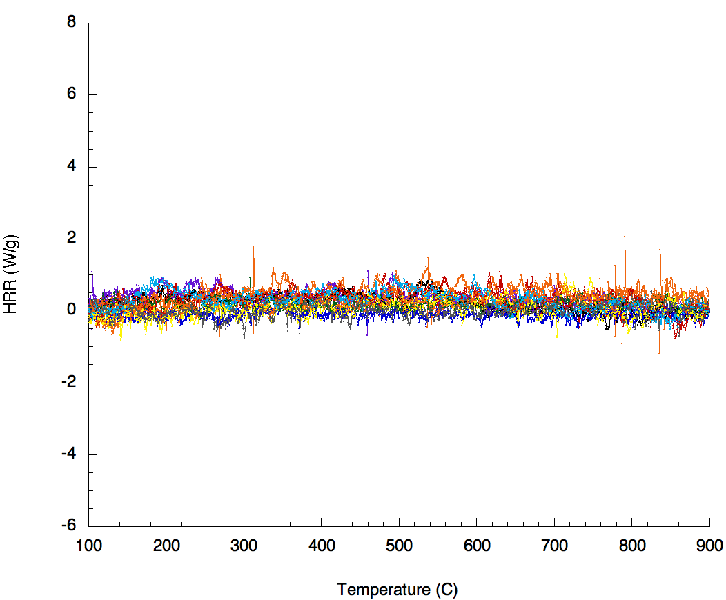
Baseline Correction Method
Standard (chemical) oxygen sensor
ASTM D7309-13 calculation
Upgraded (paramagnetic) oxygen sensor
ASTM D7309-18 calculation
Current Practice
High Precision Method

Slide 9
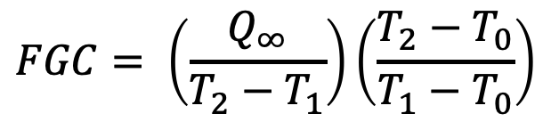
Fire Growth Capacity (FGC)
80
-5% Q∞
10
Measure Heat Release Rate Q′ vs Temperature T as per ASTM D7309 (5 replicates)
Integrate Q′/β versus T to obtain Q vs T, i.e., Q(T )
Obtain Total Heat Release
Q(T∞) = Q∞ = h_{c}(J/g)
Obtain T₁ at 5% deflection from Q(T) baseline, i.e., at 0.05Q∞
Obtain T₂ at Q∞-(0.05Q∞), i.e., 0.95Q∞.
Calculate Fire Growth Capacity (FGC)
Q∞
70
60
8
T₂
50
6
Specific Heat Release Rate, Q′ (W/g)
Q (J/g)
40
+5%
Q∞
30
4
20
2
10
T₁
0
0
200
300
400
500
600
700
800
900
Temperature, T (°C)
$$FGC= \left(\frac{Q_{∞}}{T_{2}−T_{1}}\right)\left(\frac{T_{2}−T_{0}}{T_{1}−T_{0}}\right)$$
T₀ = Standard Temperature = 25°C
T₁ ≈ Ignition temperature
T₂ = Burning temperature

Slide 10
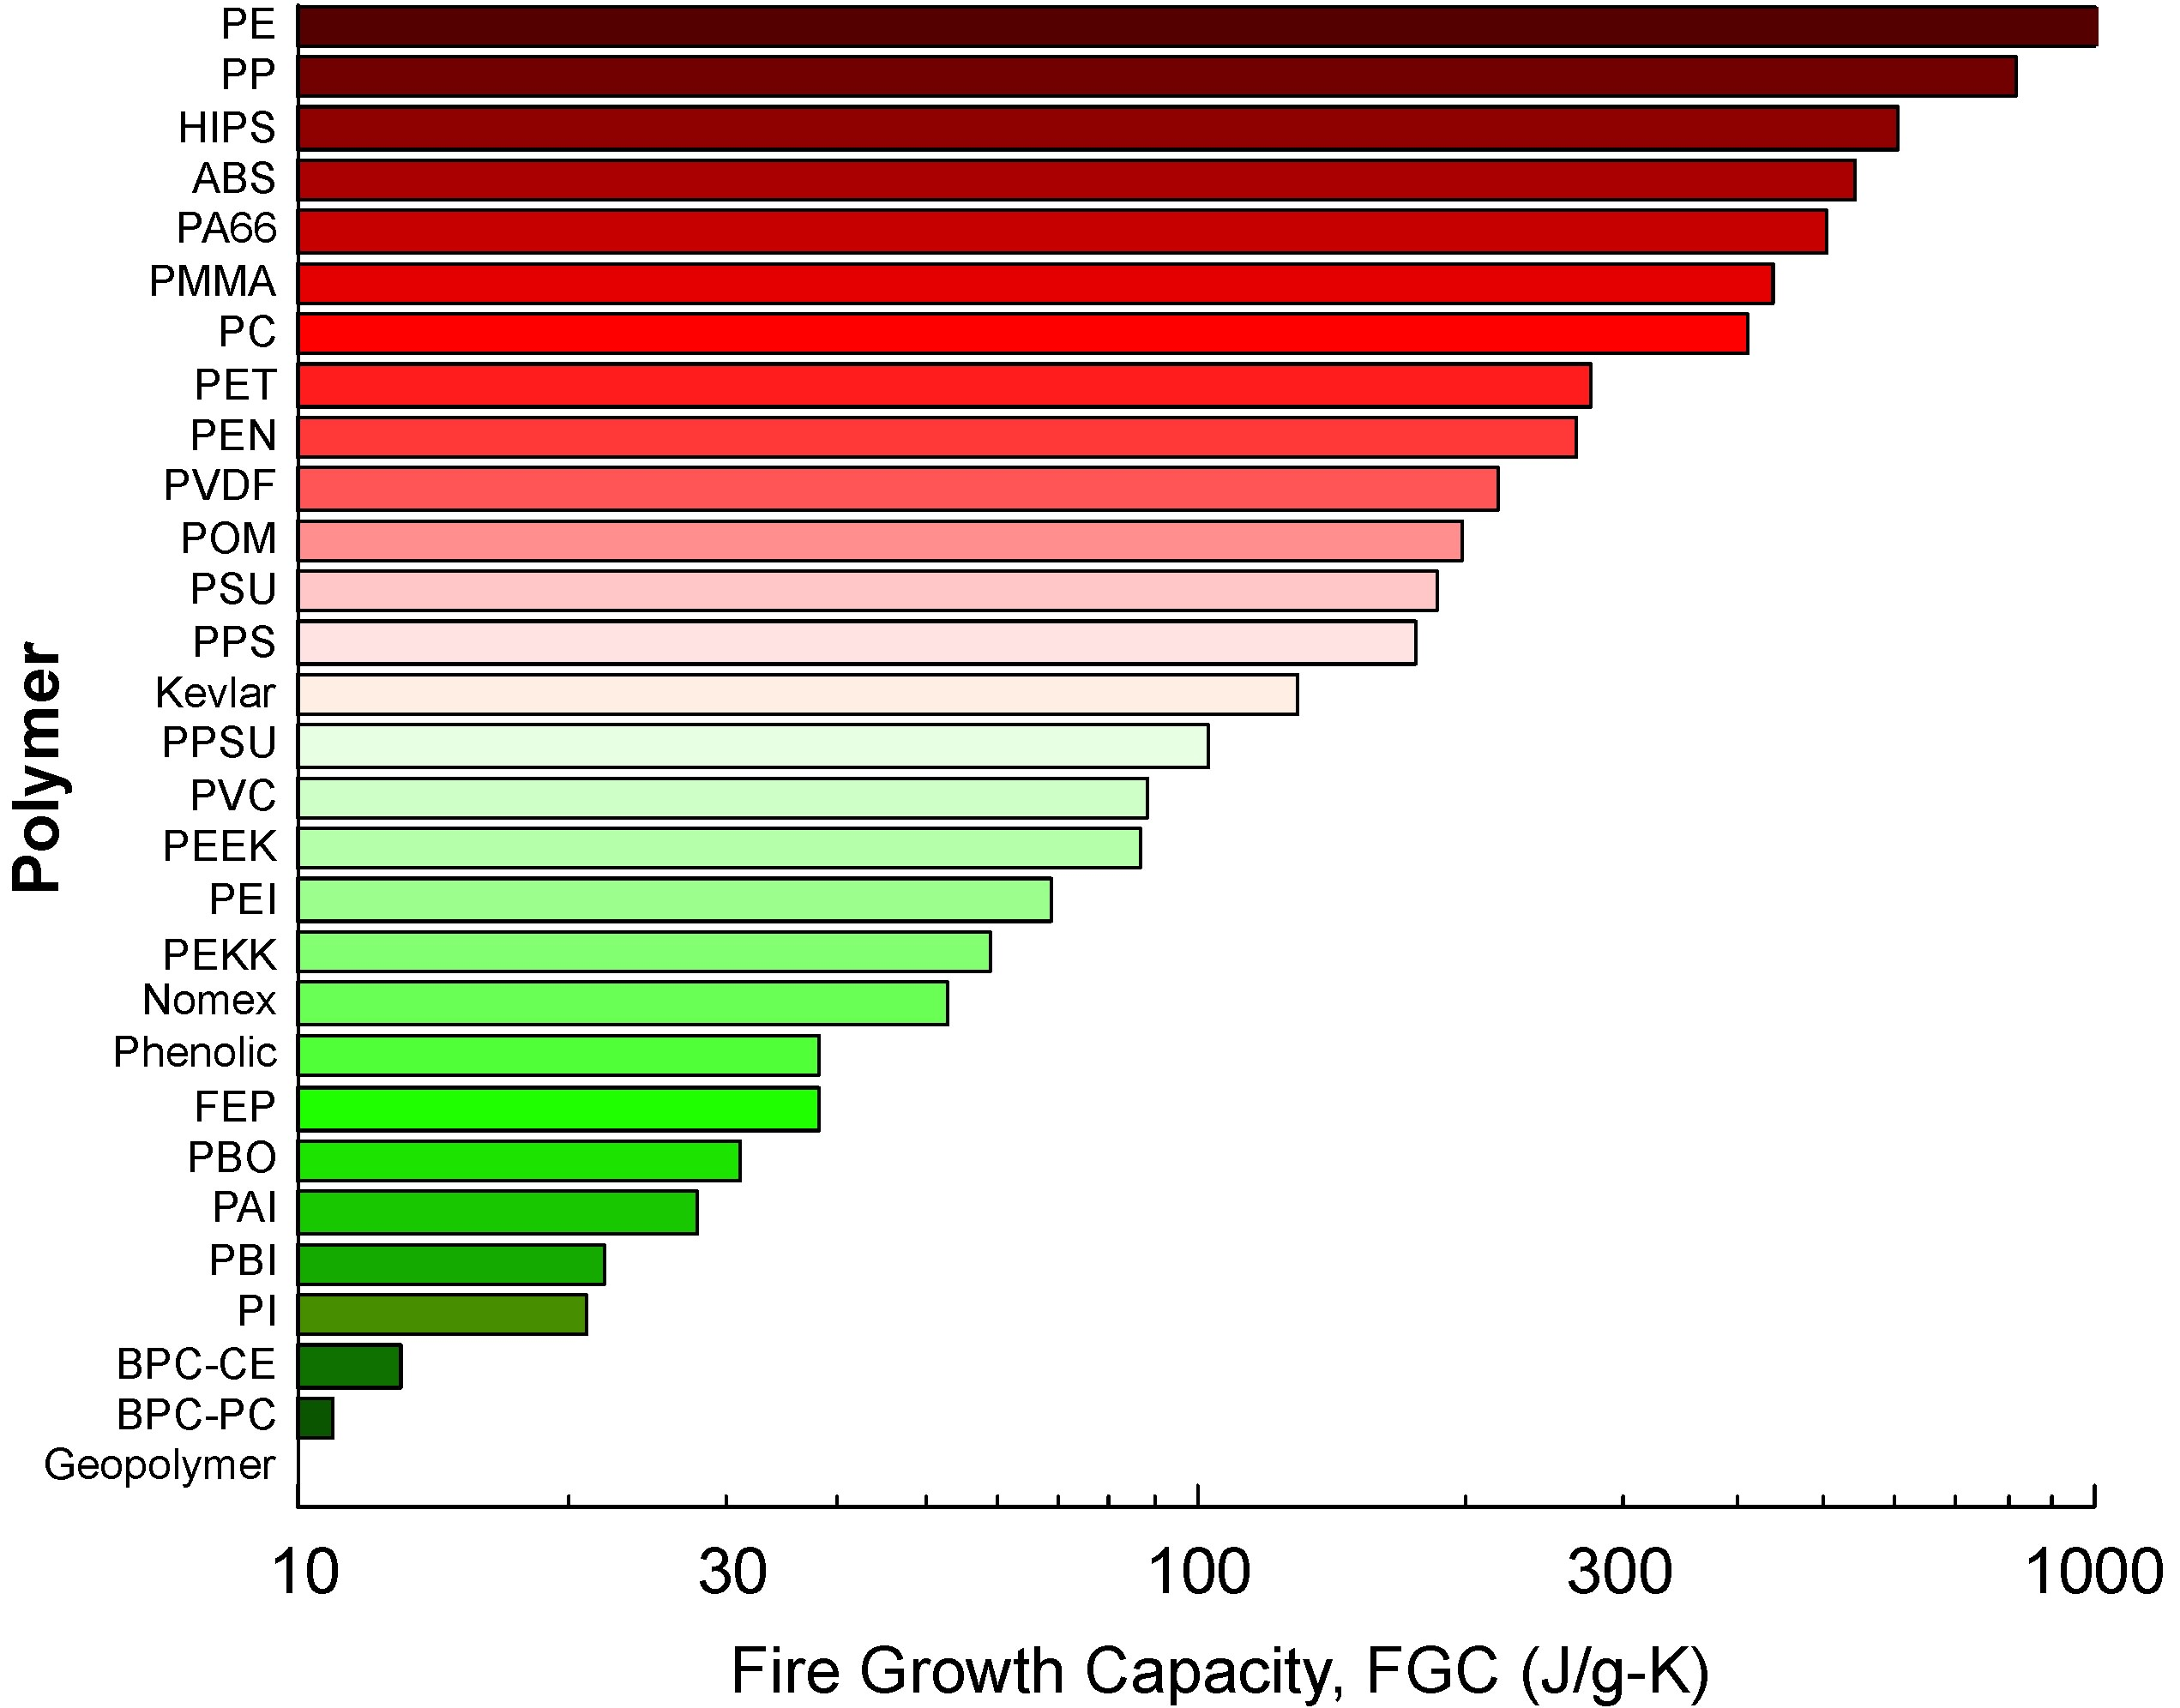
FGC

Slide 11
Revisions To ASTM D7309 Standard
New HRR Calculation
New Baseline Correction Method
Interlaboratory Study
New Precision and Bias Statement
Fire Growth Capacity

Slide 12
Interlaboratory Study
Needed for ASTM
New Precision & Bias Statement
Need Samples
  Aircraft Materials
  Composite (homogeneous & heterogeneous)
Need Participants

Slide 13
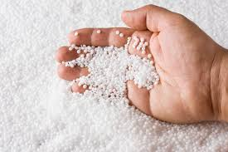
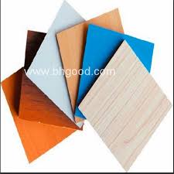
Proposal for Component Substitution
ASTM D7309 (MCC)
Test and Criterion
Components
(mg)
Similar
Different
MCC
sufficient
FAR Test
of coupon
Coupons (g)
(self supporting components)
Similar
Different
Coupon
sufficient
FAR Test
of construction
(fabricated part)

Slide 14
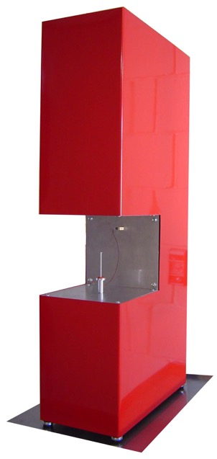
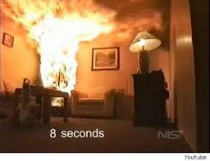
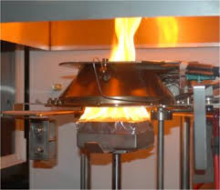
Incomplete Combustion Experiments
Extract more meaningful data from MCC
Measure effect of gas phase FR additives
Measure toxic gas production
10³ kg
1 kg
10⁻⁶ kg

Slide 15
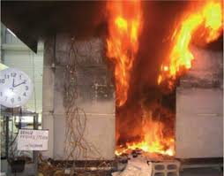
Combustion Chemistry
Fires generate toxic combustion products when oxygen becomes depleted (vitiated),
Incomplete & toxic combustion products
Fuel + Some Oxygen → CO + HCN + Hydrocarbons + Other Toxics
Excess Oxygen
Insufficient Oxygen
CO₂ + H₂O + N₂
Complete (less-toxic) combustion products
Early Stage Fire
Late Stage Fire

Slide 16
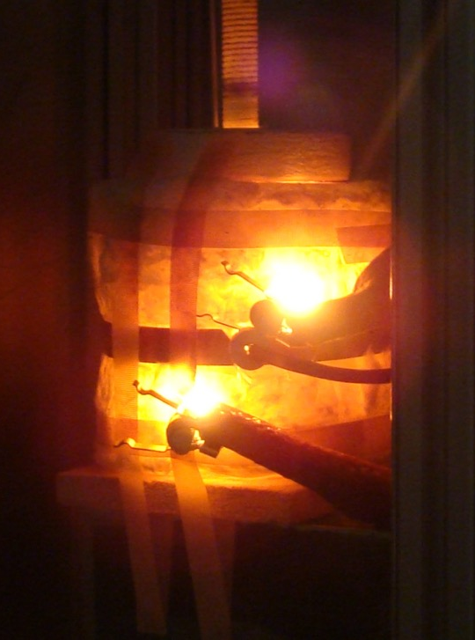
High Temperature Combustor
Installed on MCC
  High temperature
  Small volume
Approaching flame temps
  1500°C tested so far
  Soot formed
Controlled Fuel:Oxygen ratios
  Incomplete combustion

Slide 17
Controlled Fuel:Oxygen Ratio Experiments
Φ is the fuel/oxygen mass ratio relative to the stoichiometric mass ratio.
m_{Fuel} / m_{O2}
Φ
=
(m_{Fuel}/m_{O2} )_{stoichiometric}
Φ < 1 = Fuel Lean (excess oxygen)
Φ > 1 = Fuel Rich (oxygen starved)

Slide 18
Controlling Φ in MCC
Run material of mass m₀ at β = 1 K/s, X_{O2} = 0.2, and T_{c} = 900°C.
Measure ∆X_{O2}/m₀ at each sample temperature T for complete combustion of gases to obtain training set, (∆X_{O2}/m,T)₀.
Store training set (X_{O2},T,m)₀ for material.
Use (∆X_{O2}/m,T)₀ data to control O₂/N₂ flows such that:
3
2.5
∆X_{O2}(T)/m
m₀
∆X_{O2}(T)
Φ
=
=
2
(∆X_{O2}(T)/m)₀
m
(∆X_{O2}(T))₀
1.5
Percent of Oxygen Consumed, ∆ X_{O2}
1
Training Set
0.5
Program (Φ = 1)
0
Measured (Φ = 1)
200
300
400
500
600
700
Sample Temperature, T (°C)

Slide 19
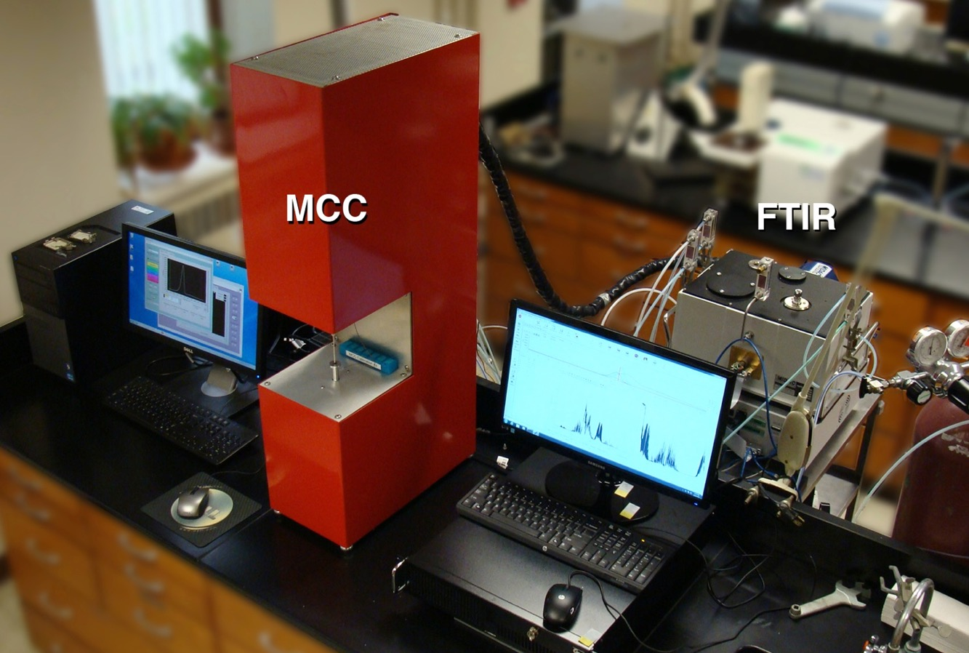
Hyphenated MCC Techniques Using FTIR & Gas Analyzers

Slide 20
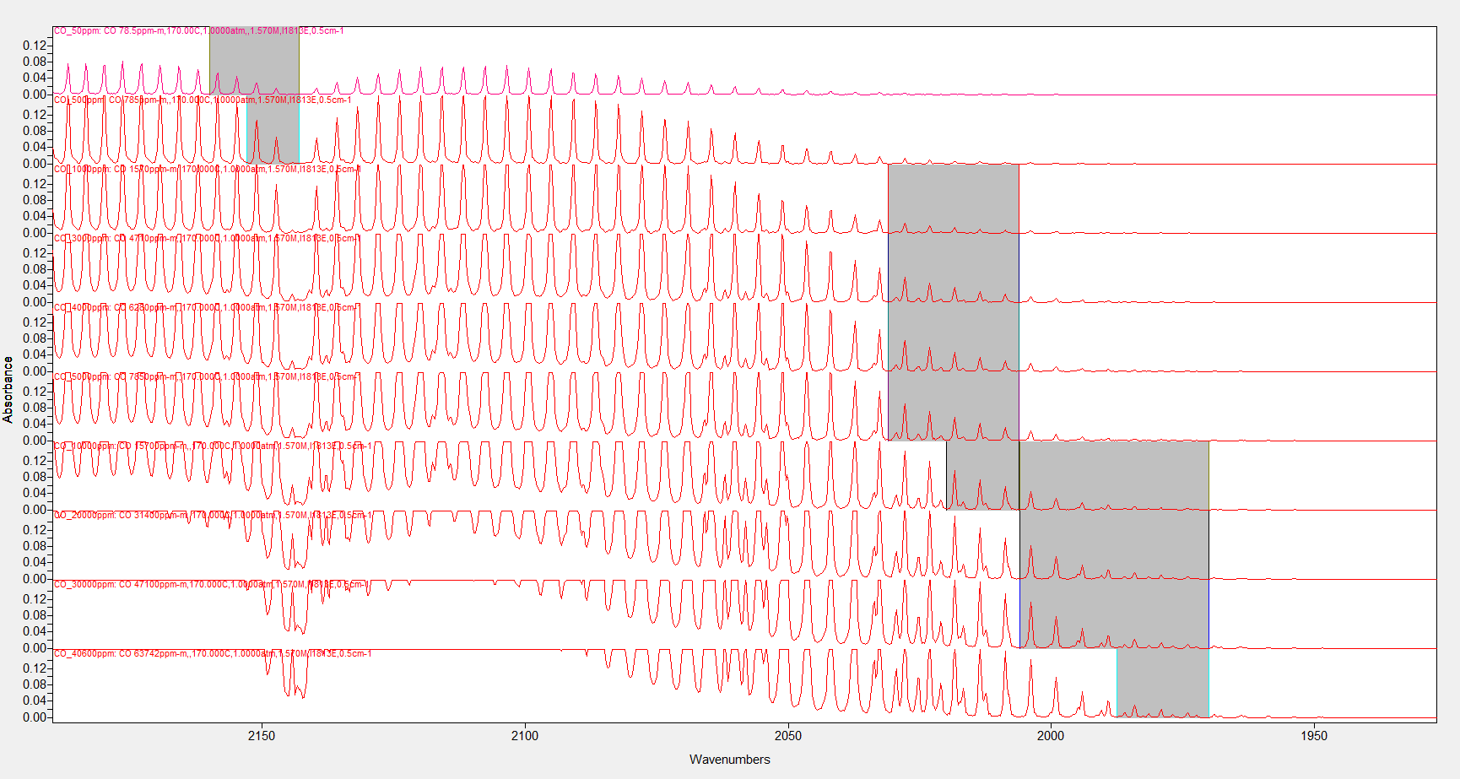
Multi-Point Calibration Spectral Regions
CO
50 ppm
500 ppm
1000 ppm
3000 ppm
4000 ppm
5000 ppm
10000 ppm
20000 ppm
30000 ppm
40600 ppm

Slide 21
FTIR Method

Slide 22
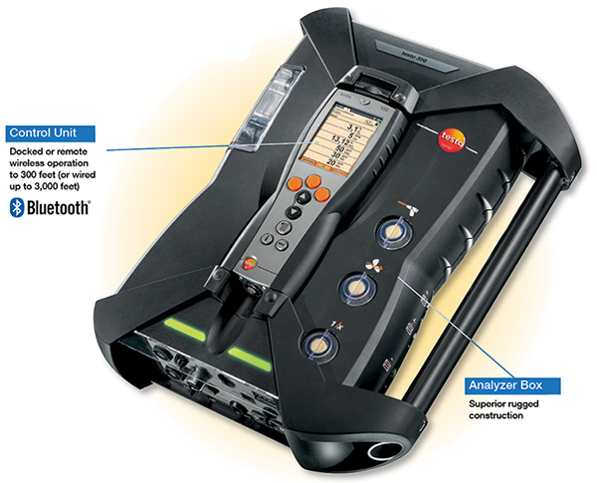
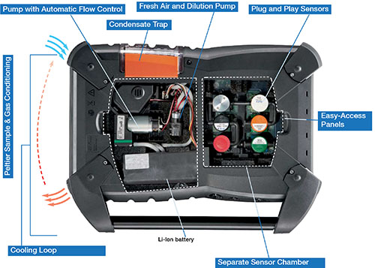
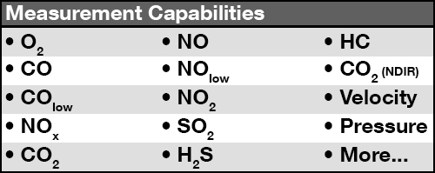
Testo Portable Gas Analyzer
No HCN?

Slide 23
Nylon Gas Analysis

Slide 24
Comparison of All Vitiated PA66 Yields
Carbon Monoxide
Hydrogen Cyanide
1000
100
10
100
CO Yield (g/kg)
HCN Yield (g/kg)
ISO Room
1
1/3 ISO Room
Controlled Atm.
Cone Calorimeter
10
Fire Propagation
Apparatus
0.1
Purser Furnace
MCC-FTIR
MCC-CO analyzer
1
0.01
0
0.5
1
1.5
2
2.5
0
0.5
1
1.5
2
2.5
Equivalence Ratio
Equivalence Ratio
(A. Stec & R. Hull, Fire Toxicity, 2010)

Slide 25
Fuel:Oxygen in Diffusion Flame
Varies from ∞ to 0 in diffusion flame
Φ_{flame} = Average Value
Laminar
Diffusion Flame
∞
Soot
Formation
Air
Air
Φ
Fuel Gases
Fuel
0
Combustible Solid
Distance into Flame Sheet

Slide 26
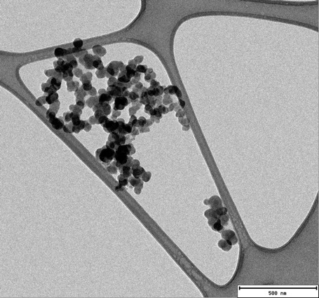
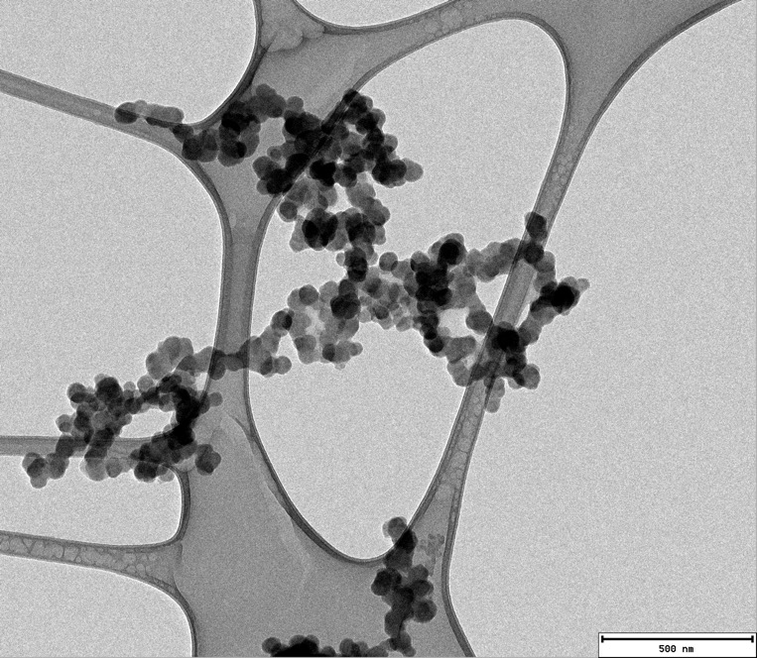
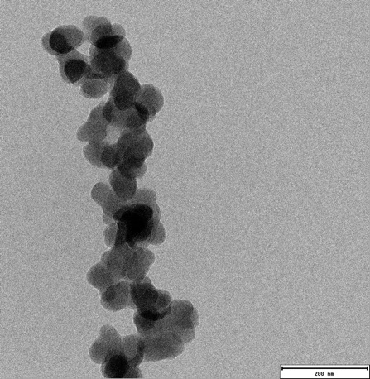
Soot Microscopy - TEM
UMass Amherst
Polymer Science & Engineering
The Silvio O Conte National Center For Polymer Research

Slide 27
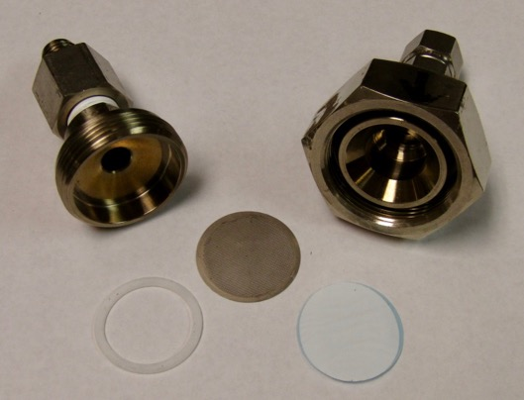
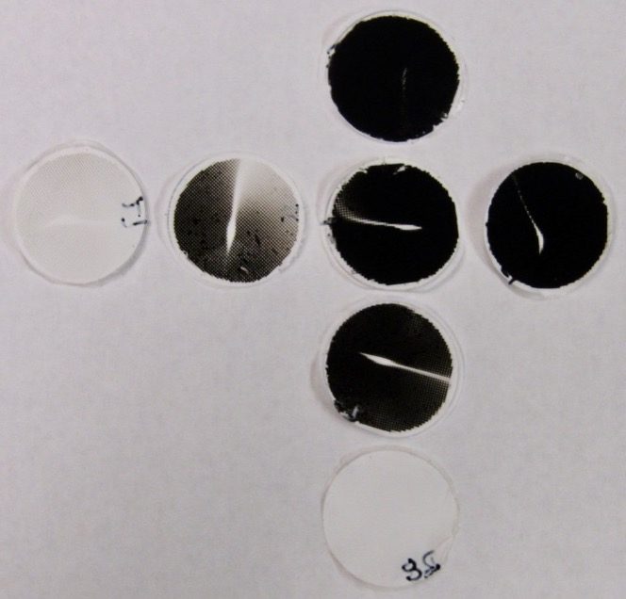
Gravimetric Soot Experiments - PS
Filter Assembly
Equivalence Ratio, Φ
0.75
1
1.25
1.5
1500°C
1375°C
Stainless Steel Filter Housing
25mm PTFE unlaminated
0.2 micron membrane filters
Vacuum dried and weighed
prior to and after testing
1250°C
1000°C

Slide 28
Gravimetric Soot Yields

Slide 29
Summary & Conclusions
Improved accuracy and precision of MCC data
  HRR calculation
  Baseline
  O2 analyzer
Fire growth capacity
Revisions to ASTM standard
  ILS
Similarity determinations for small changes
Recreates flaming combustion products
  Toxicity measurements
  Gravimetric soot measurements

Slide 30
Contact Info
Richard Walters
Federal Aviation Administration
Fire Safety Branch ANG-E21
Atlantic City Int’l Airport, NJ 08405 USA
richard.walters@faa.gov
609-485-4328

