Slide 1
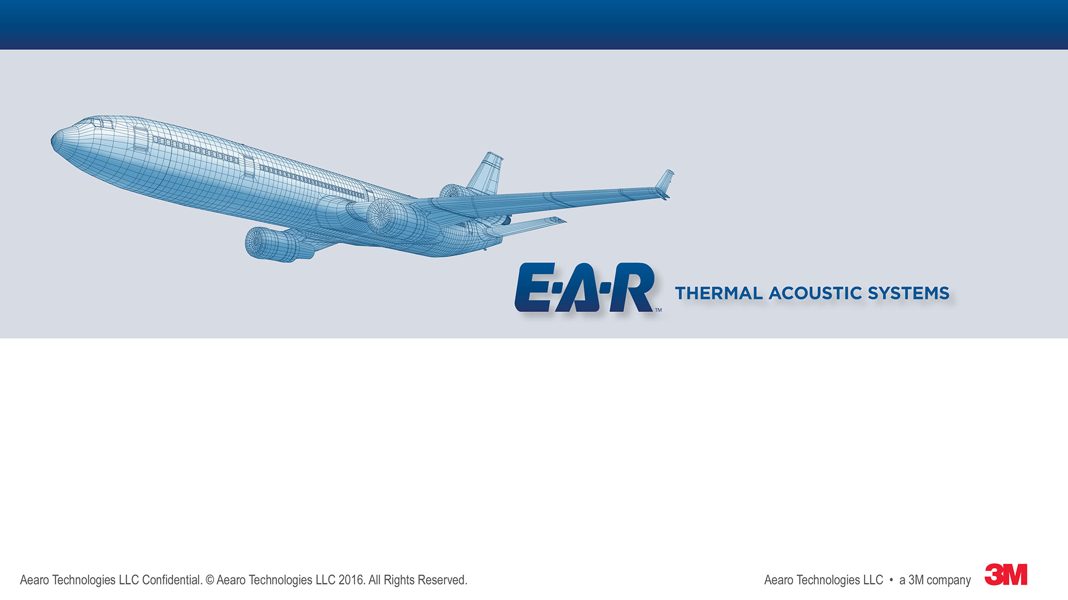

9th Triennial Aircraft Flammability Conference, Oct 29, 2019, Atlantic City, NJ
Using Microscale Combustion Calorimetry as a Predictor for Radiant Panel Behavior of Insulating Microfiber Blankets
Fredrick Vance, PhD, Aearo Technologies LLC, a 3M company
Nurkan Turkdogru Gurun, PhD, Aearo Technologies LLC, a 3M company
Mary Colston, Aearo Technologies LLC, a 3M company
Eumi Pyun, PhD, 3M Company
Liyun Ren, PhD, 3M Company

Slide 2
Outline
Introduction & background
Materials and microcalorimetry combustion
Radiant panel flammability
Conclusions & path forward

Slide 3
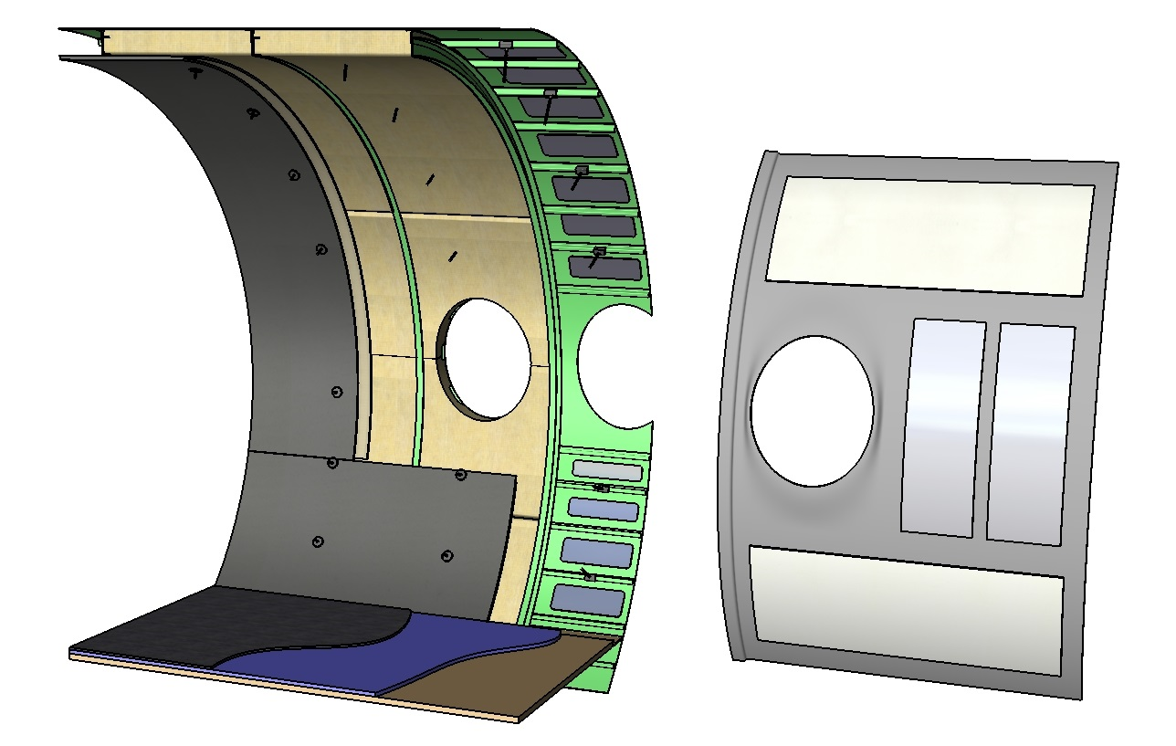
Aircraft Acoustic Treatments
Spikes
Overframe Blanket
Insulation
Carpet
Skin Damping
Trim Panel Damping
Carpet Pad
Floor Panel
Floor Panel Damping
(underneath, not shown)

Slide 4
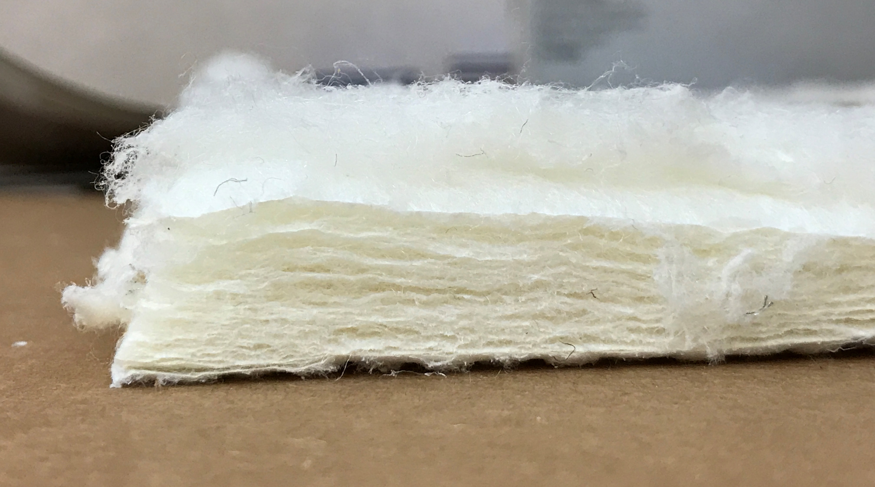
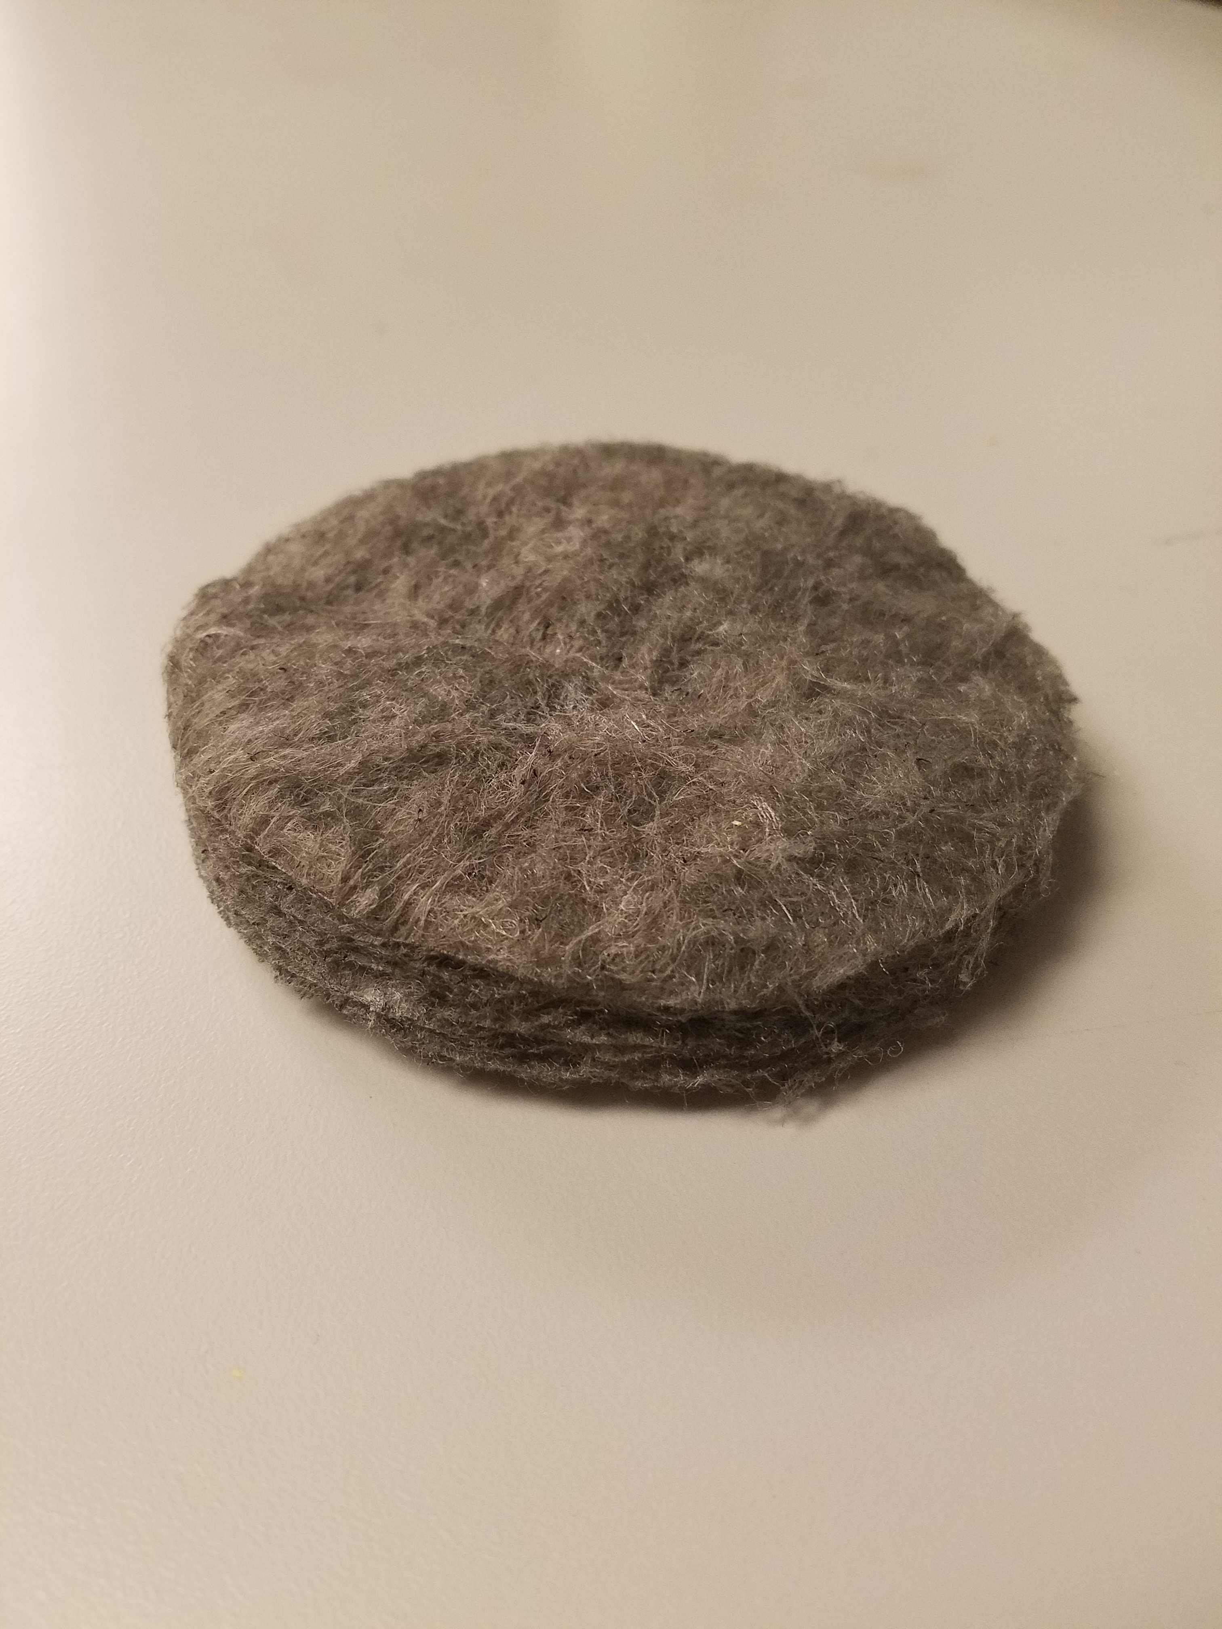
Developing New Aircraft Acoustic Materials
Insulation on an aircraft provides thermal protection (primary) as well as acoustic benefits (secondary)
Material sets limited to those passing flammability criteria for different parts of airplane
New developmental materials may offer weight, acoustic, or other benefit while meeting primary needs.

Slide 5
MCC Performed on Microfiber Webs
Microscale Combustion Calorimetry (MCC) carried out according to ASTM D 7309
  See also DOT/FAA/TC-12/53.
Materials were microfiber webs, each with two distinct fiber size populations
  Melt blow fibers provide insulation
  Staple fibers provide loft and integrity
Blends of multiple polymers showed multiple peaks in MCC

Slide 6
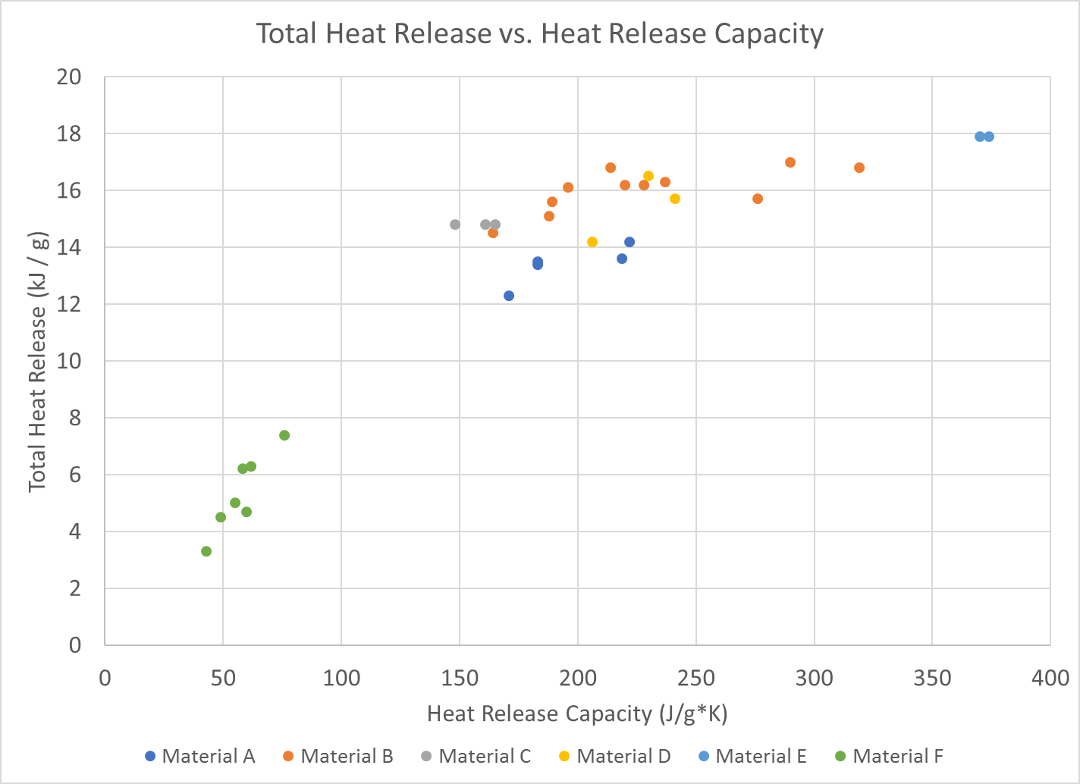
Microscale Combustion Calorimetry Results
Experimental Materials
Control

Slide 7
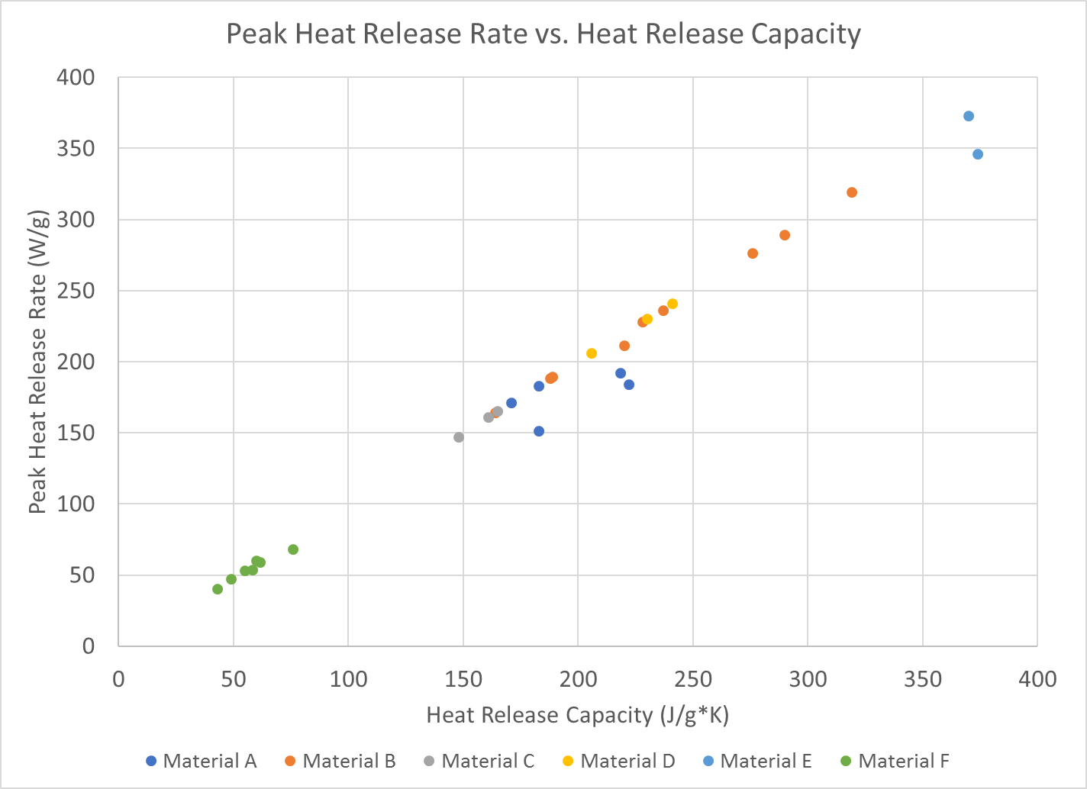
Microscale Combustion Calorimetry Results
Experimental Materials
Control

Slide 8
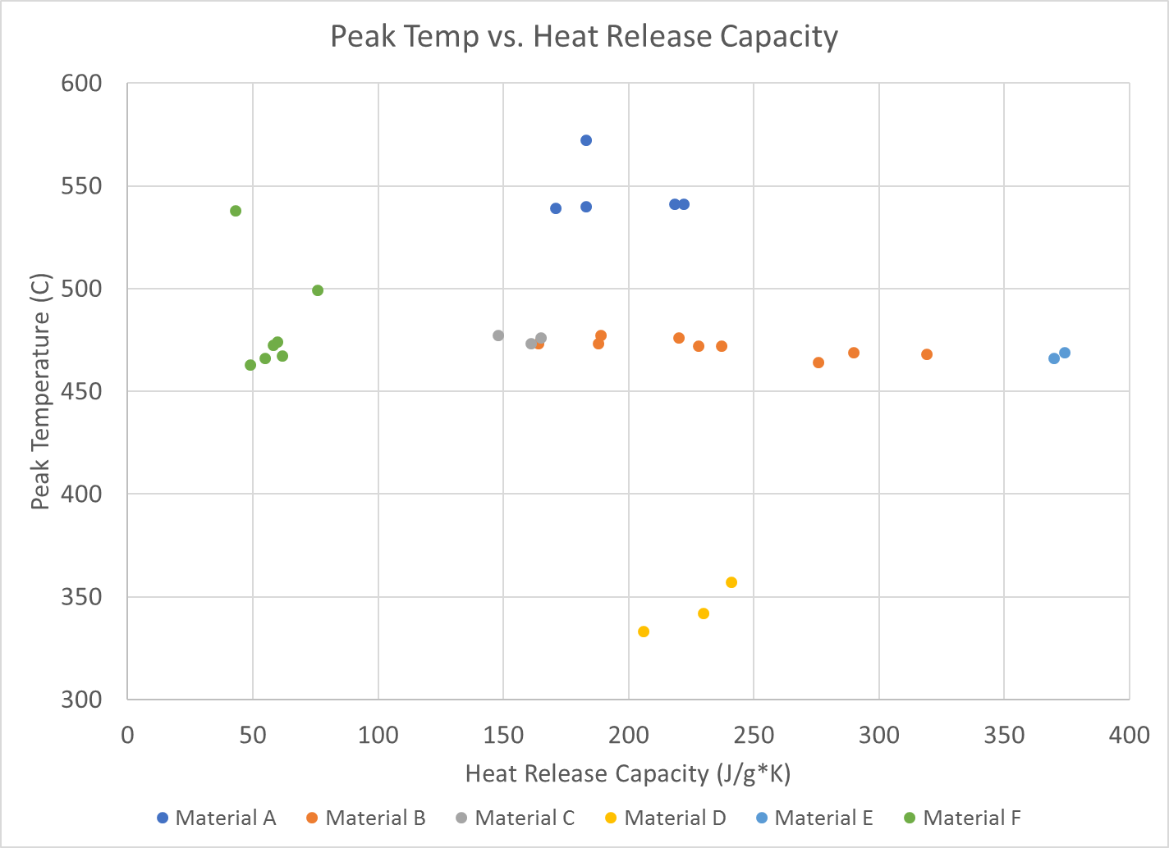
Microscale Combustion Calorimetry Results
Control
Experimental Materials

Slide 9
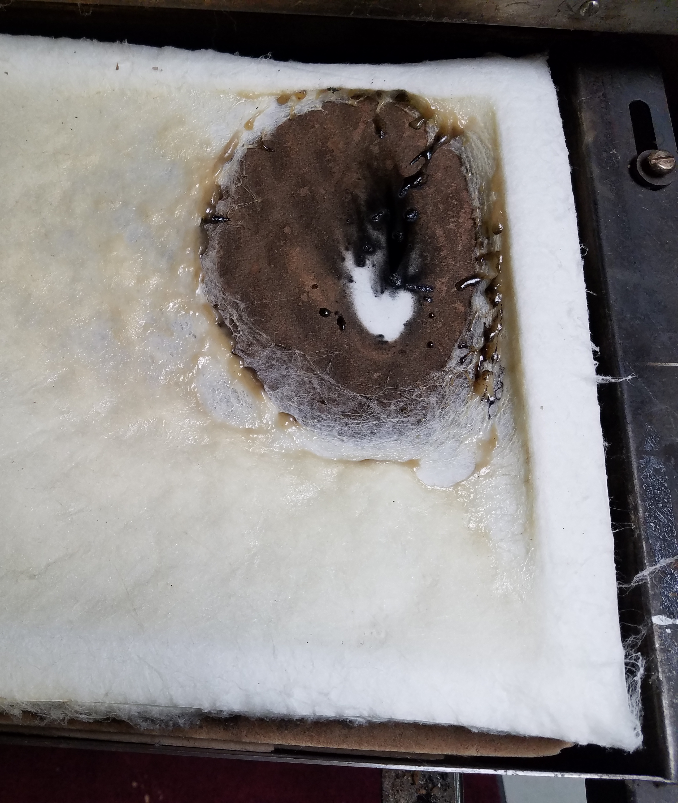
Radiant Panel Testing Results
Material Type | Description | Result
A | High temp polymer | Pass
B | Dual component, staple 1 | Pass
C | Dual component, staple 2 | Fail
D | Dual component, staple 3 | Fail
E | Dual component, staple 4 | Pass
F | Meta-aramid control | Pass

Slide 10
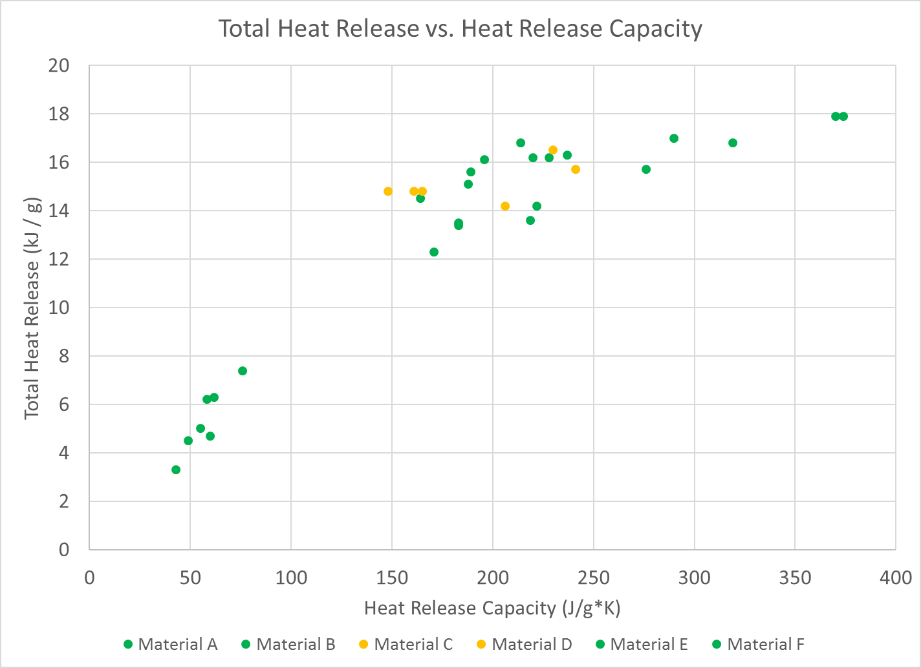
MCC vs Radiant Panel Results
Fail
Pass

Slide 11
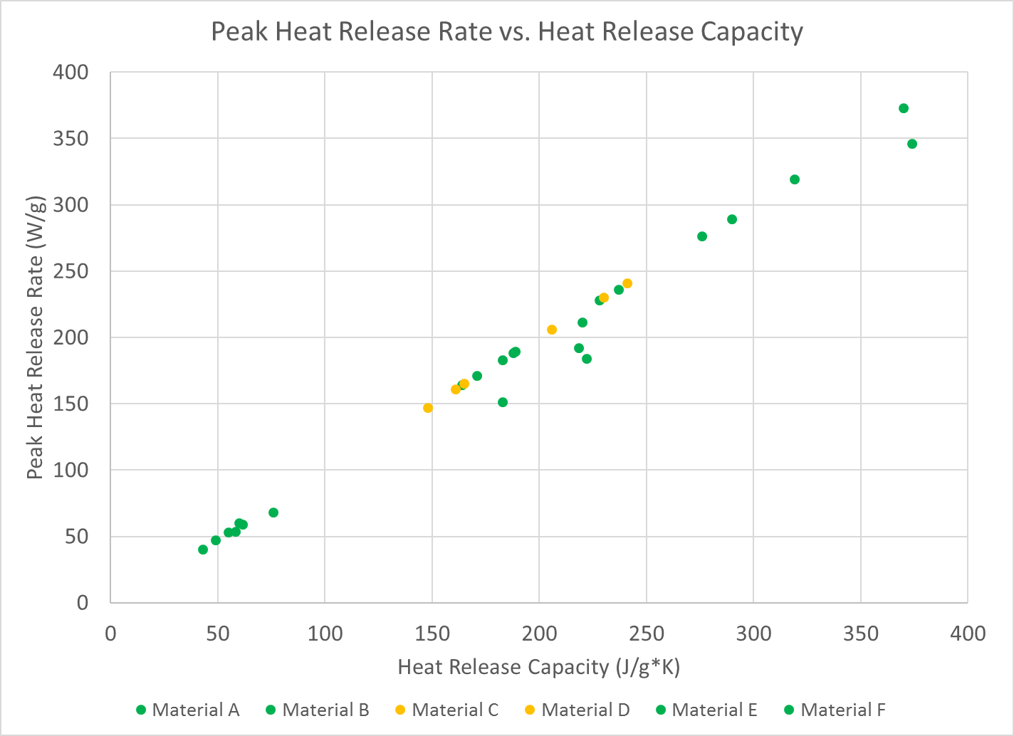
MCC vs Radiant Panel Results
Fail
Pass

Slide 12
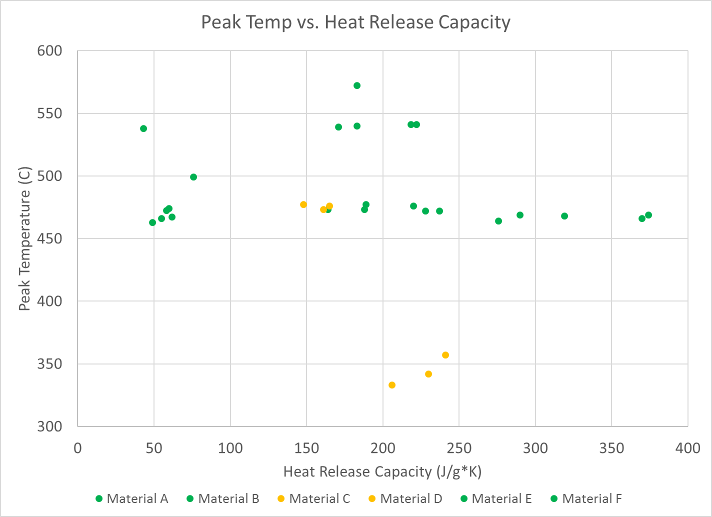
MCC vs. Radiant Panel Results
Pass
Fail

Slide 13
Conclusions and Next Steps
MCC values are not strong predictors of radiant panel results for these heterogeneous systems
Additional factors such as fiber size and flame retardant mechanism has significant influence
Future work will focus on optimizing blends for improved performance while meeting flammability targets

Slide 14
Thank You! Questions?
Fredrick Vance
fwvance@mmm.com
317-982-3312

Slide 15
Backup

Slide 16
Abstract
The insulation of an aircraft in recent years has been accomplished with a relatively small number of well-known sets of fibers or foams, limited most notably by their flammability characteristics. These materials provide the required thermal performance along with acoustic absorption suited to their purpose, whether it be in a commercial plane or a high-end luxury jet. Meanwhile, other markets like consumer apparel have benefited from the recent proliferation of polymeric microfibers, offering premium performance in the form of reduced weight, reduced thickness, or better tolerance to environmental insults like water and debris.
This study is focused on the early stage development of novel polymer-based microfiber blankets or webs suitable for cushioning, thermal insulation, and acoustic absorption in aircraft. Various fiber web constructions were evaluated with the aim of improving acoustic performance while meeting flammability requirements for airworthy certification. The fibers were constructed from a combination of materials including homopolymers and flame retardants, and the webs employed a combination of fibers varying in both composition and fiber size. Microscale Combustion Calorimetry (MCC) was employed to understand how various polymer components would impact flammability compliance as measured by the radiant panel test described in FAR 25.856(a) Appendix F Part VI. Preliminary results indicate that MCC does not definitively predict the radiant panel flammability outcome, suggesting that factors such as fiber size and web density control the kinetics of flaming combustion in these webs. These results could lead to improved sets of insulating materials suitable for aircraft use based on polymers with intrinsically higher heat of combustion and heat release capacity than the polymers these new insulating materials may displace.

Slide 17
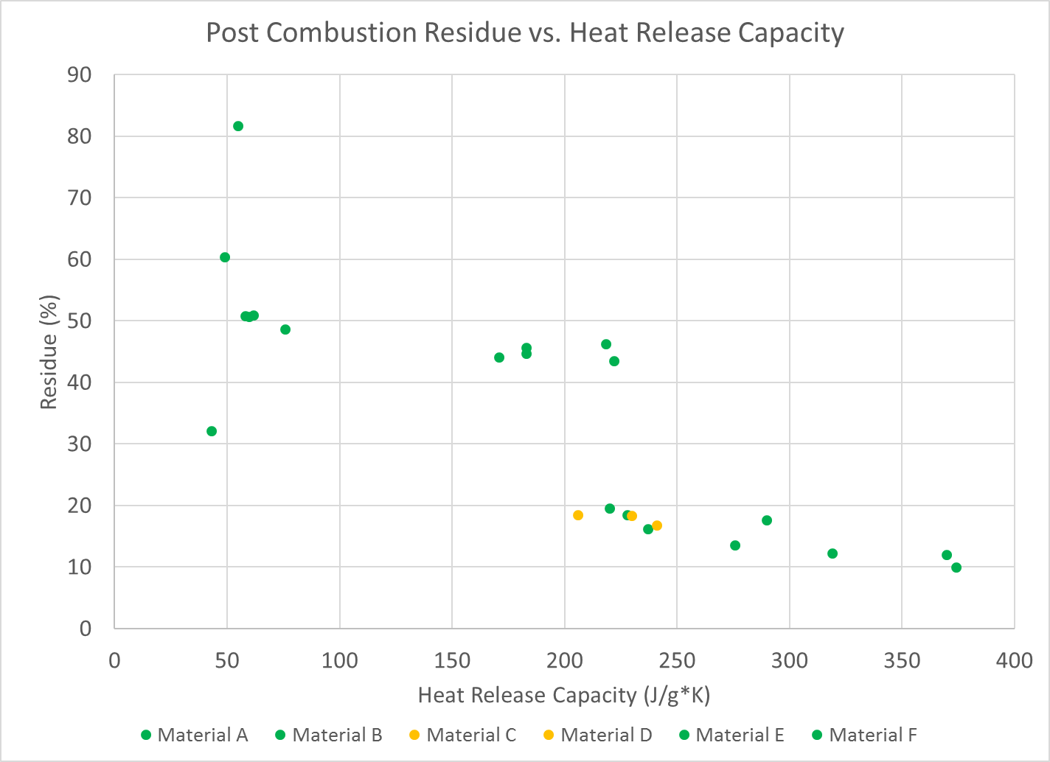
Backup

