Slide 1

Measuring toxic potency of smoke over a range of fire stages using milligram samples
Louise C. Speitel, Richard N. Walters, Natallia Safronava, & Richard E. Lyon
Federal Aviation Administration, Fire Safety Branch
http://www.fire.tc.faa.gov
9thTriennial Cabin Fire and Cabin Safety Conference
Atlantic City, NJ
October 28 - 31, 2019

Slide 2
Motivation
  Make conditions of micro combustion calorimeter (MCC) similar to the physical/chemical processes of flaming combustion by varying the fuel/oxygen ratio relative to stoichiometric (Φ) and increasing the combustor temperature to the range of flame temperatures, T_{F} = 1300⁰C-1800⁰C.
  This MCC methodology combined with analysis of combustion products is hoped to be a valuable tool in combustion toxicity assessments for aircraft materials and commercial/residential furnishings over a range of fire stages from initiation to flashover.

Slide 3
Strategy
  Upgrade the MCC combustion furnace to reach flame temperatures.
  Upgrade the FTIR method .
  Hold the equivalence ratio, Φ , and combustion temperature constant over the entire constant heating rate pyrolysis history.
  Run selected materials in the MCC-Φ with:
    Combustor Temperatures, T_{c} = 750⁰C, 1000⁰C, 1250⁰C and 1500⁰C
    Constant Φ = 0.5 to 1.75 (fuel lean to fuel rich).
Evaluate the gaseous combustion products as a function of T_{c} and Φ using FTIR and gas analyzers.

Slide 4
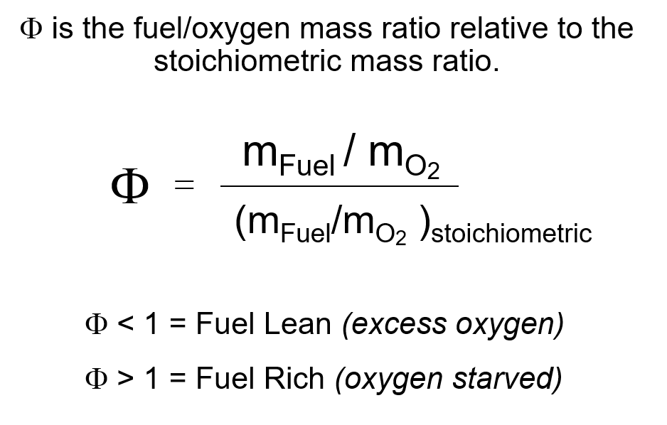
Fuel / Oxygen Ratio in MCC

Slide 5
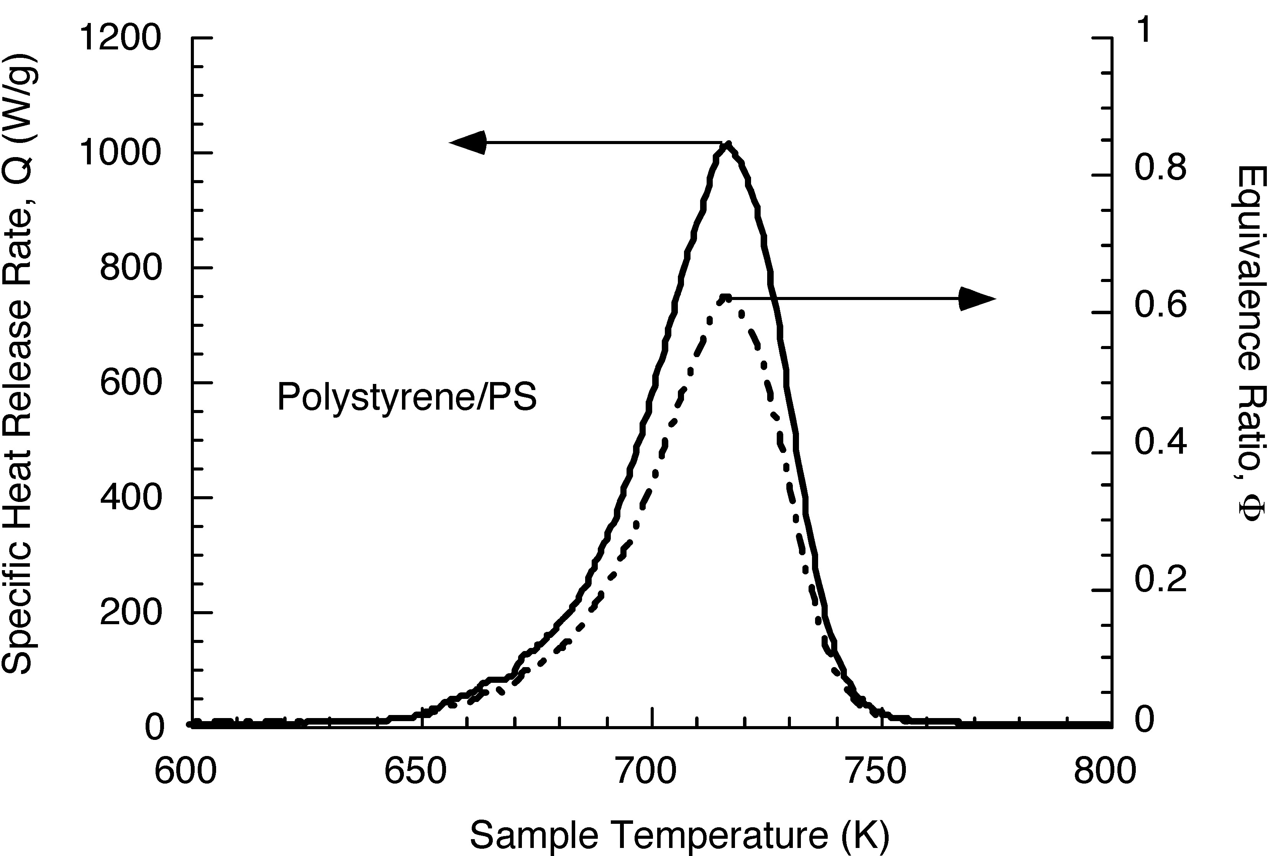
Specific Heat Release Rate, Q, and Φ in the Standard Test
(ASTM D7309)
In contrast, in MCC-Φ, the equivalence ratio is held constant (square wave shape)

Slide 6
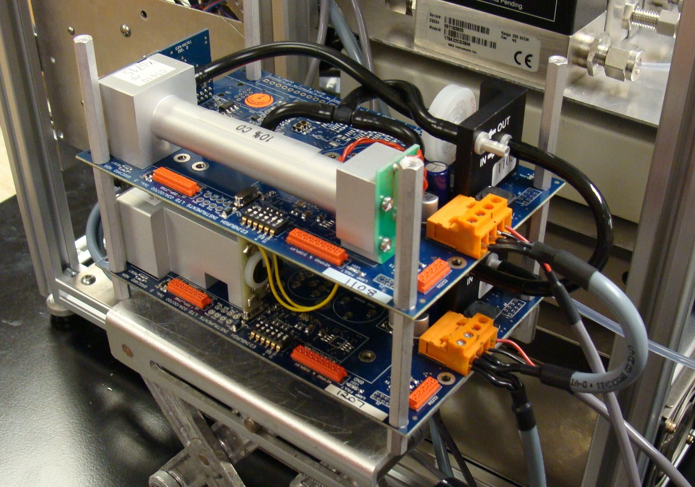
MCC-Φ (Constant Φ):
Fuel / O₂ Control and Measurement
Premixed
Combustion
(Constant T)
Pyrolysis
(Ramp T)
Flow
Meter
Flow
Meter
Sample
Sample
Desiccant
750°C - 1500 °C
Cold Trap
Pyrolyzer
(Up to 1600°C)
Pyrolyzer
O₂
Analyzer
DAQ
O₂
Analyzer
DAQ
N₂
N₂
O₂
O₂
CO
Φ
CO
Φ
CO₂
CO₂
Computer controls MFCs maintaining constant Φ
Exhaust
Exhaust

Slide 7
Schematic MCC-Φ-FTIR
Premixed
Combustion
(Constant T)
Filter
(160° C
Tube oven)
Pyrolysis
(Ramp T)
Heated
Line
(165° C)
FTIR
90 ml cell
(170 ° C)
0.5 cm⁻¹ resolution
Sample
Pyrolyzer
(up to 1600° C)
DAQ
N₂
O₂
Desiccant
Filter
Φ
O₂, CO₂, CO
Analyzers
Control From Look-up Table Maintaining Constant Φ
Exhaust
Notes:
FTIR and gas analyzers run concurrently to check quantification accuracy.

Slide 8
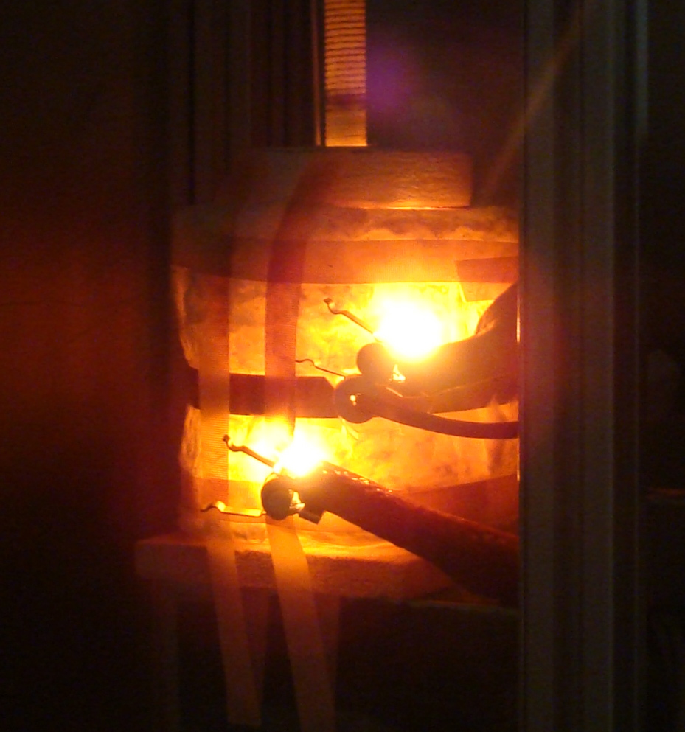
Ultra High Temperature Combustion Furnace
Combustor temperatures within the range of flame temperatures,
T_{F} = 1300⁰C-1800⁰C
Run combustor at temperatures:
  750⁰C
  1000⁰C
  1250⁰C
  1500⁰C

Slide 9
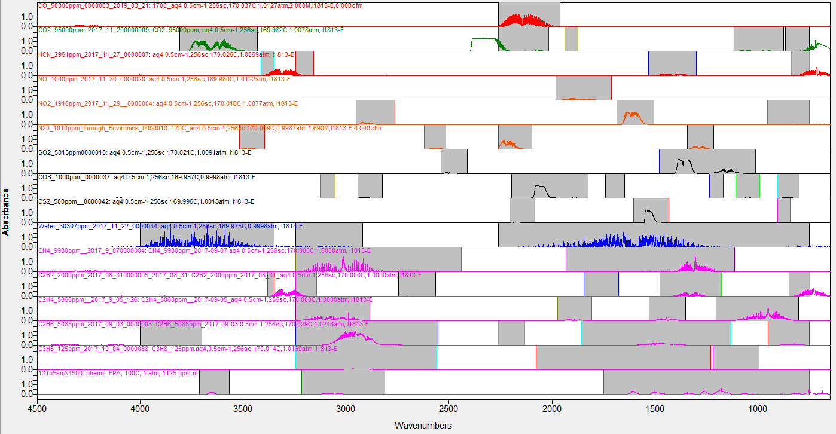
Spectral Regions for Combustion Gases: Method
Absorbance
CO
CO₂
HCN
NO
NO₂
N₂O
SO₂
COS
CS₂
H₂O
CH₄
C₂H₂
C₂H₄
C₂H₆
C₃H₈
C₆H₅OH
Wavenumbers (cm⁻¹)
Notes:
All spectra shown are for maximum calibration concentrations
Up to 32 spectra are included in the method for some gases eg.) CO₂:
Nonlinear calibration curves
Normalized spectra changing shapes
Each region must start or end at the baseline ( Zero absorbance)

Slide 10
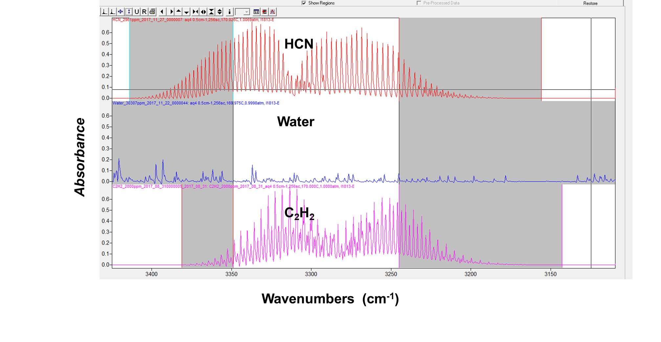
Spectral Regions for Combustion Gases: HCN and C₂H₂
Notes:
Each region must start or end at the baseline

Slide 11
CO Yields in the MCC- Φ by NDIR
Notes:
Yields

Slide 12
CO₂ Yields in the MCC- Φ by NDIR

Slide 13
CO₂/CO Yield Ratios in the MCC- Φ by NDIR

Slide 14
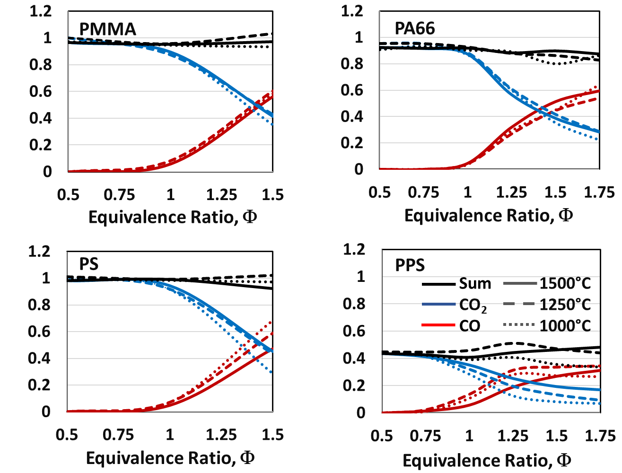
Yields of CO_{x} Normalized for the Theoretical
CO_{x} Maximums at 1000⁰C, 1250⁰C and 1500⁰C

Slide 15
MCC-Φ Yields of SO₂, COS, and CS₂ by FTIR for PPS
* Maximum theoretical SO₂ yield = 592g/kg

Slide 16
MCC-Φ Yields of HCN, N₂O, and NO by FTIR for PA66
* Maximum theoretical HCN yield = 239g/kg
Notes:
High levels of HCN at 750C for all phis (smoldering)
Lowest HCN levels at 1500C
No NO₂ detected.
NO₂ Limit of detection high due to NO₂ absorbing in spectral area with a lot of water.

Slide 17
Gas Yields in Vitiated Small/ Full/ Bench Scale: Nylon 66
A. Stec & R. Hull, Fire Toxicity, 2010
A. Tewarson, The SFPE Handbook of Fire Protection Engineering, Sec.3, Ch. 4., 2008

Slide 18
CO, CO₂, and HCN Variance for PA66 in MCC-Φ at 1000C

Slide 19
Yields of CO₂ and Water at 1500⁰C Relative to Theoretical Yield in Excess Oxygen (Φ= 0.5)
Sample | CO₂ Analyzer | CO₂ FTIR | Water FTIR
PMMA | 0.97 | 0.97 | 1.02
PS | 0.98 | 0.89 | 0.81
PA66 | 0.92 | 0.97 | 0.86
PPS* | 0.44 | 0.42 | 0.90
*Does not account for carbon in char

Slide 20
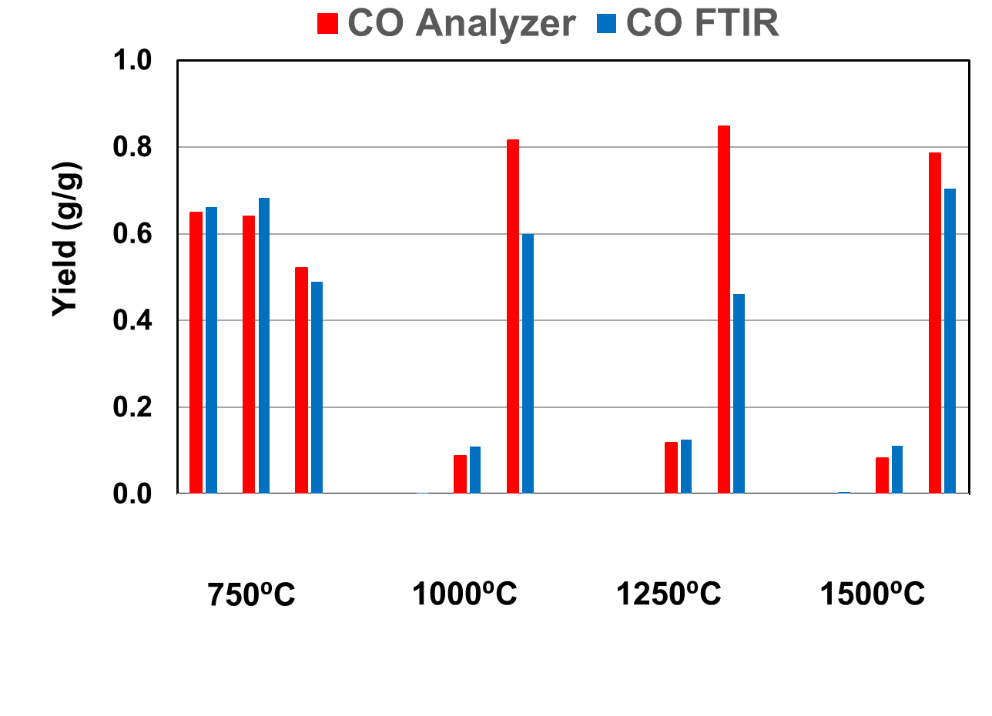
Comparison of CO Yields: NDIR and FTIR for PMMA
Arrows indicate large FTIR errors
Φ= 0.5 1 1.5 0.5 1 1.5 0.5 1 1.5 0.5 1 1.5
Notes:
Large FTIR errors are seen as indicated at 1.5 phi at 1000 and 1250 deg C

Slide 21
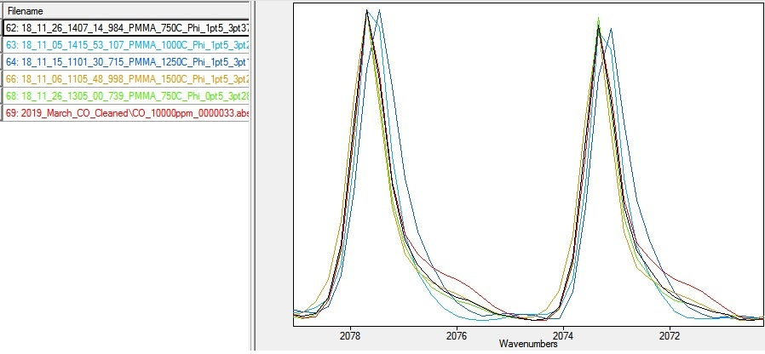
Comparison of Normalized CO Spectra for PMMA
1.0 +/- 0.15 percent CO
Large
Yield
Errors
Wavenumbers (cm⁻¹ )
Notes:
Frequencies wobble back and forth within 19 days
The resultant errors are not acceptable
A more robust method is needed:

Slide 22
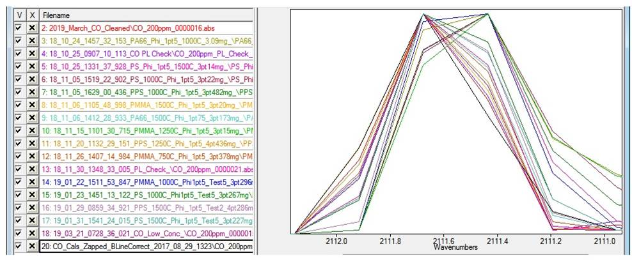
Comparison of CO Normalized Spectra for PMMA
MCC and Calibration Spectra: 200 +/- 20ppm
Significant shifting observed
Wavenumbers (cm⁻¹ )

Slide 23
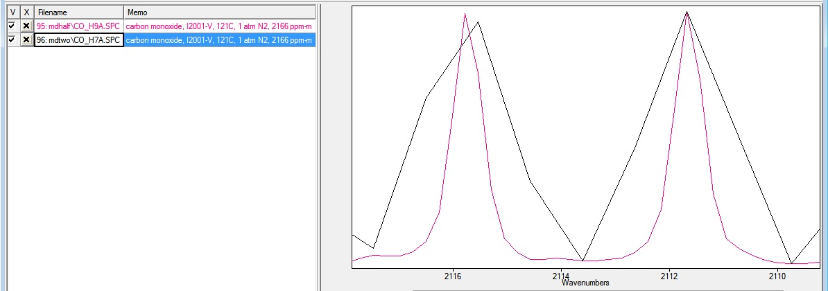
CO Normalized Spectra at High and Low Resolution
1083 ppm CO
0.5 cm⁻¹
2 cm⁻¹
Wavenumbers (cm⁻¹ )
Notes:
CO accuracy will be improved for wobbly spectra by decreasing the resolution from 0.5 to 2 cm.

Slide 24
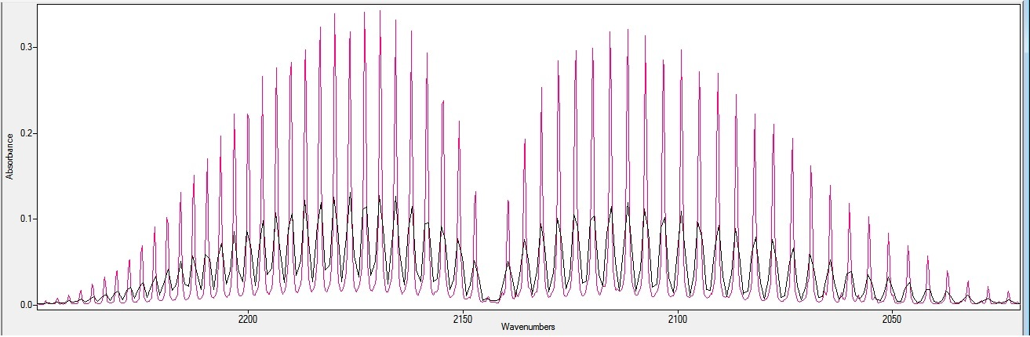
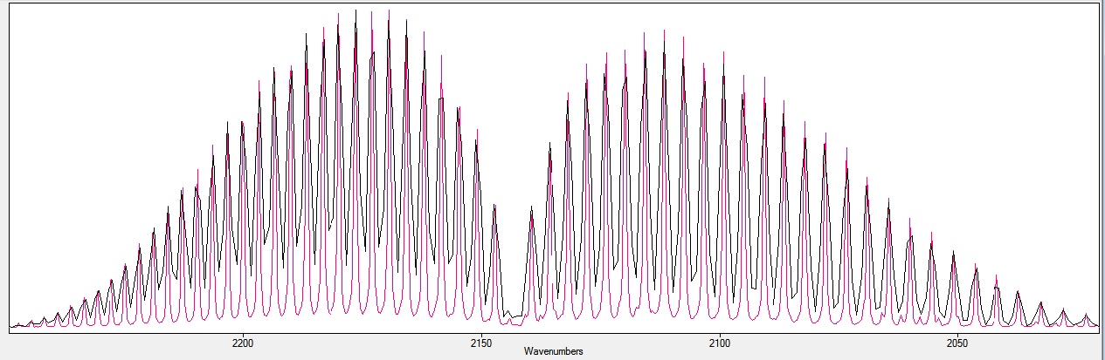
1083ppm CO Spectra at High and Low Resolution
0.5 cm⁻¹
2 cm⁻¹
Normalized
Wavenumbers (cm⁻¹ )
Notes:
Collecting spectra at a lower resolution (2cm-1) will minimize interferometer frequency shifting errors.
Advantages of high resolution (0.5 cm-1): better spectral discrimination (better discrimination, less likely to misidentify gases)
For our instrument, high 0.5 cm-1 is a disadvantage due to shifting (wobbly) spectra:
More likely to misidentify gas
Intermittant large quantification errors.
2 cm-1 should provide a more robust method.
Gases that will markedly benefit include H₂0, CO, HCN, HF, HCl, HBr, NO, CH₄ and C₂H₂

Slide 25
Conclusion
MCC- Φ at a range of combustion temperatures (T_{c}) and fuel/oxygen ratios (Φ) is a viable tool for generating gaseous and solid combustion products for various stages of fires.
The CO/CO₂ ratio, FTIR gas analysis and gravimetric soot measurements determine which MCC test conditions best reproduce flaming combustion.
The FTIR interferometer at a resolution of 0.5 cm-1 has an intermittent frequency wobble causing significant intermittent errors for CO…….
° C ° C

Slide 26
Future Work
Run future MCC-Φ tests with FTIR resolution set to 2 cm⁻¹ to improve quantification accuracy and robustness of the method, where shifting frequencies up to 0.25 cm⁻¹ do not cause a problem.
Run more materials in the MCC-Φ.
Calculate the toxic potency of smoke from burning polymers over the entire range of fire conditions from early stage (over ventilated) to late stage (vitiated) for various combustor temperatures.
Determine whether flame retardants increase the toxic potency of combustion products.
Evaluate the use of solid state metal oxide sensors for NO, NO₂ and SO₂ etc. to supplement/ replace FTIR analysis of combustion gases.

