Slide 1


Automated Material Characterization for Fire Modeling
October 29, 2019
Morgan C. Bruns
Virginia Military Institute (USA)
Isaac T. Leventon
National Institute of
Standards and Technology (USA)

Slide 2
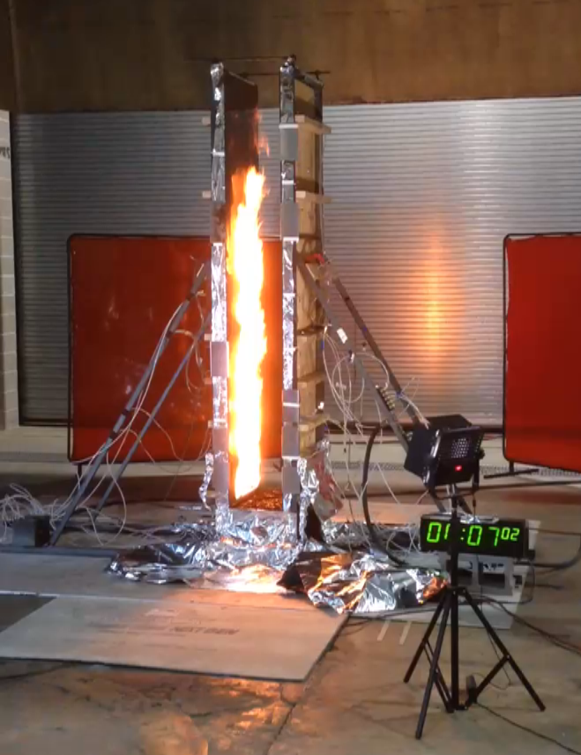
Predicting Fire Growth
To engineer safer:
  Buildings
  Products
  Materials
Accurate predictions require condensed phase pyrolysis models

Slide 3
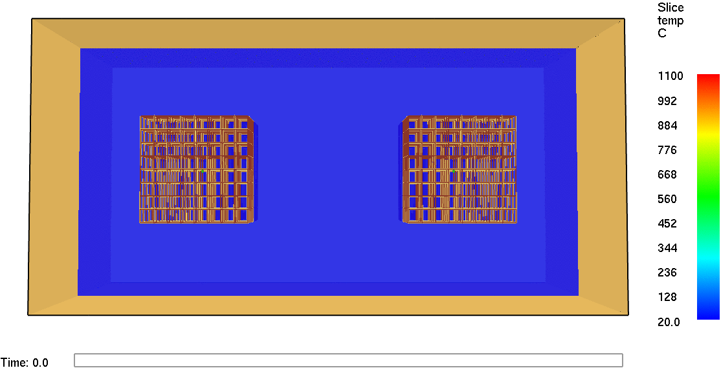
Condensed Phase Challenges
Physics
  Multiphase
  Mechanical deformation
Numerics
  Gas phase coupling
  Multiscale
  Moving boundary
Materials
  Many parameters
  Many materials

Slide 4
Condensed Phase Challenges
Physics
  Multiphase
  Mechanical deformation
Numerics
  Gas phase coupling
  Multiscale
  Moving boundary
Materials
  Many parameters
  Many materials

Slide 5
How Many Parameters?
Neglecting
Radiation
Mass transport
Charring
Temperature dependence
At least ~6N material property parameters need to be quantified

Slide 6
How many materials?
NFIRS categorizes 38 distinct “types” of solid materials “First Ignited”
These “types” are extremely broad categories such as “Plastic”, “Rubber”, and “Plywood”
For example, Lyon and Janssens (2005) contains data on 50 common plastics
Additional diversity due to processing variability, additives, blends, ageing, etc.
On the order of 10³ distinct materials relevant to fire growth predictions

Slide 7
(10¹ Parameters) × (10³ Materials)
= 10⁴ Properties for reliable fire growth predictions
A Material Property Database is needed

Slide 8
Material Property Database
Being developed at NIST
Adopting “Hierarchical” approach
Critical components
  Standard formatting
  Standard metadata
  Analysis tools

Slide 9
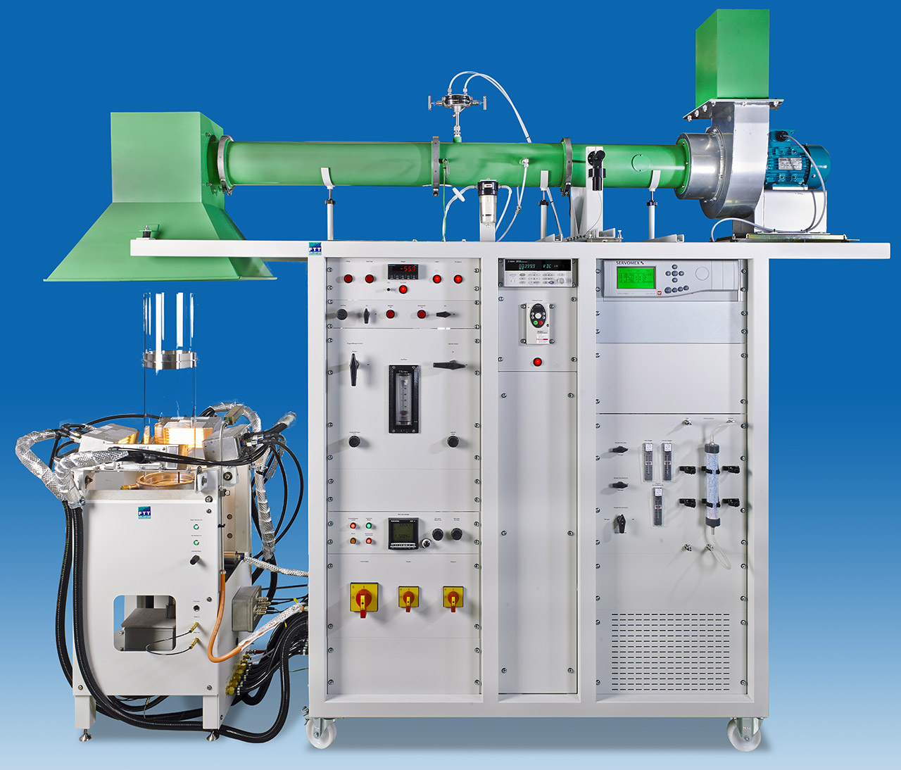
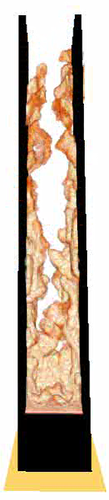
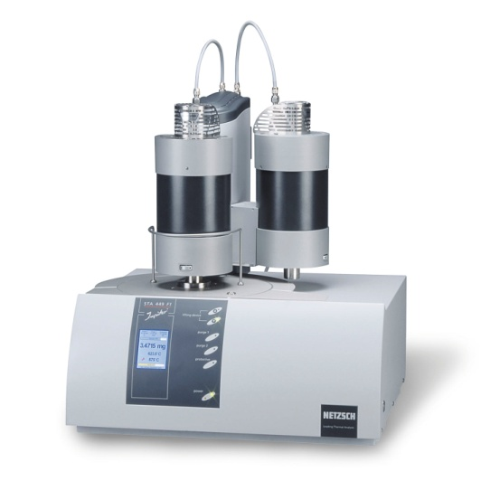
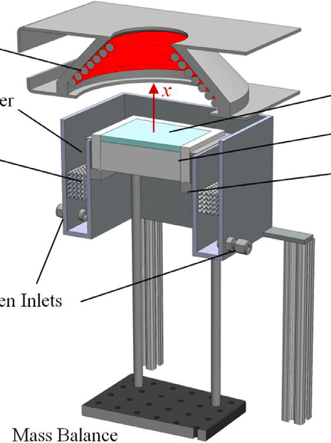
Global Approach
Fire Model
Hierarchical Approach

Slide 10
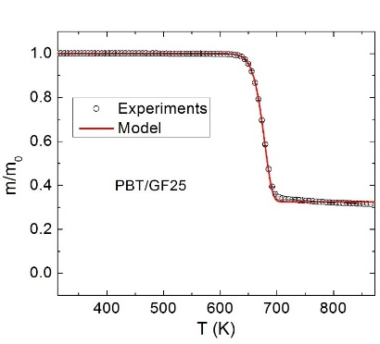
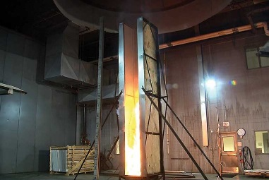
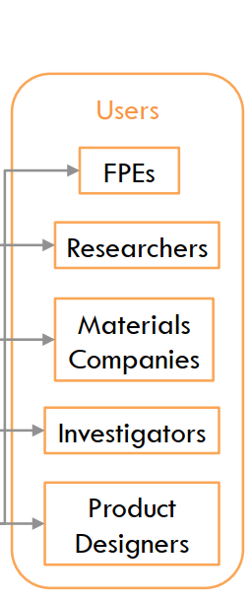
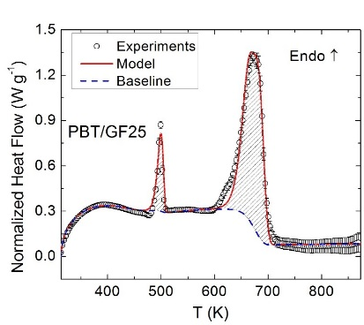
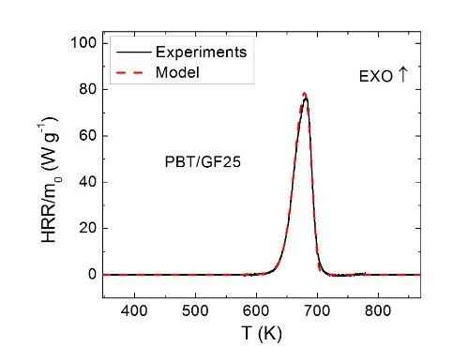
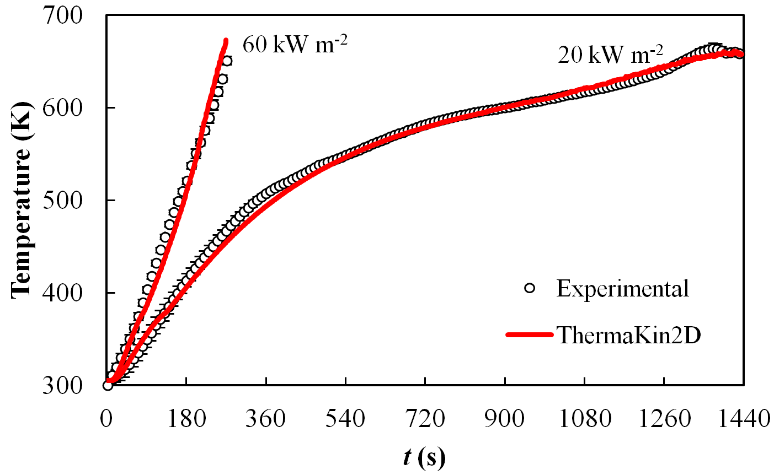
Model Parameterization:
Framework
Full scale testing for model validation
Thermophysical properties
A E v c_{p} h_{i} ∆H_{c}
k ρ
α ε
Analysis tools
Computational Model
Computational Model
Quantitative prediction of fire growth
Bench scale experiments for model calibration and validation
mg-scale testing
Measurement and Prediction of Material Flammability Performance

Slide 11
Model Parameterization
Experimental approach
  Conduct as few physical tests as possible
  Isolate parameters through each test
  Validate model across a range of scales, outside of calibration conditions
Focus of this presentation: Analysis of TGA and MCC data for
  Reaction mechanism
  Kinetics
  Heats of combustion

Slide 12
Analysis of TGA Data
How should we estimate pyrolysis kinetic parameters from raw TGA data?
Mass
Temperature

Slide 13
Method Requirements
Parameters predict data → Accurate
Many different materials → Efficient
Many different behaviors→ Robust
Parameters do not vary → Consistent

Slide 14

How to be Consistent
No free parameters
No random numbers
For given data, the method should always produce the same parameters
“With four parameters I can fit an elephant, and with five I can make him wiggle his trunk.”
~John von Neumann

Slide 15
Small-scale Tests
Flame Spread Experiments
Parameter Estimation
Model Validation
Model Parameters
Flame Spread Predictions
Fire Models
The quality of any parameter estimation algorithm is ultimately determined in model validation

Slide 16
Pyrolysis Model: Independent Unimolecular Reactions
Appropriateness to be determined by ability to predict fire growth.

Slide 17
Characteristic temperature and mass changes:
Mass
Analysis of peak condition yields:
Mass
Loss
Rate
Temperature

Slide 18
Estimating Parameters
TGA Data
Approximate Solution

Slide 19
Some Details
Smoothed data derivatives are found using Savitzky-Golay filter
“Small” mass loss rate peaks are neglected
Complete algorithm corrects preceding equations for overlapping reactions
Reaction mass changes corrected to conserve mass
Requires specification of two parameters
Requires iteration

Slide 20
Verification
Assume kinetic parameters
Generate TGA data
Use algorithm to find parameters
Purpose:
Check implementation
Test validity of approximate solution

Slide 21
Single Reaction Verification

Slide 22
Single Reaction Verification
ΔT = 10 K:
ΔT = 20 K:
Decreasing ξ
Increasing accuracy
ΔT = 40 K:

Slide 23
Two Reactions Verification
Closer fit for more separated reactions

Slide 24
Validation
Purpose:
Test algorithm with real TGA data
Materials:
Nylon 6,6
Flexible polyurethane (PU) foam
Polyvinyl Chloride (PVC)
Procedure:
In nitrogen
Samples: 3-5.5 mg
Isothermal heating for 20-30 min
Dynamic heating at 10 K/min

Slide 25
Validation: Nylon 6,6

Slide 26
Validation: Polyurethane Foam

Slide 27
Validation: PVC

Slide 28
Validation: Lodgepole Pine Leaves

Slide 29
Validation: Douglas Fir Leaves

Slide 30
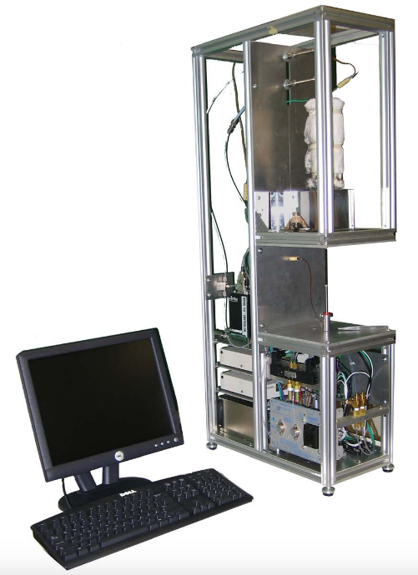
Analysis of MCC Data
How should we estimate individual reaction heats of combustion (Δh_{c,i}) from raw MCC data?
Heat
Release Rate
Temperature

Slide 31
Single Reaction
1) Value at Peak Temperature: T_{p}
2) Simple Average: N_{d} data points

Slide 32
Multiple Reactions
1) Linear System: N_{r} equations, N_{r} unknowns
2) Multiple Linear Regression: N_{d} data points

Slide 33
Verification
Assume kinetic parameters and heats of combustion
Generate TGA data
Use TGA fit algorithm to find kinetic parameters
Use TGA predictions and MCC data to find heats of combustion
Purpose:
Check implementation
Test validity of approximate solution

Slide 34
MCC: Single Reaction Verification
TGA Data
  10 K/min
  T_{p} = 650 K
MCC Data
  60 K/min
  Δh = 30 kJ/g
Solid: Simulated Data
Dash: Total HRR/mass
Dash-Dot: Peak Match
Dot: Simple Average

Slide 35
MCC: Single Reaction Verification
Scenario | Δh (kJ/g) (Total HR/mass) | Method 1: Peak Ratio Δh (kJ/g) | Method 2: Simple Average Δh (kJ/g)
ΔT = 10 K/min | 30.026 | 30.792 | 30.849
ΔT = 20 K/min | 29.997 | 28.731 | 29.556
ΔT = 40 K/min | 29.997 | 26.949 | 28.291
Total HR/mass not applicable to multiple reaction
Method 2 performs better than Method 1

Slide 36
MCC: Two Reactions Verification
Evenly distributed heat release
Method 2: Multiple linear regression

Slide 37
MCC: Two Reactions Verification
 |  | -Δh₁ (kJ/g) | -Δh₂ (kJ/g) | -Δh_{total} (kJ/g)
Specified Value |  | 15 | 45 | 21
ΔT = 10 K/min | Simple Integration | -- | -- | 20.998
 | Linear Regression | 14.854 | 44.085 | 21.021
ΔT = 20 K/min | Simple Integration | -- | -- | 20.998
 | Linear Regression | 14.953 | 43.973 | 21.061
ΔT = 40 K/min | Simple Integration | -- | -- | 20.998
 | Linear Regression | 15.415 | 42.304 | 21.501
Accuracy decreases with longer reactions
Future work: correct individual reaction values to force match of total value

Slide 38
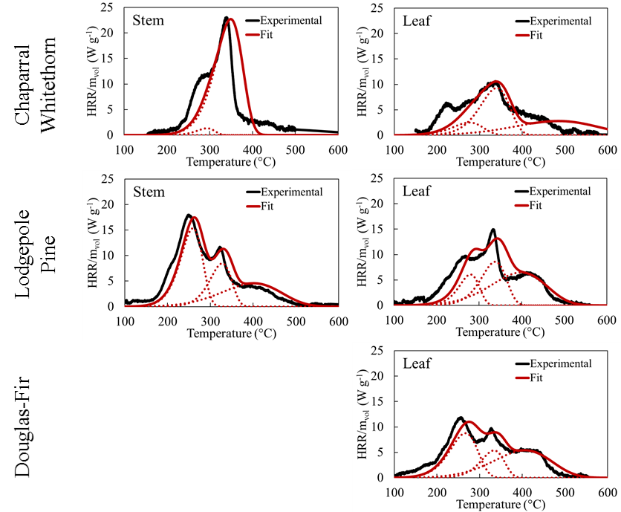
MCC: Vegetative Fuels Validation

Slide 39
MCC: Vegetative Fuel Heats of Combustion

Slide 40
Summary
Fire models need material property parameters to predict fire growth
Obtaining material properties requires
  Small-scale tests
  Parameter estimation algorithms
Parameter estimation algorithms are presented for obtaining
  pyrolysis kinetic models from TGA data
  individual reaction heats of combustions from MCC data
The algorithms performs well for
  Manufactured solution verification cases
  Multiple reaction materials with well-separated reaction peaks
More work is needed for
  Multiple reaction materials with overlapping reaction peaks

Slide 41
Model Parameterization:
Framework
Full scale testing for model validation
Thermophysical properties
A E v c_{p} h_{i} ∆H_{c}
k ρ
α ε
Analysis tools
Computational Model
Computational Model
Quantitative prediction of fire growth
Bench scale experiments for model calibration and validation
mg-scale testing

Slide 42
Extras…

Slide 43
Nondimensional Form

Slide 44
Approximate Solution
Also applies for multiple, independent reactions.

Slide 45
Small-scale Tests
Flame Spread Experiments
Parameter Estimation
Model Validation
Model Parameters
Flame Spread Predictions
Fire Models
The quality of any parameter estimation algorithm is ultimately determined in model validation

Slide 46
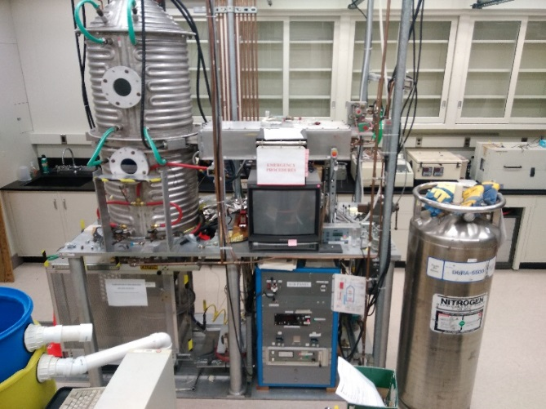
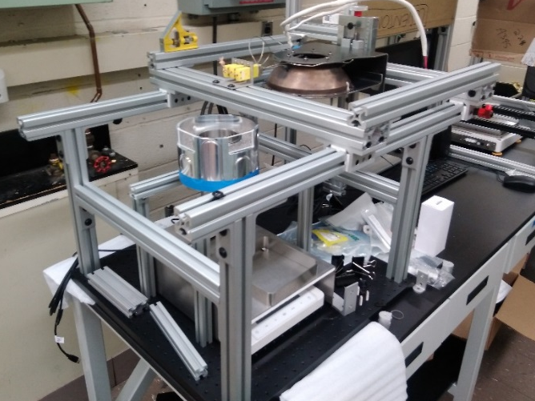
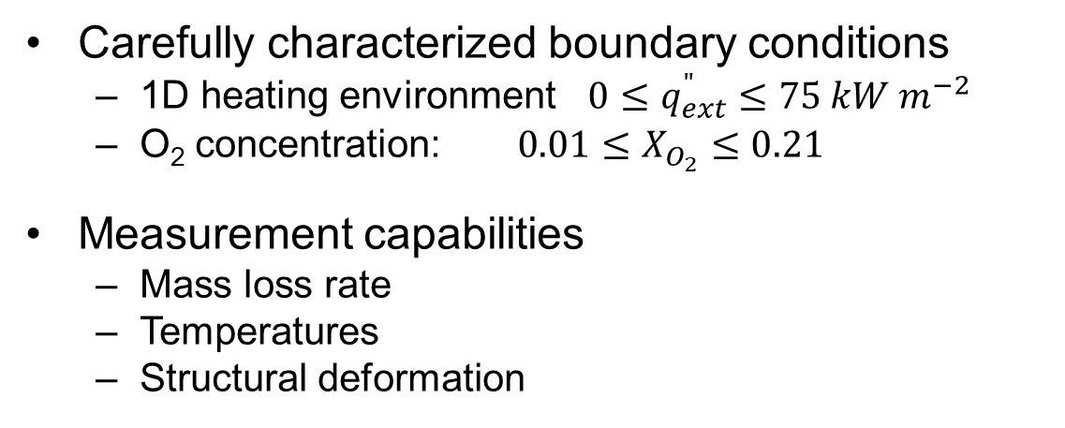
Gasification Apparatus
Introduction
The Fire Problem
Controlling Mechanisms of Fire Growth
Methodology
Experimental Apparatus
Milligram scale
Bench scale
Full Scale
Modelling
Analytical Tools
Model Validation
Applications and Future Work
Carefully characterized boundary conditions
  1D heating environment $0≤q_{ext}^{"}≤75 kW m^{−2}$
  O₂ concentration: $0.01≤X_{O_{2}}≤0.21$
Measurement capabilities
  Mass loss rate
  Temperatures
  Structural deformation
2.5 m
0.5 m
Notes:
For phosphorous, q’crit is independent of loading
For Bromine, we may see up to a 40% increase in Q’crit from higher to lower loading, but we cannot say that this trend is statistically significant. Moving forward, it will be important to model burning behavior of this system to see sensitivity of flame spread rate, increase in MLR to this value
For brominated samples, visual flame heights were not significantly different between different FR loadings:
Less than a factor of two difference between samples at the same energy release rate. Predictions of flame height as a function of energy release rate would be within 40% of one another using a single curve for all data vs. individual expressions for samples of either loading.
So what is putting these out? Less than a factor of two difference in flame height/critical energy release for sustained flaming of bromine samples but that’s close to the uncertainty in measurements so it’s difficult to say for sure.
Q’crit is definitely not affected for phosphorous based samples. These self extinguish due to the production of a thin, flaky char layer across the surface of the sample. Slowly, this layer develops and flames continue to burn only in cracks in this char or in small pockets that remain stable long after extinction across the majority of the sample’s surface. Removal of this flaky char layer (which is not difficult to do) allows for sustained, stronger flaming.
Brominated samples extinguish suddenly, much quicker despite an otherwise strong flame. First we see destabilization of the flame at it’s base, flickering, detachment of the base of the flame, vertical flickering, and final complete extinction. Two possibilities
We measure total flame heat flux to the surface of a water cooled gauge, not the sample itself. This value doesn’t vary until the flame is out entirely, but a residual glass/glass matrix layer is left at the front surface of the sample as it burns. Heat transfer through this layer may be limited thus energy transfer to the virgin material behind this glass matrix may be lower than that measured by the gauge.
Additionally, energy release rate at extinction is approximately 2x higher than that at ignition. This difference indicates that the heat of combustion or the chemical composition of the gaseous volatiles has changed later in the test as the sample has been burning for a while, is heated more indepth. This suggests extinction, more so than ignition, is goverened by gas phase affects/the presence of this flame retardant.

Slide 47
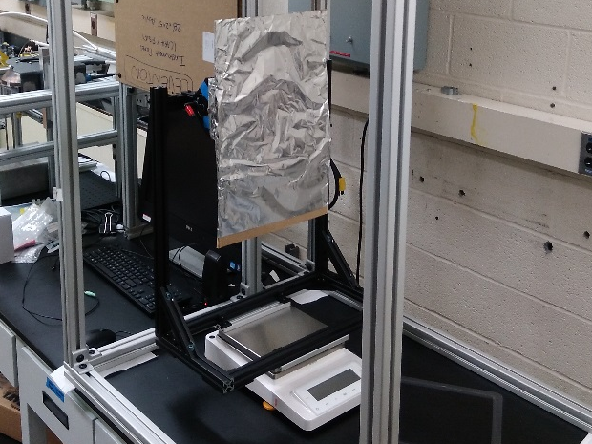
Flame Spread Apparatus
(intermediate scale)
Introduction
The Fire Problem
Controlling Mechanisms of Fire Growth
Methodology
Experimental Apparatus
Milligram scale
Bench scale
Full Scale
Modelling
Analytical Tools
Model Validation
Applications and Future Work
Steady burning, flame spread
  Sample size: up to 0.5 m tall, 0.2 m wide
  Variable configuration (orientation, aspect ratio)
Measurement capabilities
  Mass loss rate
  Flame heat flux
  Temperatures
  Heat Release Rate*
  Temperature & species profiles across flame sheet*
  *Exploratory
  project (2020)
Applications
  Model validation
  Flammability behavior
0.5 m
Notes:
For phosphorous, q’crit is independent of loading
For Bromine, we may see up to a 40% increase in Q’crit from higher to lower loading, but we cannot say that this trend is statistically significant. Moving forward, it will be important to model burning behavior of this system to see sensitivity of flame spread rate, increase in MLR to this value
For brominated samples, visual flame heights were not significantly different between different FR loadings:
Less than a factor of two difference between samples at the same energy release rate. Predictions of flame height as a function of energy release rate would be within 40% of one another using a single curve for all data vs. individual expressions for samples of either loading.
So what is putting these out? Less than a factor of two difference in flame height/critical energy release for sustained flaming of bromine samples but that’s close to the uncertainty in measurements so it’s difficult to say for sure.
Q’crit is definitely not affected for phosphorous based samples. These self extinguish due to the production of a thin, flaky char layer across the surface of the sample. Slowly, this layer develops and flames continue to burn only in cracks in this char or in small pockets that remain stable long after extinction across the majority of the sample’s surface. Removal of this flaky char layer (which is not difficult to do) allows for sustained, stronger flaming.
Brominated samples extinguish suddenly, much quicker despite an otherwise strong flame. First we see destabilization of the flame at it’s base, flickering, detachment of the base of the flame, vertical flickering, and final complete extinction. Two possibilities
We measure total flame heat flux to the surface of a water cooled gauge, not the sample itself. This value doesn’t vary until the flame is out entirely, but a residual glass/glass matrix layer is left at the front surface of the sample as it burns. Heat transfer through this layer may be limited thus energy transfer to the virgin material behind this glass matrix may be lower than that measured by the gauge.
Additionally, energy release rate at extinction is approximately 2x higher than that at ignition. This difference indicates that the heat of combustion or the chemical composition of the gaseous volatiles has changed later in the test as the sample has been burning for a while, is heated more indepth. This suggests extinction, more so than ignition, is goverened by gas phase affects/the presence of this flame retardant.

Slide 48
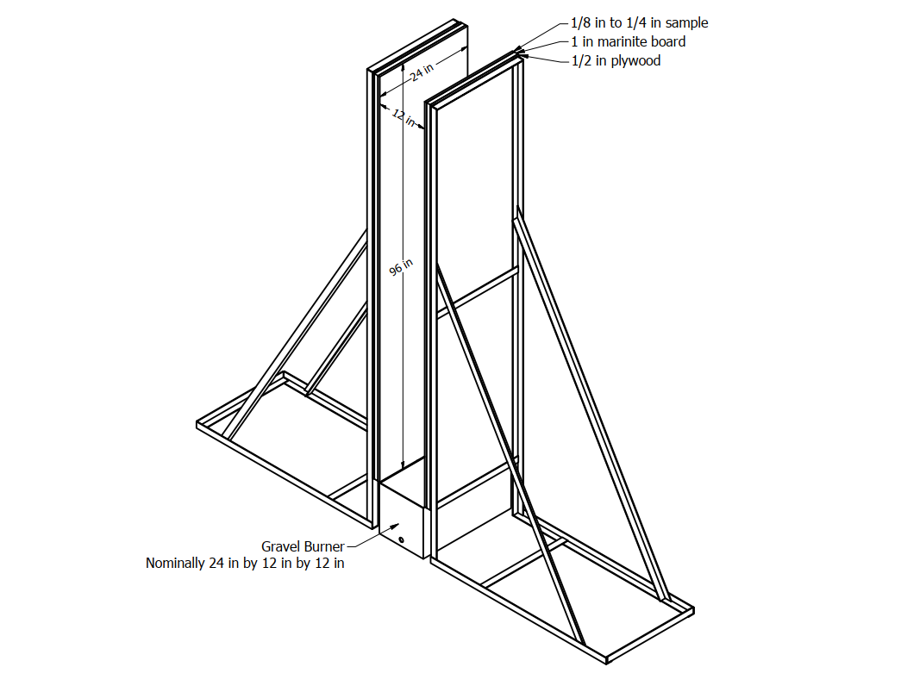
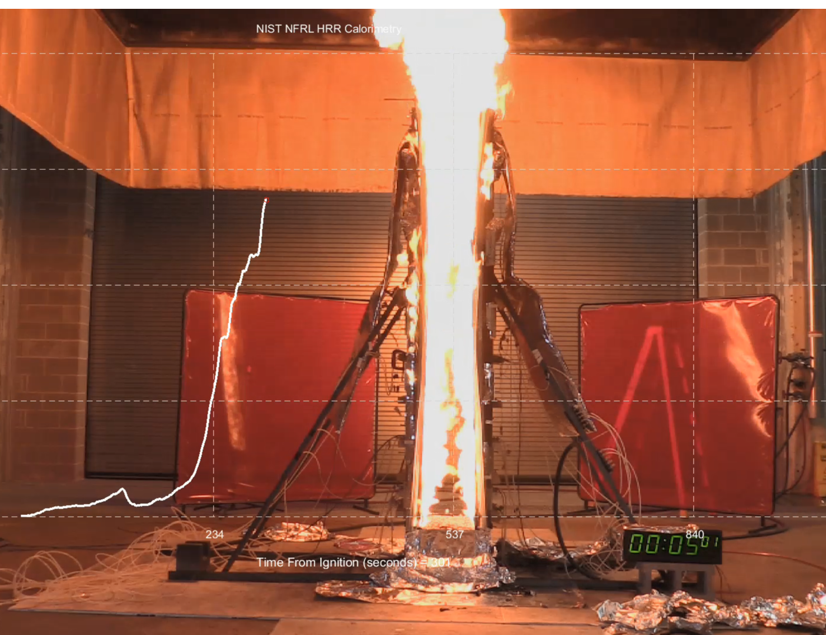
Parallel Panel Apparatus
(full scale)
Introduction
The Fire Problem
Controlling Mechanisms of Fire Growth
Methodology
Experimental Apparatus
Milligram scale
Bench scale
Full Scale
Modelling
Analytical Tools
Model Validation
Applications and Future Work
Ignitability and flame spread
  Sample size: 2.45 m tall, 0.6 m wide
Measurement capabilities
  Heat release rate
  Flame heat flux
  CO₂, CO, soot production
Notes:
For phosphorous, q’crit is independent of loading
For Bromine, we may see up to a 40% increase in Q’crit from higher to lower loading, but we cannot say that this trend is statistically significant. Moving forward, it will be important to model burning behavior of this system to see sensitivity of flame spread rate, increase in MLR to this value
For brominated samples, visual flame heights were not significantly different between different FR loadings:
Less than a factor of two difference between samples at the same energy release rate. Predictions of flame height as a function of energy release rate would be within 40% of one another using a single curve for all data vs. individual expressions for samples of either loading.
So what is putting these out? Less than a factor of two difference in flame height/critical energy release for sustained flaming of bromine samples but that’s close to the uncertainty in measurements so it’s difficult to say for sure.
Q’crit is definitely not affected for phosphorous based samples. These self extinguish due to the production of a thin, flaky char layer across the surface of the sample. Slowly, this layer develops and flames continue to burn only in cracks in this char or in small pockets that remain stable long after extinction across the majority of the sample’s surface. Removal of this flaky char layer (which is not difficult to do) allows for sustained, stronger flaming.
Brominated samples extinguish suddenly, much quicker despite an otherwise strong flame. First we see destabilization of the flame at it’s base, flickering, detachment of the base of the flame, vertical flickering, and final complete extinction. Two possibilities
We measure total flame heat flux to the surface of a water cooled gauge, not the sample itself. This value doesn’t vary until the flame is out entirely, but a residual glass/glass matrix layer is left at the front surface of the sample as it burns. Heat transfer through this layer may be limited thus energy transfer to the virgin material behind this glass matrix may be lower than that measured by the gauge.
Additionally, energy release rate at extinction is approximately 2x higher than that at ignition. This difference indicates that the heat of combustion or the chemical composition of the gaseous volatiles has changed later in the test as the sample has been burning for a while, is heated more indepth. This suggests extinction, more so than ignition, is goverened by gas phase affects/the presence of this flame retardant.

Slide 49
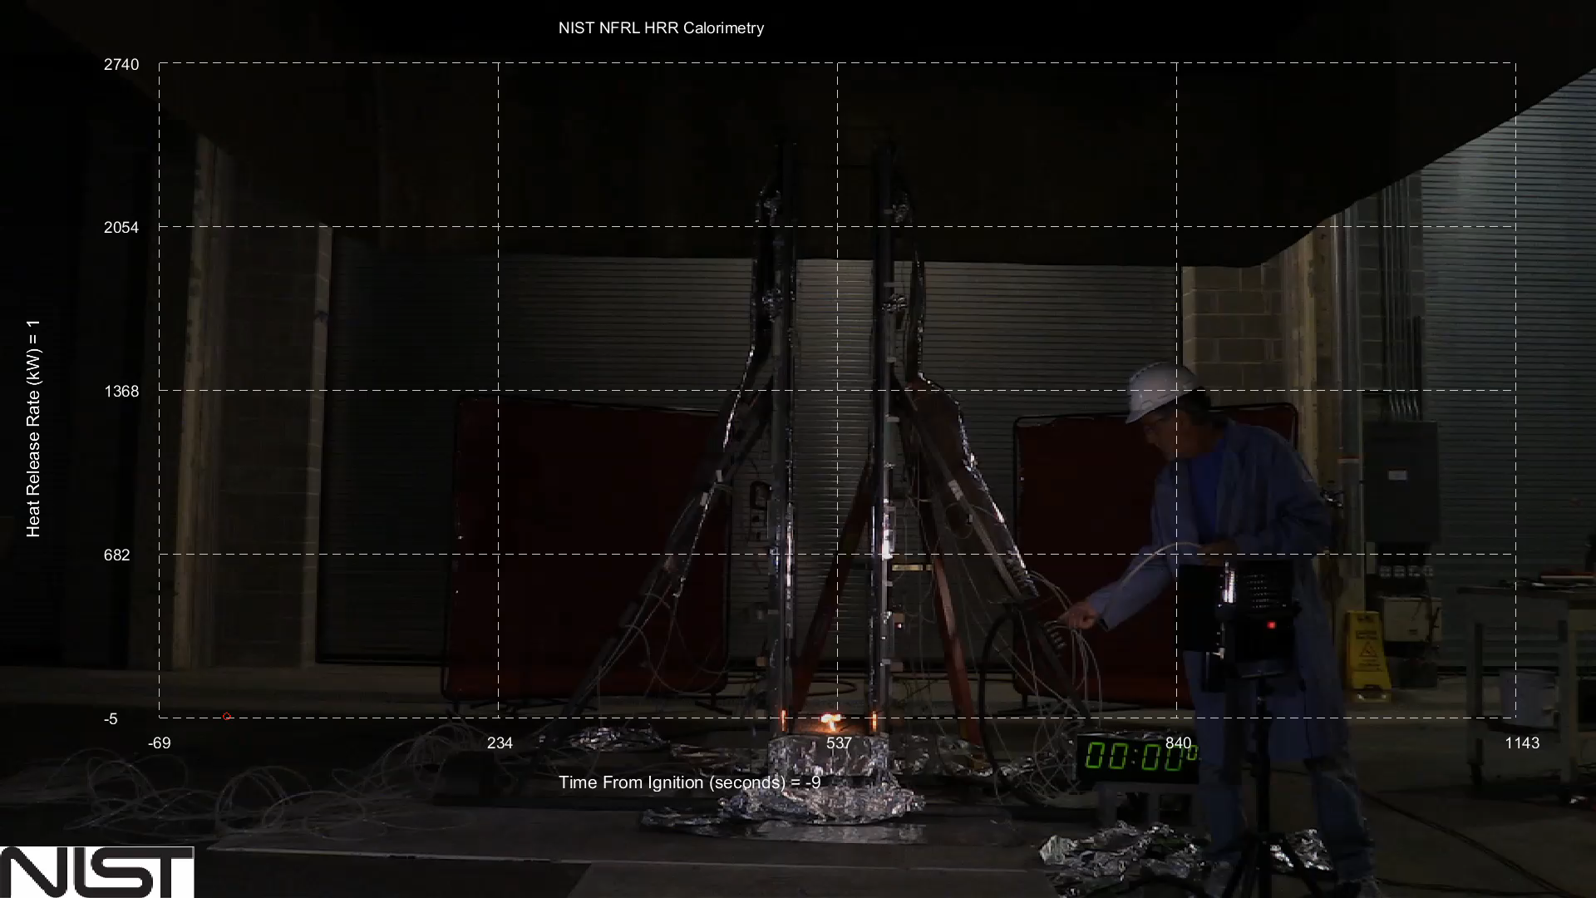
Full Scale Fire Behavior
Parallel Panel Apparatus
Introduction
The Fire Problem
Controlling Mechanisms of Fire Growth
Methodology
Experimental Apparatus
Milligram scale
Bench scale
Full Scale
Modelling
Analytical Tools
Model Validation
Applications and Future Work

Slide 50
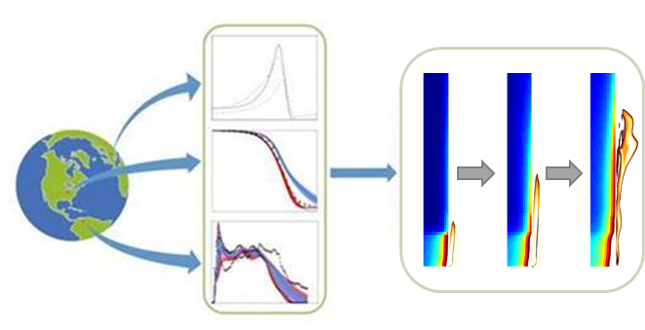
IAFSS Measurement and Computation of Fire Phenomenona (MaCFP)—Condensed Phase Workshop
April 26, 2020
Waterloo, Canada
https://iafss.org/macfp/

Slide 51
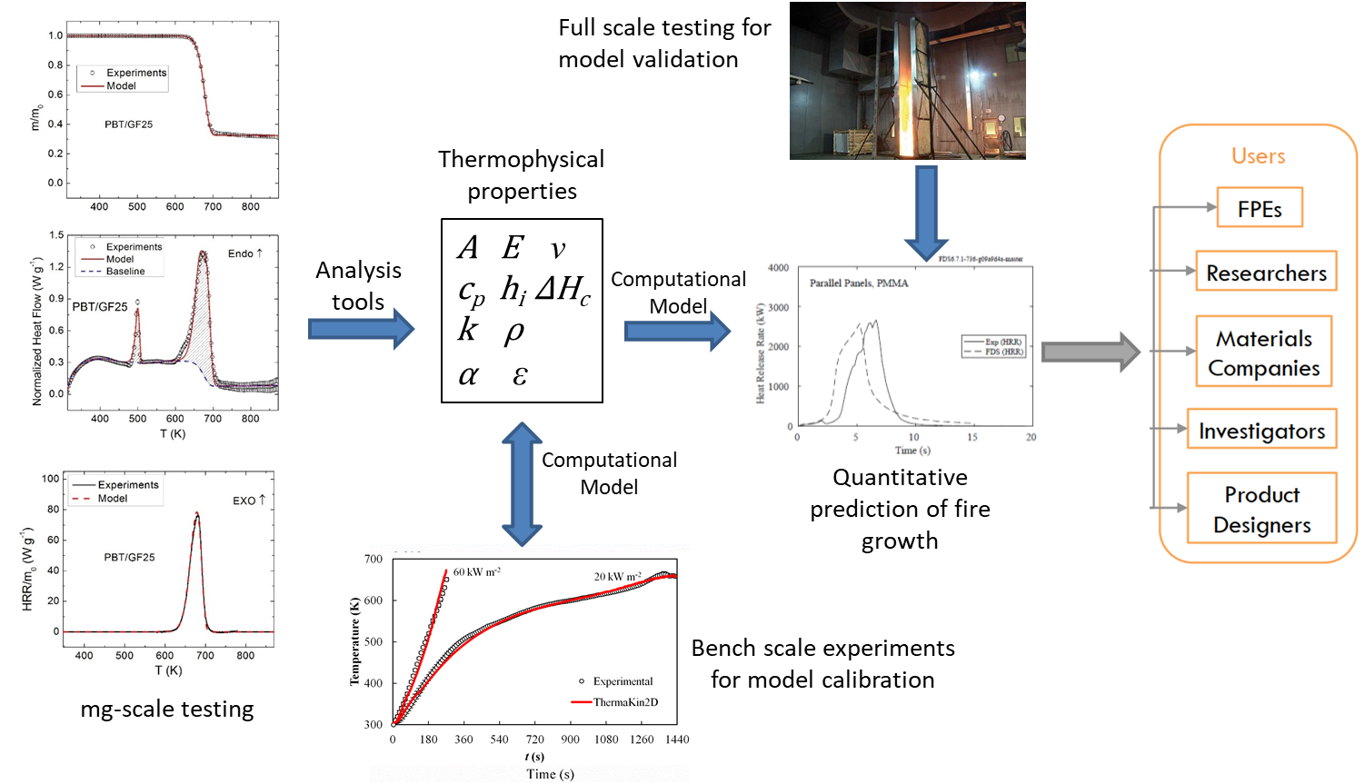
The quality of any parameter estimation algorithm is ultimately determined in model validation

