Slide 1


Assessment of FDS unstructured geometry capability on FAA Boeing 747 cargo compartment fire tests
Marcos Vanellaª, Haiqing Guo^{b}, Richard Lyon^{b} and Randall McDermottª
ª Fire Research Division, National Institute of Standards and Technology, Gaithersburg, MD
^{b} Federal Aviation Administration W. J. Hughes Technical Center, Atlantic City, NJ
Ninth Triennial International Fire and Cabin Safety Research Conference.
Resorts Casino-Hotel, Atlantic City, NJ. October 28th-31st, 2019.

Slide 2
Motivation.
B747 experiments.
Unstructured Geometry in FDS.
B747 simulations.
Comparison.
Remarks.

Slide 3
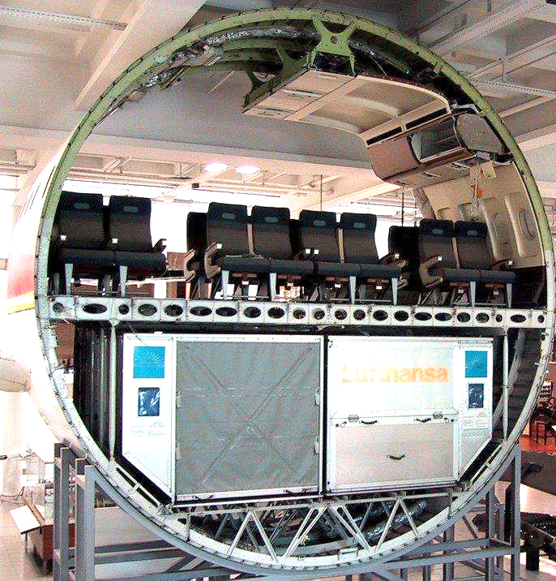
Motivation
FAA: hidden fires are not readily accessible, difficult to locate, and more challenging to extinguish.
Hidden areas in aircraft involve complex geometry, a highly curved fuselage, and densely cluttered ducts.
Full-scale studies are needed to reveal the heat and mass transfer behavior to guide detector placement and suppression systems.
FDS has new geometry capability to simulate such scenarios.
Would benefit from experiments for validation.
Source : https://www.pinterest.com/dr2tom/
Notes:
Regulation lacks sufficient understanding on how hot gases are transported along these.

Slide 4
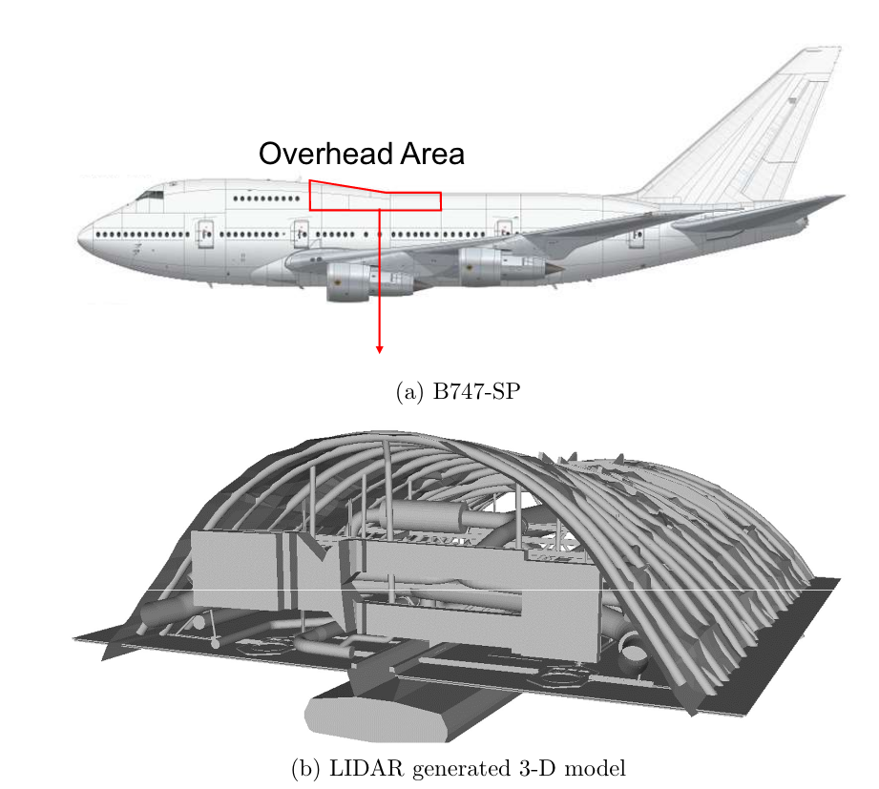
Experiments
Experiments
B747-SP at W. J. Hughes Technical center.
Overhead compartment behind upper deck.
6.7 m long x 5.4 m wide x 2 m tall.
LIDAR system used to gather high resolution cloud point data.
LIDAR data was used to generat 3D CAD geometry.

Slide 5
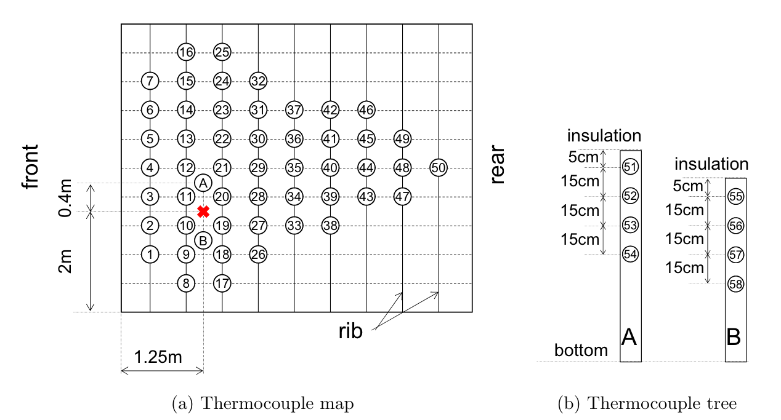
Experiments
Propane sand burner was located in two positions, forward and back.
HRR rates specified to 5.5 and 11 KW on both locations.
The overhead roof area was equipped with 50 Type-K Thermocouples.
Two thermocouple trees were located surrounding the burner, to gather depth temperature information
Notes:
TC 5cm below ceiling and spaced 0.5m apart.

Slide 6
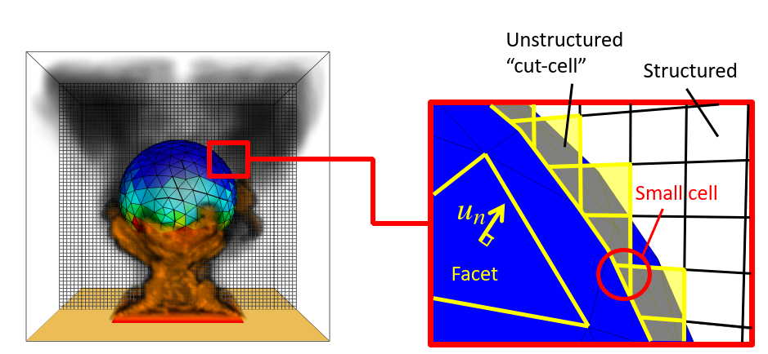
Unstructured Geometry in FDS
FDS unstructured geometry:
- FDS simulation of curved boundary surfaces.
- Well suited for conservative discretization (volumes and boundaries well defined).
- Complexity remains local to geometry surface.
- Cost of grid generation is buried in work to define cut-cells. Burden on surface meshing.
- Body surface mesh can be of different size than Cartesian grid.
- Needs efficient cut-cell computation schemes.
- Resulting meshes are computationally efficient, most cells are regular.

Slide 7
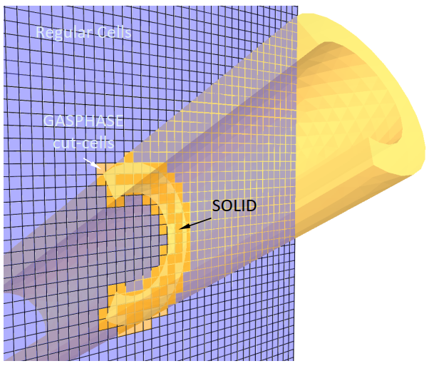
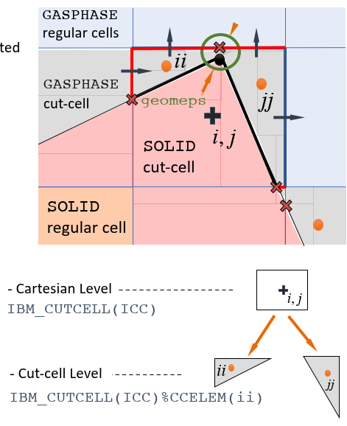
Unstructured Geometry in FDS
- Cut-cells are very irregular polyhedra.
- Stability/conditioning issues due to small cut-cells (explicit time integration, linear system solution).
- Can’t define boundary layer meshes close to body (like chimera/overset meshes).
- Geometries are defined by their surfaces -> Provides extra constraints.
Makes intersection/union harder of geometries in a scenario harder.

Slide 8
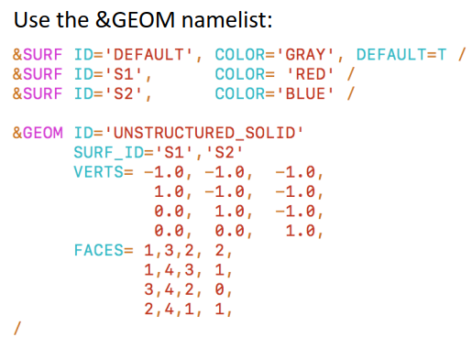
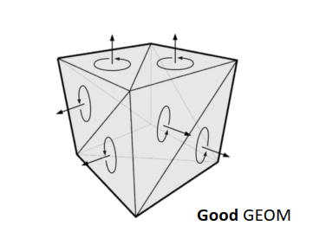
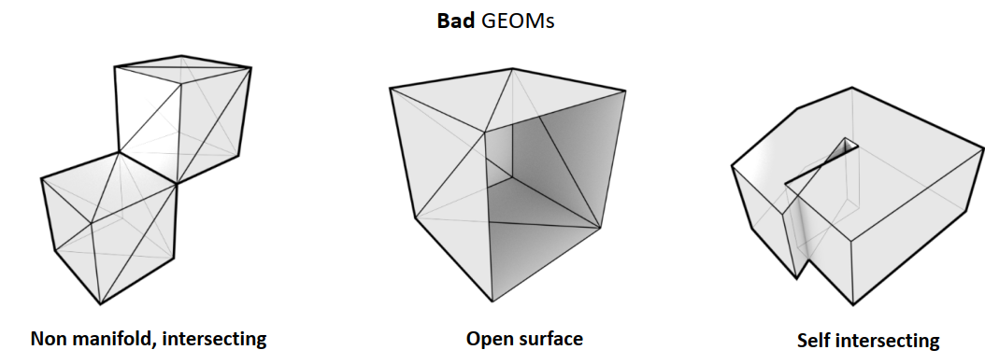
Unstructured Geometry in FDS
Good GEOMS
Bad GEOMS

Slide 9
Unstructured Geometry in FDS
Species transport in cut-cell region. Spatial discretization.
Species transport based on mass fractions:
Convective mass flux.
Ficks Law, binary diffusion
into background species.
Defined on domain , with initial and BCs in . Also, , are known.
Assume we spatially discretize the domain, and have unknowns for each species gathered in vector :
Mass
Advection
Diffusion
Reaction
BCs
Format amenable to explicit time integration (method of lines). Format used by FDS, work “on mesh”.

Slide 10
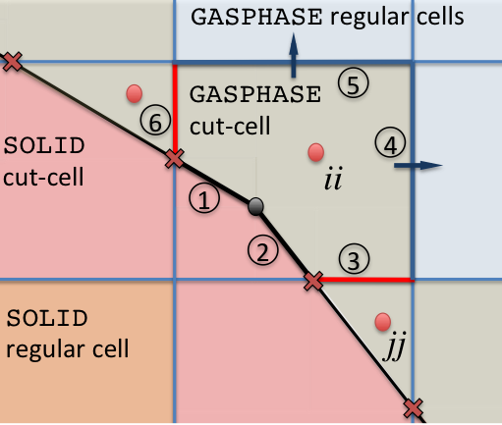
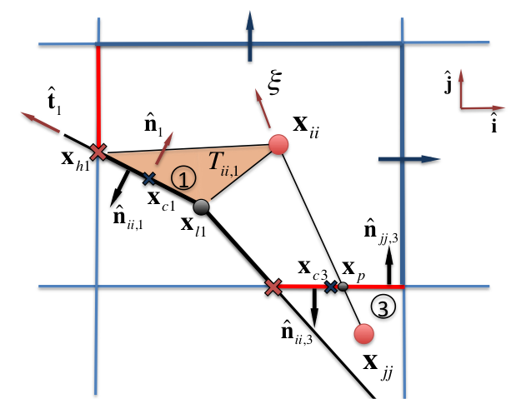
Unstructured Geometry in FDS
Finite Volume method*: Divide the domain on cells.
Time derivative
Reaction
Advective Term:
and
Godunov.
Central (linear interpolation).
A given cut face k=3 adds to the ii equation:
* J. Ferziger, M. Peric, “Computational Methods for Fluid Dynamics,” 3rd Edition, Springer (2001).
R. Leveque, “Finite Volume Methods for Hyperbolic Problems,” 1st Edition, Cambridge (2002).
R. Eymard et al., “Finite Volume Methods,” Handbook of Numerical Analysis, Vol. 7, (2002).

Slide 11
Unstructured Geometry in FDS
Diffusive Term:
A given cut face k=3 adds to the ii equation:
Interpolation
Numerical differentiation
In practice: Assemble source vectors running by face looping different face types. I.e. for Explicit Forward Euler:
Treatment of small cells: We merge small cells to large surrounding cells at the discrete equation level.
Notes:
Simply assign same unknown number to small and large cell.
Volume and flux terms will add for said unknown, cancelling out in shared faces.

Slide 12
Unstructured Geometry in FDS
Energy equation. Thermodynamic divergence*.
For cut-cell ii, discrete volume integral:
Energy-Momentum coupling. Low Mach.
* R. J. McDermott, “A velocity divergence constraint for large-eddy simulation of Low Mach flows,” J. Comput. Phys. 274, pp. 413-431 (2014).
Appendix B, FDS Technical Reference Guide, Vol 1. Mathematical Model. NIST Special Pub. 1018-1.

Slide 13
Unstructured Geometry in FDS
Energy-Momentum coupling. Divergence equivalence.
Gas
Our algorithmic choice:
Scalars in unstructured mesh:
Thermodynamic divergence in unstructured mesh:
Use divergence equivalence to push divergence to underlaying cartesian cells.
Compute structured grid momentum RHS.
In SOLID and regular faces crossing boundary compute F from Wall modeled IBM.
Solve a structured grid Poisson equation for the head H.
Project velocities on structured grid.
With these recover end of time step cut-face velocities.
Solid

Slide 14
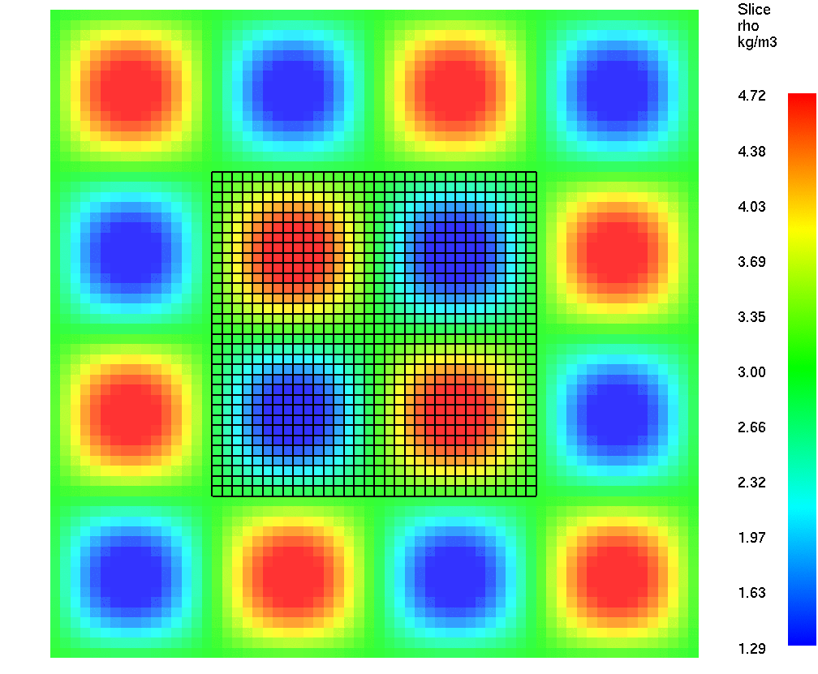
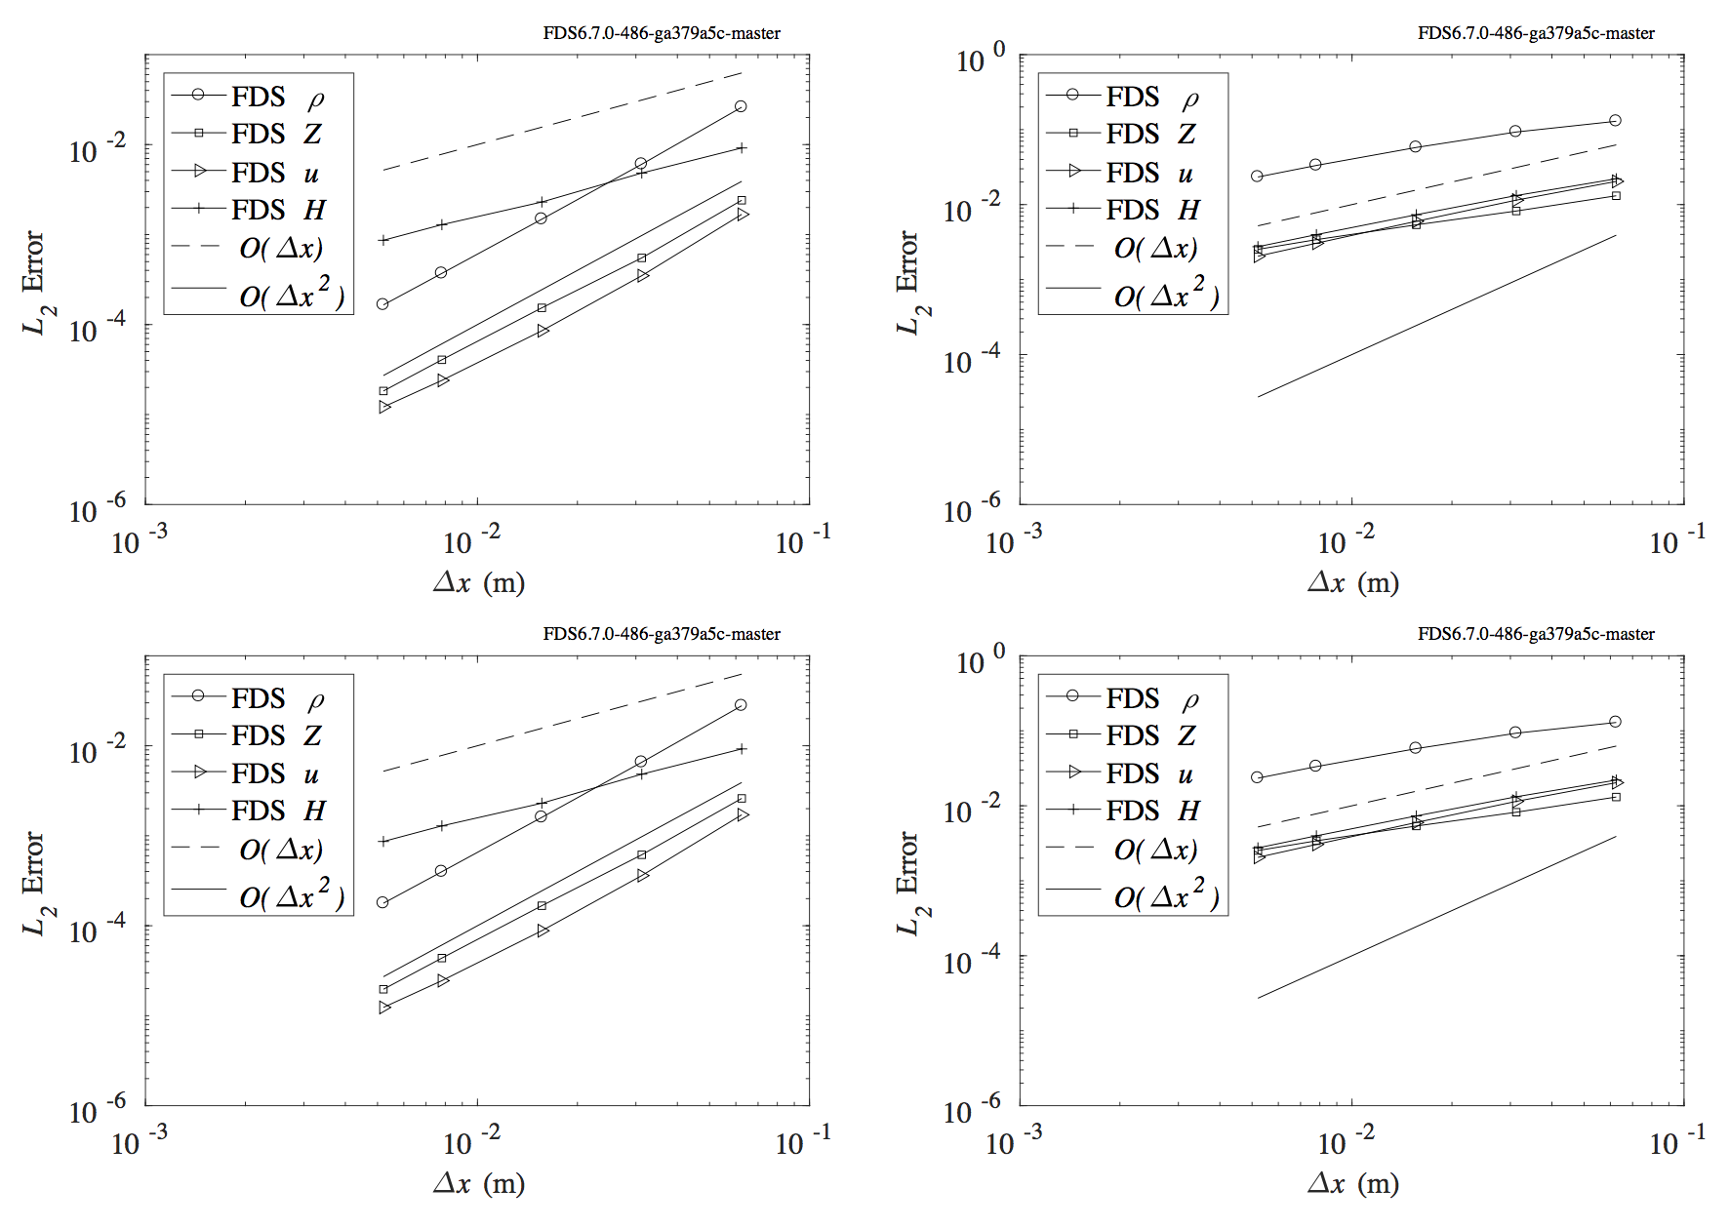
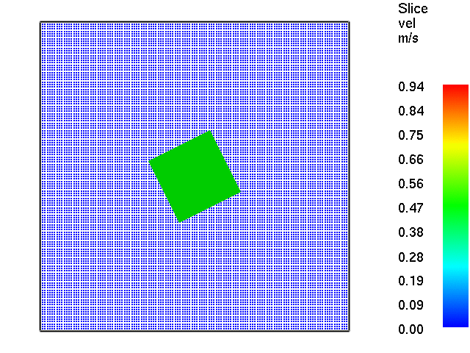
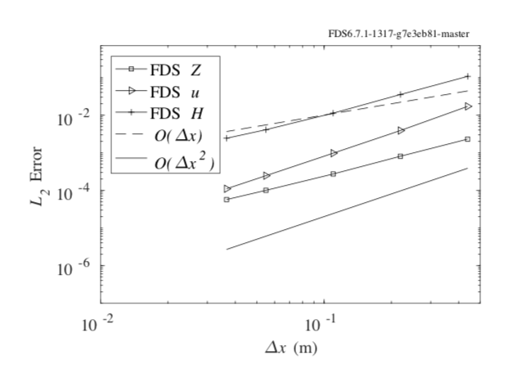
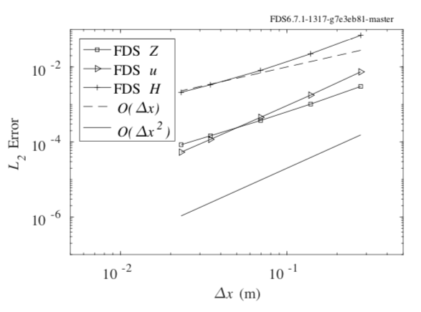
Unstructured Geometry in FDS
Verification:
Shunn Manufactured Solution test*
Explicit, centered.
Explicit, Godunov.
Manufactured Solution flow around rotated cube
Explicit, 27deg.
Explicit, 45deg.
*L. Shunn, F. Ham, P. Moin. Verification of variable-density flow solvers using manufactured solutions. Journal of Computational Physics, 231:3801-3827, 2012.
Notes:
Shunn, analytical solutions prescribed for mass fraction, density, velocity and pressure.

Slide 15
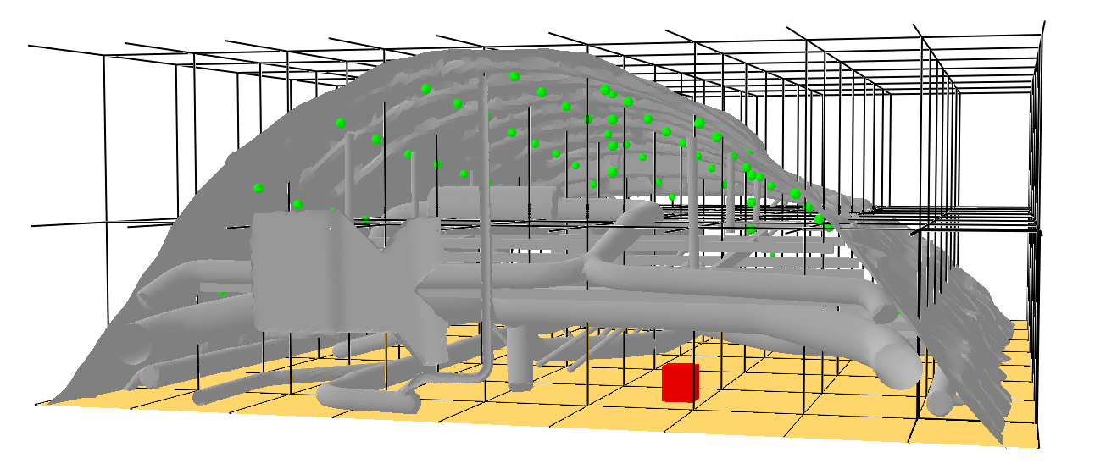
B747 Simulations
Model Setup:
Mesh resolutions: 6, 4, 2 cm (12 to 144 meshes).
Up to ~10 cells across burner.
Geometries with a total of 153K vertices and 306K triangles.
60 devices.
Insulation material prescribed on geometry, open condition at read end.
Notes:
TC 5cm below ceiling and spaced 0.5m apart.

Slide 16
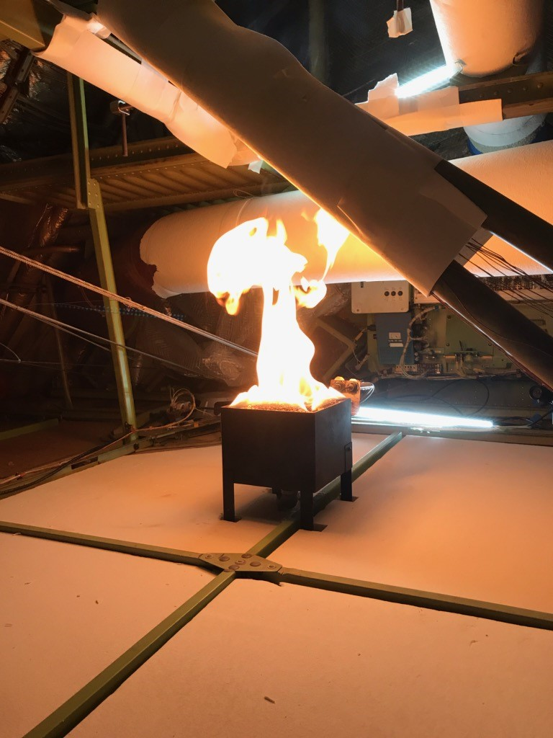
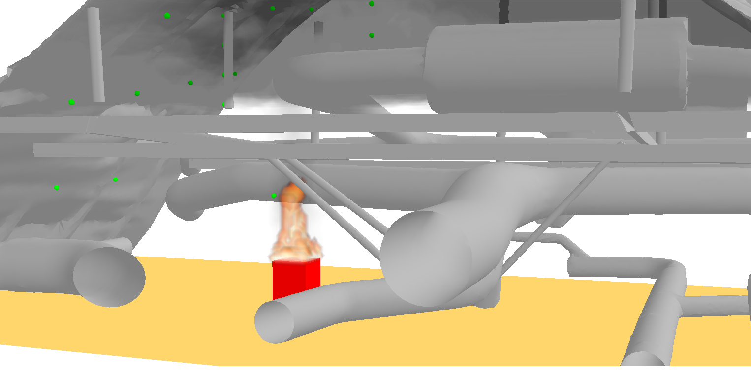
Comparison
Experiment
FDS Simulation (2 cm grid)
Front Burner – 11KW HRR case.
Notes:
TC 5cm below ceiling and spaced 0.5m apart.

Slide 17
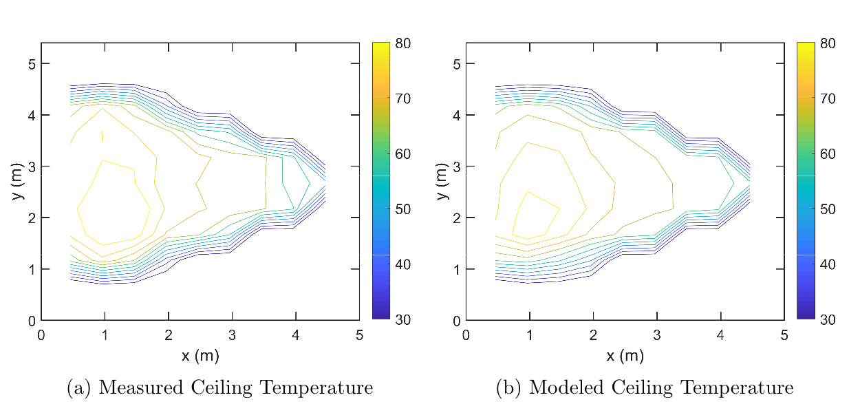
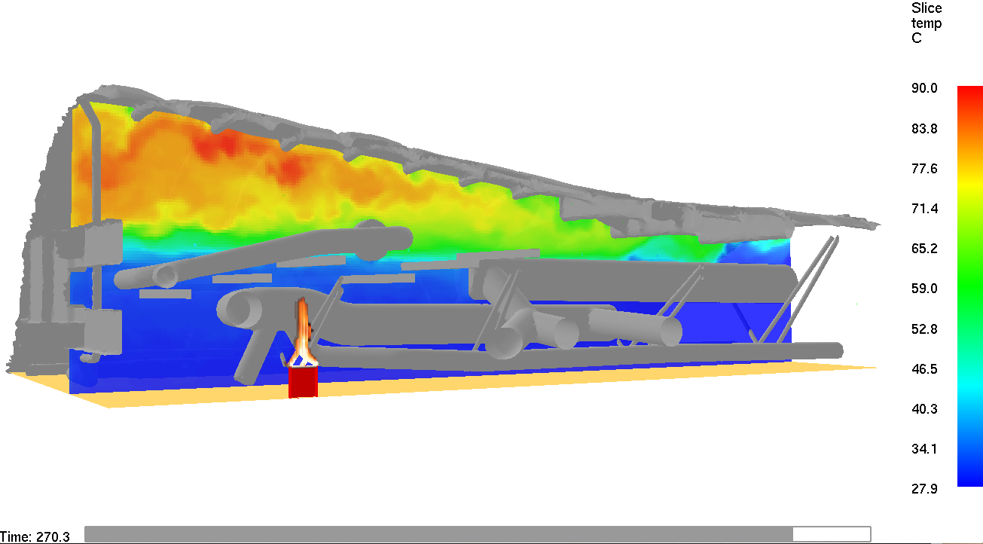
Comparison
Temperature slice along symmetry plane – hot an cold gas layers are seen.
Notes:
TC 5cm below ceiling and spaced 0.5m apart.

Slide 18
Comparison
Notes:
TC 5cm below ceiling and spaced 0.5m apart.

Slide 19
Remarks
Understanding fire in aircraft overhead compartments is of critical importance.
An experimental campaign was conducted at the FAA Hughes Technical Center, on different fire scenarios for the Boeing747-SP overhead cargo compartment.
The experimental data gathered is used in validation of FDS.
TC measurements in overhead compartment roof show good agreement. Less so in the compartment height TC trees.
Other aircraft cabin fire scenarios are being planned where FDS will be employed and tested.
Notes:
TC 5cm below ceiling and spaced 0.5m apart.

Slide 20
Thank You
Notes:
TC 5cm below ceiling and spaced 0.5m apart.

Slide 21
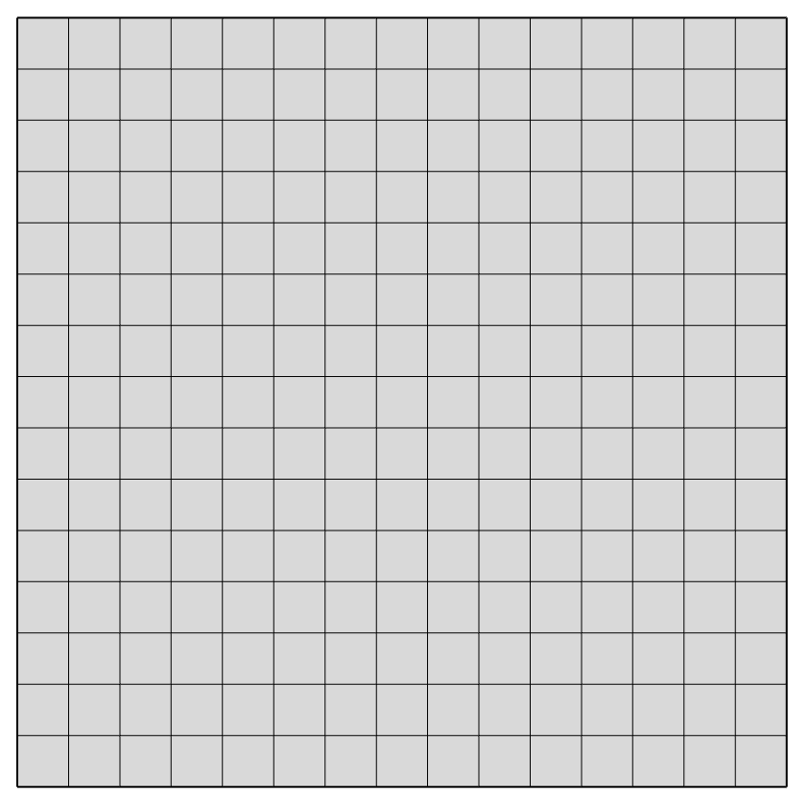
Unstructured Geometry in FDS
Consider the discrete equations for Low Mach flow:
Direct forcing Sharp Interface IBM.
Assume in forcing point p we have an approximation to
Body Force at p.
p
s
But we don’t know , we still can iterate in k the projection
Poisson.
Sharp, discrete Eulerian forcing.
End of Step velocities.
Up to convergence . Use of one iteration is common. Good for wall modeling.

Slide 22
Unstructured Geometry in FDS
Momentum transport. Immersed Boundary Method.
- Consider the time discrete equations for Low Mach flow:
Where:
- Estimate in 2D, x component of source at B:
- Typical wall stress BC imposition (DNS, wall resolved LES):
When modeling the effect of wall (boundary layer), this wall stress is estimated by other means.

Slide 23
Unstructured Geometry in FDS
- Consider a wall function model for momentum, boundary conforming mesh:
where
Take equilibrium (turbulent) boundary layer model*:
- viscous region
- log region
It can be used to estimate the needed , with . As we need to also find
, we do this by iteration.
See notes for details.
Once we have we can compute the source for point e and advance through time integration.
* S. B. Pope. “Turbulent Flows,” Cambridge University Press; 1st Edition (2000).
Notes:
There are some assumptions here:
equilibrium boundary layer model (good for channels) on each instantaneous component of velocity.
For LES tauw and other taus depend on turbulent viscosity. Treatment depends on the LES model. See tech ref guide sec 4.4/
For Tau_N we compute du/dy in usual manner.
Ue subject to CFL and viscous constraints.

Slide 24

Unstructured Geometry in FDS
IBM. A classical scheme applied through cut-faces:
1. For each cut-face centroid obtain a velocity approximation at time level :
Define surface normal point and external points .
For interpolation stencil points and compute:
Known boundary point velocity.
estimates at n+1.
Target velocity.
2. Flux match . Also, zero veloc in solid faces.
3. Iterate in k the projection:
$$u_{B}^{n+1}$$
Up to convergence. Use of one iteration is common.
4. Reconstruct on cut-faces.

Slide 25
Unstructured Geometry in FDS
Wall modeled IBM. Dynamic velocity estimation:
Solve numerically momentum in streamline-wall normal coordinates:
Scheme:
Define normal probe components for centroid d: boundary point B along normal and external point ex.
Interpolate velocities, gradients and variables to ex.
Define local coordinate system .
Apply wall function to obtain and .
Using Boundary Layer equations: numerically estimate and do a one step integration of streamwise equation for .
Recompute component required by IBM.
Details in the notes.
Notes:
We note the previous steps can be gathered in four general tasks: interpolation, wall function
estimation of wall stress, integration in local coordinate system, and recomputation of uˆn+1 on the d
gas cut-face (inertial reference frame).

Slide 26
Experiments
Sketch – picture of burner in back position.
Details of the experimental runs.
Notes:
TC 5cm below ceiling and spaced 0.5m apart.

Slide 27
Comparison
Notes:
TC 5cm below ceiling and spaced 0.5m apart.

Slide 28
B747 Simulations
Notes:
TC 5cm below ceiling and spaced 0.5m apart.

