Slide 1


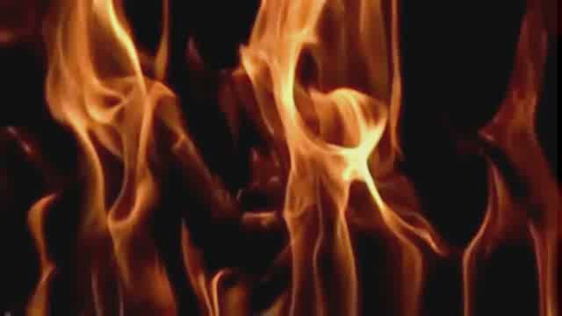



Automating the Pyrolysis Model Development Process
Gregory Fiola and Stanislav I. Stoliarov

Slide 2
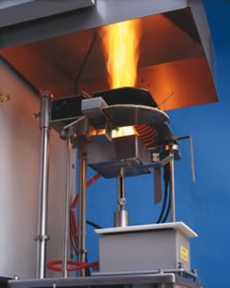
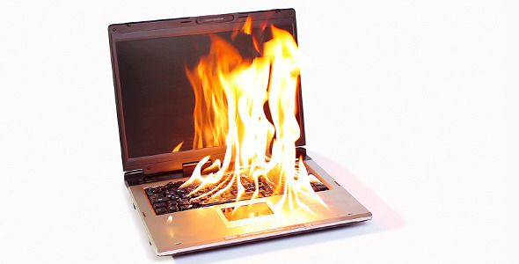
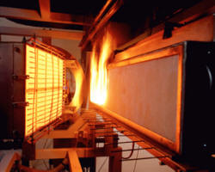

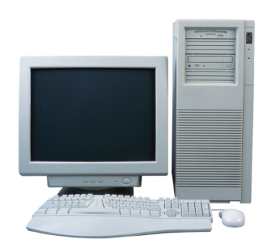
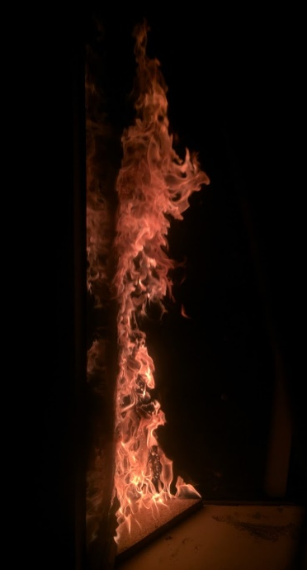
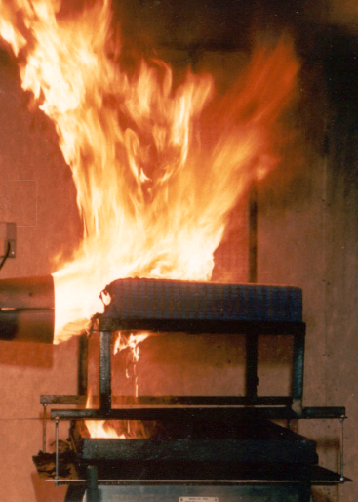
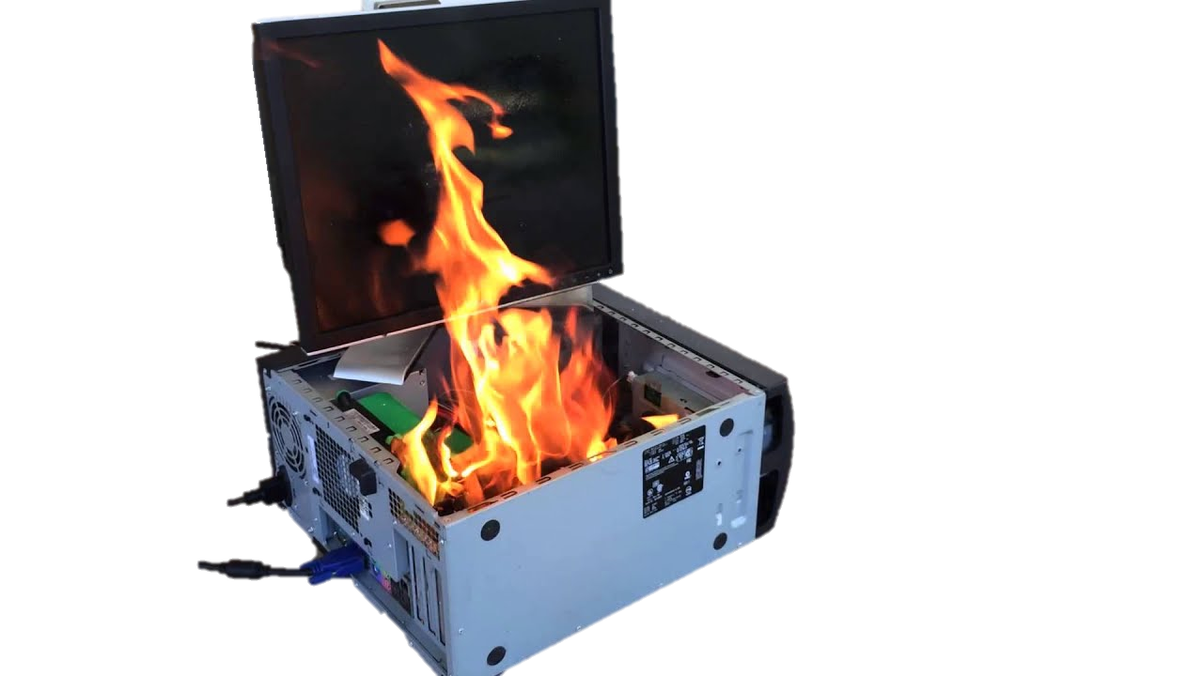

Background
Computational Fire modeling
  Predict fire behavior and spread in a wide range of scenarios
  Cheaper and safer than live tests
Limited by the ability to predict the rates of fuel generation
  Ignition
  Rate of spread
  Time to peak heat release rate (HRR)
  Extinction/Burnout
Predict
Computational Fire?

Slide 3
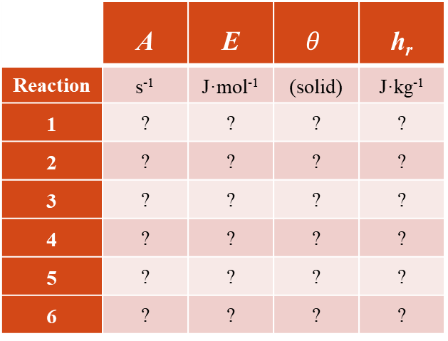
Parameterization of Material Properties
Pre-exponential
Factor
Mass Transport
Coefficient
Activation
Energy
Residual
Yield
Heat of
Reaction
Absorption
Coefficient
Thermal
Conductivity
Specific Heat
Capacity
Heat of
Combustion
Emissivity
Density
 | A | E | $$θ$$ | h_{r}
Reaction | s⁻¹ | J·mol⁻¹ | (solid) | J·kg⁻¹
1 | ? | ? | ? | ?
2 | ? | ? | ? | ?
3 | ? | ? | ? | ?
4 | ? | ? | ? | ?
5 | ? | ? | ? | ?
6 | ? | ? | ? | ?
Component | ρ | ε | κ | k | λ | c_{p} | ∆H_{C}
 | kg m⁻³ | - | kg m⁻² | W m⁻¹ K⁻¹ | m² s⁻¹ | J kg⁻¹ K⁻¹ | kJ g⁻¹
Virgin | ? | ? | ? | ? | ? | ? | ?
Int1 | ? | ? | ? | ? | ? | ? | ?
Int2 | ? | ? | ? | ? | ? | ? | ?
Int3 | ? | ? | ? | ? | ? | ? | ?
Int4 | ? | ? | ? | ? | ? | ? | ?
Int5 | ? | ? | ? | ? | ? | ? | ?
CHAR | ? | ? | ? | ? | ? | ? | ?
GF | ? | ? | ? | ? | ? | ? | ?
Gas1 | ? | ? | ? | ? | ? | ? | ?
Gas2 | ? | ? | ? | ? | ? | ? | ?
Gas3 | ? | ? | ? | ? | ? | ? | ?
Gas4 | ? | ? | ? | ? | ? | ? | ?
Gas5 | ? | ? | ? | ? | ? | ? | ?
Gas6 | ? | ? | ? | ? | ? | ? | ?
Over 100 unknown parameters!

Slide 4
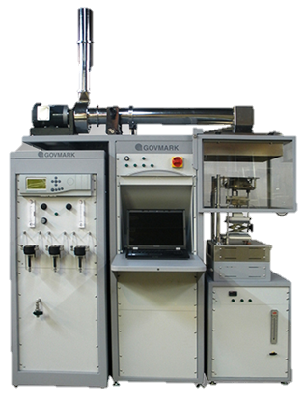
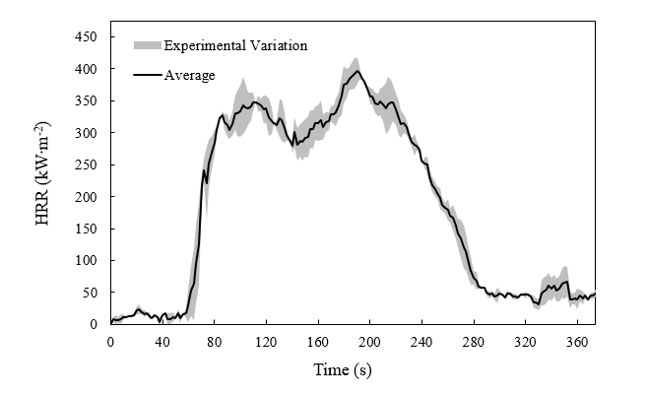

Model Parameterization – Inverse Analysis
Inverse analysis of bench scale tests:
  Cone Calorimetry
  Fire Propagation Apparatus
“Massively parallel Optimization problems” [4]
λ
∆H_{C}
h_{r}
ε
k
κ
ρ
E
c_{p}
$$θ$$
A
Polycarbonate
Courtesy Jacques De Beer
Cone Calorimeter

Slide 5

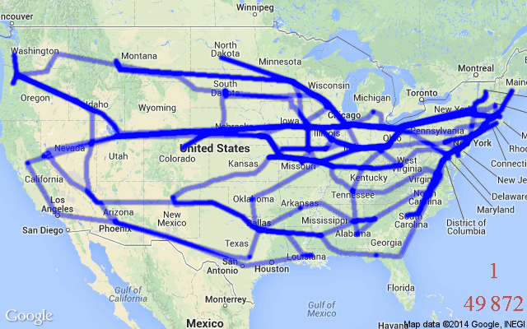
Popular Algorithms – Previous Studies
Evolutionary Algorithms
  Genetic Algorithm (GA)
    Many studies
  GA/Simulated Annealing (GASA)
    Lautenberger et al. [4]
Stochastic Hill Climber (SHC)
    Webster & Trouve [5,6]
Shuffled Complex Evolution (SCE)
    Chaos et al. [7,8]
Lautenberger et al. [4] tested all 4 against manufactured data and found that SCE was capable of reproducing inputs within 1%
The Traveling Salesman Problem
Iteration #
Distance
http://mathgifs.blogspot.com/2014/03/the-traveling-salesman.html
Optimization target:
Minimize total path distance between 48 capital cities
1.29 × 10⁵⁹ possible solutions

Slide 6

Criticisms of Bulk Optimization
Physical Meaningfulness
Compensation effects
  ‘effective’ or ‘equivalent’ properties
Validity outside of calibrated domain
Questions of a solution’s:
Existence
Uniqueness
Stability
Improper Calibration
Boundary Conditions
Experimental Uncertainty
Compensation effects
Solution Quality
Over-simplification
Poor time response

Slide 7
Alternative Method: Manual Parameterization
Developed over the course of many studies
  [8-14]
Hierarchy of well-defined experiments to isolate individual parameters
Extraction of properties from small scale (thermally thin) tests are subsequently used in bench scale (thermally thick) tests to determine remaining parameters
Argued to be more physically meaningful and accurate [8]
Gasification tests are never used as a target and therefore suitable for model validation
TGA
DSC
MCC
Radiant Absorption Setup
CAPA II
A, E, θ
c_{p} , h_{r}
∆H_{C}
κ
k
Milligram-scale
Bench-scale
Drawback: Time and labor intensity

Slide 8
Objective
Improve the manual hierarchical parametrization methodology with automated optimization algorithms that mimic manual iterations
Goals:
  Reduce labor intensity
  Improve accuracy
  Maintain physically meaningful results
  Simplicity
  Maintain user intuition

Slide 9
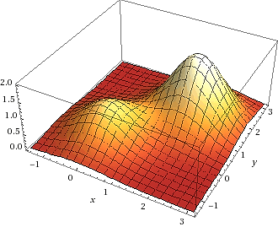
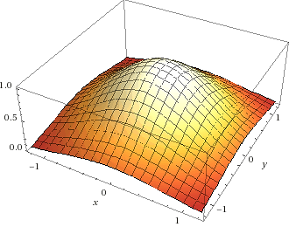

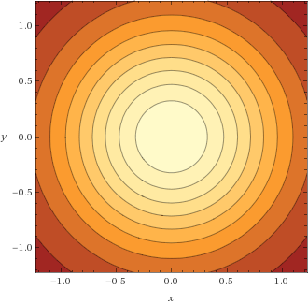
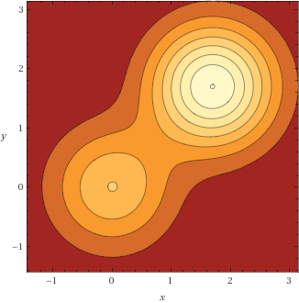


Hill Climbing
$$z=e^{−(x^{2}+y^{2})}$$
$$z=e^{−(x^{2}+y^{2})}+{2e}^{−(({x−1.7)}^{2}+{(y−1.7)}^{2})}$$
Simple heuristic search routine
Maximize a fitness function/vector by continuously ‘stepping’ up a slope
  Steps are always to neighboring cells
  Steps may vary in size
Algorithm: Maximize z
  Evaluate initial cell (elevation = z)
  Loop (until no improvement)
    Select and take a step to neighboring cell
    Evaluate new state (z)
      IF better than current cell → new current cell
      IF worse/same current cell → guess new step
      IF goal → quit
$$z$$

Slide 10
Hill Climbing
Steepest Ascent
$$z=e^{−(x^{2}+y^{2})}+{2e}^{−(({x−1.7)}^{2}+{(y−1.7)}^{2})}$$
Simple heuristic search routine
Maximize a fitness function/vector by continuously ‘stepping’ up a slope
  Steps are always to adjacent cells
Algorithm:
  Evaluate initial cell (elevation)
  Loop (until no improvement)
    Select and take a step to neighboring cell
    Evaluate new state
      IF better than current cell → new current cell
      IF worse/same current cell → guess new step
      IF goal → quit
Select and evaluate multiple steps before accepting a step
Steps vary in size and coordinate
Provides resistance to converging on local peaks
Why hill climbing?
  Simple
  Maintains physicality (deterministic)
  Mimics manual iterations
$$z$$

Slide 11
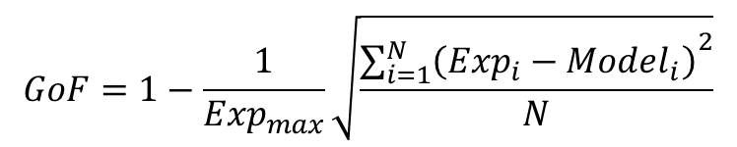
Hill Climbing within Context
Inverse analysis: Fitting model to experimental
Initial guess by physical correlations or user intuition
Guess a single material property at a time
Search space is steps within all combinations of material properties
Custom fitness function quantifying model fit of experimental data
“Goodness of Fit”
$$GoF=1−\frac{1}{{Exp}_{max}}\sqrt{\frac{{\sum_{i=1}^{N}{\left(Exp_{i}−Model_{i}\right)}}^{2}}{N}}$$

Slide 12


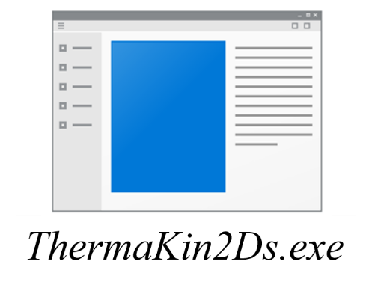


Optimization Framework
ThermaKin is a C++ code compiled into a single .exe file
  Input files: ASCII text files
    Components
    Conditions
  Output files: .txt
MATLAB scripts call ThermaKin as a subroutine within each loop
  Each iteration:
    Property adjustments made to components file
    Components & Conditions passed to ThermaKin
    Output .txt file is interpreted

Slide 13
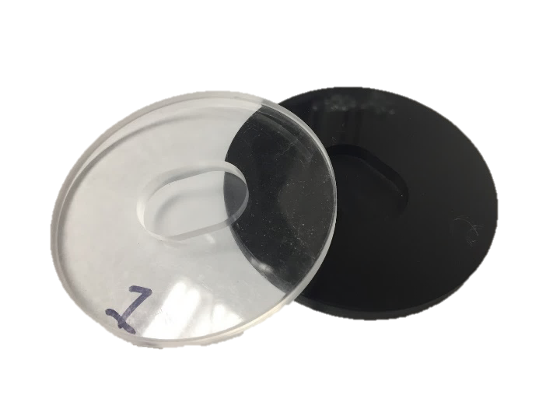
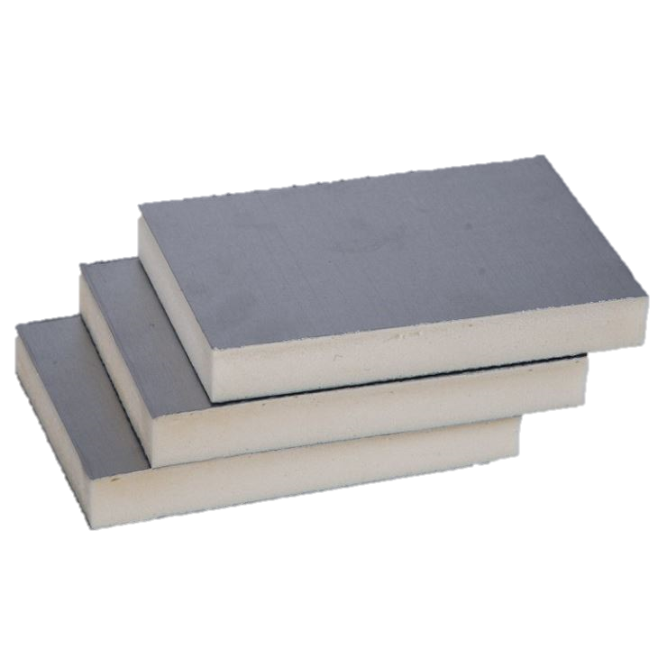

Verification Materials
Simple Complex
Poly(methy methacylate) (PMMA)
(Acrylic, plexiglass)
Rigid Polyisocyanurate (PIR) Foam
(Polyiso)
Lightweight, shatter-resistant glass alternative
Most popular polymer of study in Fire Research community
Surrogate/Benchmark fuel for understanding fire phenomena
Closed-cell thermal insulation material
Greater thermal and mechanical stability than polyurethane (PUR) foam
Recent studies motivated by Grenfell Tower disaster (London, 2017)
Two Varieties:
Cast black & clear Extruded
Two Varieties:
Foam X & Foam Y
[15]
[16]

Slide 14
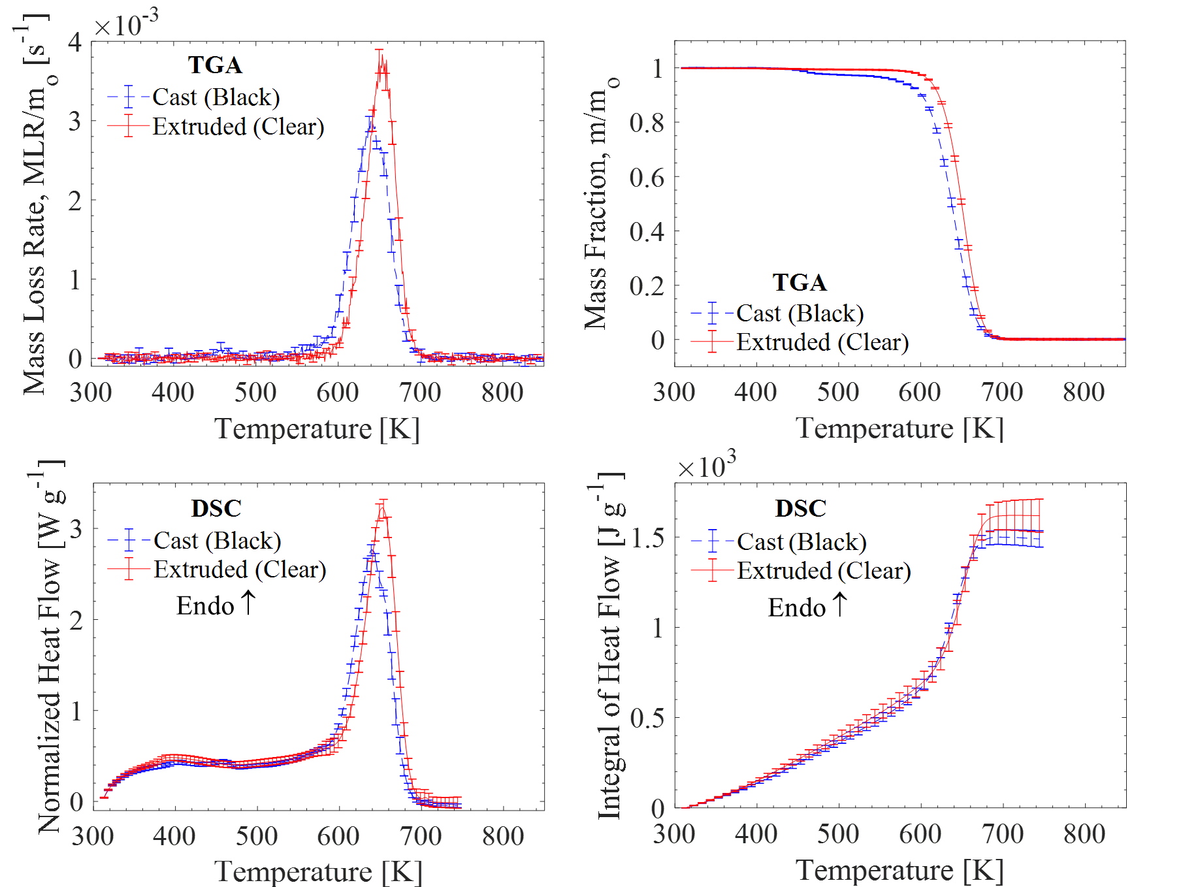
TGA/DSC Results: PMMA
Simple single first-order decomposition reaction scheme
  Slight reaction around 450 K (cast only)
Glass transition around 400 K
  Extruded: 378 K
  Cast: 395 K
Avg. 7 tests

Slide 15
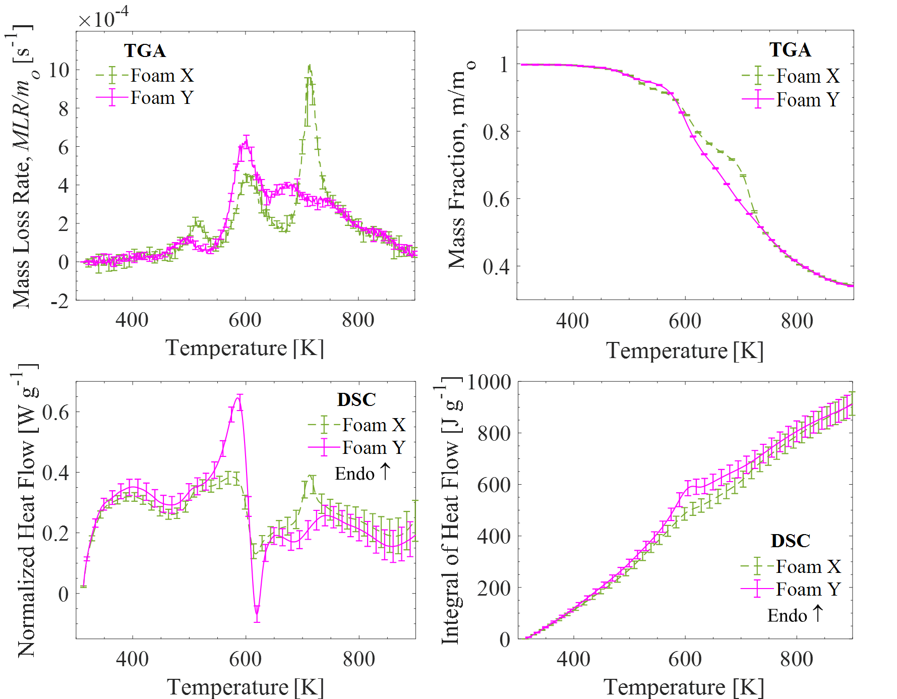
TGA/DSC Results: PIR Foam
Complicated series of consecutive reactions
  6 Reactions for Foam X
  7 Reactions for Foam Y
Sharp exothermic reaction around 600 K
  Characteristic of char structure formation
Nearly identical total heat flow and residual yields.
Avg. 10 tests

Slide 16
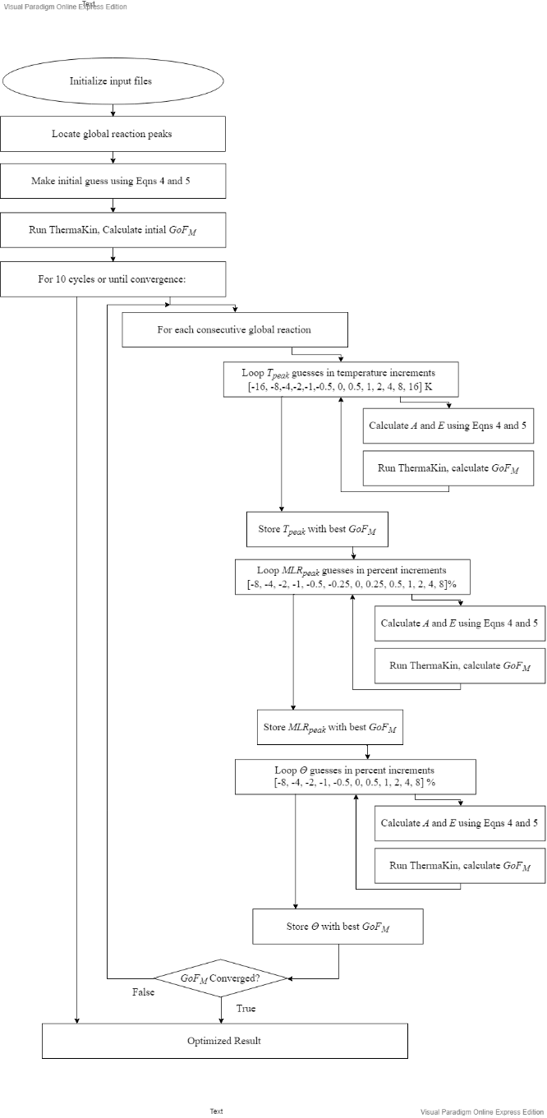
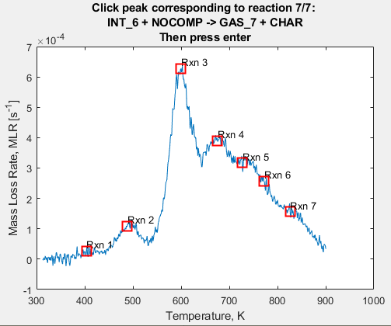

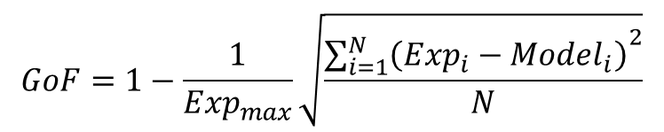
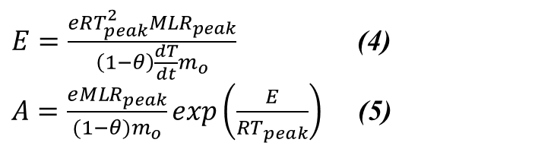
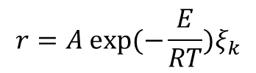
TGA Optimization: A, E, θ
Kinetics of decomposition (Arrhenius parameters) are essential to understanding/predicting a material’s response to heating
  Model predictive capabilities are highly sensitive to these values []
Very difficult to characterize due to dimensionality of the problem and compensation effects between parameters
$E=\frac{eRT_{peak}^{2}{MLR}_{peak}}{\left(1−θ\right)\frac{dT}{dt}m_{o}}$ (4)
$A=\frac{e{MLR}_{peak}}{(1−θ)m_{o}}\exp\left(\frac{E}{RT_{peak}}\right)$ (5)
Component Concentration
$$r=A exp⁡(−\frac{E}{RT})ξ_{k}$$
$$GoF=1−\frac{1}{{Exp}_{max}}\sqrt{\frac{{\sum_{i=1}^{N}{\left(Exp_{i}−Model_{i}\right)}}^{2}}{N}}$$
$$Reactant→θResidual+\left(1−θ\right)Gas$$
$$GoF_{M}=0.7{\left(GoF\right)}_{MLR}+0.3{\left(GoF\right)}_{Mass Fraction}$$

Slide 17
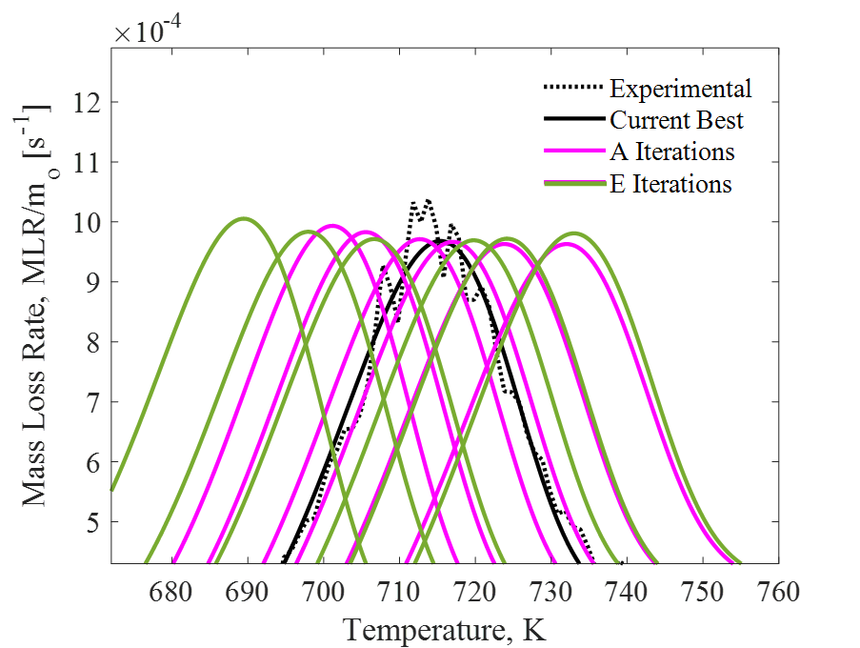
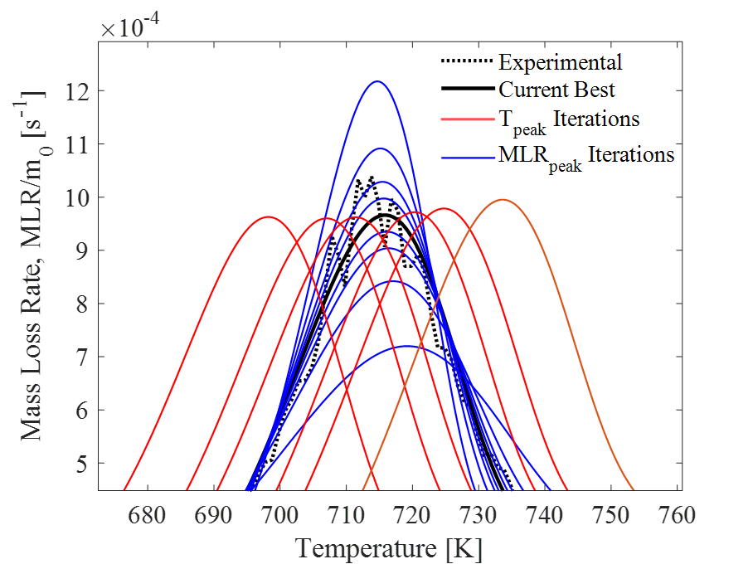
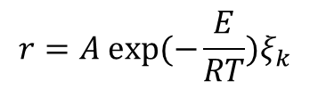
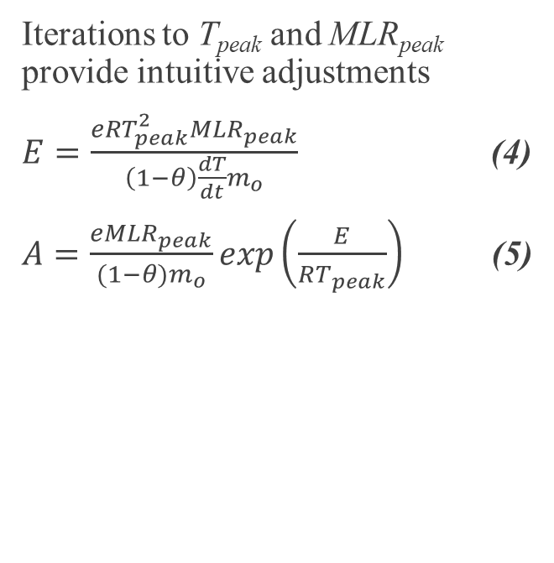
TGA Optimization: A, E, θ
$$r=A exp⁡(−\frac{E}{RT})ξ_{k}$$
Direct Iterations to A and E suffers from compensation effects between the two
Iterations to T_{peak} and MLR_{peak} provide intuitive adjustments
$E=\frac{eRT_{peak}^{2}{MLR}_{peak}}{\left(1−θ\right)\frac{dT}{dt}m_{o}}$ (4)
$A=\frac{e{MLR}_{peak}}{(1−θ)m_{o}}\exp\left(\frac{E}{RT_{peak}}\right)$ (5)

Slide 18
TGA Optimization: A, E, θ
To next cycle
$$Reactant→θResidual+\left(1−θ\right)Gas$$

Slide 19

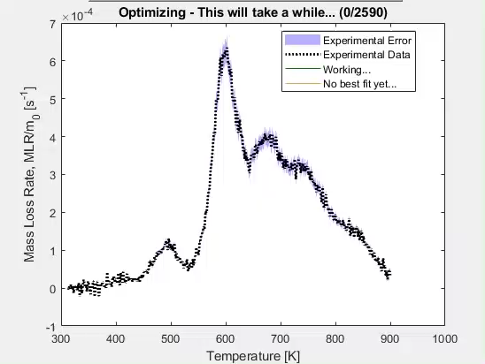
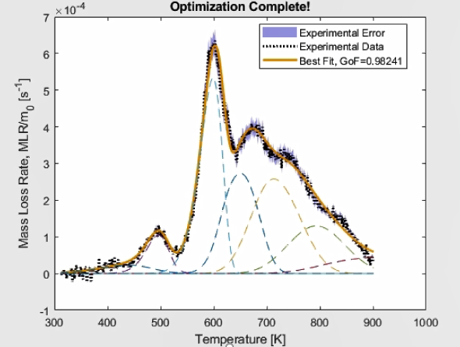
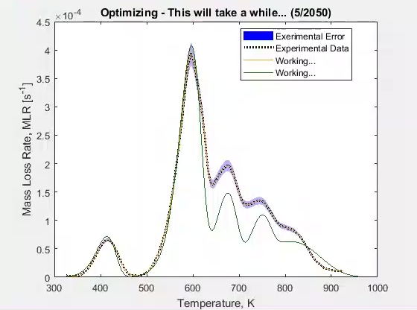
TGA Optimization: A, E, θ
~2500 Guesses
Fitness GoF_{M} = 0.98
~6 hr computational time, desktop PC

Slide 20
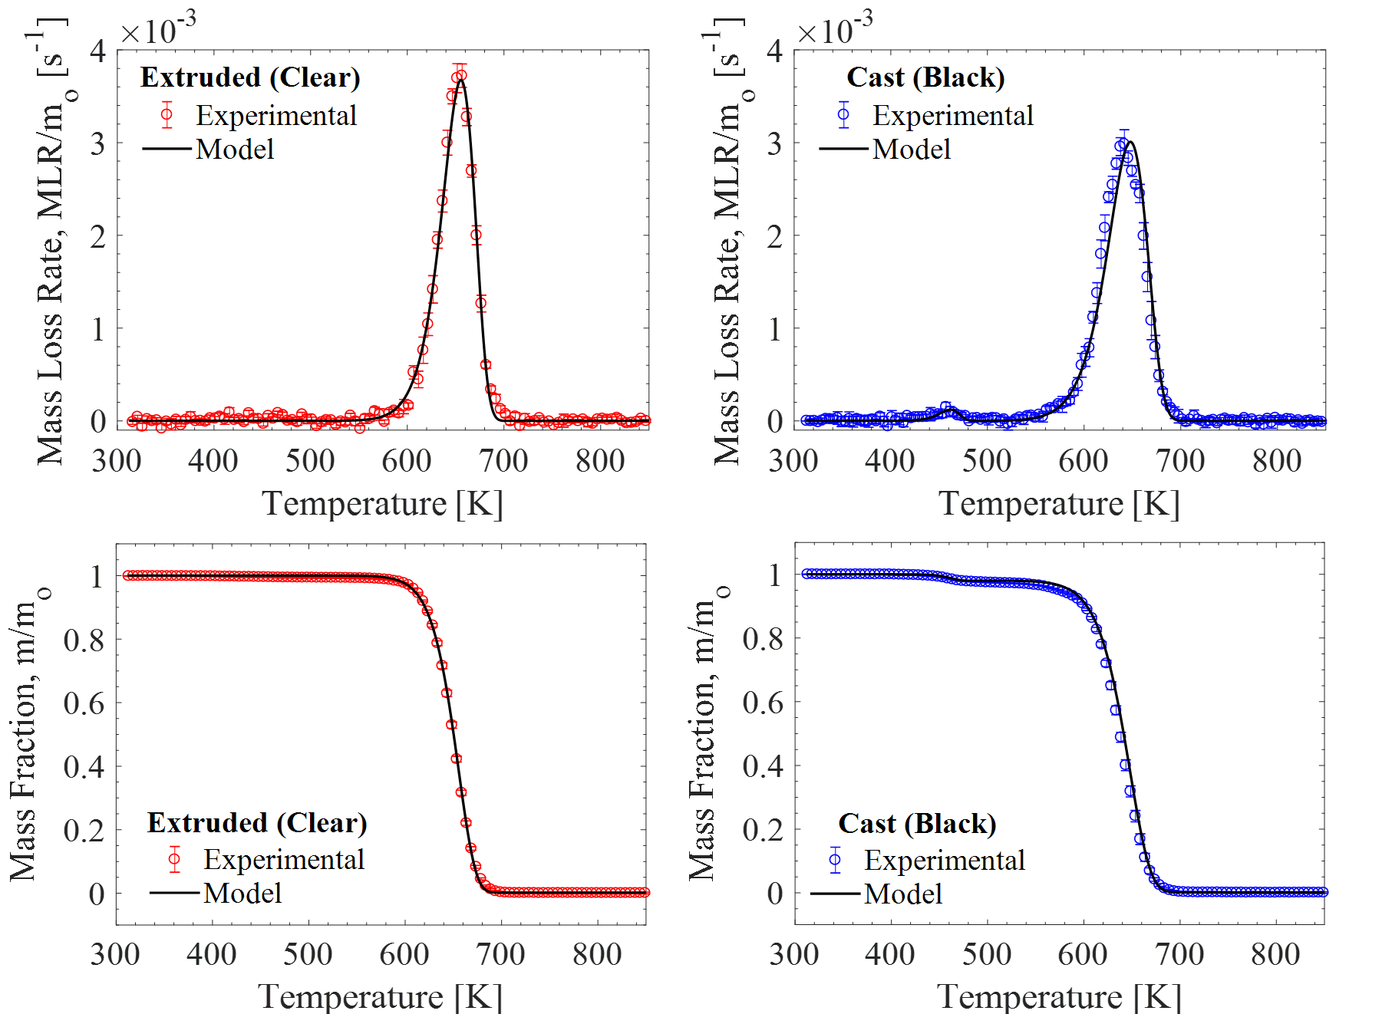
TGA Optimized: PMMA
GoF_{M} = 0.99 GoF_{M} = 0.97
Notes:
Shift right to focus on onset

Slide 21
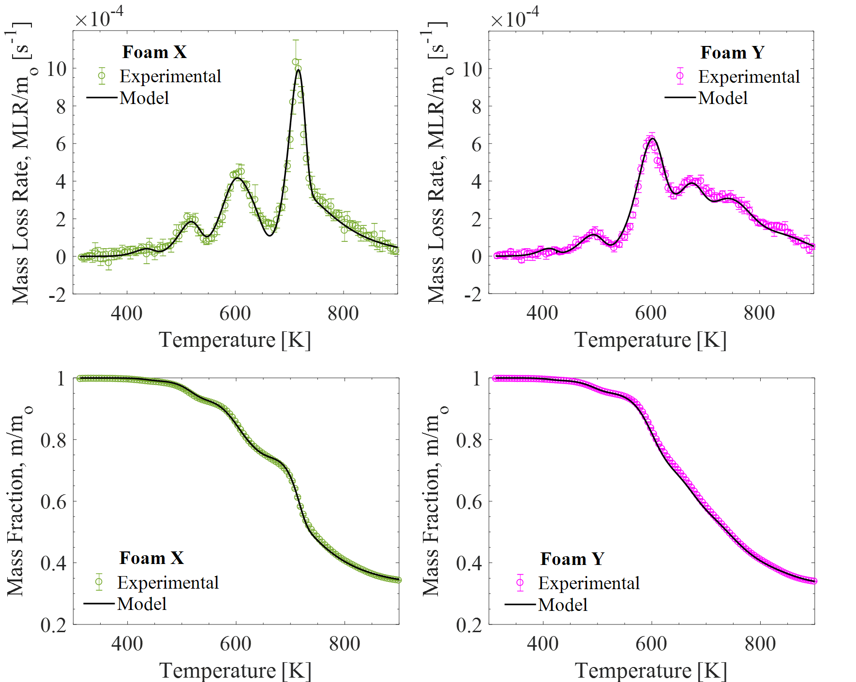
TGA Optimized: PIR Foam
GoF_{M} = 0.97 GoF_{M} = 0.97
Notes:
Talk about glass fiber

Slide 22
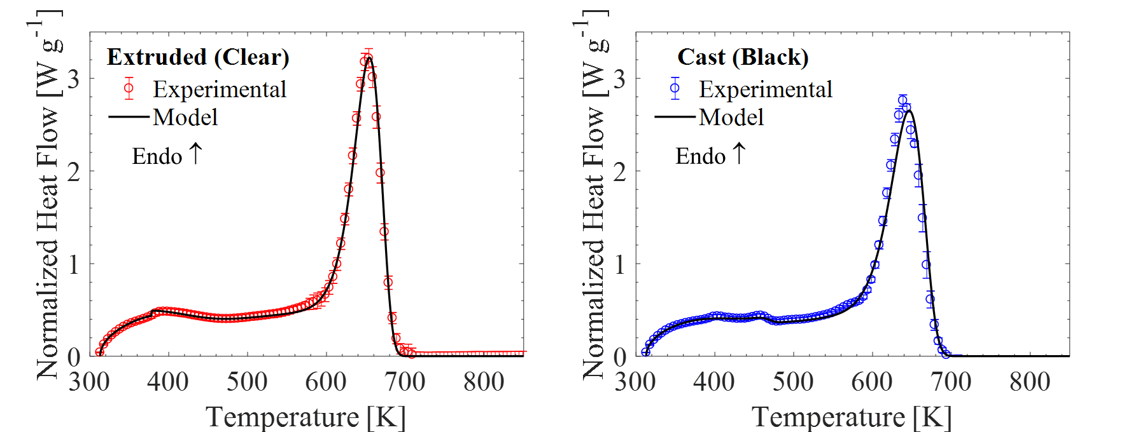
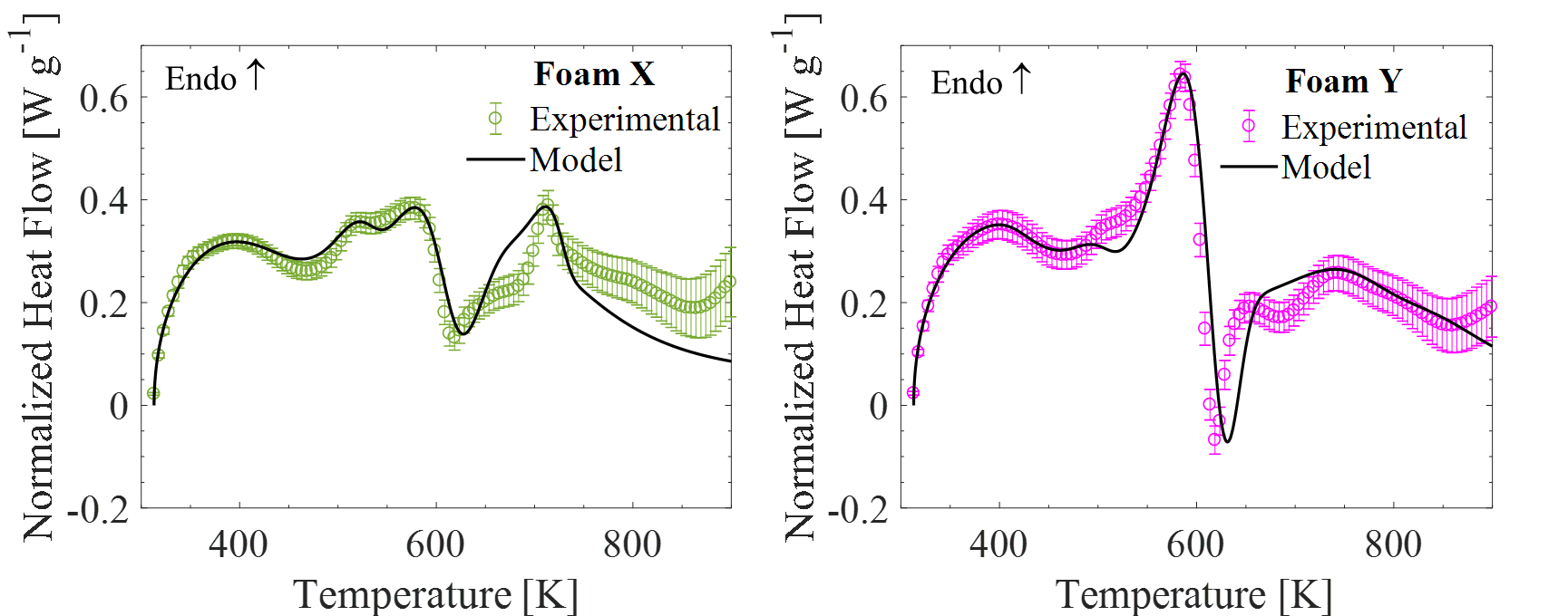
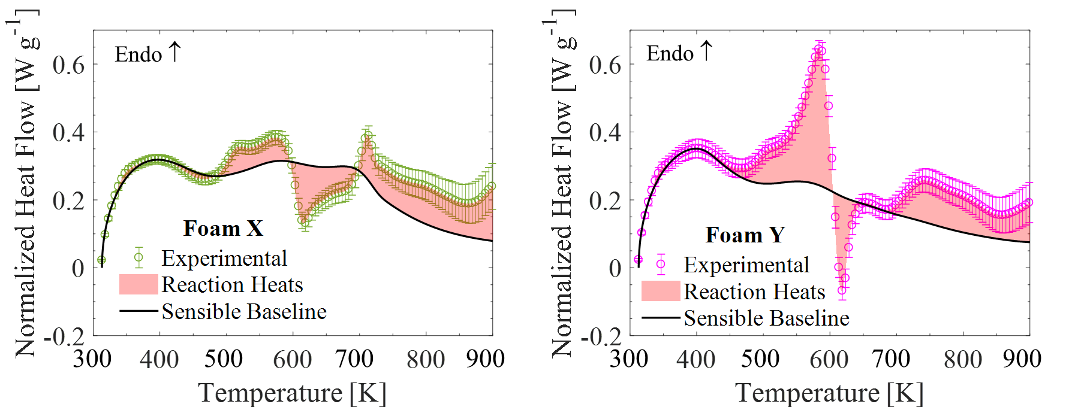
DSC Analysis: c_{p}, h_{r}
Manually Iterative inverse analysis
Determine specific heat capacity (c_{p}) by direct measurement
Determine heats of reaction by integration and iterative refinement
For each parameterization, only one variable per reaction/component, instead of 3

Slide 23
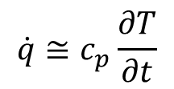
Manual Analysis: Specific Heat Capacity
$$\dot{q}≅c_{p}\frac{∂T}{∂t}$$
Experimental heat flow is divided by instantaneous heating rates to determine heat capacities of components
  Assumptions must be made for intermediate components, where reactions disrupt the heat flow

Slide 24
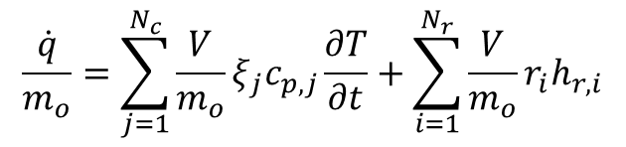

DSC Analysis: c_{p}, h_{r}
$$\frac{\dot{q}}{m_{o}}=\sum_{j=1}^{N_{c}}{\frac{V}{m_{o}}ξ_{j}c_{p,j}\frac{∂T}{∂t}+\sum_{i=1}^{N_{r}}{\frac{V}{m_{o}}r_{i}h_{r,i}}}$$
Direct Measurement
Sensible Heat
Heats of Reactions
Manual Iterations
$$+$$
Sensible heat is simulated by turning all reaction heats off
Used to determine specific heat capacity (c_{p}) for the temperatures at which each component exists
Linear (temperature dependent) or constant value fits.
Assign h_{r} to each reaction
Reaction locations are already established by TGA optimization
Initial guess by integral from baseline to experimental
  Shown as red highlighted region
Manually iterative refinement

Slide 25
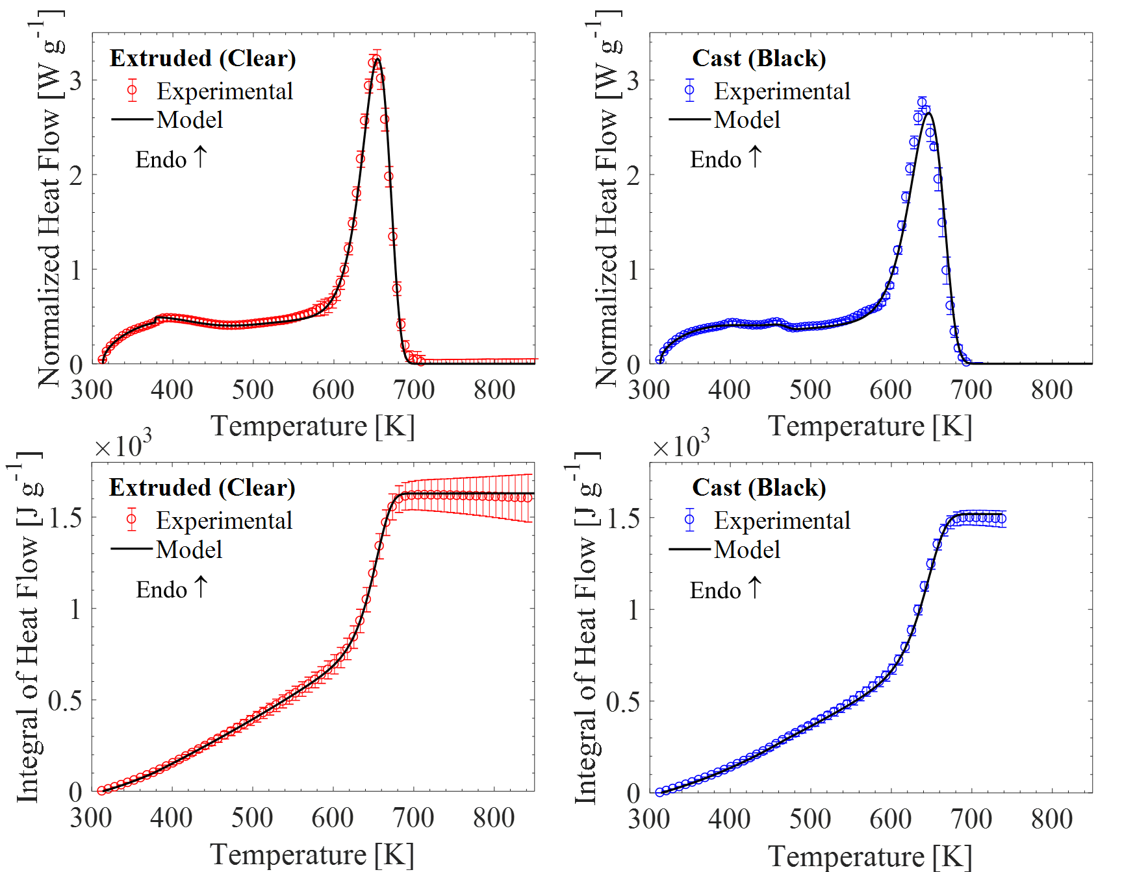
DSC Analysis: PMMA
Linear (temperature dependent) terms for two regions:
  313 K to glass transition
  Glass transition to onset of main reaction
Char specific heat was inconsequential
Solvent reaction (cast) assumed to not effect
c_{p} of MMA gas (monomer) between 400-500 K [17]

Slide 26
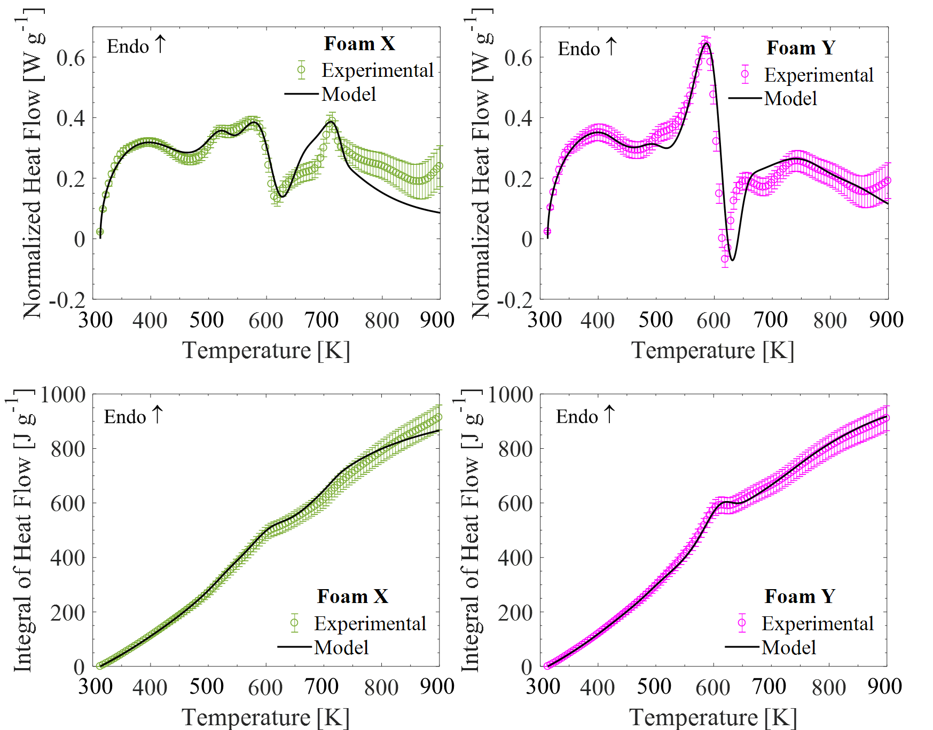
DSC Analysis: PIR Foam
Separate DSC tests performed on char to accurately characterize c_{p,char} and c_{p,GF}
c_{p,gas} corresponds to C1 - C8 hydrocarbons at 600 K [18]
PIR DSC analysis was performed by Dushyant Chaudhari and presented here for completion

Slide 27
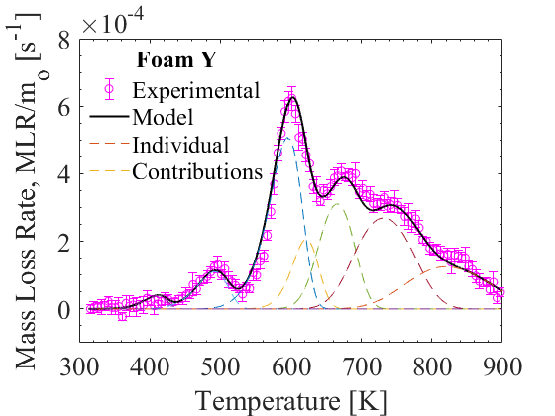
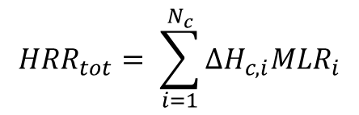

MCC Analysis: Heats of Combustion
$$HRR_{tot}= \sum_{i=1}^{N_{c}}{∆H_{c,i}MLR_{i}}$$
Gas₁
Gas₂
Gas₃
Gas₄
₃
Gas₅
Gas₆
₅
₆
Gas₇
₄
₂
₇
₁
300 500 700 900
MLR_{i}
×
∆H_{c,i}
=
$$HRR_{tot}$$

Slide 28
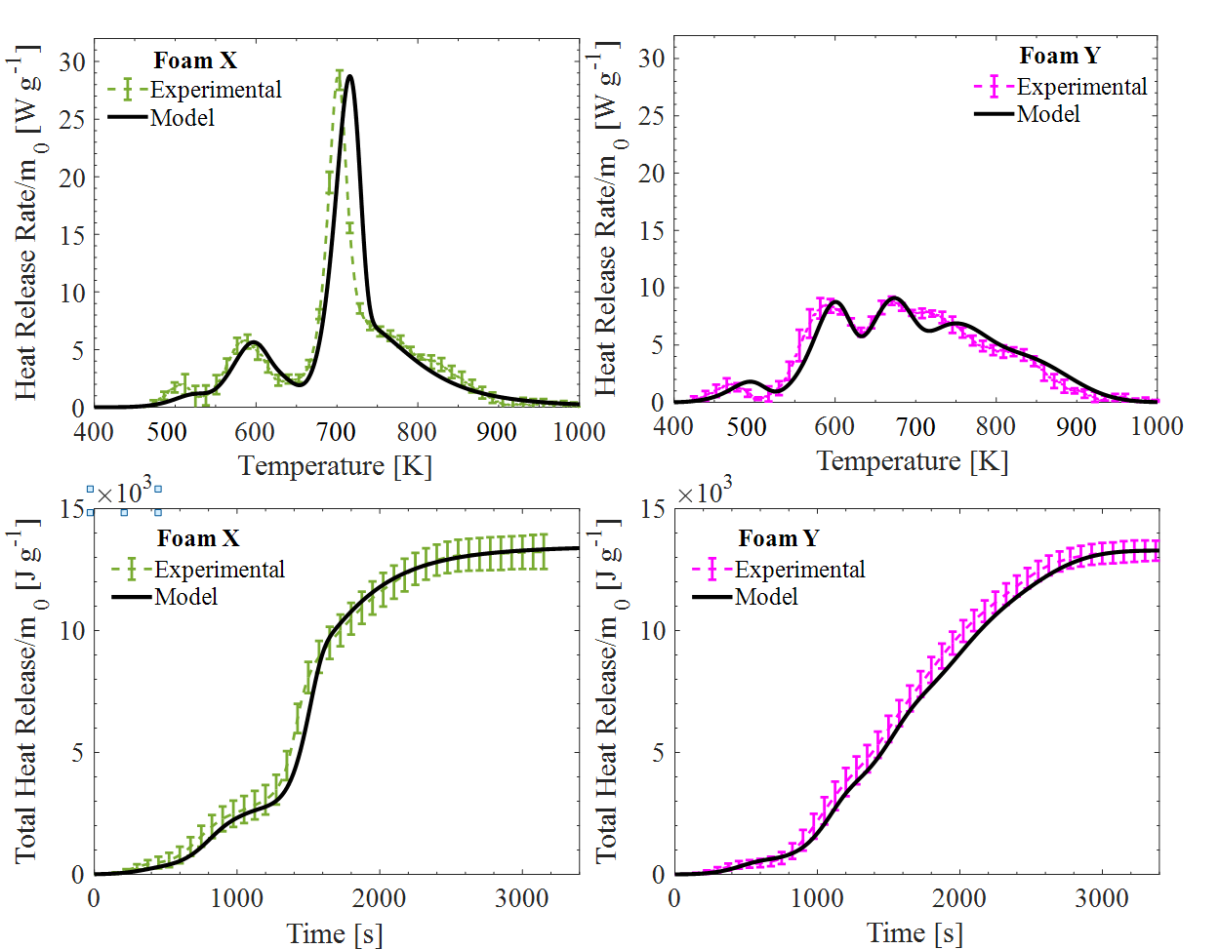
MCC Analysis: PIR Foam
Reasonable number of manual iterations converges on a good solution
∆H_{c,i} for all decomposition products, rather than global value as determined by Cone Cal.
Good agreement for total heat release (THR)
Component | ΔH­­_{c} (kJ g⁻¹) |  | Component | ΔH­­_{c} (kJ g⁻¹)
Foam X Foam Y
GAS₁ | 0 |  | GAS₁ | 0
GAS₂ | 5 |  | GAS₂ | 15
GAS₃ | 17 |  | GAS₃ | 15
GAS₄ | 9 |  | GAS₄ | 8
GAS₅ | 30 |  | GAS₅ | 24
GAS₆ | 21 |  | GAS₆ | 20
 |  |  | GAS₇ | 33
Avg. 5 tests, normalized by m₀
PIR MCC analysis was performed by Dushyant Chaudhari and presented here for completion

Slide 29
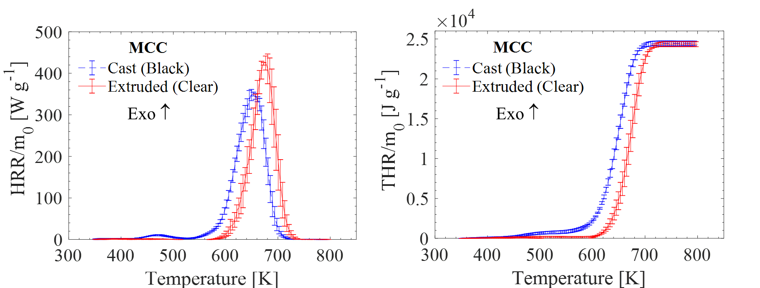
MCC Analysis: PMMA
With no overlapping reactions, and a single decomposition product, direct integration can be used
  Allows for uncertainty measurements
  Highly reproducible results
Solvent reaction (cast) is too small to resolve
  Accounts for ~2% of total mass loss
Avg. 3 tests, normalized by m₀

Slide 30
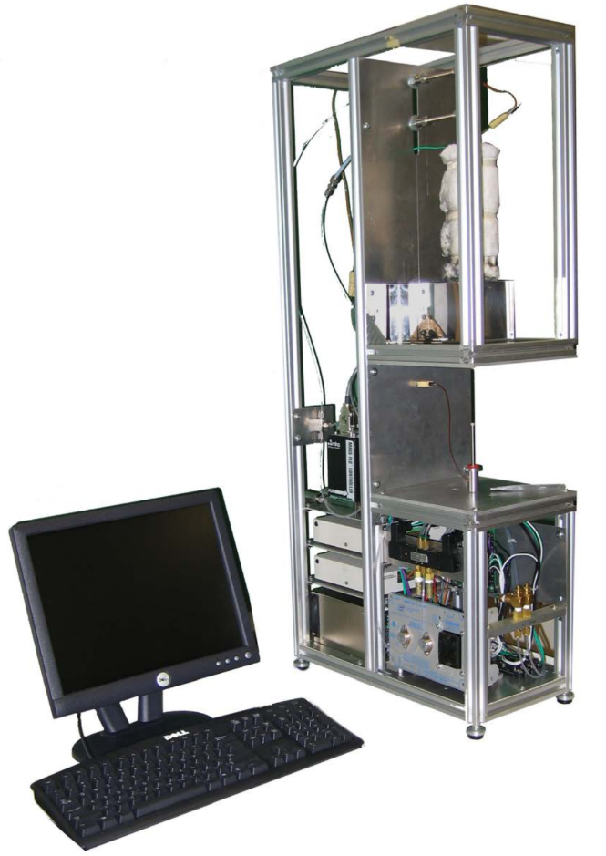
Milligram-Scale – Summary
Simultaneous Thermal Analysis
(TGA and DSC)
Inverse Analysis
Parameterized Quantities
TGA
A, E, and θ
Optimization
DSC
Manual
c_{p} and h_{r}
MCC
MCC
∆H_{c}
Manual

Slide 31
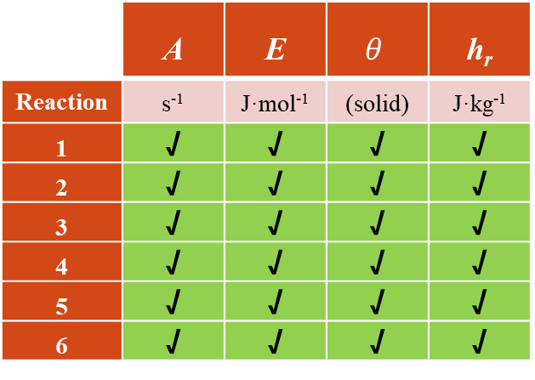
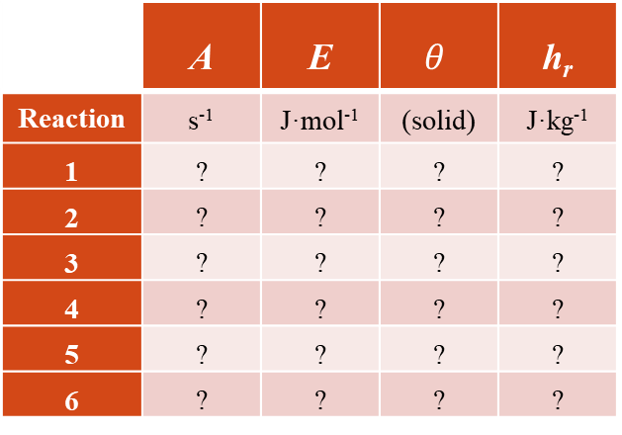
Milligram Scale – Summary
Component | ρ | ε | κ | k | λ | c_{p} | ∆H_{C}
 | kg m⁻³ | - | kg m⁻² | W m⁻¹ K⁻¹ | m² s⁻¹ | J kg⁻¹ K⁻¹ | kJ g⁻¹
Foam X | ? | ? | ? | ? | ? | ? | ?
Int1 | ? | ? | ? | ? | ? | ? | ?
Int2 | ? | ? | ? | ? | ? | ? | ?
Int3 | ? | ? | ? | ? | ? | ? | ?
Int4 | ? | ? | ? | ? | ? | ? | ?
Int5 | ? | ? | ? | ? | ? | ? | ?
CHAR | ? | ? | ? | ? | ? | ? | ?
GF | ? | ? | ? | ? | ? | ? | ?
Gas1 | ? | ? | ? | ? | ? | ? | ?
Gas2 | ? | ? | ? | ? | ? | ? | ?
Gas3 | ? | ? | ? | ? | ? | ? | ?
Gas4 | ? | ? | ? | ? | ? | ? | ?
Gas5 | ? | ? | ? | ? | ? | ? | ?
Gas6 | ? | ? | ? | ? | ? | ? | ?
Component | ρ | ε | κ | k | λ | c_{p} | ∆H_{C}
 | kg m⁻³ | - | kg m⁻² | W m⁻¹ K⁻¹ | m² s⁻¹ | J kg⁻¹ K⁻¹ | kJ g⁻¹
Foam X | ? | ? | ? | ? | ? | √ | √
Int1 | ? | ? | ? | ? | ? | √ | √
Int2 | ? | ? | ? | ? | ? | √ | √
Int3 | ? | ? | ? | ? | ? | √ | √
Int4 | ? | ? | ? | ? | ? | √ | √
Int5 | ? | ? | ? | ? | ? | √ | √
CHAR | ? | ? | ? | ? | ? | √ | √
GF | ? | ? | ? | ? | ? | √ | √
Gas1 | ? | ? | ? | ? | ? | √ | √
Gas2 | ? | ? | ? | ? | ? | √ | √
Gas3 | ? | ? | ? | ? | ? | √ | √
Gas4 | ? | ? | ? | ? | ? | √ | √
Gas5 | ? | ? | ? | ? | ? | √ | √
Gas6 | ? | ? | ? | ? | ? | √ | √
 | A | E | $$θ$$ | h_{r}
Reaction | s⁻¹ | J·mol⁻¹ | (solid) | J·kg⁻¹
1 | ? | ? | ? | ?
2 | ? | ? | ? | ?
3 | ? | ? | ? | ?
4 | ? | ? | ? | ?
5 | ? | ? | ? | ?
6 | ? | ? | ? | ?
 | A | E | $$θ$$ | h_{r}
Reaction | s⁻¹ | J·mol⁻¹ | (solid) | J·kg⁻¹
1 | √ | √ | √ | √
2 | √ | √ | √ | √
3 | √ | √ | √ | √
4 | √ | √ | √ | √
5 | √ | √ | √ | √
6 | √ | √ | √ | √

Slide 32


Grams-scale Experiments
Controlled atmosphere pyrolysis apparatus II (CAPA II)
Radiation Absorption Setup

Slide 33

Radiation Absorption Setup
Irradiate a very thin (0.9 mm) sample
Compare transmission to heat flux gauge with and without sample in place
Emissivity taken from literature
Foam samples were assumed to have ‘high’ absorption coefficient [19]
$$κ=\frac{2\ln\left(ε\right)−\ln\left(\frac{I_{x=δ}}{I_{x=0}}\right)}{δ}$$

Slide 34



CAPA II
Controlled Atmosphere Pyrolysis Apparatus II
Gasification apparatus with well defined boundary conditions:
  Fully anaerobic environment
  Water cooled pyrolysis chamber
  Spatially resolved back surface temperatures
    IR Camera
  Spatially resolved radiant flux distribution
    Accounts for changes in surface topography
  CFD-based characterization of convective losses
  Sample profile monitor
    Accounts for intumescence and char expansion
  High resolution mass balance
Gasification tests performed at 2 fluxes:
  PMMA: 25, 60 kW m⁻²
  PIR Foam: 40, 70 kW m⁻²
Samples prepared as 7cm discs
  PMMA: ¼ inch thick
  PIR Foam: ½ inch thick
Placed on copper foil substrate
  For T_{back} measurements

Slide 35
CAPA II
Controlled Atmosphere Pyrolysis Apparatus II
Quantitative profile evolution
Back Surface Temperatures
Mass evolution
Density Characterization
Inverse analysis to measure k
Validation of final model
Simultaneously measure:

Slide 36



CAPA Conductivity Optimization
Simple Hill Climbing algorithm
Conductivity can be temperature dependent
$k=a+bT+cT^{n}$
New fitness criteria:
$GoF_{T}=1−\sqrt{\frac{\sum_{i=1}^{N}{{\left(\frac{Exp_{i}−Model_{i}}{Exp_{i}}\right)}^{2}}}{N}}$

Slide 37


CAPA Conductivity Optimization
$GoF_{T}=1−\sqrt{\frac{\sum_{i=1}^{N}{{\left(\frac{Exp_{i}−Model_{i}}{Exp_{i}}\right)}^{2}}}{N}}$

Slide 38


CAPA Conductivity Optimization
0.99162
Initial guess: Manufacturer spec GoF_{T} = 0.99
~24 hour computational time, desktop PC ~ 300 Guesses

Slide 39

Conductivity Optimized: PMMA
Optimized first with only constant terms
  Satisfactory fit was not achieved
Linear Temperature dependency added
  Satisfactory fit as shown
GoF_{T} = 0.99
GoF_{T} = 0.99

Slide 40

Conductivity Optimized: PIR Foam
Optimize only constant conductivity terms
  Maintains simplicity, reduces dimensionality
Pseudo-temperature dependence
  Piecewise nature of varying intermediate components
GoF_{T} = 0.99
GoF_{T} = 0.99

Slide 41




CAPA Density Optimization: Profile Evolution
Experimental profile images post-processed to determine thickness evolution
Built within same framework as conductivity optimization
  Use of same GUI for user configuration
  Use of same GoF_{T} fitness criteria
  Initial guess:
  PMMA: Constant Density
  PIR Foam: Constant Thickness
  *Changes in thickness as a result of density affects conduction through the sample via Fourier’s Law. Component conductivities were re-optimized ensuing density optimization.
$${ Fourier^{′}s Law q}_{x}=−k\frac{dT}{dx}$$

Slide 42


Gram-Scale – Summary
Radiation Absorption Setup
Analysis
Parameterized Quantities
Assumption: ε
$$κ=\frac{2\ln\left(ε\right)−\ln\left(\frac{I_{x=δ}}{I_{x=0}} \right)}{δ}$$
Direct
κ
Measurement
CAPA II
k
Optimization
Assumption: λ
ρ
Optimization

Slide 43



Gram Scale – Summary
 | A | E | $$θ$$ | h_{r}
Reaction | s⁻¹ | J·mol⁻¹ | (solid) | J·kg⁻¹
1 | √ | √ | √ | √
2 | √ | √ | √ | √
3 | √ | √ | √ | √
4 | √ | √ | √ | √
5 | √ | √ | √ | √
6 | √ | √ | √ | √

Slide 44

Model Validation: PMMA
Part 1: Temperature evolution at alternate flux (60 kW m⁻²)
GoF_{T} = 0.97 GoF_{T} = 0.97
Fit deteriorates towards the end of the test, likely a result of non-uniformity of sample thickness and impact of epoxy layer

Slide 45
Model Validation: PMMA
Part 2: Mass Loss Rate Predictions
Good predictions, with only slight discrepancies for time to ignition on lower fluxes
GoF_{MLR} = 0.91 GoF_{MLR} = 0.94
GoF_{MLR} = 0.86 GoF_{MLR} = 0.91

Slide 46

Model Validation: PIR Foam
Part 1: Temperature evolution at alternate flux (40 kW m⁻²)
GoF_{T} = 0.97 GoF_{T} = 0.97
Slight overprediction during early heating

Slide 47

Model Validation: PIR Foam
Part 2: Mass Loss Rate & Mass Fraction Predictions: 70 kW m⁻²
MLR is highly transient during initial heating
Residual yield discrepancy possibly due to absence of blowing agent in model
  From TGA parameterization, model is bounded to residual yield of 0.34
GoF_{MLR} = 0.90 GoF_{MLR} = 0.91
θ_{char} = 0.34

Slide 48


Model Validation: PIR Foam
Part 2: Mass Loss Rate & Mass Fraction Predictions: 40 kW m⁻²
GoF_{MLR} = 0.92 GoF_{MLR} = 0.93
Good agreement in residual yield
  Does not drop below 0.34 bound
  Samples do not completely decompose, some blowing agent may be retained

Slide 49
Conclusions
Optimization algorithms effectively reduce labor intensity of manual inverse analysis
In many cases, better results are produced over manual fitting
Demonstrated ability to parameterize two PMMA and two PIR foam models
Models are validated by independent MLR predictions

Slide 50
Bibliography
[1] K. McGrattan, S. Hostikka, R. McDermott, J. Floyd, M. Vanella, Sixth Edition Fire Dynamics Simulator Technical Reference Guide Volume 1 : Mathematical Model 6.3, 1 (2015).
[2] S.I. Stoliarov, R.E. Lyon, Thermo-kinetic model of burning for pyrolyzing materials, in: Fire Saf. Sci., 2008. doi:10.3801/IAFSS.FSS.9-1141.
[3] C. Lautenberger, C. Fernandez-Pello, Generalized pyrolysis model for combustible solids, Fire Saf. J. 44 (2009) 819–839. doi:10.1016/j.firesaf.2009.03.011.
[4] C. Lautenberger, C. Fernandez-Pello, Optimization algorithms for material pyrolysis property estimation, in: Fire Saf. Sci., 2011. doi:10.3801/IAFSS.FSS.10-751.
[5] R. Webster, PYROLYSIS MODEL PARAMETER OPTIMIZATION USING A CUSTOMIZED STOCHASTIC HILL-CLIMBER ALGORITHM AND BENCH SCALE FIRE TEST DATA, University of Maryland, 2009.
[6] Z. Ghorbani, R. Webster, M. Lázaro, A. Trouvé, Limitations in the predictive capability of pyrolysis models based on a calibrated semi-empirical approach, Fire Saf. J. 61 (2013) 274–288. doi:10.1016/J.FIRESAF.2013.09.007.
[7] M. Chaos, M.M. Khan, N. Krishnamoorthy, J.L. de Ris, S.B. Dorofeev, Evaluation of optimization schemes and determination of solid fuel properties for CFD fire models using bench-scale pyrolysis tests, Proc. Combust. Inst. 33 (2011) 2599–2606. doi:10.1016/J.PROCI.2010.07.018.
[8] M. Chaos, M.M. Khan, S.B. Dorofeev, Pyrolysis of corrugated cardboard in inert and oxidative environments, Proc. Combust. Inst. (2013). doi:10.1016/j.proci.2012.06.031.
[9] S.I. Stoliarov, J. Li, Parameterization and Validation of Pyrolysis Models for Polymeric Materials, Fire Technol. 52 (2016) 79–91. doi:10.1007/s10694-015-0490-1.

Slide 51
Bibliography, Cont.
[9] J. Li, S.I. Stoliarov, Measurement of kinetics and thermodynamics of the thermal degradation for non-charring polymers, Combust. Flame. 160 (2013) 1287–1297. doi:10.1016/J.COMBUSTFLAME.2013.02.012.
[10] J. Li, S.I. Stoliarov, Measurement of kinetics and thermodynamics of the thermal degradation for charring polymers, Polym. Degrad. Stab. 106 (2014) 2–15. doi:10.1016/j.polymdegradstab.2013.09.022.
[11] M.B. McKinnon, S.I. Stoliarov, Pyrolysis model development for a multilayer floor covering, Materials (Basel). (2015). doi:10.3390/ma8095295.
[12] J. Li, J. Gong, S.I. Stoliarov, Gasification experiments for pyrolysis model parameterization and validation, Int. J. Heat Mass Transf. 77 (2014) 738–744. doi:10.1016/j.ijheatmasstransfer.2014.06.003.
[13] J. Li, J. Gong, S.I. Stoliarov, Development of pyrolysis models for charring polymers, Polym. Degrad. Stab. (2015). doi:10.1016/j.polymdegradstab.2015.03.003.
[14] Y. Ding, J.D. Swann, Q. Sun, S.I. Stoliarov, R.H. Kraemer, Development of a pyrolysis model for glass fiber reinforced polyamide 66 blended with red phosphorus: Relationship between flammability behavior and material composition, Compos. Part B Eng. 176 (2019) 107–263. doi:10.1016/J.COMPOSITESB.2019.107263.
[15] Photo Source: https://www.crownawards.com/ALL.Acrylic_Awards.Gateway_Skyline_Acrylic/LUBTD46.html?cgid=all&gclid=CjwKCAjw8ZHsBRA6EiwA7hw_saXKTtsAsVQIzArcBbSEtrIbM1D1MLBrCyZZvlNNAqtZvJoq6S3uExoCGfEQAvD_BwE
[16] Photo Source:https://www.untduct.net/untduct-pir-system/untduct-polyisocyanurate-pir-foam-air-duct.html
[17] NOAA, Cameo Chemicals, (n.d.). https://cameochemicals.noaa.gov/search/simple.
[18]P.J. Linstrom, W.G. Mallard, NIST Chemistry WebBook, NIST Standard Reference Database Number 69, (2018). doi:10.18434/T4D303.

