Slide 1
Flame Spread on Black Poly(methyl methacrylate) in Corner Configuration
Dushyant Chaudhari
Dr. Stanislav Stoliarov
Department of Fire Protection Engineering
University of Maryland

Slide 2
Introduction – Flame spread problem
Virgin material
Polymer material
Heat source
l_{e}
Thermal decomposition
Fuel production
Or pyrolysis
Heat feedback
l_{f}
Pyrolyzate gas production
Pyrolysing material
Flaming combustion
l_{p}
Complex coupling of gas phase combustion and condensed phase pyrolysis
Incident heat flux
Pyrolyzate gases

Slide 3
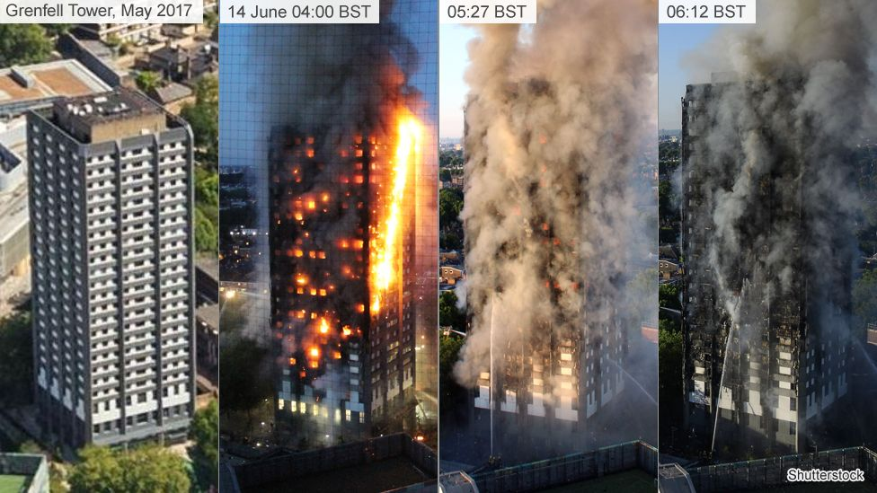
Introduction
Need for better understanding of flammability of materials and flame spread
Source : BBC ^{[1]}
Standards for assessing reaction to fire for wall lining materials (large scale tests)
ISO 9705 – Room corner test ^{[2]}
EN 13823 – Single burning item (SBI) test ^{[3]}
FM parallel panel test ^{[4]}
Notes:
Rise in use of insulation materials in construction industry
Incidents like Grenfell tower bring forward the need to better understand the propensity of flammability of insulation materials and flame spread.
Several large scale standards to classify a material before commercialization are used. Ex. – ISO 9705 – room corner test is a large scale test involving a large scale fire scenario. SBI, part of Euroclass system, imitates a corner fire with 30 kW propane burner exposure. Corner fire scenario more hazardous than single wall fire due to geometrical limitations resulting in longer flame lengths. FM parallel panel test more hazardous due to constricted geometry. Flame spread can be studied in SBI like scenario. Thus, this research will focus on SBI like scenario.

Slide 4
Literature review
Introduction of Single Burning Item (SBI) as a part of Euroclass and its correlational studies with ISO 9705 and Cone calorimeter. ^{[8,9,10]}
  Scalability of fire hazard parameters, relatively low cost
  Provide a suitable test to study flame spread fire hazard on walls in corner configuration.
Large scale fire hazard predictability for screening combustible materials. ^{[5,6,7]}
Scale-up approach example
Pyrolysis model development using small scale tests to describe kinetic decomposition parameters
(Ex. TGA-DSC, MCC)
Thermo-physical parameter determination from bench scale tests
(Ex. Cone calorimeter, CAPA II)
Scale up to larger scales vie understanding of heat and mass transfer conditions
(Ex. SBI, room corner)
Comprehensive pyrolysis model challenges ^{[6,8]}
  Furnishing experimental initial and boundary conditions such as incident heat fluxes on large scale tests
  Coupling gas phase and condensed phase for better description of ignition process and flame propagation
Notes:
Large scale fire testing involves huge investment in material development and work effort in actual testing. Qualitative organization of reaction to fire test results is not useful for performance based fire protection. Complexity of the concerning fires and considering different phases of fire behavior has caused the international research community to invest effort into making prediction/simulations better. Sub-models describing physical, chemical and thermal aspects of fire such as thermal decomposition are significant to describe the quantity that is supplied to the fire and thus the potential magnification of a fire hazard.
SBI was introduced with an effort to harmonize the reaction to fire performance assessment method for commercialization of wall linings in construction industry across Europe. The scalability of SBI to room corner tests and relatively lower costs and the configuration makes it a feasible target for quantifying transient fire hazards on large scale. (ref of brigette, Rudolf Van Mierlo, Sundstorm)
This presentation will focus on obtaining suitable boundary conditions which can be facilitated further for modeling and CFD applications.

Slide 5
Literature review
Poly(methyl methacrylate) (PMMA) used in many small scale fire hazard studies such as burning rate and flame spread. ^{[11,12]}
  Non-charring, non-swelling upon fire exposure
  Well characterized thermal degradation condensed phase model
Limited availability of incident heat flux experimental data (boundary condition) for vertical flame spread hazard. ^{[6]}
Prediction using Computational Fluid Dynamics (CFD) sensitive to radiation model being used.^{[14]}
  Experimental dataset for model validation limited, especially for large scale simulations.
TGA
DSC
CAPA II
60 kW/m²
Available condensed phase pyrolysis model developed based on milligram-scale tests (TGA-DSC) and gasification tests (CAPA II). (In collaboration with Greg Fiola) ^{[13]}

Slide 6
Objective
Build apparatus for SBI like scenario to study buoyant turbulent flame spread.
Accumulate robust dataset on turbulent wall flame spread on Black PMMA for
  Computational Fluid Dynamics (CFD) model validations
  Fast semi-empirical model for predicting turbulent flame spread on combustible walls
Heat release rate (HRR)
To quantify combustion heat release
Develop an oxygen consumption calorimetry expression considering chemical composition of fuel, moisture content
Incident flame heat flux
To quantify boundary conditions for flame spread hazard
Using water-cooled Schmidt-Boelter heat flux gauges
Soot emission map
To determine flame shape and radiation intensity
Using non-intrusive imaging

Slide 7
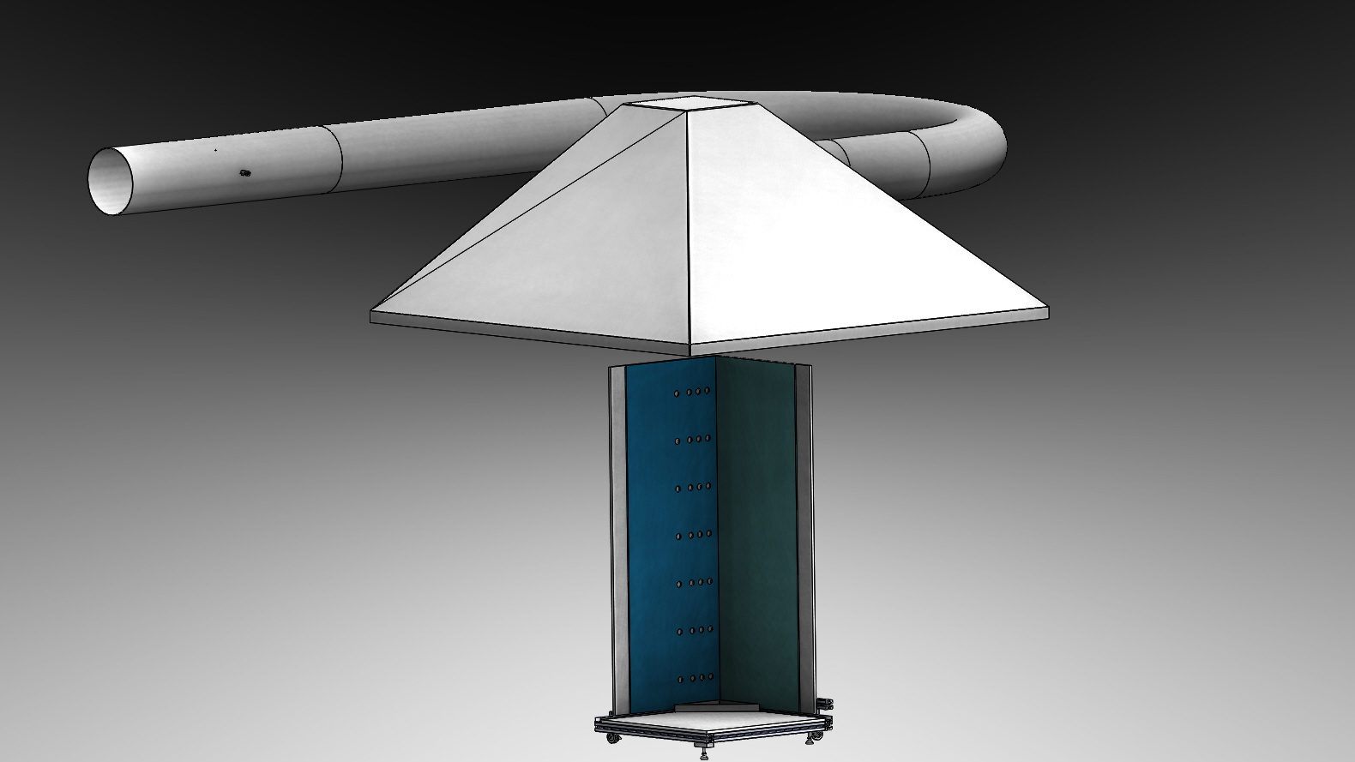

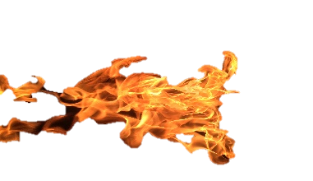
Corner configuration test setup
Exhaust hood
3 m x 3 m
(0.56 m³/s)
Measurement section
Multipoint pressure differential
Exhaust gas temperatures
Gas sampling to paramagnetic O₂ sensor with time response of < 10 sec
Corner configuration
30 kW triangular propane burner
0.5 m x 1.46 m x (5.8 x 10⁻³) m black PMMA samples
Calcium Silicate backing board
Additional ambient pressure, temperature and humidity sensor (PTH)
Notes:
Symmetricity preserved for facilitating data collection, uniform air flow, propane flow from burner and conditions such as setup location under the exhaust hood carefully repeated.

Slide 8
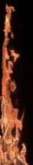
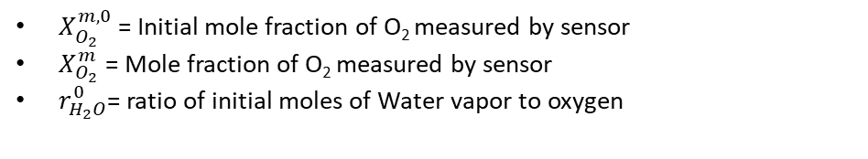
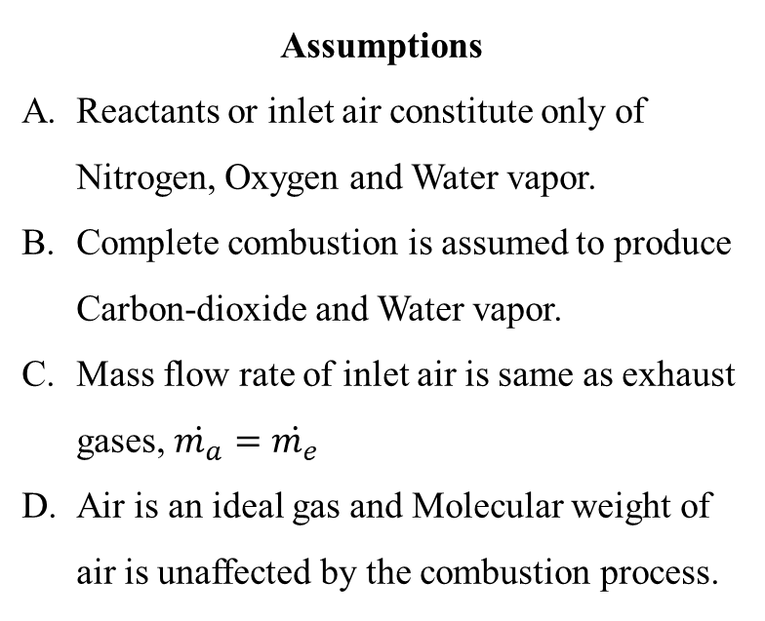
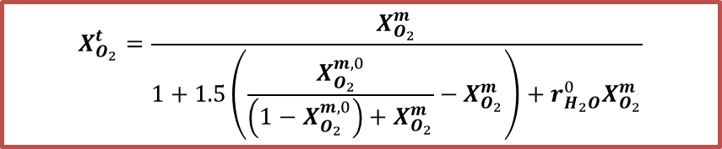


Calorimetry
Assumptions
Reactants or inlet air constitute only of Nitrogen, Oxygen and Water vapor.
Complete combustion is assumed to produce Carbon-dioxide and Water vapor.
Mass flow rate of inlet air is same as exhaust gases, $\dot{m_{a}}=\dot{m_{e}}$
Air is an ideal gas and Molecular weight of air is unaffected by the combustion process.
$$\dot{m_{e}}$$
$$\left[N_{2}, O_{2}\left(X_{O_{2}}^{t}\right), H_{2}O\left(X_{H_{2}O}^{t}\right), CO_{2}\left(X_{CO_{2}}^{t}\right)\right]$$
Exhaust collection hood
Control Volume
$$\dot{m_{a}}$$
$$\left[N_{2}, O_{2}\left(X_{O_{2}}^{0}\right), H_{2}O \left(X_{H_{2}O}^{0}\right)\right]$$
$$X_{O_{2}}^{t}=\frac{X_{O_{2}}^{m}}{1+1.5\left(\frac{X_{O_{2}}^{m,0}}{\left(1−X_{O_{2}}^{m,0}\right)+X_{O_{2}}^{m}}−X_{O_{2}}^{m}\right)+r_{H_{2}O}^{0}X_{O_{2}}^{m}}$$
Calorimetry validated by estimating Propane and PMMA heat of combustion (HOC).
Error less than 10% of theoretical HOCs.
$X_{O_{2}}^{m,0}$ = Initial mole fraction of O₂ measured by sensor
$X_{O_{2}}^{m}$ = Mole fraction of O₂ measured by sensor
$r_{H_{2}O}^{0}$= ratio of initial moles of Water vapor to oxygen
Notes:
Why a new calorimetry? To develop a principle specific for the system under consideration without assuming other formulae are applicable for this system. E.g. cone calorimetry is validated for cone but not for this system. It was deemed important to develop process specific calorimetry principle. Compared with cone type to understand the difference and similarity between the two. The factor 1.5 correspond to ratio of water and carbon dioxide produced for PMMA since PMMA was the major fuel burning. For Propane, this was changed to 1.4. The change of this factor from 1.3 to 1.6 (which span the monomers of PMMA, PS, PBT, ABE) changed the HRR by less than 2.5 %.

Slide 9

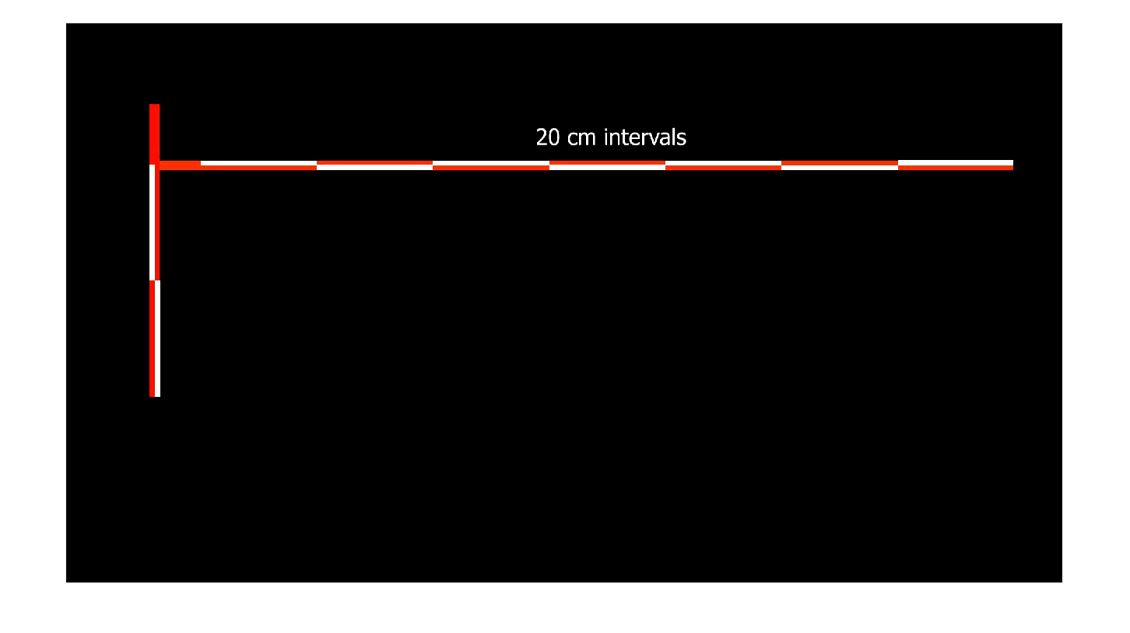
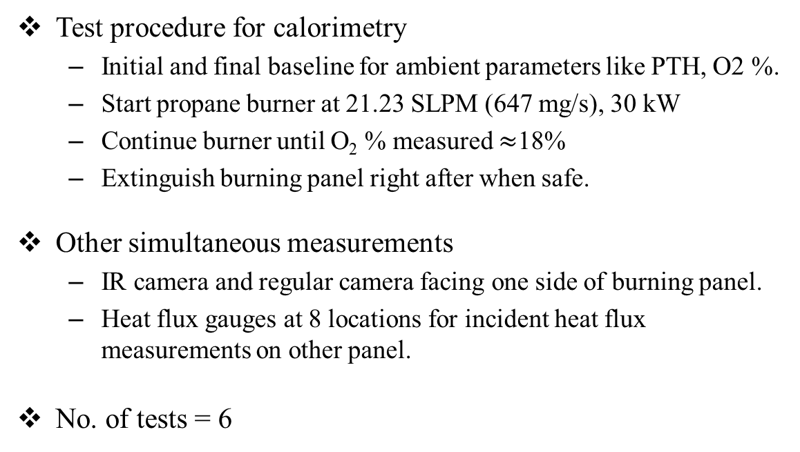
Black PMMA Corner fire experiments
0.56 m³/s
Test procedure for calorimetry
  Initial and final baseline for ambient parameters like PTH, O2 %.
  Start propane burner at 21.23 SLPM (647 mg/s), 30 kW
  Continue burner until O₂ % measured $≈$18%
  Extinguish burning panel right after when safe.
Other simultaneous measurements
  IR camera and regular camera facing one side of burning panel.
  Heat flux gauges at 8 locations for incident heat flux measurements on other panel.
No. of tests = 6
Exhaust collection hood
Notes:
Basic idea of test setup and procedure

Slide 10
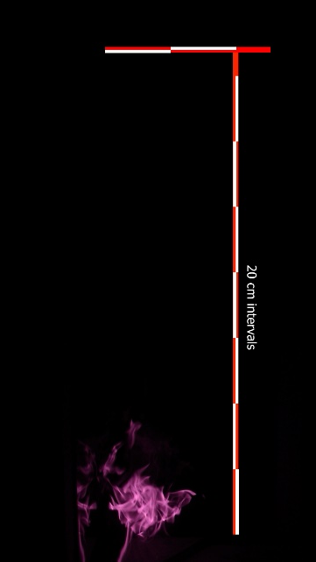
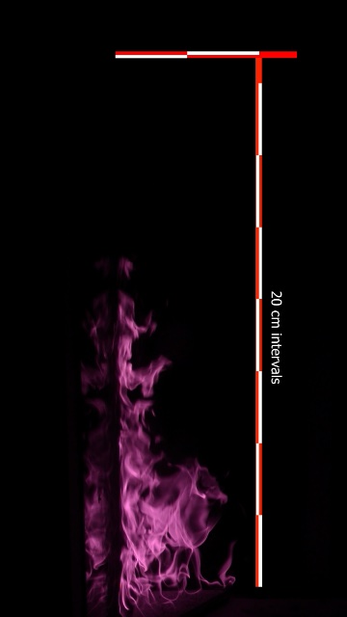
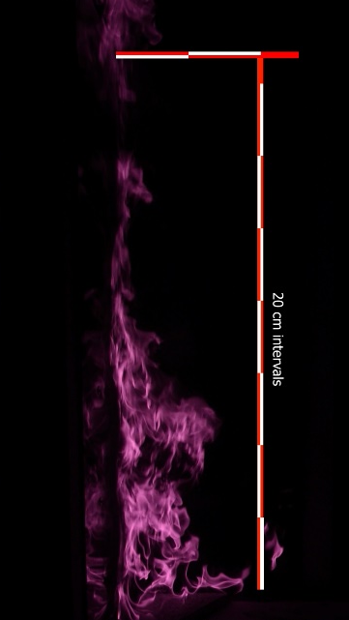
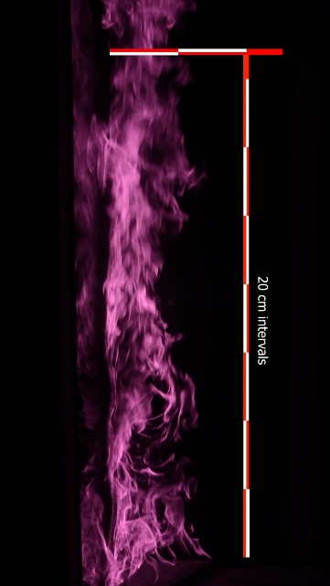
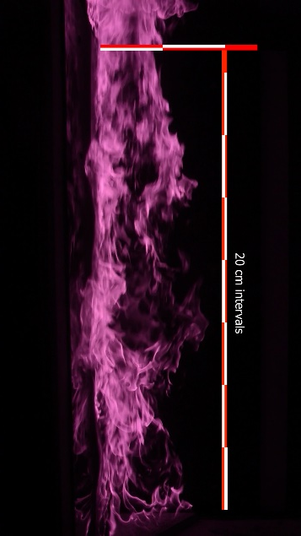
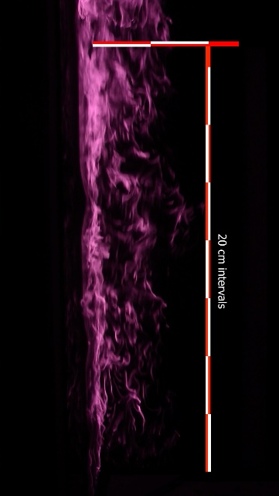
Black PMMA experiment visuals (IR)
t = 30 sec (propane ignition)
t = 70 sec (ignition)
t = 110 sec
Flame spread (10 sec interval)
40 cm
t = 150 sec
t = 190 sec
t = 230 sec
Exposed panel (1460 cm)
Notes:
Untouched, raw IR images from experiments to show the flame progression. At about 70 seconds, PMMA ignites and vertical flame spread is observed. At around 230 seconds, propane flow stopped and fire extinguished

Slide 11
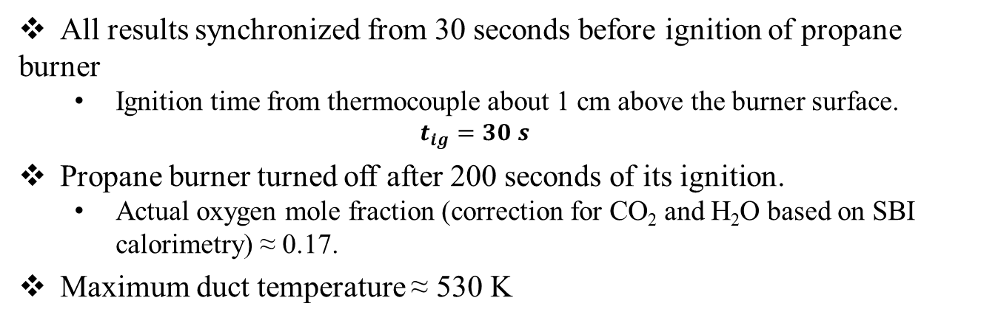
Calorimetry results
All results synchronized from 30 seconds before ignition of propane burner
  Ignition time from thermocouple about 1 cm above the burner surface.
  $$t_{ig}=30 s$$
Propane burner turned off after 200 seconds of its ignition.
  Actual oxygen mole fraction (correction for CO₂ and H₂O based on SBI calorimetry) ≈ 0.17.
Maximum duct temperature ≈ 530 K
Average duct temperatures
Oxygen mole fraction

Slide 12
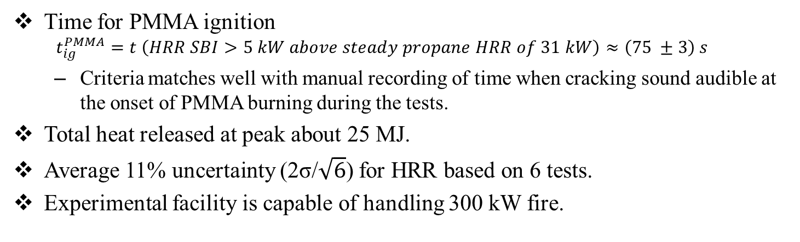
Calorimetry results
Heat release rate
Integral Heat released
Time for PMMA ignition
  $$t_{ig}^{PMMA}=t \left(HRR SBI>5 kW above steady propane HRR of 31 kW\right)≈\left(75 ±3\right) s$$
  Criteria matches well with manual recording of time when cracking sound audible at the onset of PMMA burning during the tests.
Total heat released at peak about 25 MJ.
Average 11% uncertainty (2σ/$\sqrt{6}$) for HRR based on 6 tests.
Experimental facility is capable of handling 300 kW fire.
Notes:
Fire size of 300 kW and total HRR of about 25 MJ can be studied under the experimental apparatus developed. This covers combustible materials which are used Repeatability of the experiments are promising. Data compared with cone type calorimetry to understand the difference between Oxygen calorimetry defined in the literature and the present developed methodology. Higher error bars after the propane flow is stopped indicates unreasonable data and should be ignored while formulating the model.

Slide 13
Incident heat flux
Notes:
Why?

Slide 14
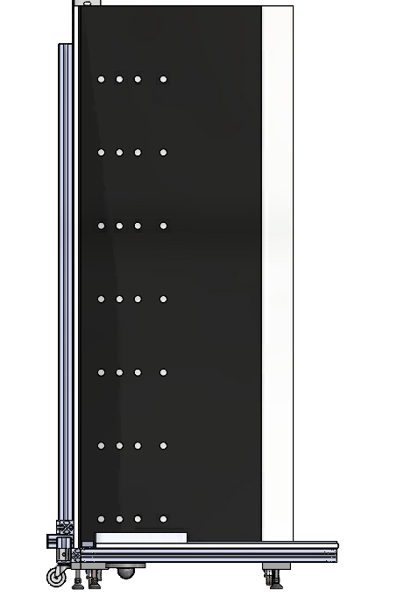
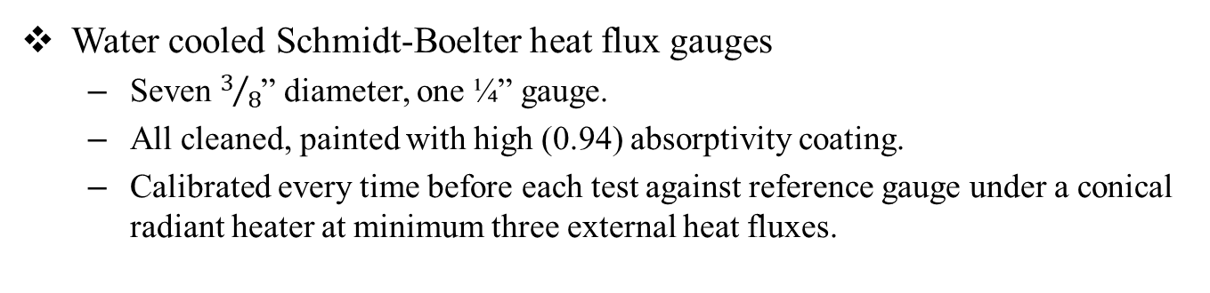
Incident heat flux experiments
Water cooled Schmidt-Boelter heat flux gauges
  Seven $3/8$” diameter, one ¼” gauge.
  All cleaned, painted with high (0.94) absorptivity coating.
  Calibrated every time before each test against reference gauge under a conical radiant heater at minimum three external heat fluxes.
5
15
x (cm)
10
22
130
Mounted flush at following locations
  y = [10; 30; 50; 70; 90; 110;130] cm from the top surface of the burner
  x = [5; 10; 15; 22] cm from the corner
110
90
y
(cm)
70
50
30
10
Notes:
Flame spread modeling requires ability to specify the flame heat feedback to the virgin sample downstream of the travel direction of buoyant combustion gases. This boundary condition is most important parameter required for predictability modeling. One face of the panel was carefully meshed to accommodate heat flux measurements at 7 vertical locations, 20 cm apart starting from 10 cm above the surface of the burner and four locations in lateral direction. The location farthest from the corner in lateral direction was shifted slightly away than regular 5 cm separation between first three, to get a clear demarcation for lateral flame spread/flame shape.

Slide 15
Data analysis of incident heat flux
Criteria for ‘acceptable data’
  Repeatability of HFG data at specific location
  Undesirable fluctuations (ex. random drops indicating gauge receded)
    Video check if high undesirable surface distortions of the panel
Binning the data
  Original data collected at 10 Hz
  10 sec bins across approximately 200 sec of ‘acceptable data’
  Statistics (mean and error) for these temporal bins with sufficient resolution.
  Additional 3% systematic error to include calibration uncertainty.
Notes:
Sufficient tests were conducted to obtain duplicate test data for each of these locations. After data collection, the HFG data was binned every 10 seconds. The 10 seconds correspond to approximate time when a significant change in the fire size was observed and also correspond to the delay and response time of oxygen measurement of exhaust gases. A systematic 3% error was included over the averaged and standard errors obtained from 10 second bins.

Slide 16
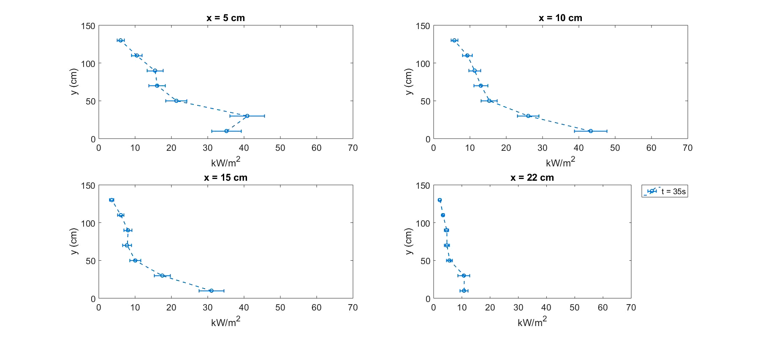
Time evolution of heat flux vs elevation
x = 5 cm from the corner
x = 10 cm from the corner
x = 15 cm from the corner
x = 22 cm from the corner
Notes:
On each plot, y axis indicate vertical elevation and plotted against total incident heat flux measured at specific lateral location; 5, 10 15 and 22 cm. As seen, as time progresses, the total incident heat flux measured by the gauge increases at each location and reaches somewhat steady values as seen by overlapping HFG trend-lines at higher times. The increase of HRR at furthest location 22cm, takes the longest, as expected indicating the lateral spread is slower than the vertical spread. An interesting observation is a pinch point in the variation of HFG along vertical direction at 50 cm elevation. This pinch point may be due to blowing effect caused possibly by a double flame occurrence due to propane and PMMA burning.

Slide 17
Incident heat flux vs HRR
Notes:
Incident heat flux known to be dependent on HRR. Thus, comparative analysis performed to identify significant relationships that would be incorporated later in the empirical flame model.
Here, HFG is compared with corresponding 10 second binned HRR for each location. The y axis on each plot is total incident heat flux, plotted against time. A common theme observed in each plot is that, once the propane ignites, it reaches a steady value until PMMA starts igniting, indicated by the dotted black vertical line in each plot. After a certain time, the heat flux achieves a steady state even if the HRR increases. This dataset can be used to develop an empirical flame model which can be coupled with a pyrolysis model for flame spread predictions.
Functional relationship between incident heat flux and HRR will be established here to utilize it in the development of empirical flame feedback model

Slide 18
IR image analysis
Notes:
Why?

Slide 19
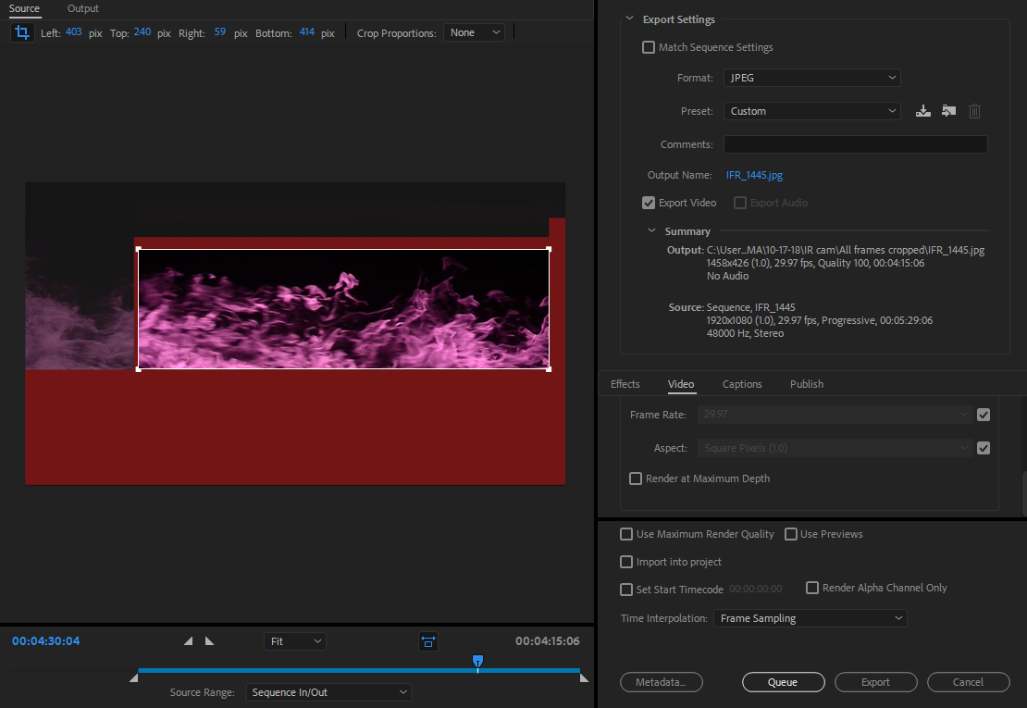
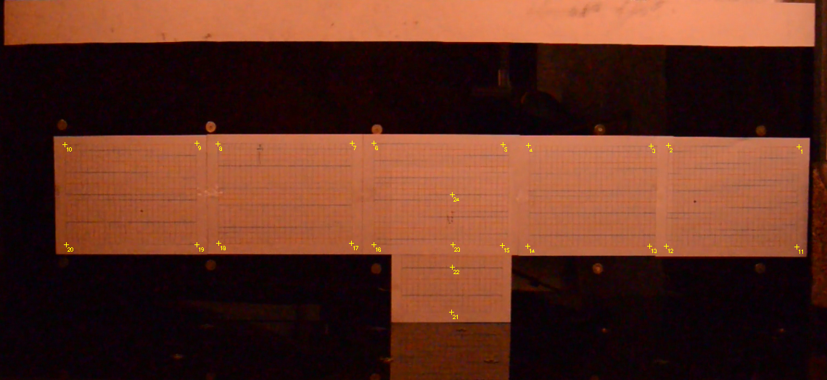
Image Analysis
Modified Nikon DSLR to capture 900 nm emissions from the tests to capture peak wavelength for soot emission. ^{[15]}
Camera set up outside the hood facing one wall, with ISO 320 F9, 5ms shutter speed at 30 fps – 8 bit images.
Camera calibrated with 1 cm grid across the entire PMMA surface.
Extents of exposed surface
Pixel/cm calibration
Notes:
Perhaps at 900 nm highest contribution to radiation is emission from the soot. Emissions from other gases or walls probably do not interfere, as nearly black regions were seen around the flame, which are vaguely visible in the snippet here.

Slide 20


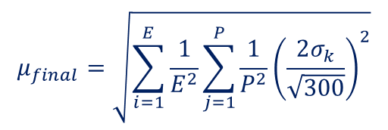
Image Analysis
Images analyzed at 10 second bins (30 fps x10 sec = 300 frames) similar to HFGs after propane ignition.
Soot emission map – based on grayscale image.
  Uncertainty (2 times standard error of the mean) propagation
Flame probability map – based on threshold of 50 on averaged grayscale images.
10 sec bins of grayscale image for each experiment
$$\frac{\left[R\right]+\left[G\right]+\left[B\right]}{3}$$
10 sec bins of grayscale image for each experiment
([𝑅]+[𝐺]+[𝐵])/3
Pixel scale to physical dimension and a uniformly spaced 0.5 cm grid for each experiment.
Averaged 6 experiment
6 tests
  E = number of experiments,
  P = number of pixels averaged during transferring to uniform mesh,
  σ_{k} = standard deviation from time averaging of 10 second bins (‘k’ images)
$$μ_{final}=\sqrt{\sum_{i=1}^{E}{\frac{1}{E^{2}}}\sum_{j=1}^{P}{\frac{1}{P^{2}}{\left(\frac{2σ_{k}}{\sqrt{300}}\right)}^{2}}}$$

Slide 21
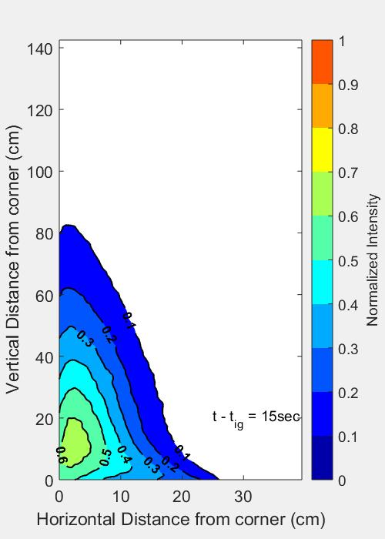
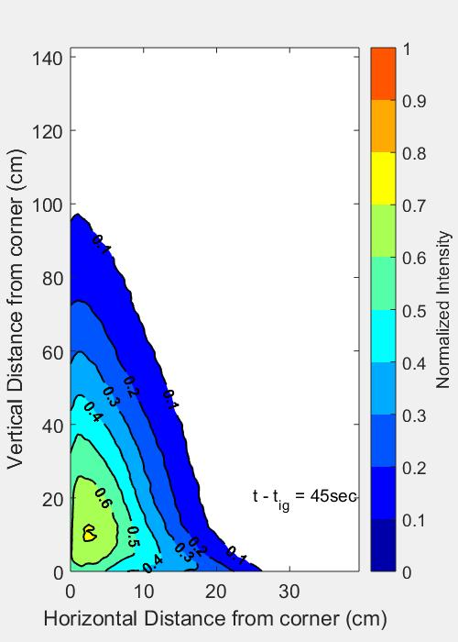
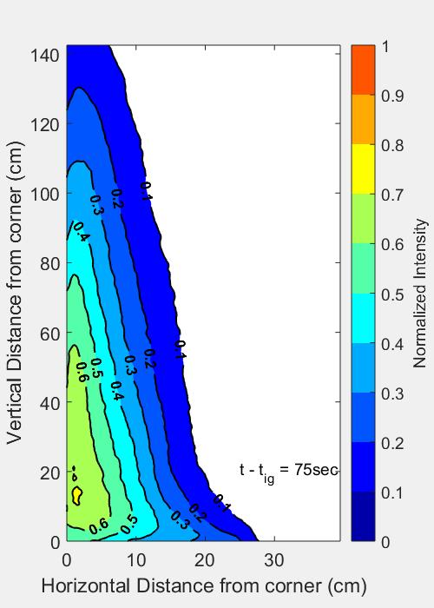
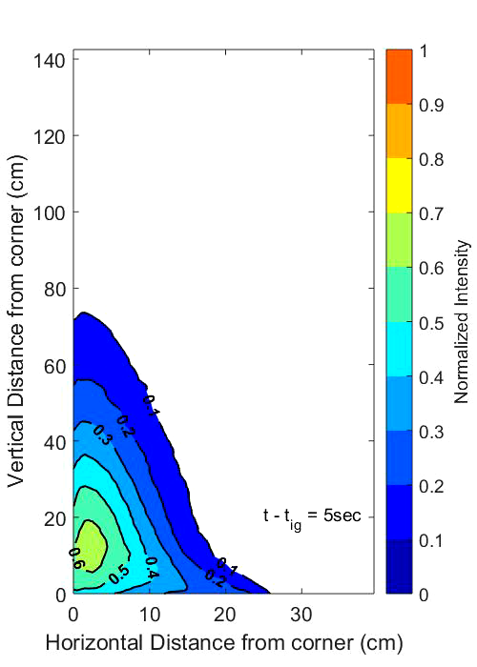
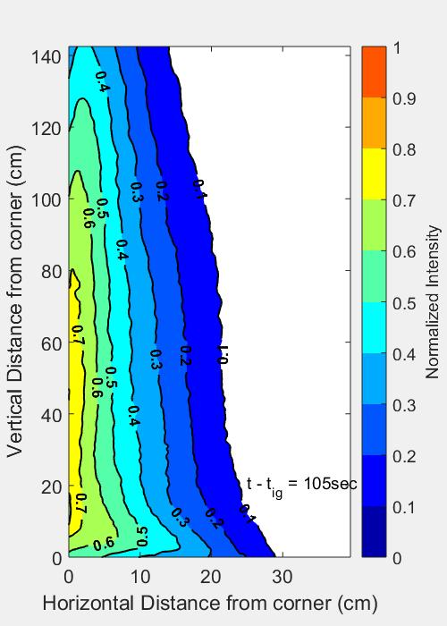
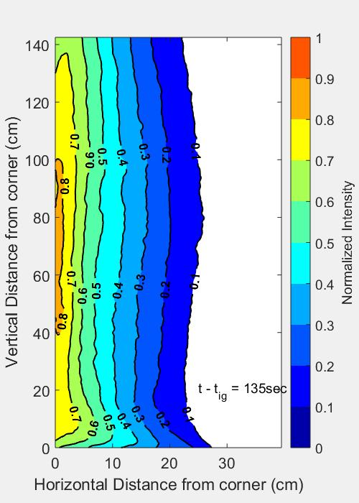
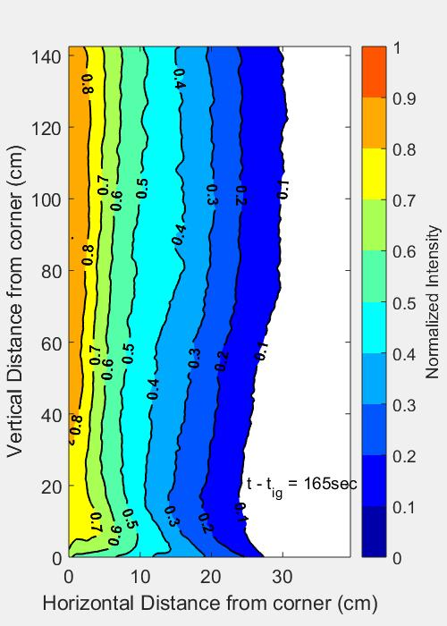
Soot emission maps
Intensity normalized by maximum intensity found across all experiments, across all averaged times.
Minimum uncertainty (-) | Mean uncertainty (-) | Maximum uncertainty (-)
2 × 10⁻⁶ | 8 × 10⁻⁴ | 7 × 10⁻³

Slide 22
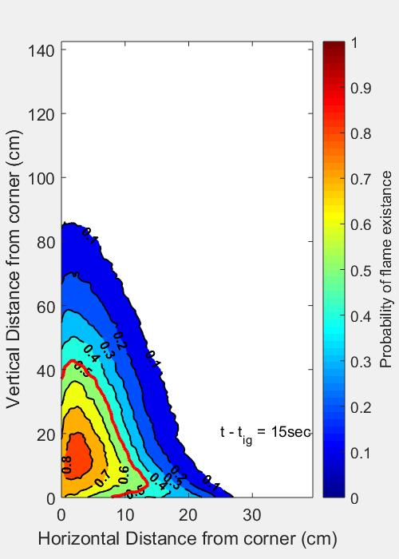
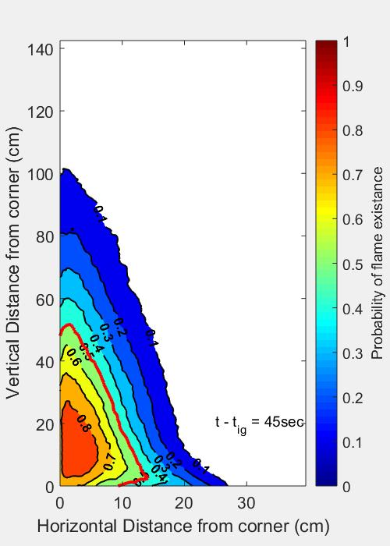
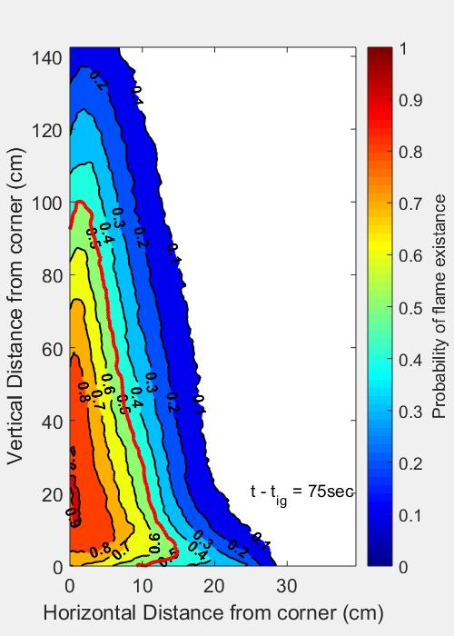
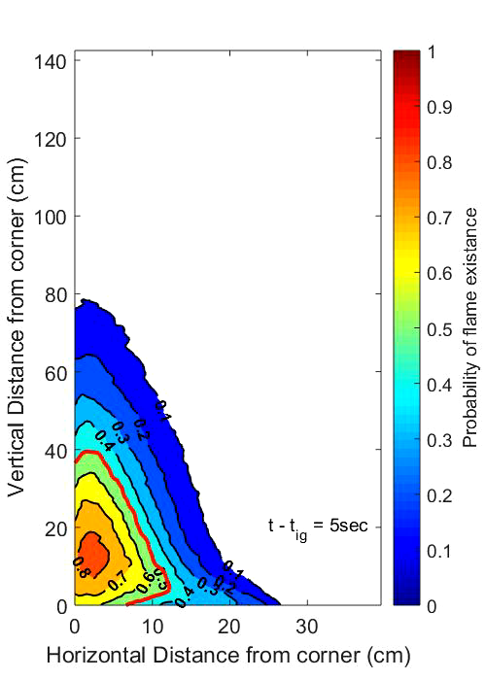
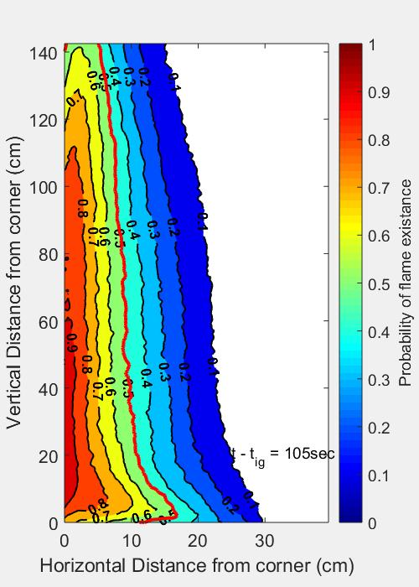
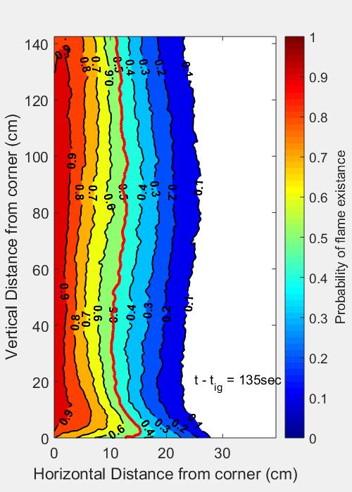
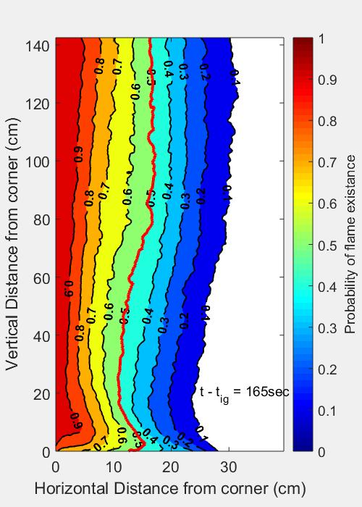
Flame probability map

Slide 23

Conclusion
System specific calorimetry by considering the chemical make-up of the fuel
Incident heat flux distribution across the panel during flame spread
High resolution flame shape and radiation intensity distribution maps
Corner configuration experimental setup to handle 300 kW fire

Slide 24
Future work
Empirical flame heat feedback model
  Based on total incident heat flux gauge data
  Propane burner flame model
  Ignited sample flame heat – feedback model
Coupling flame feedback and pyrolysis model developed from small scale experiments
Modeling Black PMMA flame spread experiments

Slide 25

Acknowledgements
Federal Aviation Administration, grant number 16-G-017.
We would like to thank the grant monitor, Dr. Richard E. Lyon, for advice and encouragement.

Slide 26
References
https://www.bbc.com/news/uk-england-london-40272168
ISO 9705:1993, Fire tests — Full-scale room test for surface products
British Standard, B. S. "EN 13823: 2002, Reaction to fire tests for building products. Building products excluding floorings exposed to the thermal attack by a single burning item." British Standards Institution, London, UK (2002).
Approvals, F. M. (2004). American National Standard for Cleanroom Materials Flammability Test Protocol. (June).
Lattimer, B. Y., Hunt, S. P., Wright, M., & Beyler, C. (2003). Corner fire growth in a room with a combustible lining. Fire Safety Science, 419–430. https://doi.org/10.3801/IAFSS.FSS.7-419
Rogaume, T. (2019). Thermal decomposition and pyrolysis of solid fuels: Objectives, challenges and modelling. Fire Safety Journal, 106, 177–188. https://doi.org/10.1016/j.firesaf.2019.04.016
Vermina Lundström, F., van Hees, P., & Guillaume, É. (2017). A review on prediction models for full-scale fire behaviour of building products. Fire and Materials, 41(3), 225–244. https://doi.org/10.1002/fam.2380
Messerschmidt, B. (2008). The Capabilites and Limitations of the Single Burning Item (SBI) test. FireSeat, 1994, 70–81. Retrieved from www.fireseat.org
Van Mierlo, R., & Sette, B. (2005). The Single Burning Item (SBI) test method - A decade of development and plans for the near future. Heron, 50(4), 191–207.
Sundström, B., Van Hees, P., & Thureson, P. (1998). Results and analysis from fire tests of building products in ISO 9705, the room/corner test. SP Report, (11).
Y. Pizzo et al., “Experimental observations on the steady-state burning rate of a vertically oriented PMMA slab,” Combust. Flame, vol. 152, no. 3, pp. 451–460, Feb. 2008.
B. T. Rhodes and J. G. Quintiere, “Burning rate and flame heat flux for PMMA in a cone calorimeter,” Fire Saf. J., vol. 26, no. 3, pp. 221–240, 1996.
Fiola, G., Chaudhari, D., & Stoliarov, S. (2020). Comparison of Pyrolysis Properties of Extruded and Cast Poly(methyl methacrylate). Submitted In IAFSS.
Zhang, J., Dembele, S., Karwatzki, J., & Wen, J. X. (2005). Effect of radiation models on CFD simulations of upward flame spread. Fire Safety Science, 421–432. https://doi.org/10.3801/IAFSS.FSS.8-421
Goulay, F., Schrader, P. E., & Michelsen, H. A. (2010). Effect of the wavelength dependence of the emissivity on inferred soot temperatures measured by spectrally resolved laser-induced incandescence. Applied Physics B: Lasers and Optics, 100(3), 655–663. https://doi.org/10.1007/s00340-010-4119-2

Slide 27
Thank you!
Questions/Comments/Suggestions?

Slide 28
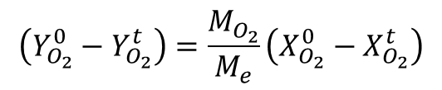

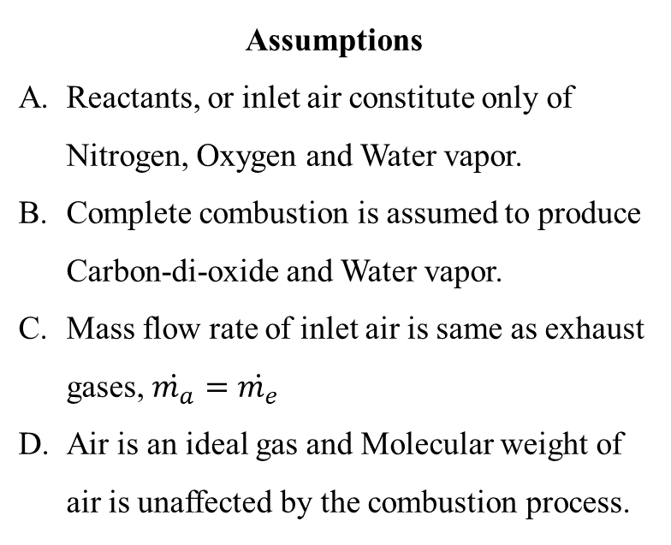
Calorimetry
$$\dot{m_{e}}$$
$$\left[N_{2}, O_{2}\left(X_{O_{2}}^{t}\right), H_{2}O\left(X_{H_{2}O}^{t}\right), CO_{2}\left(X_{CO_{2}}^{t}\right)\right]$$
Assumptions
Reactants, or inlet air constitute only of Nitrogen, Oxygen and Water vapor.
Complete combustion is assumed to produce Carbon-di-oxide and Water vapor.
Mass flow rate of inlet air is same as exhaust gases, $\dot{m_{a}}=\dot{m_{e}}$
Air is an ideal gas and Molecular weight of air is unaffected by the combustion process.
Exhaust collection hood
Control Volume
$$\dot{m_{a}}$$
$$\left[N_{2}, O_{2}\left(X_{O_{2}}^{0}\right), H_{2}O \left(X_{H_{2}O}^{0}\right)\right]$$
$$HRR=E.∆\dot{m_{O_{2}}}$$
$$∆\dot{m_{O_{2}}}=\dot{m_{a}}Y_{O_{2}}^{0}−{\dot{m}}_{e}Y_{O_{2}}^{t}=\dot{m_{e}}\left(Y_{O_{2}}^{0}−Y_{O_{2}}^{t}\right)$$
$$\left(Y_{O_{2}}^{0}−Y_{O_{2}}^{t}\right)=\frac{M_{O_{2}}}{M_{e}}\left(X_{O_{2}}^{0}−X_{O_{2}}^{t}\right)$$

Slide 29

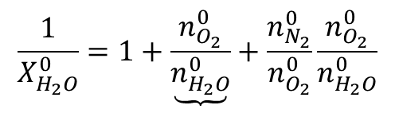
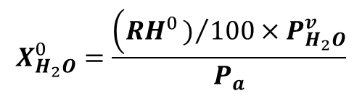
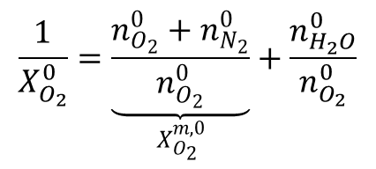
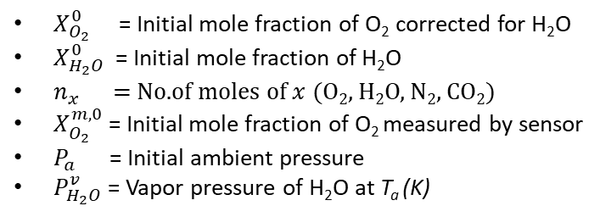
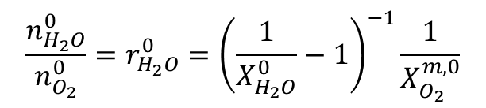

Calorimetry
Initial mole fraction of oxygen corrected for ambient water vapor
$$\frac{1}{X_{O_{2}}^{0}}=\underset{X_{O_{2}}^{m,0}}{\underbrace{\frac{n_{O_{2}}^{0}+n_{N_{2}}^{0}}{n_{O_{2}}^{0}}}}+\frac{n_{H_{2}O}^{0}}{n_{O_{2}}^{0}}$$
$$\frac{1}{X_{H_{2}O}^{0}}=1+\underbrace{\frac{n_{O_{2}}^{0}}{n_{H_{2}O}^{0}}}+\frac{n_{N_{2}}^{0}}{n_{O_{2}}^{0}}\frac{n_{O_{2}}^{0}}{n_{H_{2}O}^{0}}$$
$$\frac{n_{H_{2}O}^{0}}{n_{O_{2}}^{0}}=r_{H_{2}O}^{0}={\left(\frac{1}{X_{H_{2}O}^{0}}−1\right)}^{−1}\frac{1}{X_{O_{2}}^{m,0}}$$
$$X_{O_{2}}^{0}=X_{O_{2}}^{m,0}\left(1−X_{H_{2}O}^{0}\right)$$
Initial mole fraction of H₂O
$$X_{H_{2}O}^{0}=\frac{\left(RH^{0})/{100}×P_{H_{2}O}^{v}\right.}{P_{a}}$$
$X_{O_{2}}^{0}$ = Initial mole fraction of O₂ corrected for H₂O
$X_{H_{2}O}^{0}$ = Initial mole fraction of H₂O
$n_{x}$ = No.of moles of $x$ (O₂, H₂O, N₂, CO₂)
$X_{O_{2}}^{m,0}$ = Initial mole fraction of O₂ measured by sensor
$P_{a}$ = Initial ambient pressure
$P_{H_{2}O}^{v}$ = Vapor pressure of H₂O at T_{a} (K)
Vapor pressure of water (Tetens equation)¹
$$P_{H_{2}O}^{v}={A.exp}^{\left(\frac{BT_{a}−C}{T_{a}+D}\right)}{×10}^{3} Pa$$
A = 0.61078 Pa B = 17.27,
C = 4714.71 K D = -35.7 K
¹ John Monteith and Mike Unsworth, Principles of Environmental Physics, 3rd Edition (2007)

Slide 30

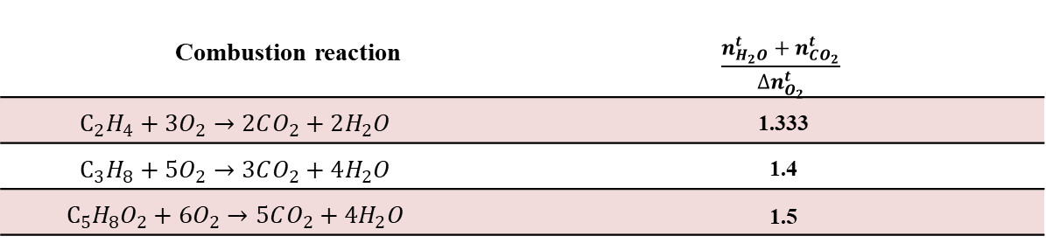
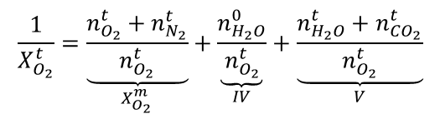

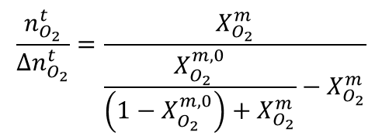
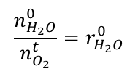
Calorimetry
Mole fraction of oxygen at time (t)
$$\frac{1}{X_{O_{2}}^{t}}=\underset{X_{O_{2}}^{m}}{\underbrace{\frac{n_{O_{2}}^{t}+n_{N_{2}}^{t}}{n_{O_{2}}^{t}}}}+\underset{IV}{\underbrace{\frac{n_{H_{2}O}^{0}}{n_{O_{2}}^{t}}}}+\underset{V}{\underbrace{\frac{n_{H_{2}O}^{t}+n_{CO_{2}}^{t}}{n_{O_{2}}^{t}}}}$$
Assuming no. of O₂ moles are conserved
$$\frac{n_{H_{2}O}^{0}}{n_{O_{2}}^{t}}=r_{H_{2}O}^{0}$$
Term IV.
$$\frac{n_{H_{2}O}^{t}+n_{CO_{2}}^{t}}{n_{O_{2}}^{t}}=\frac{\frac{n_{H_{2}O}^{t}}{∆n_{O_{2}}^{t}}+\frac{n_{CO_{2}}^{t}}{∆n_{O_{2}}^{t}}}{\frac{n_{O_{2}}^{t}}{∆n_{O_{2}}^{t}}}$$
$$\frac{n_{O_{2}}^{t}}{∆n_{O_{2}}^{t}}=\frac{X_{O_{2}}^{m}}{\frac{X_{O_{2}}^{m,0}}{\left(1−X_{O_{2}}^{m,0}\right)+X_{O_{2}}^{m}}−X_{O_{2}}^{m}}$$
Term V.
Complete combustion of Ethylene (C₂H₄), Propane (C₃H₈) and Poly (Methyl Methacrylate) (PMMA)
Combustion reaction | $$\frac{n_{H_{2}O}^{t}+n_{CO_{2}}^{t}}{∆n_{O_{2}}^{t}}$$
$$C_{2}H_{4}+3O_{2}→2CO_{2}+2H_{2}O$$ | 1.333
$$C_{3}H_{8}+5O_{2}→3CO_{2}+4H_{2}O$$ | 1.4
$$C_{5}H_{8}O_{2}+6O_{2}→5CO_{2}+4H_{2}O$$ | 1.5
$$X_{O_{2}}^{t}=\frac{X_{O_{2}}^{m}}{1+1.4\left(\frac{X_{O_{2}}^{m,0}}{\left(1−X_{O_{2}}^{m,0}\right)+X_{O_{2}}^{m}}−X_{O_{2}}^{m}\right)+r_{H_{2}O}^{0}X_{O_{2}}^{m}}$$

Slide 31
Data processing
Acquired data
  Ambient Pressure, Temperature and Humidity
  Thermocouple above the burner
  Exhaust thermocouples, Pressure difference across averaging pitot tube
  Oxygen mole fraction
Temporal synchronization of data
  Adjusting for time required by fluid (gas) to reach a sensor.
  Time of ignition - Thermocouple above the burner.
    Time when difference of this thermocouple and ambient >10 % of ambient.
  All data synchronized 30 seconds before time of ignition
Instrument | Time delay from time to ignition(s)
Exhaust thermocouples and Averaging pitot tube | 3
Oxygen sensor | 10

Slide 32
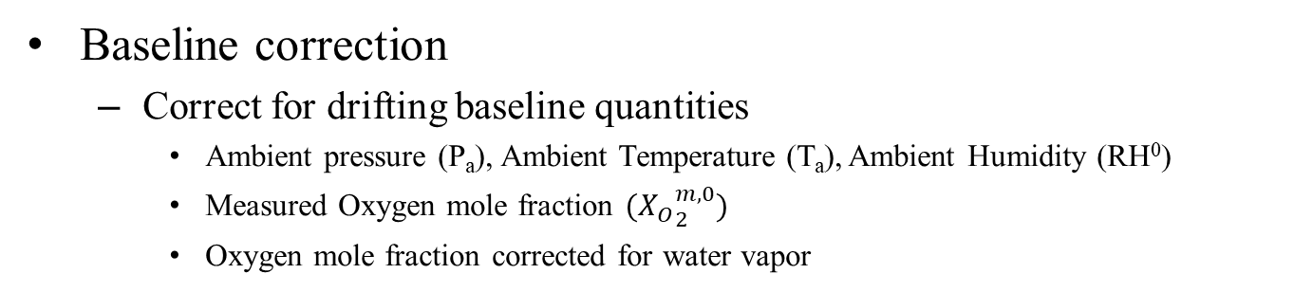

Data processing
Baseline correction
  Correct for drifting baseline quantities
    Ambient pressure (P_{a}), Ambient Temperature (T_{a}), Ambient Humidity (RH⁰)
    Measured Oxygen mole fraction $({X_{O}}_{2}^{m,0})$
    Oxygen mole fraction corrected for water vapor
Figure : Example of baseline correction $({X_{O}}_{2}^{m,0})$

Slide 33




SBI – Calorimetry validation
PMMA sheet test | Propane burner test
0.61 m × 0.53 m × (6 × 10⁻³) m | 6.47 × 10⁻⁴ kg/s for 414 seconds
Cone type Calorimetry (for comparison)
$$HRR_{CC}=E.\left(1.10\right)C\sqrt{\frac{∆P}{T_{e}}}\frac{X_{O_{2}}^{0}−X_{O_{2}}}{\left(1.105−1.5X_{O_{2}}\right)}$$
$$C=C_{f}^{e}A\sqrt{\frac{2P_{a}M_{e}}{R}}$$

Slide 34
SBI – Calorimetry validation
PMMA sheet
Propane
Test | SBI calorimetry (J/kg) | Cone type calorimetry (J/kg) | Theoretical from Oxygen consumption (J/kg)
PMMA sheet | 23.12 × 10⁶ (− 8 %) | 22.02 × 10⁶ (− 12 %) | 25.1 × 10⁶ J/kg
Propane burner | 47.18 × 10⁶ (− 1 %) | 45.14 × 10⁶ (− 5 %) | 47.55 × 10⁶ J/kg
HOC of black PMMA found to be 24.12 × 10⁶ J/kg with an experiment on 50 cm × 50 cm × 6 cm Black PMMA sheet weighing 1.752 kg
Notes:
Clear PMMA sheet so discard result having result of 23.12 *10^6 J/kg.

Slide 35
Incident heat flux
Lateral comparison at different elevations

Slide 36
Incident heat flux
Vertical comparison at different lateral positions

Slide 37
Incident heat flux vs HRR

Slide 38
Incident heat flux vs HRR

Slide 39
Incident heat flux vs HRR

Slide 40
Incident heat flux vs HRR

Slide 41
Incident heat flux vs HRR

Slide 42
Incident heat flux vs HRR

Slide 43
Incident heat flux vs HRR

