Slide 1
Preliminary Investigation in a Generic Nacelle Fire Simulator of a Sodium Bicarbonate/Bromotrifluoropropene Blend as a Powerplant Halon 1301 Replacement
9TH Triennial International Aircraft Fire & Cabin Safety Research Conference
Doug Ingerson
Federal Aviation Administration
WJ Hughes Technical Center / Fire Safety Branch
Atlantic City Int’l Airport, NJ USA
tel : 609-485-4945
email : Douglas.A.Ingerson@faa.gov
30Oct2019

Slide 2
Presentation Content
Briefly & Applicably Review…
  Some 2004 Halon-replacement Activities at the FAA Technical Center
  The US Army Replacing a Particular Hand-held Fire Extinguisher
Present Information About this Project
  Rationale & Planning
  Testing & Observations
  Conclusions

Slide 3
2004, FAATC, Hal-Rep
Pertinent Testing Activities at
the FAA Technical Center
~ Full-scale Fire Extinguishment Testing ~
~ Cargo & Powerplant Fire zone Compartments ~
FAATC = FAA Technical Center
Hal-Rep = Halon Replacement

Slide 4
2004, FAATC, Hal-Rep/Cargo
Industry curious about 2-BTP for cargo hold
  Desirable atmospheric & toxicological traits
Work ensues, then progress stalls
  EACS vs. 2-BTP in the Bldg 276 pressure vessel
  Observations indicate participation in combustion
  Report : DOT/FAA/AR-TN04/4, J. Reinhardt
    [ AIChtEEtEEpEs://www.fire.tc.faa.gov/pdf/TN04-4.pdf ]
Cargo 2-BTP halon replacement activity stops
EACS = Exploding Aerosol Can Simulator

Slide 5
2004, FAATC, Hal-Rep/Cargo
PRESSURE HISTORIES [psig vs seconds],
INSIDE the BLDG 276 PRESSURE VESSEL,
DURING AN EACS EVENT for :
  2-BTP
  HFC-125
  NO FIREX AGENT
  HALON 1301

Slide 6
2004, FAATC, Hal-Rep/Engine
Curious about powerplant halon replacement
Testing occurred during Aug/Sep 2004
Again observed peculiar behaviors
  Over-pressures at a purposeful atmospheric gap
  Evolved smoke, flames, & occasional audible noise
  Ties to re-ignition, an intentional part of this testing
Testing concludes 23sep2004
    [ AIChtEEtEEpEs://www.fire.tc.faa.gov/ppt/systems/HalonReplacement.zip ]

Slide 7
2004, FAATC, Hal-Rep/Engine
NOTES :
This is an elevation view.
Some details omitted for clarity.
Wall-Mounted Fans
“Red” Exhaust Duct
Test Section
Approach Duct
Air-Supply, Blower & Electrical Heaters
(not shown)
~ 173 cm
(~ 68 in)
Atmospheric Gap
Fire Threats
Inlet Diffuser, Candidate Injection
91.4 cm
(36 in)
sta477
sta502
sta427

Slide 8
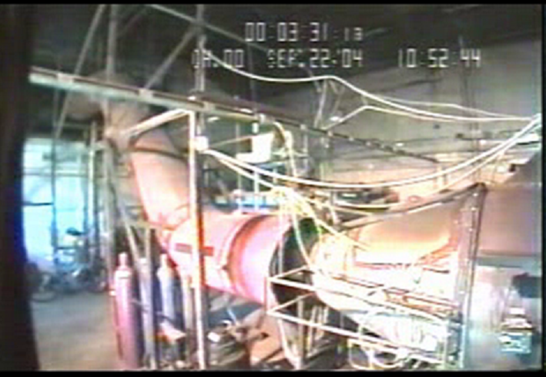
2004, FAATC, Hal-Rep/Engine
Frame #334

Slide 9
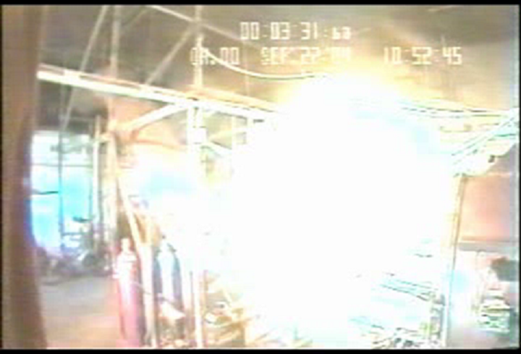
2004, FAATC, Hal-Rep/Engine
Frame #349

Slide 10
2004-2013, Hal-Rep
Additional Footnotes…
  These peculiar behaviors are real
  Work eventually extended to include NIST
    [AIChtEEtEEpEs://www.fire.tc.faa.gov/2013Conference/files/Halon_Replacement_II/LinterisOverpressure/LinterisOverpressurePres.pdf]
  Common replacement candidates are susceptible
NIST = US National Institute for Standards & Technology

Slide 11
2008-2019+ US Army, Hal-Rep HHFE
Pertinent Activities Accomplished
by the US Army
~ Replacing the Aviation Weapon System Halon 1301 Hand-held Fire Extinguisher ~
~ Conception to Design Finalization ~ (ongoing)
~ First Deliveries – TBD ~
HHFE = Hand-held fire extinguisher
TBD = to be determined

Slide 12
2008-2019+, Army, Hal-Rep, HHFE
To be fielded & replace the halon 1301 HHFE used in the crew compartments of aviation weapon systems
Replacement uses a SBC_{S}/HFC-227ea blend
Substantial body of work accomplished
  SBC_{S} & HFC-227e : particle shape/size, mixing, testing, etc.
  Technical Package : robust detailed design, includes head mechanism, injection nozzle, pressure vessel, specifications, etc. (in final stages)
  Established baseline fire extinguishment criteria and many other test requirements for development along with completion of configuration test criteria and prototype testing to meet Army aviation requirements
  Under DLA Troop Support Contract
  When complete, this will replace halon 1301 HHFEs via attrition
[AIhEEtEEtpEs://www.fire.tc.faa.gov/2013Conference/files/Halon_Replacement_II/MatherArmySuppressionAgents/MatherArmySuppressionAgentsPres.pdf]
[AIChtEEtEEpEs://www.fire.tc.faa.gov/2013Conference/files/Halon_Replacement_II/LombardoArmyHardware/LombardoArmyHardwarePres.pptx]
SBC_{S} = special sodium bicarbonate
DLA = Defense Logistics Agency

Slide 13
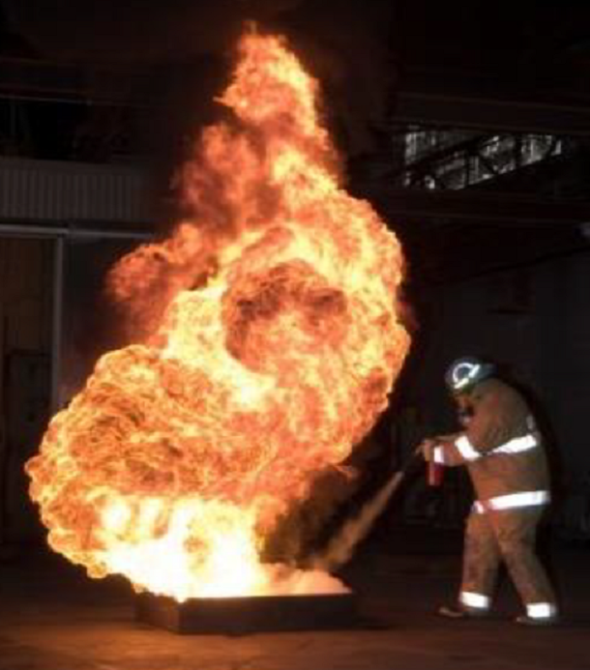
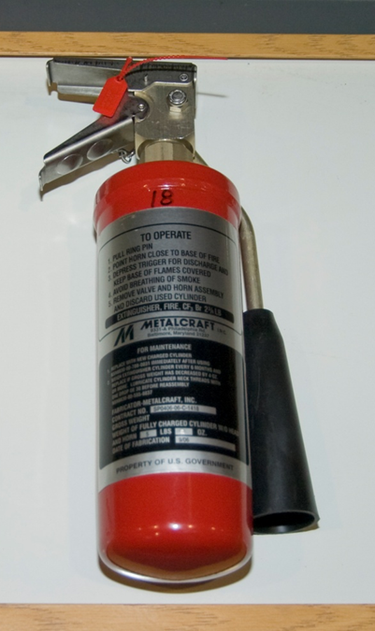
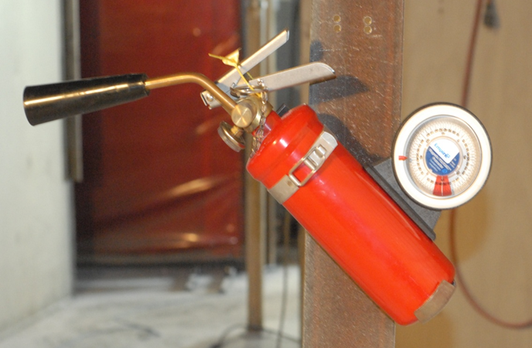
2008-2019+, Army, Hal-Rep, HHFE
halon 1301
SBC_{S}+HFC-227ea
Prototype

Slide 14
2017-Aug 2018, Low GWP Research
Investigating a SBC_{S}/2-BTP Blend in the FAATC gNFS
~ US Army & FAATC ~
~ Full-scale Fire Extinguishment Testing ~
gNFS = generic nacelle fire simulator

Slide 15





2017-2018, Planning
Fire Safety Branch contacted by the US Army
  Mr. Tim Helton, Aviation & Missile Command supporting PEO Aviation
  Army Weapon System Low GWP Fire Suppression Research Co-Lead
    point-of-contact for this fire extinguishment concept
    E-mail: timothy.m.helton4.civ_at_mail.mil

Slide 16
2017-2018, Planning
Asked about support for preliminary testing
  Also wanting a Low GWP powerplant halon-replacement candidate
  Building upon their positive HHFE experience replacing halon 1301 with blended SBC_{S}/HFC-227ea
    Utilize 2-BTP instead of HFC-227ea; again, looking at 2-BTP’s favorable atmospheric & toxicological traits
    Incorporate SPGG into the firex bottle; use a SPGG’s thermal output to enhance 2-BTP’s volatility [2-BTP boils @ 34°C/1 atm]
    Add SBC_{S} to inhibit 2-BTP from possibly augmenting combustion and to increase fire suppression capability in the fire zone
  Assess validity of simulated-SPGG-driven SBC_{S}/2-BTP against 2004 FAATC powerplant 2-BTP hal-rep testing
SPGG = solid propellant gas generator

Slide 17
2017-2018, Planning
FAA Fire Safety agreed to support the request
US Army worked up plans & an installation
  Planned for 2 weeks of testing; Aug 2018
  Unexpected schedule pressure altered initial plans
  Plans included simulating the SPGG contribution :
    Use 2 firex bottles; 1 holding “hot” 2-BTP, 1 holding SBC_{S}
    Mix the species in the injection plumbing during injection
  Attempted to recreate/utilize the 2004 gNFS discharge nozzle designs and configuration
  Sequentially investigated, assessed, & altered plan as needed while progressing

Slide 18
Aug2018, Testing
Performed 18 tests 8-17Aug2018
  gNFS “low” ventilation; ≈ 0.45 kg/s @ 127°C
  JP-8/Jet-A spray fire; ≈ 1 L/min @ 67°C
Many things about the firex varied :
  Firex agent, temperatures, & SBC_{S} quantities discharged
    1996 g [4.4 lbm] 2-BTP, solitary or SBC_{S}-mixed
    200 [0.44] or 300 g [0.66 lbm] SBC_{S}
    “Hot”- or “room”-temperature 2-BTP
  Specie mixing : bull-run tee, through-tee or single bottle
  Injection nozzles & configuration

Slide 19
Aug2018, Testing
Assessment
  Fire extinction duration; reignition time delay
  Monitored behavior at duct interface’s atmospheric gap
    Qualitatively scored escaping smoke and/or flame & if an audible noise occurred during reignition
    Scoring, respectively :
      0-3; no, a minor, an obvious or a notable escape
      0-1; no audible noise occurred during reignition or one did
    Scheme is ambiguous, but workable since all was preliminary
Subsequent graphs are sorted for clarity
  NOT presented in the sequence of test

Slide 20
Aug2018, Testing
Observations :
  Blended SBC_{S}/2-BTP always extinguished the fire threat
  Flame/smoke escaped duct interface’s atmospheric gap
  Always found post-test SBC_{S} residue in fixture
    SBC_{S} did not wholly remain aerodynamic
    Largest quantity near injection; declining aftward towards fire
  SBC_{S}/2-BTP mixing introduced variability
    Post-test review indicated pipe fluid flows were not consistent
    SBC_{S} residue indicated how blend mixed before injection
      “Chunky” & plate-like/non-aerodynamic for 2-bottle mixing
      “Dust”-like/more aerodynamic when mixed a single bottle

Slide 21
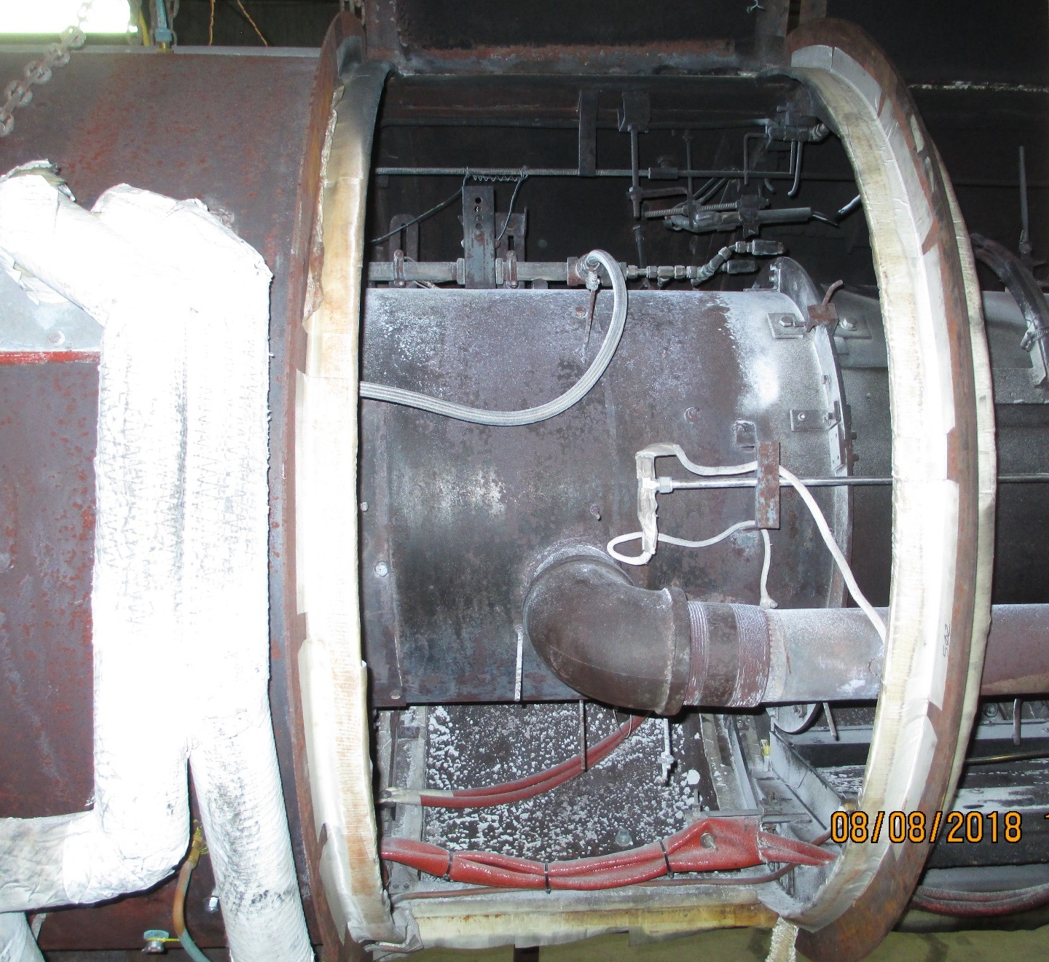
Aug2018, Testing
UP
SPRAY FIRE REGION
gNFS SHELL, 1.2 m OD
gNFS “CORE”, 0.61 m OD
SBC_{S} RESIDUE [typical]
    “whitish dust”
POOL FIRE REGION
FWD
sta477
sta502

Slide 22
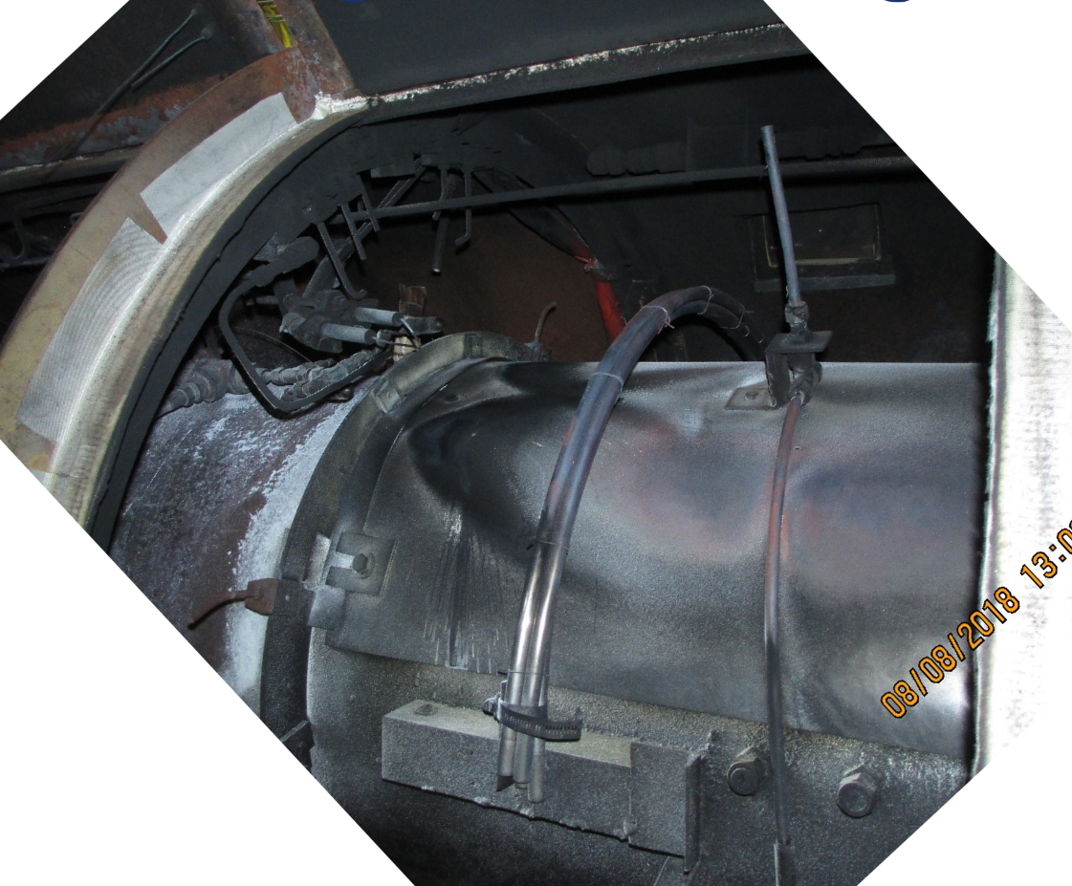
Aug2018, Testing
SPRAY FIRE REGION
…showing the fuel spray pattern
gNFS SHELL, 1.2 m OD
SBC_{S} RESIDUE [typical]
    “whitish dust”
gNFS “CORE”, 0.61 m OD
sta502
sta502
UP
FWD

Slide 23
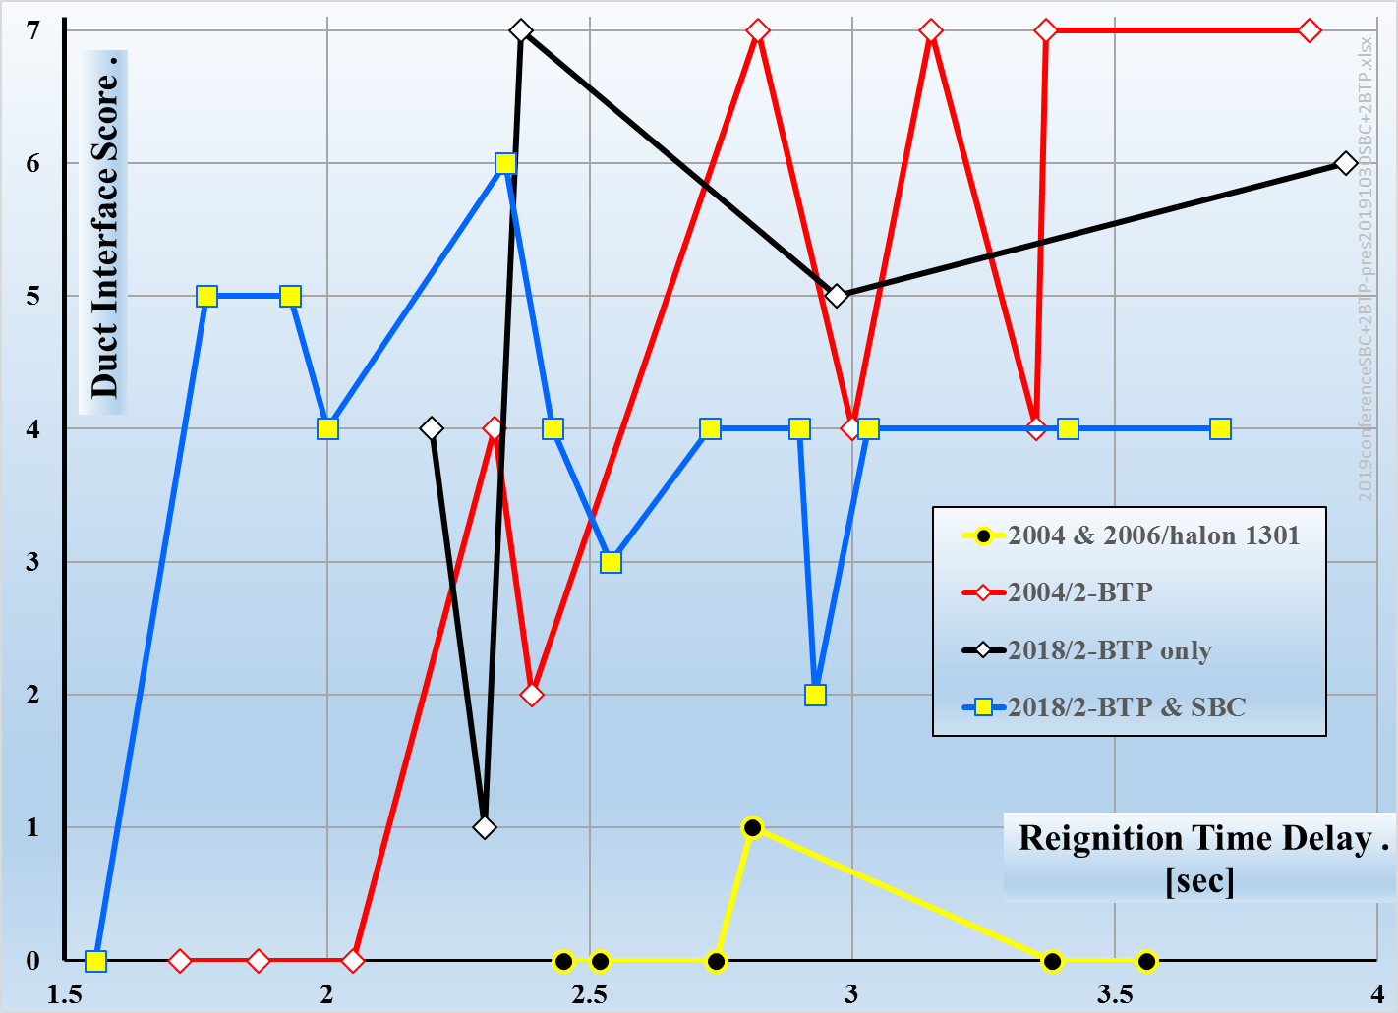
Aug2018, Comparing By Agent
    Solitary
    2-BTP
    SBC_{S}
    &
    2-BTP
1996 g,
varying fuels
    halon
    1301
By Agent = Comparing the type of injected substance by group & test date;
ignores other varied test parameters

Slide 24
Aug2018, Outcomes/Agent
The 2018 data pool is not a large data set…
However, by inspection :
  Solitary 2-BTP behaved similarly in 2018 & 2004
  SBC_{S} moderated 2-BTP’s derogatory behavior
  Neither compared similarly to halon 1301 performance

Slide 25
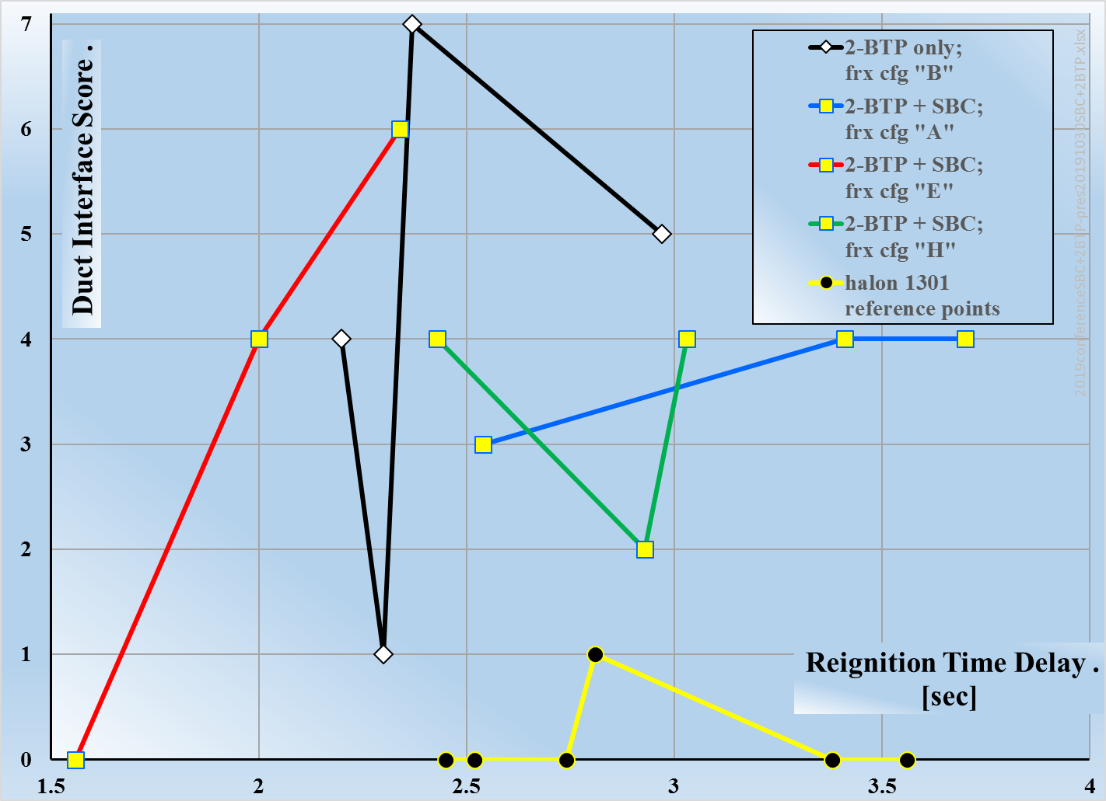
Aug2018, Comparing Peer Groups
frx cfg | August Test Dates | Pre-injection Mixing Method | 2-BTP Condition [g] | SBC_{S} Mass [g]
B | 10, 13 | none | 1996, “hot” | 0
A | 8-9 | tee/opposed | 1996, “hot” | 200
E | 14-15 | tee/2-BTP through | 1996, “hot” | 200
H | 16-17 | in single bottle | 1996, “room” | 300
Peer Groups = Repeated tests @ the same test conditions
frx = firex = fire extinguishing or fire extinguisher
cfg = configuration

Slide 26
Aug2018, Outcomes/Peer Group
Refining the review further for future considerations
By inspection,
  The “A” & “H” data clusters offer the most promise
  Reignition time delays compared to halon 1301
  Flame/smoke still “obviously” escaped from the duct interface’s atmospheric gap
  No reignition-associated noises heard
frx cfg | August Test Dates | Pre-injection Mixing Method | 2-BTP Condition [g] | SBC_{S} Mass [g]
A | 8-9 | tee/opposed | 1996, “hot” | 200
H | 16-17 | in single bottle | 1996, “room” | 300

Slide 27
Aug2018, Conclusions
Neither candidate is similar to halon 1301
Solitary 2-BTP behaved similarly in 2004 & 2018
SBC_{S} moderated 2-BTP’s derogatory behavior
The “H” data cluster implies comparable performance may be possible
  This configuration is “closest” to the end-use concept
  This configuration’s post-test SBC_{S} residue was more aerodynamic than that from the 2-bottle tests
  Need to figure out how to keep the SBC_{S} in the ventilation, keeping it available for fire extinguishment

Slide 28
Project Acknowledgements
US Army :
  Mr. Tim Helton, Aviation & Missile Command – Co-Lead
  Mr. Dan Kogut, Aberdeen Test Center
  Mr. Steve McCormick, CCDC Ground Vehicle Systems Center – Co-Lead
  Dr. Doug Mather, Project Support Contractor
  Mr. Mike Harvey, Aberdeen Test Center Contractor
  Mr. Josh Fritsch, CCDC Ground Vehicle Systems Center
FAA Technical Center, Fire Safety Branch
  Jason Fleming, TAMI
Report for research completed through FY 2018
  Final Report for the Fire Extinguishing Performance Test of the
Low Global Warming Potential (GWP) Agents
AD No. 1075359, ATEC Project No. 2016-DT-ATC-RDECO-G5550,
Report No. ATC-12480

Slide 29
Appendix Slides

Slide 30
2-BTP in
2-BTP
in
Tb
SBC_{S}
in
Tt
SBC_{S}
in

Slide 34
Example of Plumbing Configuration

