Slide 1
Investigating Carbon Dioxide in a Generic Nacelle Fire Simulator as a Halon 1301 Replacement for the Powerplant Fire Zone.
9TH Triennial International Aircraft Fire & Cabin Safety Research Conference
Doug Ingerson
Federal Aviation Administration
WJ Hughes Technical Center / Fire Safety Branch
Atlantic City Int’l Airport, NJ USA
tel : 609-485-4945
email : Douglas.A.Ingerson@faa.gov
30Oct2019

Slide 2
Presentation Content
Briefly Review…
  Powerplant Halon Replacement Test Methodology
  Test Fixture & Environment
Present Information About this Project
  Provide Results from the 1 of the 4 Test Conditions
  Conclusions & Next Steps

Slide 3
Brief Review, Halon Replacement, Powerplant/APU Fire Zones
Guiding Documentation
  “Minimum Performance Standards for Halon 1301 Replacement in the Fire Extinguishing Agents/Systems of Civil Aircraft Engine and Auxiliary Power Unit Compartments (MPSHRe rev04)”
  Working document is accessible on-line
Describes Applicable Facets About the Effort
  Preamble : background & applicability
  Test process & associated environments

Slide 4
Brief Review, Halon Replacement, Powerplant/APU Fire Zones
Test Process & Fixture
  Prescribes a test framework
    Structure, ventilation, fire threats, & fire extinguishing agent
    Specifies test conditions & numbers of replicate tests
    Test environment contains the fire phenomena of the fire zones
  Proof test to show criteria will adequately perform
    First, establish a candidate concentration field in the forced-flow
      candidate delivered to satisfy “…X %v/v Y for 0.5 second…”
      should align with or exceed a peak-inertion concentration
    Second, test against each of 4 test/fire-threat conditions
    Then, assess behaviors against respective thresholds; halon 1301, HFC-125 surrogates…

Slide 5
Brief Review, Halon Replacement, Powerplant/APU Fire Zones
Wall-Mounted Fans
“Red” Exhaust Duct
Test Section
Approach Duct
Air-Supply, Blower & Electrical Heaters
(not shown)
NOTES :
This is an elevation view.
Some details omitted for clarity.
~ 173 cm
(~ 68 in)
Atmospheric Gap
Fire Threats
Inlet Diffuser, Candidate Injection
91.4 cm
(36 in)
sta477
sta502
sta427

Slide 6
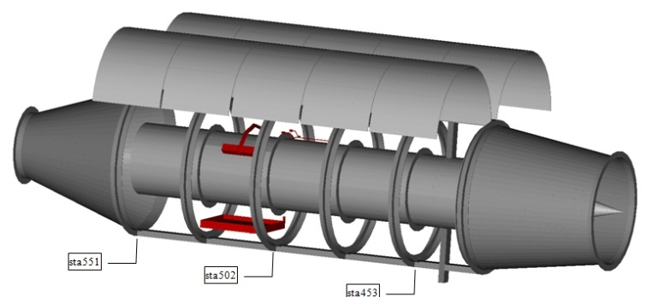
Brief Review, Halon Replacement, Powerplant/APU Fire Zones
NOTES :
This is a schematic view. Not drawn to scale.
Station (sta) numbers are incremented as inches.
Some details omitted for clarity.
Shell Doors (open)
Spray Fire Threat
Pool Fire Threat
Core Nose Cone
UP
RIGHT
(03:00)
FWD
EXHAUST
NOZZLE
CORE
INLET
DIFFUSER
sta551
sta502
sta453
Some Dimensional Information.
Inlet Diffuser Exit Flange to Exhaust Nozzle Entrance Flange,
3.1 m x 1.22 m outside diameter x 0.6096 m inside diameter, volume ≈ 2.74 m³ (96.6 ft³)

Slide 7
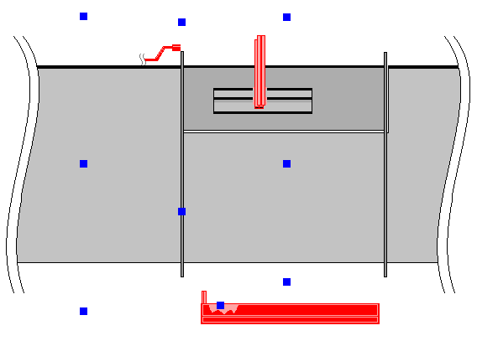
Brief Review, Halon Replacement, Powerplant/APU
Fire Zones
SAMPLE POINT (typical)
CORE
FUEL SPRAY NOZZLES
“HOT” SURFACE
FUEL PAN
FORWARD & AFT rings
sta 490 & sta 514
90°
MID ring
sta 502
120°
120°
CONCENTRIC CORE & SHELL
  0.61 m (2 ft) OD CORE, 1.2 m (4 ft) OD SHELL
11 SAMPLE POINTS IN “FREE” STREAM
  APPROXIMATELY 0.15 m OFF THE CORE SURFACE
12TH SAMPLE POINT IS IN THE FWD WAKE
  REGION OF THE FUEL PAN
“PROTECTED” VOLUME :
  ≈ 0.61 m LONG x 0.61 m ID x 1.2 m OD
sta 514
sta 502
sta 490
0.30 m
(12 in)
0.30 m
(12 in)

Slide 8
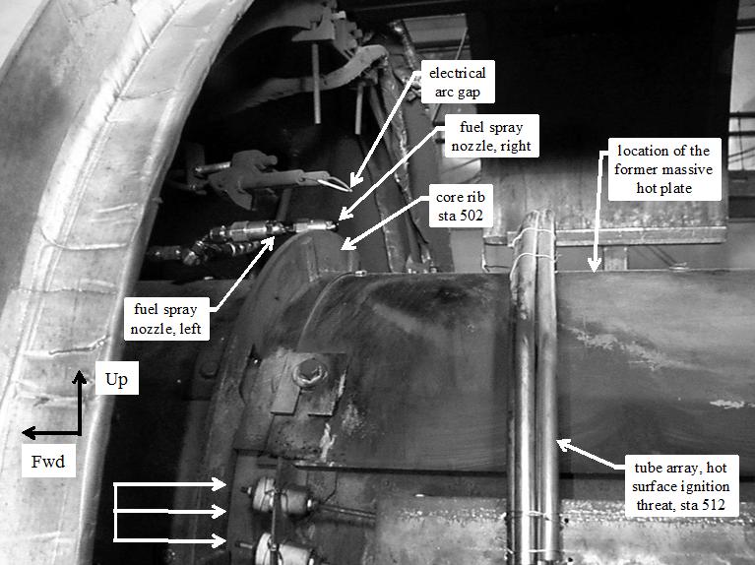
Brief Review, Halon Replacement, Powerplant/APU Fire Zones
Spray Fire Threat
Ventilation = “high” ≈ 1.2 kg @ 49°C
Fuel flow ≈ 1 L/min @ 67°C
Fuel flow, electrical ignition arc, & “hot” surface are present during the migration of the firex agent pulse through the test section
Looking at/using the duration the fire is suppressed for comparison
The fire’s suppressed duration = reignition time delay [ RTD ]
firex = fire extinguishing or fire extinguisher

Slide 9
CO2 & MPSHReR04
Main curiosity : Can CO2 criteria be reduced?
  FAA AC 20-100 requires 37%v/v CO2 for 0.5 second
  1 literature source reports CO2 peak-inertion ≈ 28%v/v
  Can CO2 be reduced from 37%v/v to 28%v/v ?
Performed sporadic testing 2016-2017
  Tested against “high”-ventilation/turbine-fuel-spray fire
  Established superior & inferior CO2 conditions
  Subsequently captured associated concentration fields

Slide 10
CO2 & MPSHReR04
Particulars of note
  Performed HFC-125 surrogate check tests
  CO2 properties required solitary CO2 in firex bottle
  CO2 coming from a local, bulk, “low”-pressure source
  Manually actuated the discharge valve
  Injected CO2 using halon 1301 injection plumbing
  Prepared & used the FAA-owned Meggitt [ Pacific Scientific ] Halonyzer 02 to measure concentration field
  Expected result ≈ CO2 peak-inertion [ 28%v/v CO2 ]

Slide 11
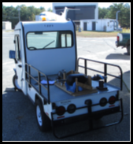
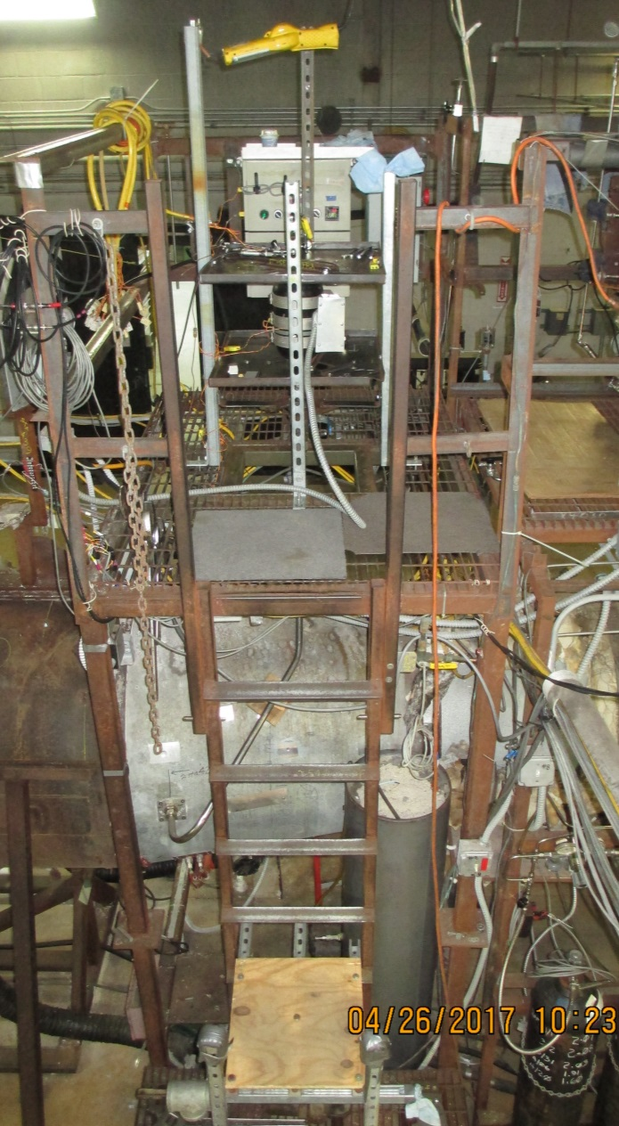
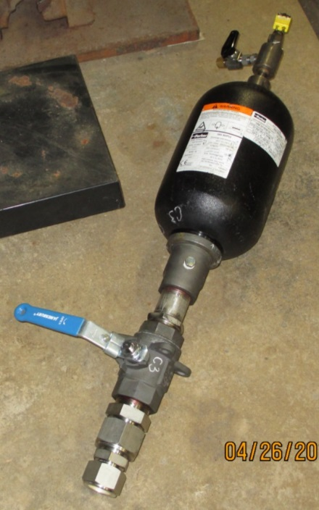
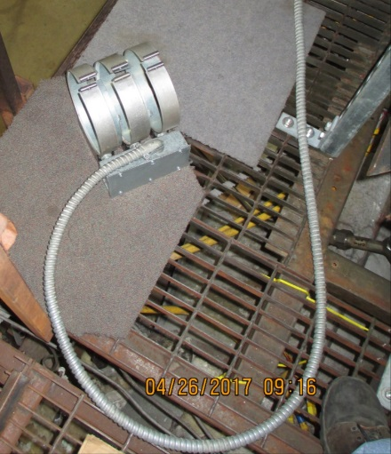
CO2 & MPSHReR04
VV02/C MOUNTED IN FRAME FOR TEST STRADDLING THE INLET DIFFUSER
[ VV02 IS MANUALLY DISCHARGED ]
CO2 BULK SOURCE
3 x 1 kW
BAND
HEATERS
VV02/C
STORAGE
VESSEL

Slide 12
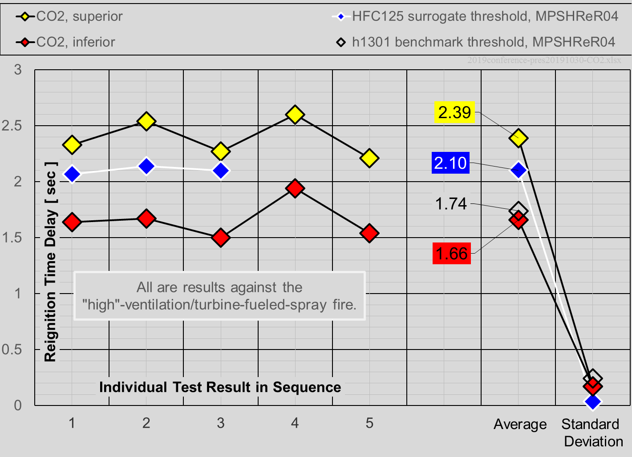
CO2 & MPSHReR04, Fire
3.31 kg CO2
3.63 kg HFC-125
2.95 kg CO2
1.63 kg h1301

Slide 13
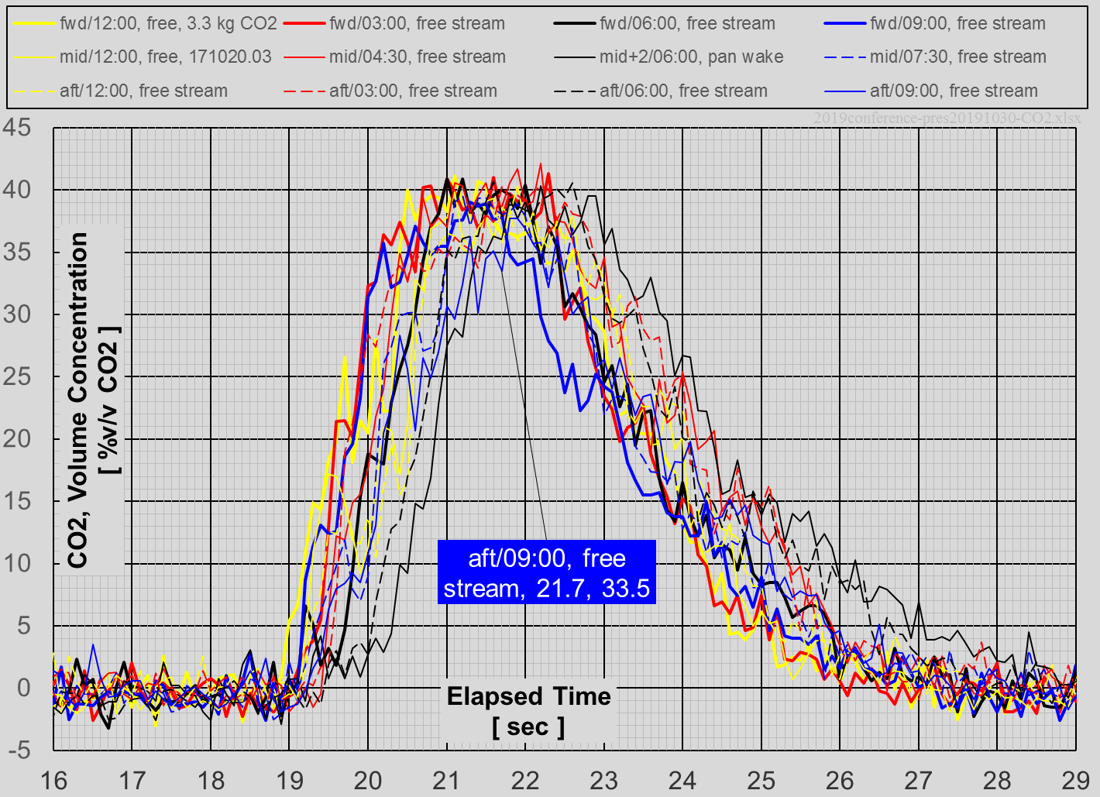
CO2 & MPSHReR04, Distribution

Slide 14
CO2 & MPSHReR04, Test Results
TEST DESCRIPTION | FIREX AGENT | REIGNITION TIME DELAY STATISTICS AVERAGE & SAMPLE STANDARD DEVIATIONS [seconds] | HALF-SECOND RESIDENT CONCENTRATIONS & AVERAGE [%v/v CO2]
SUPERIOR | CO2 | 2.39, 0.171 | 33, 34, 36 average = 34.33
SURROGATE THRESHOLD | HFC-125 | 2.10, 0.035 | n/a
INFERIOR | CO2 | 1.66, 0.172 | 31, 33, 33 average = 32.33
BENCHMARK THRESHOLD | HALON 1301 | 1.74, 0.242 | n/a
OUTCOME = 33.5%v/v CO2 = 34%v/v CO2

Slide 15
CO2 & MPSHReR04,
Conclusions & Next Steps
34%v/v CO2 ≠ 28%v/v CO2 peak-inertion
At face-value, premise fails
Curiosity remains about the disconnect
  Why curious? halon 1301 peak-inertion around 6%v/v vs. n-heptane…
  CO2 residence an issue?
  Check literature deeper for CO2 peak-inertion values?
  Other?
Work is paused, due to other higher priorities; however, future effort looks uncertain…

Slide 16
Project Acknowledgements
FAA Technical Center, Fire Safety Branch :
    Ms. Louise Speitel
    Mr. Rick Whedbee
    Mr. Tom Carmen
    Mr. Sean Crowley
    Mr. Mark Materio, Technology and Management International, LLC
    Mr. Mike Donio, Technology and Management International, LLC

Slide 17
APPENDIX SLIDES

Slide 18
Appendix REFERENCES
  Advisory Circular 20-100, 1977, "General Guidelines for Measuring Fire-Extinguishing Agent Concentrations in Powerplant Compartments," United States Department of Transportation, Federal Aviation Administration, Washington, D.C. http://www.faa.gov/documentLibrary/media/Advisory_Circular/AC20-100.pdf
  Ingerson, D., 2010, “Minimum Performance Standards for Halon 1301 Replacement in the Fire Extinguishing Agents/Systems of Civil Aircraft Engine and Auxiliary Power Unit Compartments, revision 04”, draft/working document, United States Department of Transportation, Federal Aviation Administration, W.J. Hughes, Technical Center, Atlantic City, NJ. AIChtEEtEEpEs://www.fire.tc.faa.gov/pdf/systems/MPSErev04_MPSeRev04doc-02submtd.pdf
  Zabetakis, M. G., “Flammability Characteristics of Combustible Gases and Vapors,” Bulletin 627, U.S. Department of the Interior, Bureau of Mines, Washington, DC, November 1965.
  Previous presentations on this topic…
  2016 Triennial International Fire & Cabin Safety Research Conference
  26Oct2016 : AIChtEEtEEpEs://www.fire.tc.faa.gov/2016Conference/files/Powerplant_II/IngersonCarbonDioxide/IngersonCarbonDioxidePres.pdf
  International Aircraft System Fire Protection Forum
  22Oct2015 : AIChtEEtEEpEs://www.fire.tc.faa.gov/pdf/systems/Oct15Meeting/Ingerson-1015-RecnsdrCO2.pdf
  18May2016 : AIChtEEtEEpEs://www.fire.tc.faa.gov/pdf/systems/May16Meeting/Ingerson-0516-HalonStatus.pdf
  10May2017 : AIChtEEtEEpEs://www.fire.tc.faa.gov/pdf/systems/May17Meeting/Ingerson-0517-RecnsdrCO2Status_finl.pdf
  01Nov2017 : AIChtEEtEEpEs://www.fire.tc.faa.gov/pdf/systems/Nov17Meeting/Ingerson-1117-NacelleCO2status.pdf
  08May2018 : AIChtEEtEEpEs://www.fire.tc.faa.gov/pdf/systems/May18Meeting/Ingerson-0518-halonreplacement.pdf
  An Overview of the general situation along with pertinent background :
  31Oct2018 : AIChtEEtEEpEs://www.fire.tc.faa.gov/pdf/systems/Oct18Meeting/Ingerson-1018-PwrplantHalRepOvrview.pdf

Slide 19
Appendix BASIS FOR RECONSIDERATION
≈ 28 %v/v CO2

Slide 20
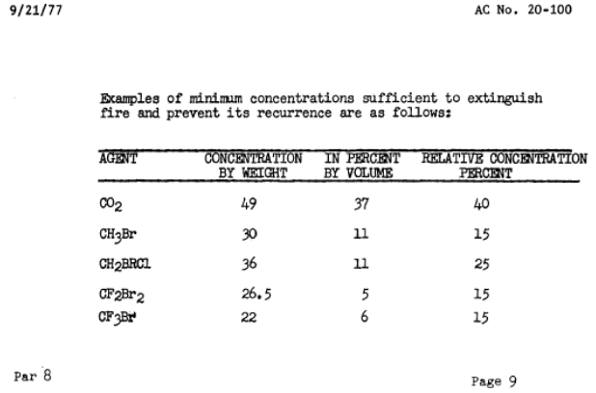
Appendix BASIS FOR RECONSIDERATION
≈ 28 %v/v CO2 per BoM Bulletin 627 < 37%v/v CO2 per FAA AC 20-100

Slide 21
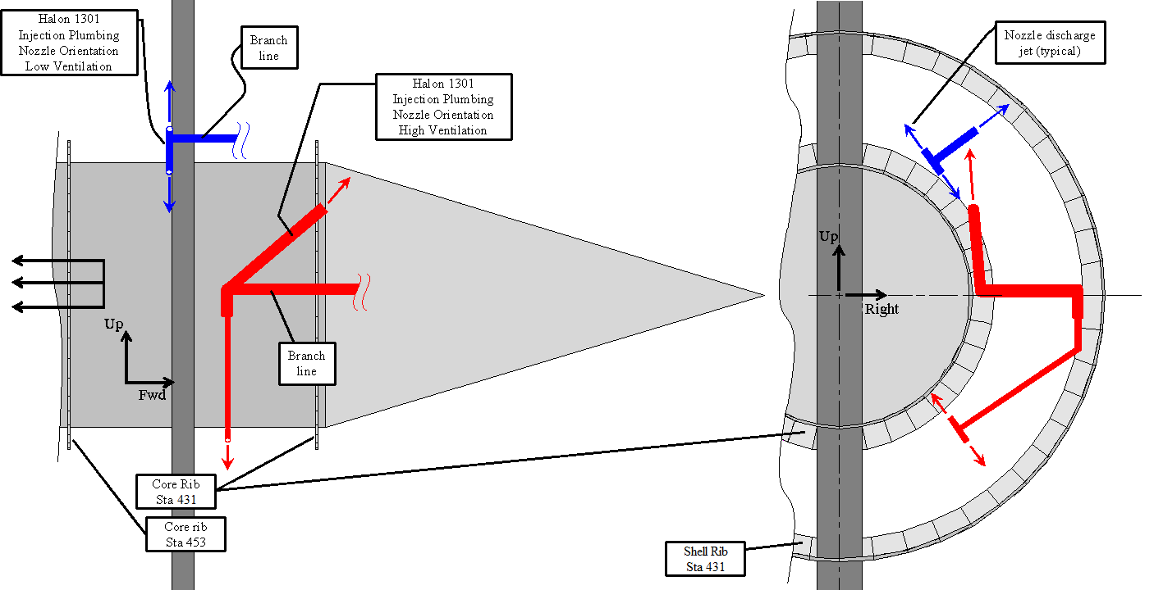
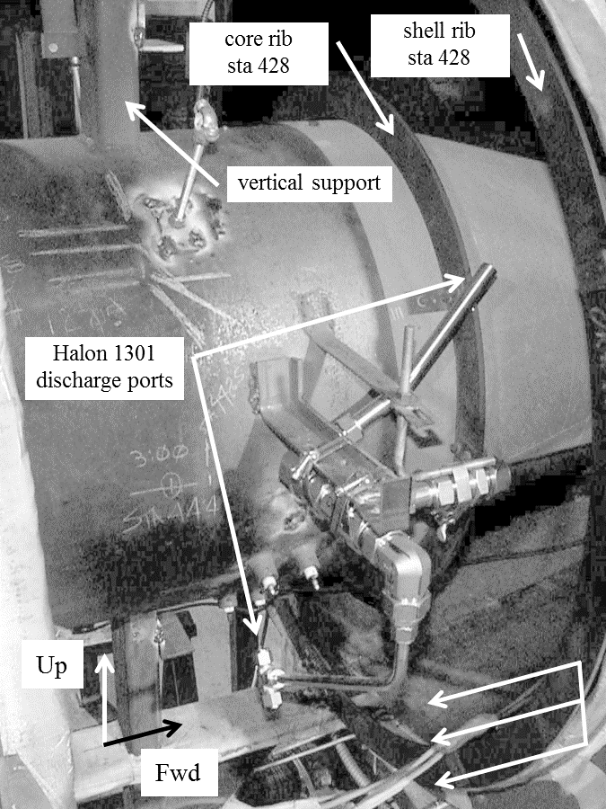
Appendix FIREX & FIRE THREAT ASSOCIATIONS
Up
Fwd
FIRE THREAT
FIREX INJECTION

Slide 22
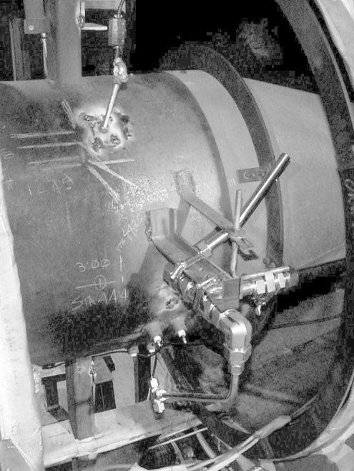
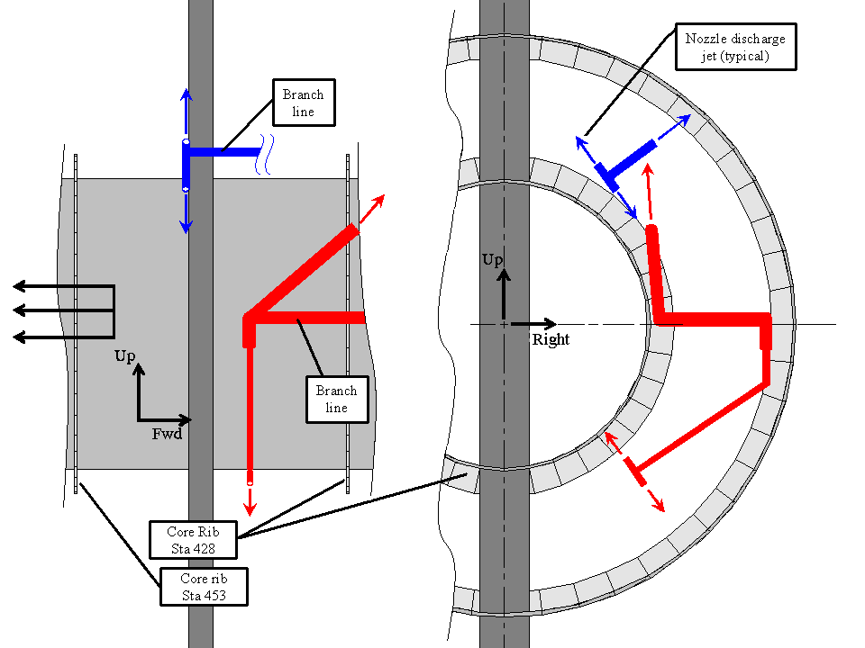
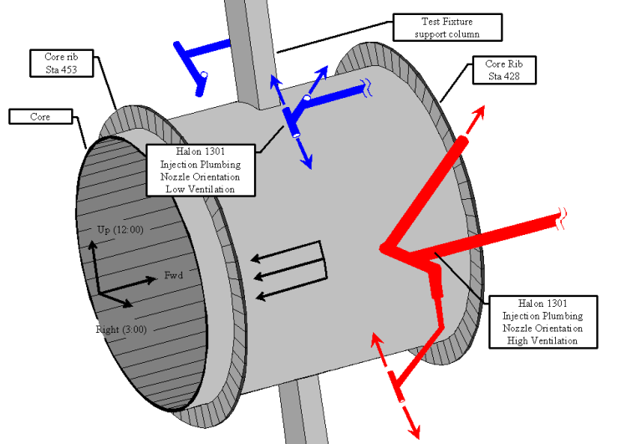
Appendix INJECTION PLUMBING NETWORK

Slide 23
Appendix INJECTION PLUMBING NETWORK

Slide 24
Appendix TABULATED TEST RESULTS, TO DATE
Test Identification [YYYYmmdd-##] | Test Type | Firex Agent | Firex Agent Mass [kg] | General MPSHReR04 Parameter | gNFS Ventilation | gNFS Fire Threat | Reignition Time Delay [sec] | Half-second Resident Concentration [%v/v CO2]
..20161011-02 | fire extinguishment | HFC-125 | 3.63 | surrogate threashold | high | spray/turbine | 2.07 | n/a
..20161011-03 | fire extinguishment | HFC-125 | 3.63 | surrogate threashold | high | spray/turbine | 2.14 | n/a
..20161011-04 | fire extinguishment | HFC-125 | 3.63 | surrogate threashold | high | spray/turbine | 2.1 | n/a
..20170526-05 | fire extinguishment | CO2 | 2.95 | inferior | high | spray/turbine | 1.64 | n/a
..20170607-03 | fire extinguishment | CO2 | 2.95 | inferior | high | spray/turbine | 1.67 | n/a
..20170703-04 | fire extinguishment | CO2 | 2.95 | inferior | high | spray/turbine | 1.50 | n/a
..20170713-04 | fire extinguishment | CO2 | 2.95 | inferior | high | spray/turbine | 1.94 | n/a
..20170727-04 | fire extinguishment | CO2 | 3.31 | superior | high | spray/turbine | 2.33 | n/a
..20170728-04 | fire extinguishment | CO2 | 3.31 | superior | high | spray/turbine | 2.54 | n/a
..20170815-04 | fire extinguishment | CO2 | 3.31 | superior | high | spray/turbine | 2.27 | n/a
..20170822-03 | fire extinguishment | CO2 | 3.31 | superior | high | spray/turbine | 2.60 | n/a
..20170823-04 | fire extinguishment | CO2 | 3.31 | superior | high | spray/turbine | 2.21 | n/a
..20170824-04 | fire extinguishment | CO2 | 2.95 | inferior | high | spray/turbine | 1.54 | n/a
..20171020-03 | agent distribution | CO2 | 3.31 | superior | high | n/a | n/a | 33.5
..20171024-03 | agent distribution | CO2 | 2.95 | inferior | high | n/a | n/a | 33.4
..20171030-02 | agent distribution | CO2 | 3.31 | superior | high | n/a | n/a | 36.4
..20171106-02 | agent distribution | CO2 | 2.95 | inferior | high | n/a | n/a | 33.5
..20171107-02 | agent distribution | CO2 | 3.31 | superior | high | n/a | n/a | 34.2
..20171108-02 | agent distribution | CO2 | 2.95 | inferior | high | n/a | n/a | 31.3

Slide 25
Appendix CO2 DISPERSION IN THE TEST ENVIRONMENT

Slide 26
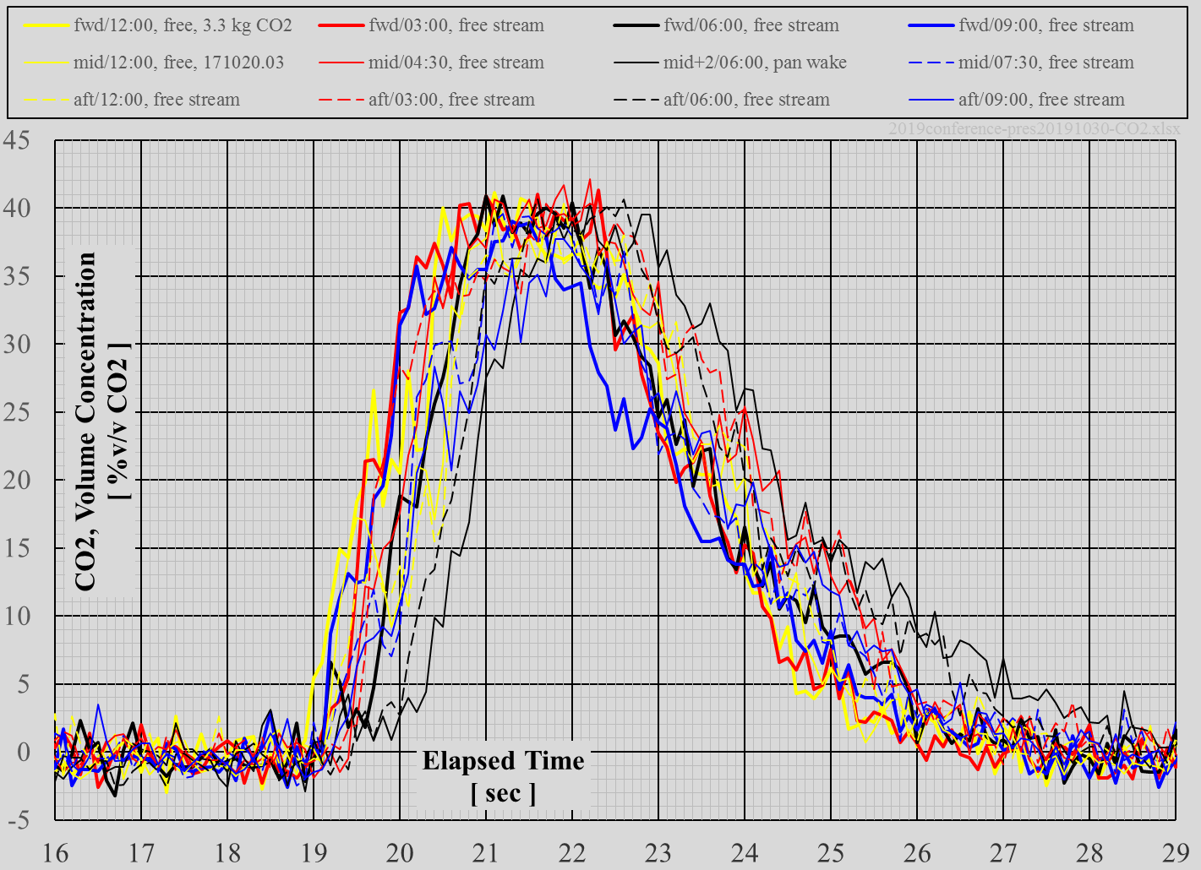
CO2 superior, 1 of 3

Slide 27
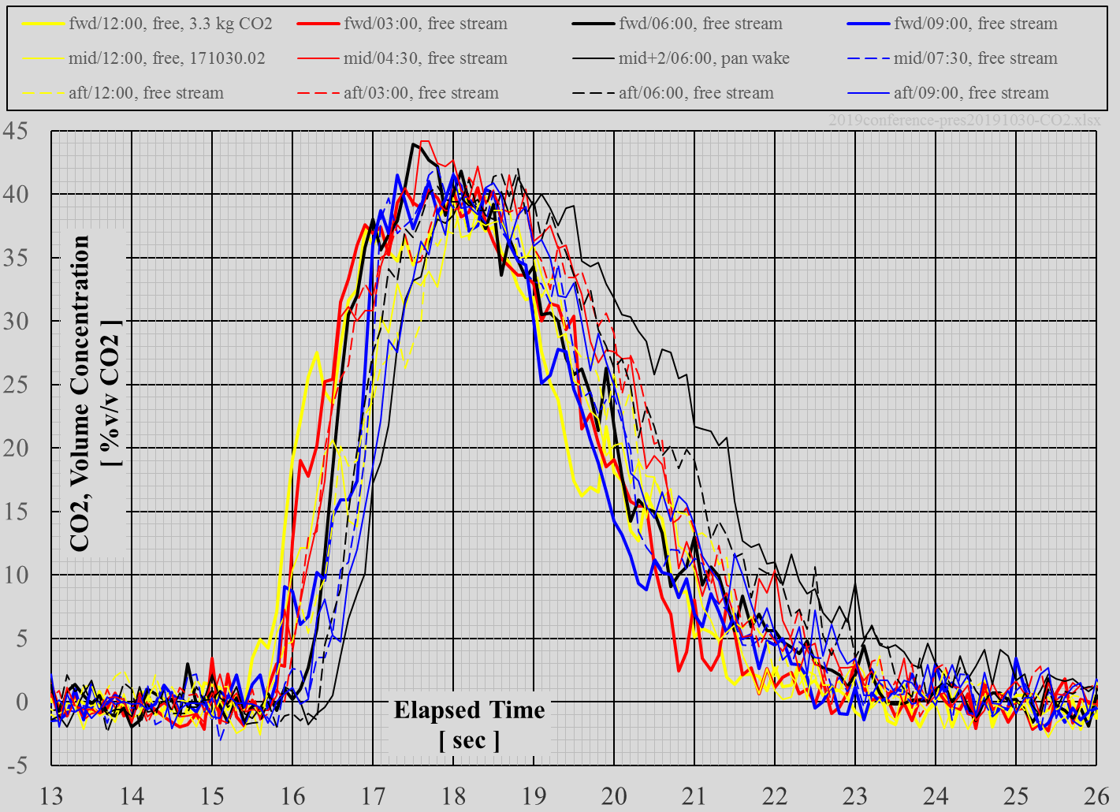
CO2 superior, 2 of 3

Slide 28
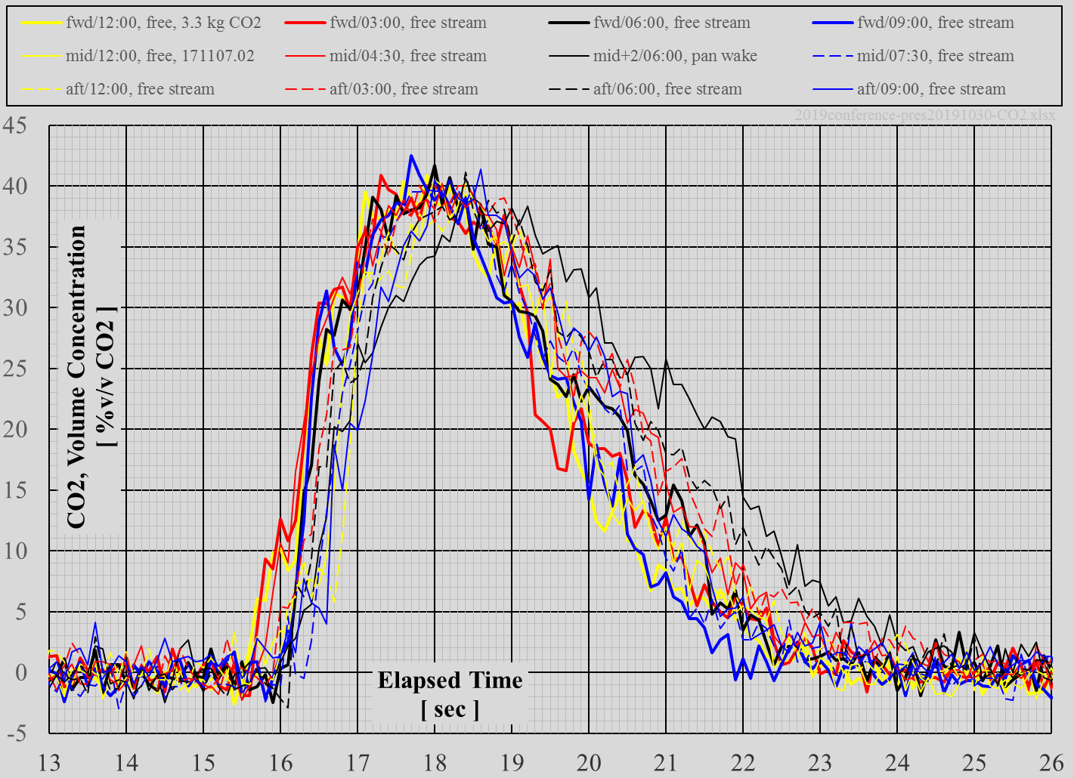
CO2 superior, 3 of 3

Slide 29
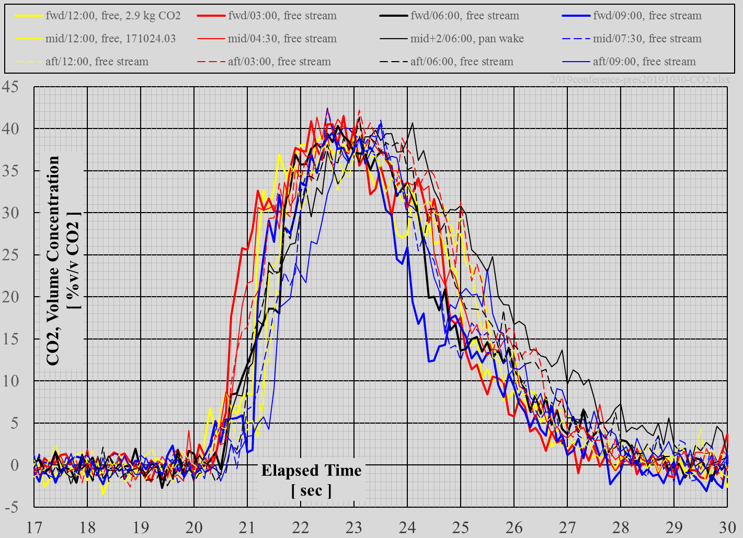
CO2 inferior, 1 of 3

Slide 30
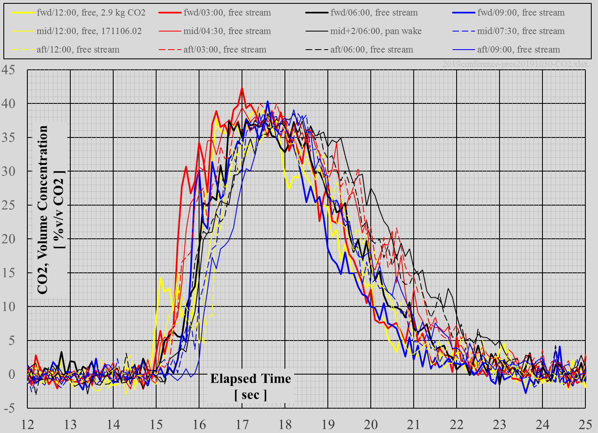
CO2 inferior, 2 of 3

Slide 31
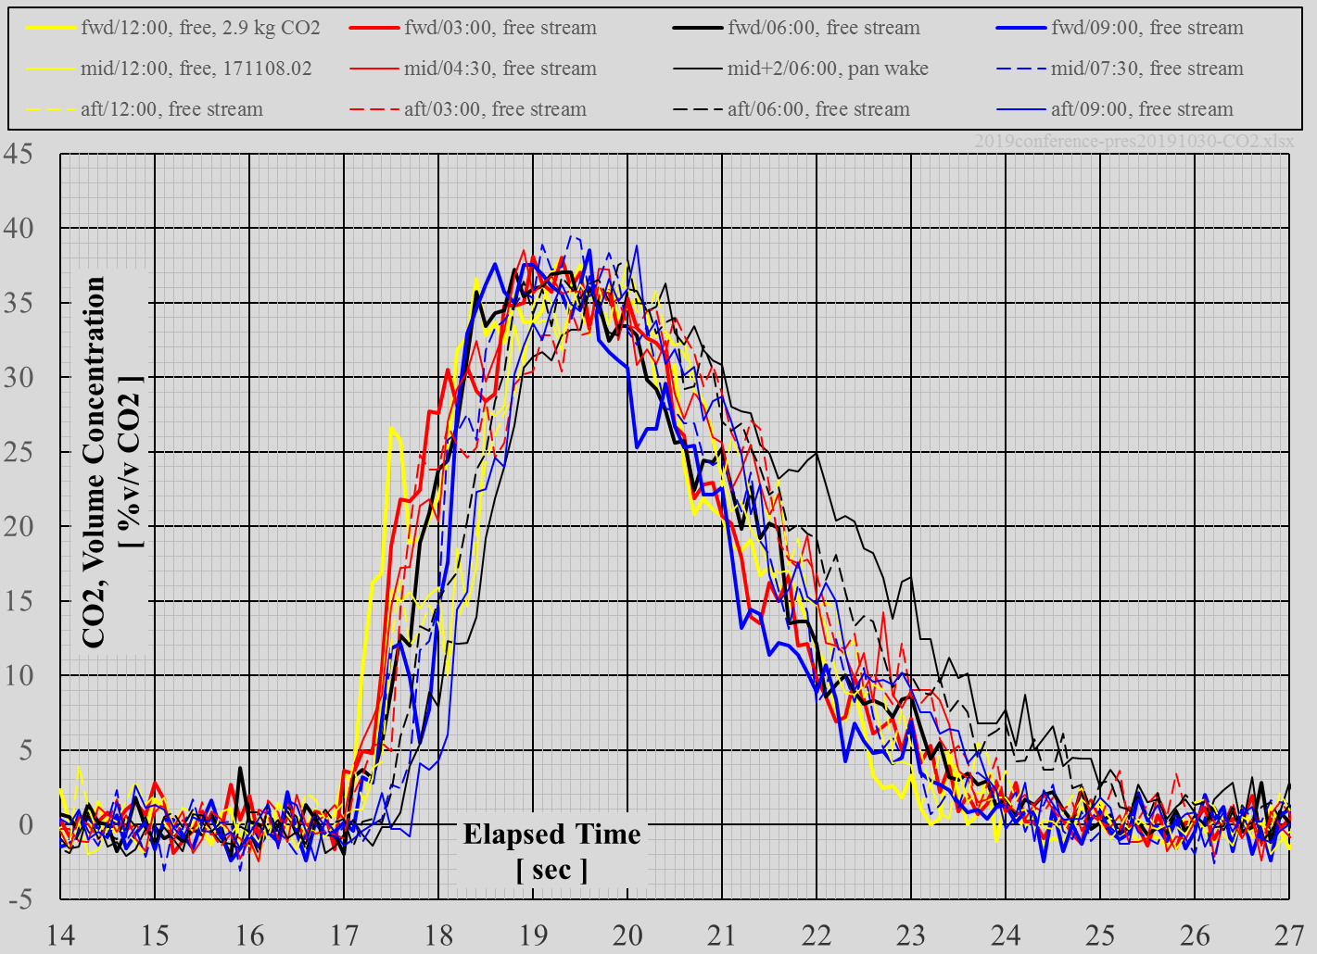
CO2 inferior, 3 of 3

