Slide 1
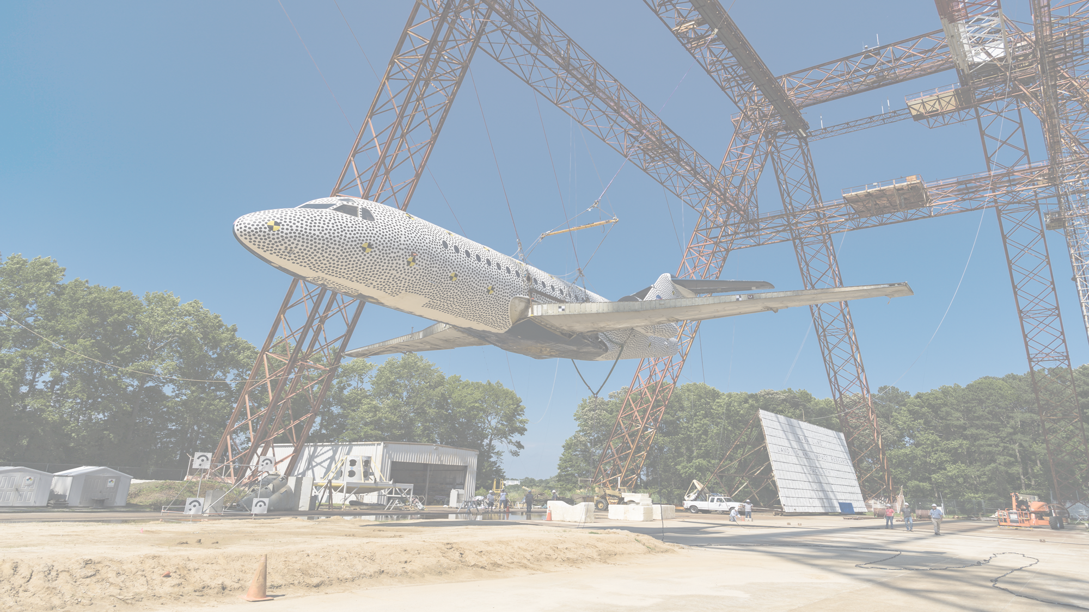
Development of a Full-Scale Finite Element Model of the Fokker
F28 Fellowship Aircraft and Crash Simulation Predictions
Karen E. Jackson, Ph.D.
National Institute of Aerospace
Hampton, VA 23681
Jacob B. Putnam
NASA Langley Research Center
Hampton, VA 23681
9th TRIENNIAL INTERNATIONAL AIRCRAFT FIRE AND
CABIN SAFETY RESEARCH CONFERENCE
Atlantic City, NJ
October 28-31, 2019

Slide 2
Outline
Description of the F28 Model Development
Test-Analysis Comparisons
  - Inertial Property Comparisons
  - Kinematic Comparisons
  - Time History Comparisons
  - Airframe Damage Comparisons
Conclusions
Future Work

Slide 3
Description of the F28 Model Development
When the F28 hardware was purchased in 2000, NASA also obtained a NASTRAN loads model of the aircraft from Fokker
The NASTRAN model was converted into LS-DYNA format, material properties were updated, and missing structure was added
NASTRAN loads model

Slide 4
Description of the F28 Model Development

Slide 5
Top Layer is Gantry
Unwashed
Sand (GUS)
360-in. (30-ft)
1440-in. (120-ft)
14-in.
Soil Model Contains:
2 Parts
2 Material cards
170,082 Nodes
125,280 Solid elements
1 Boundary SPC to fix
bottom nodes and nodes
on two sides
*MAT_SOIL_AND_FOAM_TITLE
Gantry Unwashed Sand (GUS)
$# mid ro g bulk a0 a1 a2 pc
99510 1.96E-4 3340.0 19370.0 6.326 3.707 0.5432 -1.0
$# vcr ref lcid
0.0 0.0 0
$# eps1 eps2 eps3 eps4 eps5 eps6 eps7 eps8
0.0 -0.00252 -0.00479 -0.00703 -0.00917 -0.0103 -0.01143 -0.01254
$# eps9 eps10
-0.01362 -0.01599
$# p1 p2 p3 p4 p5 p6 p7 p8
0.0 10.0 20.0 30.0 40.0 45.0 50.0 55.0
$# p9 p10
60.0 71.15

Slide 6
360-in. (30-ft)
Bottom Layer is
Modeled as
Carson Sink Wet
Soil
1440-in. (120-ft)
10-in.
Soil Model Contains:
*MAT_SOIL_AND_FOAM_TITLE
Carson Sink Wet
$ MID RO G K A0 A1 A2 PC
504 0.000135 500 12600 1.968 1.858 0.439 -1
$ VCR REF
0.0 0.0
$ EPS1 EPS2 EPS3 EPS4 EPS5 EPS6 EPS7 EPS8
0 -0.007 -0.0102 -0.013 -0.019 -0.063 -0.125 -0.185
$ EPS9 EPS10
-0.22 -0.259
$ P1 P2 P3 P4 P5 P6 P7 P8
0 4.5 5.36 6 7 12 19.6 32
$ P9 P10
47 67
2 Parts
2 Material cards
170,082 Nodes
125,280 Solid elements
1 Boundary SPC to fix
bottom nodes and nodes
on two sides

Slide 7
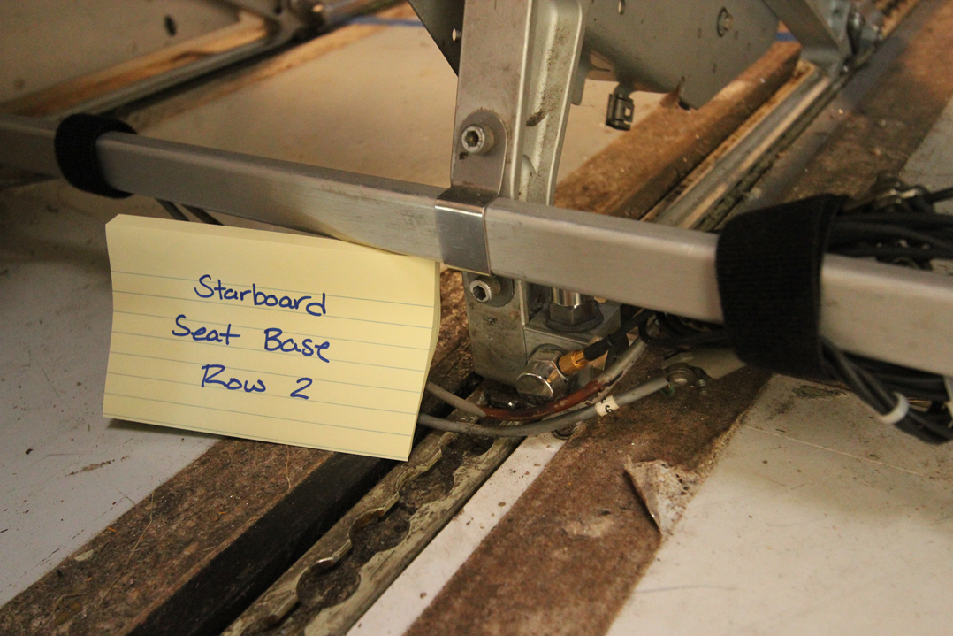
Description of the F28 Model Development
Four nodes where the seat mass
attaches to the rear seat rail
Seat Accelerometer

Slide 8
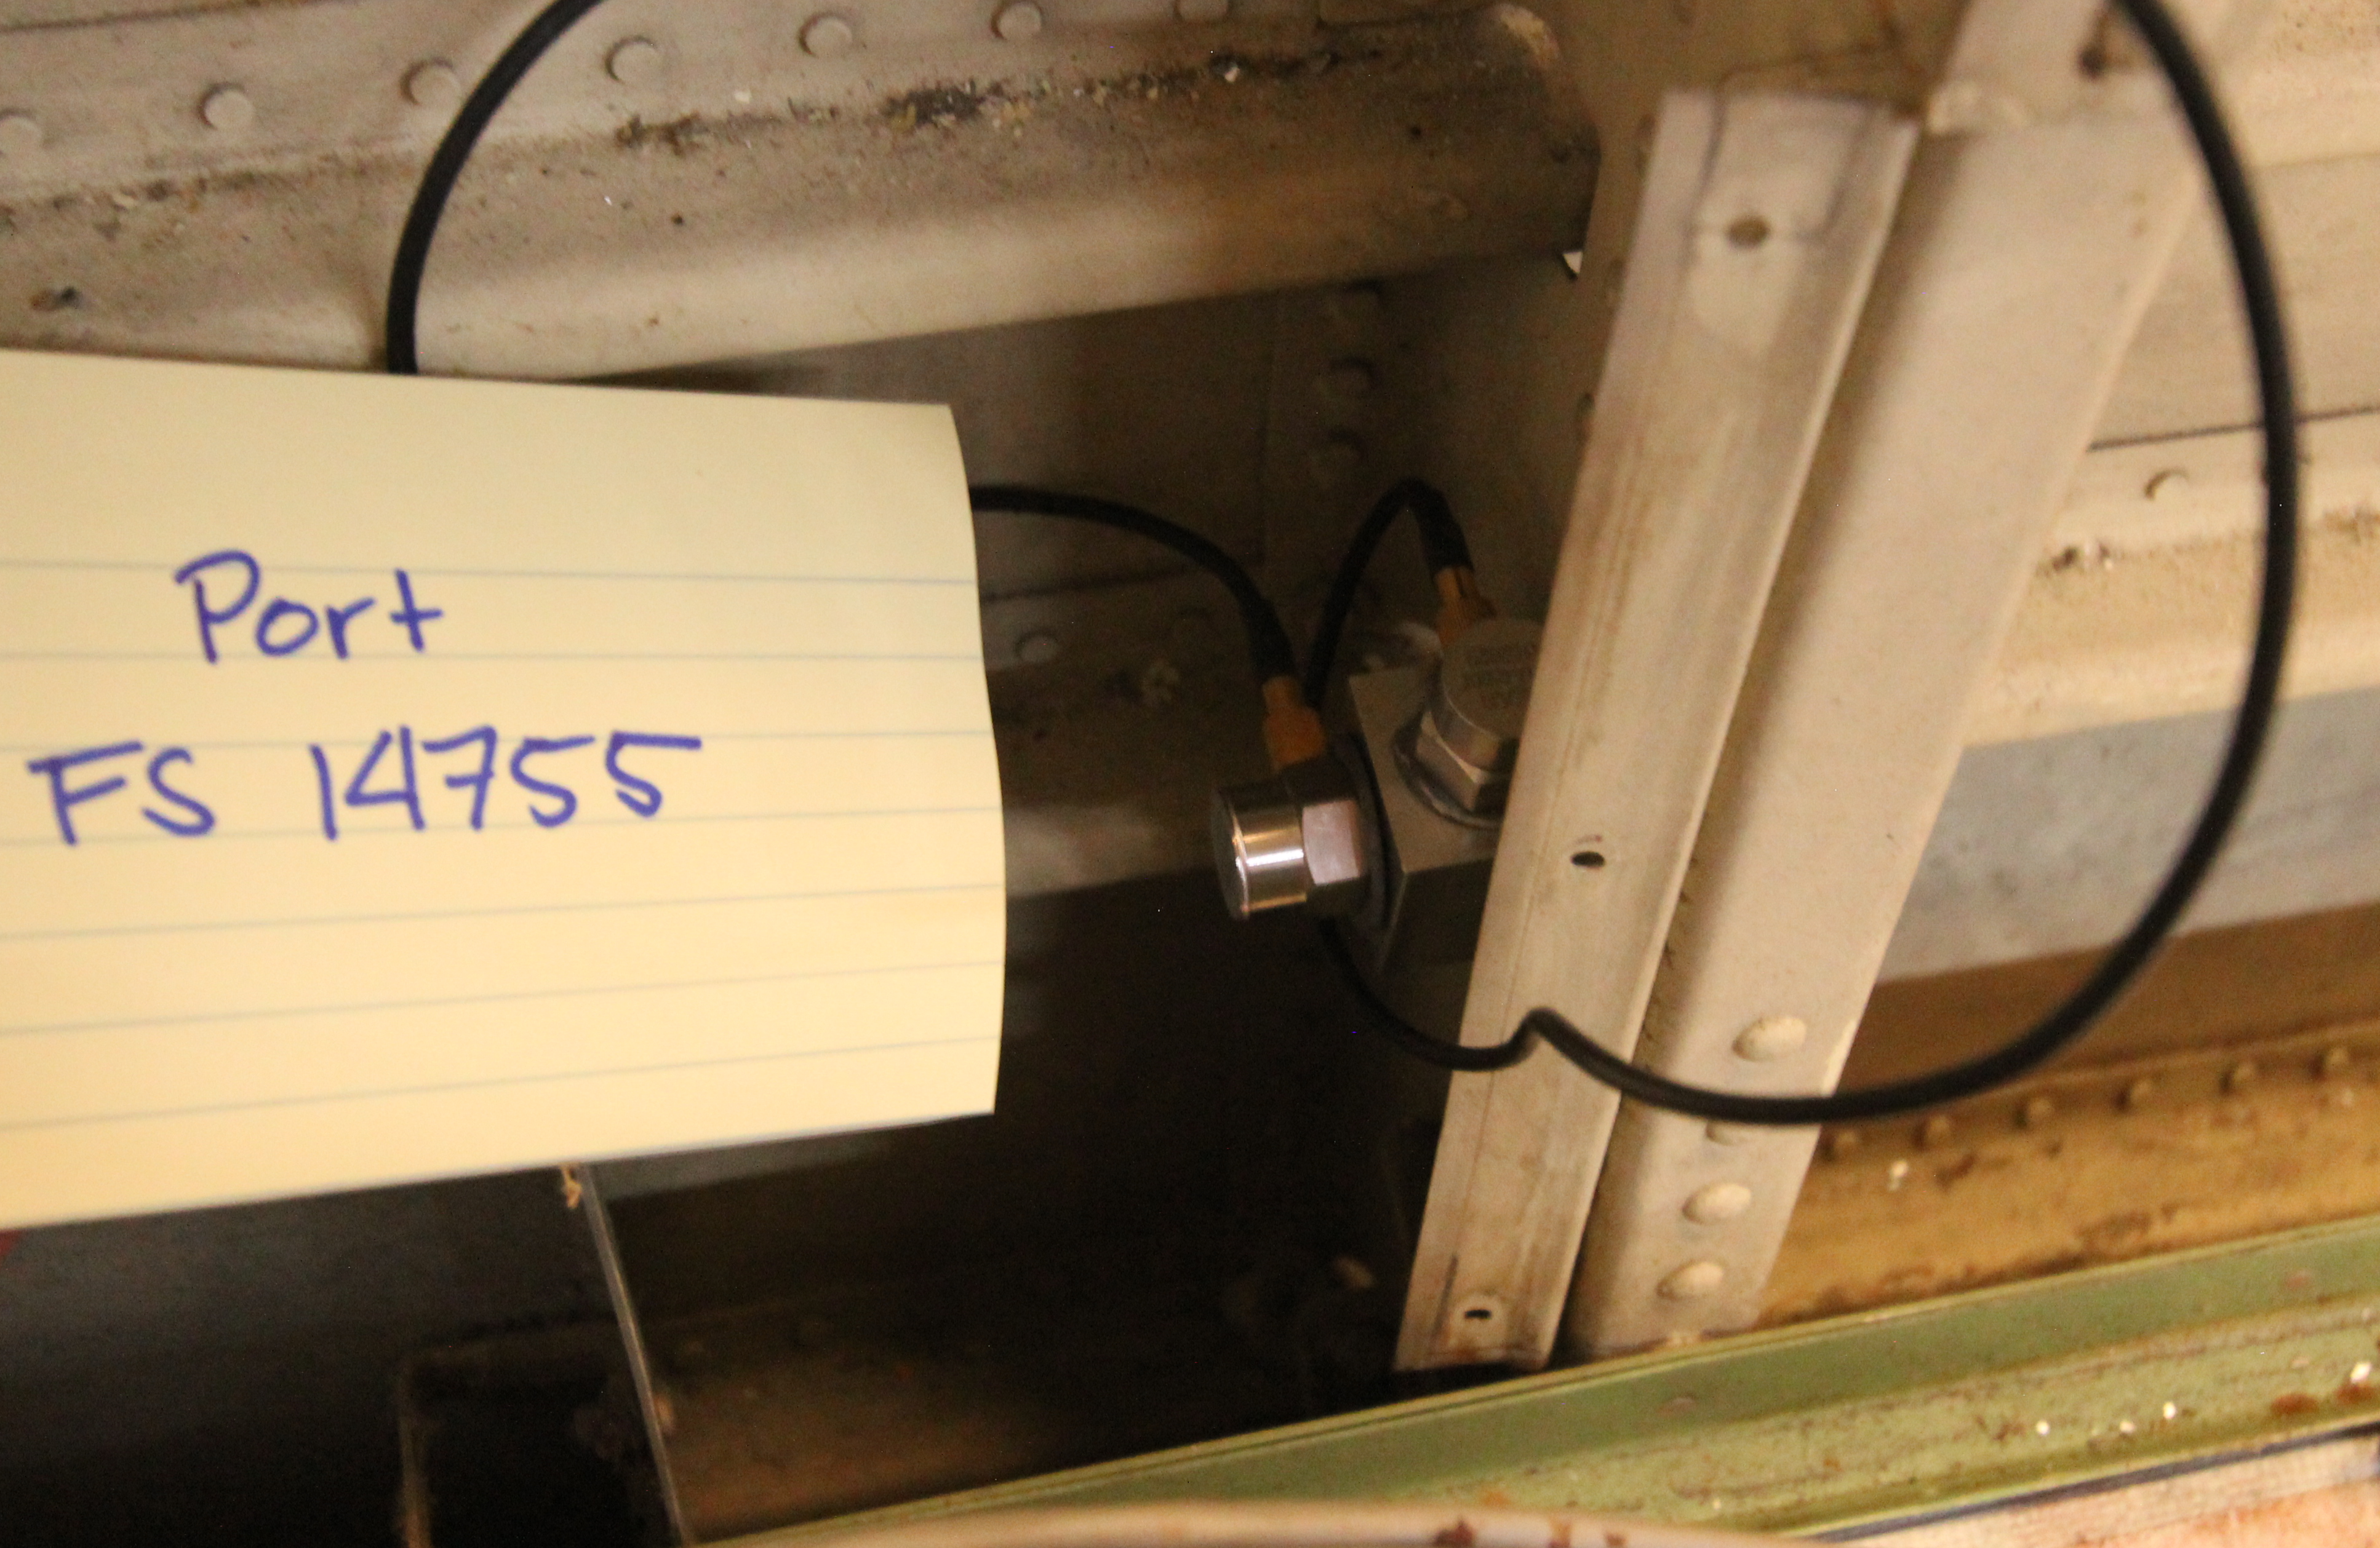
Description of the F28 Model Development
Frame Accelerometer
Nodes on the frame, located
3-4-inches above the floor

Slide 9
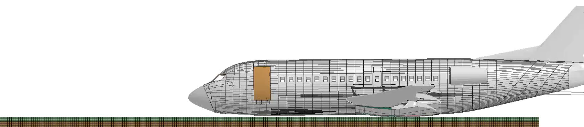
Description of the F28 Simulation
Measured Initial Velocities
Measured Initial Attitudes
Forward Velocity = 65.3-ft/s, 783.6-in/s
Vertical Velocity = 31.8-ft/s, 381.6-in/s
Lateral Velocity = 0.0=ft/s, 0.0-in/s
Pitch = 0.38° nose down
Roll = 4.3° Starboard side down
Yaw = 2.58° nose left
● The model was executed to an end time of 1.75-seconds and required approx.
26 hours to execute to normal completion on 8 processors of a Linux-based workstation.
Version ls1010d (double precision) of LS-DYNA was used.
● Nodal output was requested for frame and seat base accelerometers (in local coordinates)

Slide 10
Test-Analysis Comparisons: Inertial Properties
Parameter Model Test Difference (percent)
Weight, lb. 32,951.4 33,306 354.6 (1.06%)
CGx, in. 449.5 455.0 5.5 (1.2%)
CGy, in. 0.89 0.0 0.89
CGz, in. -85.3 -80.0 5.3 (6.6%)

Slide 11
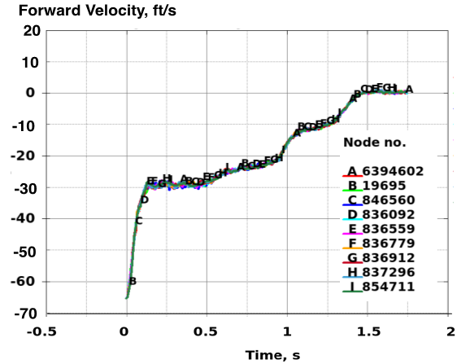
Test-Analysis Comparisons: Kinematics
TEST
Photogrammetric responses
of 10+ targets, forward
and vertical velocity
Analysis
Forward and vertical velocity
responses of 10+ nodes on
the surface of the model,
plotted to the same scales
for comparison with
photogrammetric test data

Slide 12
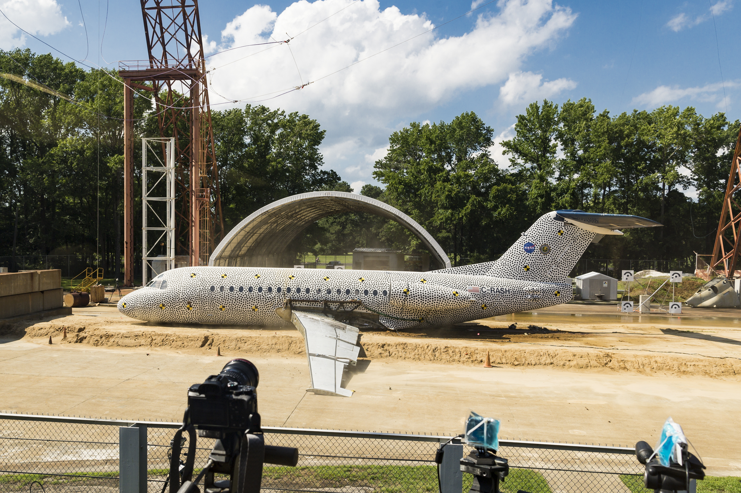
Test-Analysis Comparisons: Kinematics
Parameter Slideout
Post-test measurement 31.9-ft.
Simulation 32.2-ft.
Percentage difference 0.9%

Slide 13
Test-Analysis Comparison: Pilot Seat Vertical Responses
*Both test and analytical responses were filtered using a Butterworth 60 Hz low pass filter

Slide 14
Test-Analysis Comparison: Pilot Seat Forward Responses

Slide 15
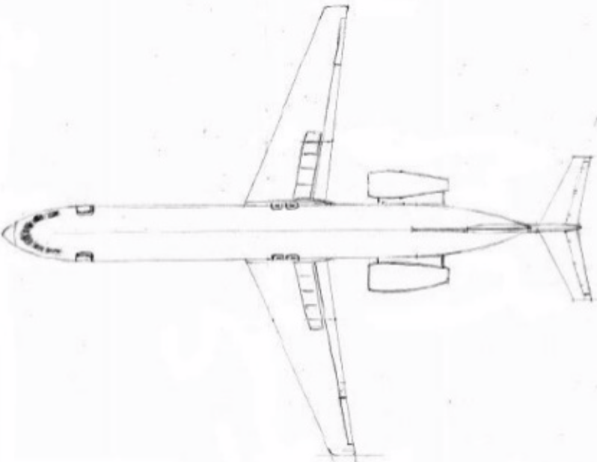
TAC: Cabin Seat Base Vertical Acceleration Responses
Star-
board
Row 2
Row 5
Row 10
Port

Slide 16
TAC: Cabin Seat Base Forward Acceleration Responses
Star-
board
Row 2
Row 5
Row 10
Port

Slide 17
TAC: Cabin Frame Vertical Acceleration Responses (Port Side)

Slide 18
TAC: Cabin Frame Forward Acceleration Responses (Port Side)

Slide 19
TAC: Cabin Frame Vertical Acceleration Responses (Starboard Side)

Slide 20
TAC: Cabin Frame Forward Acceleration Responses (Starboard Side)

Slide 21
TAC: Port & Starboard Engines

Slide 22
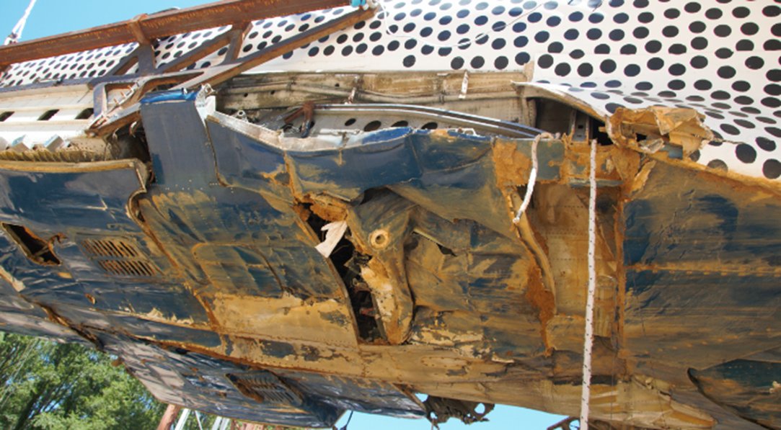
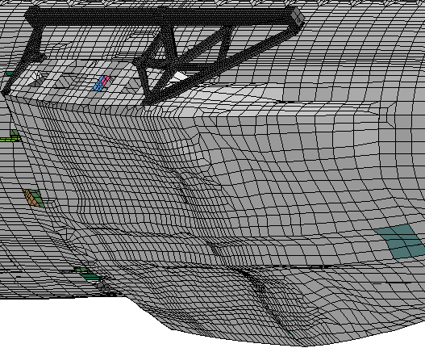
Test-Analysis Comparisons: Airframe Damage
Photo showing airframe damage, crushing and
flattening of the bottom surface, and skin wrinkling
Model depiction showing crushing
of the bottom of the wing-box

Slide 23
Conclusions
A finite element model of the F28 aircraft was developed and executed using LS-DYNA
Inertial and kinematic comparisons with test data showed excellent agreement
Time history responses were inconsistent, some channels showed good agreement with test, some showed poor agreement
Currently, using the ISO 16250 standard to evaluate the test-analysis comparisons quantitatively

Slide 24
Future Work
Once we are satisfied that the model is “validated,” water impact and ditching simulations will be performed

