Slide 1
A Data Set for Calibrating the ES-2re Virtual Anthropomorphic Test Device for Aviation Configurations
FAA Triennial Fire and Cabin Safety Conference
David Moorcroft
October, 2019

Slide 2
Background
FAA PS-ANM-25-03-R1 defines the technical criteria for approving side-facing seats
Requires the use of the ES-2re for the injury criteria test
49 CFR 572 Subpart U

Slide 3
ES-2re Injury Criteria (1)
Head: HIC < 1000
Upper Neck Tension Force < 405 lb
Upper Neck Compressive Force < 405 lb
Upper Neck Torque (x-axis) < 1018 in-lb
Upper Neck Shear < 186 lb
Upper Torso Strap Load < 1750 lb

Slide 4
ES-2re Injury Criteria (2)
Upper, Middle, Lower Rib Deflection < 1.73 inch
Sum(Front+Middle+Rear) Abdominal Force < 562 lb
Pubic Symphysis Force < 1350 lb
Lower Leg Flail Limit (35°)
Restraints Must Remain on ATD
Occupant Support Criteria

Slide 5
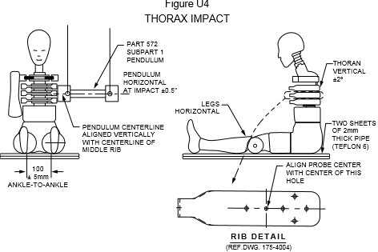
Background
Physical Anthropomorphic Test Devices (ATD) must meet certain requirements which include calibration tests.
Notes:
Overall height, weight, segment dimensions and weights, component tests, etc.

Slide 6
Background
FAA allows for the use of modeling and simulation to demonstrate compliance with federal regulations in certain scenarios [Advisory Circular 20-146A]
Need for an accurate representation of the virtual Anthropomorphic Test Devices (v-ATD)
SAE ARP 5765A defines a methodology for calibrating a v-ATD
Currently Hybrid II and FAA Hybrid III only
Rev B to include ES-2re

Slide 7
v-ATD Requirements [ARP 5765A]
Meet the requirements of the physical ATD geometry, mass distribution, joint locations, sensor locations, etc.
Sub-Assembly Evaluation
Pelvis Shape Evaluation
Dynamic Response Evaluation
Evaluates loading conditions not covered by the other evaluations
Notes:
General meaning it applies to all ATDs and was previously defined for the H2 + H3

Slide 8
ES-2re Requirements
Defined by 49 CFR Part 572 subpart U
159.6 ± 2.6 lb, 35.8 ± 0.4 inch sitting height
Sub-Assembly Evaluations
572.182 Head
572.183 Neck [low speed]
572.184 Shoulder
572.185 Thorax
572.186 Abdomen
572.187 Lumbar Spine
572.188 Pelvis
Notes:
7 sub-assembly tests

Slide 9
ES-2re Requirements
Dynamic Response Evaluation [Proposed]
Evaluate neck tension close to injury limit (405 lb), shoulder belt interaction, and leg flail (35° limit)
Two test conditions considered
Rigid seat, 3-pt harness, with and without a half-wall/armrest
9G sled peak selected to produce neck tension ~405 lb
Teflon on seat pan and floor to limit friction
Teflon was used in the Hybrid II and FAA Hybrid III tests
Minimum three (3) repetitions

Slide 10
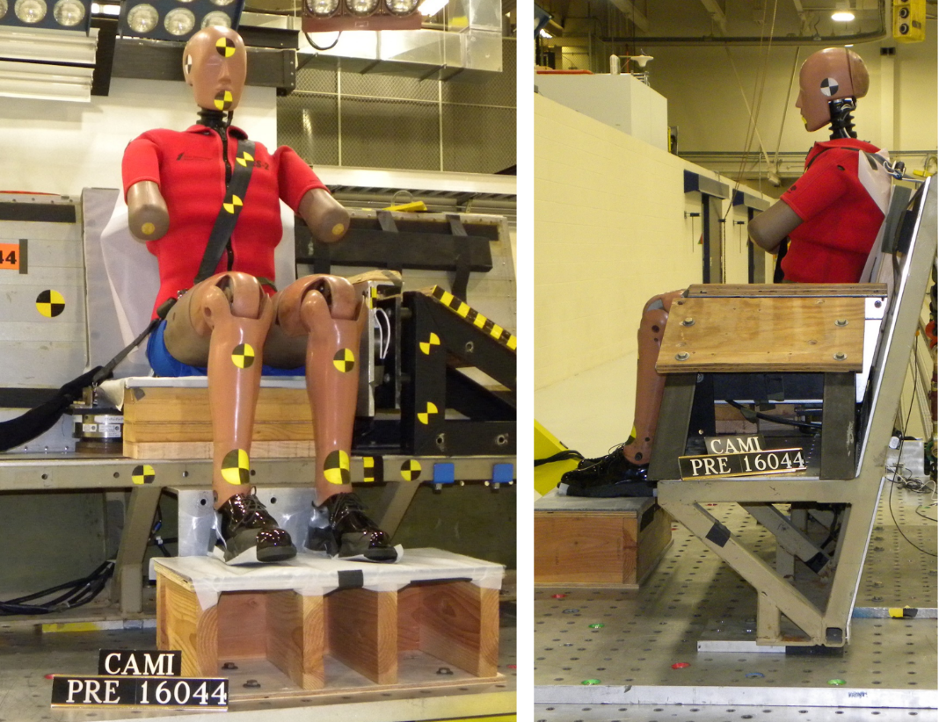
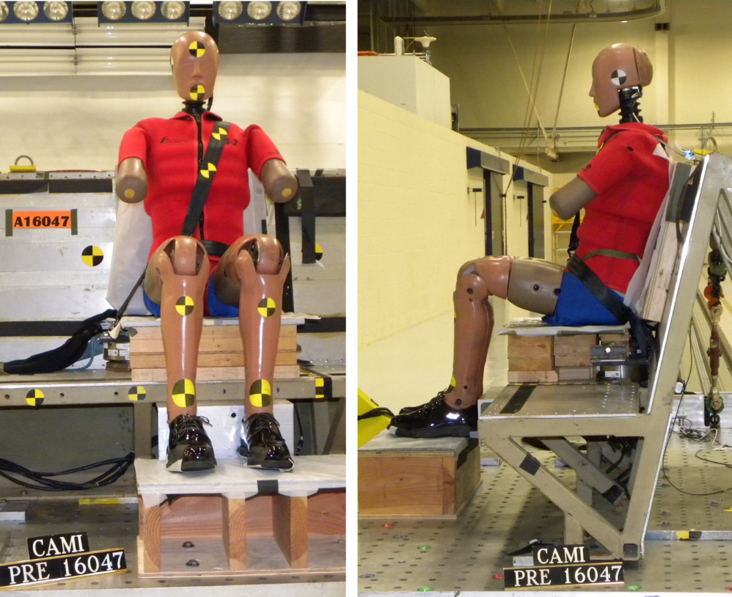
Test Conditions [160.8 lb]

Slide 11
Video (With Armrest)

Slide 12
Video (No Armrest)

Slide 13
Test Summary
Test # | Armrest | Sled Peak G | Velocity (ft/s) | Neck Tension (lb) | Sh Belt Load (lb) | Belt Payout (in)
A16044 | Yes | 9.2 | 26.9 | 395 | 1292 | 1.0
A16045 | Yes | 9.2 | 26.8 | 400 | 1369 | 1.0
A16046 | Yes | 9.3 | 26.6 | 393 | 1377 | 0.6
A16047 | No | 9.4 | 26.6 | 432 | 1364 | 0.4
A16048 | No | 9.4 | 26.5 | 395 | 1338 | 0.9
A16049 | No | 9.4 | 26.8 | 397 | 1372 | 0.8
A16050 | No | 9.3 | 26.8 | 423 | 1380 | 0.6
Avg |  |  |  | 405 | 1342
St Dev |  |  |  | 16 | 40

Slide 14
ARP Channel List [Proposed]
Sled Ax | Shoulder Belt Load
Neck Tension | Right Lap Belt Load
Neck Shear (Fx, Fy) | Center Lap Belt Load
Neck Mx | Belt Payout
Neck My | Wall Load
Neck Mz | Leg Rotation
Blue text denotes primary channel
Black text denotes secondary channel
Notes:
12 channels

Slide 15
Error Calculations
Error calculations follow the method defined in SAE ARP 5765A (except #4)
Magnitude error = relative error on the peak
Shape error = Sprague and Geers comprehensive error
All calculations from 0 ms – 400 ms (by default)
Calculated with 1k data

Slide 16
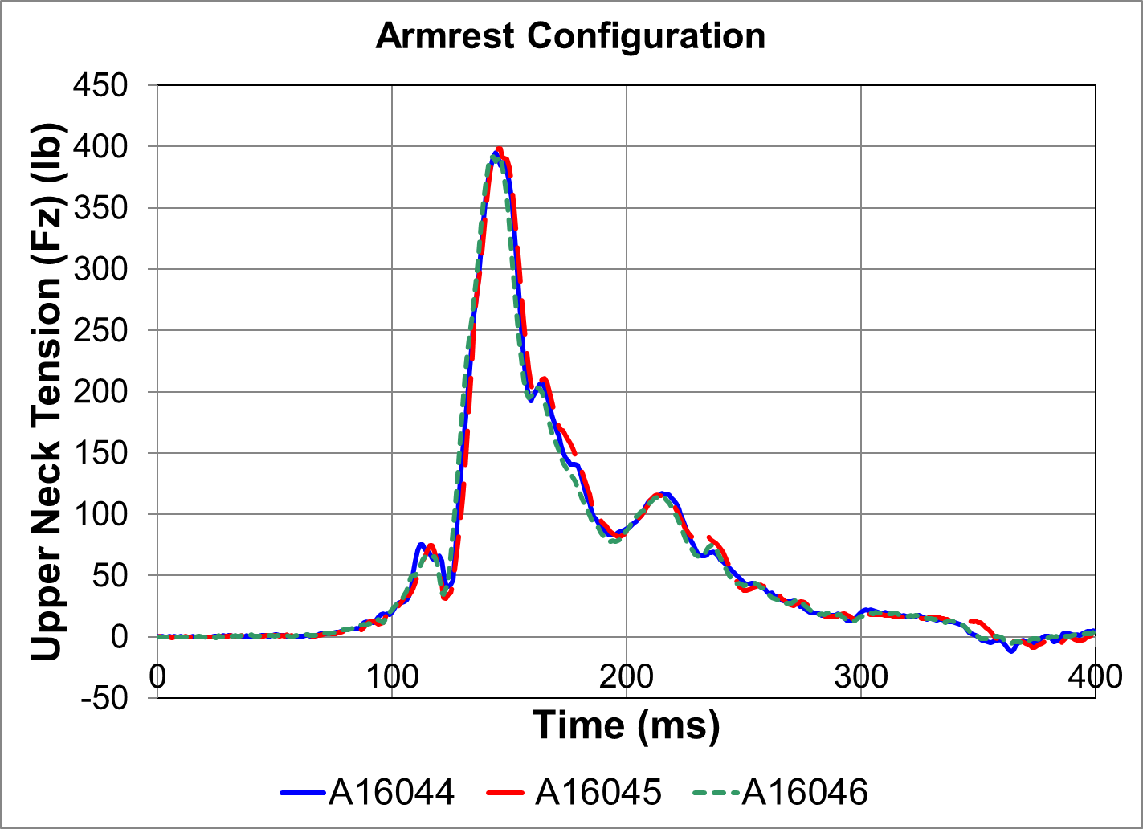
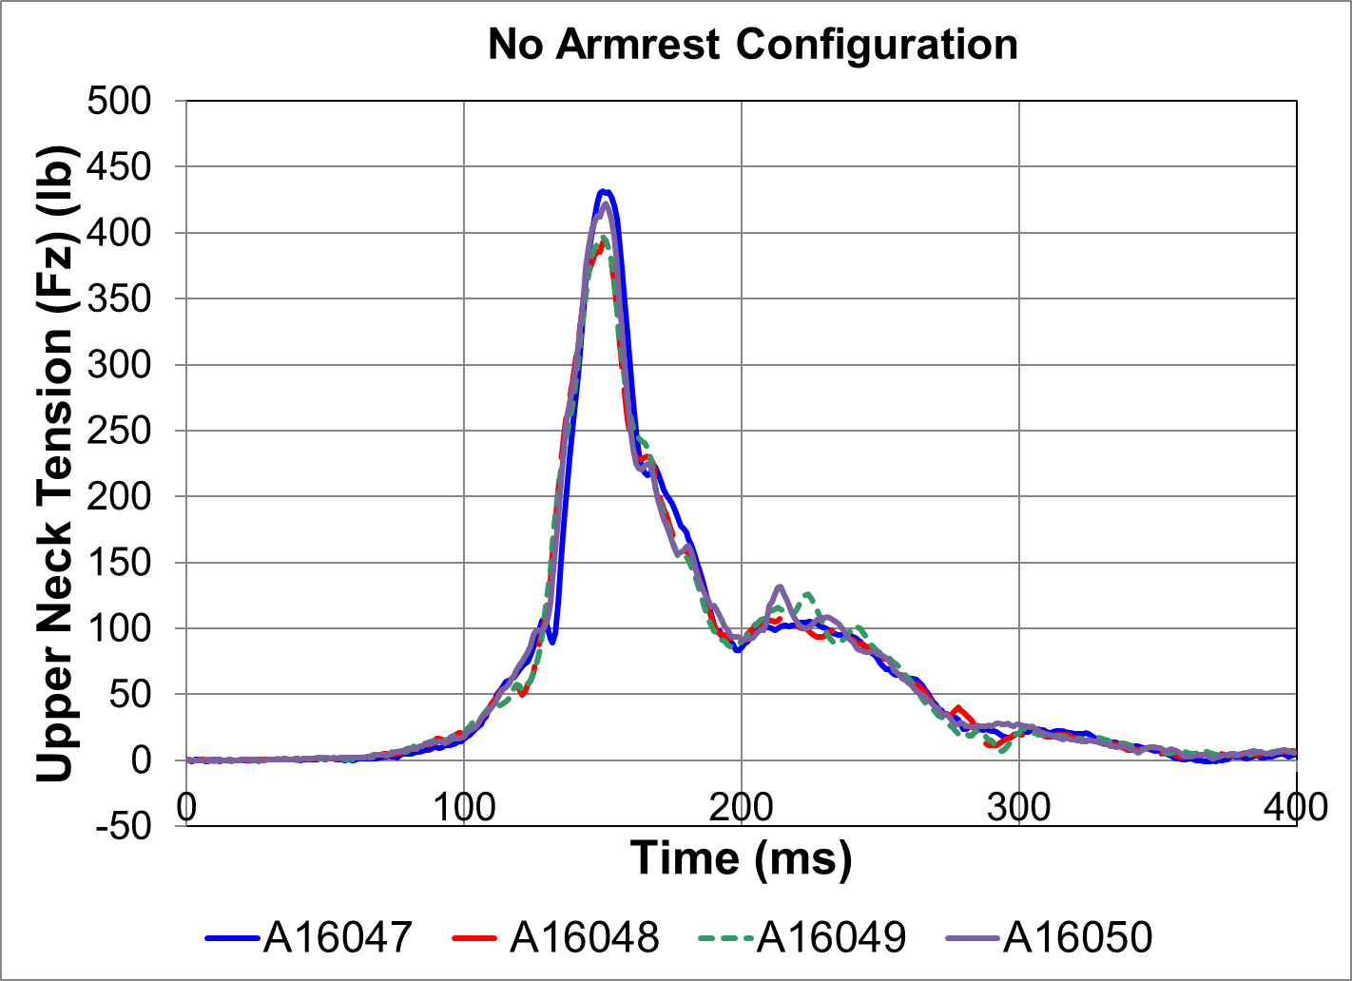
Test Repeatability: Neck Fz
Max Mag Error: 2%
Max Shape Error: 5%
Max Mag Error: 9%
Max Shape Error: 6%
Notes:
44-45: mag error 0.9%, shape 2.6%
44-46: mag error 0.8%, shape 3.1%
45-46: mag error 1.7%, shape 5.1%
47-48: mag error 8.8%, shape 5.9%

Slide 17
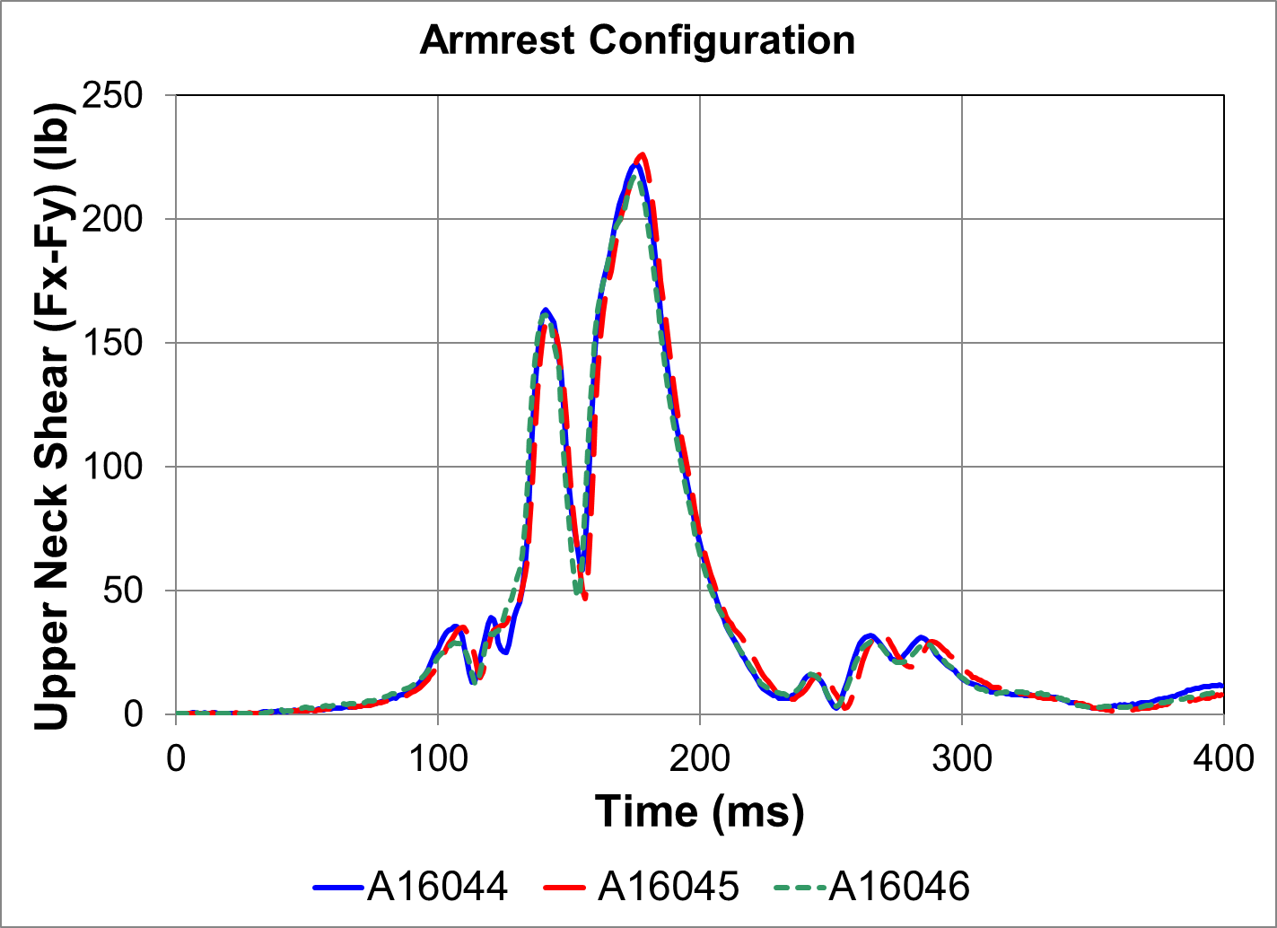
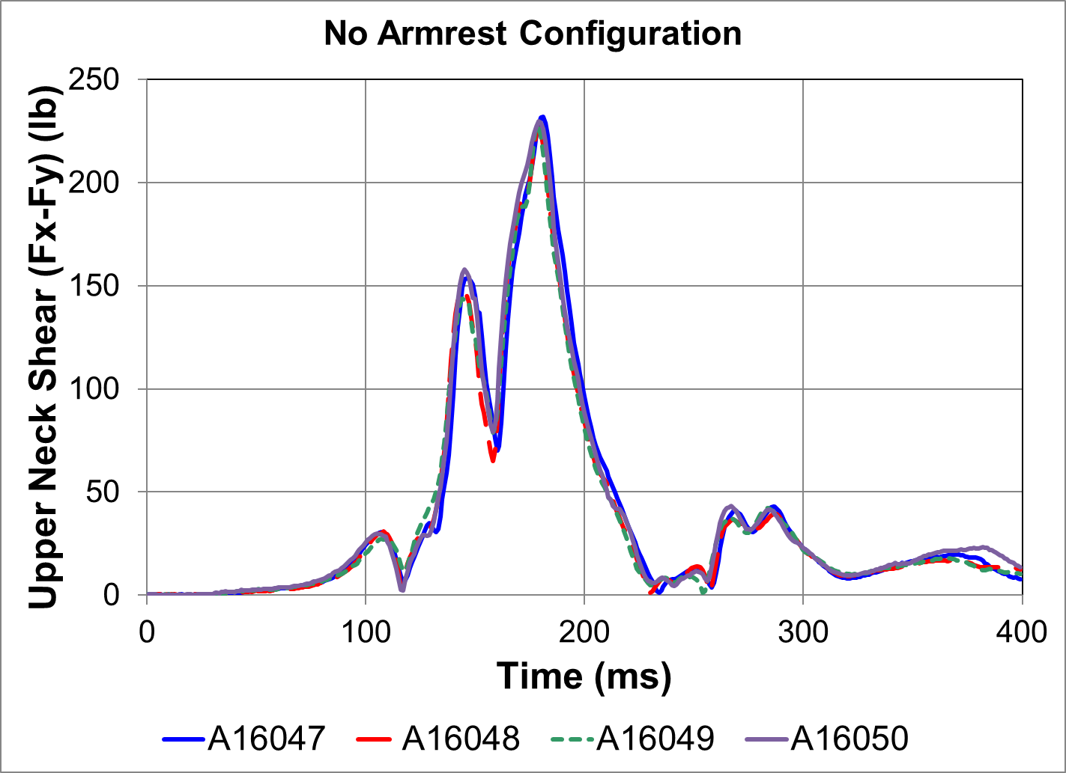
Test Repeatability: Neck Shear
Max Mag Error: 4%
Max Shape Error: 5%
Max Mag Error: 3%
Max Shape Error: 5%
Notes:
45-46: mag error 3.8%, shape 4.6%
47-48: mag error 2.5%, shape 5.1%

Slide 18
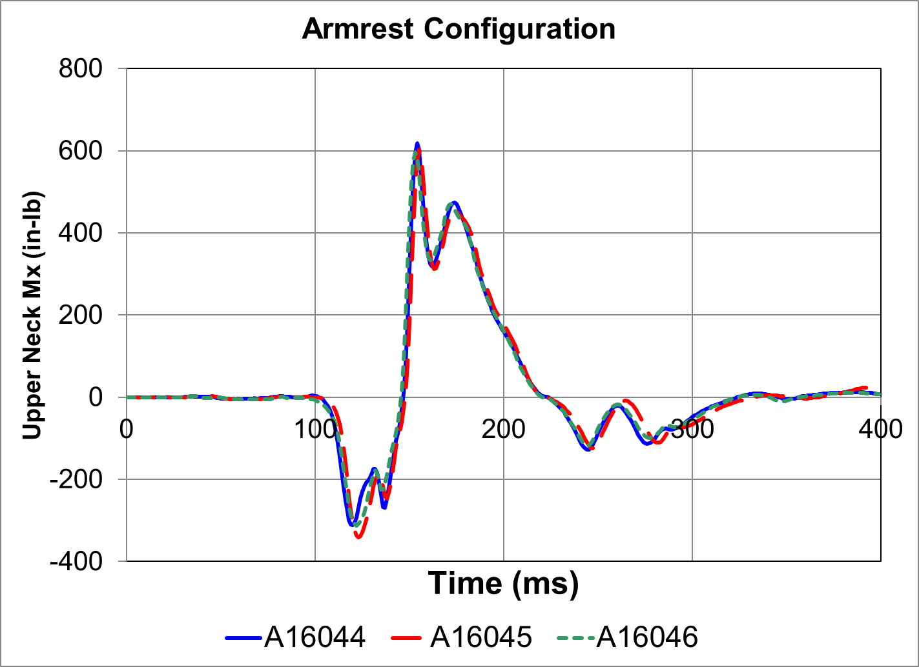
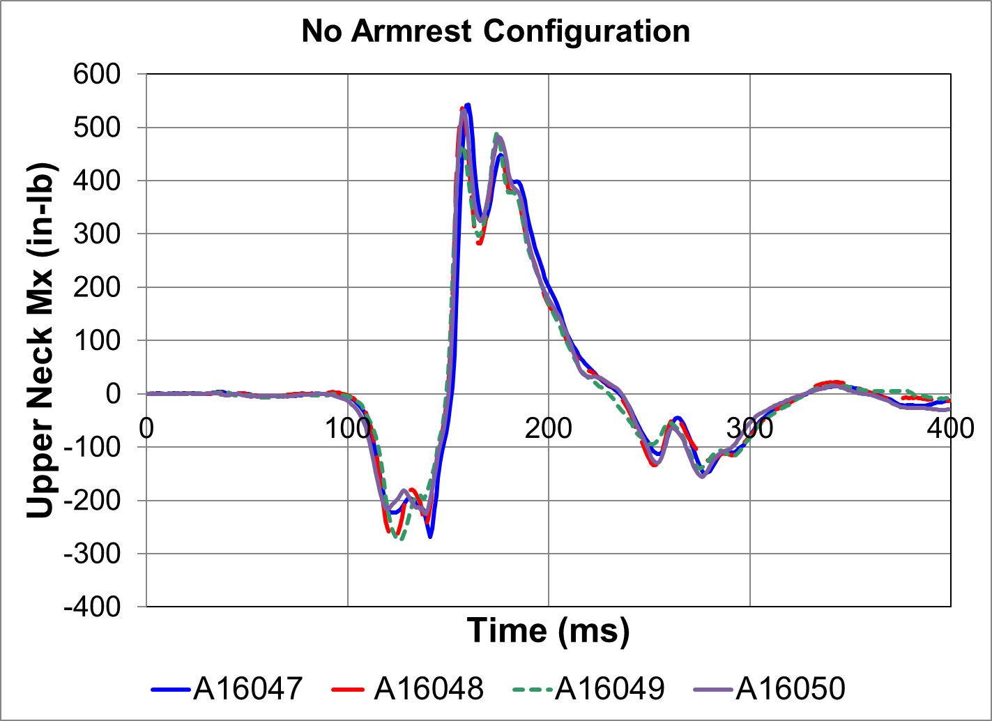
Test Repeatability: Neck Mx
Max Mag Error: 4%
Max Shape Error: 4%
Max Mag Error: 10%
Max Shape Error: 9%
Notes:
44-46: mag error 3.6%, shape 3.8%
47-49: mag error 10.2%, shape 8.6%

Slide 19
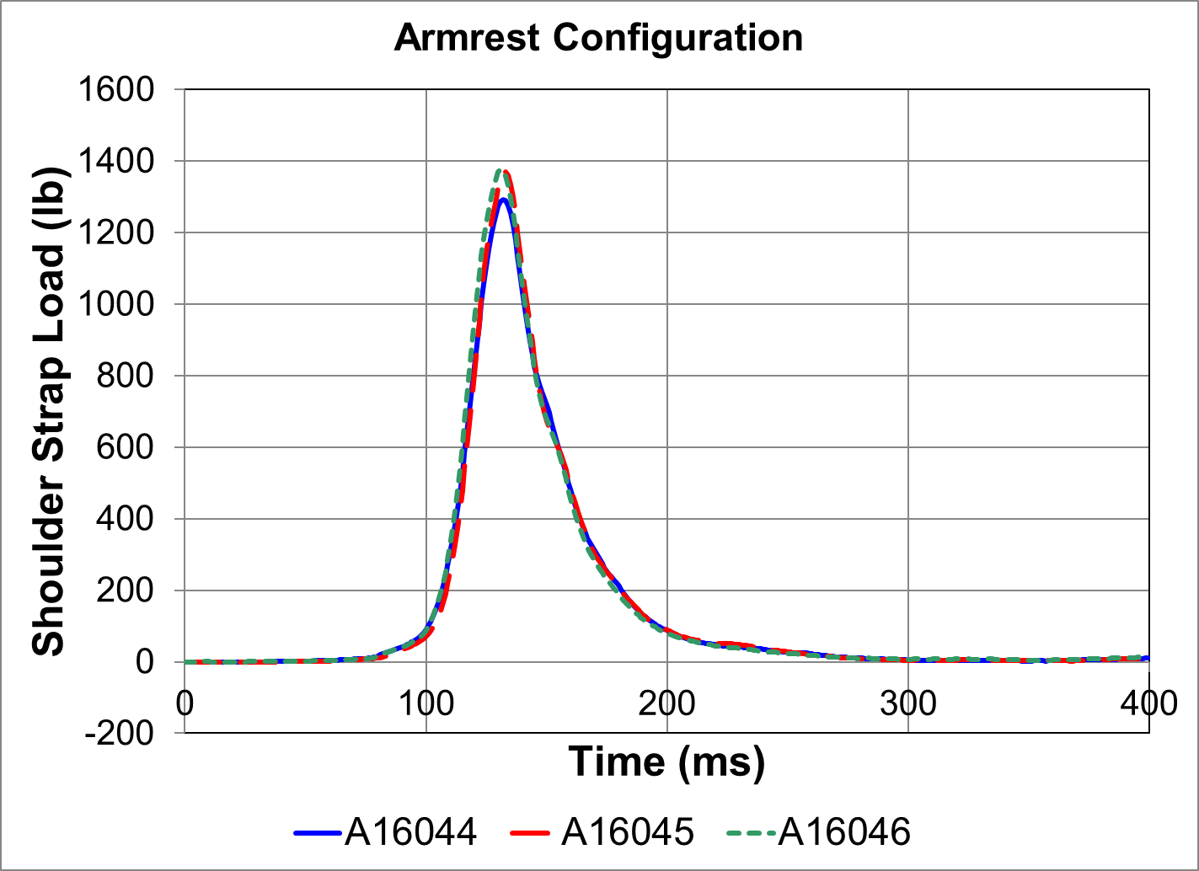
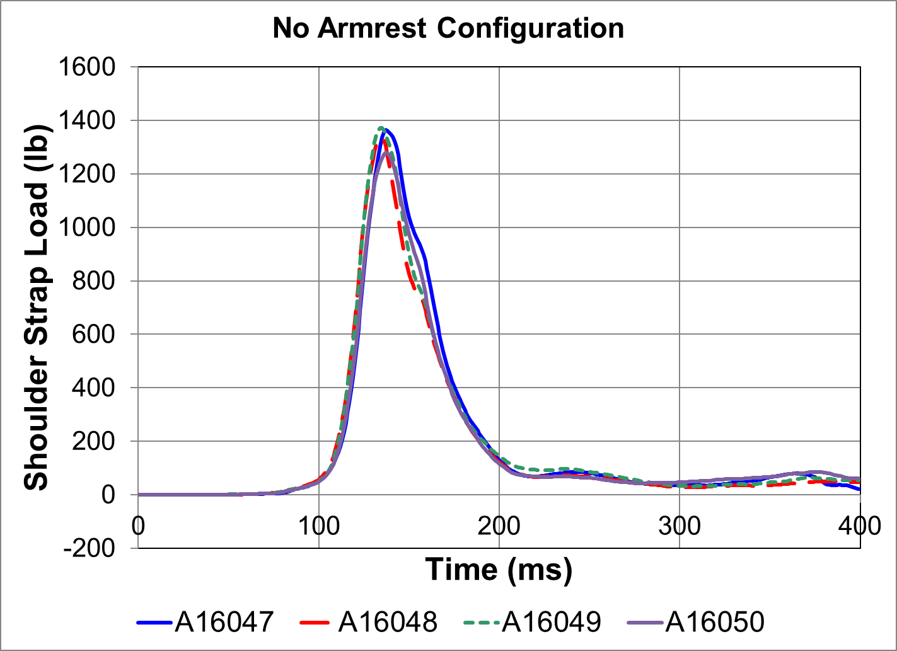
Test Repeatability: Sh. Belt Load
Max Mag Error: 7%
Max Shape Error: 5%
Max Mag Error: 7%
Max Shape Error: 5%
Notes:
44-46: mag error 6.6%, shape 5.1%
49-50: mag error 6.7%, shape 5.45%

Slide 20
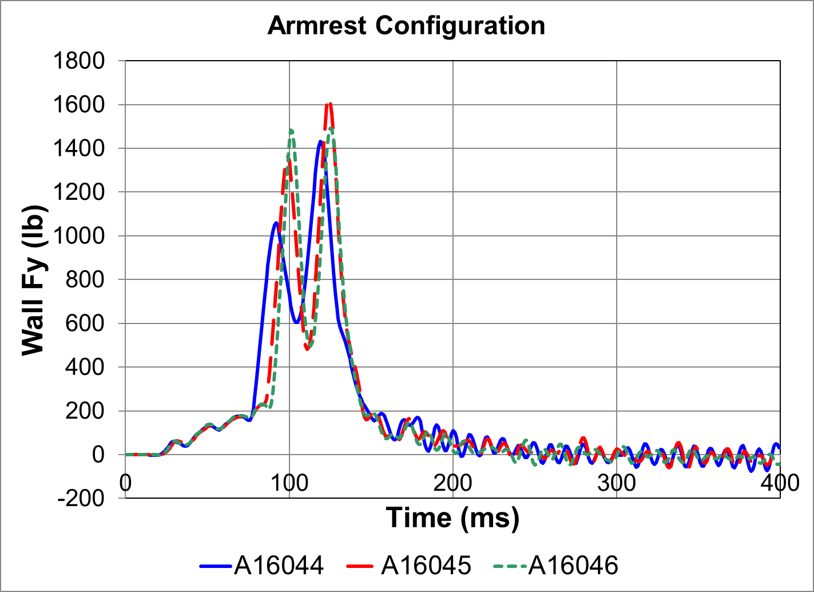
Test Repeatability: Wall Load
Pubic symphysis force also shows double spike, max load is 252 lbs
Max Mag Error: 14%
Max Shape Error: 17%
Notes:
44-45: mag error 14.0%, shape 14.8%
44-46: mag error 4.2%, shape 17.1%
Abdomen force < 50 lbs each
Pubic Symphysis force 210 lbs for A16044

Slide 21
Discussion
Preliminary photometric analysis contains a geometrical error that will be corrected
Data will not be included in full package until the error is corrected
Leg flail can be addressed via other means

Slide 22
Leg Flail
ES-2re demonstrates poor coupling between torque and the amount of rotation
Angle limit is essentially a go/no-go evaluation of the mitigation strategy

Slide 23
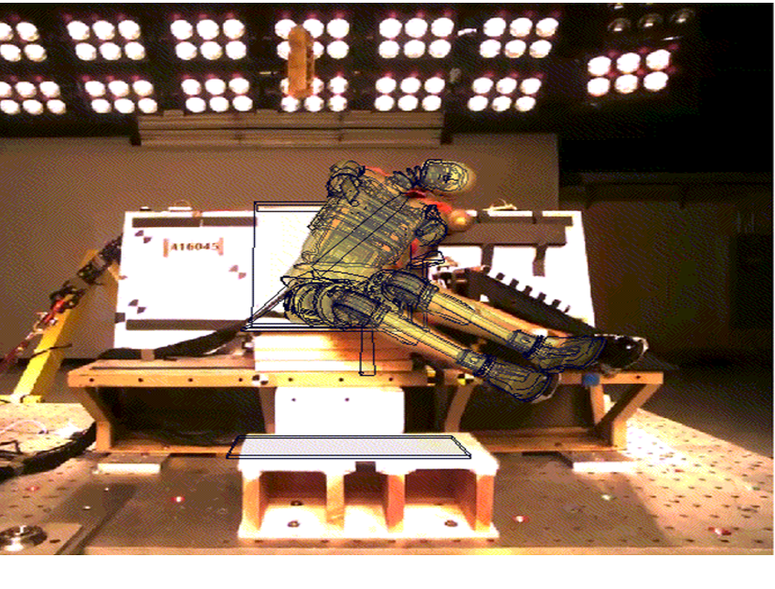
Leg Flail
Leg flail could be evaluated qualitatively as long as the leg freely flails beyond 35°
Model courtesy of Dynamore
Notes:
For physical ATD going 80 degrees, flail of 70 degrees or 90 degrees is good enough .
Replace picture with gif?

Slide 24
Leg Flail
Alternate quantitative data source is available
Robert D. Huculak & Hamid M. Lankarani (2015) Methods of evaluating ES-2 leg flail in dynamic evaluation and certification tests of side-facing aircraft seats, International Journal of Crashworthiness, 20:6, 613-628, DOI: 10.1080/13588265.2015.1076586

Slide 25
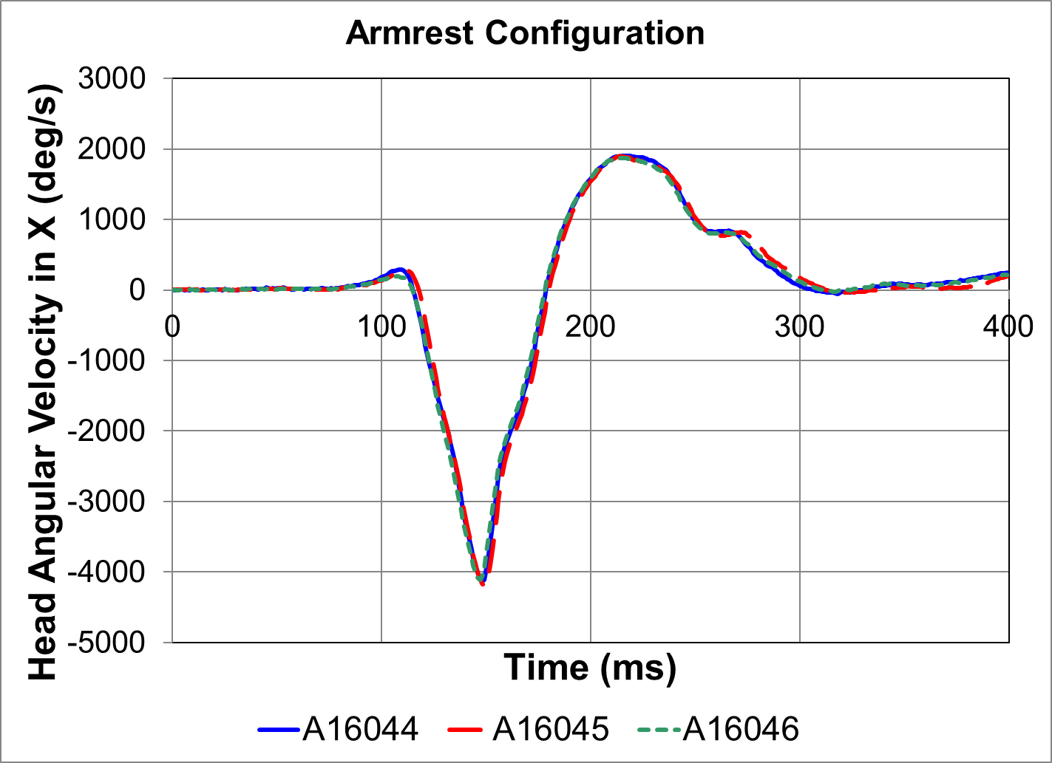
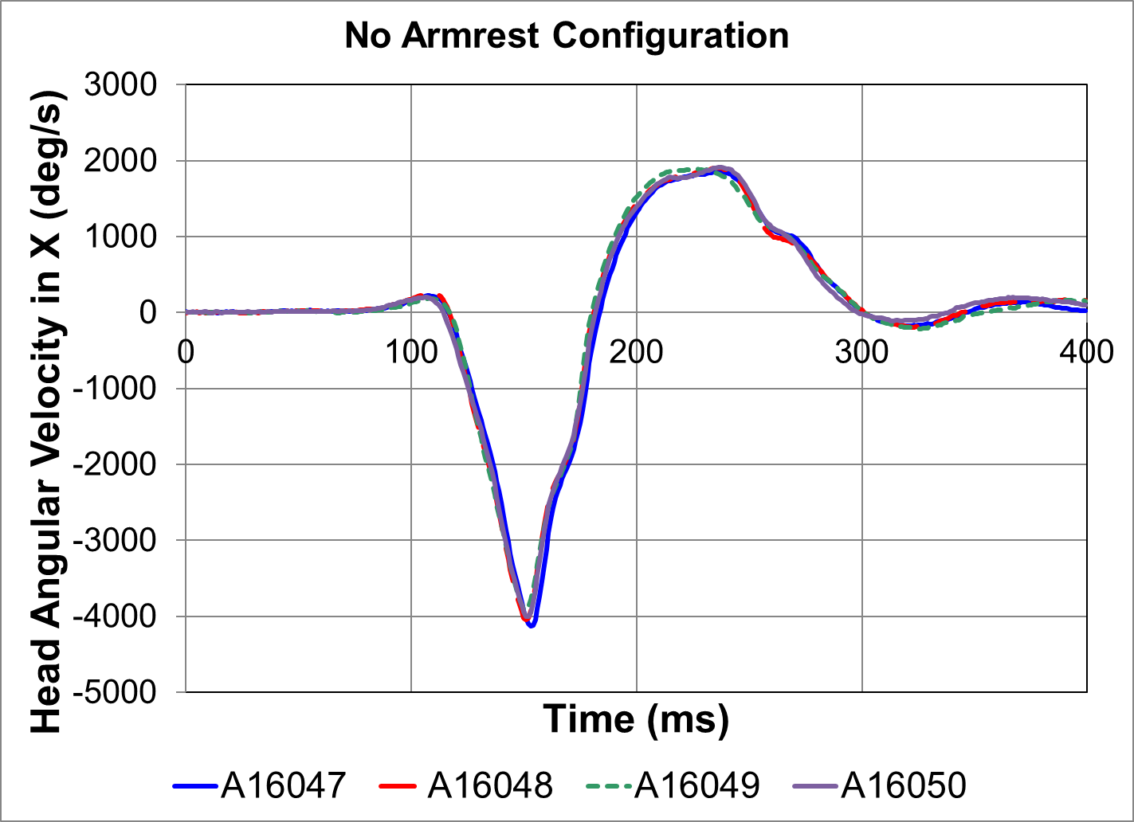
Test Repeatability: Head Rx

Slide 26
Range of Impact Angles
The data included in this test series is only intended to evaluate the ES-2re during pure lateral loading
Extrapolation to the standard test conditions of ±10° yaw should be evaluated during system level validation
Physical testing of the ES-2re beyond 65° is not recommended
Per Humanetics communication

Slide 27
Data Set
A data set package will be made available to anyone interested
Pre-test pictures and measurements
Post-test pictures
Electronic data
Videos
May be posted to the SAE SEAT committee webpage to support ARP 5765 Rev B

Slide 28
Summary
Full scale dynamic test conditions to evaluate the ES-2re v-ATD have been defined
Test data shows good repeatability (generally <10% variability)
A data package will be available to any interested party
Initial work by v-ATD developers shows good correlation between the v-ATD and physical ATD

Slide 29
Acknowledgements
Thanks to the Biodynamics Team for running the sled tests: David Moorcroft, Amanda Taylor, Jeff Ashmore, Ronnie Minnick, David DeSelms (retired), Jim Biegler (contractor)
Restraints provided by AmSafe Corp. Commercial Aviation
A report containing the details of this project will be published as an Office of Aviation Medicine Report

