Slide 1
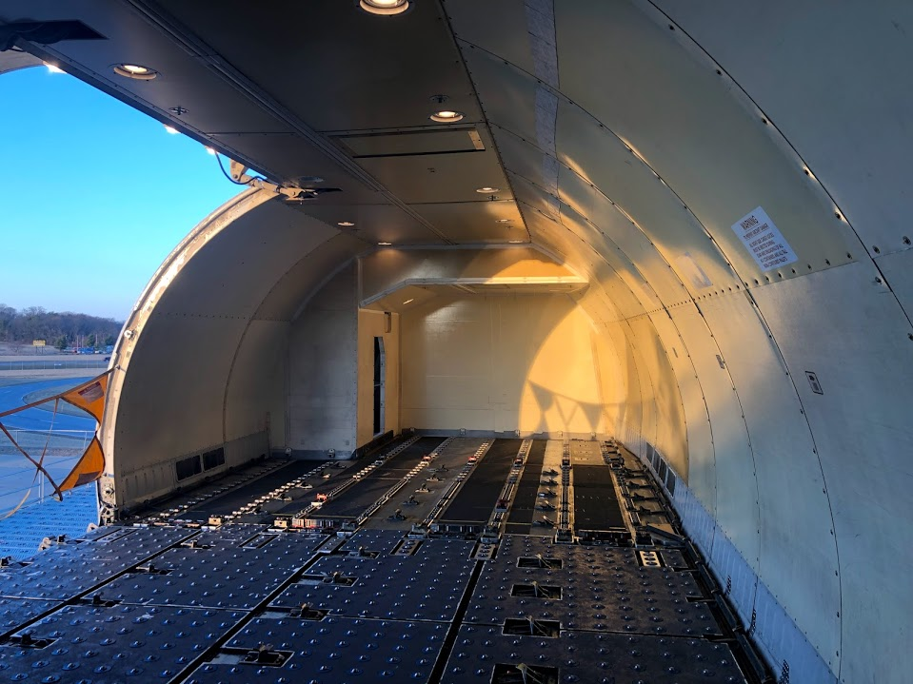
Improvements in Aircraft Smoke Detection
Presented to: 9th Triennial International Aircraft Fire and Cabin Safety Research Conference
By: Jennifer Wood
Date: October 30, 2019

Slide 2

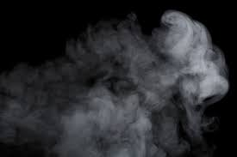
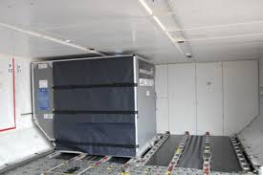
Introduction
Flight detection systems must provide a visual indication to flight crew within one minute of fire starting [1]
Minimum Performance Standards issued by FAA to decrease the frequency of nuisance alarms, e.g.
  Dust
  Water vapor/humidity
  Insecticides
Prior research by Chin: high proportion of smoke detector activations due to non-fire sources [2]

Slide 3
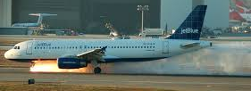

Background
Fires & false alarms lead to:
  Flight diversions
  Flight delays
  Flight cancellations
  Emergency evacuations
  Lack of trust in systems (false alarms)
2014 database proved nuisance alarms made up 91.3% of reported incidents inside of cargo compartments

Slide 4
Background cont.
Scalability of Smoke Density and the Viability of New Detection Methods in Aircrafts Research by Chin
  ASD outperformed the wired detector in response time
  Blue & IR wavelength and gas sensor technology responded well in comparison to light obscuration
  Wireless detectors proposed

Slide 5
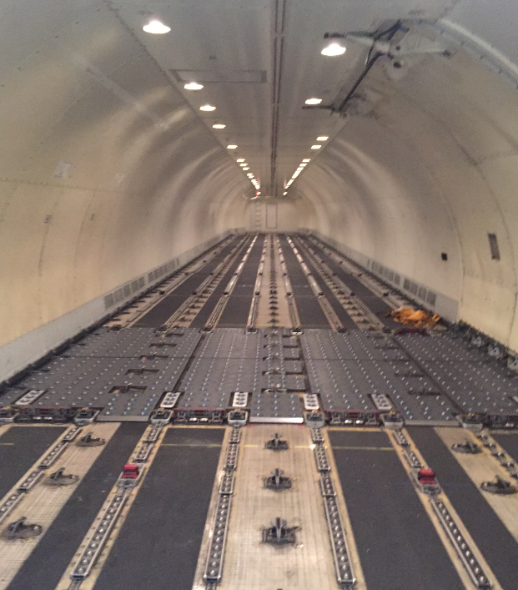
Objective
Address the ability of state-of-the-art (S-O-A) detectors and detection systems
  Blue & IR sensors
  Gas sensors
  Wired and Wireless Detectors
Assess differences in fire detection time for detectors within a ULD versus a cargo compartment ceiling
Further exploration of nuisance source testing
Ongoing project

Slide 6
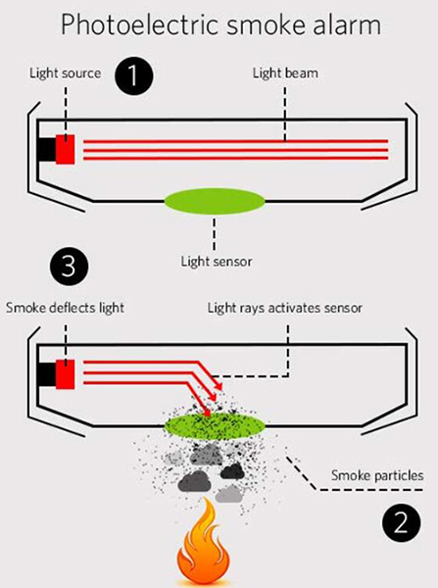
Current Technologies
Smoke detectors most commonly used in cargo compartments
    Often found on ceiling of cargo compartment
      Draw-Through Type (Air Sampling Port) OR
      Open-Area Type (Single Unit)
    Photoelectric sensing
Notes:
Analyzing the hazard of Lithium Ion batteries
Blue whirl – using a fire tornado that generates a minimal amount of soot to remediate oil spills by burning without air pollution
Understanding sprinkler sprays to alter last century’s design methods using state-of-the-art diagnostics
Fire detection on aircraft – developing new technologies to reliably detect fires (without false alarms) in cargo compartments
Wildland fires – developing improved fire simulations to better predict the spread of wildland fires
New materials research – developing next generation fire retardants which are effective and environmentally friendly

Slide 7
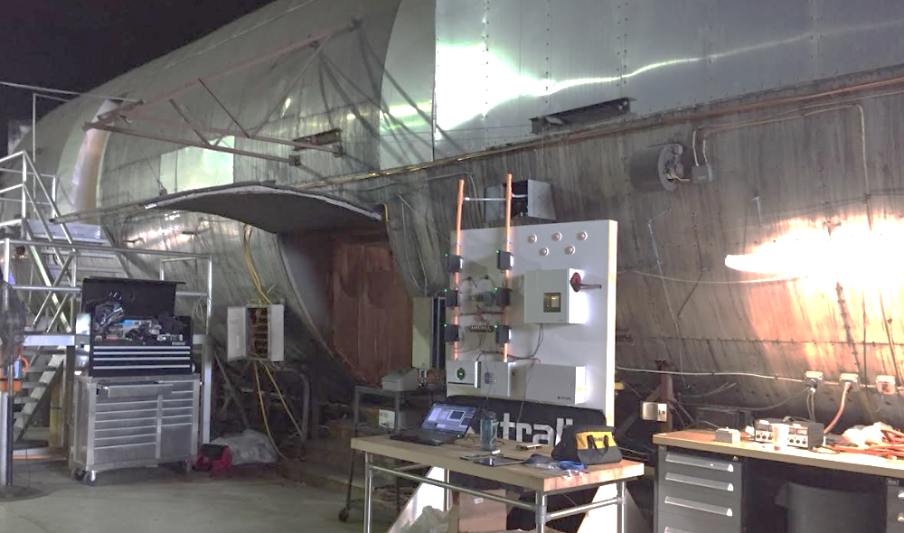
Experimental Program
Experiments conducted in Summer 2019 at the FAA Technical Center
Testing performed inside cargo compartment of DC-10

Slide 8
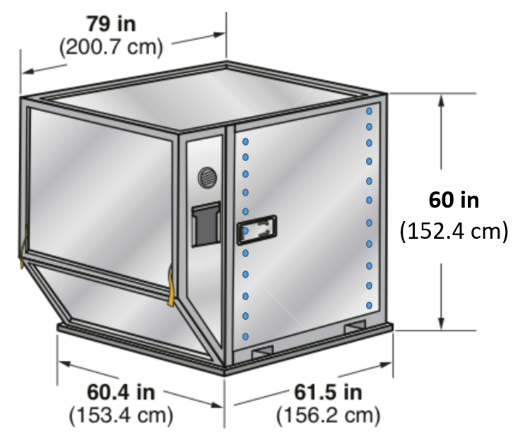
Testing: Unit Loading Device (ULD)
Account for wide variety of ULD shapes & sizes, used 3 different leakage models
  “small” leakage = no alterations, all holes sealed
  “medium” leakage = only edge column of holes sealed
  “large” leakage = both columns of holes open
  CO₂ leakage rate test results:
Hole Columns
LD3 ULD Model | Leakage Rate (cfm)
Small Leak | 3.6
Medium Leak | 5.4
Large Leak | 9.1

Slide 9
Instrumentation
# | Instrument | Description/Measurement | Quantity
1 | Light Obscuration Meters | amount of white light transmitted through the smoke received by a photocell | 6
2 | Gas Analyzers | concentration of carbon monoxide, carbon dioxide, and oxygen. | 4 Sampling Points
3 | Thermocouples (K-type) | temperature at single points, placed at ceiling level and on trees. | 45
4 | Infrared (IR) Camera | amount of heat emitting from a certain area to create “thermal image” | 1
5 | Scanning Mobility Particle Sizer Spectrometer (SMPS) | density, diameter, and size distribution of airborne submicron particles. | 1

Slide 10
Instrumentation
# | Instrument | Description/Measurement | Quantity
6 | Blue & IR Signal | light transmission in specific wavelengths using blue and IR signals (signals indicate prevalence of small (< 1 μm) or large particles in smoke) | 1
7 | Air Sampling Detectors (ASD) | ASGD measures concentration of gases at selected positions through air sampling pipes, similarly to an ASSD which works as a smoke detector | 3 sampling ports/3 different systems
8 | Wireless Smoke Detectors | Photoelectric smoke detector using a wireless transmission system powered by batteries. | 2
9 | Wired Smoke Detector | Photoelectric smoke detector with hard wired power supply | 1
10 | GoPro | Video recording camera to document test conditions | 2

Slide 11
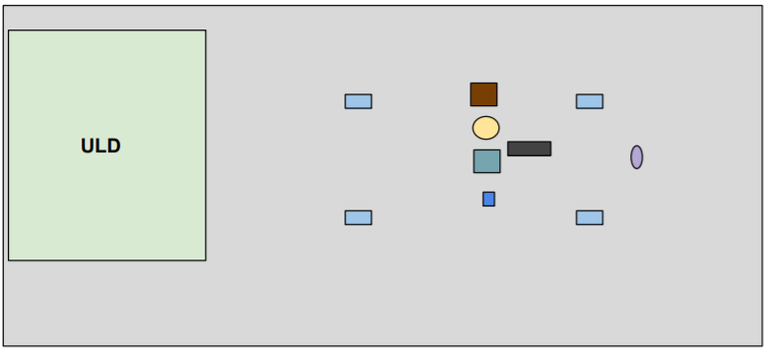
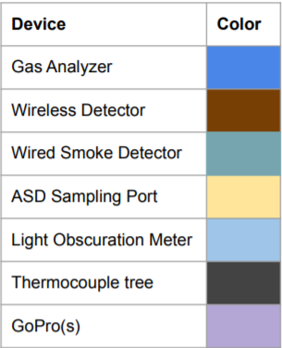
Test Set Up: Cargo Compartment

Slide 12
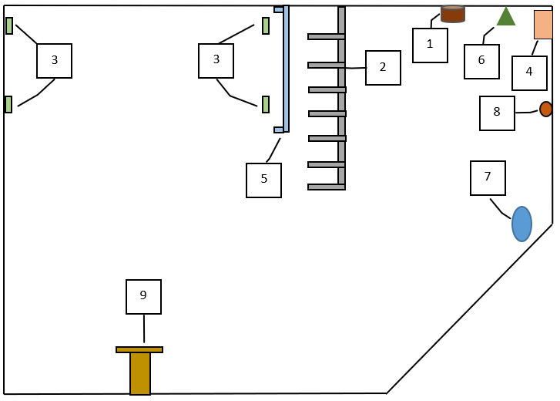
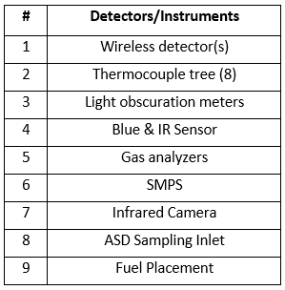
Test Set Up: Inside of ULD

Slide 13
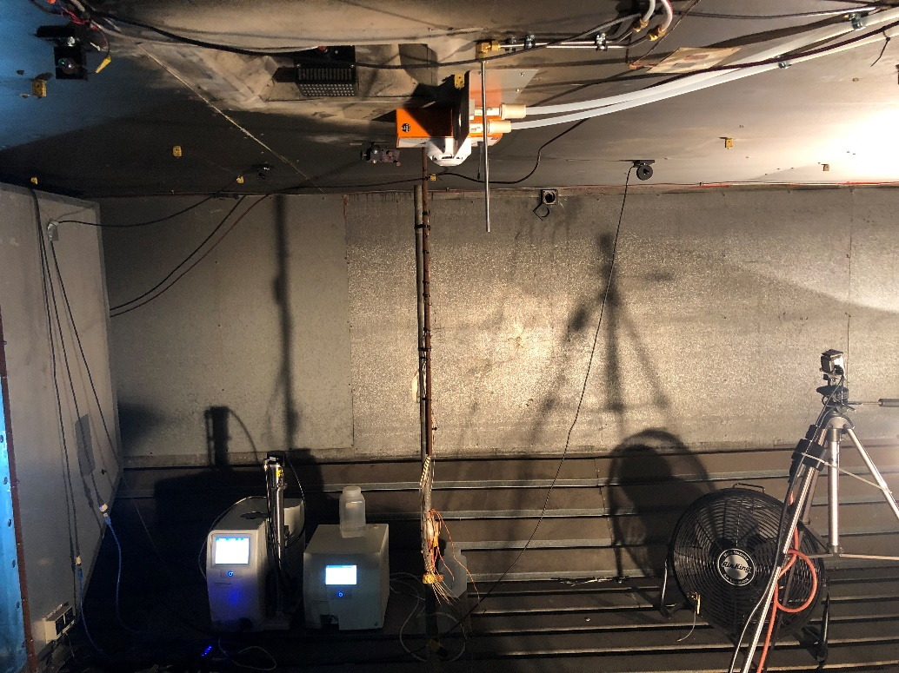
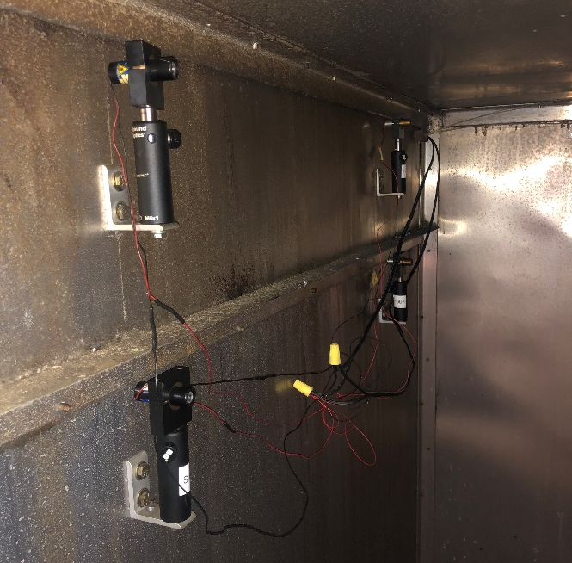
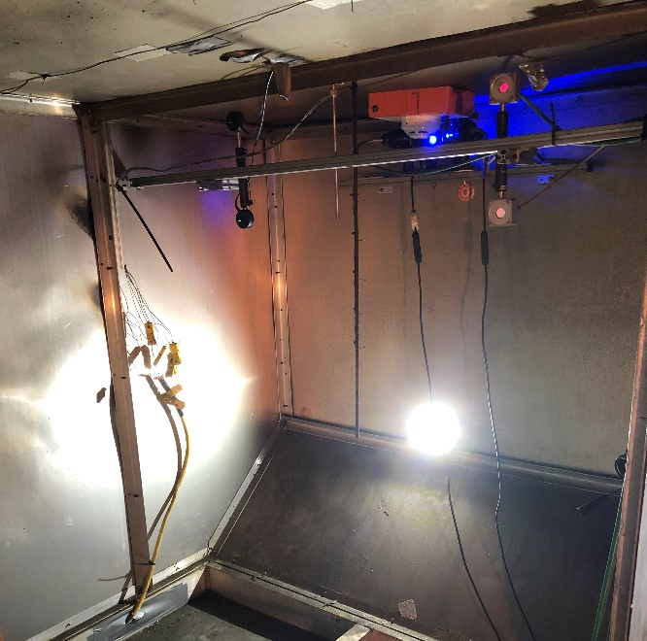
Test Set Up: Implementation
Cargo Compartment
Inside ULD

Slide 14
Fuels & Test Matrix
Source/Location | Small Leakage Model | Medium Leakage Model | Large Leakage Model
PU Foam (flaming) | 3.0 by 3.0 by 2.0 in. burned 4” off the ground, near 100 g of foam Use of 4 mL of heptane to assist ignition (poured in corner) Ignite corner
PU Foam (smoldering) | 100 g of foam, cut into pieces varying near 1 x 1 x 1.5 inches Foam on hot plate at a constant temperature ranging between 400-600 °F
Suitcase (whole suitcase) | Entire suitcase standing up, filled with 10 cotton XL cotton t-shirts Smoldering induced via electric charcoal starter at 550 W
Shredded Paper | Paper strips approximately 6 – 10 mm in width by 25.4 – 102 mm in length Shredded paper consisted of a mix of 20 lb paper and cardstock 42.6 g (1.5 oz) tamped down in 1’ tall metal tube with 1”x1” flue space in center. Tube placed on a 11.75” high ring stand and ignited via an 8” Bunsen burner with 6” flame.
Wood | 100 g of hickory wood chips Wood chips on propane burner at constant temperature ranging between 400-600 °F
Baled Cotton | 15 g of cotton Cotton on hot plate at a constant temperature ranging between 400-600 °F
Lithium Ion Battery | Place four Lithium Ion Batteries inside sealed pipe cage with a single hole at top Use a cartridge heater to force thermal runaway
Humidifier | Release water humidifier into air for 30 min. until ULD reaches a light obscuration < 60%

Slide 15
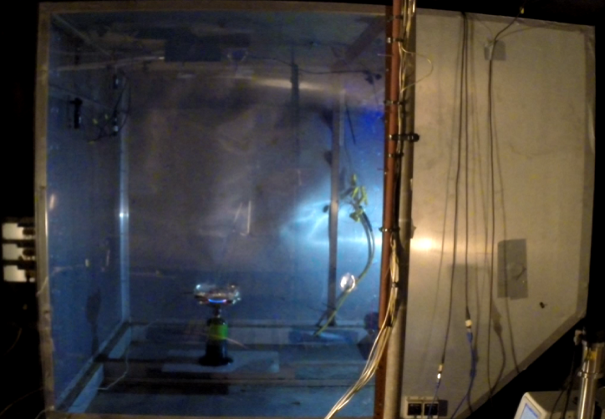
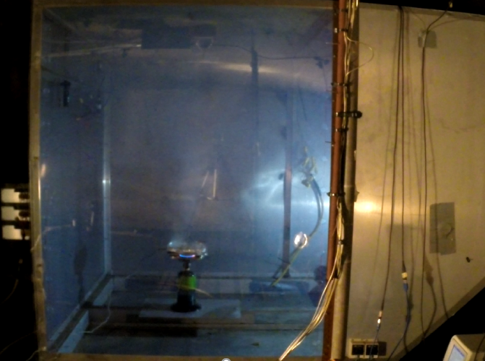
Cargo Compartment view of ULD
60 seconds
120 seconds

Slide 16
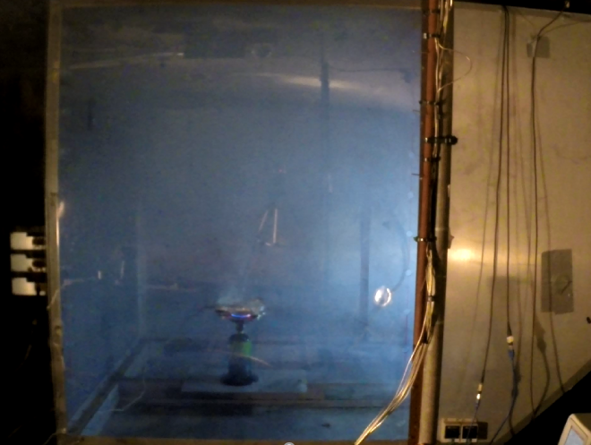
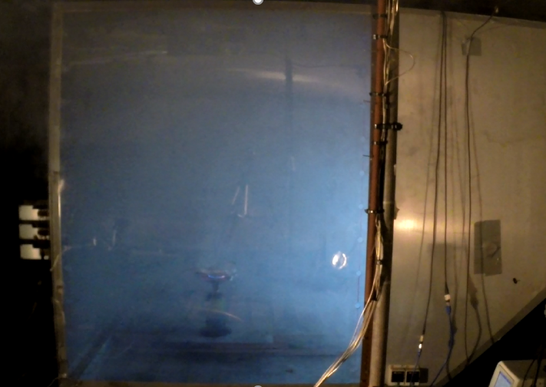
Cargo Compartment view of ULD
180 seconds
240 seconds

Slide 17
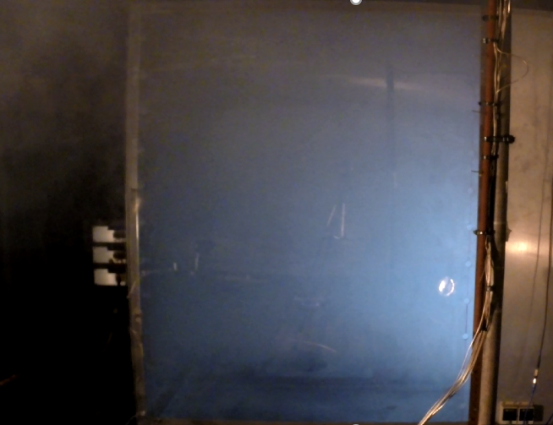
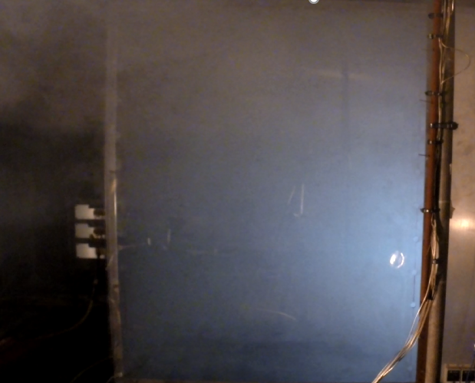
Cargo Compartment view of ULD
300 seconds
360 seconds

Slide 18
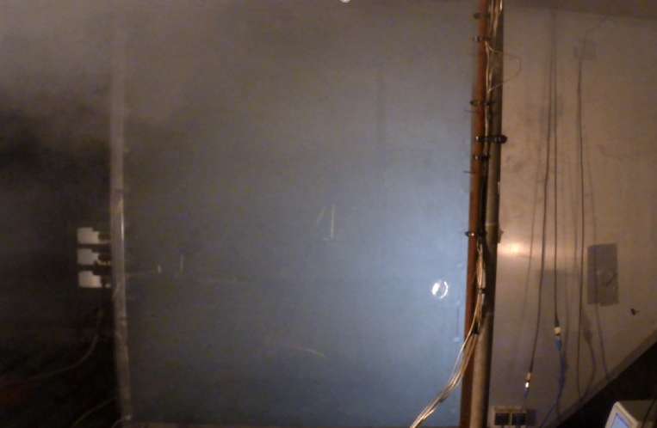
Cargo Compartment view of ULD
420 seconds

Slide 19
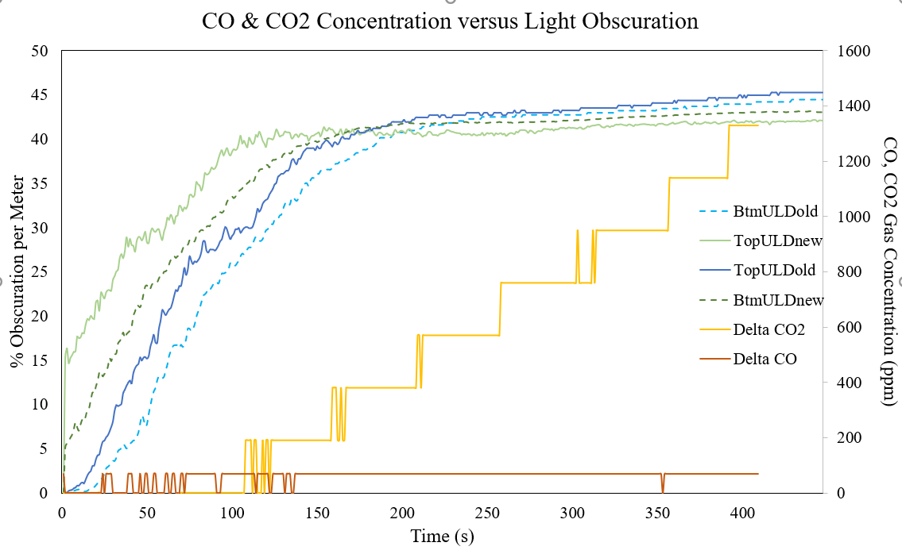
Preliminary Results – Smoldering PU Foam

Slide 20
Preliminary Results – Smoldering PU Foam
Wireless Detector -ULD
ASSD-ULD

Slide 21
Future Analysis
Continuation of converting the raw data
Comparison between measurement points
  1st Stage: Comparison of all measurements with light obscuration meter
  2nd Stage: Analysis of Stage 1 results and comparison between:
    Blue + IR signals
    Gas analyzers
    SMPS data: particle size & density
    Different ULD leakage models

Slide 22
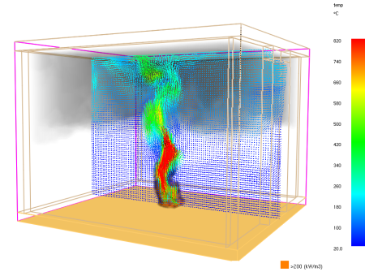
Computer Simulations
Fire Dynamic Simulator (FDS): recreate test scenario
    Fire characteristics
    Surrounding environmental characteristics
    Geometric variations in cargo compartment
    Models presence of other ULDs

Slide 23

Acknowledgements
Federal Aviation Administration
  Robert I. Ochs, PhD
  Engineering Team
  Technicians
Selena Chin’s Research & Thesis
Academic Advisor: Dr. Milke
Undergraduate Assistants: Emily James and Adam Lee
Space Age Electronics
Xtralis (by Honeywell)

Slide 24
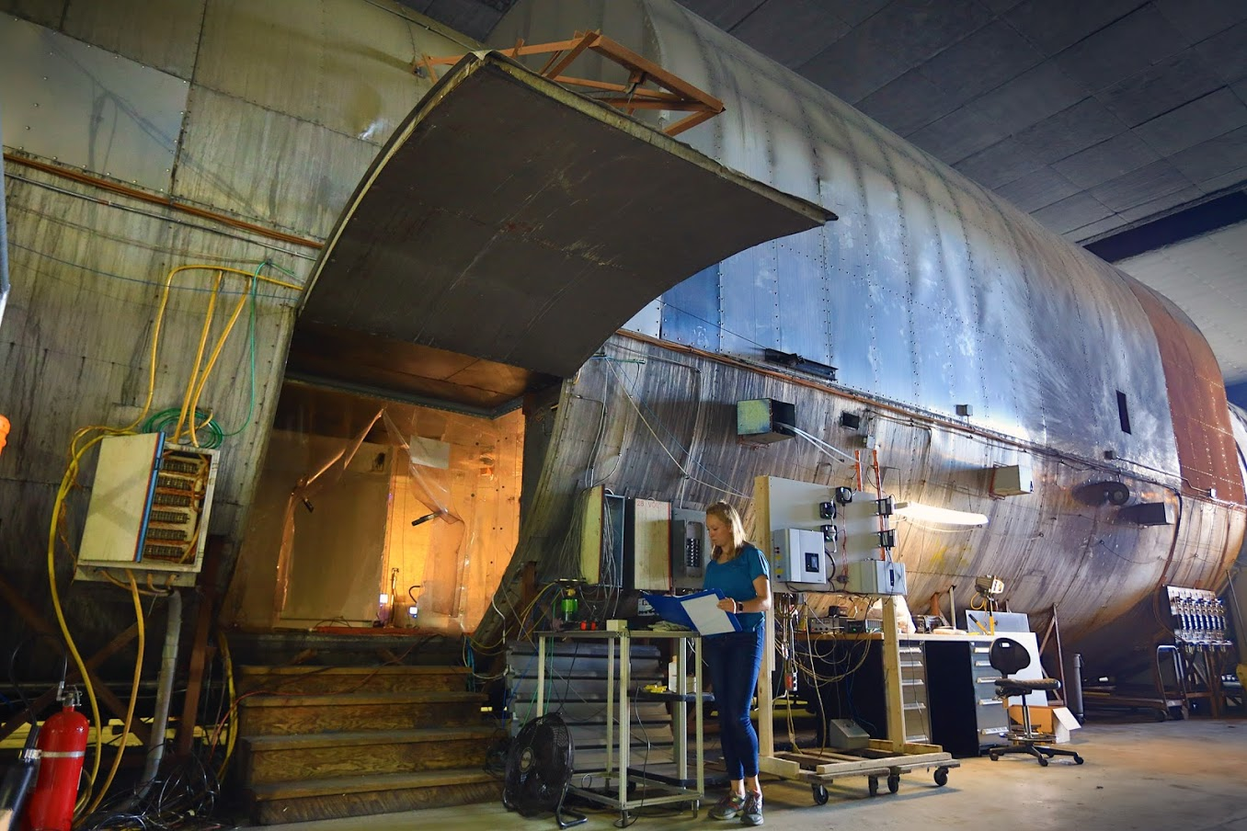
Thank You!
Questions?
  Contact: Jennifer Wood
  Fire Protection Engineering Graduate Student,
  University of Maryland College Park
  Email: jenniferwood2211@gmail.com

