Slide 1
Aircraft Seat Dimensions
Evaluation of the Effects of Seat Pitch and Width on Transport Category Airplane Egress
9th Triennial International Aircraft Fire and Cabin Safety Research Conference
David Weed
October 29, 2019

Slide 2
Introduction
David Weed
Team Coordinator, Cabin Safety Research Team
My Standard Disclaimer:
I am a Scientist
I do not make regulations: I do research
I do not write the gospel of Cabin Safety: I do inform my sponsors
I do aim for humor

Slide 3
Outline
Background
More Background
Study Design
Research Plan

Slide 4
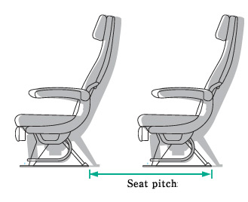
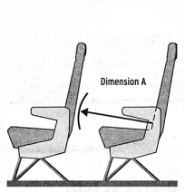
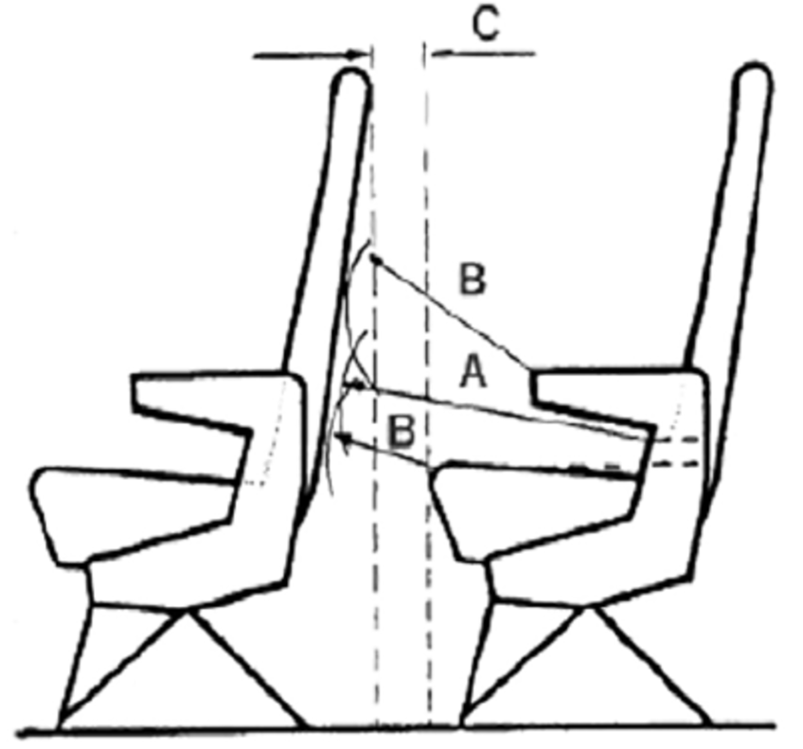
Background
Definition and Disclaimer
Seat Pitch
UK CAA AN64:
“Dimension A”
“Dimension B”
“Dimension C”

Slide 5
Background
2015/2017 – Public Concern
Fliers Rights Petition
Fliers Rights vs FAA
2017/2018 – Government Response
DOT OIG Cabin Safety Audit
FAA Reauthorization Act of 2018

Slide 6
Background
FAA Reauthorization Act of 2018
Section 337 – Aircraft Cabin Evacuation Procedures
Section 577 – Minimum Dimensions for Passenger Seats
CAMI to conduct study to provide data for requirements

Slide 7
Background
FAA Reauthorization Act of 2018
Congressional Hearing – September 26th, 2019
Media Attention
2 Weeks, ~150 Story/Google Hits
10/17/19: CAMI “Media Day”

Slide 8
More Background
Anatomy of an Aircraft Evacuation
“90 second rule”
Aircraft Cabin Evacuation Research
Seat Pitch
Access to Egress (2000-2002)
Demographics then and 2016

Slide 9
Study Design
A note on what the study is NOT looking at:
Animals
Children
Disabled Passengers
Luggage
Slides
“90 seconds”

Slide 10
Study Design
What the study IS looking at
Population Demographics
Ergonomic Minimums
Seat Pitch
Seat Width

Slide 11
Study Design
Population
Group Size
Demographics
Motivation
Flight Attendants
Money

Slide 12
Study Design - Motivation
Motivation Example
Notes:
Example motivation clip

Slide 13
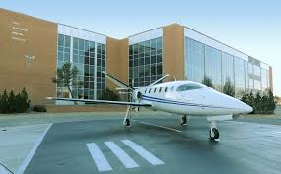
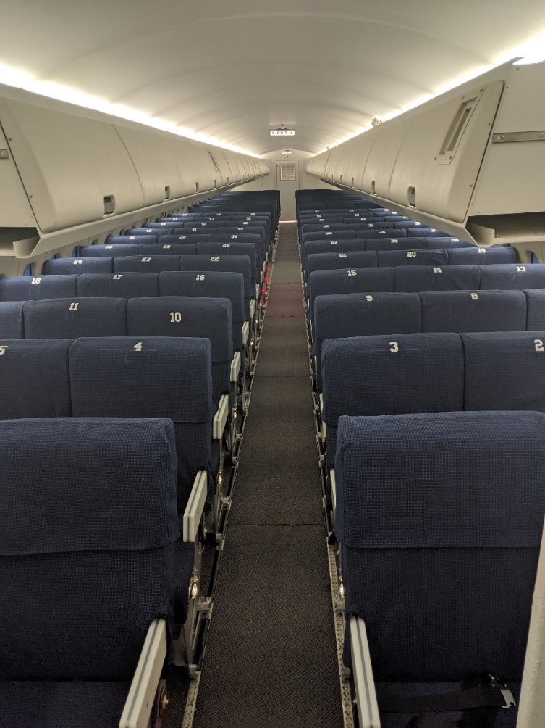
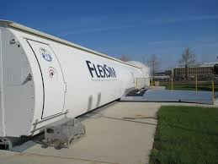
Study Design
Facilities
CAMI
FlexSim

Slide 14
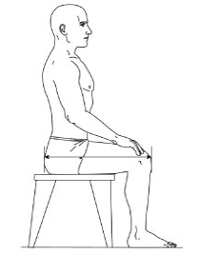
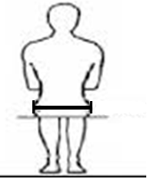
Research Plan
Anthropometrics
Height, Weight, Girth
Shoulder Width, Sitting Hip Width
Buttock-to-Knee, Knee-to-Floor

Slide 15
Research Plan
Test Days
November, December
Weather Permitting
Test Runs
Informed Consent, Measuring
4 Evacuations per group
Between Trial, Post-Trial Self-Reports

Slide 16
Research Plan
Data Breakdown
Paper Data
Demographics, Anthropometry, Self-reports
Video Data
48 Group Evacuation Times
2832 Individual Egress Times
Eye Strain

Slide 17
Research Plan
Data Analysis
Excel, SPSS
Coffee, Pure Cane Sugar
Final Report
Summer 2020

Slide 18
Conclusion
Stay Tuned

Slide 19
Questions
Questions?
Comments?
Concerns?
Cheers!

