Slide 1
Evaluation of Serious Games for Passenger Education
Melissa Beben, MS

Slide 2
Passenger Education
....are they paying attention?
A 2000 NTSB Safety Study investigated 46 accidents that occurred between September 1997 and 1999 involving 2651 passengers. Of 399 responses received to a questionnaire asking whether the passenger had watched the briefing and read the safety card, 44% responded that they neither listened to the safety briefing nor examined the card.

Slide 3
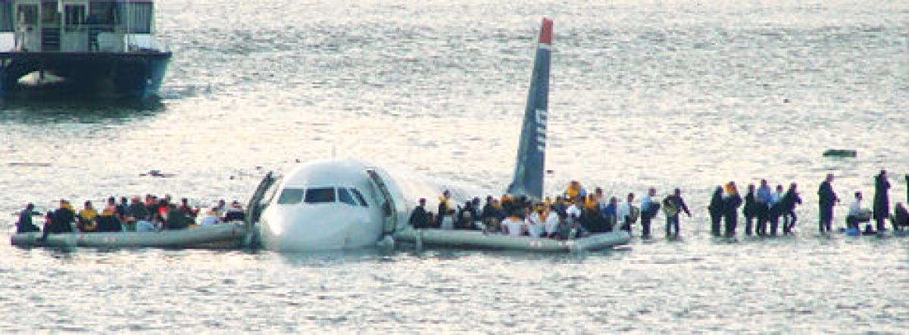
US Airways Flight 1549
Of the 150 passengers, 17% reported watching some of the preflight safety briefing.
13% reported watching some of the demonstration.
8% reported reading the safety card before or during the flight.
70% reported not watching the safety briefing.
90% reported not reading the safety card.

Slide 4
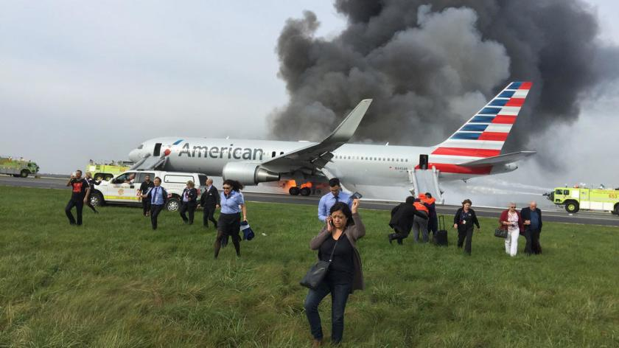
American Airlines Flight 383

Slide 5
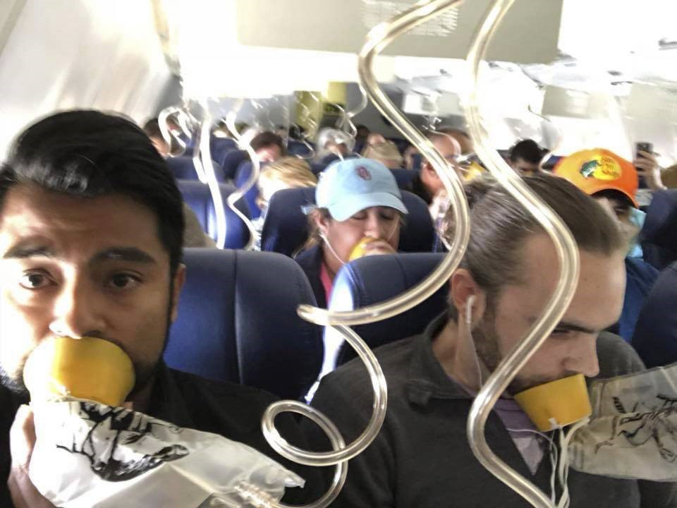
Southwest Flight 1380

Slide 6
FAA Reauthorization Act of 2018
These and similar incidents, and their related public outcry and reporting, led to the addition of several items to the FAA reauthorization act of 2018 calling for research into methods to mitigate or eliminate future occurrences of these events. Passenger information efforts were identified by the Cabin Safety Research Team (CSRT) as a possibly fruitful area of research for changing passenger behavior during accidents, in addition to parallel research efforts conducted by other teams on physical attributes and any changes that may assist in future mitigation.

Slide 7
Evaluation of Serious Games for Passenger Education
This study is running in conjunction with the study Effects of Airplane Seat Dimensions on Egress:
  Participants will begin the day going through the procedures and measurements of the initial study. The first 30 participants through measurement will be selected to participate in the Serious Games study.
  12 groups of 30 participants
  Participants will first be given passenger education pre-test
  Participants will then be given a cognitive test, the Automated Neurological Assessment Metrics (ANAM), to assess several cognitive functions including reaction time and memory search

Slide 8
Evaluation of Serious Games for Passenger Education
  ANAM, Simple Reaction Time
  This test measures simple reaction time by presenting the user with a series of "*" symbols on the display. The user is instructed to respond as quickly as possible by tapping in the response area (lower right on the screen) with their thumb each time the stimulus appears. This test is repeated at the end of the test battery.

Slide 9
Evaluation of Serious Games for Passenger Education
ANAM, Memory Search
The test assesses verbal short-term memory. A set of characters (the positive memory set) is displayed for memorization. Individual characters are then displayed and the user presses designated buttons to indicate if each character is or is not a member of the memorized set.

Slide 10
Evaluation of Serious Games for Passenger Education
Participants will then begin the study. They will be given a series of 3 briefing types with 3 different presentation styles.
Group # | Presentation Style
 | Brace Position | Life Vest | Oxygen Mask
Groups 1 & 2 | Briefing Card | Video Briefing | Serious Game
Groups 3 & 4 | Briefing Card | Serious Game | Video Briefing
Groups 5 & 6 | Video Briefing | Briefing Card | Serious Game
Groups 7 & 8 | Serious Game | Briefing Card | Video Briefing
Groups 9 & 10 | Video Briefing | Serious Game | Briefing Card
Groups 11&12 | Serious Game | Video Briefing | Briefing Card

Slide 11
Evaluation of Serious Games for Passenger Education
Participants will be given a passenger education post-test after each briefing/presentation.
After finishing the last post-test, participants will be transferred back over to the study, Effects on Airplane Seat Dimensions on Egress
Once completing the study, Effects of Airplane Seat Dimensions on Egress, participants will return for a final passenger education post-test

Slide 12
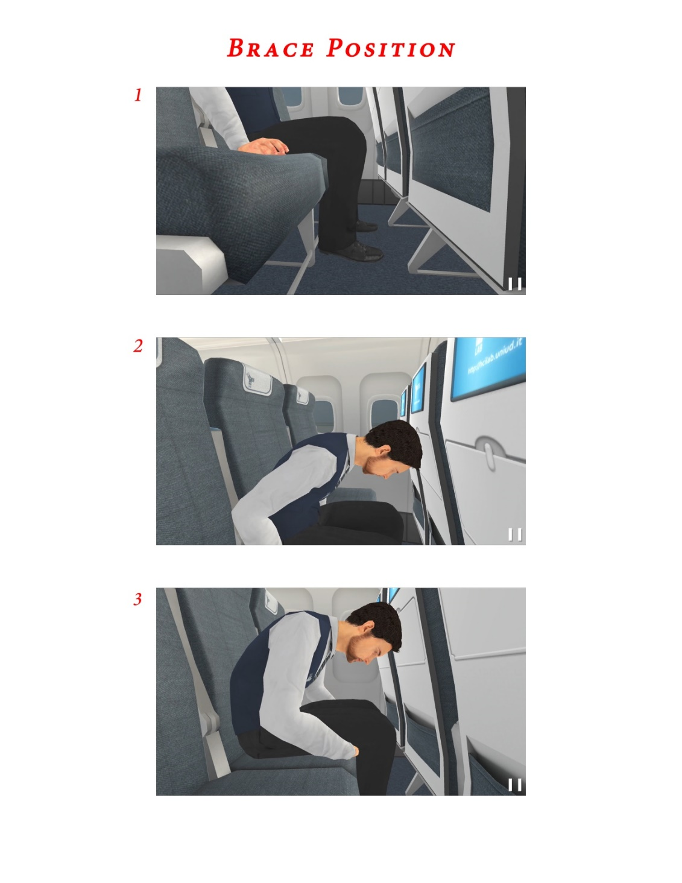
Briefing Card

Slide 13

Video Briefing

Slide 14

Serious Games

Slide 15
Questions
?

