Slide 1
Inflatable Emergency Equipment
Life Preserver
Retention
Melissa Beben, MS
Principal Investigator
Cabin Safety Research
FAA Civil Aerospace Medical Institute

Slide 2
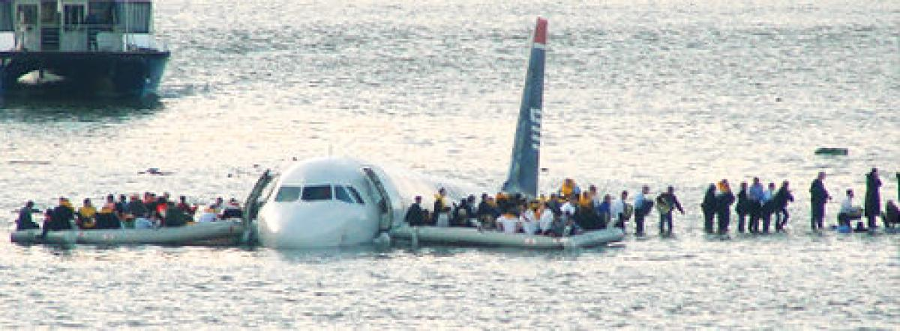
January 15, 2009
Flight 1549

Slide 3
NTSB Recommendation
Revise the life vest performance standards contained in Technical Standard Order-C13f to ensure that they result in a life vest that passengers can quickly and correctly don. (A-10-85).

Slide 4
Evaluation of Individual Inflatable Aviation Life Preserver Donning Tests
Corbett, CL, Weed, DB, Ruppel, DJ, Larcher, KG, & McLean, GA (2014). Inflatable Emergency Equipment I: Evaluation of Individual Inflatable Aviation Life Preserver Donning Tests (Report No. DOT/FAA/AM-14/14). Washington DC: U.S. Department of Transportation.
156 participants, 69 males and 87 females, aged from 23 to 75.
This study examined life preserver donning performance relative to different levels of instructional information presented to participants.
Notes:
A & BA “This airplane is also equipped with life preservers. B “Since our flight will take us over water, the airplane is equipped with life preservers with donning instructions printed on the life preserver. If an emergency occurs, open the life preserver package, remove and open the life preserver, then follow the pictorial instructions on the life preserver”. C “Since our flight will take us over water, the airplane is equipped with life preservers located under your seat. Instructions for using the life preserver are on the Passenger Safety Card located in the seatback pocket in front of you. Please take a moment to review the instructions. When you are finished, put the card back in the pocket.” The research facilitator paused the briefing until the test participant replaced the card in the seat pocket”. D Since our flight will take us over water, the airplane is equipped with life preservers located under your seat. To use the life preserver, pull off the tear tab to open the package, and then remove the life preserver from the package. Put the life preserver over your head. Bring the strap around your waist and insert the tab into the buckle. Pull the strap so it is tightly secured around your waist”.

Slide 5
Evaluation of Individual Inflatable Aviation Life Preserver Donning Tests
There were 5 levels of instruction
(A) No instructions in the briefing, no instructional markings on life preserver
(BA) No instructions in the briefing, Instructional markings on life preserver
(B) Markings referenced in briefing, markings on life preserver
(C) Instructions on briefing card, markings on life preserver
(D) Instructions and demonstration in briefing, markings on life preserver
Notes:
A & BA “This airplane is also equipped with life preservers. B “Since our flight will take us over water, the airplane is equipped with life preservers with donning instructions printed on the life preserver. If an emergency occurs, open the life preserver package, remove and open the life preserver, then follow the pictorial instructions on the life preserver”. C “Since our flight will take us over water, the airplane is equipped with life preservers located under your seat. Instructions for using the life preserver are on the Passenger Safety Card located in the seatback pocket in front of you. Please take a moment to review the instructions. When you are finished, put the card back in the pocket.” The research facilitator paused the briefing until the test participant replaced the card in the seat pocket”. D Since our flight will take us over water, the airplane is equipped with life preservers located under your seat. To use the life preserver, pull off the tear tab to open the package, and then remove the life preserver from the package. Put the life preserver over your head. Bring the strap around your waist and insert the tab into the buckle. Pull the strap so it is tightly secured around your waist”.

Slide 6
TSO Test Time (TSO-C13f)
Timing starts on signal when the test subject has both hands on the packaged life preserver and stops when the life preserver is properly donned, secured, and adjusted for fit. At least 75% total and 60% in each age group must don the life preserver within 25 seconds, unassisted, starting with the life preserver in its storage package.
Notes:
A & BA “This airplane is also equipped with life preservers. B “Since our flight will take us over water, the airplane is equipped with life preservers with donning instructions printed on the life preserver. If an emergency occurs, open the life preserver package, remove and open the life preserver, then follow the pictorial instructions on the life preserver”. C “Since our flight will take us over water, the airplane is equipped with life preservers located under your seat. Instructions for using the life preserver are on the Passenger Safety Card located in the seatback pocket in front of you. Please take a moment to review the instructions. When you are finished, put the card back in the pocket.” The research facilitator paused the briefing until the test participant replaced the card in the seat pocket”. D Since our flight will take us over water, the airplane is equipped with life preservers located under your seat. To use the life preserver, pull off the tear tab to open the package, and then remove the life preserver from the package. Put the life preserver over your head. Bring the strap around your waist and insert the tab into the buckle. Pull the strap so it is tightly secured around your waist”.

Slide 7
CAMI Report
Donning test - Requirement of 75% correct and complete dons within 25 seconds was not met.
Recommended - donning test should include only the donning activity, starting with the life preserver on the participant’s lap, outside of the package, but folded. Package opening should be tested separately from donning.

Slide 8
Evaluation of Individual Inflatable Aviation Life Preserver Retention Characteristics
Beben, MS, McLean, CL, Ashmore, JD, DeSelms, DE, Guinn, KJ, Ruppel, DJ, Taylor, AM, Weed, DB (2019). Inflatable Emergency Equipment II: Evaluation of Individual Life Preserver Retention Characteristics, In Publication, October 2019. Washington DC: U.S. Department of Transportation.
6 participants, 5 males and 1 female, aged from 30-64:
(1) small female (62 inches, average weight)
(1) 95th percentile male
Measurements taken included height, weight, girth, head circumference, and neck circumference.
Notes:
A & B “This airplane is also equipped with life preservers. C “Since our flight will take us over water, the airplane is equipped with life preservers with donning instructions printed on the life preserver. If an emergency occurs, open the life preserver package, remove and open the life preserver, then follow the pictorial instructions on the life preserver”. D “Since our flight will take us over water, the airplane is equipped with life preservers located under your seat. Instructions for using the life preserver are on the Passenger Safety Card located in the seatback pocket in front of you. Please take a moment to review the instructions. When you are finished, put the card back in the pocket.” The research facilitator paused the briefing until the test participant replaced the card in the seat pocket”. E Since our flight will take us over water, the airplane is equipped with life preservers located under your seat. To use the life preserver, pull off the tear tab to open the package, and then remove the life preserver from the package. Put the life preserver over your head. Bring the strap around your waist and insert the tab into the buckle. Pull the strap so it is tightly secured around your waist”.

Slide 9
Evaluation of Individual Inflatable Aviation Life Preserver Retention Characteristics
This study used 7 different life preserver models from 4 Original Equipment Manufacturers (OEMs):
(3) Single Inflatable Chamber
(4) Dual Inflatable Chamber
This study evaluated the TSO retention method and the retention characteristics of inflatable life preservers, as wearers jumped into water in different “attitudes” from a height of 5 feet above the water.
Notes:
A & B “This airplane is also equipped with life preservers. C “Since our flight will take us over water, the airplane is equipped with life preservers with donning instructions printed on the life preserver. If an emergency occurs, open the life preserver package, remove and open the life preserver, then follow the pictorial instructions on the life preserver”. D “Since our flight will take us over water, the airplane is equipped with life preservers located under your seat. Instructions for using the life preserver are on the Passenger Safety Card located in the seatback pocket in front of you. Please take a moment to review the instructions. When you are finished, put the card back in the pocket.” The research facilitator paused the briefing until the test participant replaced the card in the seat pocket”. E Since our flight will take us over water, the airplane is equipped with life preservers located under your seat. To use the life preserver, pull off the tear tab to open the package, and then remove the life preserver from the package. Put the life preserver over your head. Bring the strap around your waist and insert the tab into the buckle. Pull the strap so it is tightly secured around your waist”.

Slide 10
Evaluation of Individual Inflatable Aviation Life Preserver Retention Characteristics
Retention characteristics:
Chamber type (single vs dual)
Waist strap adjustment (loose vs tight)
Arm position ( extended over the head or straight down beside the body)
There were eight total combinations (attitudes) of life preserver chamber type, waist strap adjustment, and arm position.

Slide 11
Experimental Design - Attitudes
Life Preserver Chamber Type | Arm Position/Waist Strap Adjustment
 | Up |  | Down
Single Inflatable Chamber | Loose strap | Tight strap | Loose strap | Tight strap
Dual Inflatable Chamber | Loose strap | Tight strap | Loose strap | Tight strap

Slide 12
TSO jump test (TSO-C13f)
An inflated adult, adult-child, or child Type I or Type II life preserver, excluding infant-small child life preservers, must remain attached and not cause injury to the wearer when the wearer jumps into the water at any attitude from a height above the water of at least 5 feet. There must not be any damage to the preserver following the jump. Minor skin chafing is not considered an injury in this respect.

Slide 13
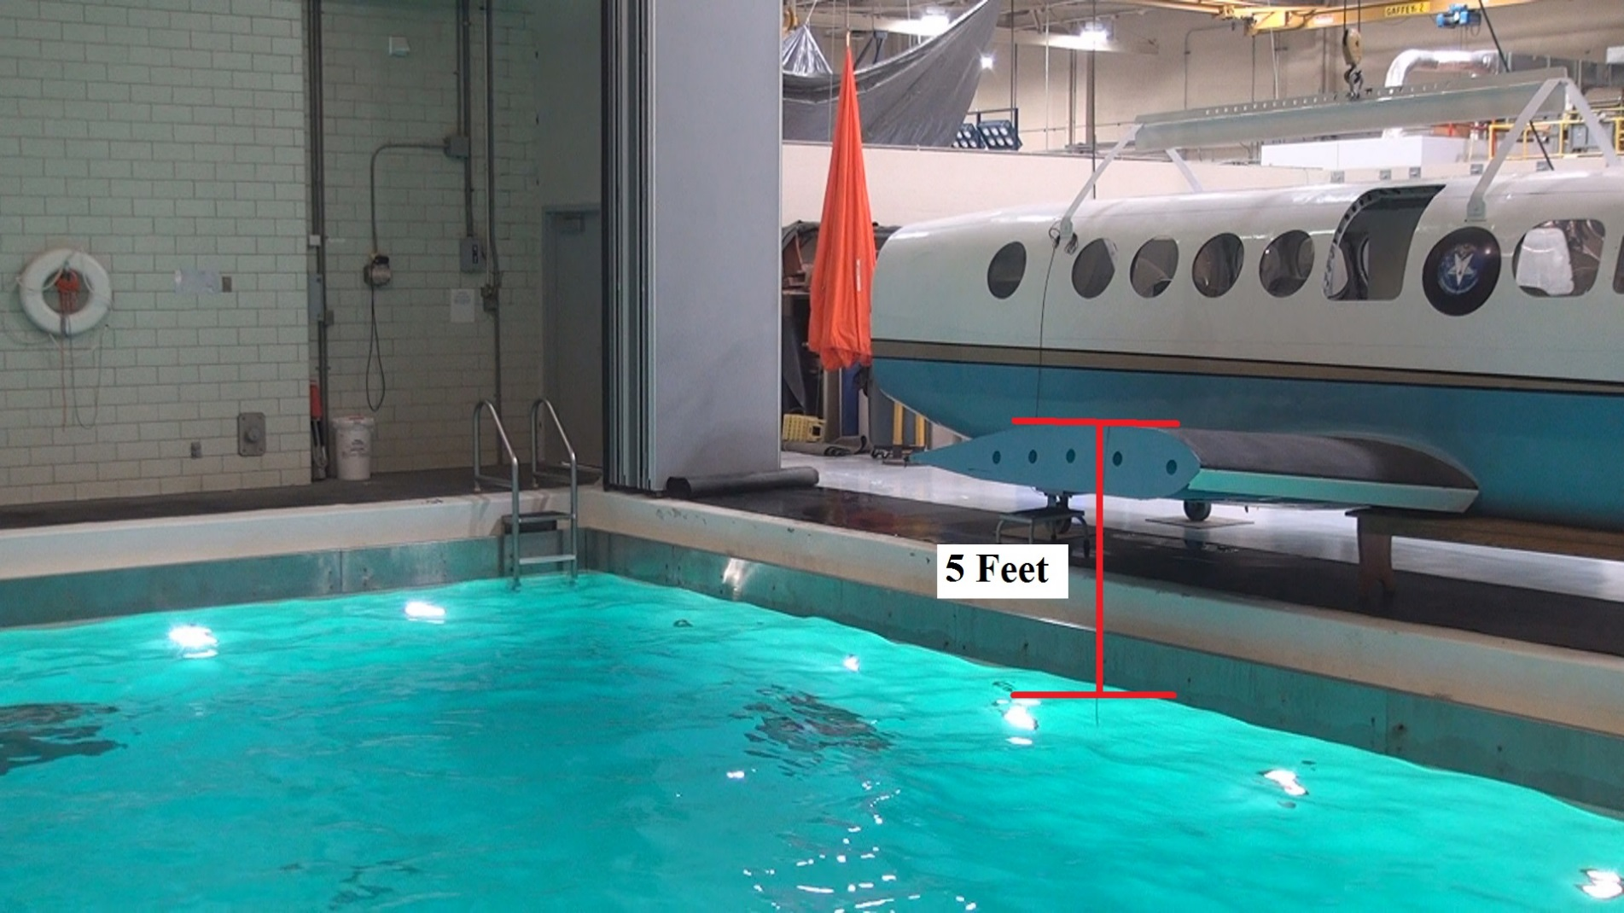
Research Facility

Slide 14
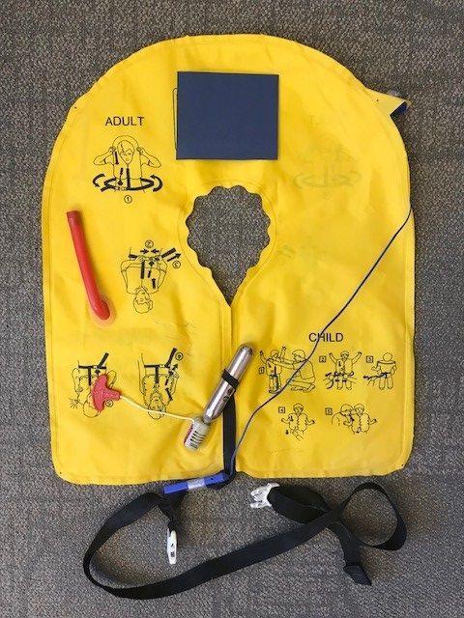
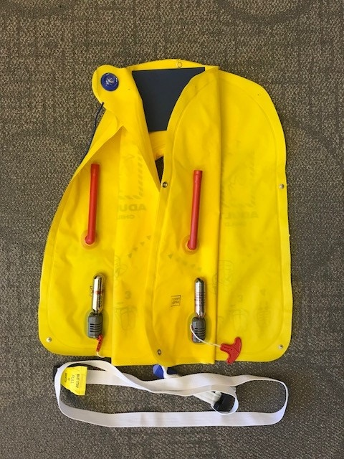
Retention Characteristics Chamber Type (Single vs Dual)

Slide 15
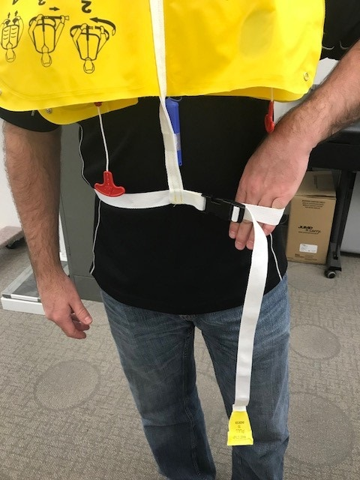
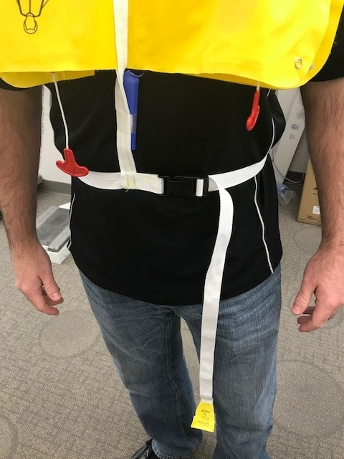
Retention Characteristics Waist Strap Adjustment (Loose vs Tight)

Slide 16
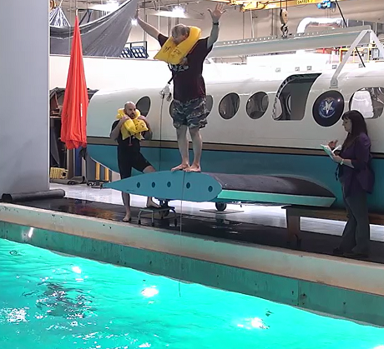
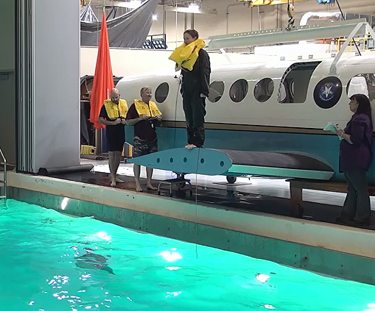
Retention Characteristics Arm Position (Up vs Down)

Slide 17
Scoring
Scoring of the jump was more stringent than TSO jump tests. A more detailed interpretation of the life preserver remaining attached included that the life preserver remain secured around the wearer’s neck. Each jump received a score of a “pass” or “fail”. A “pass” signified that the preserver remained inflated, secured around the neck, and did not cause injury to a wearer. A “fail” signified that the preserver deflated, popped off the neck, or caused injury.

Slide 18
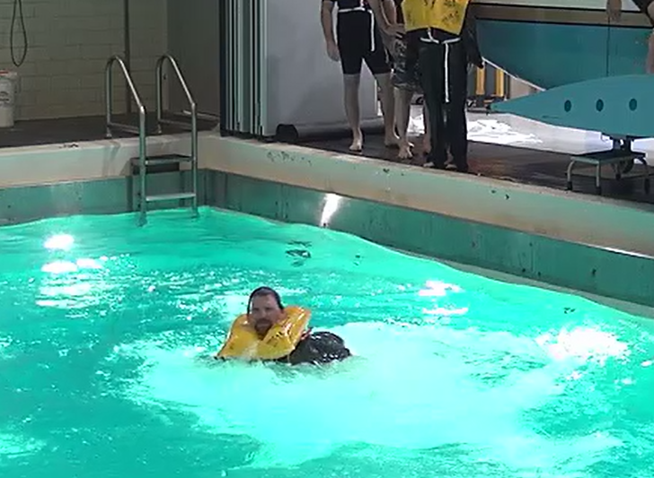
Scoring - Pass

Slide 19
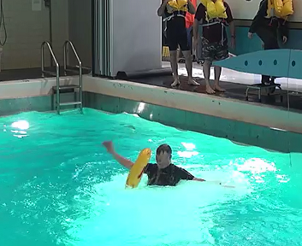
Scoring - Fail

Slide 20
Results by Characteristic
Chamber Type
Chamber Type | # jumps | Pass | Pass % | Fail | Fail %
Single | 46 | 13 | 28.3% | 33 | 71.7%
Dual | 76 | 53 | 69.7% | 23 | 30.3%

Slide 21
Results by Characteristic
Waist Strap
Waist Strap | # jumps | Pass | Pass % | Fail | Fail %
Loose | 61 | 27 | 44.3% | 34 | 55.7%
Tight | 61 | 39 | 63.9% | 22 | 36.1%

Slide 22
Results by Characteristic
Arm Position
Arm Position | # jumps | Pass | Pass % | Fail | Fail %
Up | 63 | 35 | 55.6% | 28 | 44.4%
Down | 59 | 31 | 52.5% | 28 | 47.5%

Slide 23
Results by Attitude
 |  | Arm Position |  |  |  | Totals
 |  | Up |  | Down
Waist Strap Adjustment |  | Loose strap | Tight strap | Loose strap | Tight strap
Single Inflatable Chamber | Total | 12 | 13 | 11 | 10 | 46
 | Pass | 2 | 6 | 0 | 5 | 13
 | Pass % | 16.7% | 46.2% | 0% | 50% | 28.3%
 | Fail | 10 | 7 | 11 | 5 | 33
 | Fail % | 83.3% | 53.8% | 100% | 50% | 71.7%

Slide 24
Results by Attitude
 |  | Arm Position |  |  |  | Totals
 |  | Up |  | Down
Waist Strap Adjustment |  | Loose strap | Tight strap | Loose strap | Tight strap
Dual Inflatable Chamber | Total | 19 | 19 | 19 | 19 | 76
 | Pass | 13 | 14 | 12 | 14 | 53
 | Pass % | 68.4% | 73.7% | 63.2% | 73.7% | 69.7%
 | Fail | 6 | 5 | 7 | 5 | 23
 | Fail % | 31.6% | 26.3% | 36.8% | 26.3% | 30.3%

Slide 25
Results by Attitude
 |  | Arm Position |  |  |  | Totals
 |  | Up |  | Down
Waist Strap Adjustment |  | Loose strap | Tight strap | Loose strap | Tight strap
Both | Total | 31 | 32 | 30 | 29 | 122
 | Pass | 15 | 20 | 12 | 19 | 66
 | Pass % | 48.4% | 62.5% | 40% | 65.5% | 54.1%
 | Fail | 16 | 12 | 18 | 10 | 56
 | Fail % | 51.6% | 37.5% | 60% | 34.5% | 45.9%

Slide 26
TSO failures
The more stringent test procedures in this study resulted in many failures. However, in following the procedures outlined in the TSO, there were only seven failures. All other life preservers remained physically tethered to the participants via the waist strap, although the final location of the waist strap on the participant varied by participant size and waist strap tightness. All but seven preservers passed the jump test set forth by TSO-C13f. They remained inflated, secured (by the waist strap in many instances) and did not cause injury to the wearer.

Slide 27
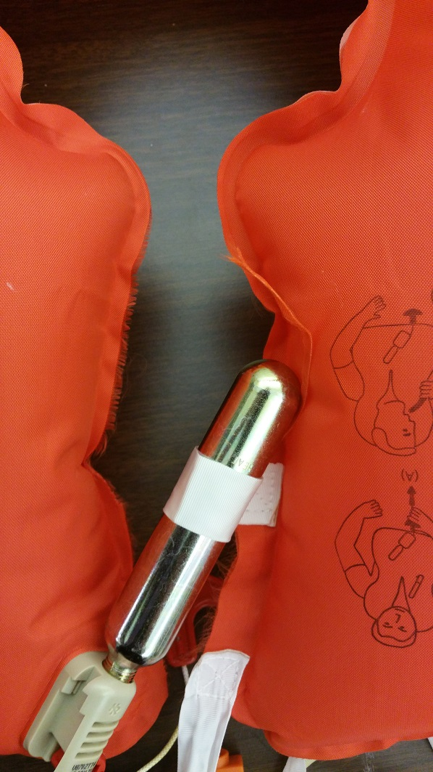
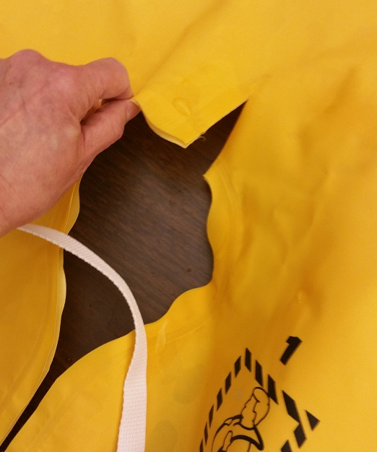

Slide 28
CAMI Report
Life preserver inflation chamber type (single vs dual) was the main determinant of life preserver retention in the more stringent testing procedures.
Waist strap adjustment (loose vs tight) produced a significant difference.
Arm position did not yield a significant difference.

Slide 29
TSO-C13g (2/3/17)
New models of life preservers identified and manufactured on or after the effective date of this TSO must meet the requirements in SAE International Aerospace Standard (AS) 1354, Individual Inflatable Life Preserver, dated February 2016, as modified by Appendix 1.
The donning test shall start on signal with the packaged life preserver held on the test subject’s lap, or for a constant wear life preserver, the test shall start in the partially donned configuration. Timing stops when the life preserver is properly donned, secured, and adjusted for fit (the means of adjustment shall be adjusted for a snug fit on the test subject). Donning tests shall be video captured; separate timing shall be recorded for each individual subject.

Slide 30
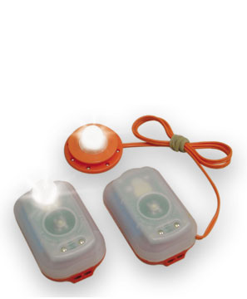
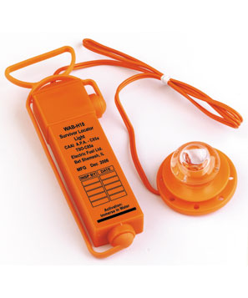
Future Research
Evaluation of Individual Inflatable Aviation Life Preserver Survivor Locator Lights

Slide 31
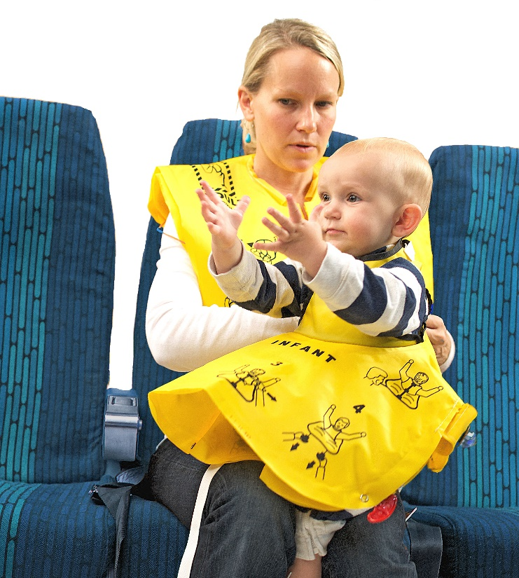
Future Research
Evaluation of Infant Life Preservers

