Slide 1
Status of SAE G-27 Lithium Battery packaging performance Committee
Presented to Ninth Triennial International Aircraft Fire and Cabin Safety Research Conference
October 28-31, 2019
Atlantic City, New Jersey, USA
Doug Ferguson, Co-Chair G-27 Committee
Claude Chanson, Co-Chair G-27 Committee
Nicole Mattern, SAE Specialist G27 Committee

Slide 2
SAE G27 Committee
Why is committee formed and why a packaging standard?
The Council of the International Civil Aviation Organization (ICAO) established a prohibition on the transport of lithium batteries as cargo on passenger aircraft as a temporary measure until controls were put into place which establish an acceptable level of safety. A performance-based packaging standard was identified as one of the controls.
ICAO’s intent to have a performance based packaging standard declared in late 2015; SAE International chosen to lead this effort as SAE standard.
“Performance based package standard for lithium batteries as cargo on aircraft” (AS6413)
This SAE Aerospace Standard (AS) specifies a minimum performance package standard that supports the safe shipment of lithium batteries as cargo on aircraft.

Slide 3
AS 6413 Development
Standards Development Process
G27 committee currently has ~ 280 individuals
Initial outline of a performance standard was drafted by ~ 20 individuals from different stakeholder communities
Balloting process involves all stakeholders with opportunity to comment on proposed standard:
Ballot disapprovals must be resolved between the commentor and document author.
Comments from non-voting members must be reviewed and considered.
Voting Member list (~50) is currently being reviewed and updated to account for change in activity level of original members.

Slide 4
AS 6413 Development
Standards Development Process
Since February, 2016:
One telephone/Webex conference call of full G27 committee per month
9 face to face meetings of G-27 committee in US and Europe.
Next face to face meeting in Barcelona, Spain, Nov 4-7
Anticipate finalizing wording for baseline test method
Anticipate identifying improvements for non-baseline methods
Requirement for some type of validation testing of standard in multiple facilities has been raised and is in planning.

Slide 5
AS 6413 Development
Standards Development Process
Three (3) face to face meetings scheduled for 2020
Anticipate having a standard that can be put forward as a ballot proposal before end of 2020.

Slide 6
AS 6413 Draft Content
This standard provides a test method to demonstrate and document the control of the potential hazards from Lithium metal batteries (UN 3090) and Lithium ion batteries (UN 3480) when transported as cargo on aircraft.
It addresses the need to control the hazards which might arise from a failure of an individual cell by containing the hazards within the package.
Controlling the consequences of a failure within the package is intended to prevent uncontrolled fire and pressure pulses that may compromise current fire suppression systems within the cargo compartment.
The intent of this test is to severely abuse a single cell such that it is most likely to enter thermal runaway with the presumption that a single cell may enter thermal runaway during transport.

Slide 7
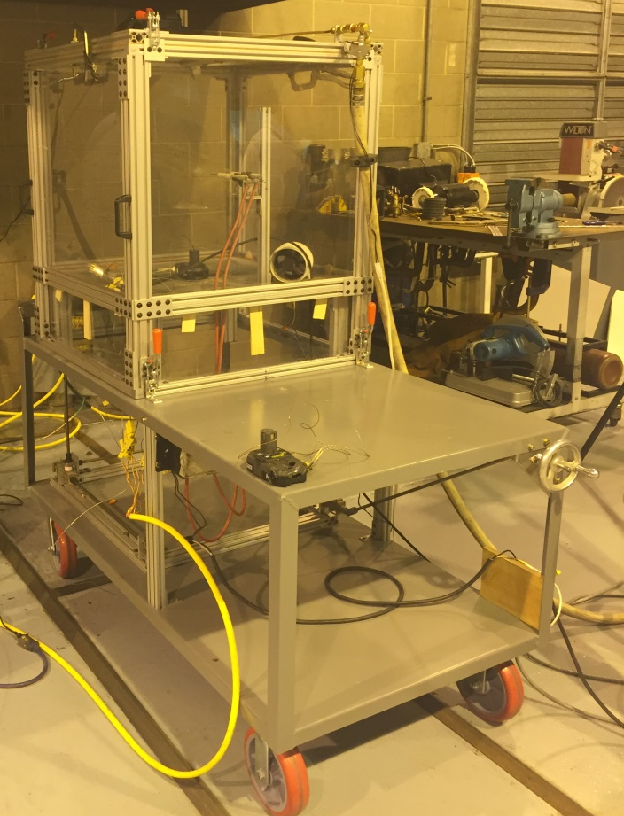
AS 6413 Draft Content
Baseline Test Method
The package will be placed in a transparent box with a [0.3] m³ free volume that will contain gases generated from Thermal Runaway (TR). The box will have a rapid overpressure opening that will be sealed with a rupture foil. A spark ignition source will be energized continuously within the box volume, capable of igniting vapors reaching a flammable concentration within the box.
Rationale for volume size is explained within draft standard

Slide 8
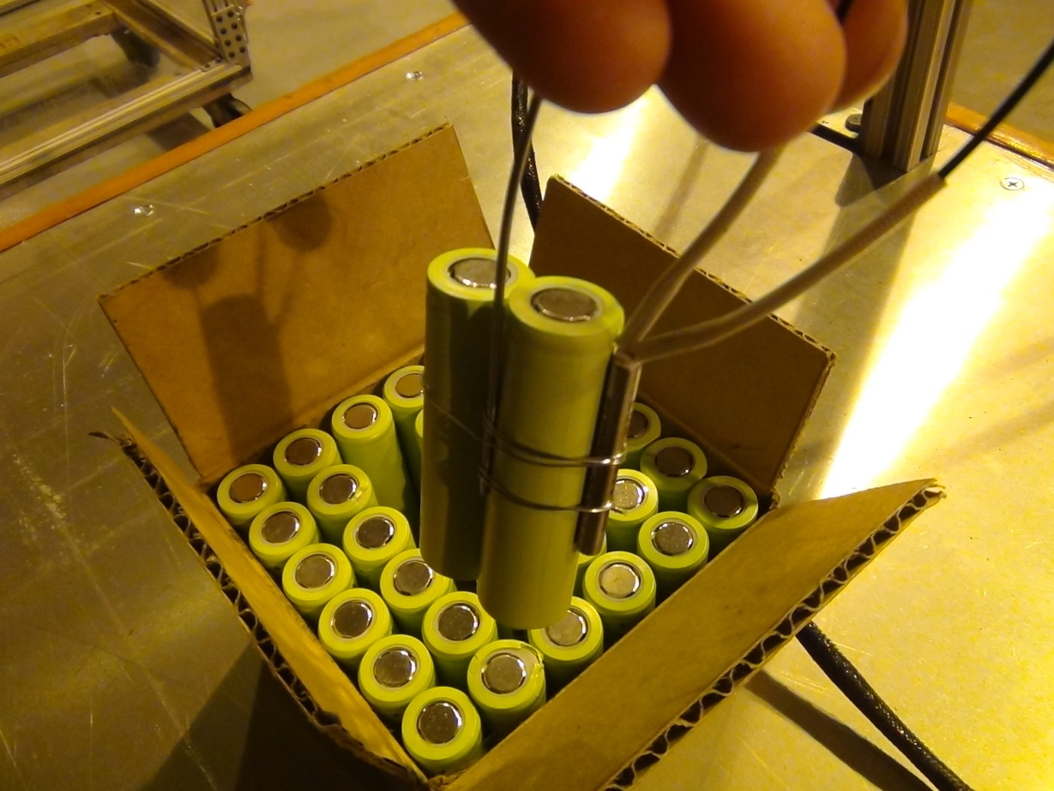
AS 6413 Draft Content
For testing individual cells, Use a heat source (e.g. tape, cartridge) to create a temperature rise at 5 to 20 °C (9 to 36 °F) per minute as measured at an external point on the cell that is most representative of the cells internal temperature.
If reducing SOC for shipment is part of package preparation to meet the performance requirements, a margin of safety is to be applied. Cells to be tested at the SOC of cells or batteries when tested in the package shall be at an SOC of 110% of maximum SOC allowed as presented for transport up to a max of 100%.

Slide 9
AS 6413 Draft Content
If there is clear external evidence of cell thermal runaway, power to the heat source will be stopped.
If clear evidence of cell thermal runaway has not occurred, monitor the cell temperature as measured at an external point on the cell that is most representative of the cells internal temperature and hold at 200°C (392°F) for 1 hour then remove power to the heat source.
The unit under test will be monitored for 5 hours after removal of power to the heat source.
For testing batteries, the goal is to use the same methodology applied to a single cell within the battery, but there may be more than one single method for triggering TR, depending on the battery type and construction.

Slide 10
AS 6413 Draft Content
Verification of “non-hazardous flame” and a “non hazardous particle” achieved visually or with witness panels
Visually: no flame or fragments
Witness panel: cheese cloth placed less than 25 mm away from package does not ignite
Surface of package shall not be sufficient to ignite adjacent materials.
Temperature of thermocouple placed on package surface adjacent to the initiation cell shall not increase by more than 150 C for more than 3 minutes during the remaining 5 hours after the heater for the initiation cell is turned off.
Average increase in temperature of each thermocouple on each face of package shall not be greater than 100C during the remaining 5 hours after the heater for the initiation cell is turned off.
Non-hazardous quantity of flammable vapor released outside package
No ignition of vapor collected within test chamber

Slide 11
AS 6413 Draft Content
Baseline Test Method - Video

Slide 12
AS 6413 Draft Content
Information requirements for traceability
A similar approach has been proposed as in the UN model regulation: the description of a Summary Report Sheet, readily available for the transport stakeholders, and a detailed Test Report content (possibly containing restricted access information).
Summary Report Sheet with a subset of the necessary data for documenting and validating the successful conduct and completion of the test:
List of identification and traceability information (Name of the test laboratory and contact information for the testing Laboratory, the package qualification owner, the part number and description of the cells/batteries and the the packaging, the tests results summary, the State of Charge tested, etc..)
Test Report with the detailed laboratory information for traceability ( data recording, video recording, test set up and result detailed description, etc…)

Slide 13
AS6413 range of test methods being developed
Test description | Comments
Test (I) Cells and or batteries in specific packaging | Mostly complete
Test (II) Oversize battery in packaging | Impact of pipe connecting battery/package to test chamber is still being discussed.
Test (III) Subsystem of oversized battery in packaging | More discussion needed to clarify possible consensus
Test (IV) Sub-Packaging | Mostly complete
Test (V) Benign Cell@SOC | Mostly complete
Test (VI) Benign Battery@SOC | Mostly complete
Test (VII) Generic Packaging | More discussion needed to gain consensus on some issues.
Test (VIII) Reduced Cell Configuration | General consensus on issues, details being discussed and incorporated.

Slide 14
G27 Open Issues: “external fire”
“External fire considerations” meeting in September 2017 in Louisville, Kentucky:
Recognition that the “internal protection” packaging is reducing the hazard, but not eliminating it completely in case of external fire.
Possible protections and tests described.
A separate Working Group for External Fire Considerations has been established with monthly Webex/telecon and provides updates at each face to face meeting
Proposal to identify that AS6413 does not address potential hazards outside the package with some information regarding mitigation methods for addressing concerns of external cargo fire.
Potential Path to address concerns for external fire considerations:
“Slash sheets” to AS6413 with the slash sheet external fire consideration testing called out independently from internal thermal runaway testing.
Slash sheet methods are applied to a package but could also be applied to a container, an overpack or some other mitigation item.

Slide 15
QUESTIONS?
Doug Ferguson
Boeing Associate Technical Fellow
SAE G-27 Co-Chair
o +1 562.593.2950
douglas.e.ferguson@boeing.com
Nicole Mattern
Aerospace Standards Specialist
SAE International
o +1.724.772.4039
Nicole.Mattern@sae.org
Claude Chanson
General Manager - RECHARGE
SAE G-27 Co-Chair
o +32 (2)777-0567
cchanson@rechargebatteries.org

