Slide 1
New Hazard-Based Classification System for Shipping Lithium Batteries as Dangerous Goods: Background and Update
Ninth Triennial International Aircraft Fire and Cabin Safety Research Conference
October 28 – 31, 2019
Atlantic City, New Jersey
George A. Kerchner
Wiley Rein LLP
PRBA – The Rechargeable Battery Association
1776 K Street, NW
Washington, DC 20006
gkerchner@wileyrein.com

Slide 2
PRBA – The Rechargeable Battery Association
Established in 1991
Members include:
  Primary and secondary cell/battery manufacturers
  Manufacturers of electronic equipment, medical devices, power tools, automobiles
  Retailers, testing labs, and battery recyclers
  Airlines, dangerous goods consultants, packaging manufacturers
Focus now on regulatory, legislative, and policy issues at state, national and international level:
  Safety, recycling, transportation, fire code
International transportation forums:
  UN Sub-Committee of Experts
  ICAO Dangerous Goods Panel
  IMO Sub-Committee on Carriage of Cargoes and Containers

Slide 3
UN Working Group for Lithium Battery Classification Project
Purpose of UN classification project?
  Address new lithium battery technologies entering market
  Example: UN Sub-Committee in 2005 – 2006 considered RECHARGE and PRBA proposals for regulating rechargeable lithium metal polymer batteries
  Provide greater “granularity” to classify different lithium battery chemistries based on varying hazards

Slide 4
UN Lithium Battery Working Group
Participants in working group include –
  Korean, Chinese, Japanese, U.S., and European lithium cell, battery, equipment, and automobile manufacturers
  Dangerous goods transport authorities
  Test labs
  Aircraft manufacturers
  Airlines
  Packaging manufacturers

Slide 5
Schedule of Meetings
November 6 – 8, 2017 Paris, France
December 6 – 8, 2017 Geneva, Switzerland
December 5 and 6, 2018 Geneva, Switzerland
October 7 – 9, 2019 Arlington, Texas
May 2020 Europe (tentative)
Fall 2020 China (tentative)

Slide 6
Baseline Testing on Lithium ion Cells
Baseline testing just completed on lithium ion cells by seven labs located in U.S. (3), Poland (1), China (1), France (1), and Germany (1)
Lithium ion cells tested at 100% SOC
  2.45 Ah – 18650
  4.80 Ah – Pouch
  Cells from same manufacturers and same lots
6

Slide 7
Baseline Test Setup
Six pouch and 18650 cells, 100% SoC
Parallel configuration (not electrically connected)
1 thermocouple on each cell
Voltage measurement on each cell
Insulation on all sides of 18650s
Rigid plates to hold configuration together, prevent expansion (in pouch cells), and release of cells

Slide 8
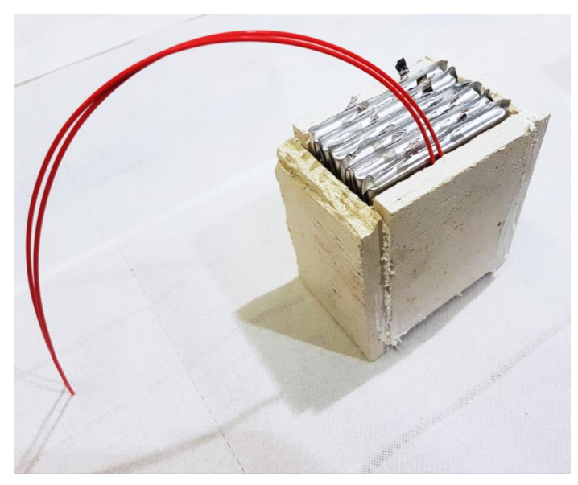
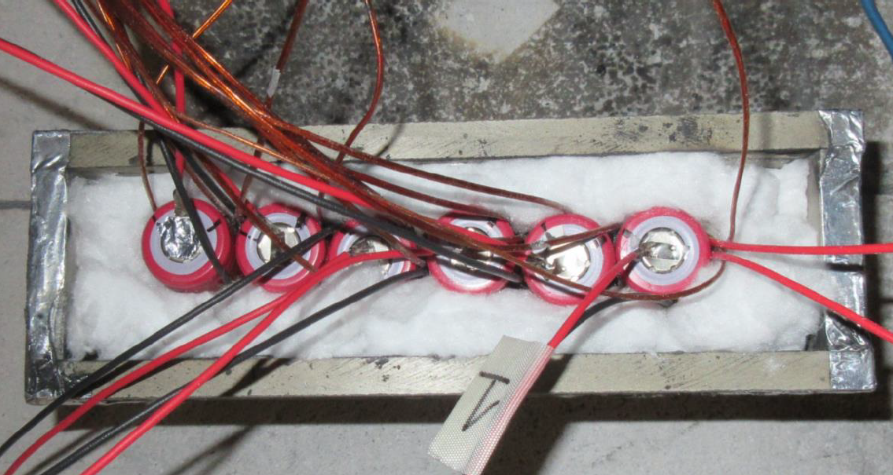
Typical Test Setup for Cells

Slide 9
Test Procedure
With cells touching each other, heat 1st cell at 20C/min
Turn heater off when first cell goes into thermal runaway
Repeat test three times

Slide 10
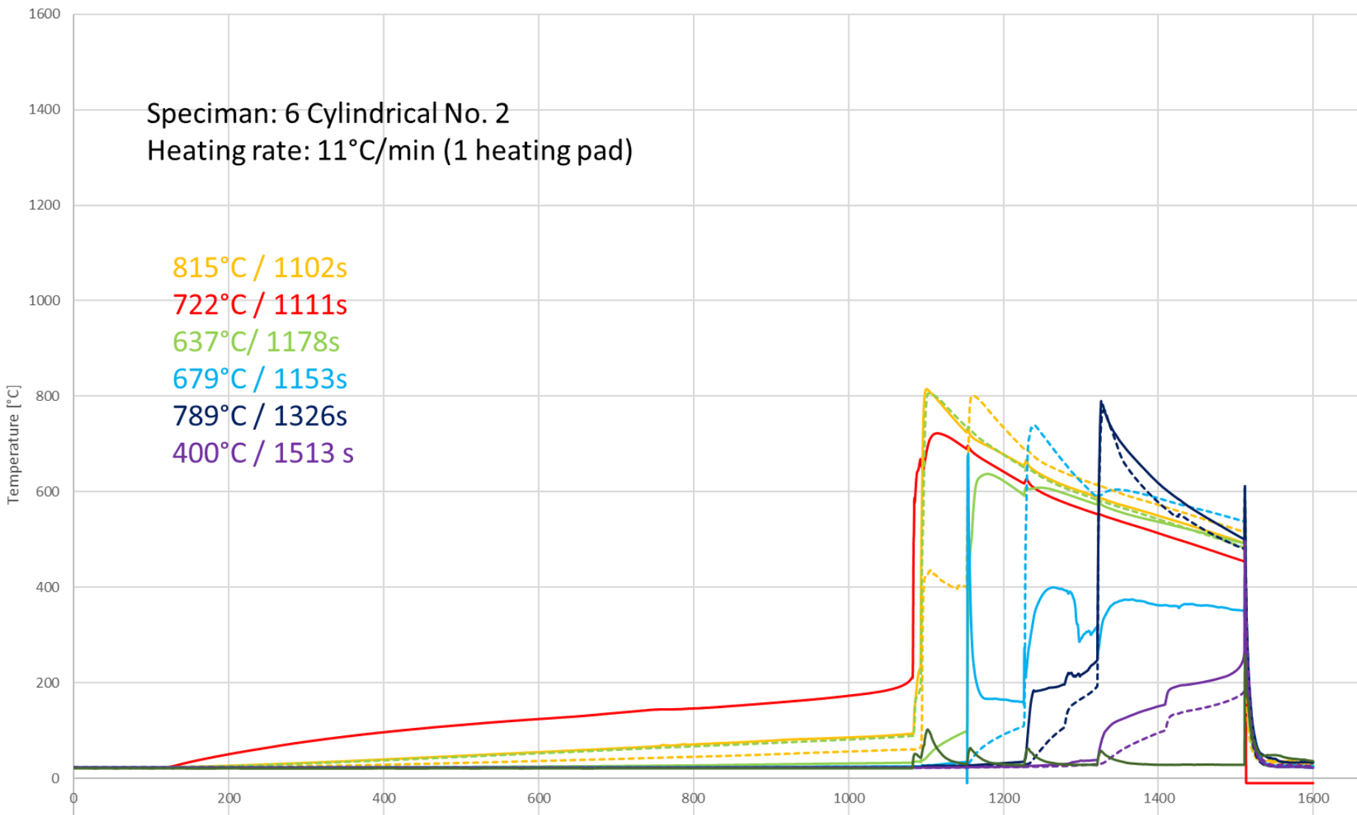
Typical 18650 Test Results

Slide 11
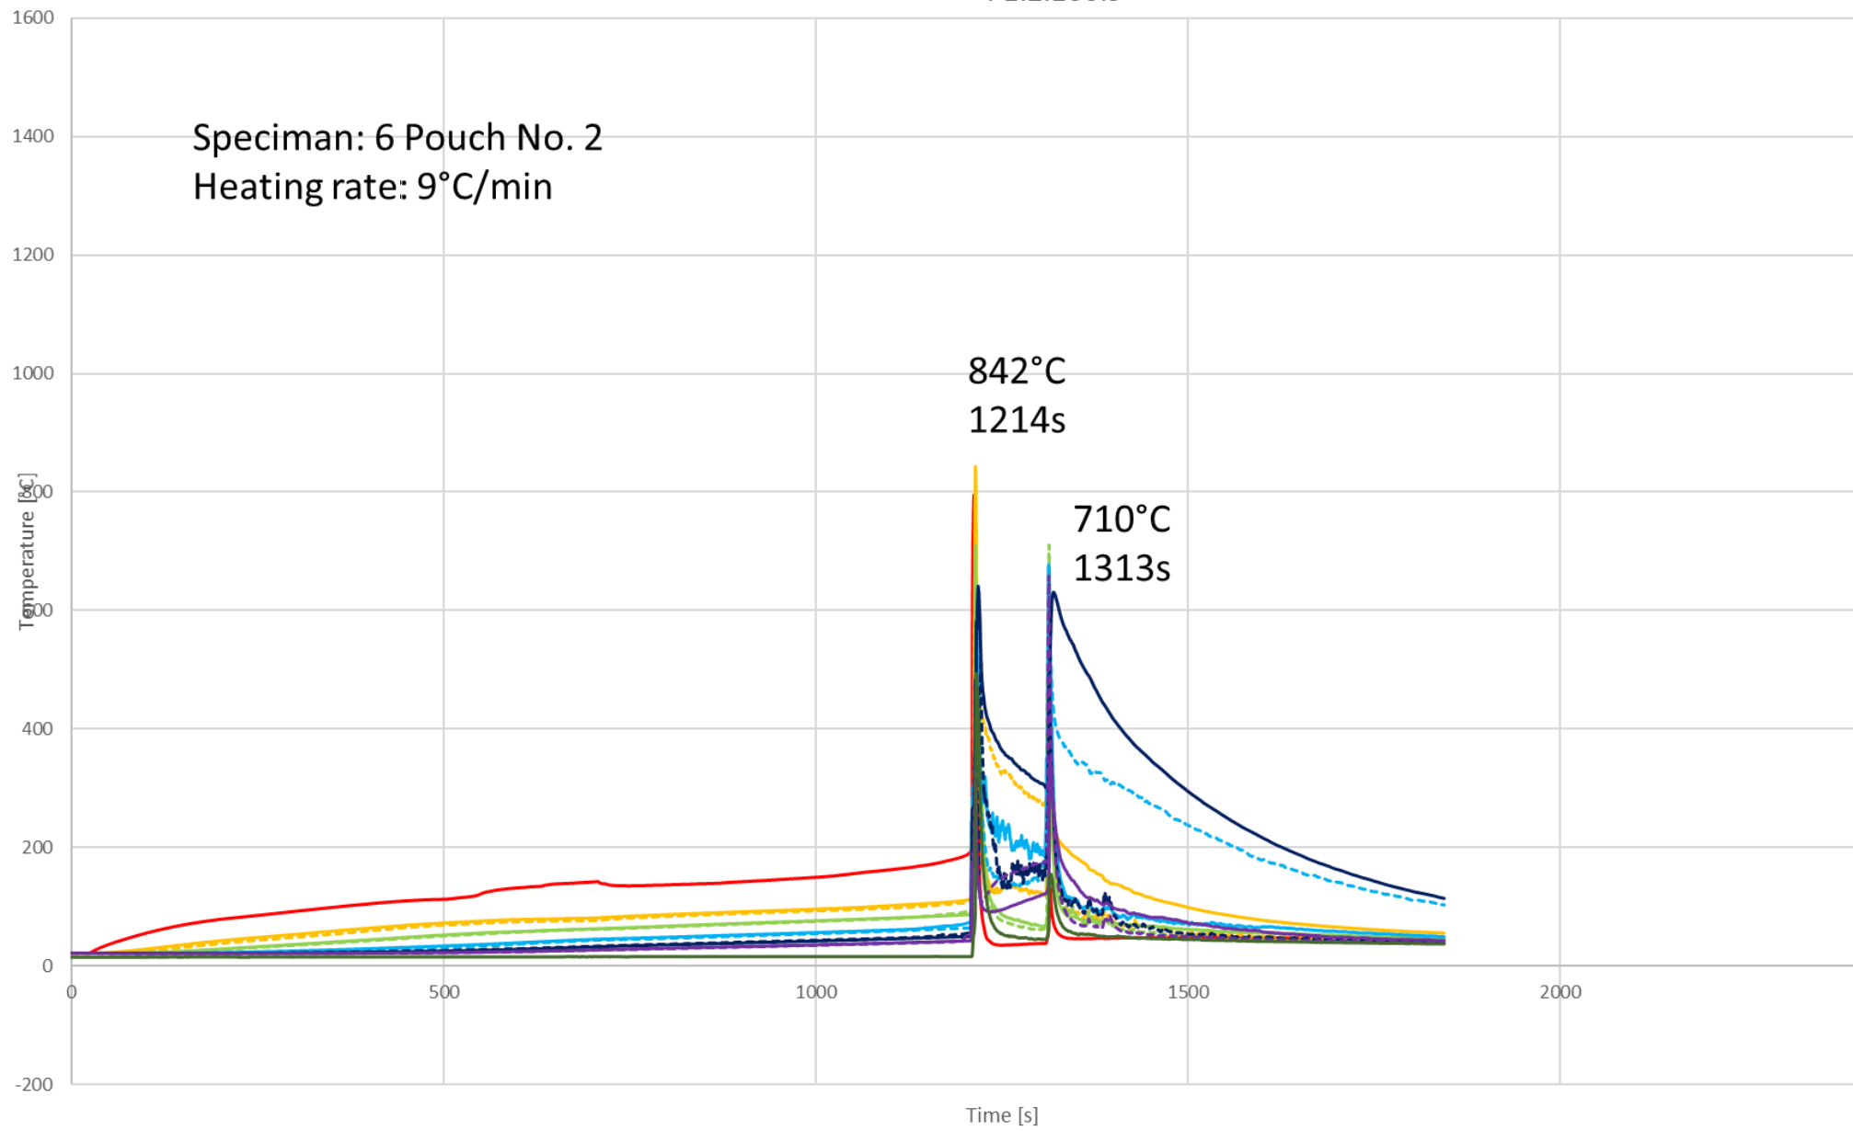
Typical Pouch Test Results

Slide 12
Results of Baseline Tests on Lithium ion Cells
As expected, at 100% SOC resulted in significant propagation and energy release
Test results between labs were relatively consistent
Variability in test results indicates protocols
(e.g., setup, procedures) will need to be refined
Test data, meeting minutes available on RECHARGE website (https://www.rechargebatteries.org/)

Slide 13
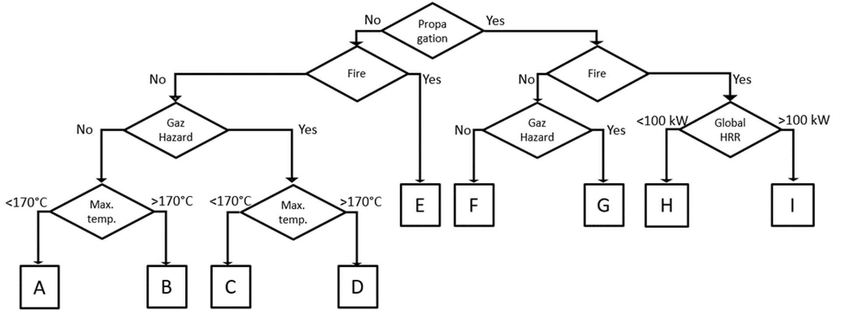
Hypothetical Dangerous Goods Classification System for Lithium Batteries – Version 1

Slide 14
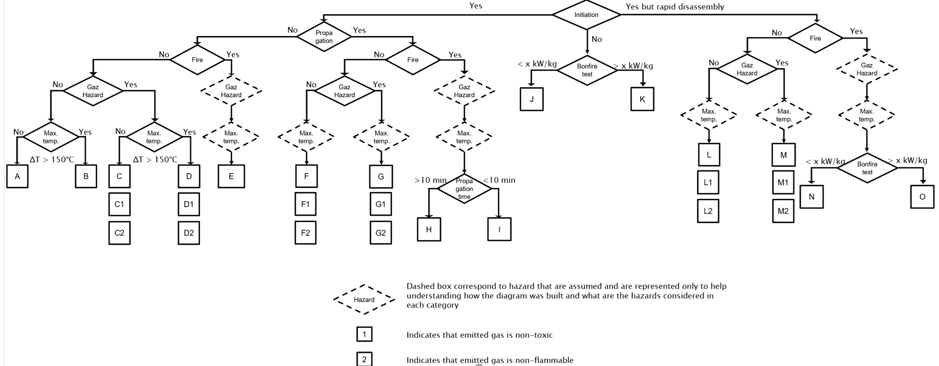
Hypothetical Dangerous Goods Classification System for Lithium Batteries – Version 2

Slide 15
Current “UN 38.3” Lithium Cell and Battery Tests: UN Manual of Tests and Criteria
Test 1: Altitude Simulation
Test 2: Thermal
Test 3: Vibration
Test 4: Shock
Test 5: External Short Circuit
Test 6: Impact
Test 7: Overcharge
Test 8: Forced Discharge

Slide 16
Next Steps, Timeline
Labs reconvene to refine new test procedures
Revise testing concept/flowchart
Test same lithium ion cells at lower state of charge
Likely four to six years to complete project
Extensive consultation within UN Sub-Committee of Experts and ICAO Dangerous Goods Panel

