Slide 1
Updated Experimental Investigation of the NexGen Burner
8th Triennial International Fire & Cabin Safety Research Conference
October 24th~27th, 2016
Fire Test Center
University of Cincinnati, Cincinnati, OH, USA
October 25, 2016
Samir Tambe, Ryan Hasselbeck, and San-Mou Jeng

Slide 2
Project Overview
Project Objective:
  To adapt the NexGen burner for power plant tests and conduct research on its performance
Previously Presented Work (7th Triennial Conference)
  Effect of Burner setup and calibration TC size
  Sensitivity of Burner to air and fuel flow rates and temperatures
  Effect of burner orientation on performance
  Comparison of fire test results between NexGen and Gas burners
Recent Developments
  Study of Flame Retention Heads (FRH) and Delavan fuel nozzles
  Burner sensitivity to operating conditions
  Burner sensitivity to assembly tolerances
  Sensitivity to inclination and test set-up
  Study of ignitorless stator configuration, comparison with FRH configuration

Slide 3
Outline
  Study of Flame Retention Heads (FRH) and Delavan fuel nozzles
  Burner sensitivity to operating conditions
  Burner sensitivity to assembly tolerances
  Sensitivity to inclination and test set-up
  Study of ignitorless stator configuration, comparison with FRH configuration

Slide 4
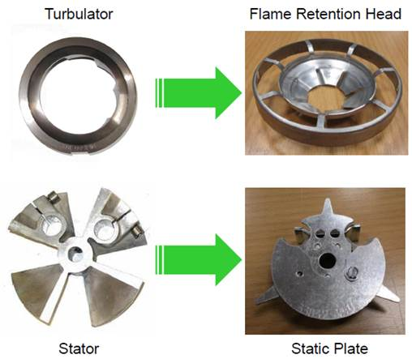
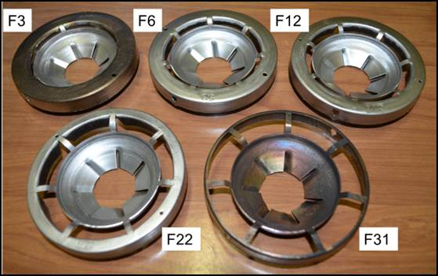
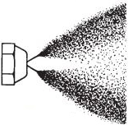
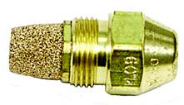
Overview – FRH and Fuel nozzle
Objective:
  To test the FRH and the Delavan fuel nozzles
Background:
  Around 2013, the powerplant burner was updated to use the FRH/static plate in place of the turbulator/stator, and with Delavan fuel nozzles
Approach:
  Fuel nozzle spray characterization
  Flame visualization and temperature map
  Variety of FRHs tested
  Delavan 2.0, 2.25, and 2.50 GPH nozzles tested

Slide 5
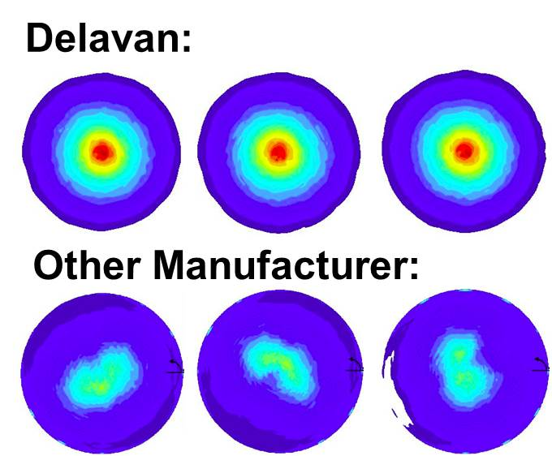
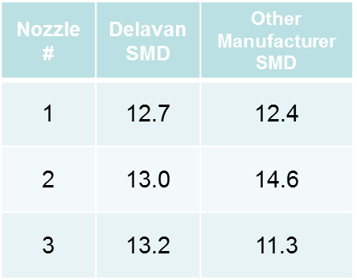
Fuel Nozzle Characterization
Delavan nozzles provide more uniform and consistent spray characteristics than other manufacturers in all methods tested.

Slide 6
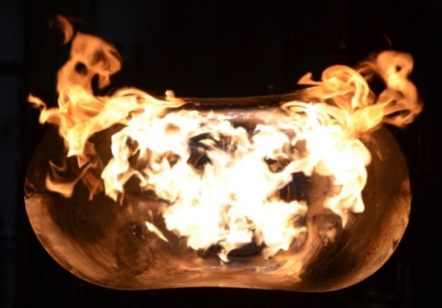
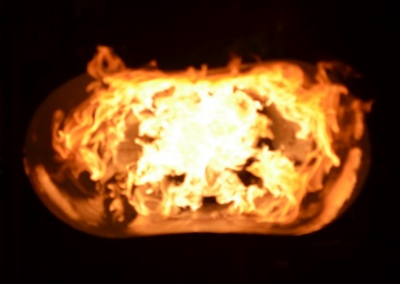
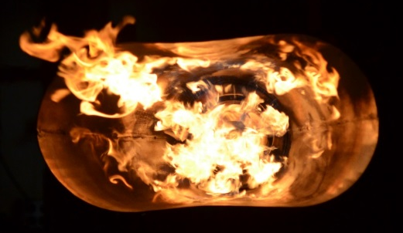
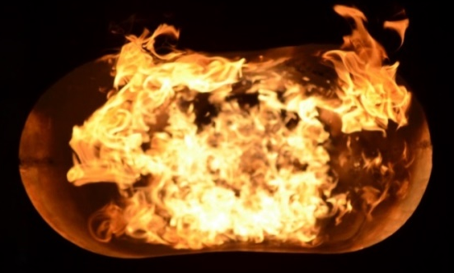

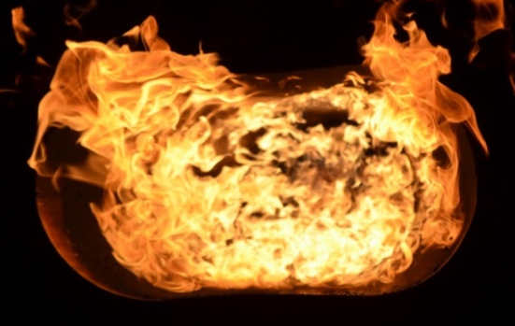

FRH and Fuel Nozzle: Flame Shapes
FRH-> | F12 | F22 | F31
2.0 GPH
2.25 GPH
2.5 GPH
For the larger FRHs, the flame distribution is more uniform

Slide 7
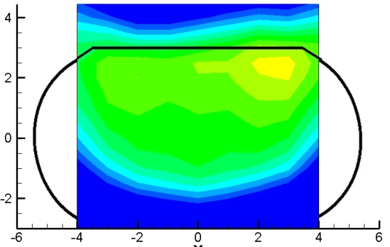
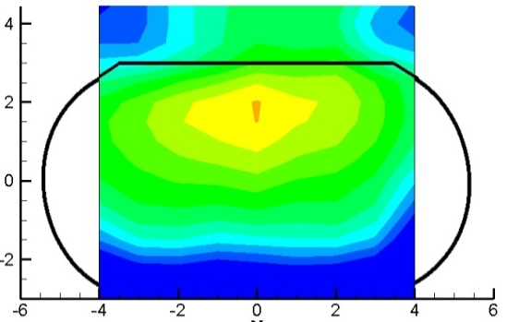
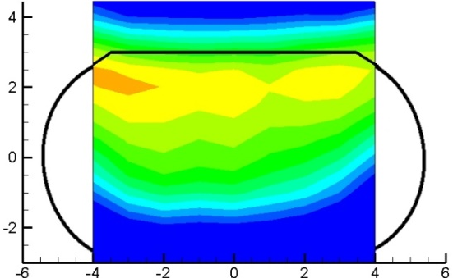
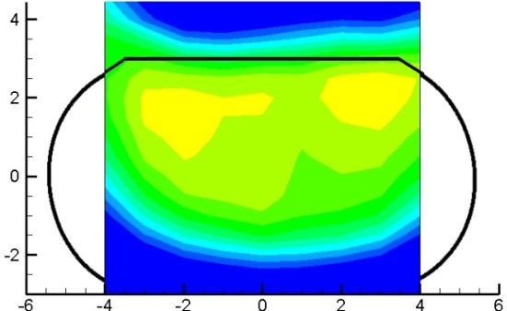
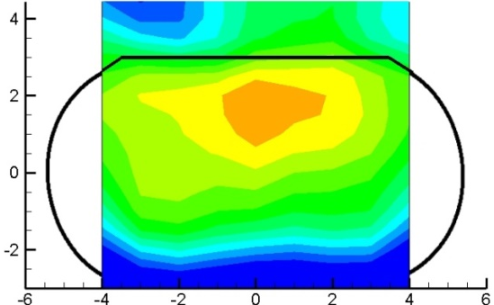
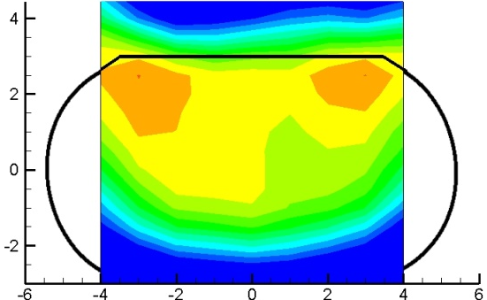
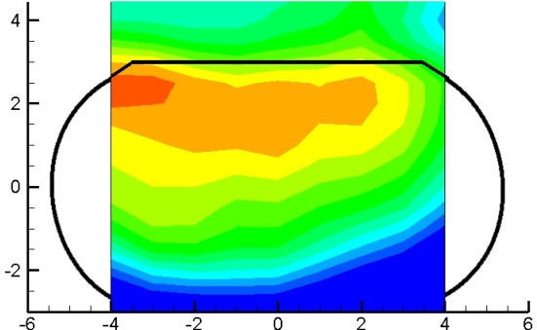

FRH and Fuel Nozzle: Temperature Maps
 | F12 | F22 | F31
2.0 GPH
2.25 GPH
2.5 GPH
F22 has a flatter temperature distribution near the center while F31 has a peaked distribution

Slide 8
Outline
  Study of Flame Retention Heads (FRH) and Delavan fuel nozzles
  Burner sensitivity to operating conditions
  Burner sensitivity to assembly tolerances
  Sensitivity to inclination and test set-up
  Study of ignitorless stator configuration, comparison with FRH configuration

Slide 9
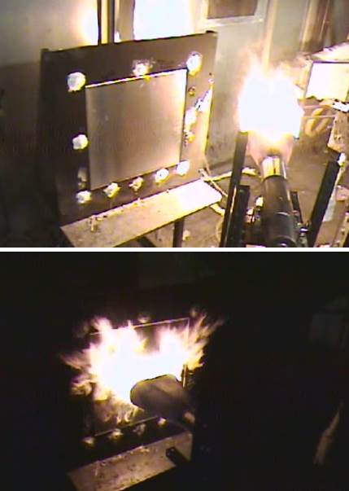
Overview – Operating Conditions
Objective:
  To determine the sensitivity of the NexGen burner to changes in operating conditions (flow rates, temperatures)
Background:
  Test conditions defined by FAA for
  powerplant tests:
  Air: 50 psig, 50º ± 10º F
  Fuel: 100 ± 5 psig (2.5 GPH), 42 ±10º F
Approach:
  Burnthrough tests using 1/8” Al panels
  Vary Fuel Flow Rate ±10%
  Vary Air Mass Flow Rate ±10%
  Vary Fuel Temperature (30º - 90º F)
  Vary Air Temperature (40º - 100º F)

Slide 10
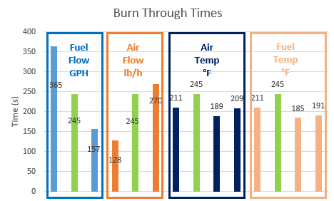
Operating Conditions - Burnthrough
Burnthrough times decrease significantly as fuel flow rate increases and air mass flow rate decreases
No significant effect of air or fuel temperatures
Recommendation: Tight tolerance on fuel pressure and air mass flow
  ±5% of baseline flow rates/pressures

Slide 11
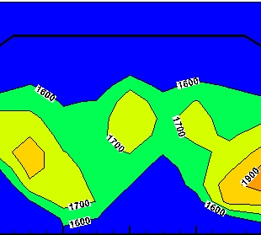
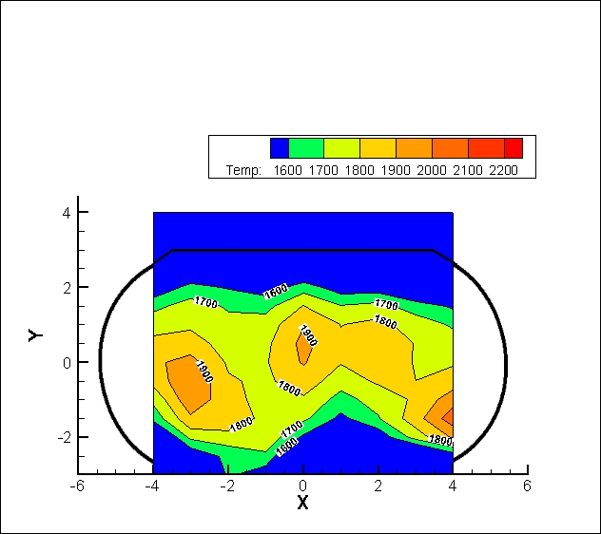
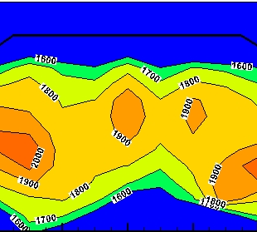

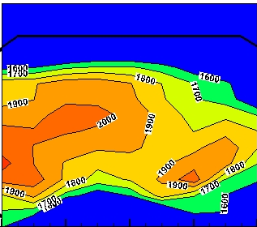
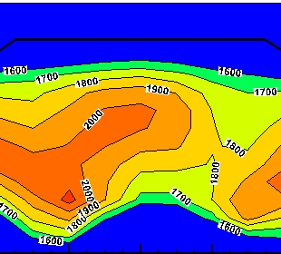
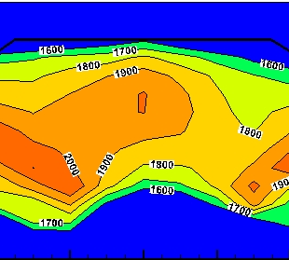
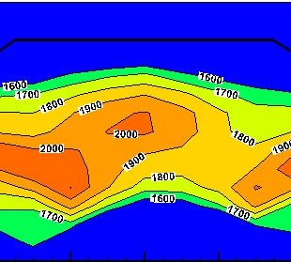
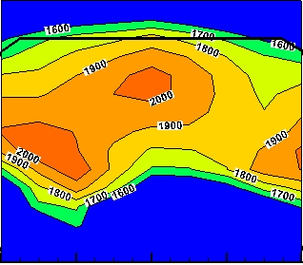
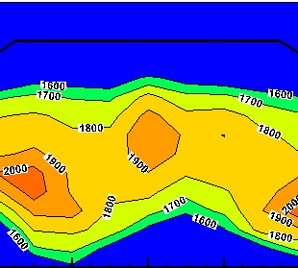

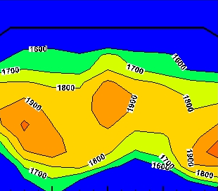
Operating Conditions - Temperature Maps
80 psig
(2.15 GPH)
105 psig
(2.46 GPH)
123 psig
(2.66 GPH)
FUEL
FLOW
43 psig
(239 PPH)
50 psig
(265 PPH)
57 psig
(293 PPH)
AIR
FLOW
30 F
42 F
40 F
50 F
FUEL
TEMP
AIR
TEMP
70 F
90 F
80 F
100 F

Slide 12
Outline
  Study of Flame Retention Heads (FRH) and Delavan fuel nozzles
  Burner sensitivity to operating conditions
  Burner sensitivity to assembly tolerances
  Sensitivity to inclination and test set-up
  Study of ignitorless stator configuration, comparison with FRH configuration

Slide 13
Overview – Assembly Tolerance
Objective:
  To determine the sensitivity of the NexGen burner to changes in burner assembly or due to damage to burner parts
Background:
  The NexGen burner “calibration” will depend on input parameters, including:
    Specified burner design and assembly
    Prescribed air and fuel settings
  Need to investigate impact of errors in burner construction or of damage to burner parts
Approach:
  Vary fuel nozzle and cone positions
  Vary cone material and design
  Test impact of deformed Flame Retention Head (FRH)

Slide 14
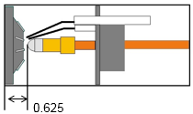
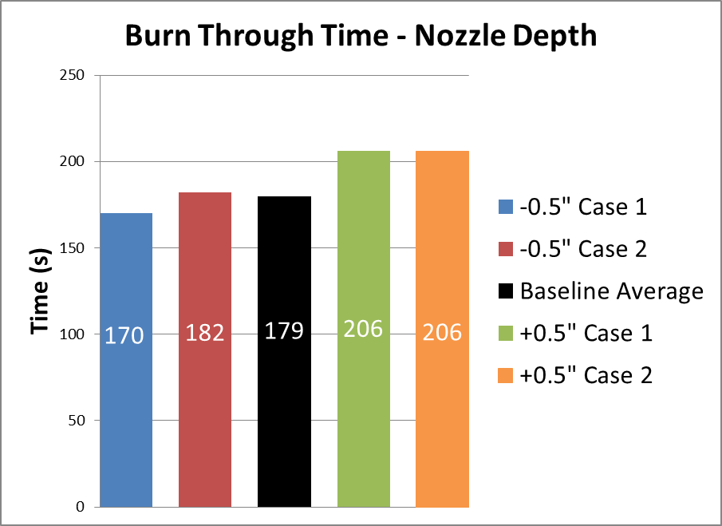
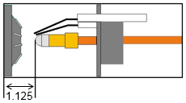
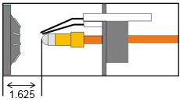
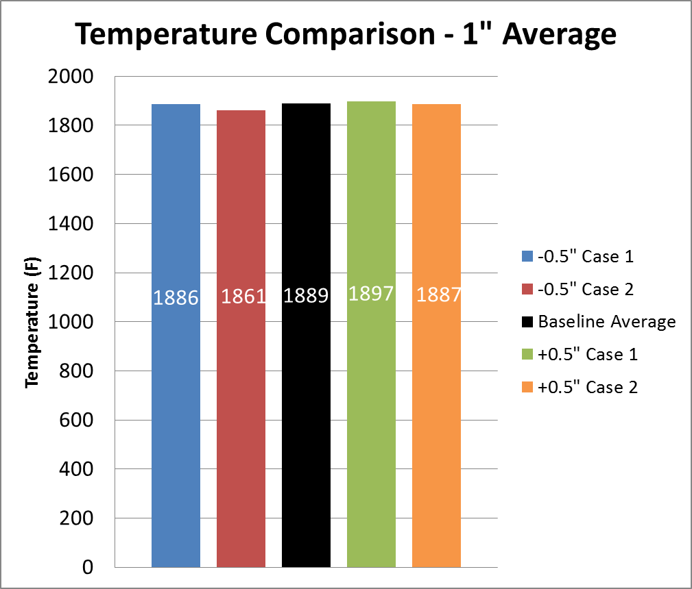
Assembly tolerance – Nozzle Depth
-0.5”
Baseline
+0.5”
Nozzle insertion depth tolerance of ±0.25” acceptable

Slide 15

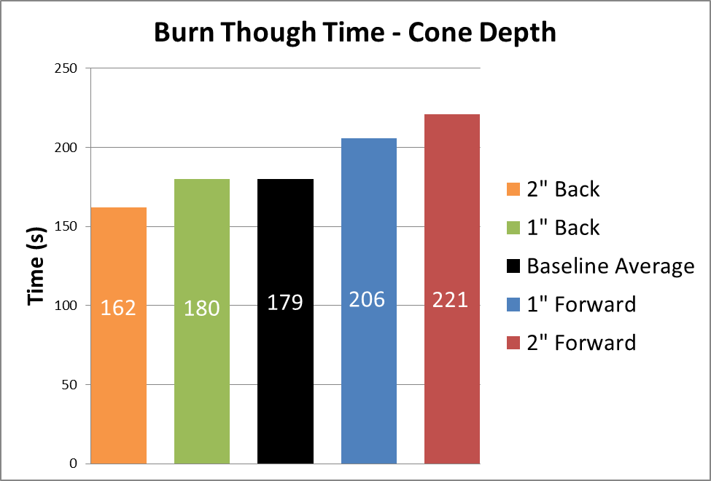


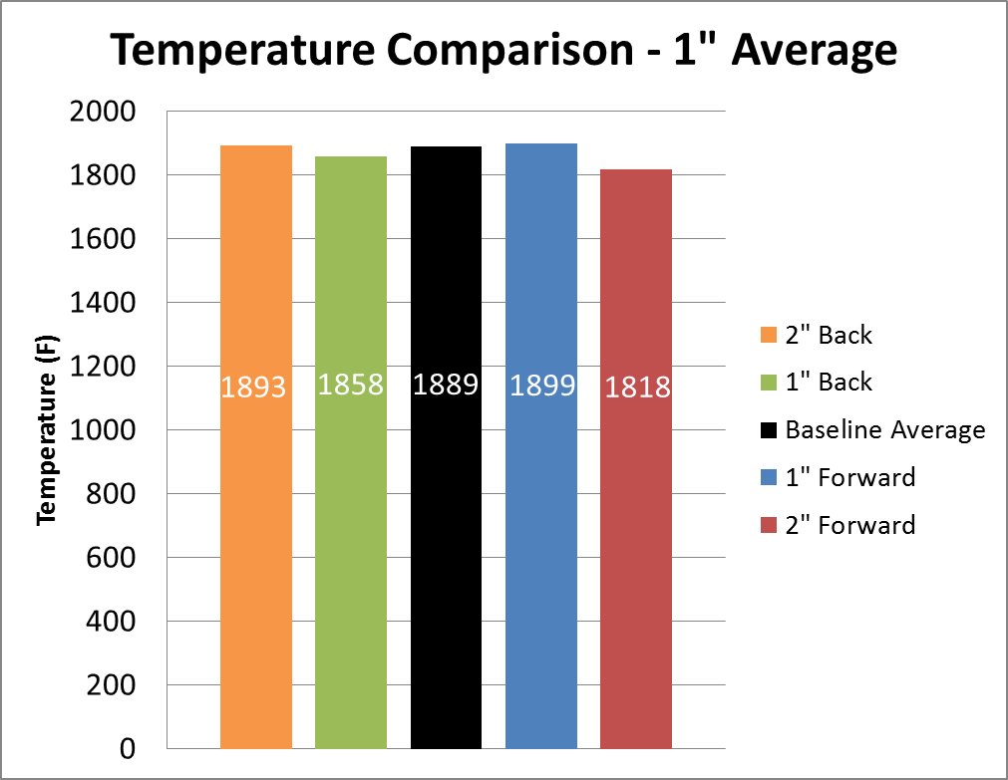
Assembly Tolerance – Cone Depth
Cone position tolerance of ±1” acceptable

Slide 16
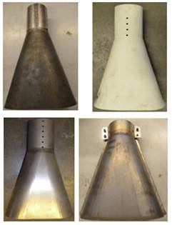
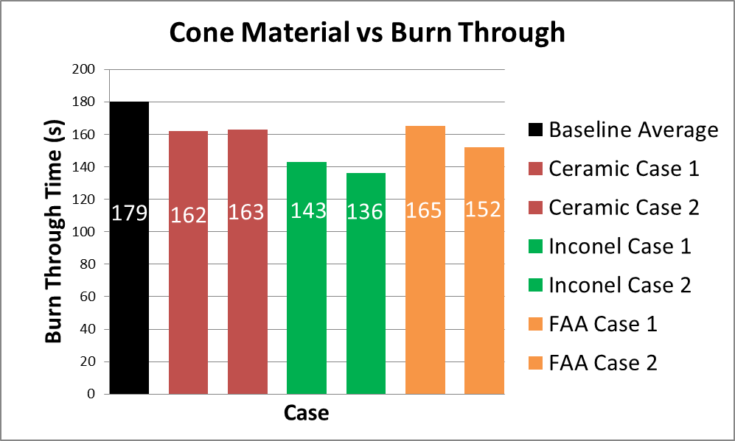
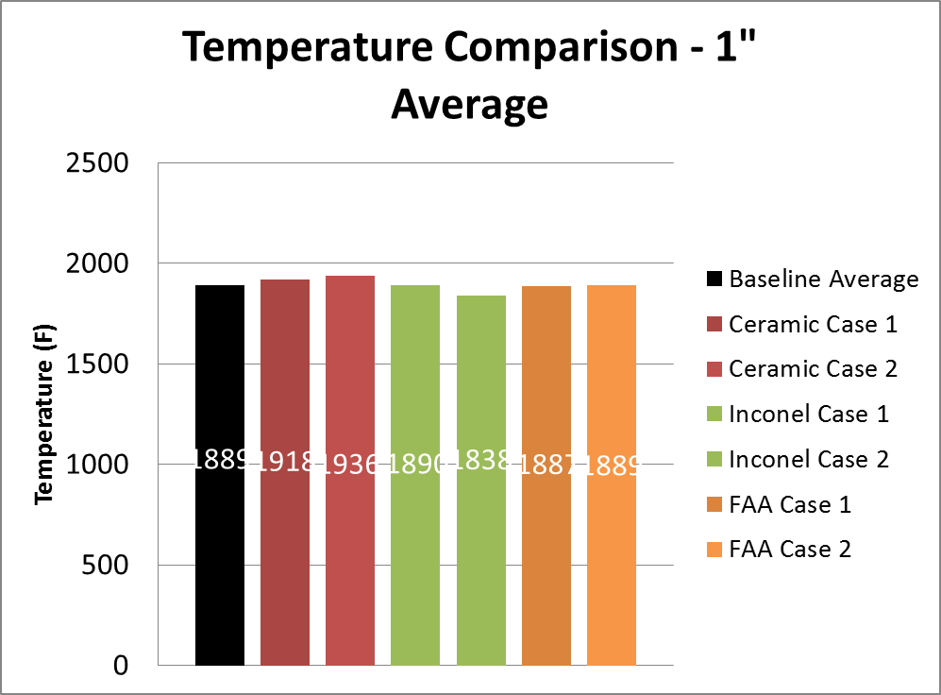
Assembly Tolerance – Cone Type
Baseline
Ceramic
Inconel
FAA
Standardization of cone material and construction is needed
Notes:
Combined

Slide 17
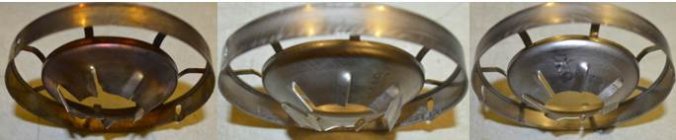
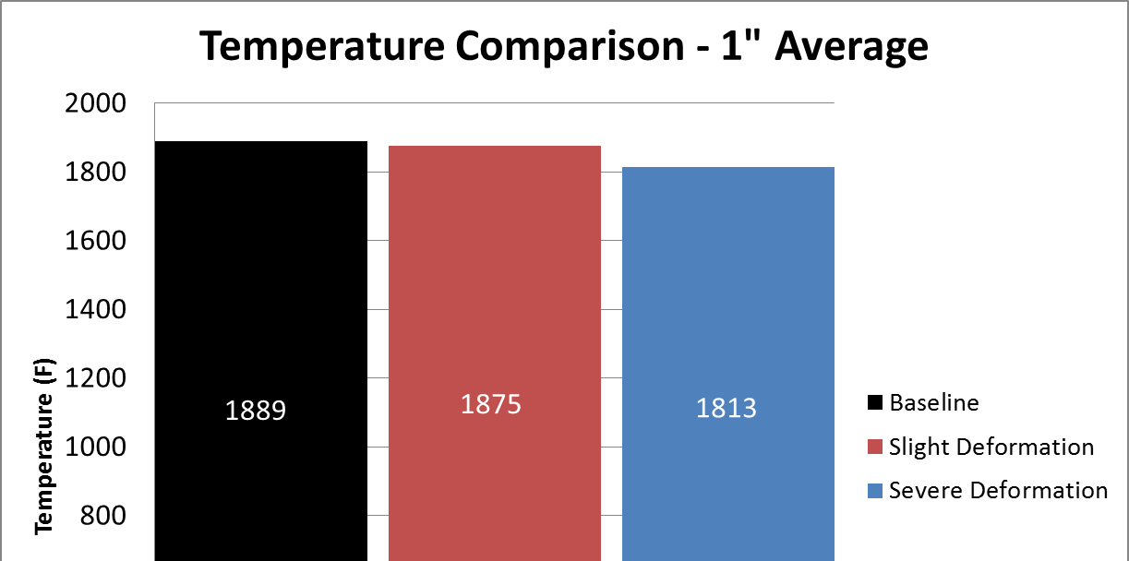
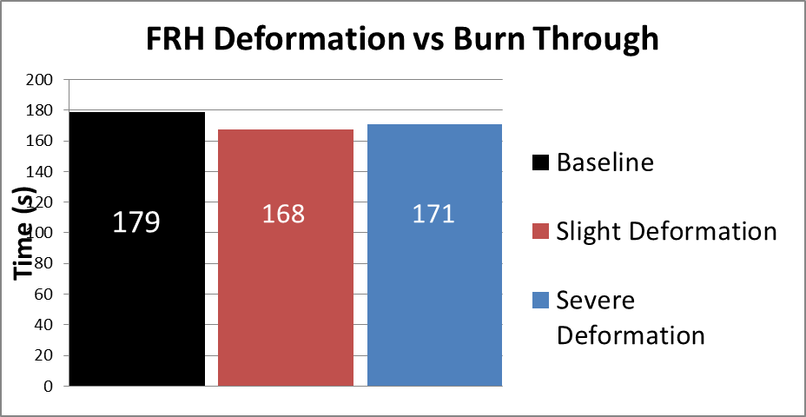
Assembly Tolerance – FRH Deformation
Severely Deformed
Baseline
Normal wear and tear of FRH has minimal impact

Slide 18
Outline
  Study of Flame Retention Heads (FRH) and Delavan fuel nozzles
  Burner sensitivity to operating conditions
  Burner sensitivity to assembly tolerances
  Sensitivity to inclination and test set-up
  Study of ignitorless stator configuration, comparison with FRH configuration

Slide 19
Overview – Test Setup
Objective:
  To determine the impact of differences in test set-up or test cell conditions on NexGen burner performance
Background:
  Power plant components do not have a standard test orientation, and may need different burner inclinations
  Test article setup and Test cell conditions may differ between test houses
Approach:
  Change burner inclination
  Change the test article setup
    Use different fixtures,
    Use of insulation between test article and fixture
  Change ambient air velocity in the test cell

Slide 20
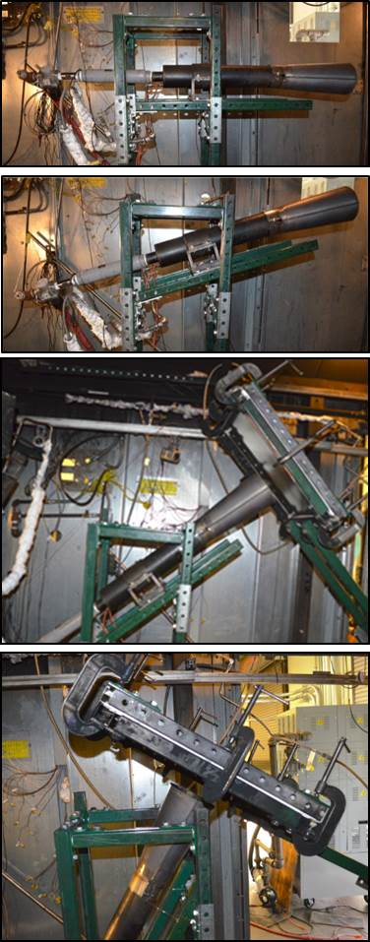
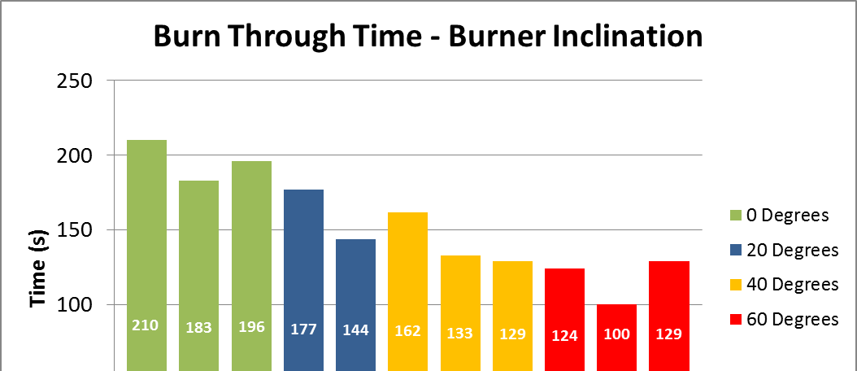
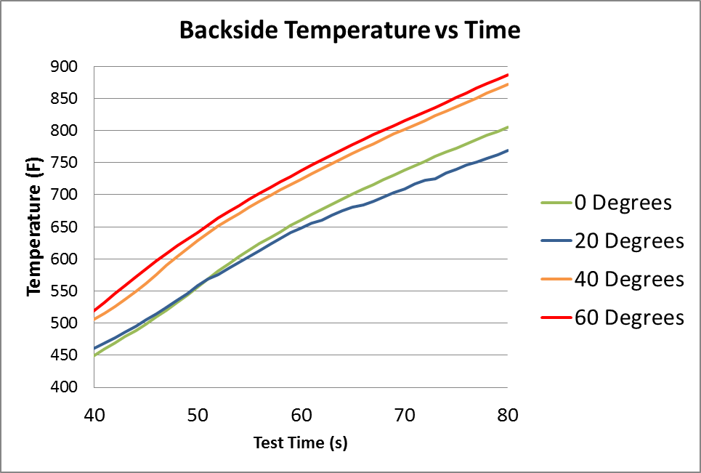
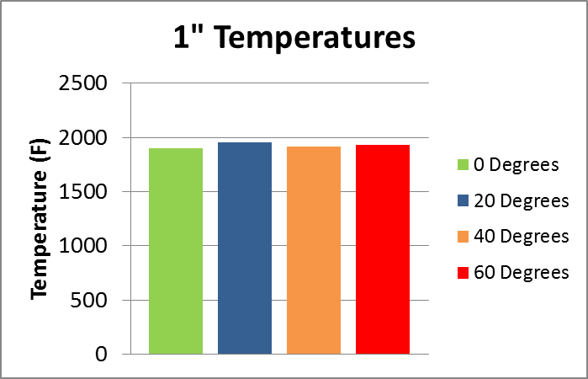
Test Setup - Burner Inclination
0°
Positive correlation between burner inclination and flame severity
60°
*Burner settings maintained constant

Slide 21
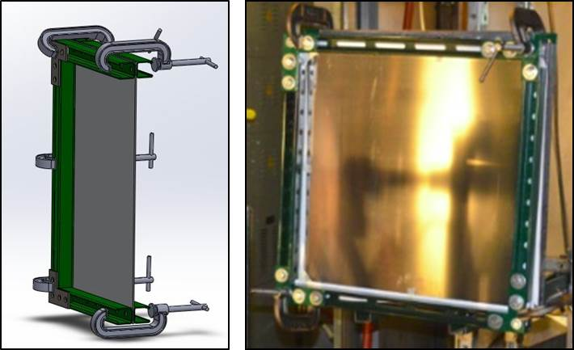
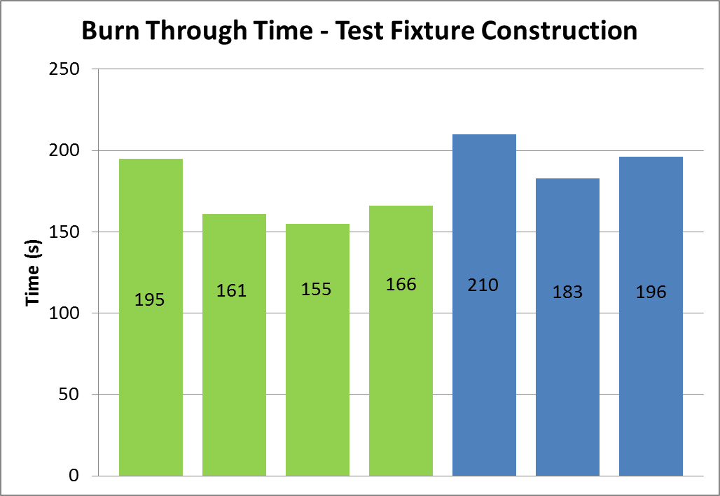
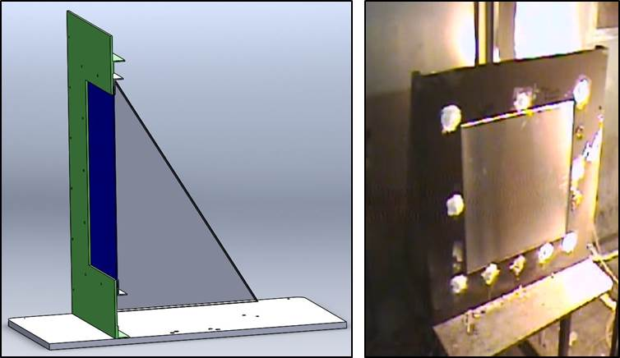
Test Setup – Fixture Design
Unistrut Stand
Baseline
Unistrut
Baseline Stand
Results are within normal burn-through variance, though close to limits. Significantly different test fixture designs may have greater impact

Slide 22


Test Setup – Ceramic Insulation
Baseline
No Insulation
No observable difference in burn through times with and without insulation (for 24” x 24” panels).

Slide 23


Test Setup – Ambient Air Velocity
*Test for cargo liner material – vertical burner
Test cell air velocity may influence test results
Exhaust Port centered over test article
Thermocouple located 4” above test article, centered with respect to burner

Slide 24
Outline
  Study of Flame Retention Heads (FRH) and Delavan fuel nozzles
  Burner sensitivity to operating conditions
  Burner sensitivity to assembly tolerances
  Sensitivity to inclination and test set-up
  Study of ignitorless stator configuration, comparison with FRH configuration

Slide 25

Overview
  Burner configuration was recently updated to use an ignitorless stator and turbulator configuration in place of the FRH and static plate

Slide 26





Temperature and Burn Through Results
Ignitorless Stator
Flame Retention Head
Ignitorless stator configuration is slightly more severe as compared to FRH configuration

Slide 27
Outline
  Study of newly proposed Flame Retention Heads (FRH) and Delavan fuel nozzles
  Burner sensitivity to operating conditions
  Burner sensitivity to assembly tolerances
  Sensitivity to inclination and test set-up
  Study of ignitorless stator configuration
  Effect of test cell ambient air velocity
  Thank You!
  Questions?

