Slide 1
Next Generation Fire Test Burner for Powerplant Fire Testing Applications
The 8th Triennial Int’l Fire & Cabin
Safety Research Conference
Atlantic City, NJ
October 24-27, 2016
Steve Summer
Steve Rehn
Federal Aviation Administration
Fire Safety Branch
http://www.fire.tc.faa.gov

Slide 2
Background
Currently specified oil burners are no longer commercially available
Industry is left with the propane burner, however this burner has been shown to be less severe than an engine flammable fluid flame
FAA Tech Center Fire Safety Branch has been tasked by Transport Airplane Directorate to develop burner performance standards for the next-generation fire test burner for powerplant fire testing
New burner should be much easier to calibrate, provide more consistent results, and be readily available for industry use.

Slide 3
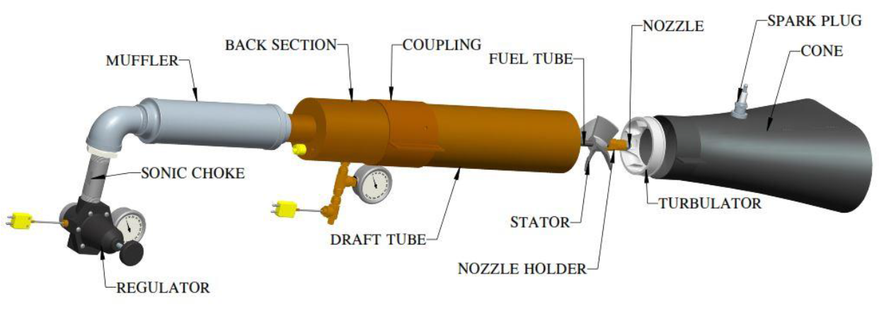
NexGen Burner Overview
Temperature & pressure controlled air & fuel supplied to the burner allows for stable flame output with no changes made downstream from input controls

Slide 4
Current Status

Slide 5
Round Robin – Participating Labs
Materials were sent to 8 different labs (9 burners) for comparative testing
1 lab utilizing a Blue Angel burner
Set up with same tube, stator and turbulator as Park
2 labs utilizing Park burner
2 labs utilizing Carlin burner
4 labs utilizing Sonic burner
1 lab utilizing both Park and Sonic
In large test cell (~1000 m³)
In small test cell (~100 m³)

Slide 6
Round Robin – Materials Tested
Slug Calorimeter
10″x10″ copper panel with thermal absorptive coating on front face and thermocouple on back face to determine heat flux (Q=mC_{p}∆T). Panel was mounted on a 24″x24″ steel plate.
Copper slug exposed to burner flame for a period of 10-20 seconds.
Repeated 3x with sufficient time for full cooling of all materials (burner, thermocouples copper panel, etc) between each test.

Slide 7
Round Robin – Materials Tested
1/8″ thick, 24″x24″ 2024 Aluminum Sheet
Burnthrough time recorded and reported
Repeated 3x
Double-layered TexTech felt (to be mounted in a 24″x24″ opening)
Burnthrough time recorded and reported
Repeated 3x

Slide 8
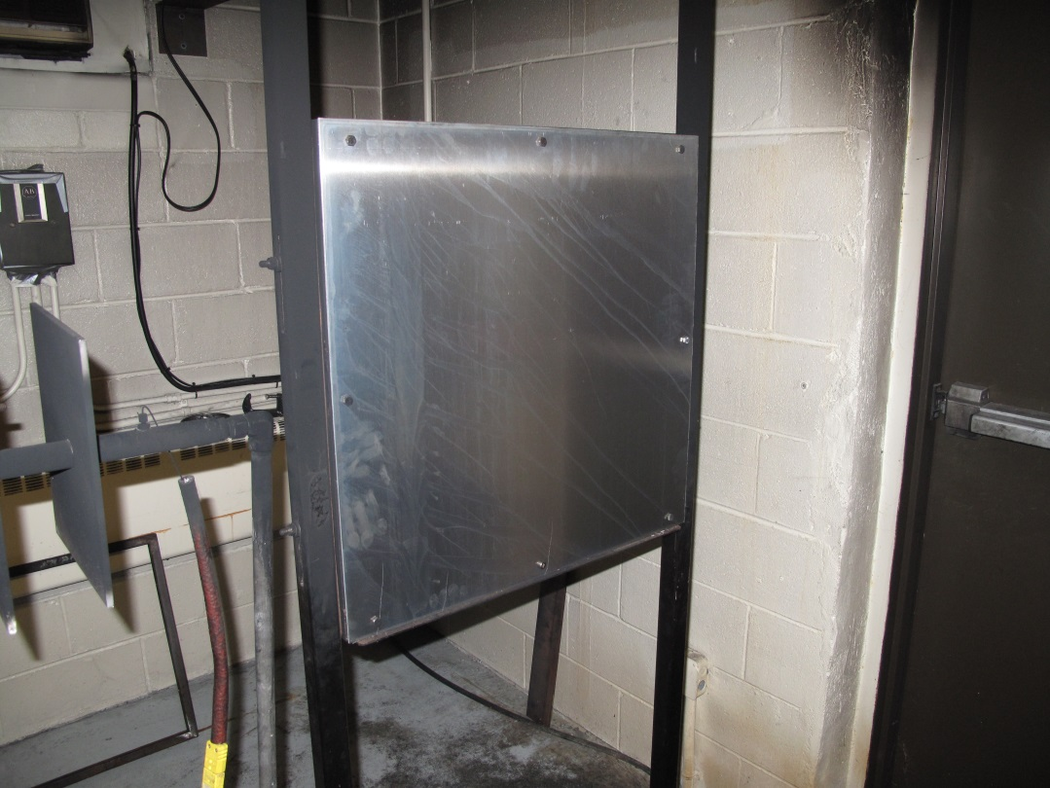
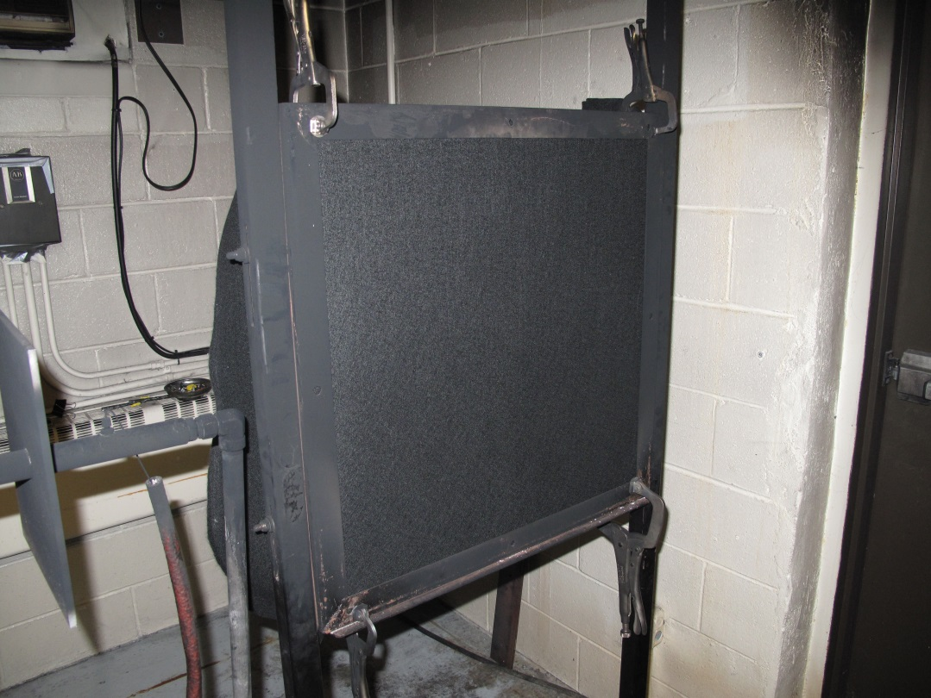
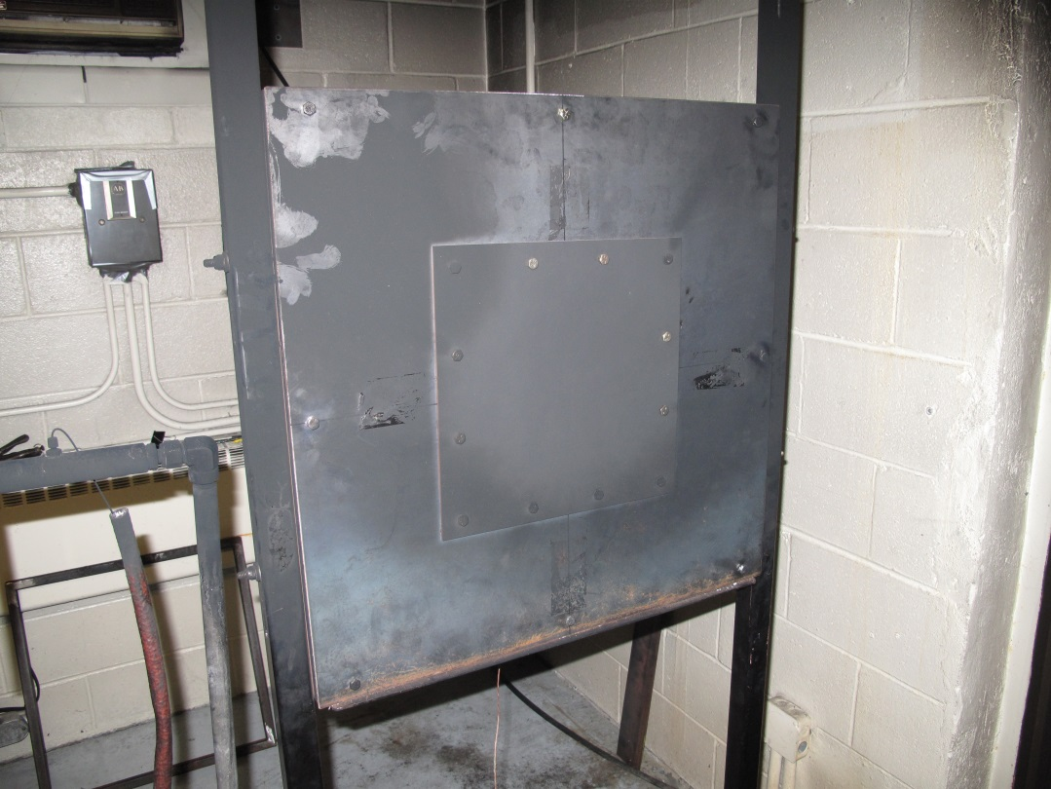

Slide 9
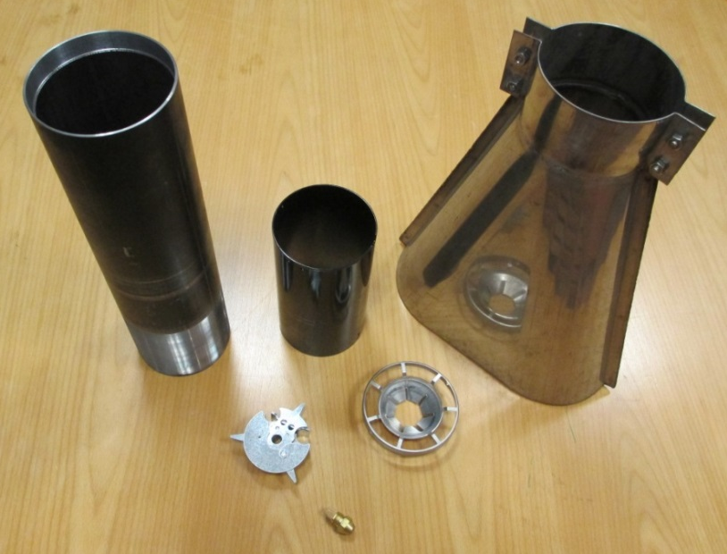
Round Robin – NexGen Burner Settings
Burner configuration was with static plate and flame retention head
Fuel nozzle – 2.5 gph 80° W style fuel nozzle
Face of FRH to nozzle tip: 1-1/8”
Fuel nozzle adapter to static plate: 2-3/8”
Static plate angle: centerline of igniters at 0°
Fuel pressure: 100 psi +/- 5 psi
Note: This pressure is to be used as a starting point when flow checking the fuel flow rate. Actual pressure used during testing should be that found from the fuel flowrate check
Air pressure: 50 psi
Air temperature: 50º ± 10ºF
Fuel temperature: 42º ± 10ºF

Slide 10
Calibration
All labs will calibrate using 1/8”, exposed bead, Type K, stainless steel sheathed thermocouples for calibration
Labs utilizing the Sonic Burner are not expected to necessarily achieve the calibration temperatures or heat fluxes, but rather are calibrating the fuel/air temperature and pressure input to the burner. Temperature and heat flux calibration data should be recorded and reported however.
Labs utilizing burners other than the Sonic Burner, should calibrate to a minimum average of 2000°F, with each thermocouple reading 2000°F ± 150°F. In addition, the burner should provide a heat flux density of at least 9.3 BTU/ft²-s or 4500 BTU/hr as per AC 20-135.
Changing or deviating from provided burner settings to achieve higher or more uniform calibration temperatures is not recommended
Three separate calibration runs should be recorded
Each calibration should include a 2-minute warm-up of the burner, a 1-minute thermocouple flame soak, and a 30-second data collection period of flame temperature. This should be followed by the heat flux calibration.

Slide 11
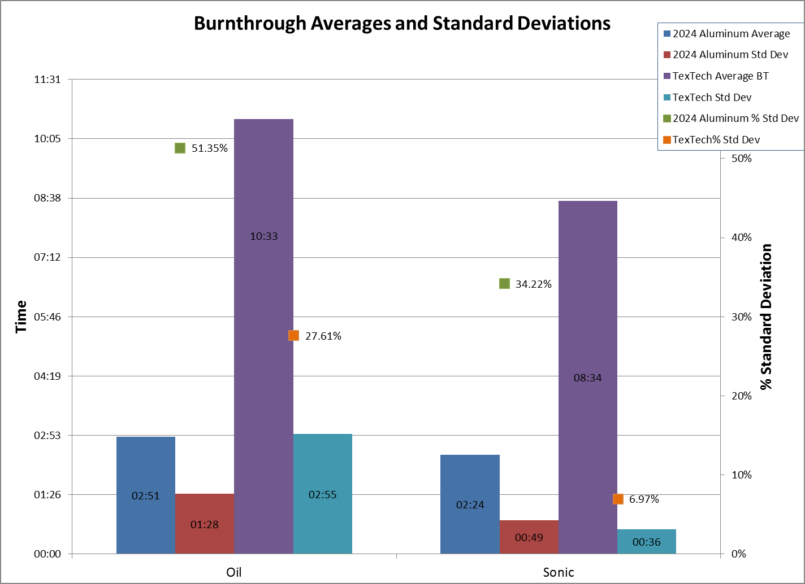

Slide 12
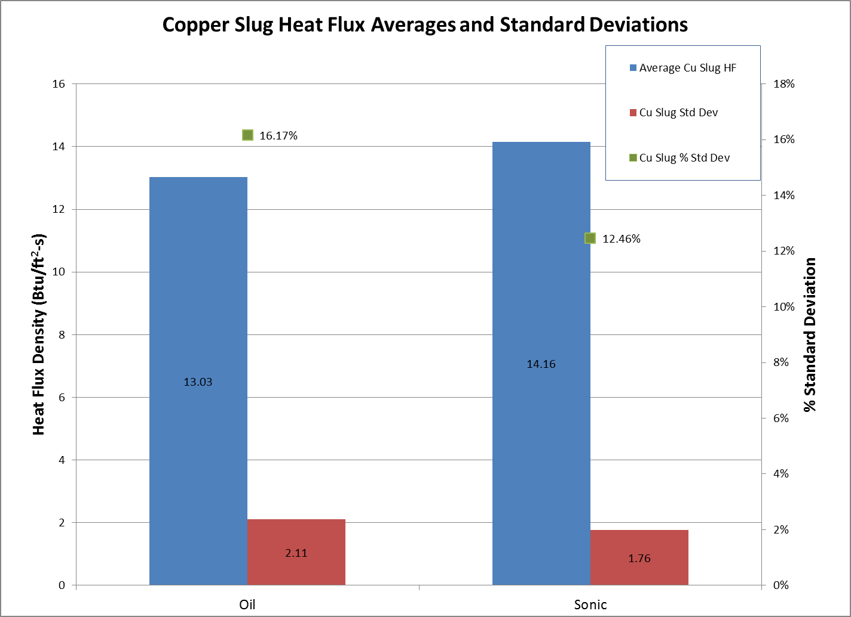

Slide 13
Burner Re-configuration
Reconfigured burner to current Materials configuration
Replace flame retention head (FRH) with turbulator
Replace static plate with ignitor-less stator
Install spark plug in cone

Slide 14
FRH vs Ignitorless Stator Setup
Conducted tests to compare calibration results with the FRH setup under a variety of conditions
Air pressure = 50, 55 & 60 psi
Fuel flow = 2.50, 2.57, 2.63 gph
Delavan 80°W vs Delavan 80°B Nozzle
Tested limited amount of panels remaining from the comparative testing conducted previously (slug calorimeter, aluminum, & Textech

Slide 15
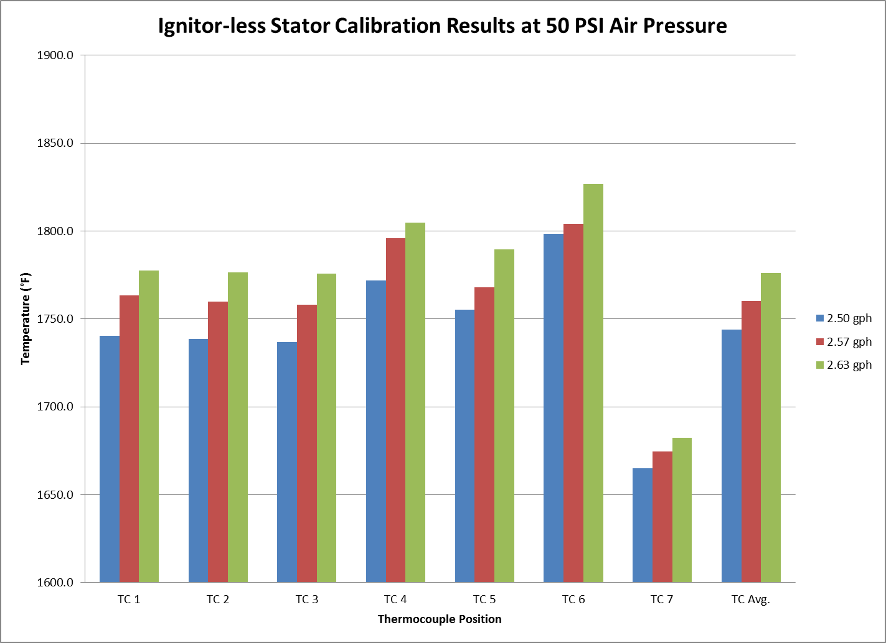

Slide 16
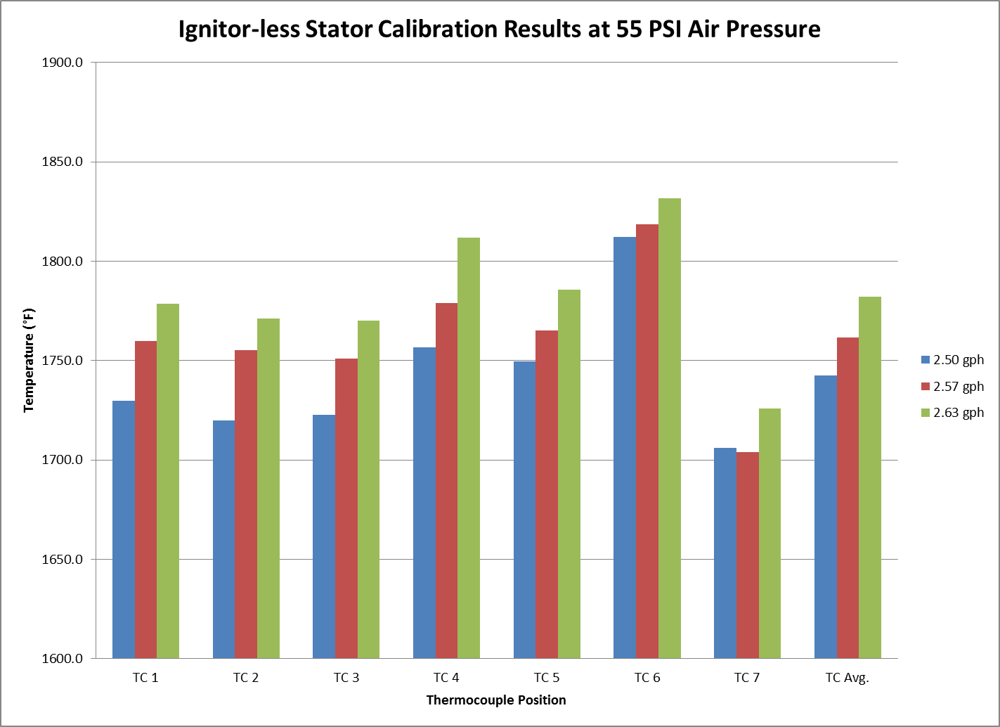

Slide 17
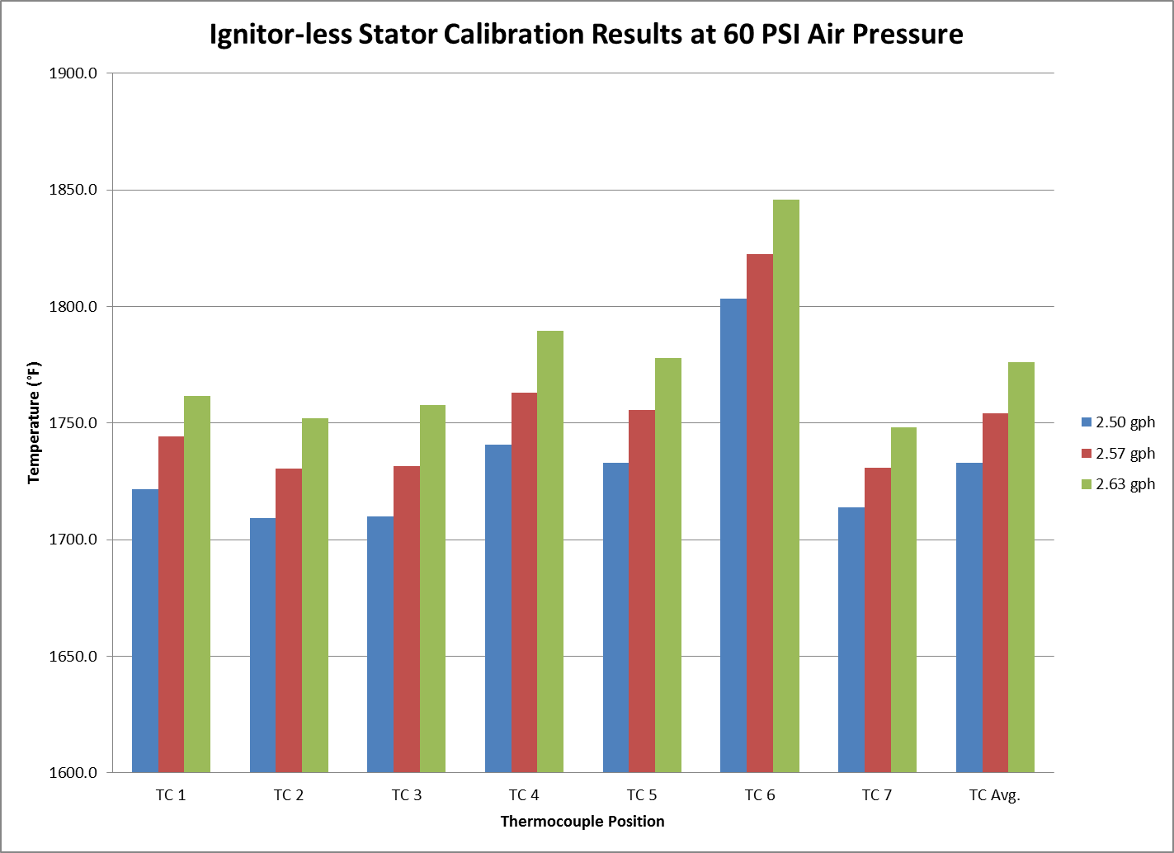

Slide 18
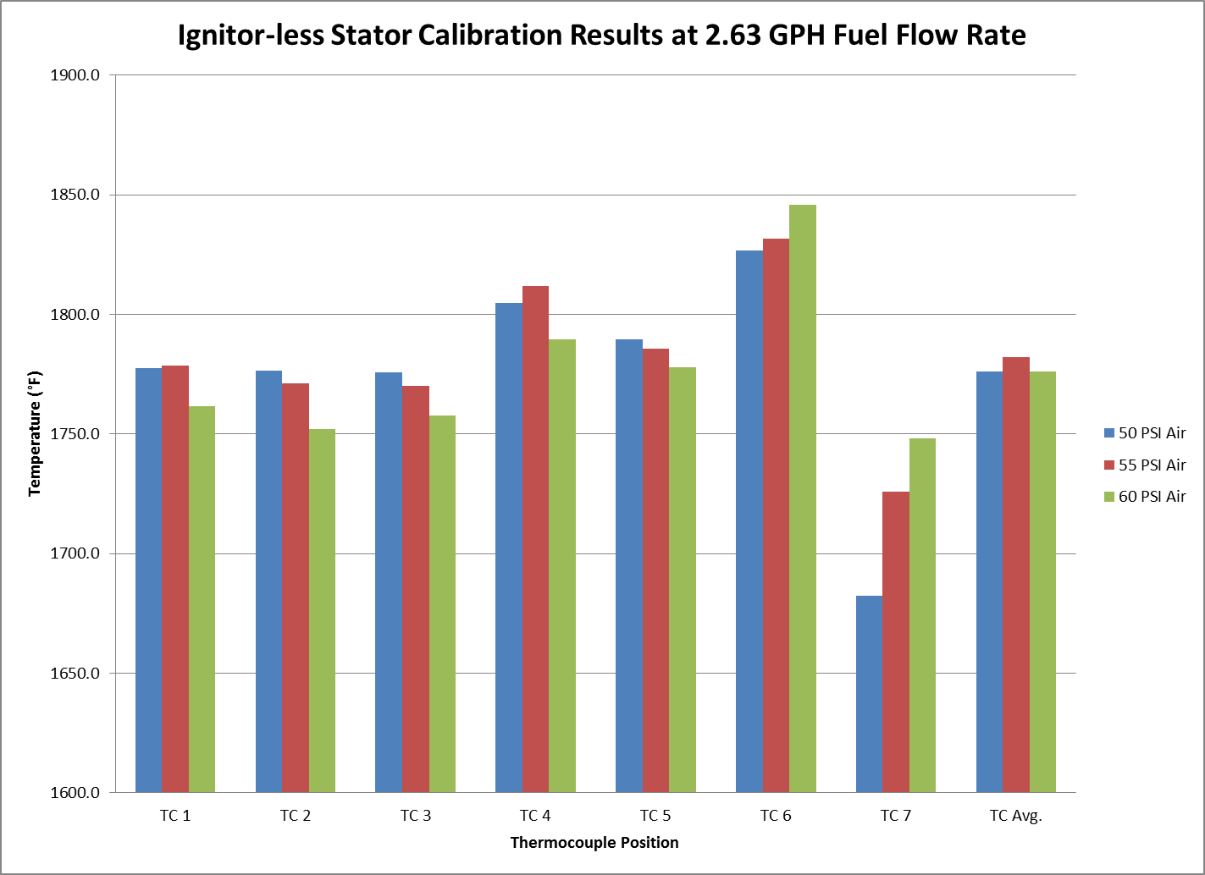

Slide 19
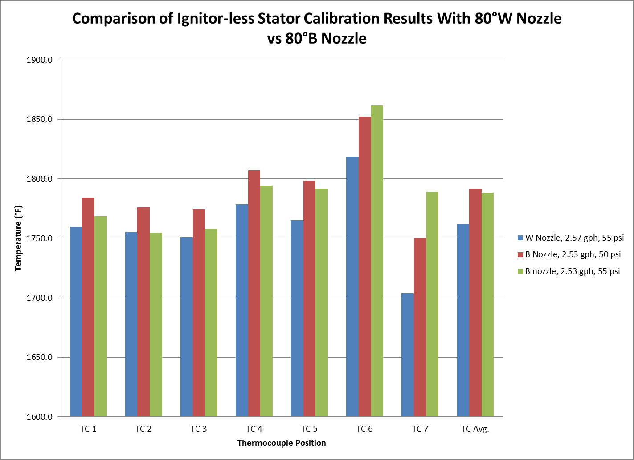

Slide 20
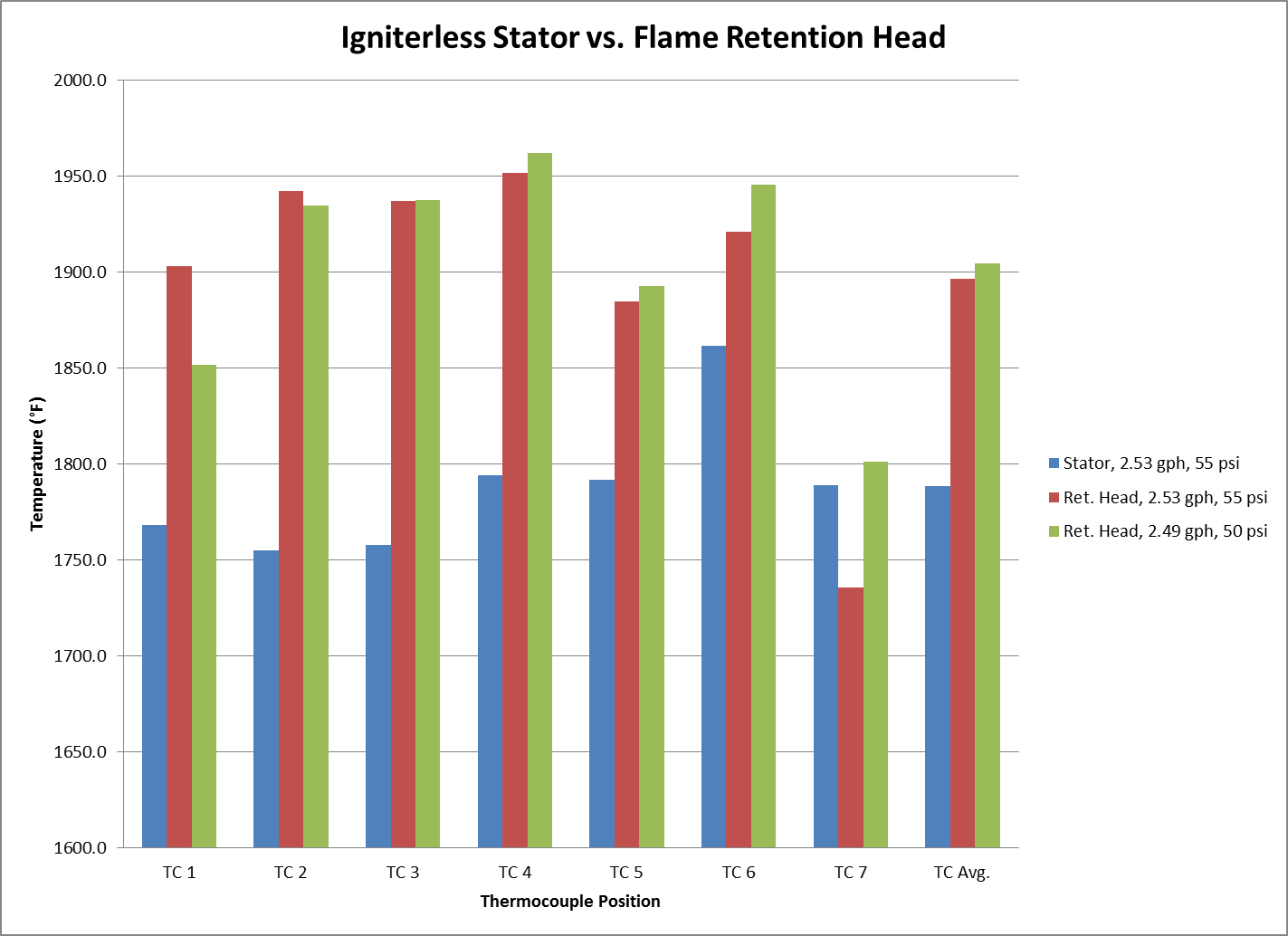

Slide 21
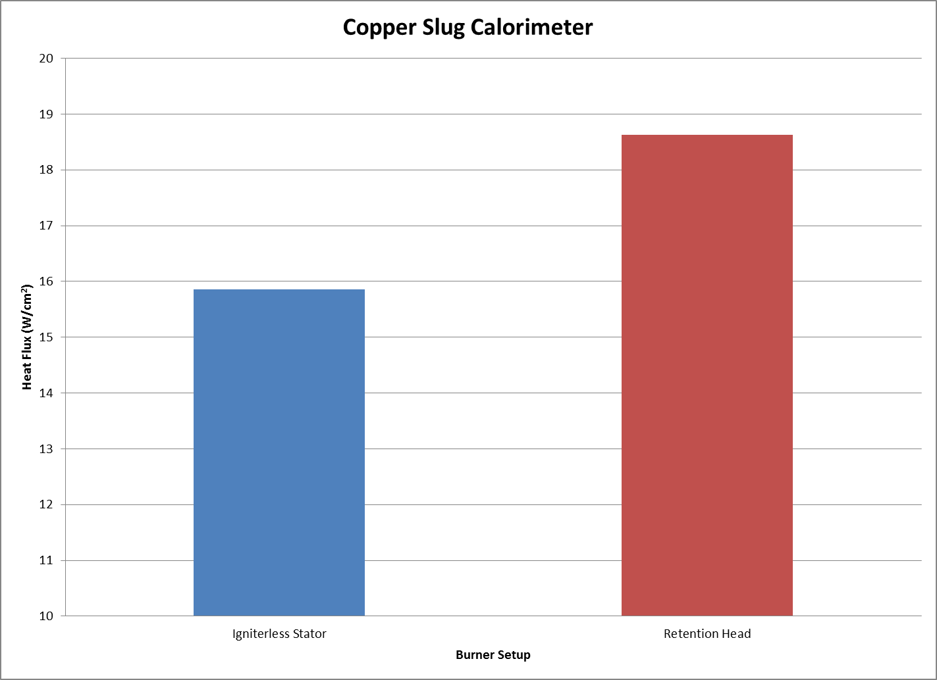

Slide 22
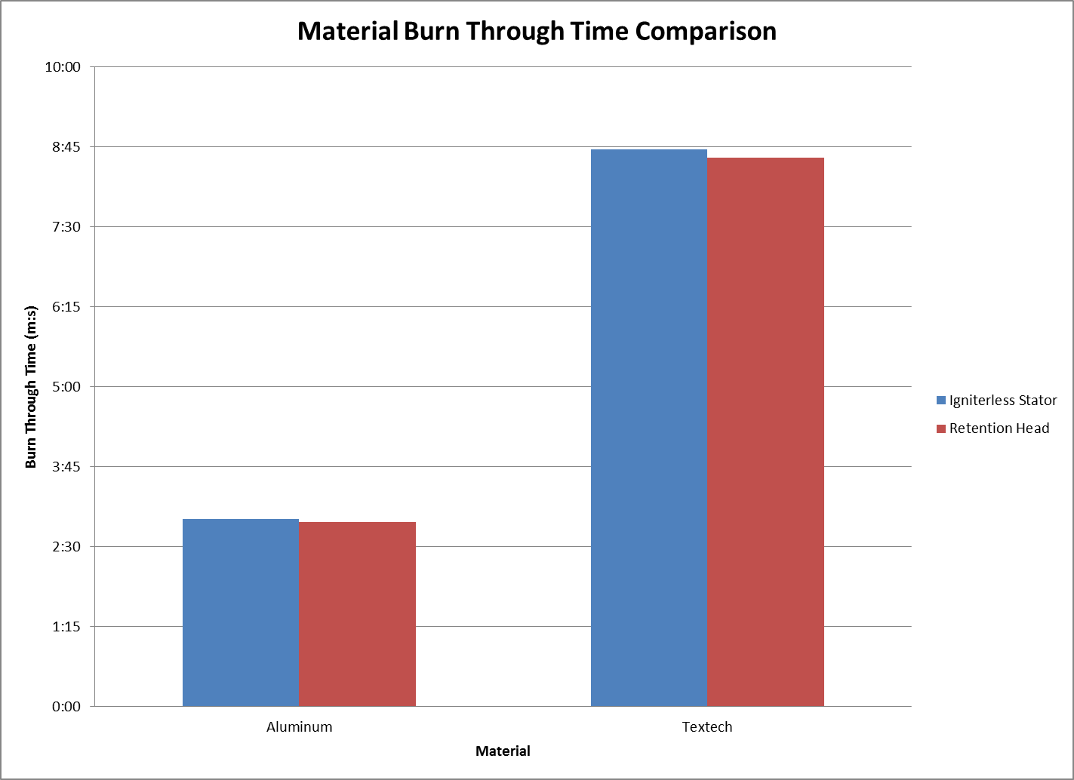

Slide 23
FRH vs Ignitorless Stator Setup - Summary
Under all conditions tested, calibration with the ignitor-less stator resulted in significantly lower temperature readings than with the FRH.
Additionally, heat flux when measured/calculated with the copper slug calorimeter was significantly lower
However, burnthrough times for a limited number of aluminum and TexTech panels showed excellent agreement with FRH test data

Slide 24
Fuel Nozzle Comparison
Conducted tests to compare calibration results with a 2.0 gph nozzle vs the 2.5 gph
2.0 gph nozzle tested with 40, 45 and 50 psi air pressure
Tested limited amount of panels remaining from the comparative testing conducted previously (slug calorimeter, aluminum, & Textech

Slide 25
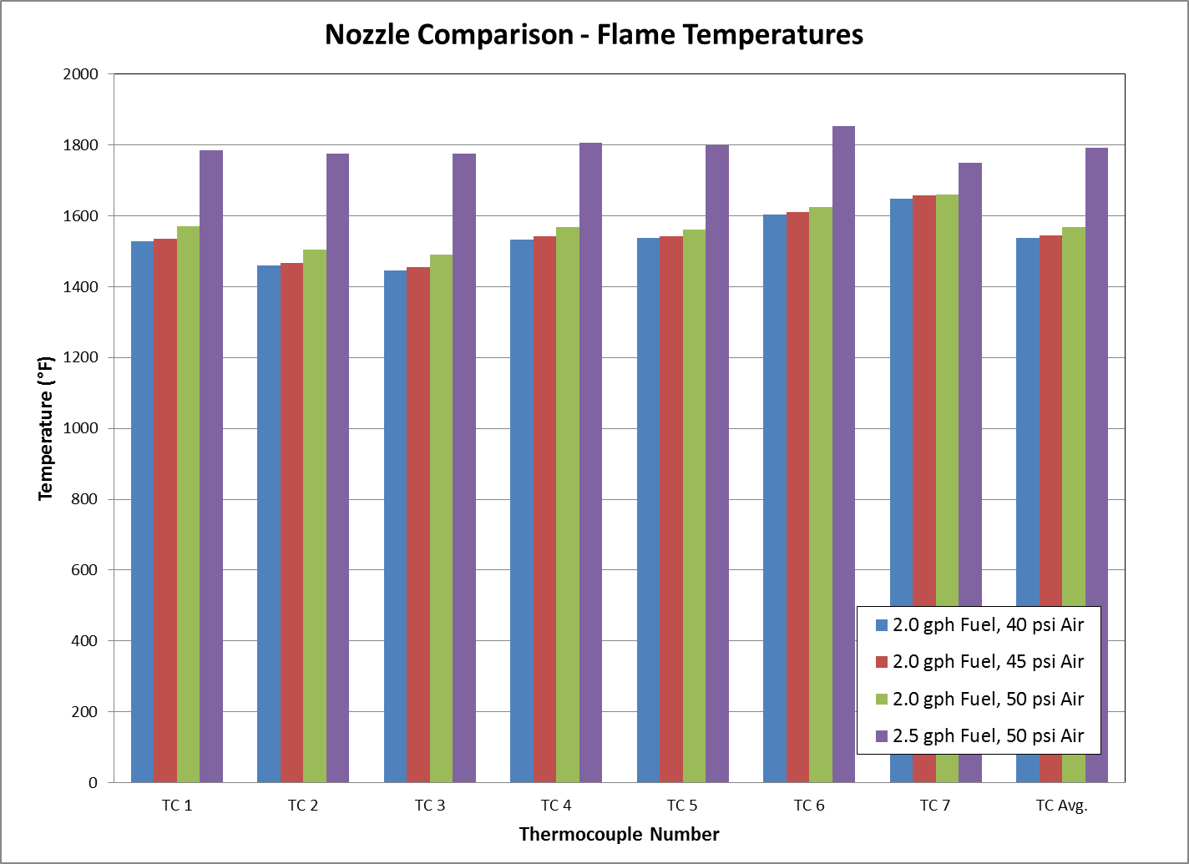

Slide 26
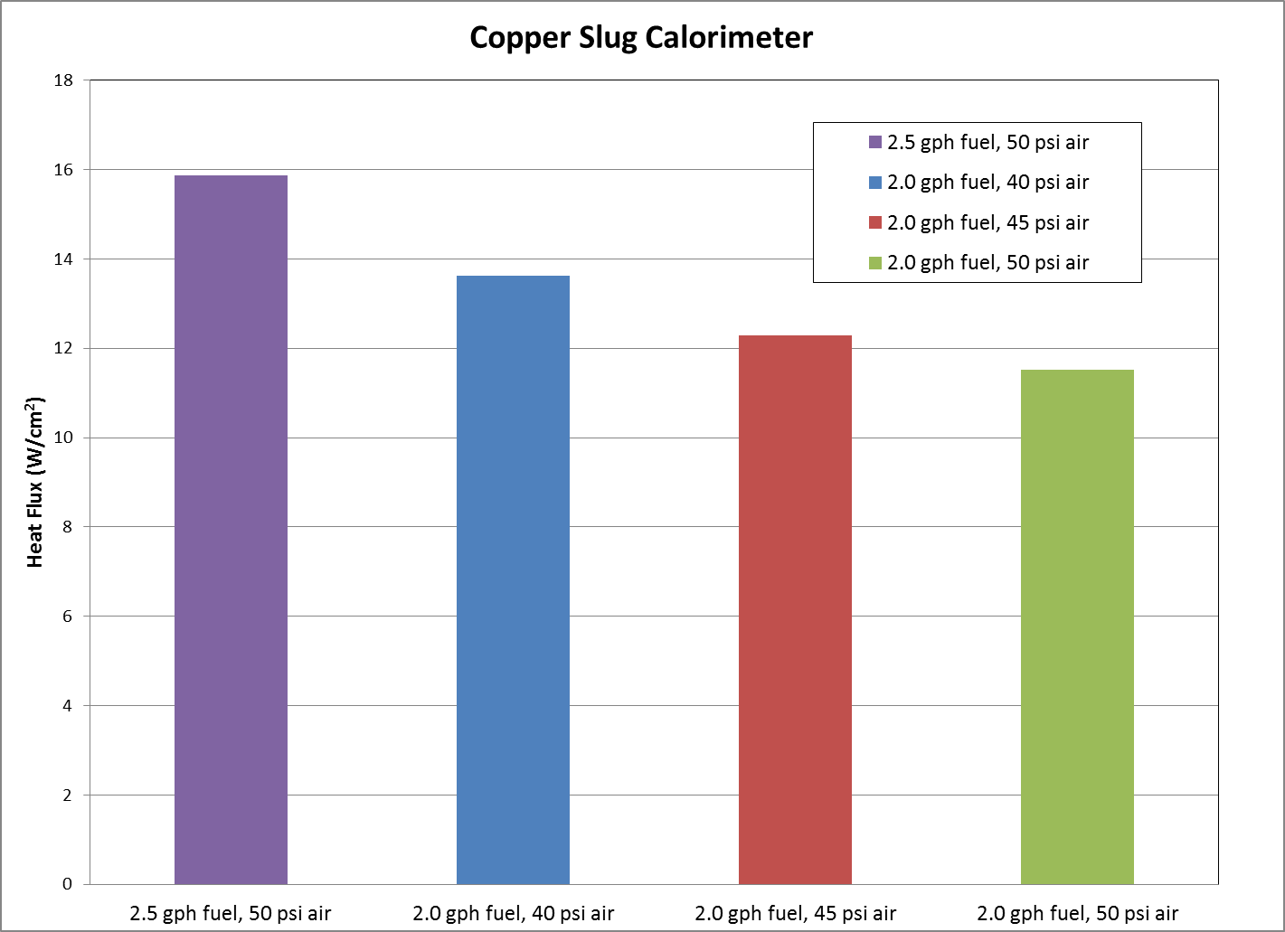

Slide 27
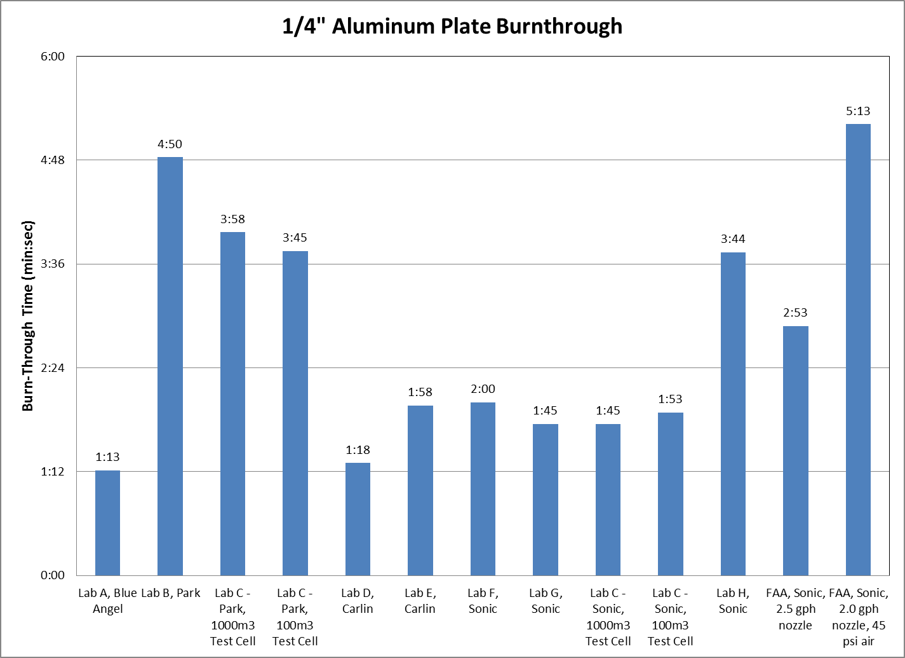

Slide 28
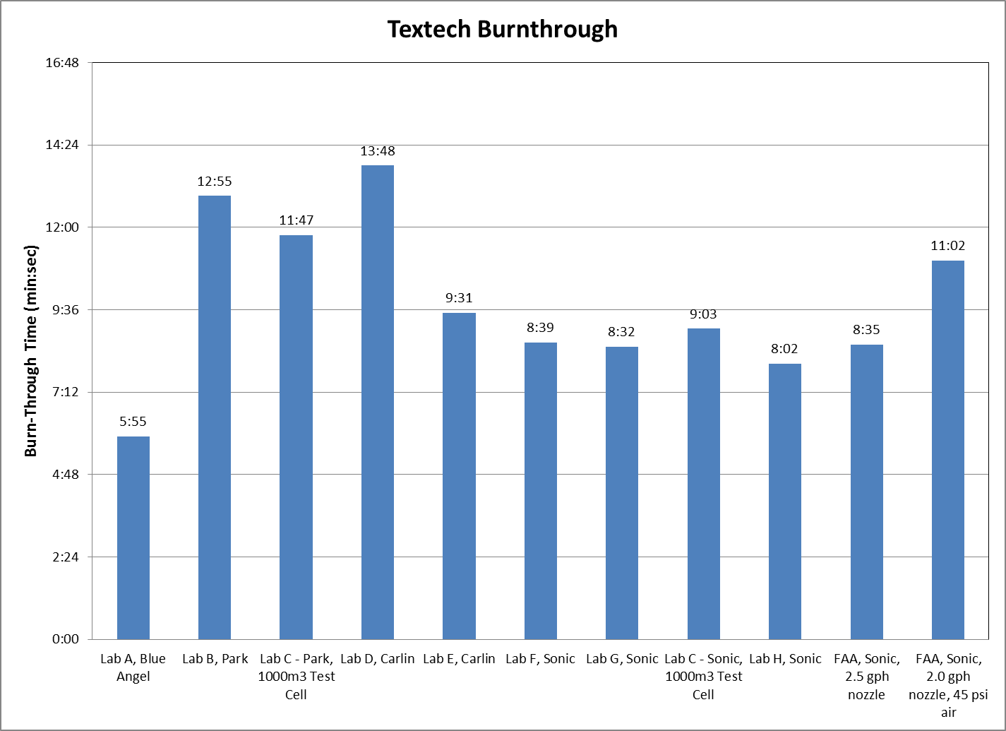

Slide 29
Fuel Nozzle Comparison - Summary
2.0 gph nozzle with all tested air pressures resulted in significantly lower temperature readings than with the 2.5 gph.
Additionally, heat flux when measured/calculated with the copper slug calorimeter was significantly lower
Significant change in burnthrough times also exhibited (only tested with 45 psi air)

Slide 30
Current Status

Slide 31
Future Round Robin – Material Difficulty
Searching for additional non-metallic materials to test in a round robin to assist in showing comparability and repeatability across burners
A number of materials have been evaluated but found to be unsuitable for round robin testing
Silicones, garolites, cargo liner, etc
Currently working to obtain additional materials for evaluation
Fiberglass fabric, carbon fiber tape
Once suitable materials are found, solicitations will be sent to labs for round robin participation

Slide 32
Current Status

Slide 33
Current Status – AC 20-135
A sub-group had been formed with the goal of developing proposed rewording of AC20-135 in a parallel effort with NexGen burner development.
Testing requirements (i.e. when/how to vibrate sample, orientation of sample, etc) and testing equipment (i.e. thermocouple type, heat transfer calibration device, etc) will be addressed.
Actual burner operation and calibration will be left open subject to burner development.
After initial sub-group meetings, it became evident that a more formal involvement from FAA was required and it was suggested that a proposal be submitted to the FAA from industry with the request that a formal group chartered for this task.

Slide 34
Current Status – AC 20-135 (cont.)
Dirk Kearsley (BAE Systems) had drafted this request and submitted to FAA (6/2014).
Internal FAA group of experts (Headquarters, Directorates, ACOs, etc) has been formed to initiate an evaluation of AC
Sham Hariram working as industry focal point with group
Work to be completed in two phases
Incorporate NexGen burner as an acceptable burner for powerplant testing utilizing existing calibration requirements and clean up initial wording to ensure consistency
Address longer term, more complete revision of AC to fully incorporate NexGen burner with operating/calibration specifics and address all of industry comments

Slide 35
Questions?
Contact Information:
Steve Summer
609-485-4138
Steven.Summer@faa.gov
Steve Rehn
609-485-5587
Steven.Rehn@faa.gov

