Slide 1
Inter-laboratory Study of Radiant Panel Test for Measuring Flammability of Thermal/Acoustic Insulation Materials

Slide 2
Introduction
New Handbook chapter being written
Need more data to finalize changes
Industry dimension survey
Round Robin
Air Flow Study
  Varied openings around the sliding platform to test how it affected air flow and material test results.
  Future Work

Slide 3
Dimension Survey

Slide 4
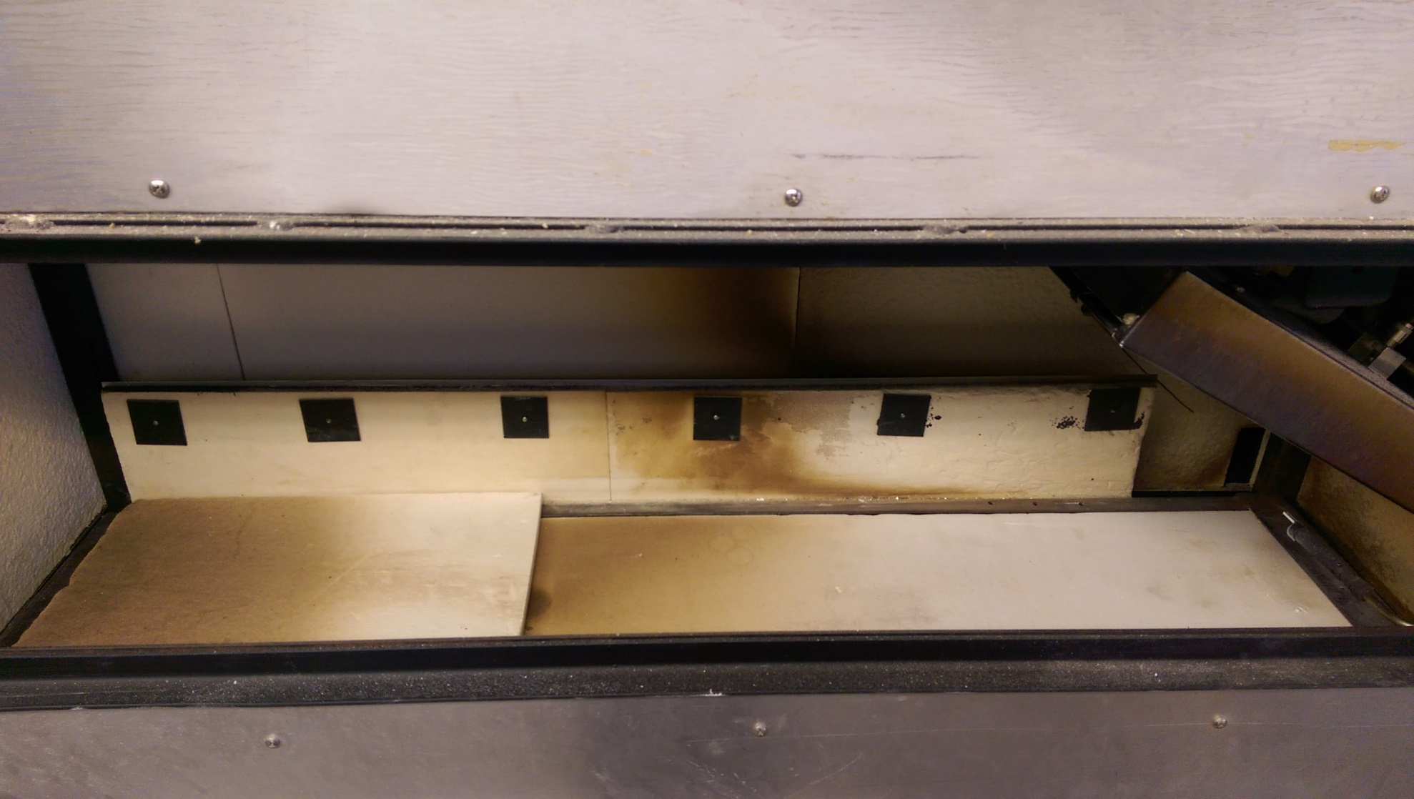
Dimension Survey

Slide 5
Dimension Survey
Gaps around the drawer are the biggest difference between machines

Slide 6
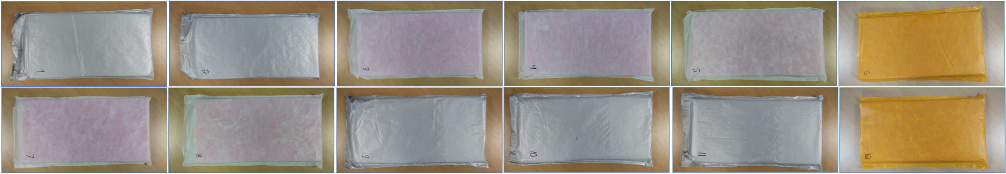
Round Robin
Materials sent out to 28 labs (including FAA)
24 Responses Received
12 samples for each lab

Slide 11
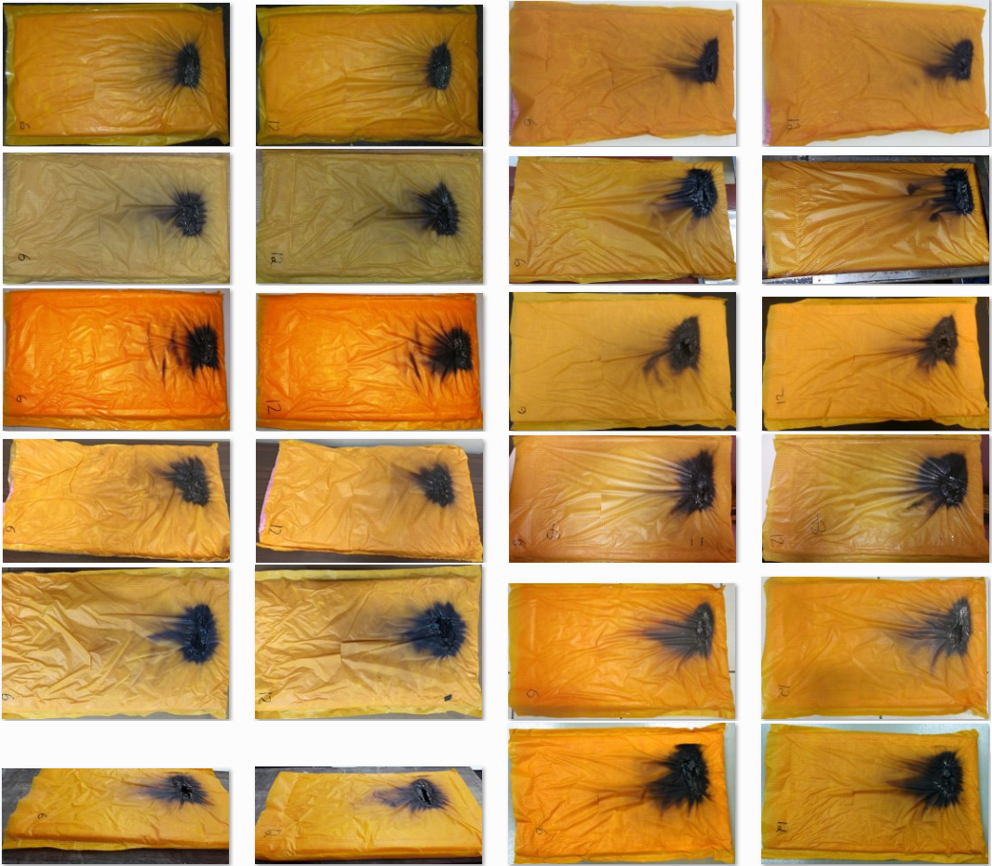
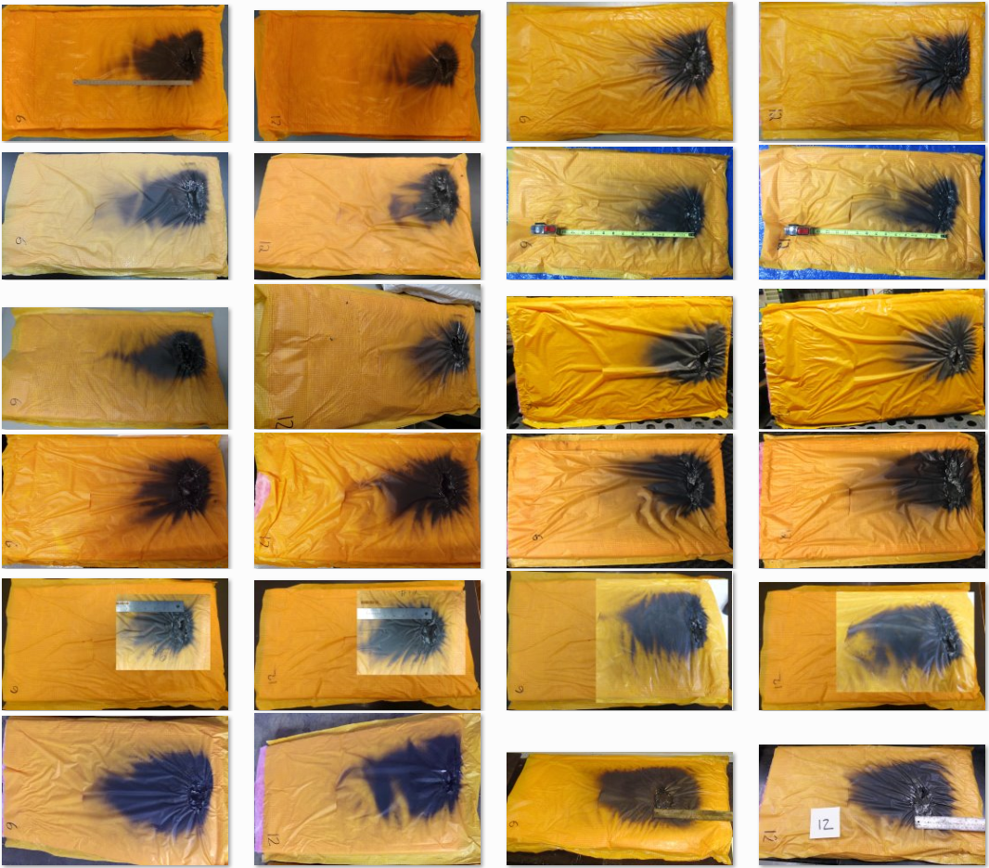
Polyimide
1-12
13-24

Slide 12
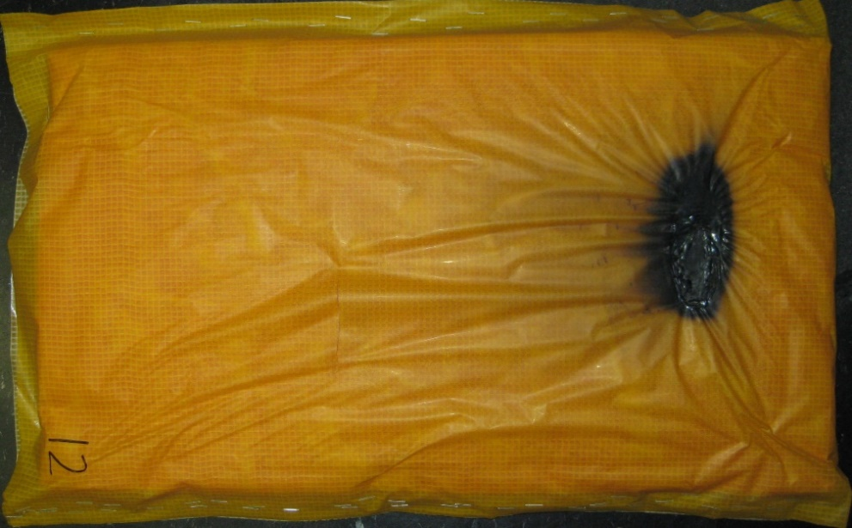
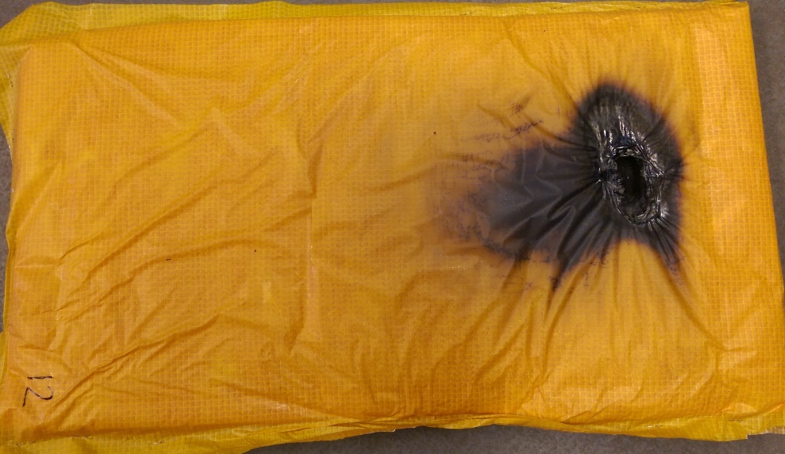
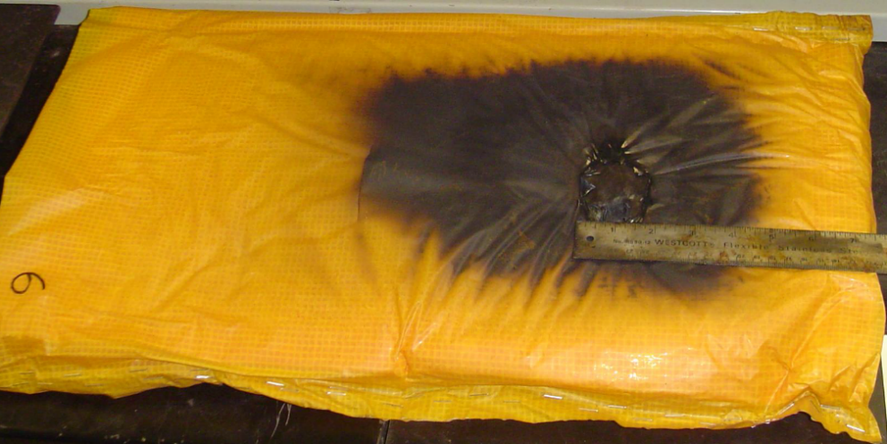
Polyimide
FAA’s test result
Same test, completely different results.

Slide 13
Air Flow Study
New handbook has a larger drawer length compared to the current handbook.
This was done to allow less air to flow into the chamber during testing.
Larger drawer isn’t necessary – the openings around the drawer are what we need to standardize.
We ran some tests to see how changing the size of these openings affects calibration and test results.

Slide 14
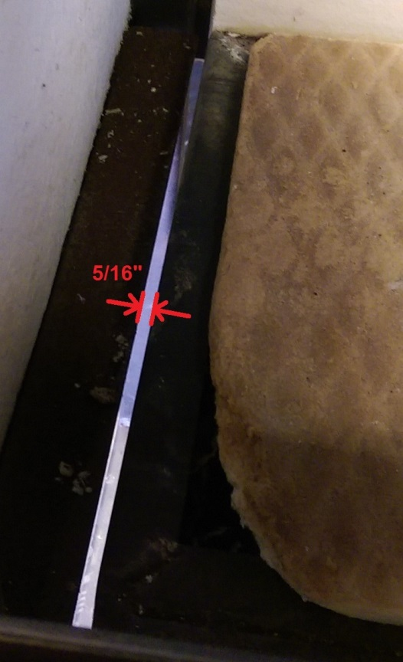
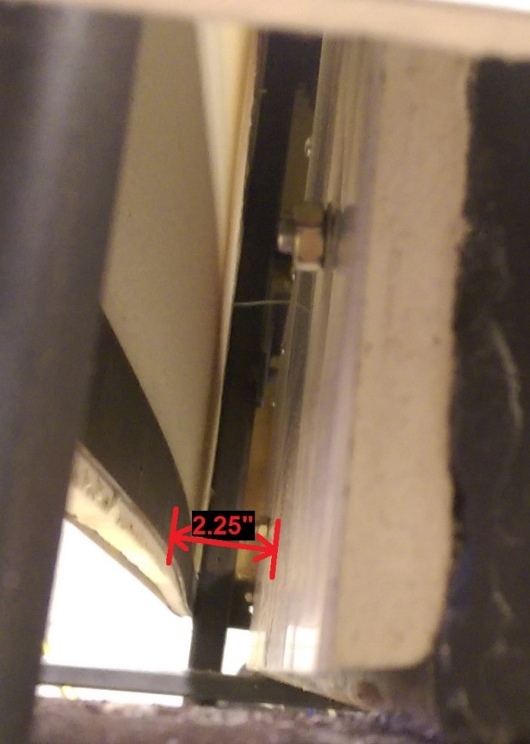
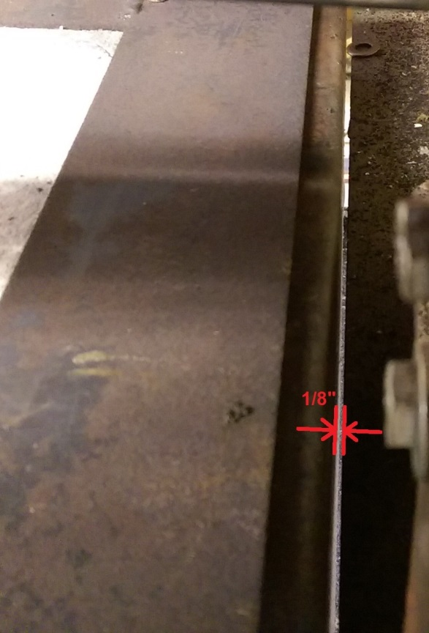
Air Flow Study
Normal openings around the FAA’s radiant panel
Left | Right | Front | Back
5/16” | 1/8” | 0” | 2.25”

Slide 15
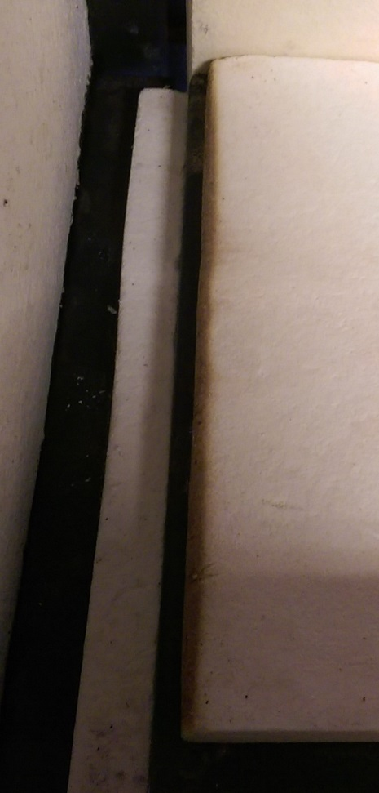
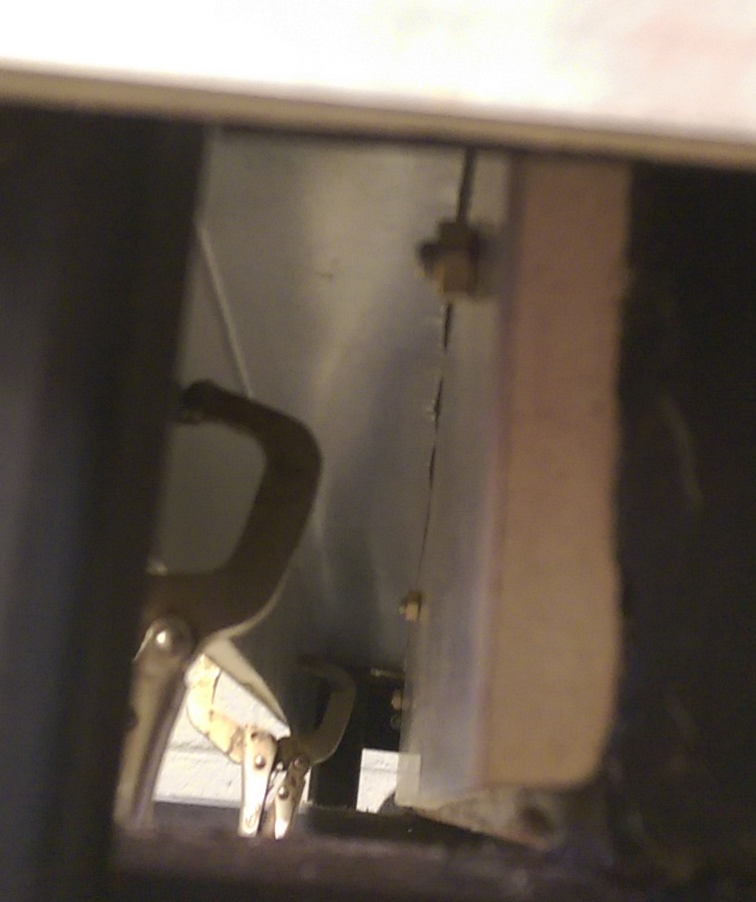
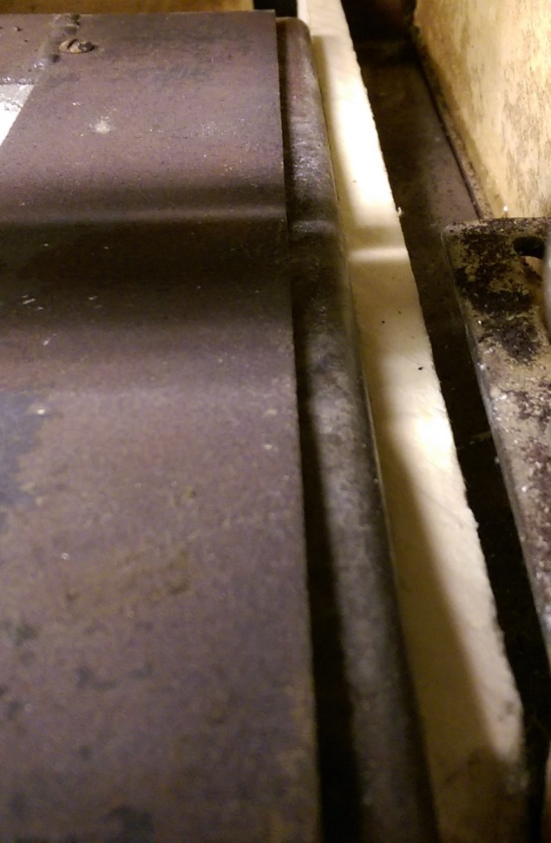
Air Flow Study
Closed off left, rear, and right gaps

Slide 16
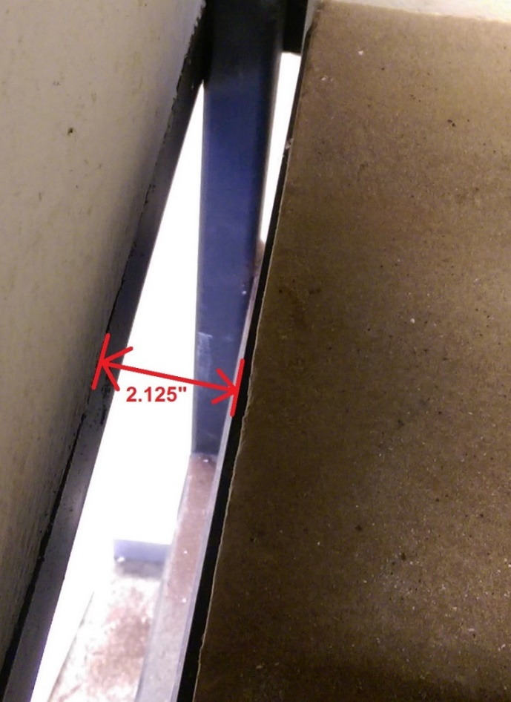
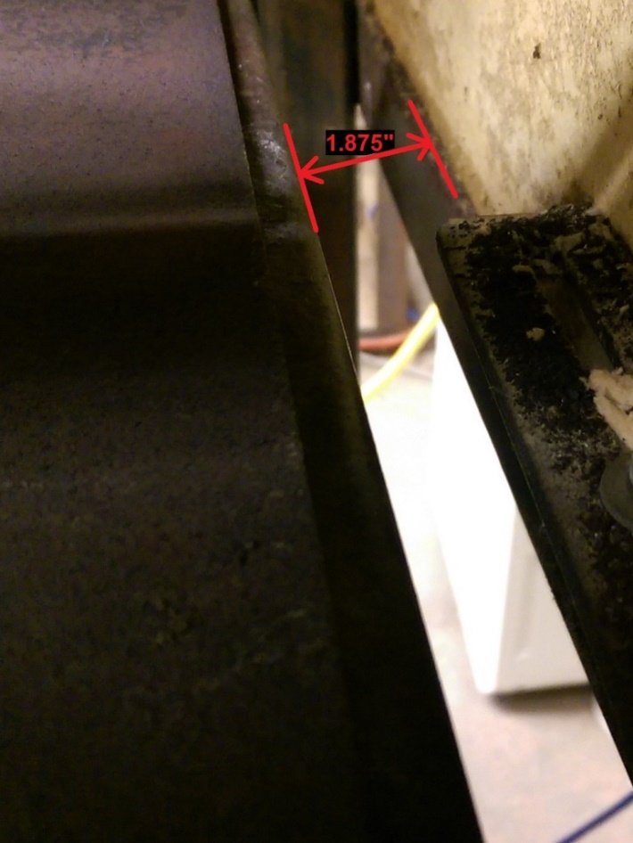
Air Flow Study
Gaps around the drawer fully open
2.125” Left Gap
1.875” Right Gap

Slide 17
Air Flow Study
 | Closed Around Drawer | NormalAround Drawer | Open w/ ~2” Gap on Each Side
Open Area Around Drawer(in²) | 2.09 | 123.77 | 183.44
Panel Set Point (°F) | 1096 | 1105 | 1137
Heat Flux (BTU/ft²s) | 1.501 | 1.502 | 1.495
Chamber Temperature(°F) | 381 | 366 | 425
Chimney Air Velocity (FPM) | 205 | 260 | 278

Slide 18
Air Flow Study
Openings Around Drawer: 2.125” left, 1.875” right, 2.25 rear
Set Point (°F) | 1095 | 1110 | 1125 | 1137
Heat Flux (BTU/ft²s) | 1.398 | 1.439 | 1.481 | 1.495
Thermocouple (°F) | 385 | 395 | 410 | 425
Chimney (FPM) | 245 | 255 | 268 | 278
Under Right Side of Drawer (FPM) | 90 | 91 | 95 | 95
Under Left Side of Drawer (FPM) | 65 | 60 | 65 | 65
As the panel temperature increases, the air flow into the chamber increases causing you to need to increase the panel temperature further to compensate

Slide 19
Round Robin Data

Slide 20
Round Robin Data

Slide 21
Air Flow Study

Slide 22
Air Flow Study

Slide 23
Air Flow Study

Slide 24
Air Flow Study

Slide 25
Air Flow Study
At the June meeting, we finalized plans to further study this issue
Continue conducting tests with 3 different air gap levels
  Fully open
  Partially open
  Fully closed
Place array of thermocouples in the retaining frame to test how material temperature changes
Place smoke bomb below chamber to observe how the air travels through it
Additional material tests

Slide 26
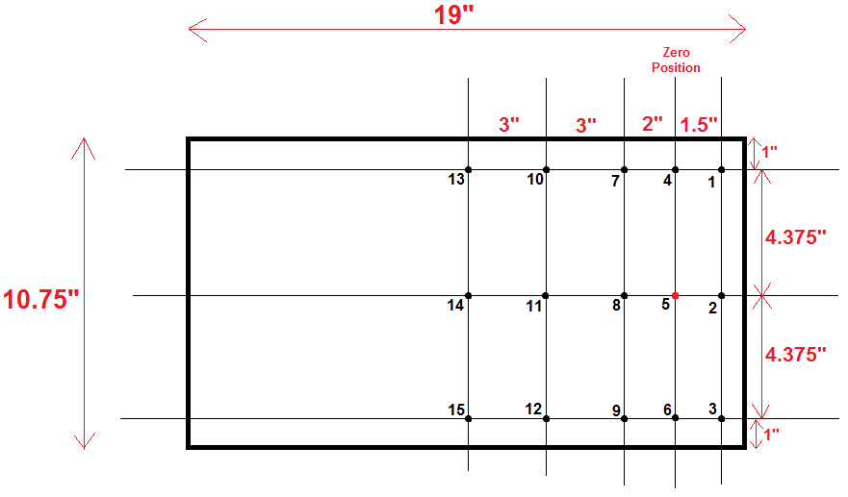
Air Flow Study
Array of 15 thermocouples placed inside retaining frame
Tested at each air-gap configuration
Calibrated with calorimeter to 1.5 Btu/ft²s each time
3 tests with each configuration
Temperature averaged over 5 minutes

Slide 27
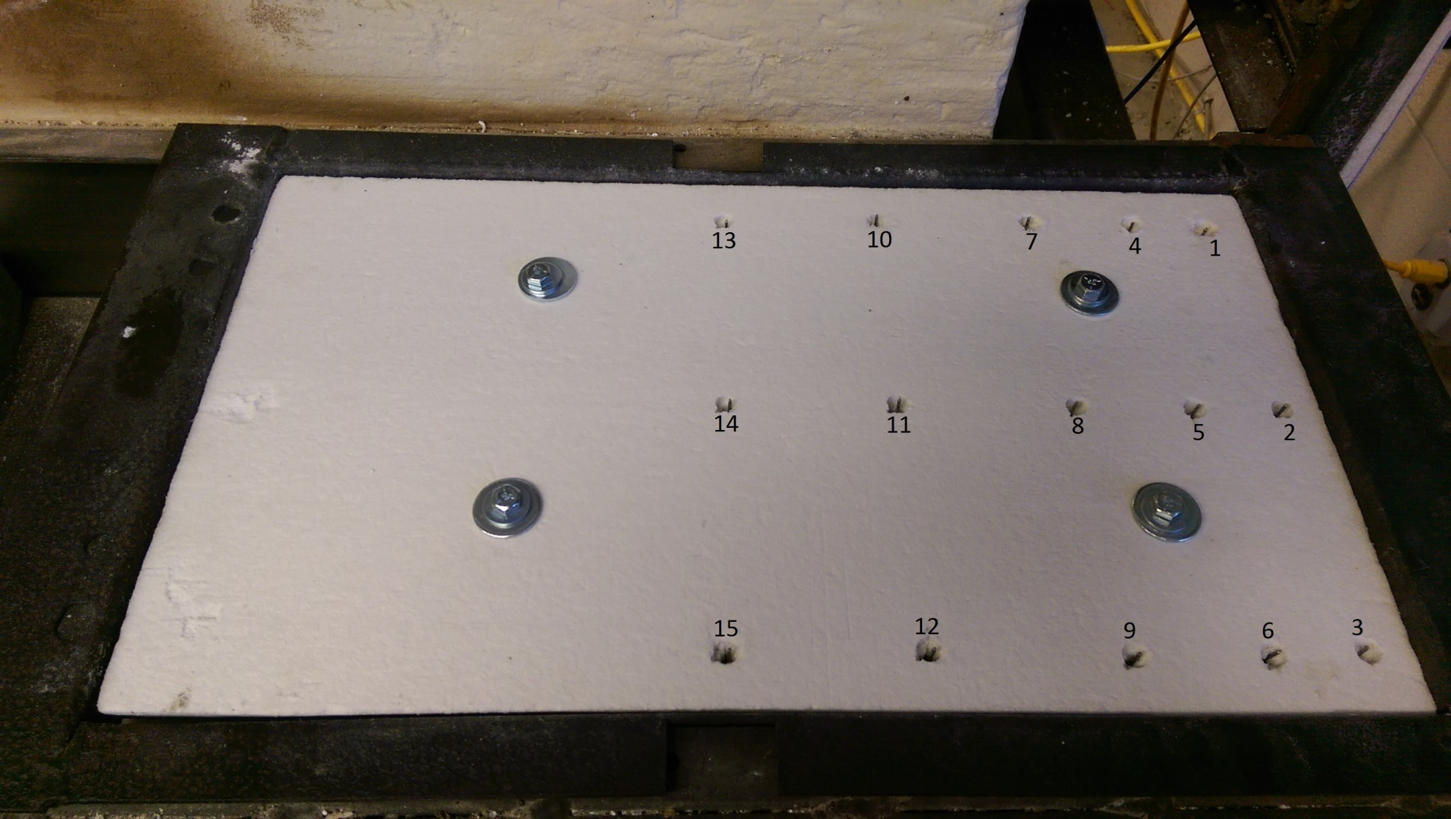
Air Flow Study

Slide 28
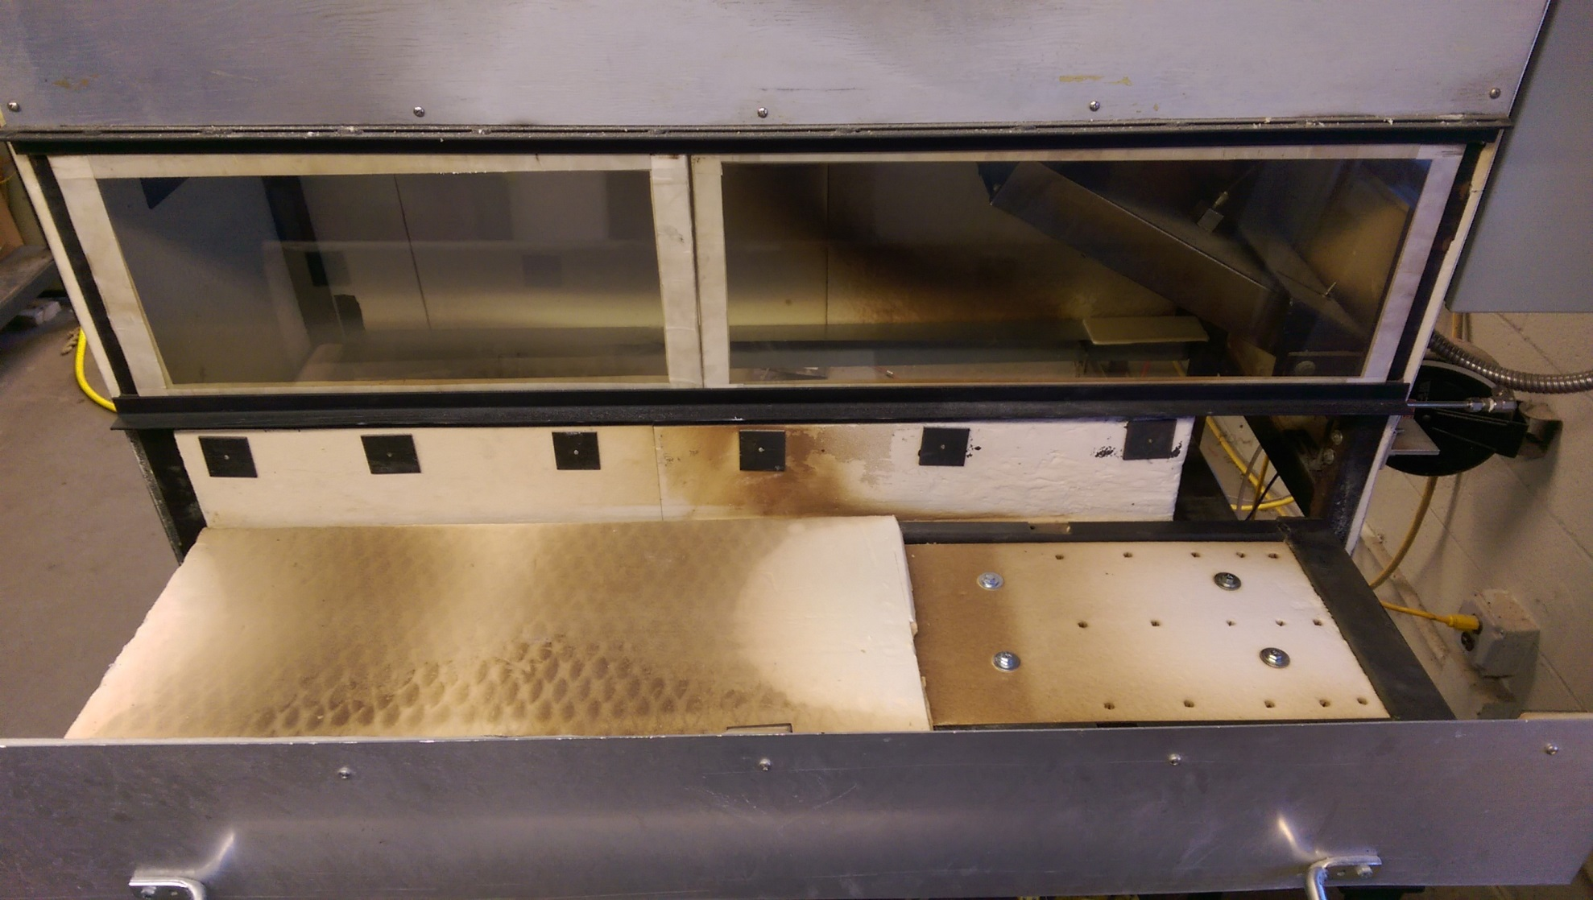
Air Flow Study

Slide 29
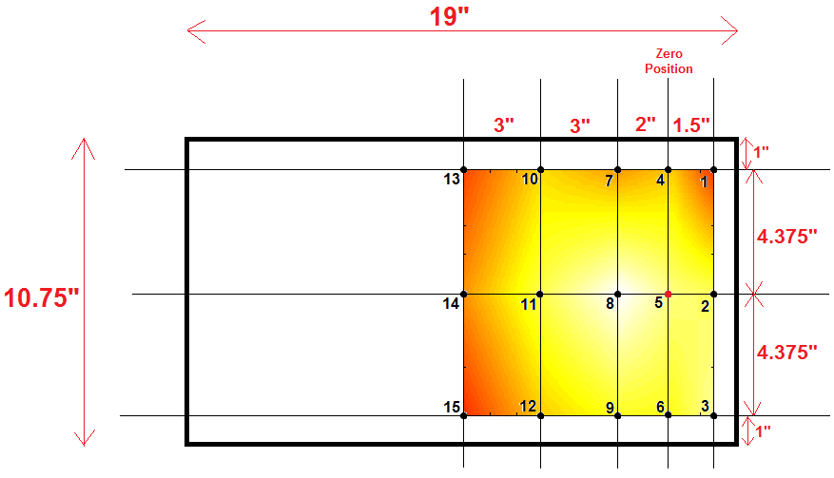
Air Flow Study

Slide 30
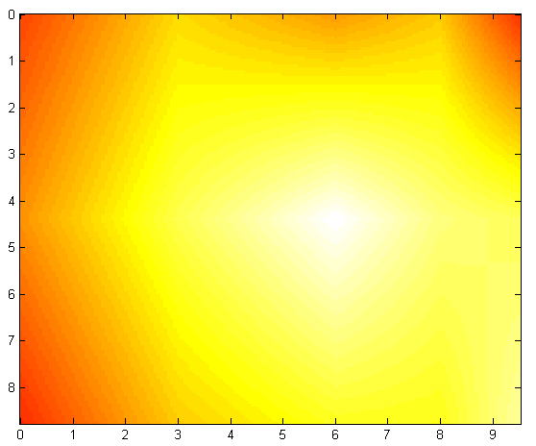

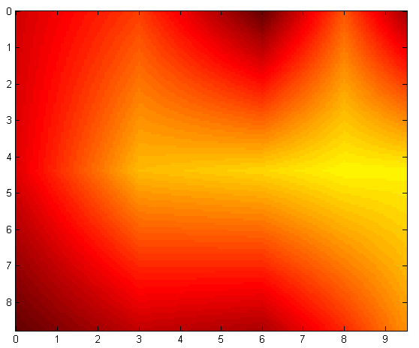
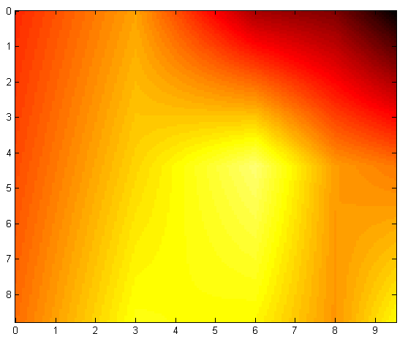
Intermediate Gaps
Right: 0.125”
Left: 0.3125”
Rear: 2.25”
Front: 0”
Set Point: 1113°F
Chamber Temp: 370°F
Fully Closed
Right: 0”
Left: 0”
Rear: 0”
Front: 0”
Set Point: 1112°F
Chamber Temp: 384°F
Fully Open
Right: 1.875”
Left: 2.125”
Rear: 2.25”
Front: 0”
Set Point: 1158°F
Chamber Temp: 467°F

Slide 31
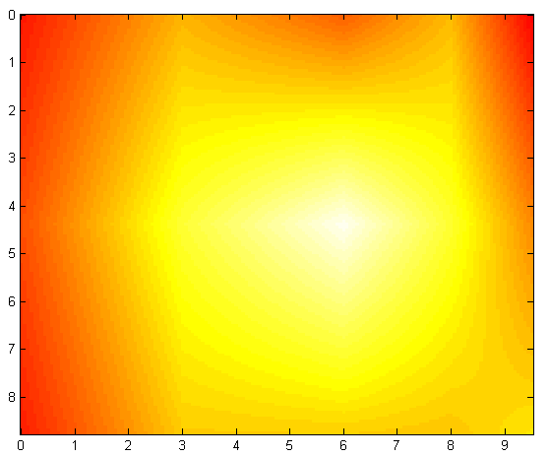
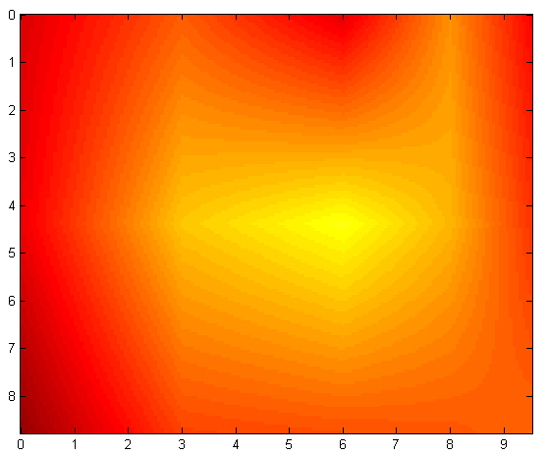
Air Flow Study
Right Closed
Right: 0.125”
Left: 2.125”
Rear: 2.25”
Front: 0”
Set Point: 1113°F
Chamber Temp: 369°F
Right Open
Right: 1.875”
Left: 0”
Rear: 0”
Front: 0”
Set Point: 1126°F
Chamber Temp: 360°F

Slide 32
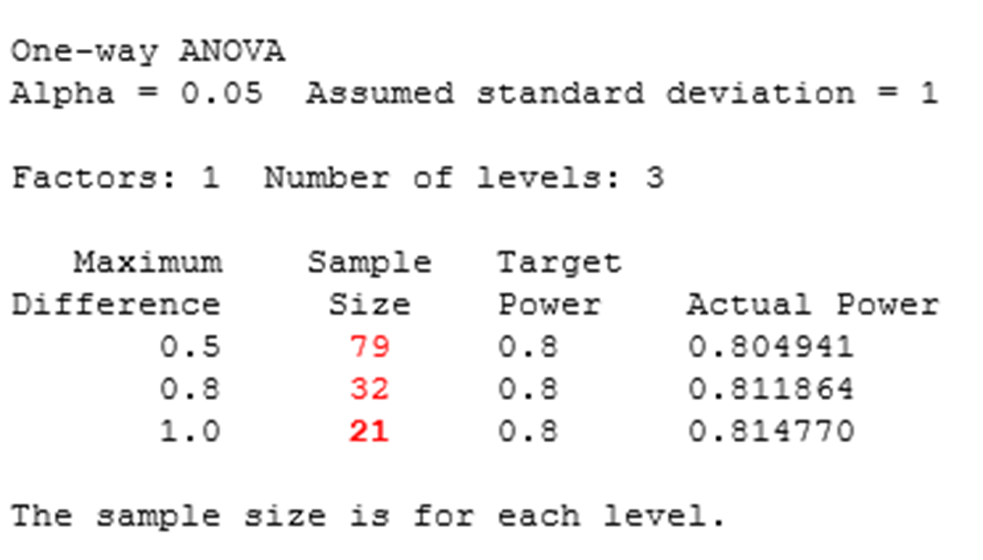
Future Work
Send thermocouple array to 3 other labs to test
Statistically determined that at least 20 samples of a material would be required at each air gap level to get the best results
60 Metalized PEEK samples total for each lab

Slide 33
Questions?

