Slide 1
RTCA Development of a New Flammability Test for Electronic Boxes

Slide 2
Introduction
RTCA DO-160G is the current international standard for environmental testing of commercial avionics
Section 26, Category C defines the flammability testing requirements for electronic housings and component parts
Next revision for DO-160(H) is due January 2019
The goal is to eliminate confusion on how to apply the current standards and simplify the tests required for the next revision

Slide 3
Current test standards
Small part exemptions

Slide 4
Goal
Create alternative test procedure where the electronic enclosure with its internal components is tested whole instead of testing each part individually

Slide 5
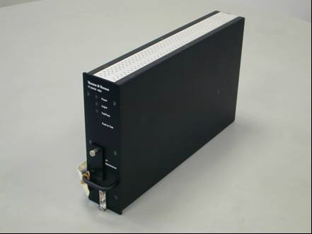
Current Test Methods
Identified two current test methods which test electronic enclosures whole
These will be used as a starting point to be evaluated and refined for this group

Slide 6
Method 1
Telecom Industry test (ANSI T.319)
Methane line burner as fuel source
11 $7/{64}"$ holes spaced $1/2"$ apart
Fuel regulated by a methane flow controller (simulates circuit board igniting and burning through to completion)

Slide 7
Method 1
If printed circuit boards (PCB) are oriented horizontally, methane flow rate is fixed at 5L/min for 120s
If PCBs are vertical, methane flow rate follows a curve based on PCB height
$Q_{peak}=\left(0.071×h^{1.26}−0.03\right)×1.8$
Q_{peak} = Maximum methane flow rate (L/min)
h = vertical dimension of tallest PCB (cm)

Slide 8
Method 1

Slide 9
Method 1
Requires insertion of a programmable burner into the equipment chassis
Flame is placed to impinge area within chassis with most fuel load
Heat released is measured along with observations of smoke
Fire is not allowed to escape the enclosure to ignite any surrounding equipment

Slide 10
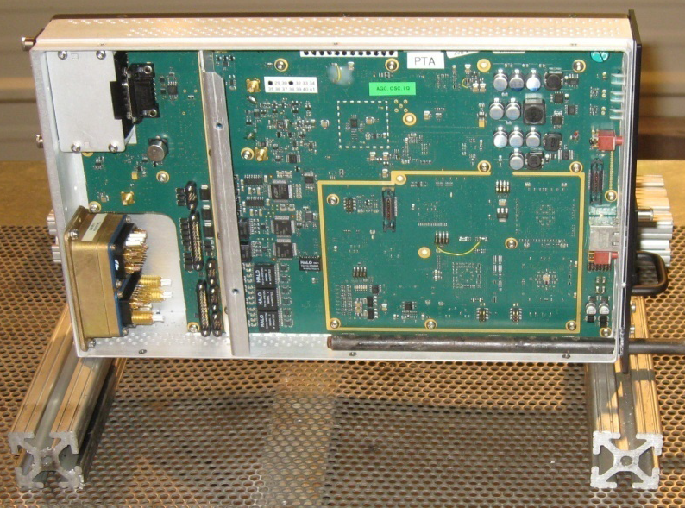
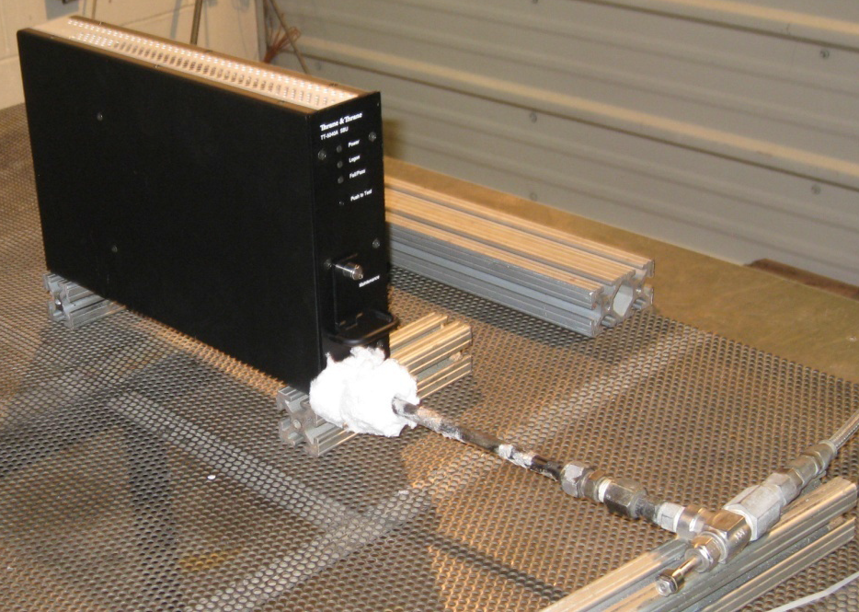
Method 1

Slide 11
Method 1

Slide 12
Method 1

Slide 13
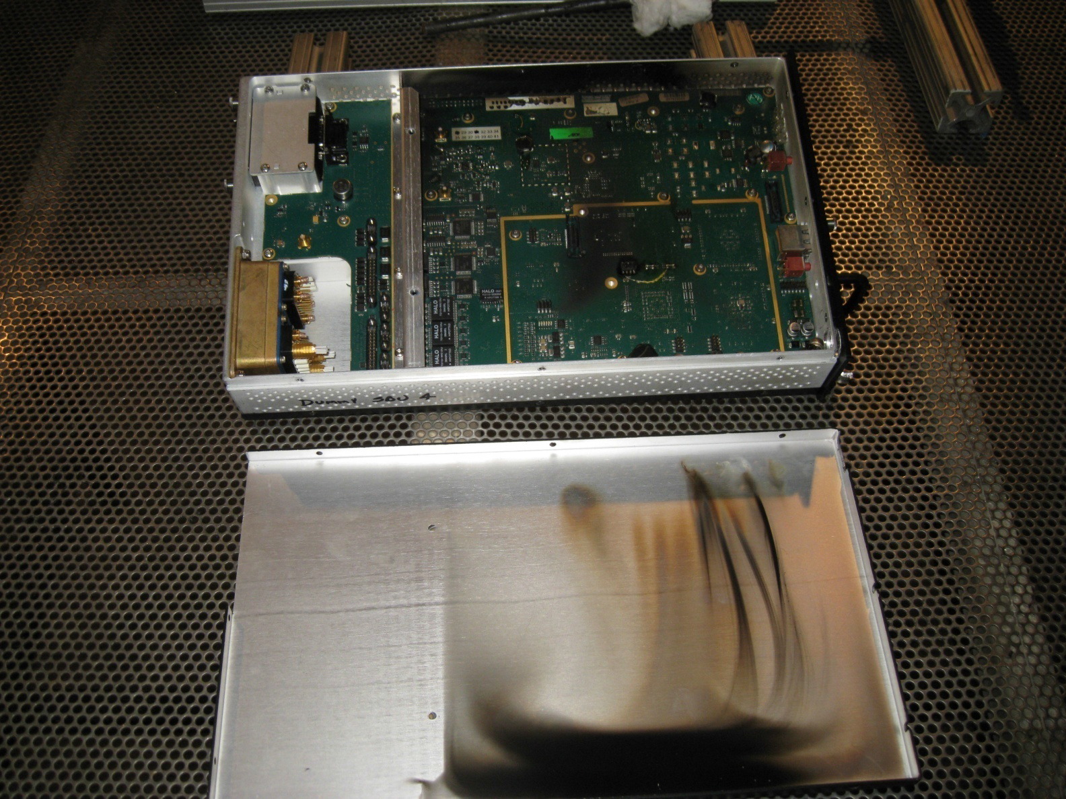
Method 1

Slide 14
Method 2
Foam block + heptane as fuel source
Fuel load is based on the mass of each material in the box and its combustion energy
Polymer | Combustion Energy (MJ/kg)
Epoxy | 34.3
PA | 32.6
PE | 47
PP | 47
PET | 23.2

Slide 15
Method 2
Foam block + heptane is sized to match the combustion energy of the internal components of the box
Ratio is kept close to 10mL heptane to 4”x4”x9” foam block, but can be adjusted if space is limited
Foam block is positioned near critical parts for worst case scenario
Fire Source | Combustion Energy (MJ/kg)
PUR | 37.3
n-Heptane | 44.7

Slide 16
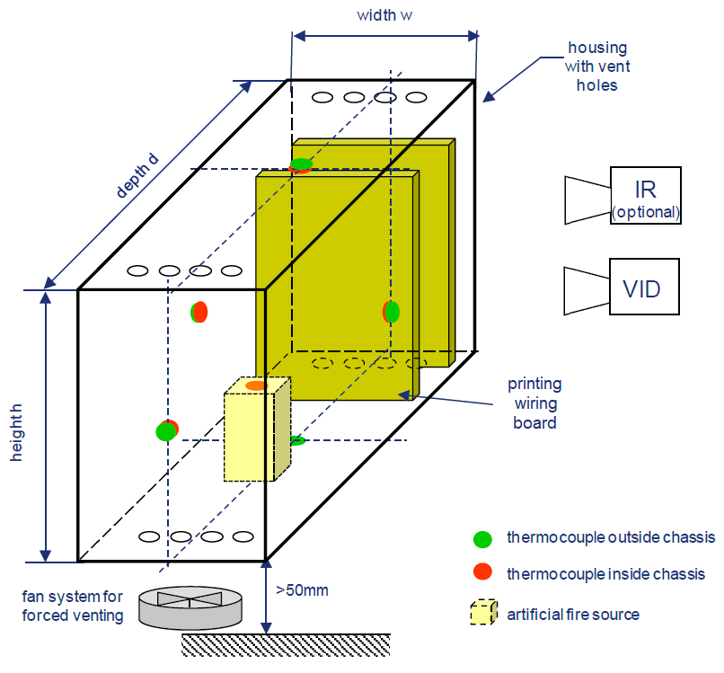
Method 2
Fire must not leave the housing and propagate into the surrounding area

Slide 17
Comparative Testing
Testing by Element in Minnesota
Burn boxes whole using a programmable line burner with methane
Determine placement of the burner within the box
Determine how many burns necessary/test locations
Evaluate results of test
Compare approach/results with Airbus foam block method

Slide 18
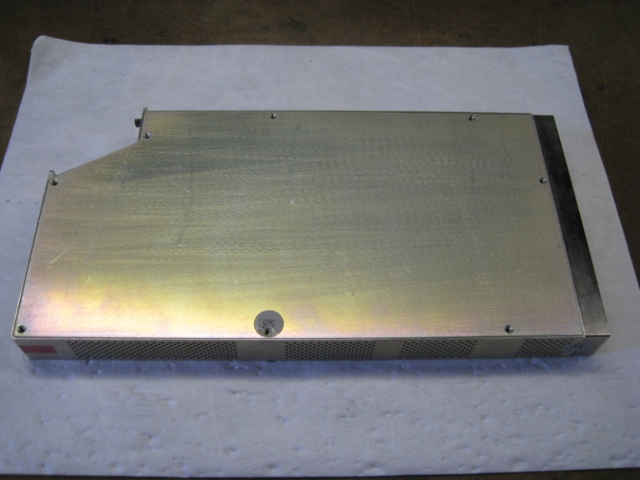
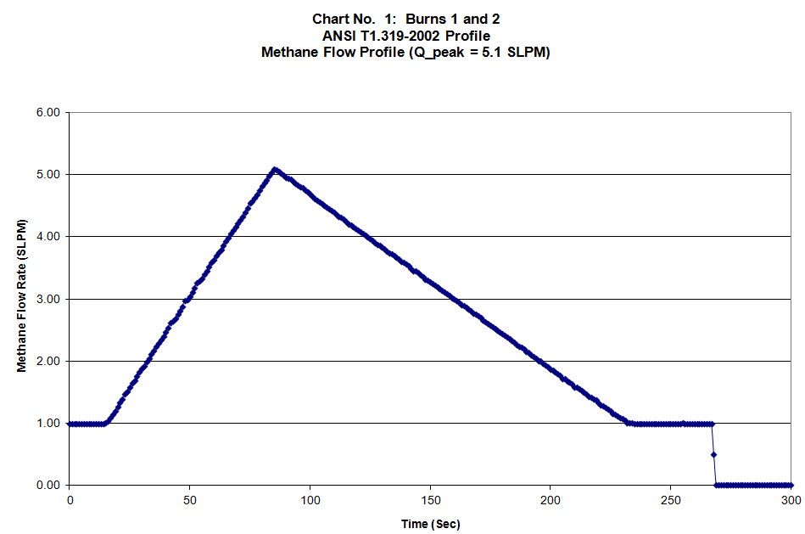
Comparative Testing
Two units were provided for comparative testing
This unit consisted of two circuit board assemblies mounted inside of an aluminum chassis
The chassis had ventilation holes at the top and the bottom
Methane flow profile was calculated based on height of PCB

Slide 19
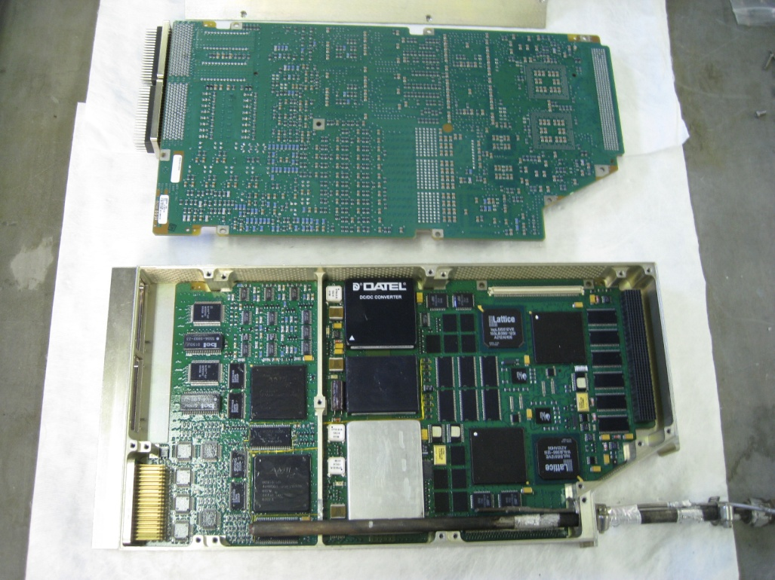
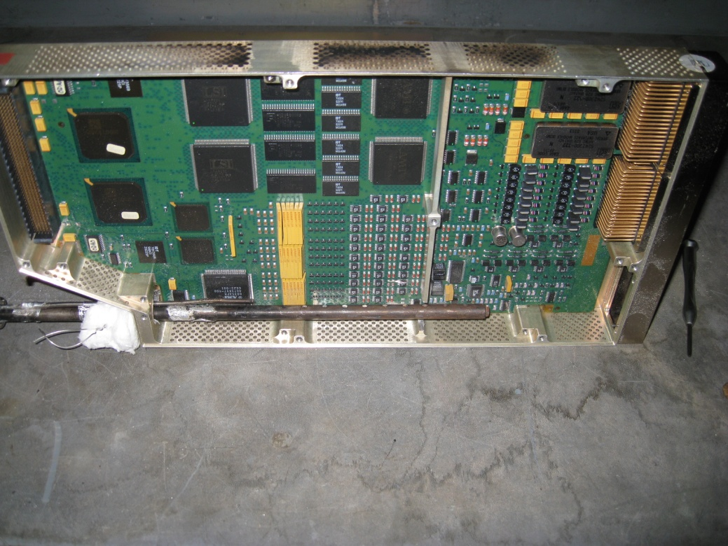
Comparative Testing
Two burns were conducted
In each case one of the two circuit boards was replaced by the line burner.
First burn straight up, second burn rotated to impinge circuit board
SLIIM Module placed 2” above electronic box

Slide 20
Comparative Testing
Burner rotated towards PCB

Slide 21
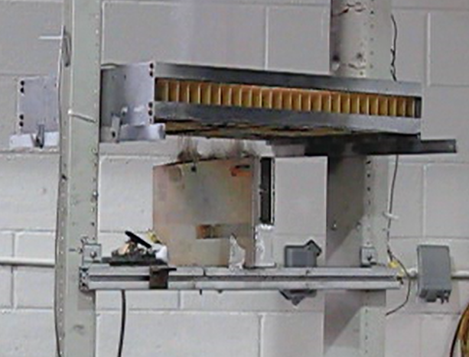
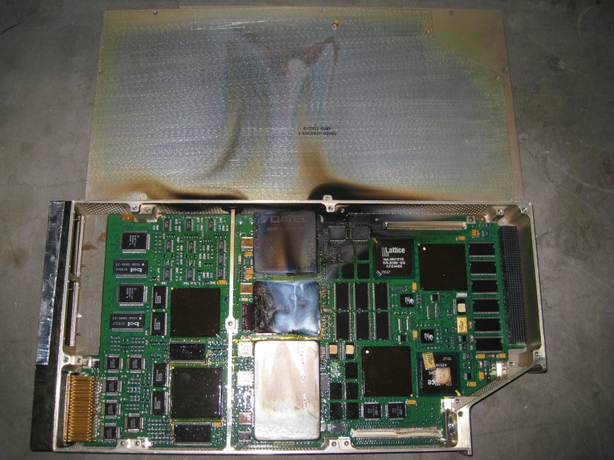
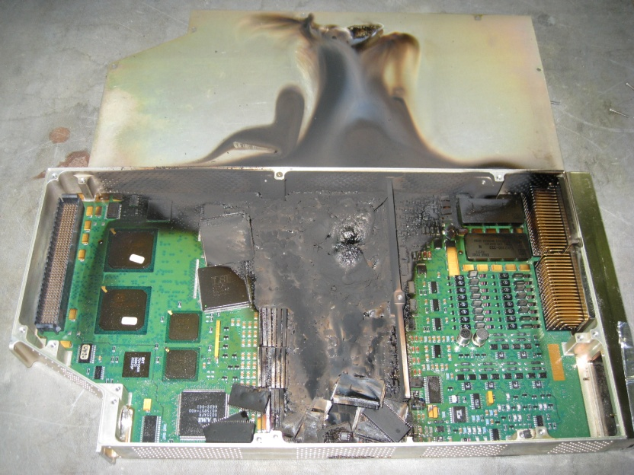
Comparative Testing
No visible flames outside of the unit throughout the duration of both tests
Damage more severe from the second burn
Smoke mirrored line burner

Slide 22
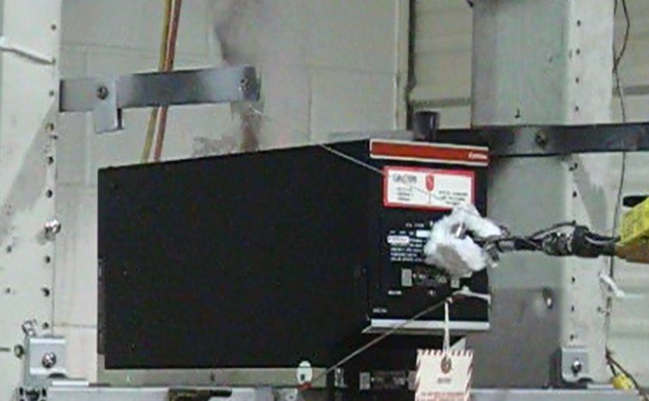
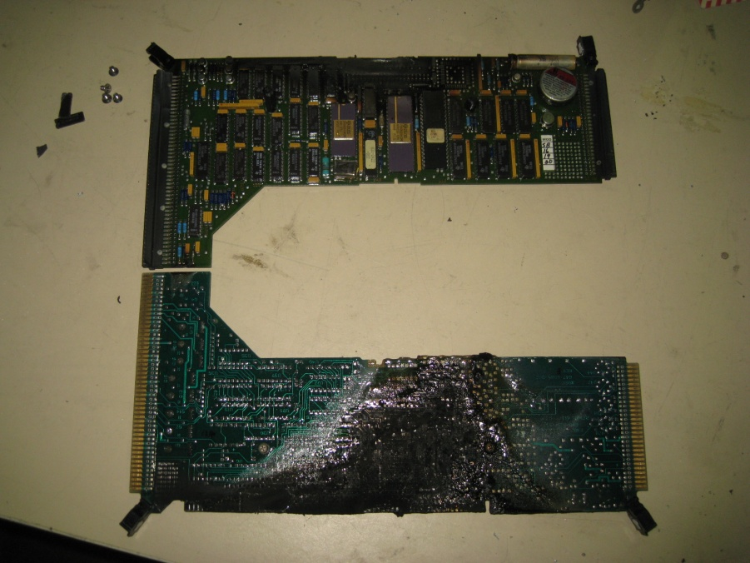
Comparative Testing
Unit consists of 6 PCBs mounted inside of an aluminum enclosure
Methane line burner self-extinguished in multiple locations
Experiment: additional holes drilled into top and bottom of enclosure – Ventilation to support combustion, insert flame sideways – hit all 6 PCBs

Slide 23
Comparative Testing

Slide 24
Lessons Learned
Evaluation and Testing can be performed in one day
Placement of line burner and number of test locations is subjective
Line burner may be too large for small units
Burner rotation can affect test results
The line burner may self extinguish prior to a draft forming (enclosures with limited ventilation)
Need a clear definition of pass / fail

Slide 25
June Task Group Meeting
Group decided to move forward with the line burner
More consistent
Works better with small enclosures
As a starting point, we agreed to use 12 second flame with 1.5” height as the maximum allowable flame to escape, based on vertical Bunsen Burner test
Other focus will be on guidance: where to place burner, how many burns in each box, what happens if burner goes out, etc.

Slide 26
Draft Test Procedure
Alan Thompson wrote a first draft for this new test procedure
Mostly based on Telecom test procedure presented earlier
Lots of testing still needs to be done
Adjust pass/fail criteria?
Use SLIIM module?
Burner placement?
Fuel flow rate changes?

Slide 27
Future FAA Work
Finish setting up our line burner
Comparison tests with Bunsen Burner
Must retain or improve level of safety
Need to source electronic boxes and SLIIM module
Possibly make a generic box that can be tested several times with only replacing the insides

Slide 28
Questions?

