Slide 1
Propagation of a Fire in Electrical Boxes
Fire Safety Engineering & Fire Test
Thomas Krause, PhD & Thomas Vielhaben

Slide 2
Outline
Compliance showing for electrical boxes
Sample box overview
Escape of a fire from a box
Propagation of a fire into a box
Propagation of a fire inside a box
Conclusion

Slide 3
Compliance showing for electrical boxes
Dissect box and apply Bunsen burner for all components
Internal: PWBs, adhesives, cable, capacitors, processors…
External: Housing, labels, connectors
Apply a flame to the box in some way
Line burner for Printed Wiring Boards
Foam block fire inside the box
Similarity statements
Requires existing data from option 1 & 2
Can lead to generalized guidelines ho to treat certain types of boxes

Slide 4
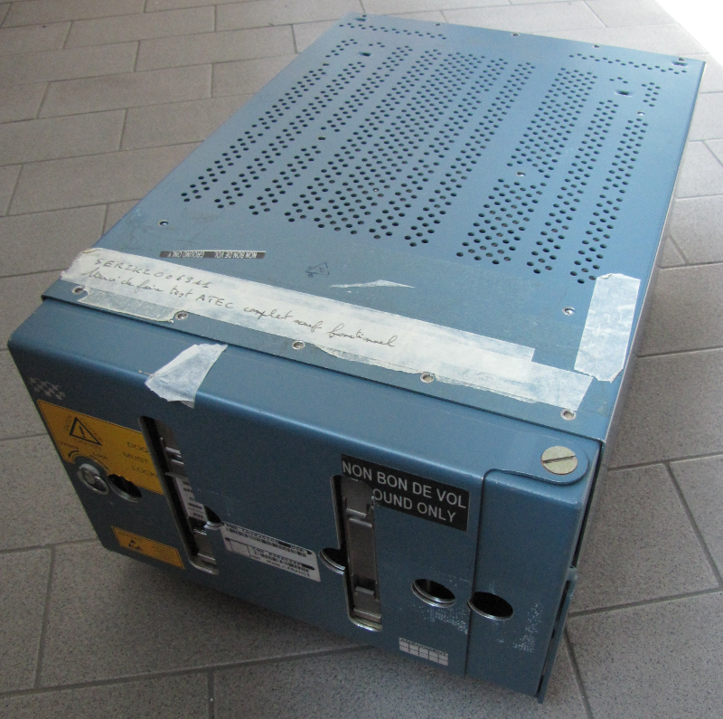
Sample box overview
8 MCU
198 mm
380 mm
259 mm

Slide 5
Sample box overview
Front access panel for storage exchange
Ventilation holes on top and bottom
Back side ports

Slide 6
Sample box overview
4 holes à 20 mm: 4 x 7.07 mm² = 314mm²
861 holes à 3 mm: 861 x 7.07 mm² = 6086 mm²
550 holes à 3 mm: 550 x 7.07 mm² = 3888 mm²
Part of device | Area / cm²
Top | 61
Bottom | 39
Front | 3
Total | 103
103 cm²/4037 cm² = 2.6% of total surface is open

Slide 7
Calculation of fire load
It assumed that the average calorific value of any polymers used in the contruction of the unit equals H_{polymer =} 35 kJ/g and their average density is ρ_{polymer} = 1.3 g/cm³.
The amount of polymers is estimated from a visual inspection of the subcomponents and given as a volume V.
The total theroretical combustion energy H_{total} is calculated as follows:
→ H_{total} = V* ρ / H_{polymer}

Slide 8
Calculation of fire load
Part of PCB | Fire load / MJ
Removable PCBs | 27.6
Non-removable PCB | 2.9
Steering PCBs | 17.7
PCB rails | 1.4
Total | 49.6
This is the equivalent of 1.05 kg / 1.31 l / 0.35 gal of kerosene (46 kJ/g)
As a means of comparison: An oil burner used for the certification of cargo compartment liners uses 0.17 gal kerosene per test (2 gal/h, 5 min) which equals about 23 MJ

Slide 9
Escape of a fire from a box
There shall be at least six thermocouples installed for every test:
On top of the fire source, 25 mm above the housing.
On top of the fire source, 50 mm above the housing.
In the centre of each vertical surface.
In case of multiple fire sources, there shall be two additional thermocouples above each of them.
top view
25 mm
25 mm
25 mm
25 mm
front view
side view

Slide 10
Escape of a fire from a box
26.5 g foam + 4.5 ml heptane = 1.1 MJ

Slide 11
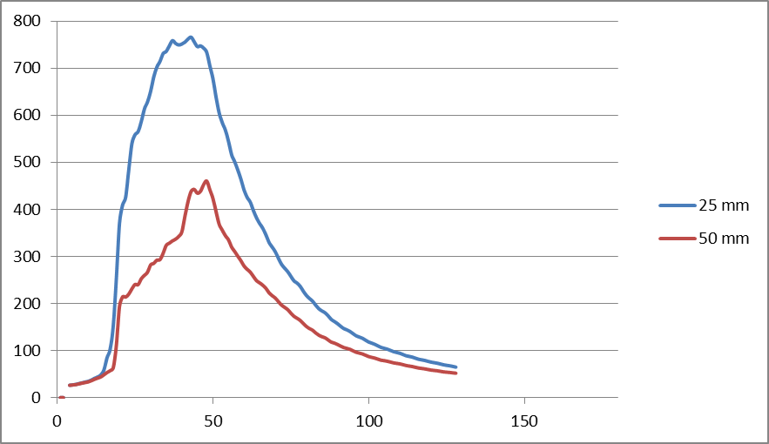
Escape of a fire from a box
26.5 g foam + 4.5 ml heptane = 1.1 MJ

Slide 12
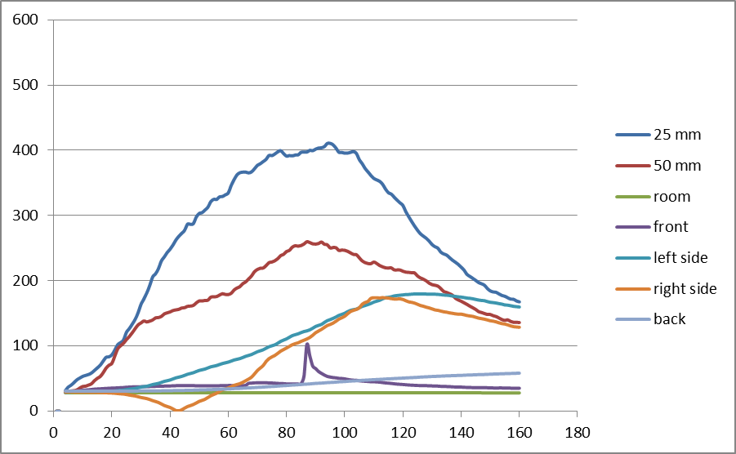
Escape of a fire from a box
64.8 g foam + 10 ml heptane = 2.7 MJ
VIDEO
No flame spread out of the device

Slide 13
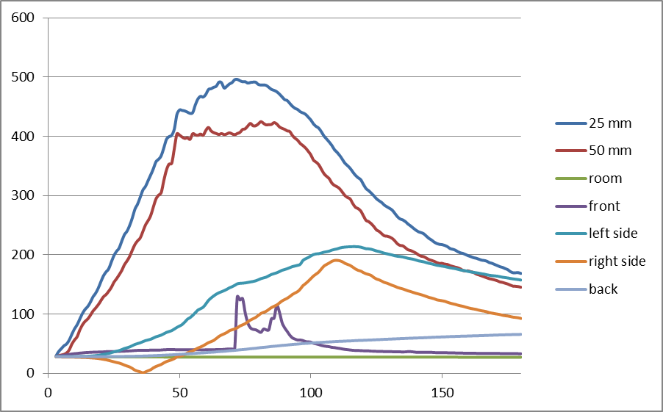
Escape of a fire from a box
66.4 g foam + 10 ml heptane = 2.7 MJ
VIDEO

Slide 14
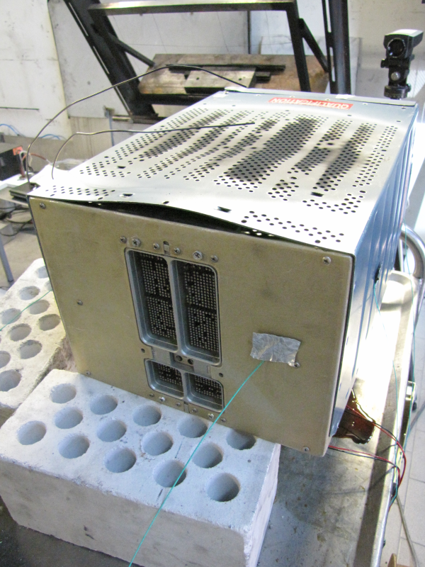
Escape of a fire from a box
66.4 g foam + 10 ml heptane = 2.7 MJ
VIDEO
Any small gap triggers a breach of flames. It shows the importance of a small inter-screw distance.

Slide 15
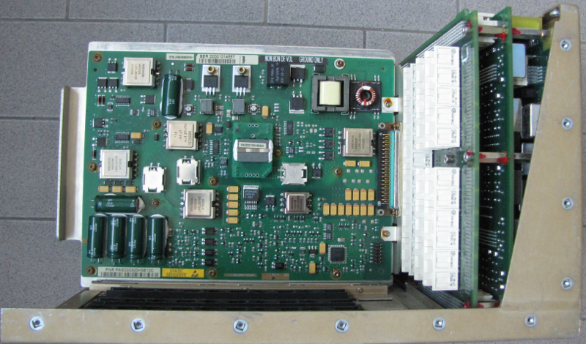
Propagation of a fire into a box
4 in

Slide 16
Propagation of a fire into a box
VIDEO

Slide 17
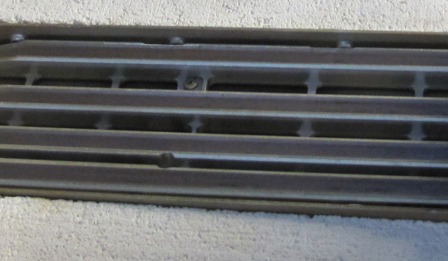
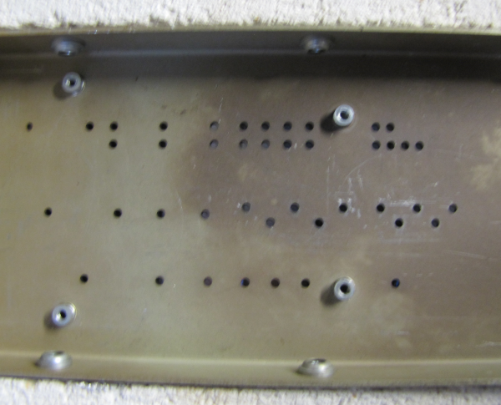
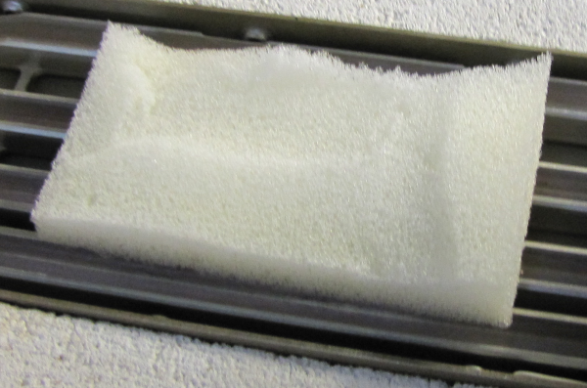
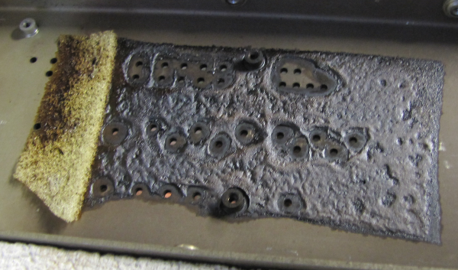
Propagation of a fire into a box

Slide 18
© Airbus Operations GmbH. All rights reserved. Confidential and proprietary document. This document and all information contained herein is the sole property of Airbus Operations GmbH. No intellectual property rights are granted by the delivery of this document or the disclosure of its content. This document shall not be reproduced or disclosed to a third party without the express written consent of Airbus Operations GmbH. This document and its content shall not be used for any purpose other than that for which it is supplied. The statements made herein do not constitute an offer. They are based on the mentioned assumptions and are expressed in good faith. Where the supporting grounds for these statements are not shown, Airbus Operations GmbH will be pleased to explain the basis thereof. AIRBUS, its logo, A300, A310, A318, A319, A320, A321, A330, A340, A350, A380, A400M are registered trademarks.

