Slide 1
The Eighth Triennial International Fire & Cabin Safety Research Conference
Sonic Burner Use in Cargo Liner and Seat Cushion Flammability Tests
The Eighth Triennial International Fire and Cabin Safety Research Conference
Tim Salter, FAA Technical Center
October 24-27, 2016, Atlantic City, NJ

Slide 2
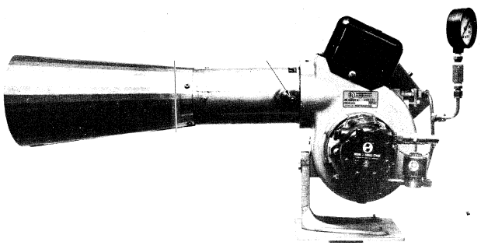
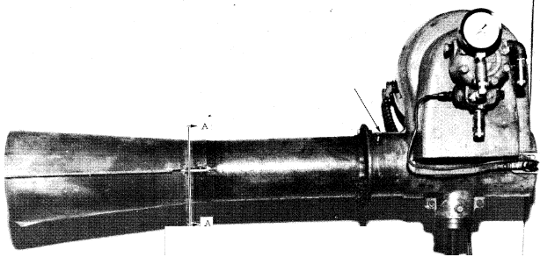
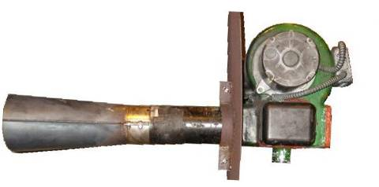
Introduction
The FAA has utilized various forms of a modified home heating oil burner for aircraft material and system fire testing
As aircraft fire safety evolved over the past 50 years, more test methods were developed that employed the oil burner as the test apparatus
At the same time, the oil burners specified in the regulations went out of production and were no longer obtainable
Carlin 200 CRD
Lennox OB-32
Park DPL 3400
Notes:
Quick background on the oil burner…
The FAA has utilized various multiple forms of a modified home heating oil burner for aircraft material and system fire testing
The flame produced by this type of burner is used to simulate the effects of a severe fire in a controlled laboratory-scale test
As aircraft fire safety evolved over the past 50 years, more test methods were developed that employed the oil burner as the test apparatus
The burner is used to test power plant components and firewalls, cargo compartment liners, seat cushions, and thermal acoustic insulation
At the same time, the oil burners specified in the regulations went out of production and were no longer obtainable
Newer oil burners could be used and were considered equivalent if the required heat flux and flame temperatures could be achieved

Slide 3
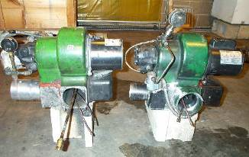
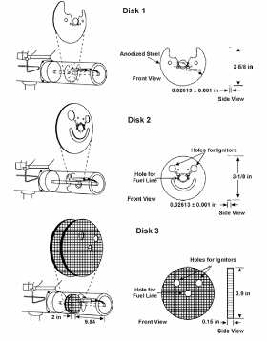
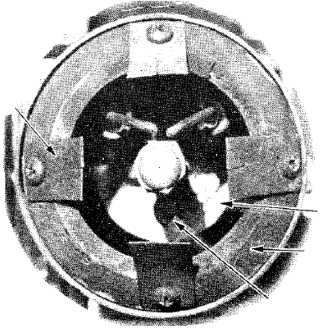
Lessons Learned Over the Years
Not all burners are created equal
Burner configuration can alter the flame characteristics and influence test results
Fluctuations in burner air flow can effect test result
It’s an oil burner for heating a home, not precision lab equipment!
Notes:
What have we learned about the burner over the years?
Not all burners are created equal
Which is undesirable for lab test equipment
The configuration of the burner internal components can drastically alter flame characteristics
And each lab has there own unique burner configuration which leads to poor test result reproducibility
Fluctuations in burner air flow can have a significant effect on test results
Especially for lighter weight materials
And lastly, it is a modified oil burner originally designed for heating a home, and not a precision piece of laboratory test equipment!
So it really isn’t the best design for generating repeatable and reproducible test results for any test method

Slide 4
Replacement Burner Design
Readily available components
Construct in-house or contract out
Increased repeatability and reproducibility
Adaptable to multiple “oil burner” tests
Rely on proper setup and configuration
Detailed dimensions and instructions
Constructed to be equal among labs
Low maintenance
Comparable to Park DPL 3400
Notes:
It was decided that a new and improved fire test burner would be designed
that would avoid problems encountered in the past with oil burners
The new burner will be constructed from readily available components
Capable of being constructed in-house or by a local machine shop
Achieve a higher level of repeatability and reproducibility compared to past burners
Be adaptable to multiple “oil burner” tests
Rely on proper setup and configuration
rather than heat flux or temperature “calibration”
Have detailed dimensions and assembly instructions
available to anyone who wishes to build the device
Constructed to be equal so each lab has the same burner
This includes eliminating adjustability of components, and optional parts such as static disks or tabs that alter flame characteristics
Be low maintenance
And the burner must be comparable to the Park DPL 3400
So that it may be considered an “equivalent” alternative to older burners

Slide 5
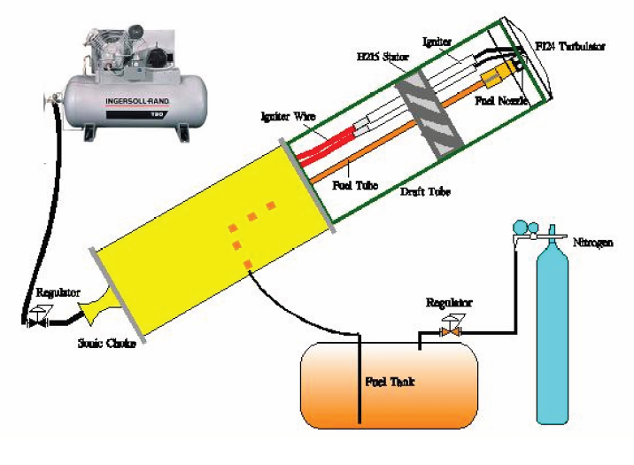
Sonic Burner Initial Concept
Compressed air metered with a “sonic nozzle”
  No electric blower motors
Fuel provided by a pressurized fuel tank
  No motor driven fuel pump
Utilize original Park DPL 3400 components
  Stator, turbulator, igniters, ignition wires, fuel nozzle
Notes:
The initial concept of the burner …
Would use compressed air metered by a sonic nozzle and air pressure regulator
to produce more consistent air flow compared to electric blowers
Fuel is provided by a pressurized fuel tank
to improve fuel flow consistency compared to an electric pump
Utilize original Park DPL 3400 components
Including the Stator, turbulator, igniters, ignition wires, fuel nozzle
Basically, keep the burner design the same internally, but increase repeatability of air and fuel delivery

Slide 6
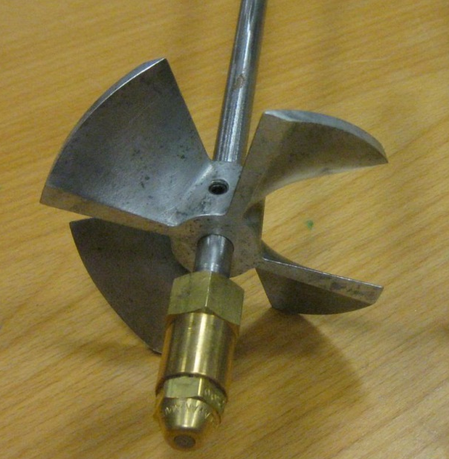
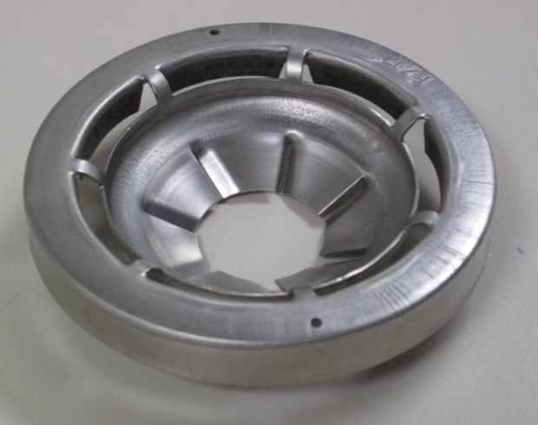
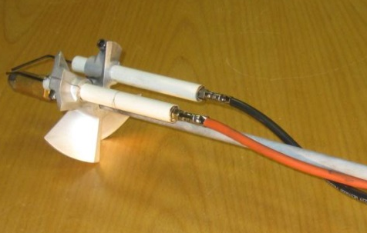
Sonic Internal Design Concepts
Design # 1:
Original stator and turbulator with internal igniters
Design # 2:
Flame retention head with internal igniters
Design # 3:
Igniterless stator and turbulator
*Final Design*
Notes:
A number of internal component designs were test in the sonic burner during the development period…
The first design used the original stator and turbulator with internal igniters and wiring as used in the park-type burners
As with previous burners, this design would require adjustment to produce a satisfactory flame, and would still have the problem of all labs having a unique burner configuration
The second design used a flame retention head in place of the turbulator at the end of the draft tube and a flat plate to hold the igniters in place of the stator
The flame retention head configuration could produce a uniform flame and did not require adjustments as with the previous design
However, it is an “off the shelf part” that could potentially become obsolete and still utilized internal igniters and wiring that could disrupt the flame characteristics
The final design utilizes the original turbulator design, but a symmetrical stator without provisions for igniters and used a automotive type spark plug mounted externally on the burner cone for igniting the air/fuel mixture
The symmetrical stator design and elimination of inter igniters and wiring makes for a much more uniform airflow profile emitted from the burner which allows for improved flame and uniformity
This is crucial to the operating concept of the sonic burner and is why it makes for more repeatable and reproducible test results compared to previous burners.
This

Slide 7
FAA Park Vs. Sonic Comparison
Notes:
6 test sample types
2 different epoxy coated woven fiberglass liners
1 Kevlar liner
1 PAN felt material
2 additional materials

Slide 8
Round Robin Testing
Once testing was completed at the FAA test facility, the next step was to organize a round robin…
What is a round robin?
  A round robin is an interlab study where participating flammability test facilities are all provided with identical test specimens and required to run a particular flammability test in a manner specified by the FAA. All test equipment as well as test procedures between labs are designed to be as equal as possible.
Notes:
Once burner comparative testing was completed at the FAA test facility, the next step was to organize a round robin…
What is a round robin?
A round robin is an interlab study where participating flammability test facilities are all provided with identical test specimens and required to run a particular flammability test in a manner specified by the FAA. All test equipment as well as test procedures between labs are designed to be as equal as possible.

Slide 9
Sonic Cargo Liner Round Robin

Slide 10
Sonic Seat Cushion Round Robin
FH = Fire Hardened FB = Fireblocked

Slide 11
Park & Sonic Seat Round Robin

Slide 12


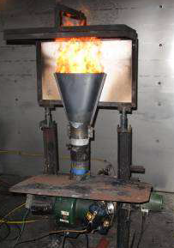
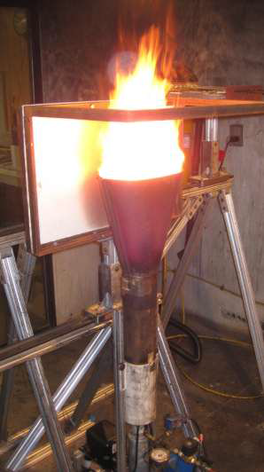
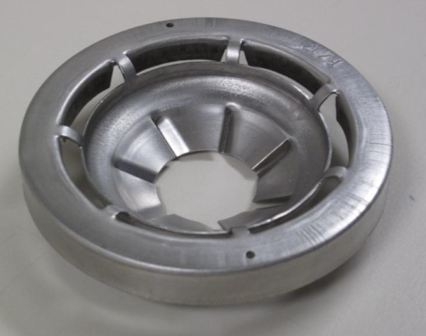



Sonic Burner Development
Park Burner
Sonic Burner

Slide 13
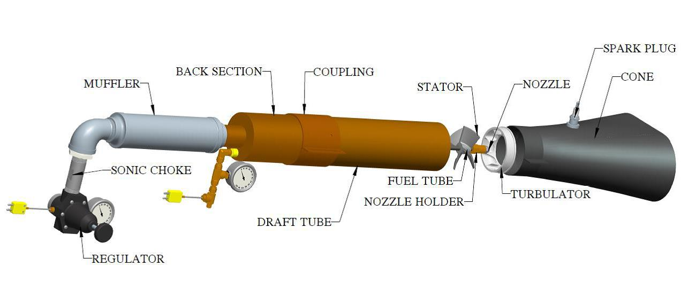
Sonic Burner Operating Principles
Automotive-type spark plug for ignition of fuel/air mixture
Internal components force swirling motion on air to enhance mixing
Sonic nozzle and regulator control airflow
SONIC NOZZLE
Fuel nozzle produces conical fuel spray pattern
Air supplied from air compressor
Fuel supplied from pressurized tank
Notes:
Here is an overview of the sonic burner operating principles…
Compressed air is provided to the burner by and air compressor
The air flow through the burner is controlled via an air pressure regulator and sonic orifice
Fuel is deliver from a pressurized fuel tank with constant pressure
The internal stator and turbulator components produce a swirling, mixing effect on the airflow as it exits the burner and mixes with the fuel spray emitted from the fuel nozzle,
And finally an automotive spark plug mounted on the outside of the burner cone ignites the air/fuel mixture before finally exiting the burner cone
This is important as it eliminates the internal igniters and wiring that can impede and redirect airflow
Also, only the spark plug electrode is exposed to the inside of the cone to generate air/fuel ignition, but does not protrude into the air/fuel mixture so as to disrupt the flow of the mixture as it exits the burner

Slide 14
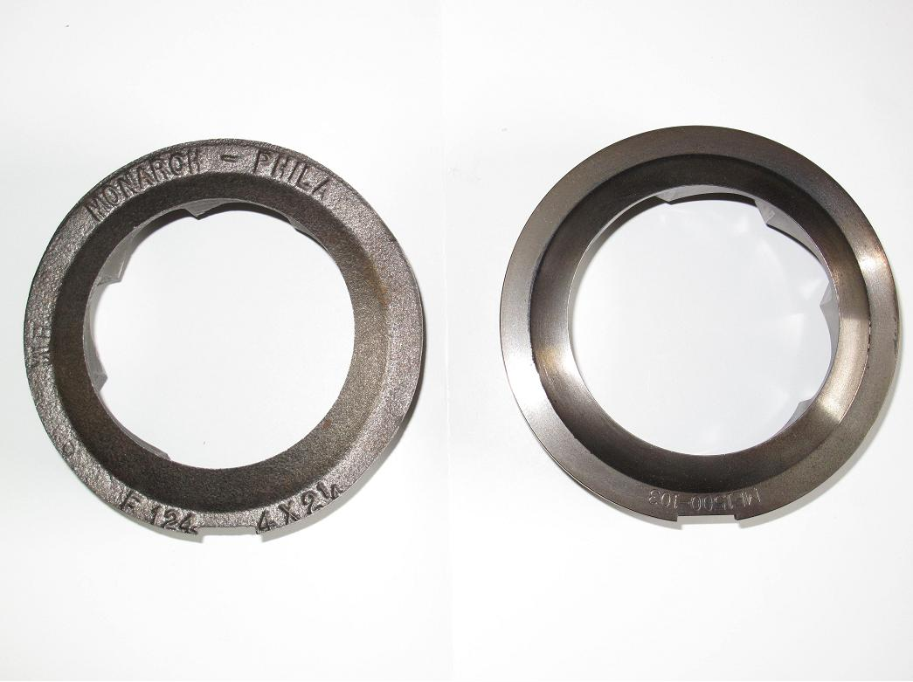
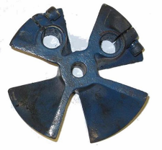

Internal Component Design
A computer numerical controlled (CNC) mill was used to cut new stators and turbulators
The turbulator remains nearly the same, while the new stator no longer has provisions for igniters
Symmetrical design produces uniform airflow
Park Burner
Sonic Burner
Turbulator
Stator
Notes:
A computer numerical controlled, or CNC, mill was used to cut new stators and turbulators
Based on the original components used in the Park-type burners
The turbulator remains nearly the same, while the new stator no longer has provisions for igniters
This makes for a more symmetrical stator design and results in a more uniform and repeatable airflow can

Slide 15
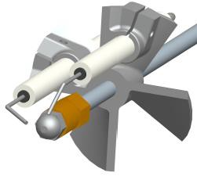
Internal Component Adjustment
Park-Type Burner
Notes:
On the left, you can see the possible adjustments on previous burners indicated by the red arrows.
On the right, you can see the possible Sonic burner adjustments indicated by the green arrows. (none)
The idea being that if all burners are configured the same, all burners should perform the same, and the need for heat flux and temperature calibration can be eliminated

Slide 16
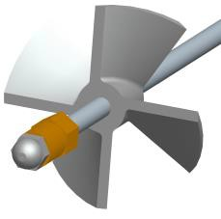
Internal Component Adjustment
Park-Type Burner
Sonic Burner
None
Notes:
On the left, you can see the possible adjustments on previous burners indicated by the red arrows.
On the right, you can see the possible Sonic burner adjustments indicated by the green arrows. (none)
The idea being that if all burners are configured the same, all burners should perform the same, and the need for heat flux and temperature calibration can be eliminated

Slide 17
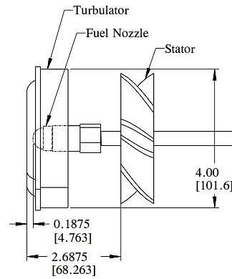
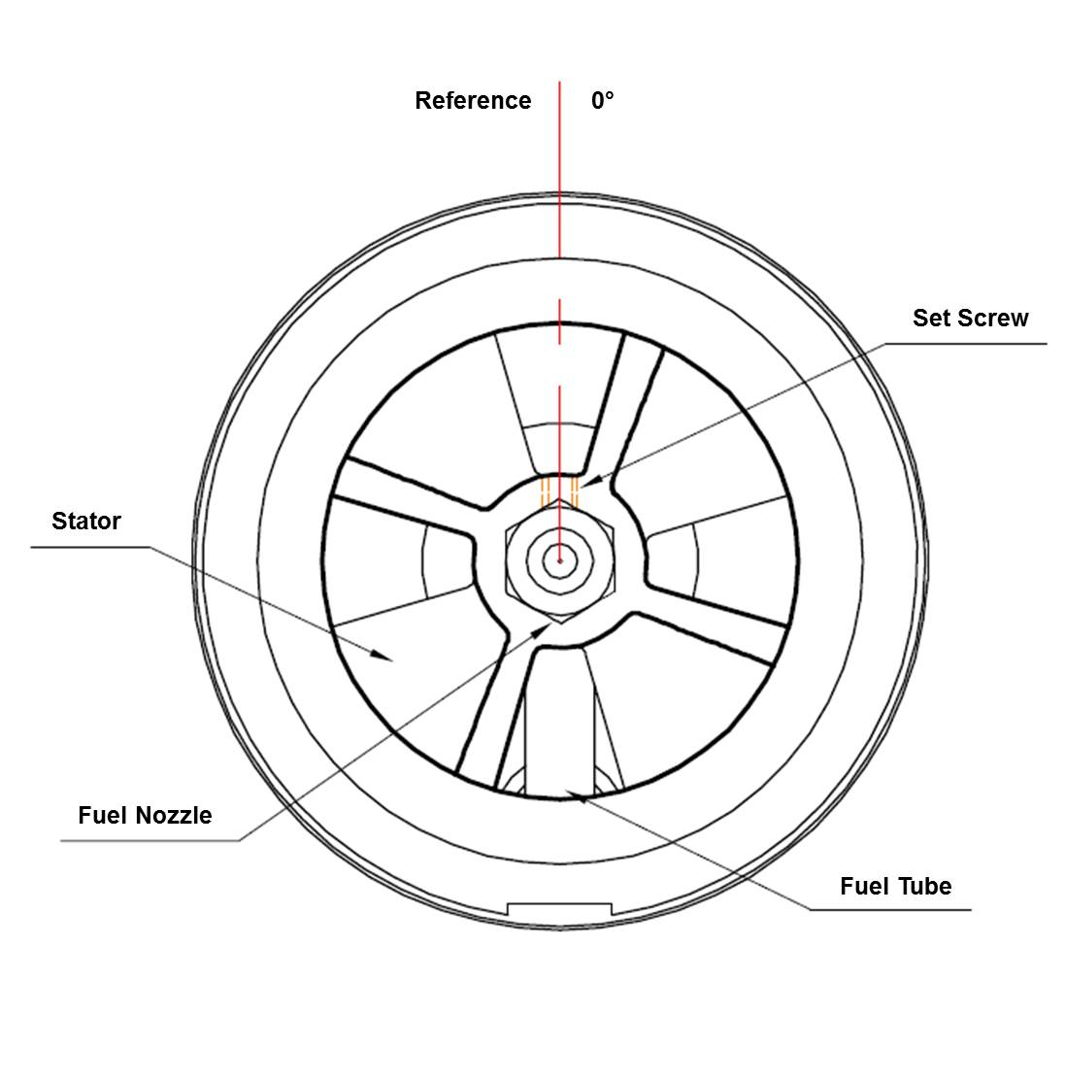
Sonic Internal Configuration
Notes:
All Sonic Burner internal component locations are clearly defined with tolerances in each test method
Meaning stator depth, stator angle on the fuel rod, and fuel nozzle depth
This makes it such that all sonic burner for a particular test method are nearly identical
This further improves repeatability and reproducibility among labs.

Slide 18
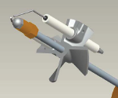
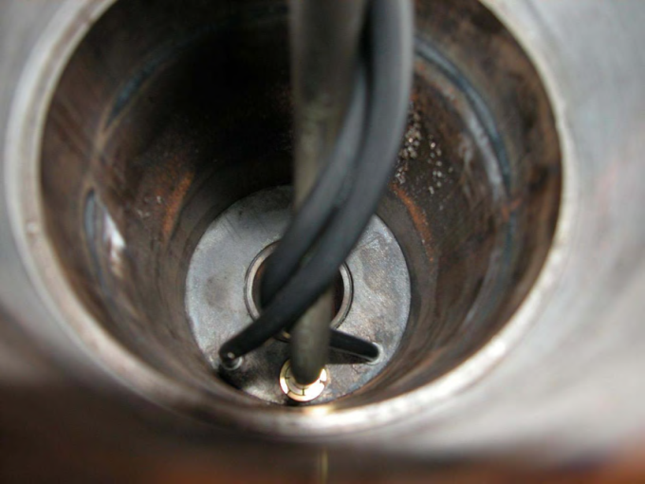
Park Ignition Components
No specified configuration for igniters or wires
Igniters and ignitor wires can alter burner airflow and the flame characteristics
Test result repeatability and reproducibility concern
Notes:
Fuel and air ignition components…
No specified configuration for igniters or wires
Meaning each burner had it’s own unique internal ignitor and ignition wire arrangement
Internal igniters and ignitor wires can influence airflow in the burner
Which can alter the burner flame characteristics and reduce test result reproducibility among test labs

Slide 19
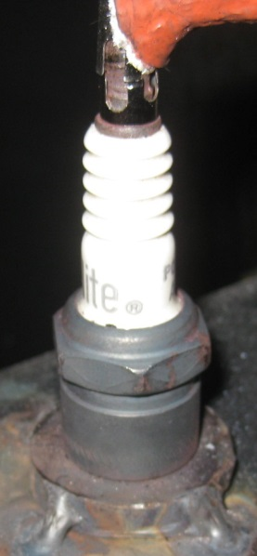
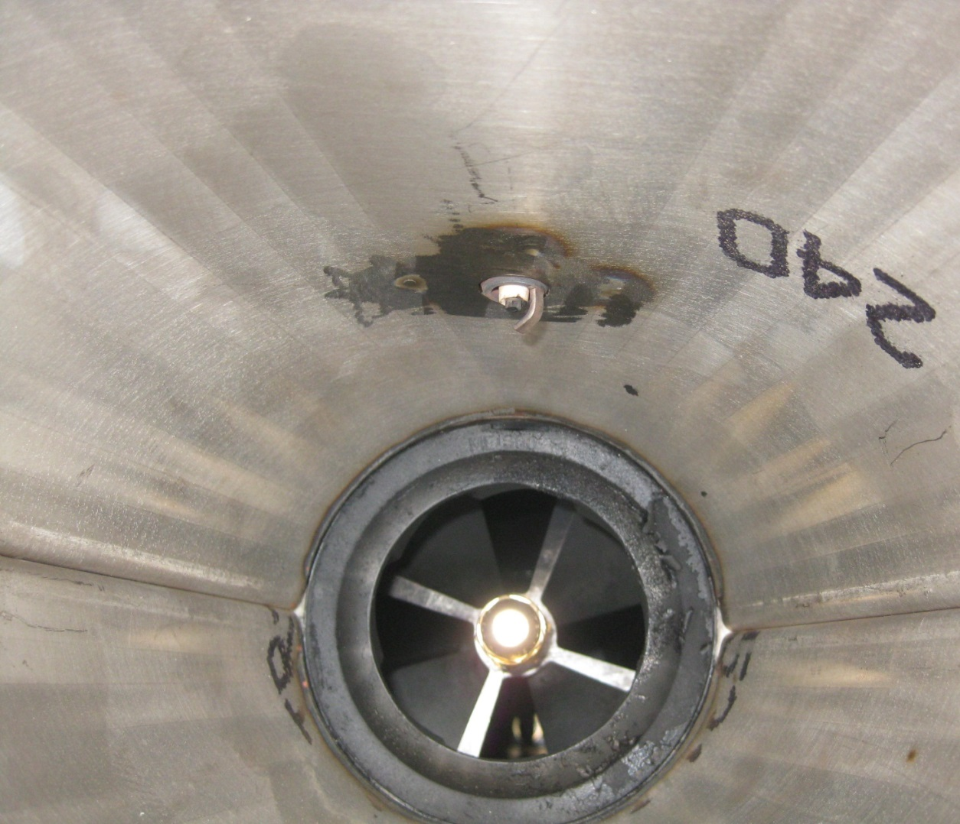
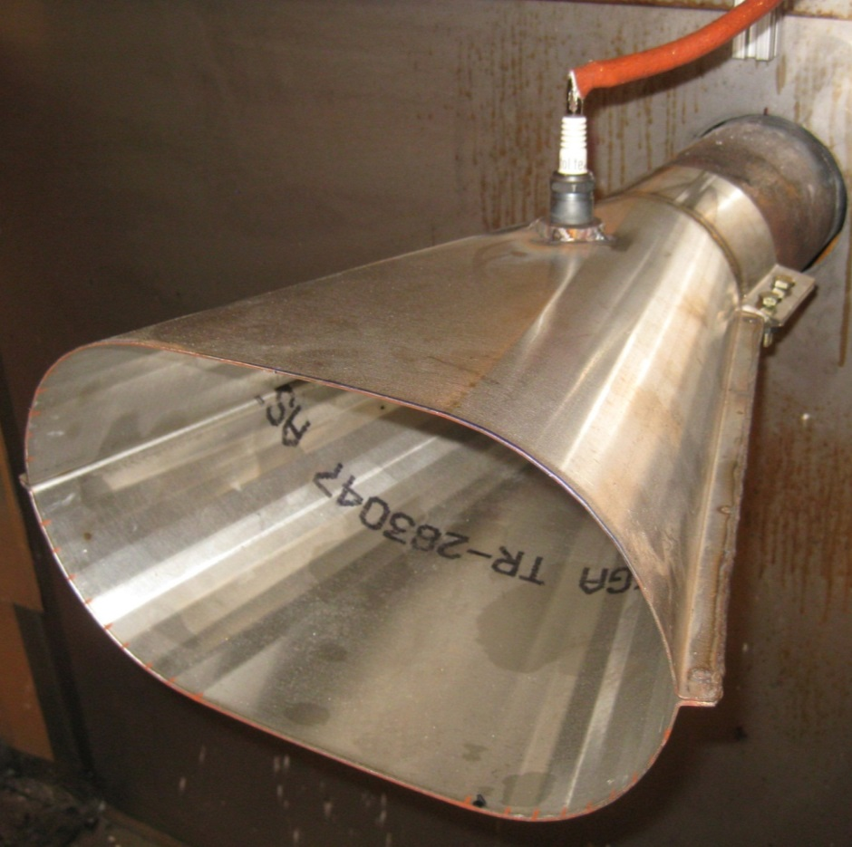
Sonic Ignition Components
Notes:
The internal ignitors and associated wires found in in previous burners have been eliminated
This reduces the number of obstructions within the draft tube that can influence the uniformity of the air flow emitted from the burner

Slide 20
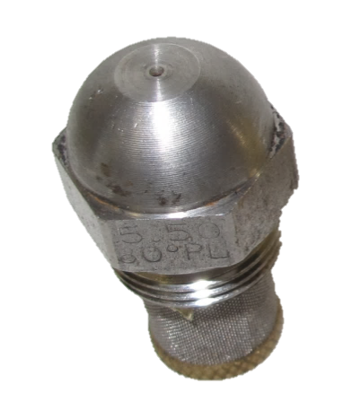
Fuel Nozzle
Park Burner Fuel Nozzles
Fuel nozzle brand recommended for Park burner found to produce uneven spray patterns
Flame temperature profile changes drastically by rotating nozzle
Notes:
A study was performed on the performance of the fuel nozzles recommend for use in Park-type burners
Testing revealed these fuel nozzles often produced a uneven spray pattern and causing the burner flame to be biased to one side or another as it exits the burner cone
Simply rotating a nozzle produced had a drastic effect on the flame and temperature profile measured using a 7-thermocouple rake
Flow testing also proved that measured flow rates often differed from the rated flow of the fuel nozzle, and nozzles with the same flow rating would produce different flow rates at the same fuel pressure
The problem was attributed to manufacturer quality control
Multiple nozzle designs and from different manufacturers were tested to source a fuel nozzle with improved spray uniformity and flow repeatability.
Fuel nozzles produced by the Delavan company were selected for the uniformity of the fuel spray pattern, and measured fuel flow that more closely match the rating of the fuel nozzle.

Slide 21
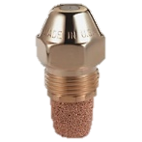
Fuel Nozzle
Park Burner Fuel Nozzles
Fuel nozzle brand recommended for Park burner found to produce uneven spray patterns
Flame temperature profile changes drastically by rotating nozzle
Alternative fuel nozzle recommended for use in Sonic burner
Notes:
A study was performed on the performance of the fuel nozzles recommend for use in Park-type burners
Testing revealed these fuel nozzles often produced a uneven spray pattern and causing the burner flame to be biased to one side or another as it exits the burner cone
Simply rotating a nozzle produced had a drastic effect on the flame and temperature profile measured using a 7-thermocouple rake
Flow testing also proved that measured flow rates often differed from the rated flow of the fuel nozzle, and nozzles with the same flow rating would produce different flow rates at the same fuel pressure
The problem was attributed to manufacturer quality control
Multiple nozzle designs and from different manufacturers were tested to source a fuel nozzle with improved spray uniformity and flow repeatability.
Fuel nozzles produced by the Delavan company were selected for the uniformity of the fuel spray pattern, and measured fuel flow that more closely match the rating of the fuel nozzle.

Slide 22
Sonic Burner Control Systems
3 Systems

Slide 23
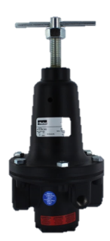
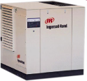

Sonic Burner Control Systems
Air Supply

Slide 24
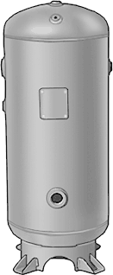
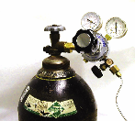
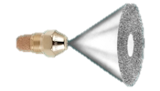
Sonic Burner Control Systems
Air Supply
Fuel Supply

Slide 25
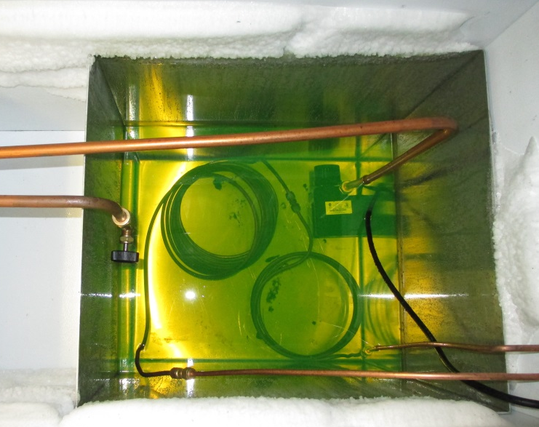
Sonic Burner Control Systems
Air Supply
Fuel Supply
Temperature Conditioning

Slide 26

Fuel Flow and Temperature Control

Slide 27
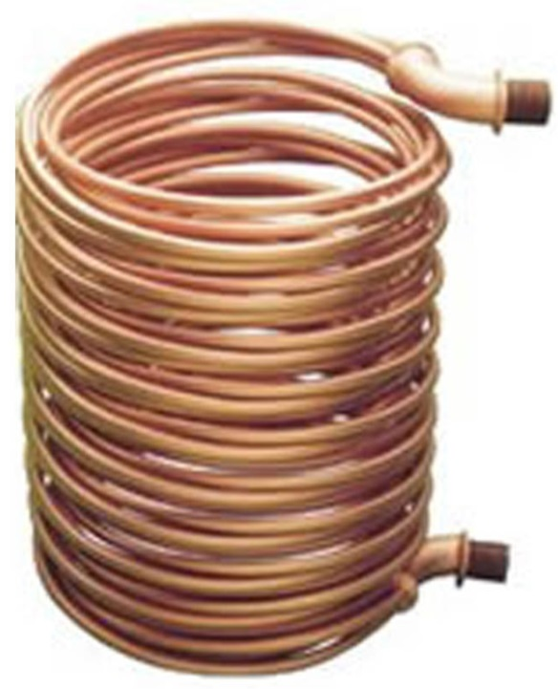
Fuel Flow and Temperature Control

Slide 28
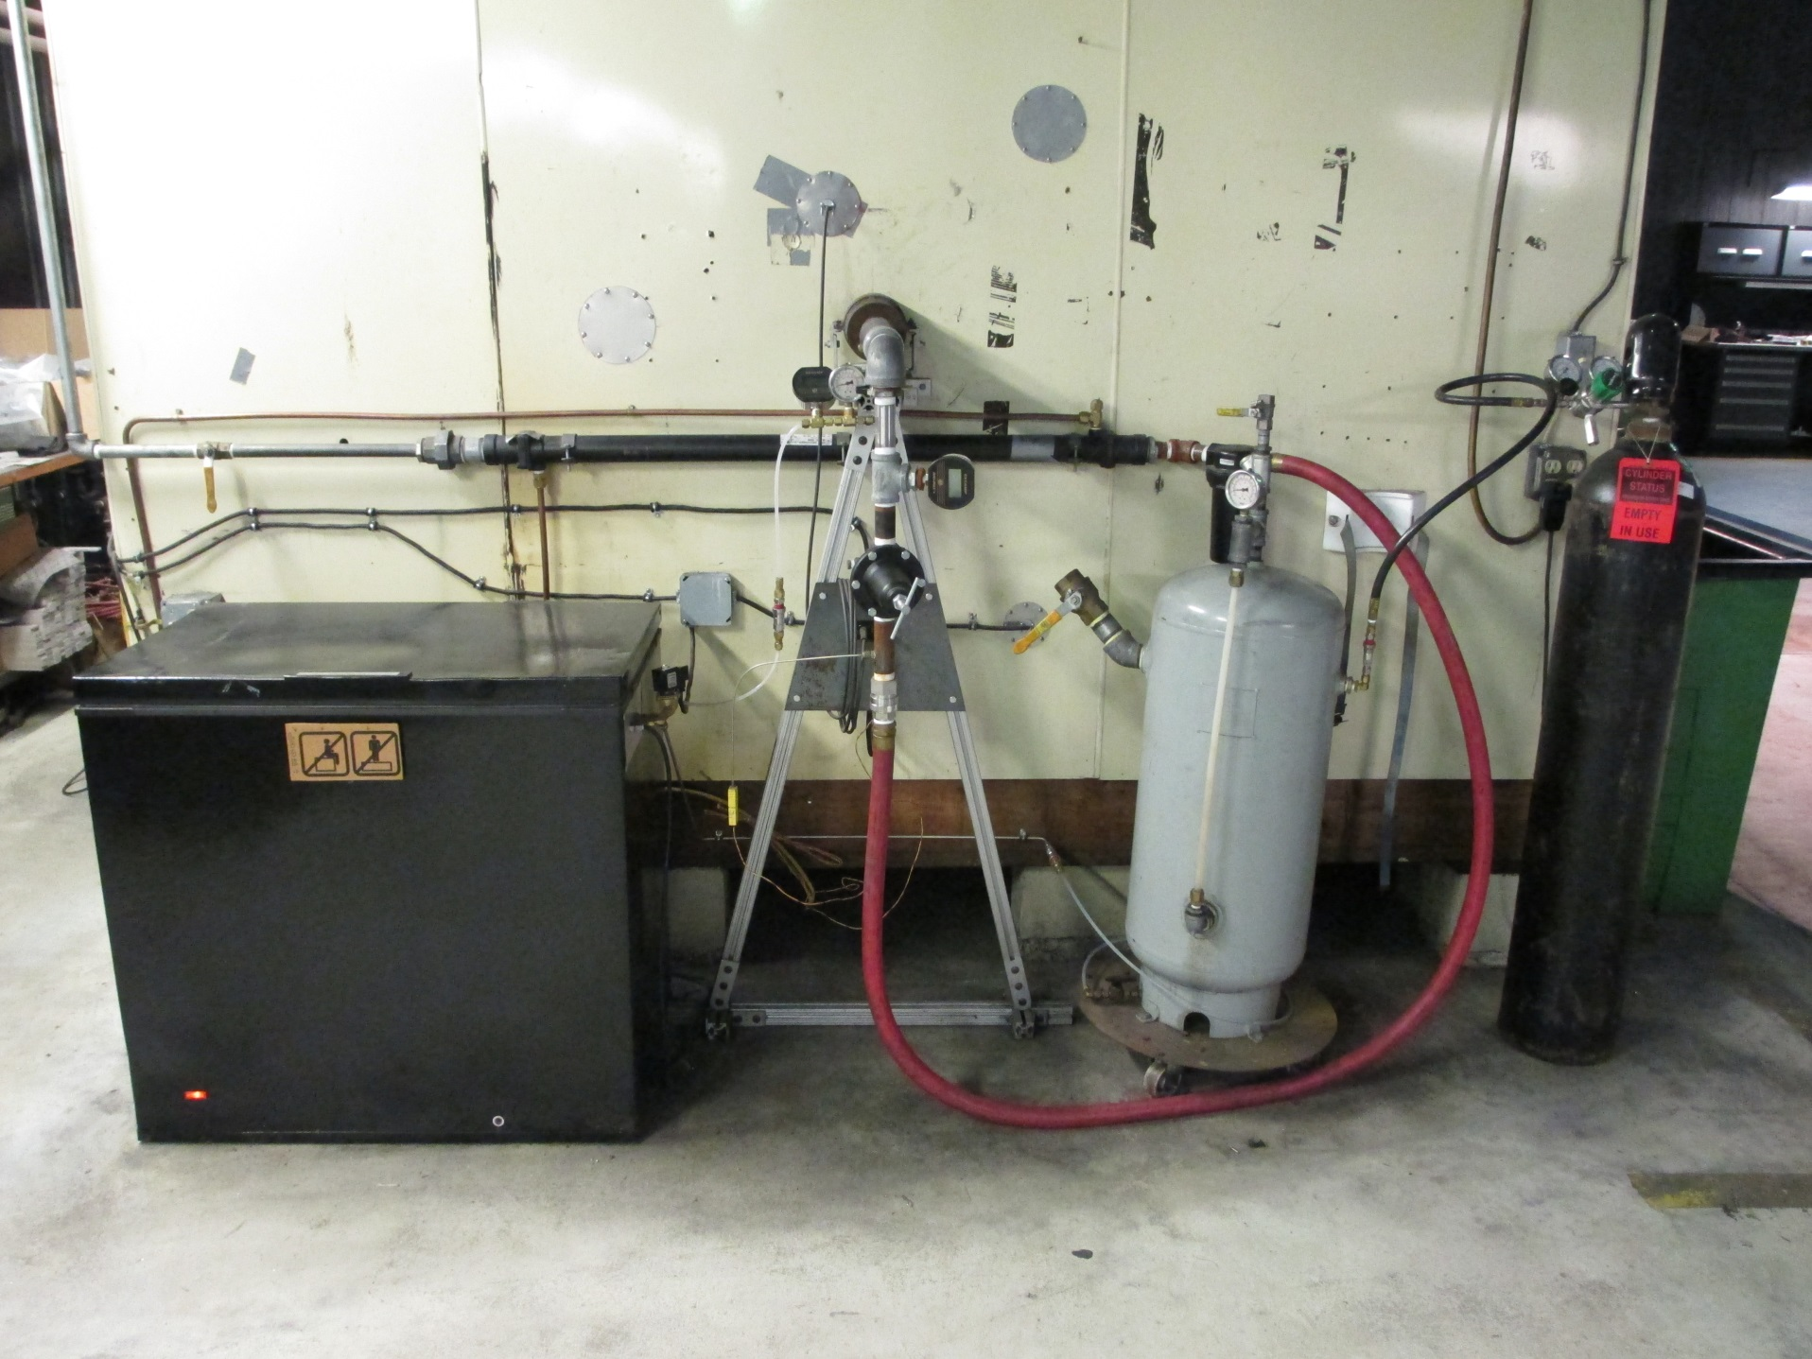

Slide 29
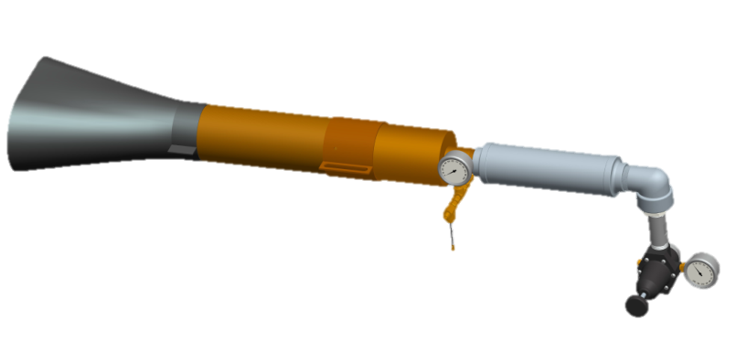

Slide 31
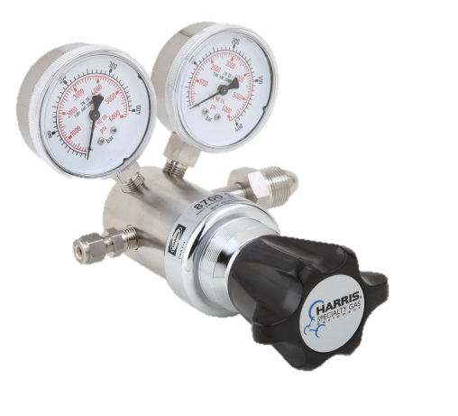

Slide 34
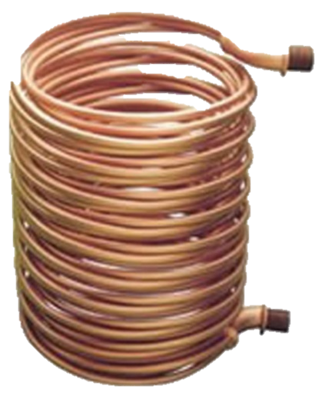

Slide 36
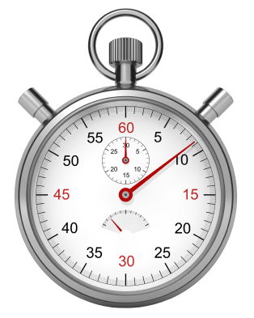
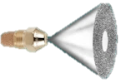
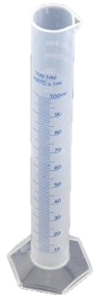

Slide 37
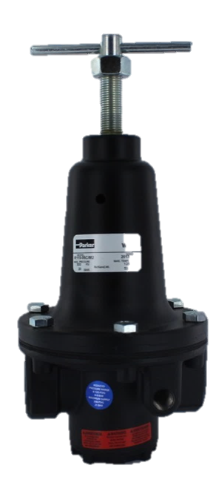
Air Flow and Temperature Control

Slide 38
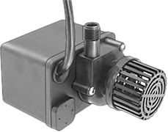
Air Flow and Temperature Control

Slide 39
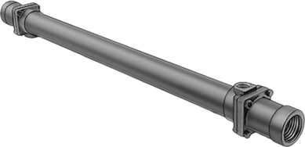
Air Flow and Temperature Control

Slide 40
Air Flow and Temperature Control

Slide 42
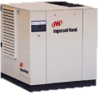

Slide 47
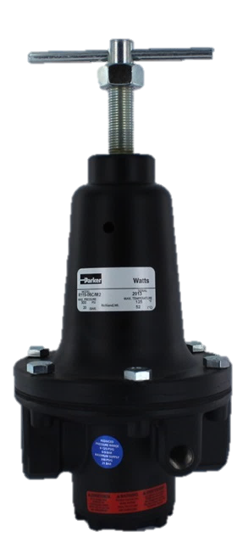

Slide 48
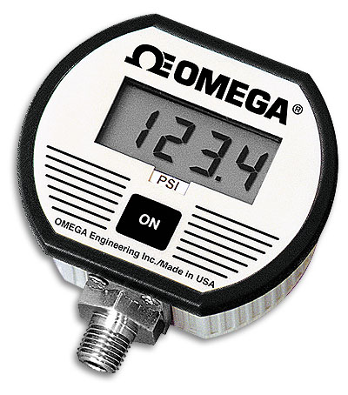

Slide 51
Fuel & Air Pressure Measurement
Fuel and air pressure gauges are required have a NIST (or equivalent) certification and have an accuracy of +/-2% or less
The operational pressure range of the gauge should be matched appropriately to the fuel and air pressures of the burner

Slide 52
Sonic Burner Specific Topics
Flame temperature validation check
Thermocouples for flame temperature check
Fuel and air measurement points
Burner and sample test rig
Compressor for Sonic burner air supply
Fire Test Handbook updates
  Chapter 7: Seat Cushion Flammability Test Method
  Chapter 8: Cargo Liner Test Method
Other items and updates

Slide 53
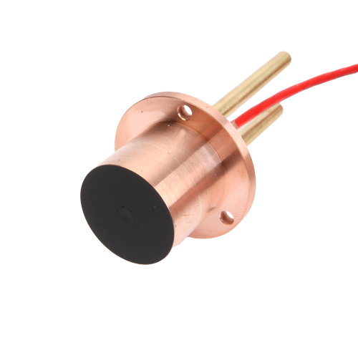
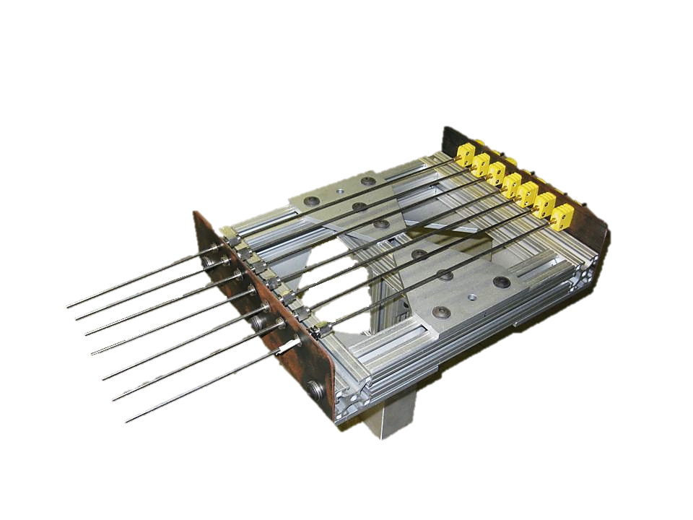
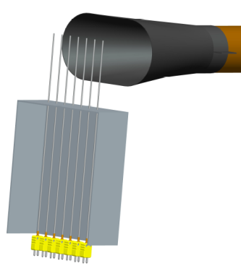
Heat Flux and Temperature Calibration for Park-Type Burner
Gardon gauge sensor measure flame heat flux
1/16” thermocouples measure flame temperature intensity and uniformity
Adjust burner internal components until burner flame meets heat flux and temperature requirements before testing materials
Notes:
Park burners are calibrated to meet a specified heat flux using a Gardon type gauge and also a flame temperature minimum measured using a thermocouple rake comprised of seven 1/16” thermocouples space 1 inch apart
The stator and turbulator inside a Park burner can be adjusted to compensate for any irregularities in burner performance in order to meet these requirements
This adjustability leads to each lab having there own unique burner configuration which is undesirable for what is a considered a precision test lab tool

Slide 54
Flame Temperature Validation for
Sonic Burner
No heat flux requirement
1/8” thermocouples used to measure flame temperature intensity and uniformity
Recommended temperature range, not a requirement
Used as a “check” to ensure burner is configured and operating properly
Notes:
Sonic burners are not calibrated, but do have a flame temperature validation check that is used as an indication of proper burner configuration and operation.
The sonic burner is not adjustable, and cannot be altered to compensate for flame temperature irregularities
This temperature check is a recommended temperature range that should be easily met if the sonic burner has been assembled and configured properly, and there are no problems with the burner air or fuel supplies.
NexGen burner designed to be setup only in one standardized configuration
No adjustments on the NexGen burner to manipulate flame
Low temperatures may also indicate worn thermocouples
Replace low reading TC’s after confirming proper burner configuration and operation
It is considered acceptable to continue testing in certain cases where TC’s read slightly below the 1600 F temperature level only after the previous steps have been performed
Proper fuel flow and air pressure should also be confirmed

Slide 55



Flame Temperature Measurement Thermocouples
1/8” thermocouples more robust and have a longer service life compared to 1/16” thermocouples
Less sensitive to rapid temperature changes but not crucial for Sonic burner flame validation
Notes:
1/8” thermocouples are now used for measuring the temperature of the Sonic burner flame while the park-type burners use 1/16” thermocouples
The 1/8” thermocouples are more robust and have a longer service life compared to 1/16” thermocouples before needing replacement
The larger 1/8” thermocouples are less sensitive to rapid temperature changes compared to the smaller 1/16” thermocouples, but this is not crucial for the Sonic burner flame validation check

Slide 56


Fuel & Air Measurement Points
Just prior to where the fuel/air enter the burner
Air
  40°F - 60°F
  45 ± 1 psi
Fuel
  32°F - 52°F
  2.0 ± 0.1 gal/hr
  ± 2 psi from initial reading
Fuel
Air

Slide 57


Burner and Sample Test Rig

Slide 58


Burner and Sample Test Rig

Slide 59
Compressor for Sonic Air Supply
Airflow requirements are known based the equation for mass flowrate
Each test lab is different
Too many variables to specify a compressor
Best course of action is to consult an air compressor manufacturer
Determine which unit is best suited for a particular lab and be capable of supplying sufficient air to the burner

Slide 60
Fire Test Handbook Updates for Seat Cushion and Cargo Liner Test Methods
Main Chapter: Test Method and Park Burner
Scope and Definitions
Apparatus
Test Samples and Conditioning
Preparation of Apparatus
Calibration
Test Procedure
If using a Sonic Burner
Return to Main Chapter
Apparatus
Preparation of Apparatus
Flame Validation Procedure
Chapter Supplement: Sonic Burner
Notes:
All Sonic Burner information now appears in Chapter Supplement

Slide 61


Leather Seat Restraint Method
0.125-inch diameter stainless steel rod

Slide 62
Sonic Cargo Instructional Video
An instructional video produced at the FAA Technical Center was recently released for conducting the cargo liner oil burner test method using a Sonic burner based on Chapter 8 of the Fire Test Handbook
Video link is in the Chapter 8 section of the Handbook on the Fire Safety Website
www.fire.tc.faa.gov

Slide 63
Future Use of Park-Type and Sonic Oil Burners
Park-type and Sonic burners may be used for certification testing
  Chapter 7: Oil Burner Test for Seat Cushions
  Chapter 8: Oil Burner Test Cargo Liner
Park-type burners will be allowed for certification testing in the future
Either burner may be used for these tests

Slide 64

Seat and Cargo Task Groups
Wednesday, Oct. 26, Carousel D-F in South Tower
Cargo Task Group
8:30 AM - 10:00 AM
Seat Task Group
10:30 AM - 12:00 PM

Slide 65
Questions?

