Slide 1
NexGen Burner for Insulation Burnthrough

Slide 2
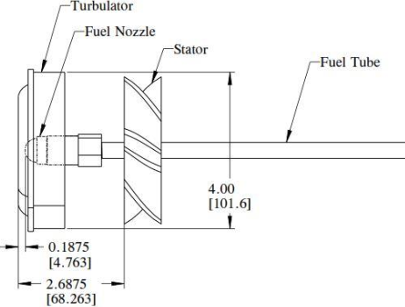
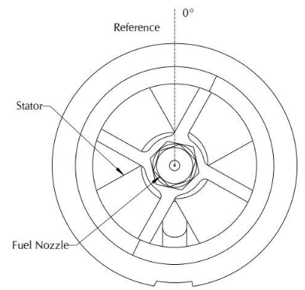
Introduction
Objective
Methodology
To determine if the new ignitorless stator can be considered equivalent to the original stator baseline configuration for the NexGen burner when testing according to the insulation burnthrough rule 14CFR25.856b
Both failure modes for the burnthrough rule will be evaluated for equivalency. These modes are:
  Burnthrough time: Polyacrylonitrile (PAN) material of two different areal weight will be tested in the picture frame sample holder, and the time to material burnthrough will be measured
    8579: 9 oz/yd²
    8611: 16 oz/yd²
  Backside Heat Flux: Nextel paper will be installed on the insulation burnthrough rig, and the backside heat flux will be measured with two Gardon heat flux gauges, one on each side of the test rig. The time to reach 2.0 BTU/ft²s will be used as the comparison point.
For both failure modes, the performance of the new stator at various inlet air pressures will be compared
to the performance of the NexGen burner configured according to the parameters outlined in AC25.856-2A

Slide 3
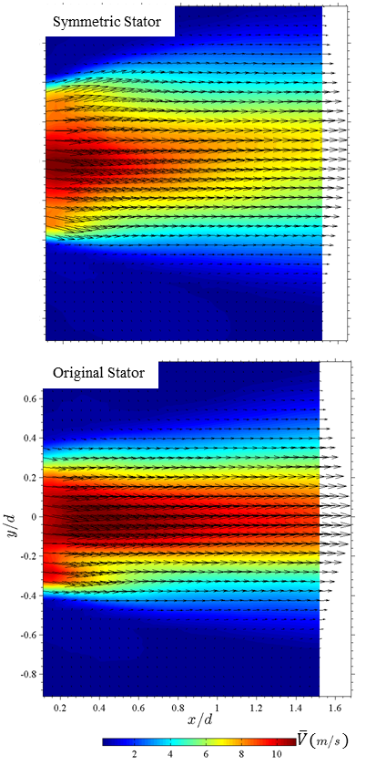
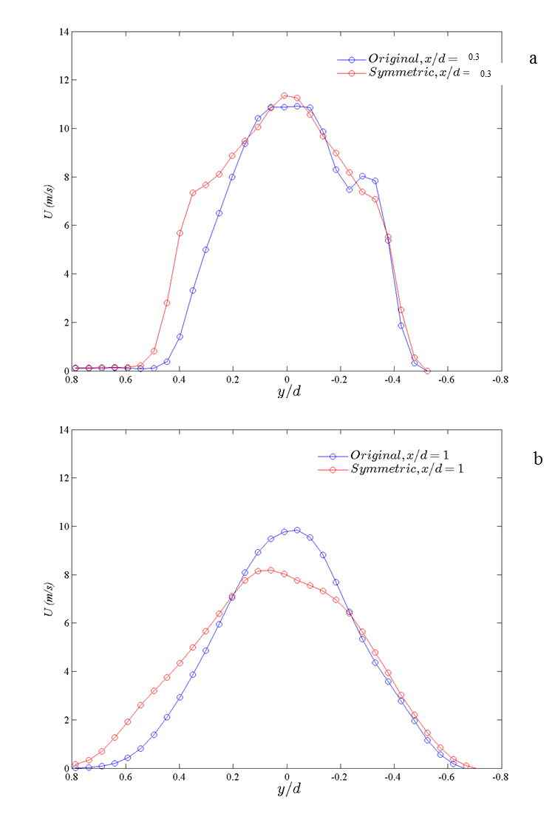
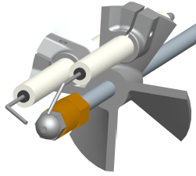
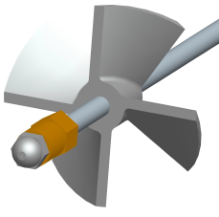
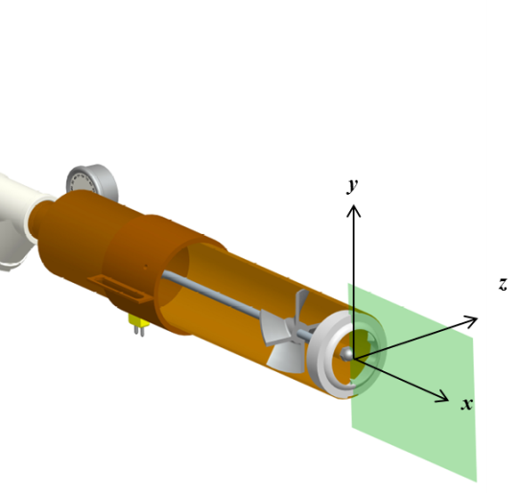
2D PIV Symmetric Stator
Mean In-Plane Velocity
Axial Velocity Profiles
Original Stator
Symmetric Stator
Symmetric stator provides more uniform
velocity distribution

Slide 4
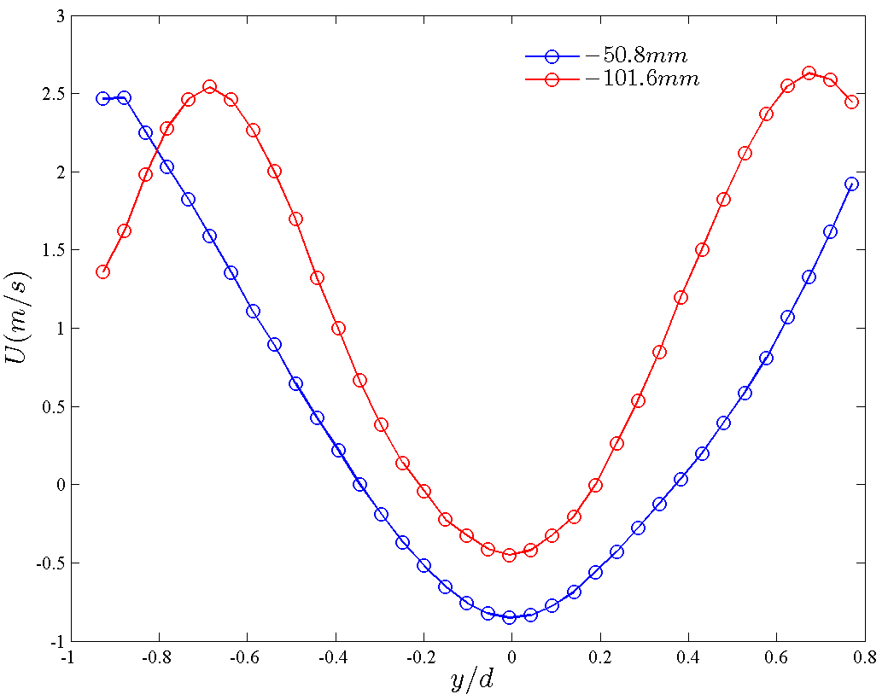
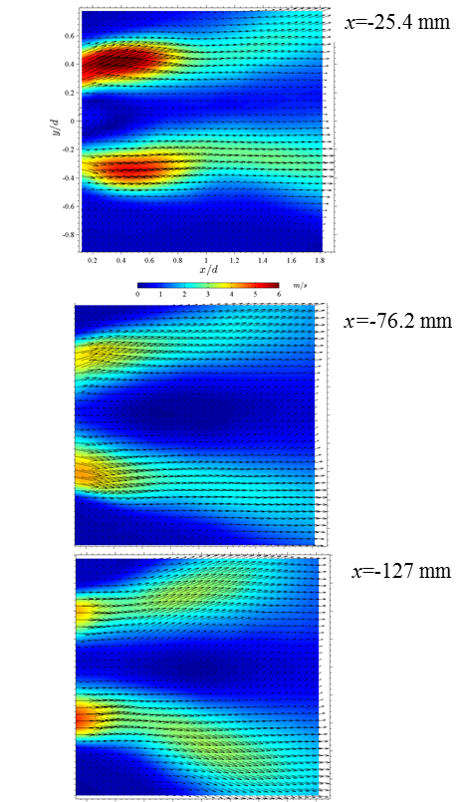
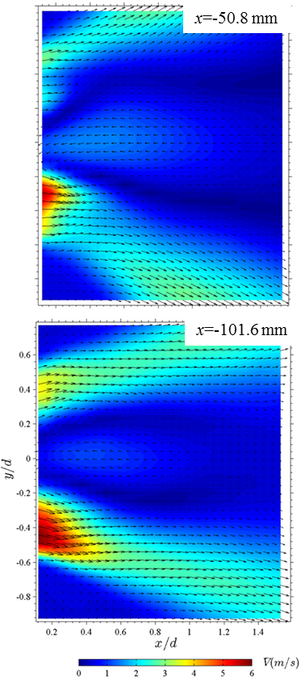
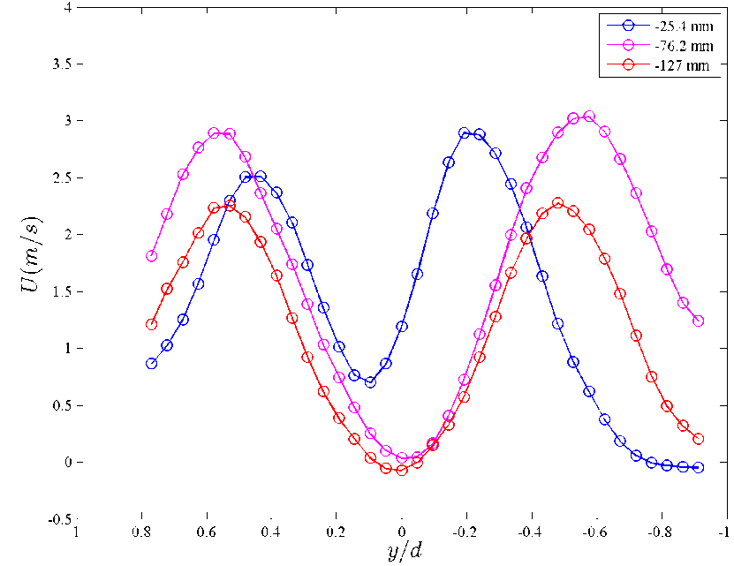
2D PIV Symmetric Stator
Original Stator
Symmetric Stator
Symmetric Stator
Original Stator
Symmetric stator provides greater
jet growth, reverse flow

Slide 5
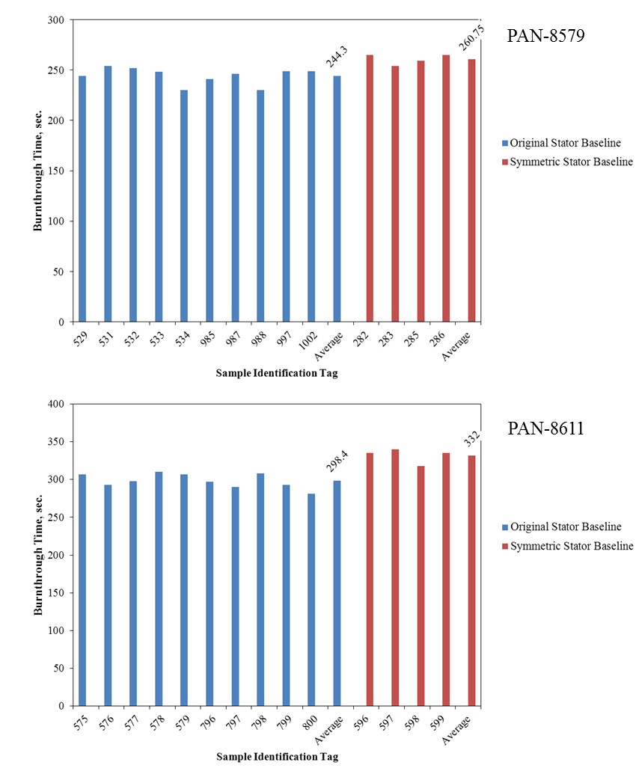
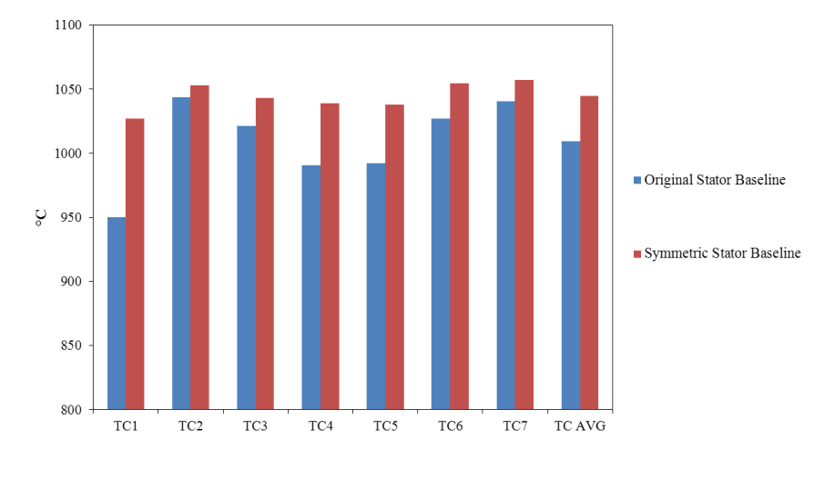
Symmetric Stator Baseline Performance
Material Burnthrough Time
Measured Flame Temperature
T( )
Both stators tested at identical air, fuel flow rate
Higher flame temperature found with symmetric
stator
Longer burnthrough times found with symmetric
stator

Slide 6
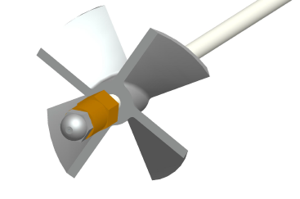
Description of various burner configurations for burnthrough testing
Configuration | Description
Baseline 60 psig | Original Stator with igniters
New Stator 60 psig | New Stator no igniters 60 psig air pressure
New Stator 65 psig | New Stator no igniters 65 psig air pressure
New Stator 70 psig | New Stator no igniters 70 psig air pressure
New Stator 75 psig | New Stator no igniters 75 psig air pressure
New Stator 80 psig | New Stator no igniters 80 psig air pressure
Baseline Stator Configuration (Left) and New Stator Configuration (Right)

Slide 7
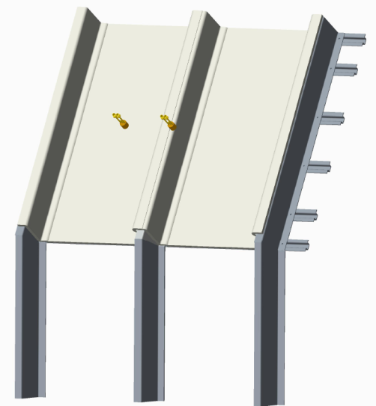
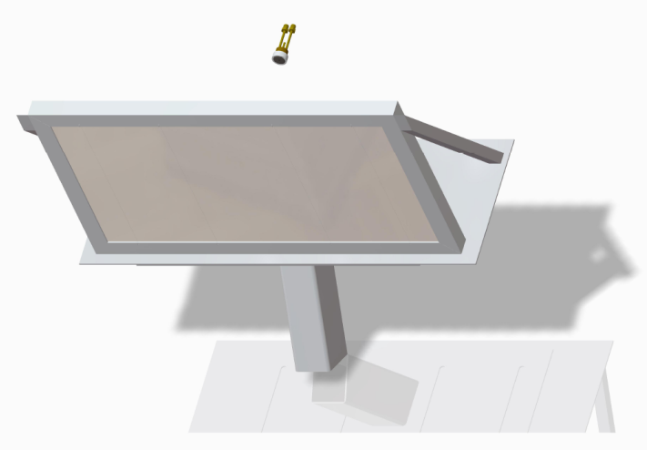
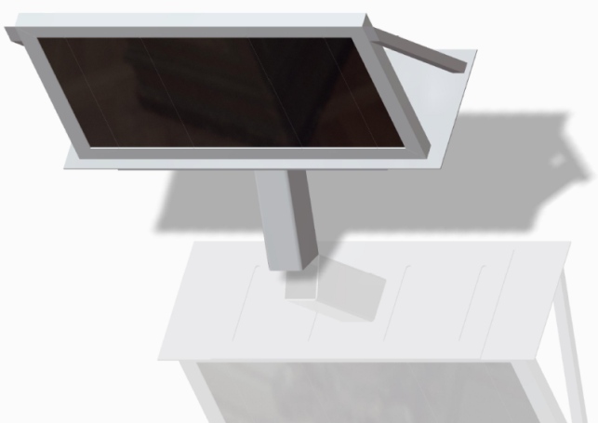
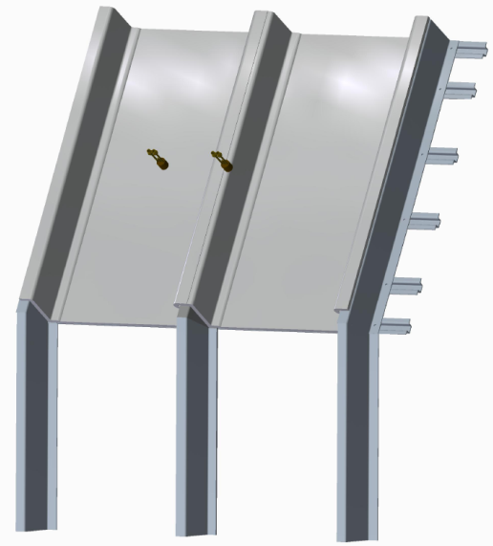
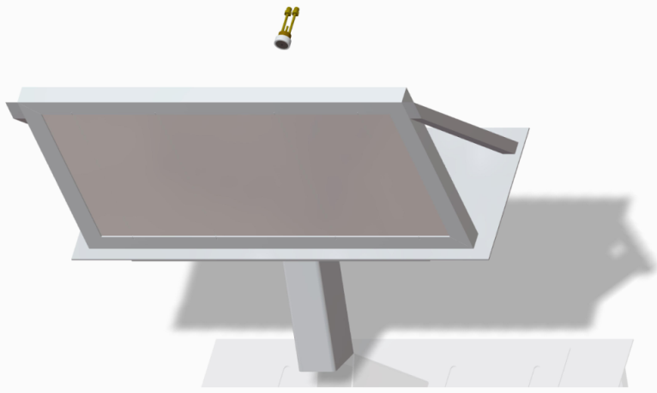
Nextel on Test Rig
Nextel on Picture Frame
PAN on Picture Frame
Insulation Blanket on Test Rig
Insulation Blanket on Picture Frame
.34 pcf FG
Nextel Paper
Metallized Tedlar
Metallized Tedlar

Slide 8
PAN on Picture Frame
PAN on Picture Frame

Slide 9
Nextel on Test Rig
Nextel on Test Rig

Slide 10
Nextel on Picture Frame
Nextel on Picture Frame

Slide 11
Insulation Blanket on Picture Frame
Insulation Blanket on Picture Frame
.34 pcf FG
Nextel Paper
Metallized Tedlar
Metallized Tedlar

Slide 12
Insulation Blanket on Test Rig
Insulation Blanket on Test Rig
.34 pcf FG
Nextel Paper
Metallized Tedlar
Metallized Tedlar

Slide 13
New Stator Testing Summary
The new stator was found to provide similar results to the baseline configuration when adjustments are made to the sonic choke inlet pressure
  PAN burnthrough times at 65 psig were within 2-3% of the baseline configuration
  At 65 psig, backside heat flux measurements were within 1.5% of full scale when Nextel paper was tested on the picture frame
  Testing an actual insulation blanket introduced variables that increased the variation in heat flux measurements between the baseline and new stator configurations
The new stator is favorable over the original stator for several reasons
  Ease of setup: No igniters, wires, etc. in the draft tube. Less dimensions to specify
  Better consistency: left-to-right heat flux measurements variations reduced with new setup

Slide 14
2016 Comparative Test Series: In Progress
Participation by 11 labs across 3 continents
  Accufleet – USA
  Airbus – Germany
  Boeing – USA
  DGA – France
  Embraer – Brazil
  FAATC – USA
  Govmark – USA
  Jehier – France
  Rescoll – France
  Resonate – N. Ireland
  Triumph – USA
Each lab shipped samples for two-part test series
  10 PAN-8579 9 oz/yd² felt samples for picture frame testing
  10 PAN-8611 16 oz/yd² felt samples for picture frame testing
  6 Brook One BO856B-II thermal acoustic insulation blankets for test rig testing
Testing with original stator (with igniters and wires)
  5 PAN-8579
  5 PAN-8611
  6 BO856B-II (3 tests worth)
Testing with new stator (no igniters or wires)
  5 PAN-8579
  5 PAN-8611
Comprehensive testing instructions e-mailed to each lab

Slide 15

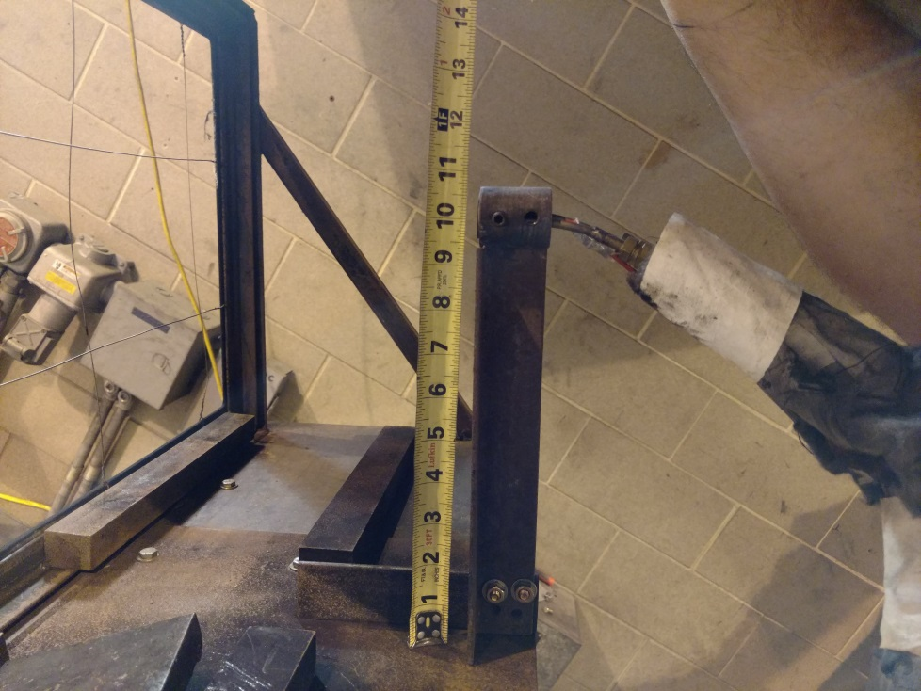
Test Details
Instructions include all details for setting up burners, equipment, and test samples
A gardon gauge is to be installed on picture frame to get heat flux data while testing PAN samples

Slide 16
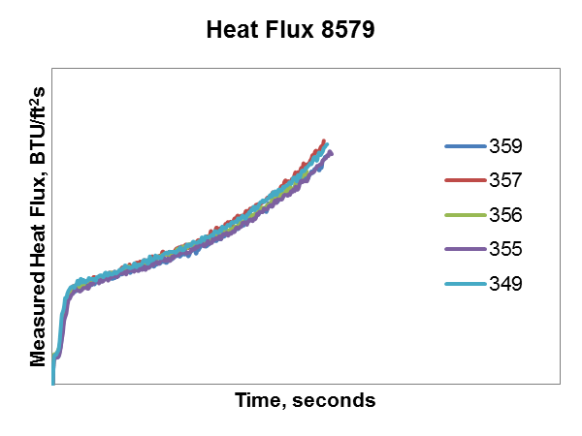
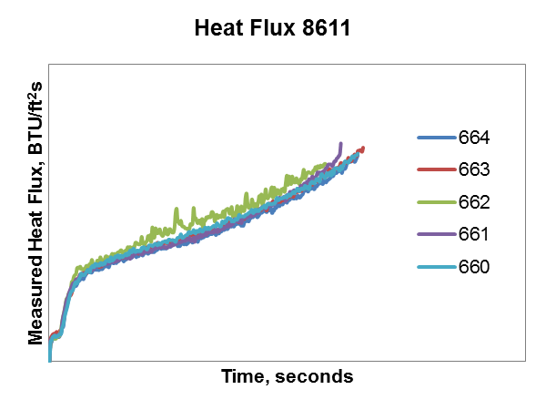
Old Stator
 | Old Stator |  | New Stator
 | 8579 | 8611 | 8579 | 8611
Average BT
Std Dev
% Std Dev | 3.66 | 5.26 | 3.18 | 1.89

Slide 17
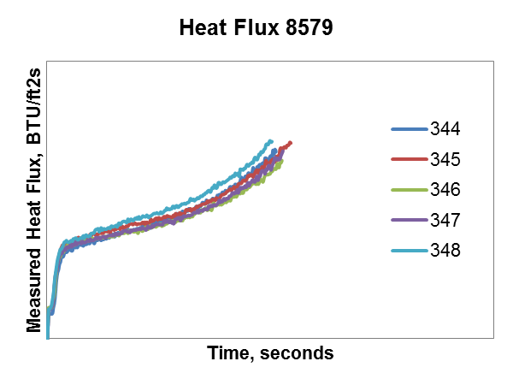
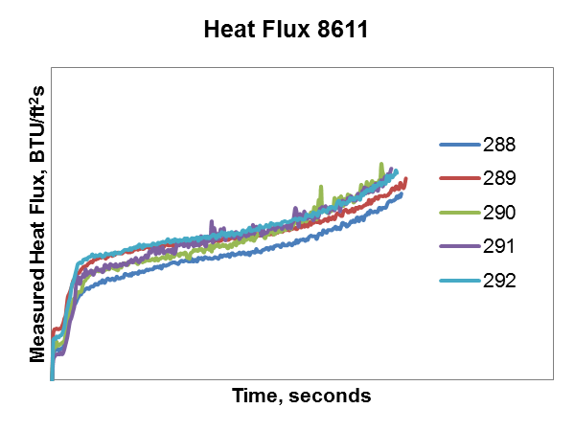
New Stator
 | Old Stator |  | New Stator
 | 8579 | 8611 | 8579 | 8611
Average BT
Std Dev
% Std Dev | 3.66 | 5.26 | 3.18 | 1.89

Slide 18
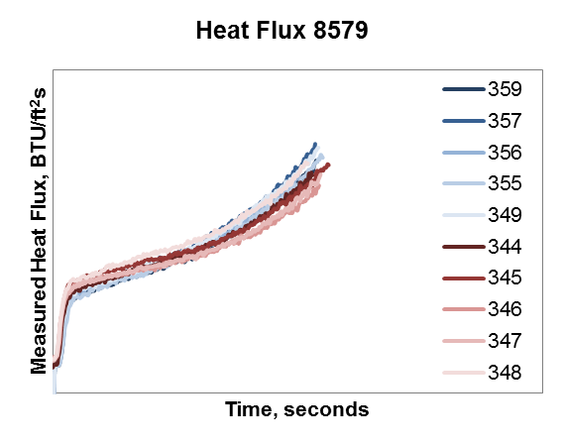
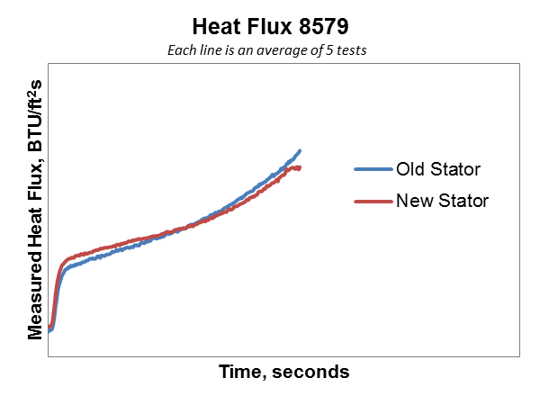
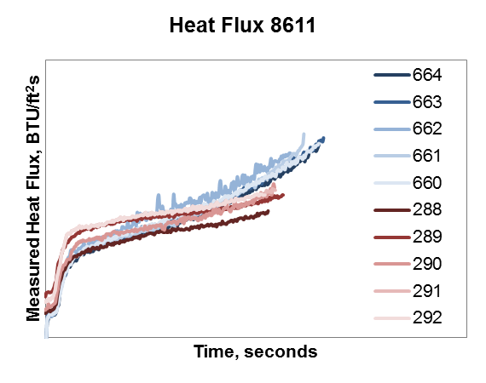
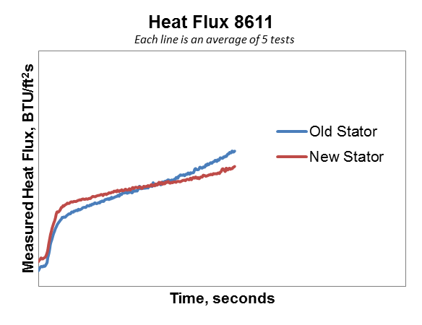
All Tests
Average of All Tests

Slide 19
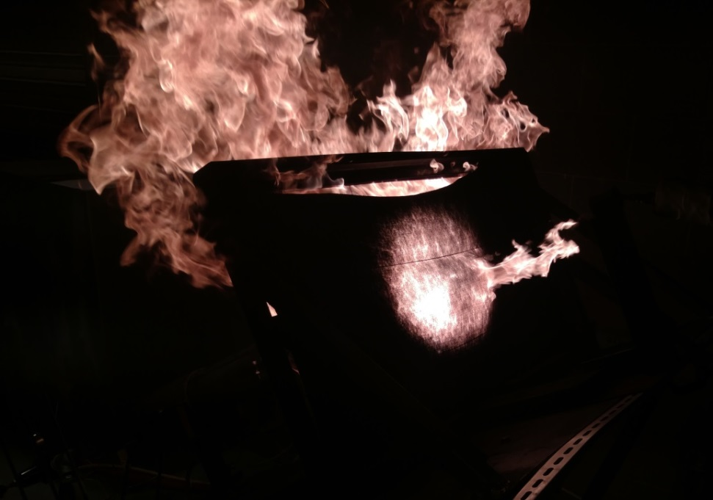
RR 2016 Summary – To Date
Results will be compiled over next few months
Final results should be available by March 2017 IAMFTWG meeting

Slide 20
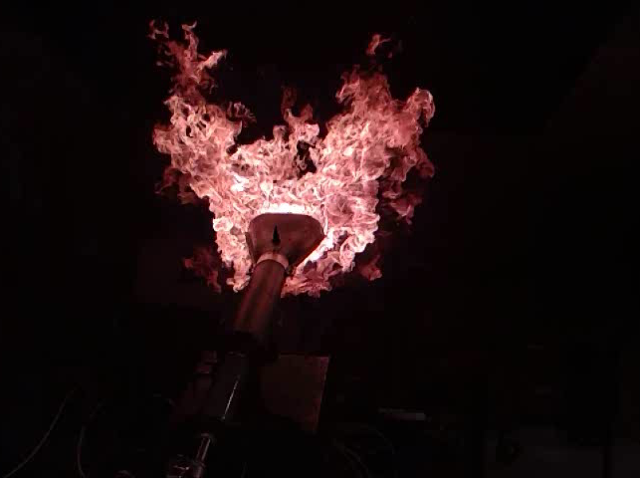
Questions?
Robert I. Ochs
Fire Safety Branch
William J. Hughes Technical Center
ANG-E212; Bldg 287
Atlantic City, NJ 08405
T 609 485 4651
E robert.ochs@faa.gov

