Slide 1
FAA Policy Statement PS-ANM-25.853-01-R2 Clarifications and Additions for future Advisory Circular
Michael Jensen FSTG Team Lead
FAA Triennial Atlantic City, NJ
October 26, 2016

Slide 2
Questions of Interpretation
Since the Policy Statement (PS-ANM-25.853-01-R2) release, there have been questions regarding the interpretation of the policy.
Revision 1 and 2 of the Policy clarified a number of those issues.
A presentation given at the Triennial in Philadelphia in 2013 provided additional clarifications.
There have been requests for additional Methods of Compliance (MoCs), wider applicability and further clarifications.

Slide 3
PS Clarifications and Additions – Working Plan
Through the IAMFTWG, the Flammability Standardization Task Group (FSTG) collected requests that were assigned to Team Leaders to develop proposed wording and new data and analyses (where required) to clarify and devise new MoCs.
All changes, data and analyses developed by FSTG have been or will be provided to the FAA Transport Airplane Directorate and EASA for consideration in adding to the proposed AC that will replace the current Policy Statement.

Slide 4
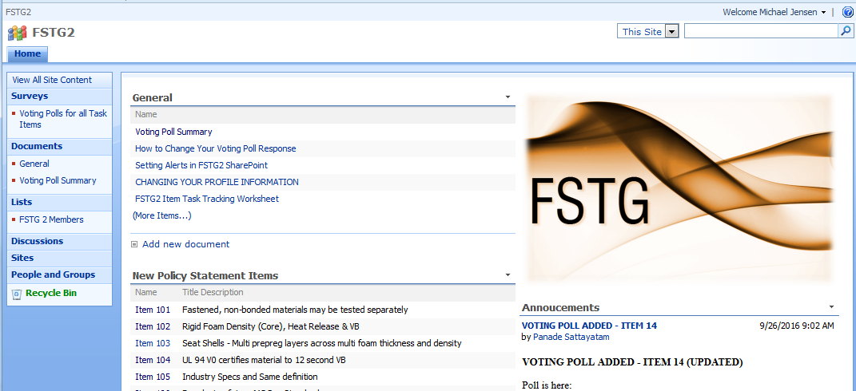
FSTG SharePoint (hosted by Zodiac)
A Zodiac sponsored SharePoint was used to coordinate information.

Slide 5
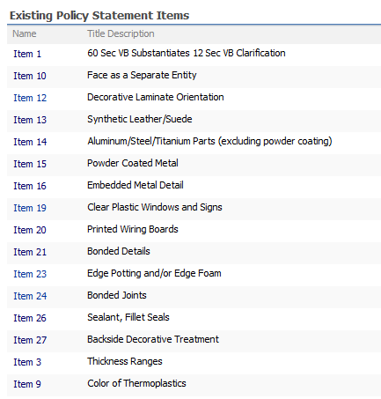
Existing Items

Slide 6
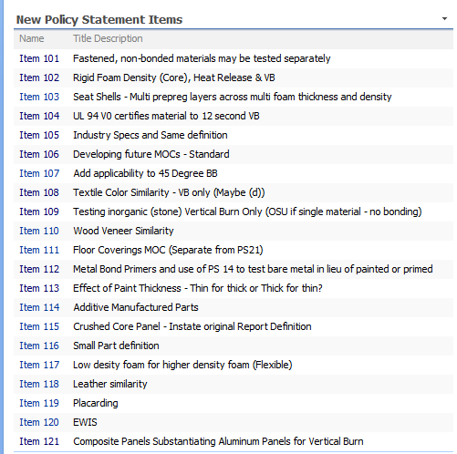
New Items

Slide 7
PS-1 Update
Ref # | Feature/ Construction | 25.853(a) Bunsen Burner Test Requirement/Similarity | 25.853(d) Heat Release and Smoke Test Requirement/Similarity
1 | Materials and constructions, general | 60-second vertical Bunsen burner test data may be used to substantiate configurations that only require 12-second vertical Bunsen burner data. Vertical Bunsen burner test data may be used to substantiate configurations that only require horizontal Bunsen burner testing. Additionally, for panel constructions¹, 14 CFR 25.853(d) heat release data may be used to substantiate 60 second or 12 second vertical Bunsen burner requirements | Test requirement is decided based on size criteria.² 1) Test required if greater than 2 sq ft, 2) No test if less than 1 sq ft, and 3) Specific determination required between 1 and 2 sq ft.

Slide 8
PS-1 Continued
1 - A panel construction is defined as any of the following 3 constructions/materials:
Sandwich Panel - A rigid panel fabricated using face sheets (either reinforced thermosetting resins or metal) on either side of a core material (a rigid foam or a honeycomb structure made of aluminum or phenolic resin and Nomex paper, Kevlar, Ultem or fiberglass).
Laminates - A composite laminate (0.020” or greater in thickness) made from resin (phenolic, epoxy, polyester or bismaleimide) reinforced fiber (fiberglass, carbon, Kevlar, Nomex or quartz).
Thermoplastics – Thermoformable plastic resins (sheet, injection molded or extruded) greater than 0.02”. Includes any reinforcement fibers (fiberglass, carbon, Kevlar, Nomex or quartz).
2 - As a general rule, components with exposed-surface areas of one square foot or less may be considered small enough that they do not have to meet the standards of § 25.853(d). Components with exposed-surface areas greater than two square feet may be considered large enough that they do have to meet these standards. Those with exposed-surface areas greater than one square foot, but less than two square feet, must be considered in conjunction with the areas of the cabin in which they are installed. From the final rule Improved Flammability Standards for Materials Used in the Interiors of Transport Category Airplane Cabins (60 FR 6616, February 2, 1995).

Slide 9
PS-3 25.853(d) Update
Except for foam core panels with composite laminate face sheets —where each thickness must be tested, the following approaches are acceptable:
Test the maximum and a minimum thickness¹ of the range shown in the table to show compliance for all intermediate nominal thicknesses.
Test the maximum and a minimum thickness¹ of a range determined as follows:
Select any maximum for a range and determine the minimum of the range using the following:
At least 30% of the maximum for ranges with a maximum up to .06” (1,5mm)
At least 40% of the maximum for ranges with a maximum between .06” (1,5mm) and .25” (6,3mm)
At least 48% of the maximum for ranges with a maximum over .25” (6,3mm)**
A narrower range is also acceptable.
1 - Thickness could be either the nominal part thickness, nominal core thickness or nominal sandwich thickness (excluding decorative finish from thickness definition), but the comparison must be consistent, core thickness compared to core thickness, or panel thickness compared to panel thickness.

Slide 10
PS-3 25.853(d) (cont.)
Examples - The following ranges are examples of those that could be defined where testing the minimum and maximum will show compliance for all intermediate thicknesses:
0.3 mm and 1 mm (1 mm<06”; 0.3 mm is 30% of 1 mm)
0.2 mm and 0.5 mm (0.5mm<06”; 0.2mm is 40% of .5 mm)
.02” and .06” (.06”=.06”; .02” is 33% of .06”)
.04” and .06” (.06”=.06”; .02” is 50% of .06”
.06” and .1” (.1” is >.06” and <.25”; .06” is 60% of .1”)
1.5 mm and 2.5 mm (2.5 mm >.06” and <.25”; 1.5mm is 60% of 2.5 mm)
.01” and .25” (.25=.25”; .01” is 40% of .25”)
2.5 mm and 6 mm (6 mm >.06” and <.25”; 1.5 mm is 42% of 6 mm)
5 mm and 6 mm (6 mm >.06” and <.25”; 5 mm is 83% of 6 mm)
.25” and .50” (.50”>.25”; .25” is 50% of .50”)
6 mm and 12.5 mm (12.5 mm >.25”; 6 mm is 48% of 12.5 mm)
.50” and 1.00” (1.00”>.25”; .50” is 50% of 1.00”)
12.5 mm and 25.5 mm (25.5 mm >.25”; 12.5 mm is 49% of 25.5 mm)
1.00” And 1.75” (1.75”>.25”; 1.00” is 57% of 1.75”)
25.5 mm and 44.5 mm (44.5 mm >.25”; 25.5 mm is 57% of 44.5 mm)

Slide 11
PS-9 Update
Ref # | Feature/ Construction | 25.853(a) Bunsen Burner Test Requirement/Similarity | 25.853(d) Heat Release and Smoke Test Requirement/Similarity
9 | Thermoplastic, elastomers and decorative non-textile floor coverings color | Data from testing an integrally colored material substantiates the same material type and thickness for a different color. | Data from testing an integrally colored thermoplastic substantiates the same thickness thermoplastic of a different color, provided the peak and total heat release measurement are 55 KW/m2 and 55 KW-min/m2 or less, respectively, and specific optical density Ds is no more than 180.

Slide 12
PS-10 Update
Ref # | Feature/ Construction | 25.853(a) Bunsen Burner Test Requirement/Similarity | 25.853(d) Heat Release and Smoke Test Requirement/Similarity
10 | Skin testing (Face As Separate Entity) | Data may be collected from each face of a sandwich panel independently when the panel thickness is greater than or equal to 0.25” and the thickness is the only difference between the core materials. NOTE: The test coupon is a completed sandwich panel. | Not applicable

Slide 13
PS-11 Update
Ref # | Feature/ Construction | 25.853(a) Bunsen Burner Test Requirement/Similarity | 25.853(d) Heat Release and Smoke Test Requirement/Similarity
11 | Decorative texture | Data from testing one texture of a decorative type or thermoplastic substantiates a panel with the same decorative type with a different texture. | Data from testing one texture of a decorative type or thermoplastic substantiates a panel with the same decorative type with a different texture.

Slide 14
PS-13 update
Ref # | Feature/ Construction | 25.853(a) Bunsen Burner Test Requirement/Similarity | 25.853(d) Heat Release and Smoke Test Requirement/Similarity
13 | Synthetic leather/suede | For Tapis Ultra leather™ and E-Leather™ SL3UL, SL3SL, and SL3L products, testing one color substantiates all other colors because all values have significant margin with respect to the pass/fail criteria for the 12-second and 60 second vertical tests. | Testing each color of synthetic leather/suede material is required.

Slide 15
PS-14 Update
Reference Number | Feature / Construction | 25.853 (a) Bunsen Burner Test Requirement/ Similarity | 25.853 (d) Heat Release and Smoke Test Requirement/ Similarity
14 | Metals¹ | Unfinished metal parts do not require testing. | Metals with inorganic coatings, non-bonded bare metals and plated metals do not need to be tested for heat release and smoke. Metals with organic coatings (e.g. primer, paint, corrosion inhibiters) must be tested for heat release and smoke if over the size criteria (see ref. 1).
 |  | Finished metal parts do not require testing, provided standard paint/finishes are used (for example, inorganic finishes, corrosion inhibiting dry films, epoxy or urethane primers and topcoats).
 | 1 - Excluding metals and alloys containing more than 10% Magnesium and those in group one of the periodic table.

Slide 16
PS-15 Update
Reference Number | Feature / Construction | 25.853(a) Bunsen Burner Test Requirement/Similarity | 25.853(d) Heat Release and Smoke Test Requirement/Similarity
15 | Powder coated metal | Powder coated metal parts do not require testing unless they contain more than 10% magnesium. | Testing a part with one color substantiates any other color with the same powder coat system, provided that the peak and total heat release measurement are 55 KW/m² and 55 KW-min/m² or below, respectively and specific optical density D­_{s} is no more than 180.
Would like to eliminate Mg exclusion as it is covered by new compliance test

Slide 17
PS-16 Update
See PS-21 Bonded Items new proposal

Slide 18
PS-20 Update
Ref # | Feature/ Construction | 25.853(a) Bunsen Burner Test Requirement/Similarity | 25.853(d) Heat Release and Smoke Test Requirement/Similarity
20 | Printed wiring boards (PWB) | The test coupon must replicate the Printed Wiring Board laminate construction; however, either of the following is acceptable; Metal tracings may be excluded from the tested configuration, Any metal tracings may be used in the test configuration. The test must include all coatings used in the type design, such as solder mask and conformal coating. Testing of the laminate in the thinnest cross section will substantiate thicker constructions made from the same laminate materials and conformal coatings. | No test requirement

Slide 19
PS-21 Update
The following method of compliance options may be used to substantiate secondary bonded details (Table 1) or items of similar surface area (Table 2) based on the types of materials being bonded. This MOC also applies to multiple bonded details such as a placard bonded to a metal detail bonded to a panel.* If the bonded part is small and would not contribute to the propagation of a fire in accordance with appendix F, part I (a)(1)(v), no testing is required for compliance.
Secondary bonding is generally applicable to the bonding of previously cured/formed material surfaces. Secondary Bonded constructions include materials bonded with liquid/paste adhesives, adhesive films/double sided tapes (including foam tapes) and reinforced adhesive films/tapes. However, Option 1 additionally includes provisions for co-cured details (e.g., brackets, bosses, inserts, etc.) bonded to a composite construction. Secondary Bonded constructions do not include fabricated parts- large material cross-sections that are co-cured such as honey panel composite constructions (e.g., may not substantiate the skins and core of a composite panel separately).

Slide 20
PS-21 Update (cont.)
Table 1 - Compliance Options for Bonded Details
Materials to be Bonded | Allowed Bonding Compliance Options
A – Details that tend to shrink/melt away from the flame when tested such as Hook and Loop Tapes, Single Sided Adhesive Tapes, Films, elastomers with integral adhesive and Thermoplastics less than .015” thick. | 3 or 4
B – Non-metallic bonded details not covered in A | 1, 2, 3 or 4
C – Bonded metal details* | Testing of base substrate shows compliance
*Doesn’t apply to metals with more than 10% magnesium.

Slide 21
PS-21 Update (cont.)
Table 2 – Compliance Options for bonding items of similar surface area
Materials to be Bonded | Allowed Bonding Compliance Options
A – Floor Coverings to flooring Film “moisture” barriers Non-Adhesive Carpets, Hard Floor Coverings, tiles or padding bonded using fabric reinforced adhesive tapes Non-Adhesive Carpets, Hard Floor Coverings, tiles or padding bonded using adhesive films, double sided tapes with film or foam reinforcement or contact cements Adhesive coated carpets, hard floor coverings or tiles | 3 or 4 1, 2, 3 or 4 3 or 4 3 or 4
B - Bonding Items of similar Size Thin Coverings (decorative laminates, fabrics, paint coatings, etc.) being bonded to a panel¹ Thick Substrates (Counter tops, Panels, etc.) being bonded to a panel¹ | 3 or 4 1, 2, or 4
C – Bonded Metal* | Testing of base substrate shows compliance
*Doesn’t apply to metals with more than 10% magnesium.

Slide 22
PS-21 Update (cont.)
1 – For this MOC, a panel is defined as a:
Composite construction that is: a laminate greater than 0.025” (resin reinforced fabric/tape), or a sandwich construction using a minimum of one ply of resin reinforced fabric/tape on both sides of a foam or honeycomb core.
A metal surface thicker than 0.012”
A thermoplastic sheet greater than TBD” thick

Slide 23
PS-21 Update (cont.)
Bunsen Burner flammability requirements are shown in each of the compliance options below.
OPTION #1: Adhesive and Substrates tested separately:
Test the adhesive by itself using a ¼” to 1/16” thick plaque or a single layer for fabric reinforced or foam tapes to 12-second Vertical Bunsen Burner (VBB) and separately test the substrates, without adhesive, to the applicable requirements in appendix F, part I (a)(1)(i), (a)(1)(ii) or (a)(1)(iv).
NOTE: It is not acceptable to use this option for adhesives or fabric reinforced/foam tapes if the adhesive/tape passes the test by rapidly melting/retreating from the flame.
NOTE: This MOC is also valid when adhesive is not used and the bonded construction is created from co-curing with a composite panel (e.g., no adhesive).

Slide 24
PS-21 Update (cont.)
OPTION #2: Adhesives evaluated in a thin bonded construction and Substrates tested separately:
Without adhesive, separately test the substrates to the applicable requirements in appendix F, part I (a)(1)(i), (a)(1)(ii) or (a)(1)(iv), and show compliance of the specific adhesive using data created when two non-metallic materials are bonded together. At least one of the non-metallic materials shall be less than or equal to 0.25” thick to ensure the flame is in contact with the adhesive during the test. The adhesive test data must be to the least stringent test of the two substrates being substantiated or better. For example, if bonding a large thermoplastic placard to a honeycomb sandwich panel, the panel would be tested to appendix F, part I (a)(1)(i), the placard would be tested to appendix F, part I (a)(1)(ii) and the data for the adhesive between two non-metallic materials must be per appendix F, part I (a)(1)(ii) or the more stringent appendix F, part I (a)(1)(i).

Slide 25
PS-21 Update (cont.)
OPTION #3: Bonding to a Worst Case Substrate:
Test the substrate bonded to a thin one or two ply epoxy, phenolic or polyester resin impregnated glass, Kevlar or carbon fabric at a thickness of 0.021” or less (considered worst case) in accordance with the applicable requirements in appendix F, part I (a)(1)(i), (a)(1)(ii), (a)(1)(iv) or (a)(1)(v). Once qualified in this manner, the substrate/adhesive combination may be bonded to other compliant substrates without further test. Test data on the minimum thickness of the substrate substantiates any thicker substrate of the same material.
OPTION #4: As Installed Configuration
Test the “as installed“ configuration to the applicable requirements of 25.853(a) appendix F, part I based on the detail being bonded. If the bonded area of the detail is greater than 2 square feet, test the bonded construction to 60-second VBB.
NOTE: If the base panel is over 0.25” thick, the back side would be either tested to the same test requirement, or by using item # 10 (FASE) to the base panel testing.

Slide 26
PS-21 Update (cont.)
Heat Release and Smoke applicability for all Options The test requirement for bonded details is decided based on size and installation/proximity criteria defined below. See footnote 1 for a discussion of the size-based requirement. A bonded detail can be excluded from testing if one or more of the following are true: a) It is a bond line less than or equal to 1.0” wide on an individual item b) It is located fully within 2.0” of panel edge c) It is located fully within 4.0” of cabin floor d) It is lineally applied and less than or equal to 2 ft² in total surface area on a panel surface

Slide 27
PS-23 Update
Ref # | Feature/ Construction | 25.853(a) Bunsen Burner Test Requirement/Similarity | 25.853(d) Heat Release and Smoke Test Requirement/Similarity
23 | Edge potting and/or edge foam | The edge fill in a panel may be shown compliant using one of the following options: OPTION #1: Test a plaque of edge fill material by itself per appendix F, part 1, (a)(1)(ii) (12-second) (Plaque of nominal size: 0.25” x 3” x 12”). OPTION #2: Test a standard panel containing the edge fill material per appendix F, part I, (a)(1)(i).(60-second vertical burn). (Standard Panel 3” x 12” with 0.125” to 1” of the edge fill material), configured with the edge fill along the bottom and one vertical edge of the test samples. (See Appendix Z of FAA report DOT/FAA/TC-12/10) GENERAL NOTE 1: Decorative on the panel over the edge potting does not require additional testing. Test data from the base panel with the decorative substantiates the decorative in the area over the edge potting including decorative wrapped over the edge. | No test required when edge fill material less than 1” deep into the panel measured from the edges (looking at the panel’s face).

Slide 28
PS-24 Update
Added two general notes:
GENERAL NOTE 1 : Decorative on the panel over the Bonded Joint does not require additional testing. Test data from the base panel with the decorative substantiates the decorative in the area over the bonded Joint.
GENERAL NOTE 2: This MOC may be used to show compliance for multi-ditch and pot panels.

Slide 29
PS-26 Update
Ref # | Feature/ Construction | 25.853(a) Bunsen Burner Test Requirement/Similarity | 25.853(d) Heat Release and Smoke Test Requirement/Similarity
26 | Sealant Fay and Fillet Seals | No test required | No test required

Slide 30
PS-27 Update
Ref # | Feature/ Construction | 25.853(a) Bunsen Burner Test Requirement/Similarity | 25.853(d) Heat Release and Smoke Test Requirement/Similarity
27 | Backside decorative treatment | Test data from a ≤ 0.25” thick panel tested with a decorative (decorative laminate, paint, primer or powder coating) on the backside substantiates the same panel with no decorative on the backside. Test data from a panel tested with two layers decorative (decorative laminate, paint, primer or powder coating) on the backside (e.g. a repair) substantiates a single layer of the same decorative on the backside. | Test data from a panel tested with a decorative (decorative laminate, paint, primer or powder coating) on the backside substantiates the same panel with no decorative on the backside. Test data from a panel tested with two layers decorative (decorative laminate, paint, primer or powder coating) on the backside (e.g. a repair) substantiates a single layer of the same decorative on the backside.

Slide 31
New Items – In-work
The following new items are in work, but not yet finalized:
101 - Fastened, non-bonded materials tested separately
105 - Industry specs and the definition of “Same”
106 - Developing future MOCs
108 - Textile color similarity
109 - Testing Stone
110 - Wood veneer similarity

Slide 32
New Items – In-work (cont.)
111 - Floor Coverings - Combined with PS-21
112 - Metal Bond Primers
114 - Additive manufactured parts
115 - Crushed Core Panel
118 - Leather Similarity
119 - Placarding
121 – Composite panels substantiating aluminum panels for vertical burn

Slide 33
Item 107 – 45° Degree Applicability
Add applicability of Policy Statement to 14CFR 25.853(h) and 25.855 (d) Appendix F, Part 1, (a)(1)(i) [45 degree Bunsen Burner test] for the following items:
PS3, 4, 5, 6, 7, 8, 9, 11, 12, 13, 18, 22, 24, 27

Slide 34
New Items – No plan forward
The following items were not worked due to lack of interest, time or a sponsor/leader:
102 – Rigid Foam Density
103 – Multiple prepreg layers across multiple foam thicknesses and densities.
104 – UL 94 V0 for 12 sec Vertical burn
116 – Small Part Definition
117 – Low density flexible foam for high density
120 – Electrical wire and cables

Slide 35
A special thanks to our Team Leaders!
Anna Nguyen | Grant Joplin/Andrew Olsen | Asfaw Beyene
Bart Mooij | Gwen Garman | Marjan Chini
Blake Hall | Hans & Jacques | Martin
Charles Nam | Heiko Nuessel | Melanie Prince
Chris Boyer | Ingo Weichert | Michael Jensen
Chuck Story | Jeff Smith | Michael Miler
Chuck Wilson | Jeff Smith/Jason Bertram | Patrick Zimmerman
Dan Slaton | Keith Couilliard | Scott Campbell
Gilberto Niitsu | Klaus Boesser | Tom Little
Glenn Swain | Magno Gil | Steven den Dikken

Slide 36
Questions?
? ? ?

