Slide 1
An Overview of FAA Fire Safety Research Since the Previous Triennial Conference in 2013
Gus Sarkos
Manager, Fire Safety Branch
FAA Wm. J. Hughes Technical Center
Atlantic City International Airport, NJ 08405

Slide 2
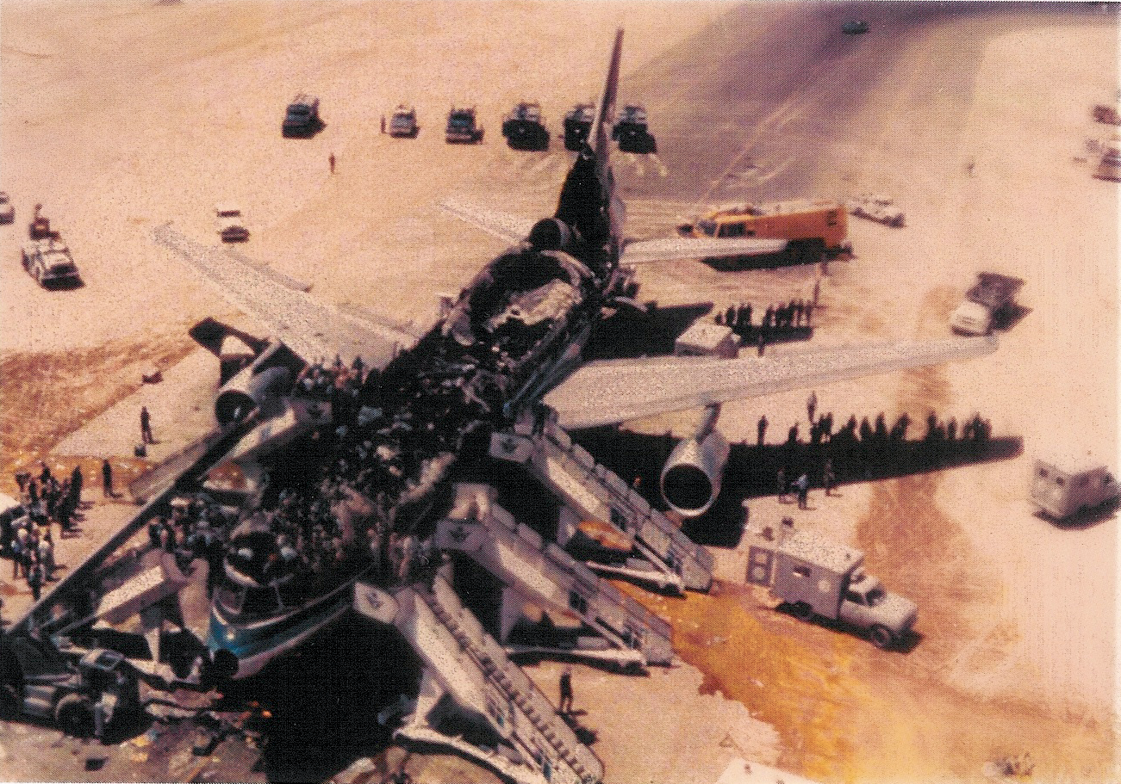
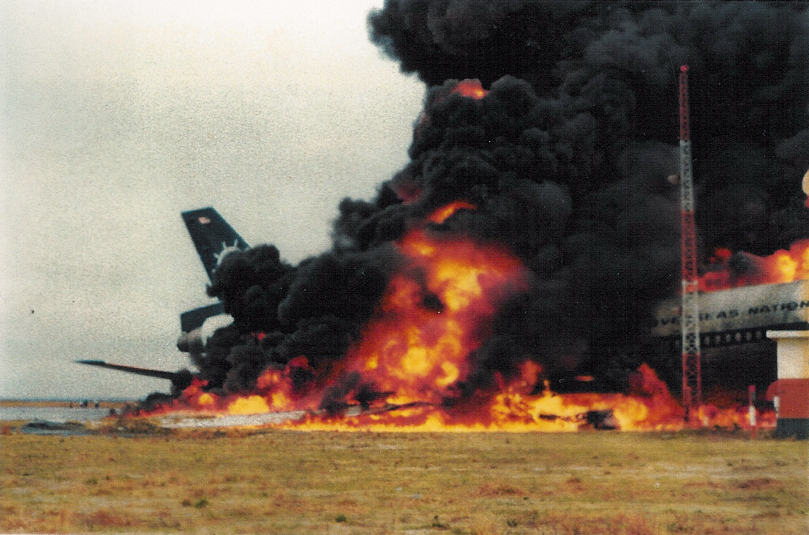
Aircraft Fire Safety
Areas of Concern
Postcrash Fire
In-flight Fire

Slide 3
Program Drivers
New Technology (Composite Fuselage, Magnesium Alloys, Fuel Cells)
New Fire Threats (Lithium Batteries)
Accidents/Incidents
NTSB Recommendations
EPA Restrictions on Effective Fire Safety Technology (Halon Extinguishing Agents, Brominated Flame Retardants)
Inherent Fire Risks in Aircraft Design and Operation

Slide 4
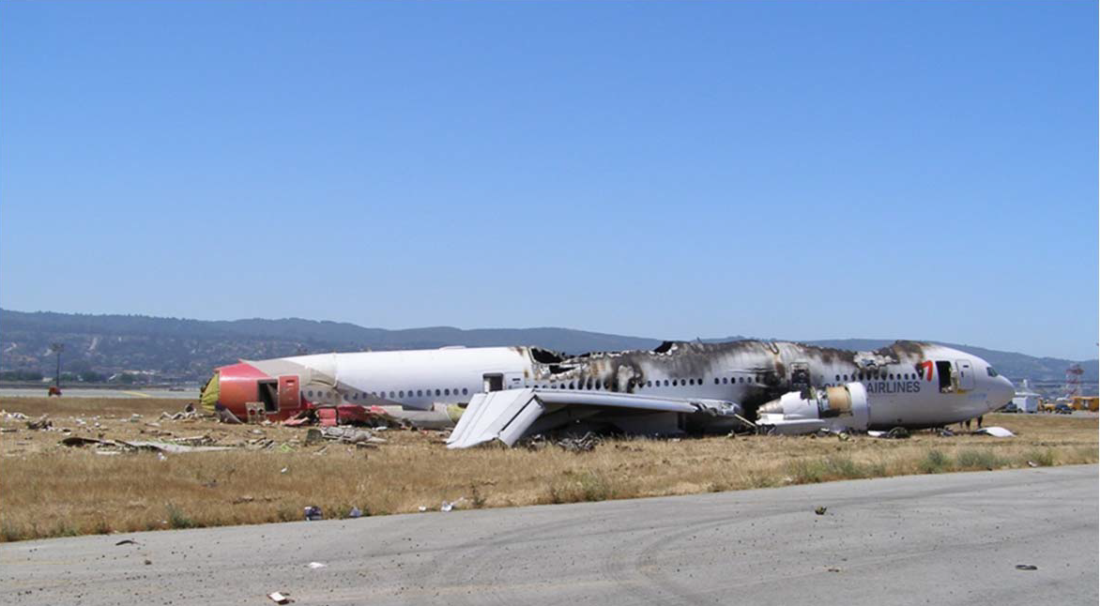
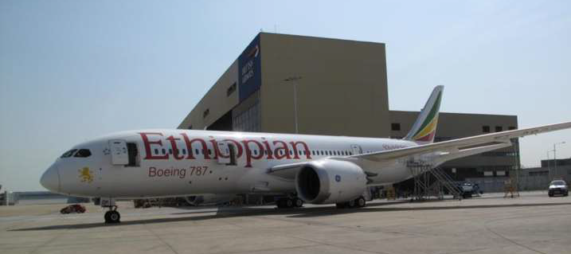
Accidents/Incidents in 2013
Standards contributed to survivability
Event suggests more research is needed

Slide 5
Material Fire Tests & Material Fire Behavior
New Material Flammability Test Methods/Standards
Improved Required Flammability Test Methods/Standards
Material Fire Behavior During
  Small-Scale Fire Tests
  Intermediate-Scale Fire Tests
  Full-Scale Fire Tests

Slide 6
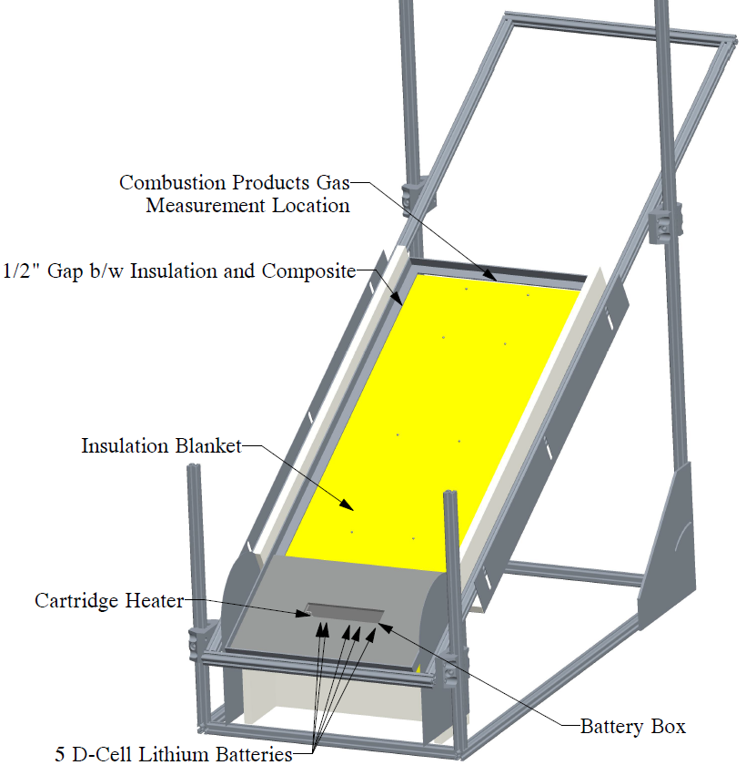
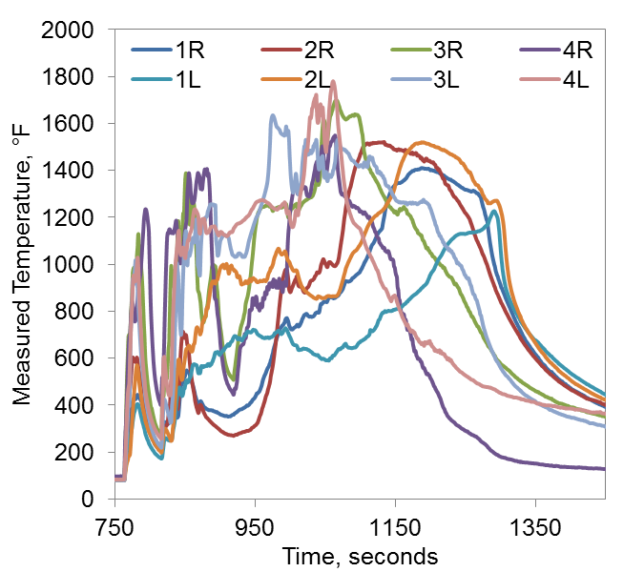
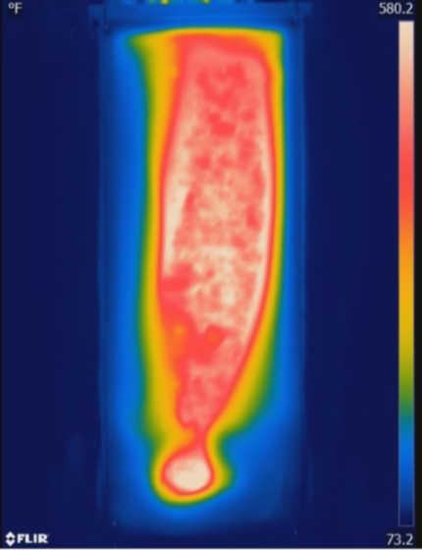
Examined Composite Structure Fire Behavior in Relation to the Ethiopian 787 Fire
Measured Inboard Flame Temperatures
9 min

Slide 7
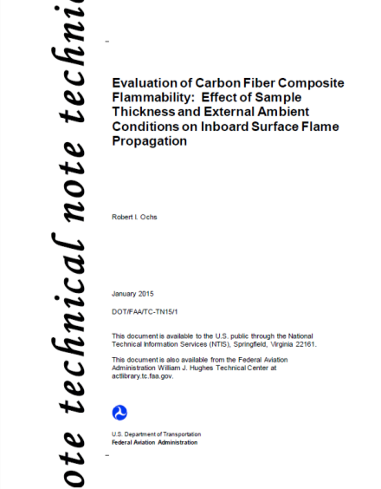
Determined Conditions Impacting Composite Structure Fire Behavior
Comparison of Three Heat Transfer
Conditions for 4 Ply and HC Core
Measured Burn Length for
Various Panel Thicknesses

Slide 8
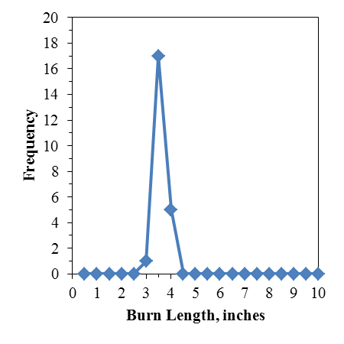
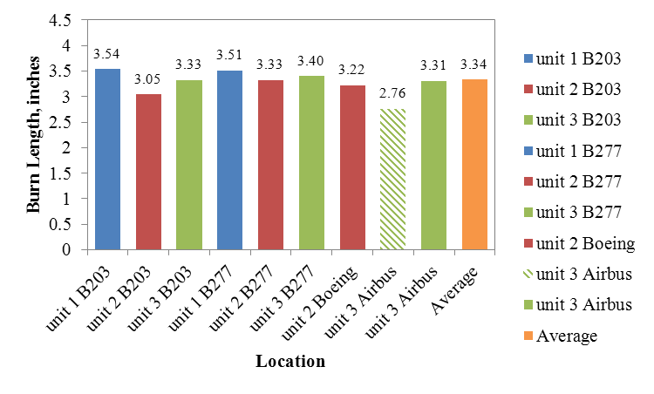
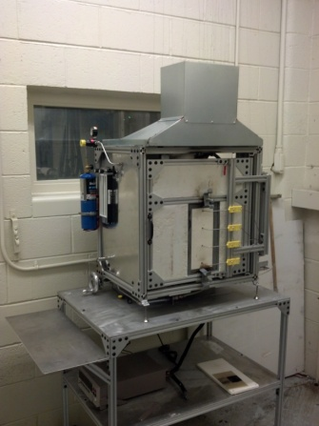
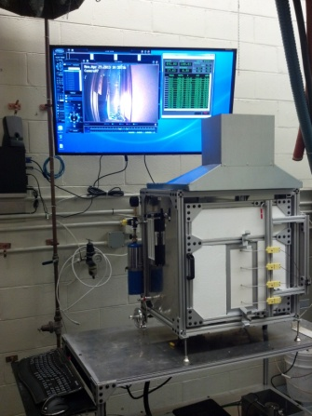
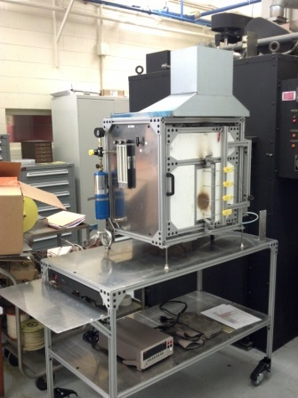
Continued Development of a VFP Test for Composite Fuselage Structures
Histogram
Average Burn Length – 4 Ply CFRP
Unit #1
Unit #2
Unit #3

Slide 9
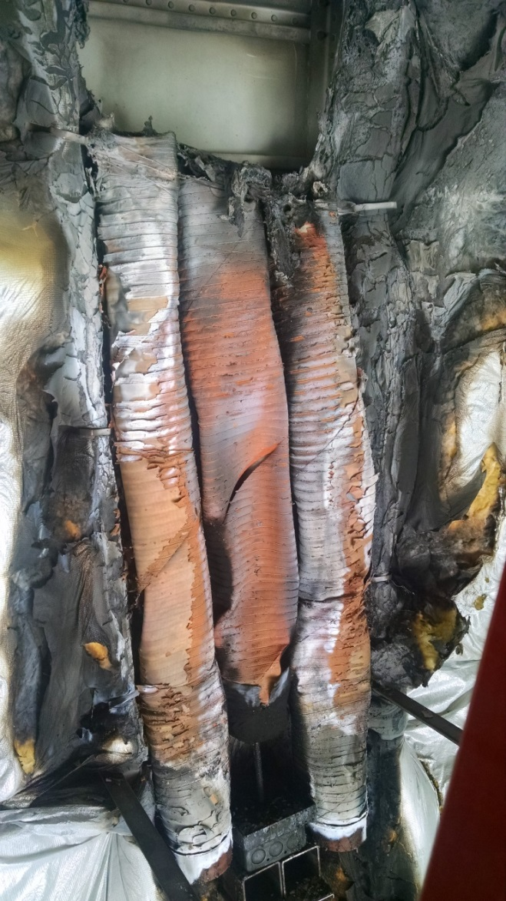
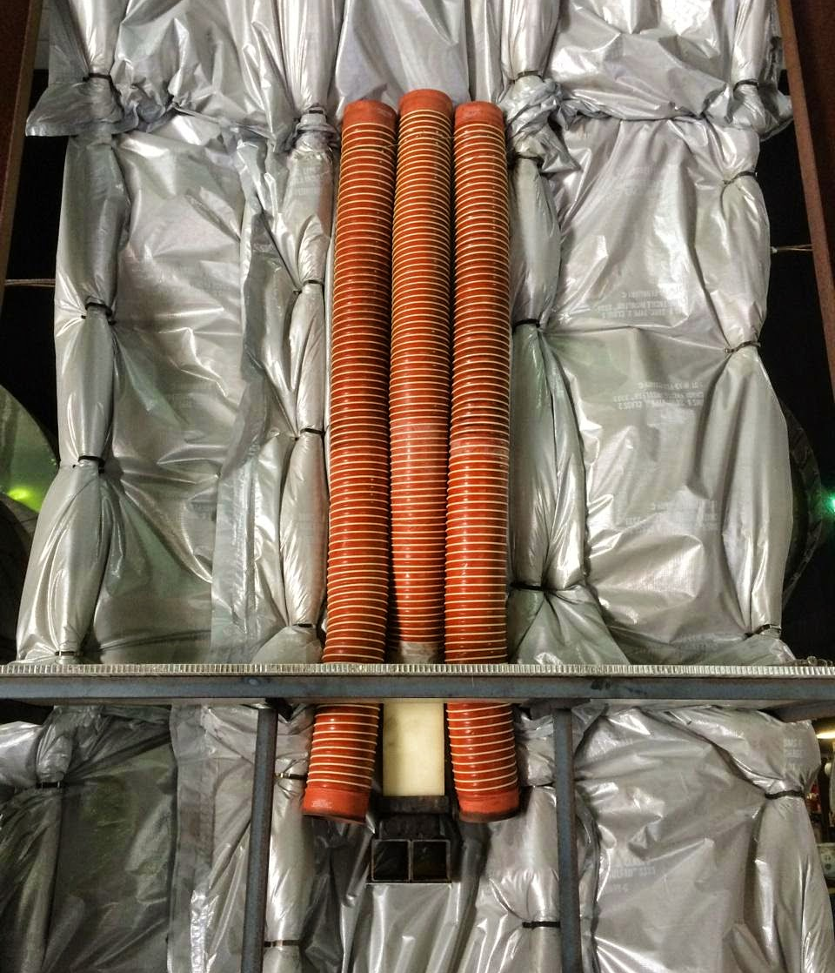
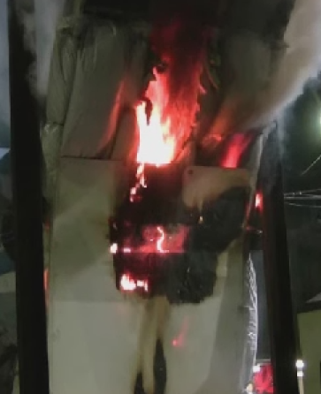
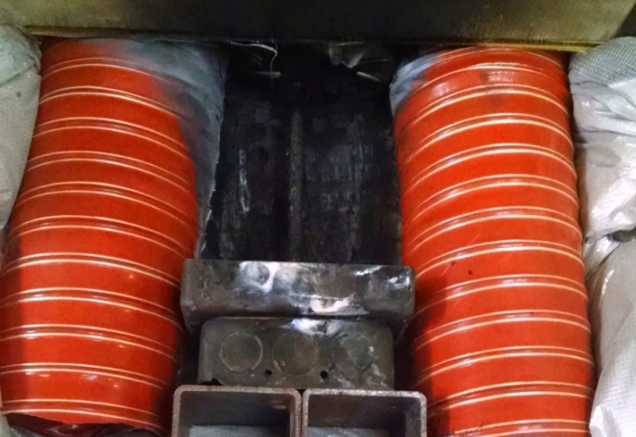
Conducted Riser Fire Tests in Fuselage Section Rig
Silicone/Nylon Duct – After Test
Test Rig Configuration
Silicone/Nylon Duct – During Test
Foam Block Fire Source
Results Demonstrate Inadequacy of
VBB Test
Silicone/Steel Duct – After Test

Slide 10
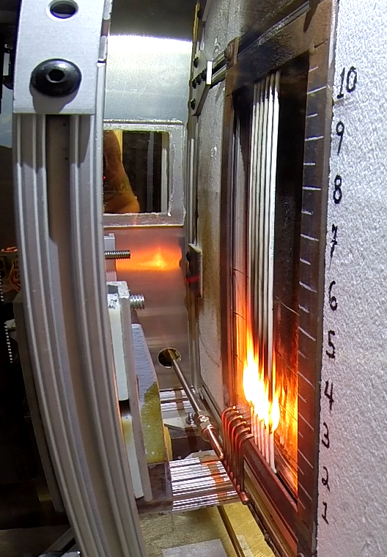
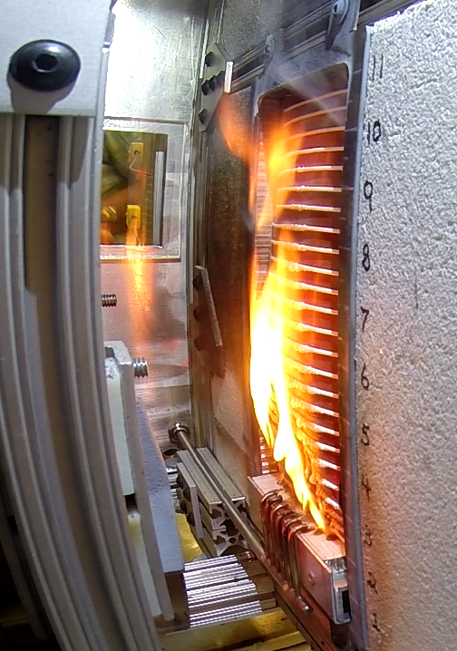
Continued Development of VFP Test for Electrical Wiring and Ducting

Slide 11
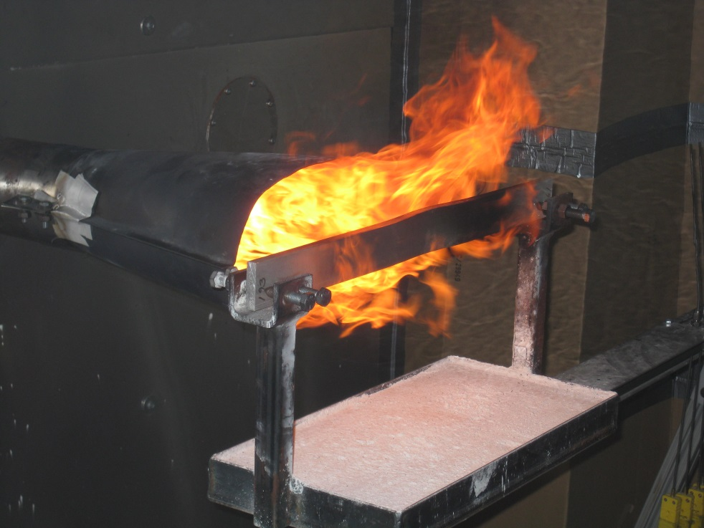
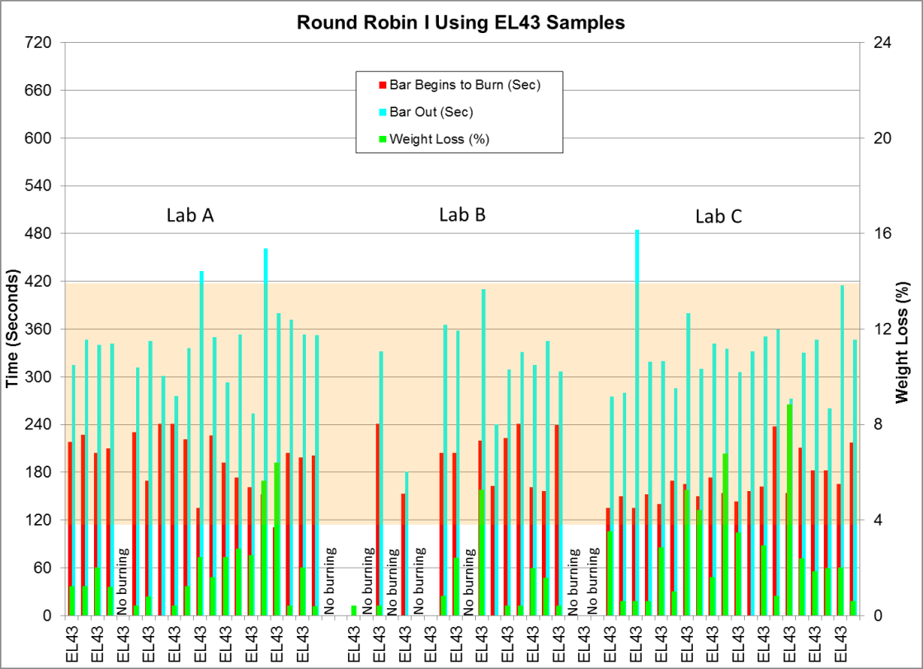
Improved Standardization of a Flammability Test Method for Magnesium Alloy Seat Structure
Final Report: DOT/FAA/TC-13/52

Slide 12
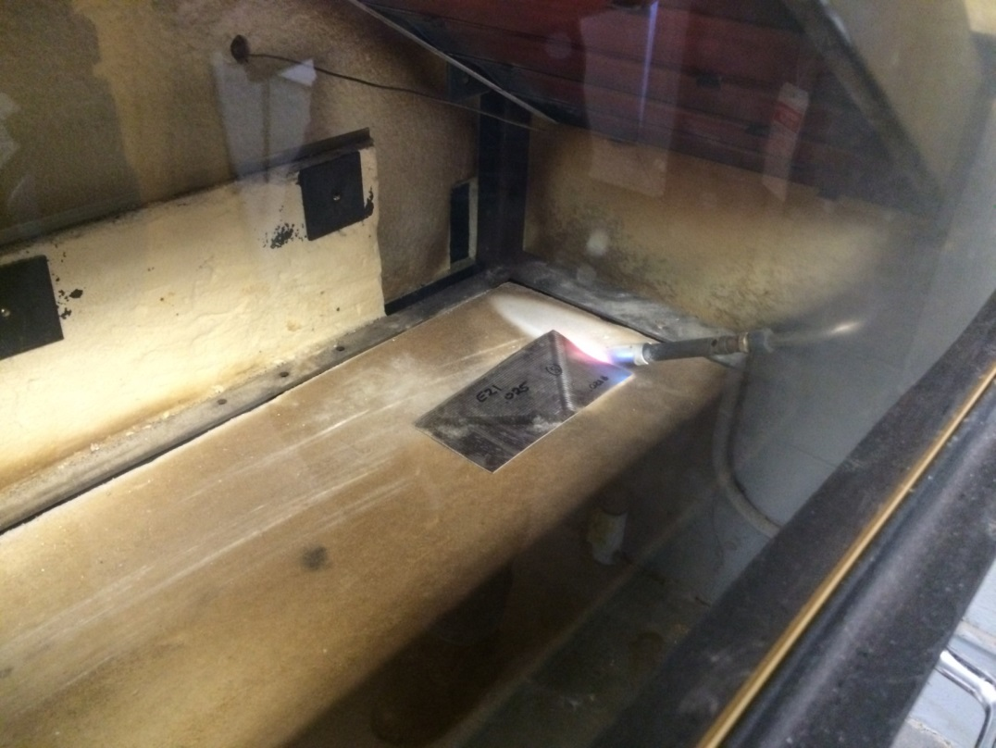
Developing Criteria for Flammability Testing of Magnesium Alloys in Other Seat and Cabin Applications

Slide 13
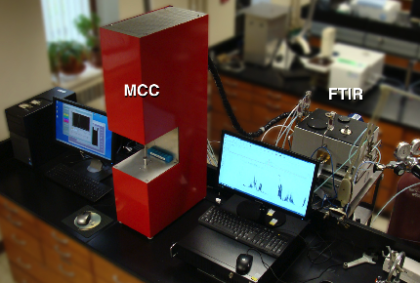
Adapted the Microscale Combustion Calorimeter (MCC) to Examine Gas Emissions in Vitiated Air
10
Early Stage Cabin Fire
1
CO / CO₂
Increasing toxicity
0.1
0.01
Late Stage Cabin Fire
FAA microscale combustion calorimeter (MCC) with infrared analysis of toxic combustion products from burning plastics.
0.001
0
0.5
1
1.5
2
2.5
Fuel / Air Ratio

Slide 14
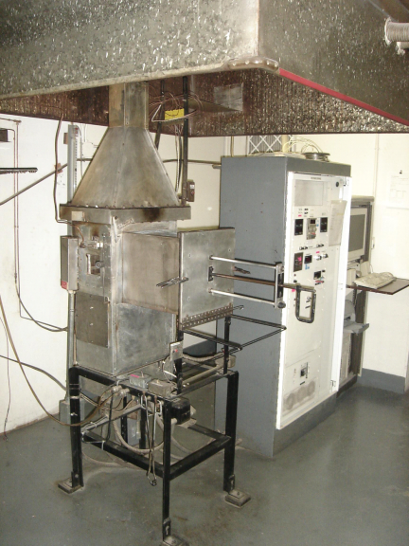
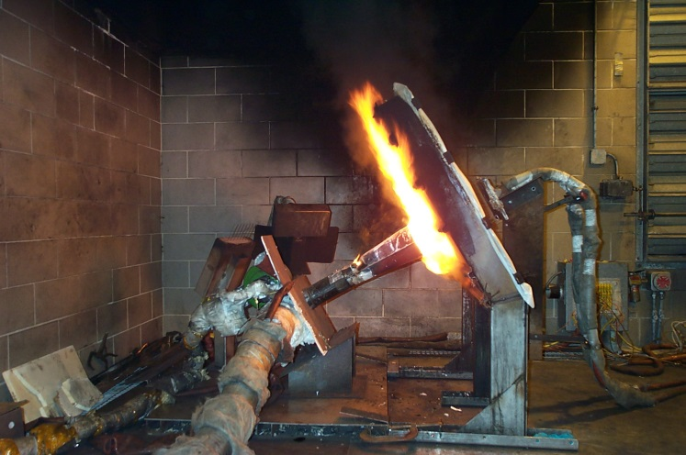
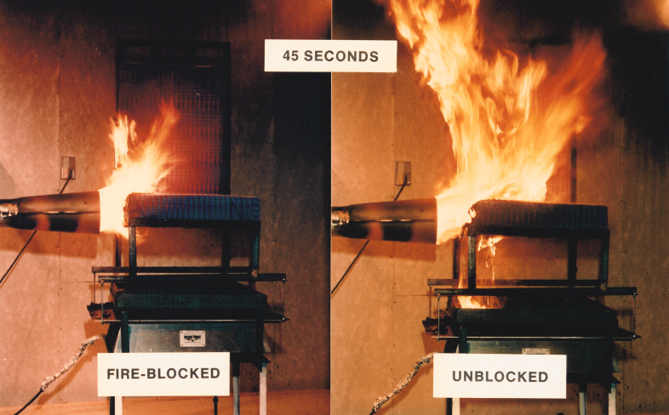
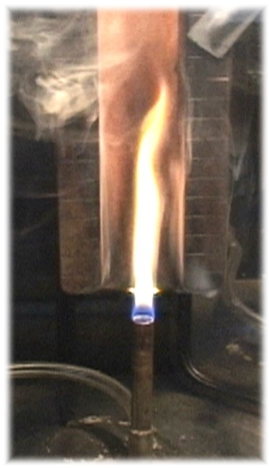
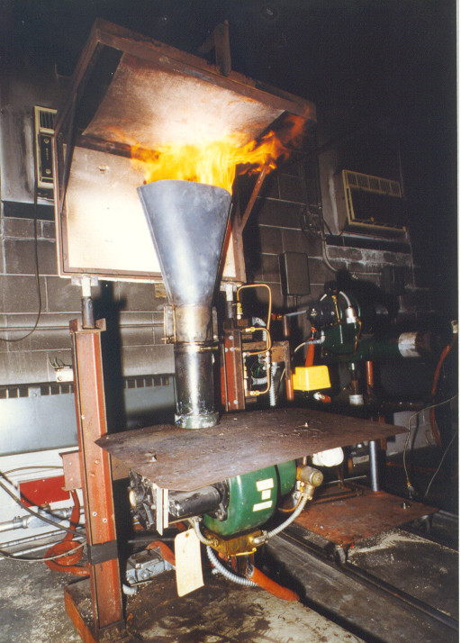
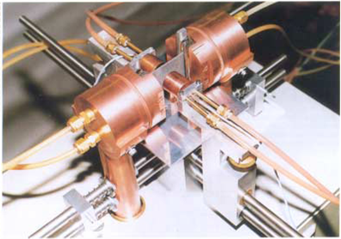
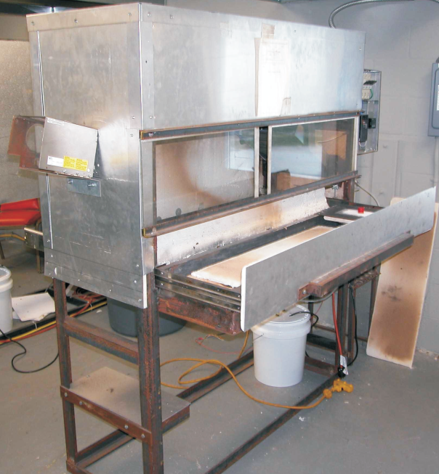
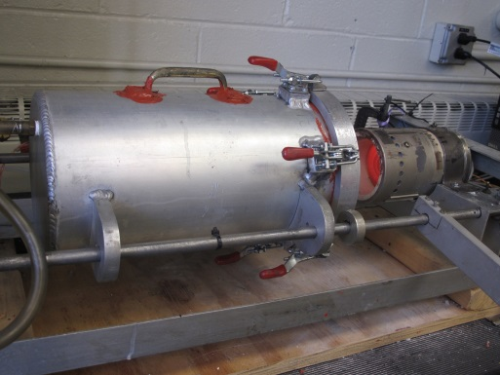
Improving Material Flammability Tests
Currently Required by Regulation

Slide 15
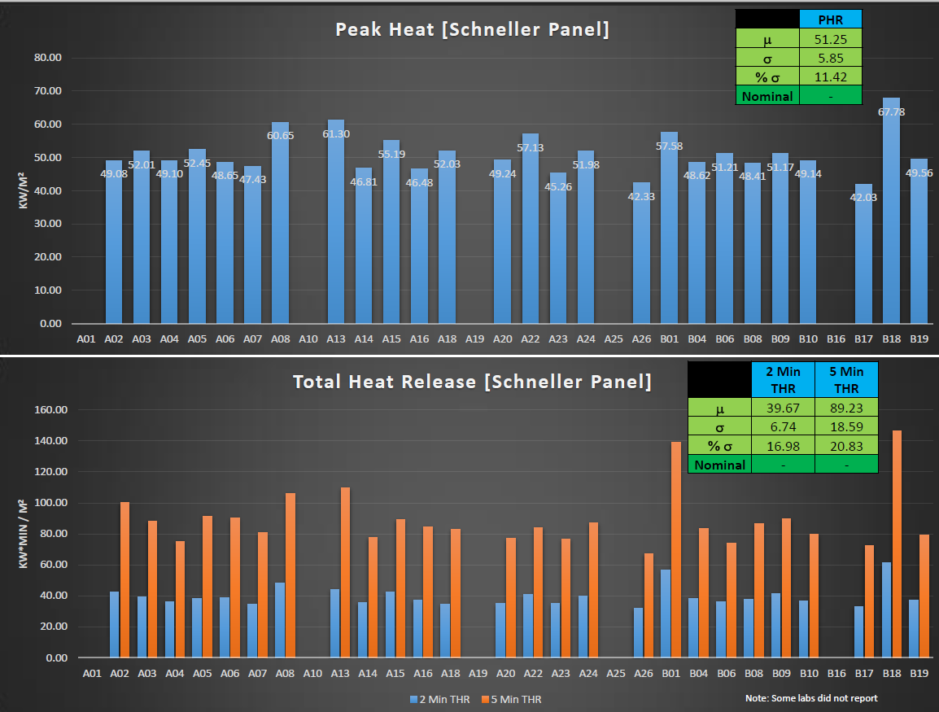
Conducted OSU Round Robins to Evaluate Impact of Improvements on Test Data Reproducibility

Slide 16
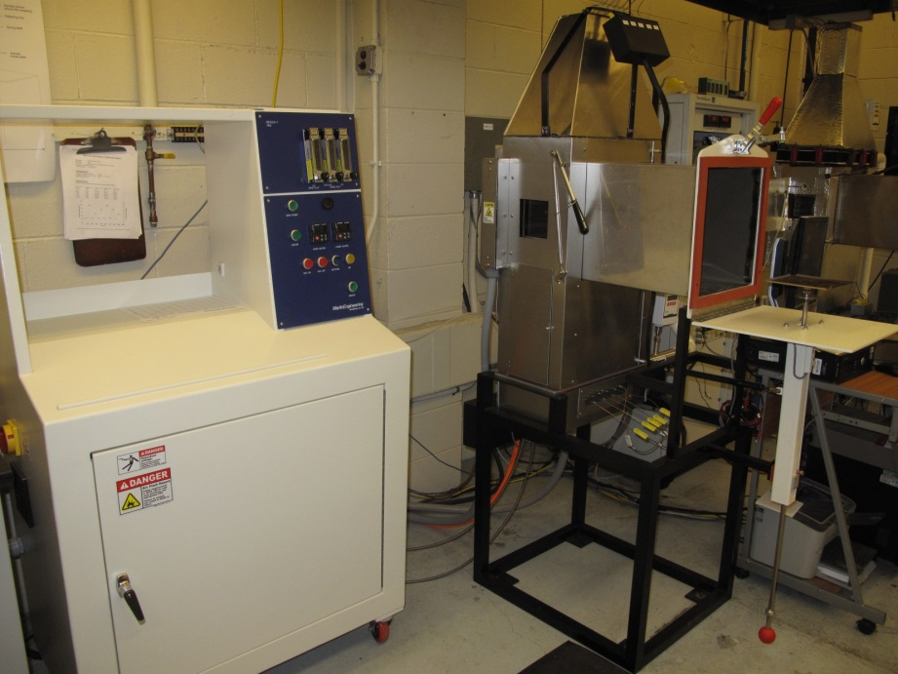
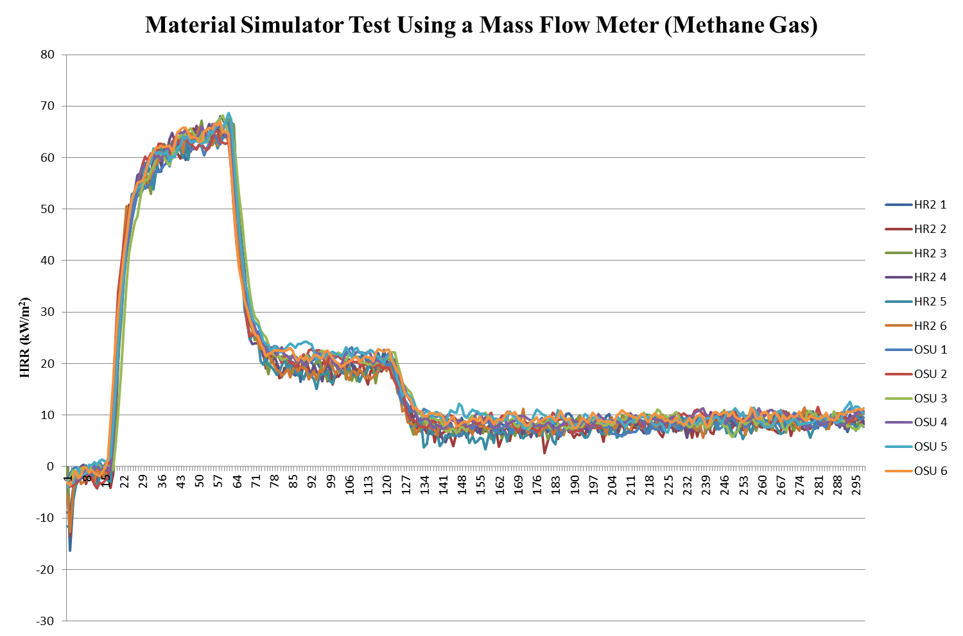
Developing Improved Version of the OSU Rate of Heat Release Apparatus (HR2)

Slide 17
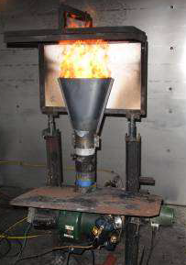
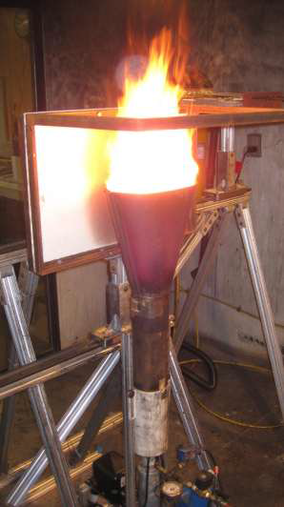
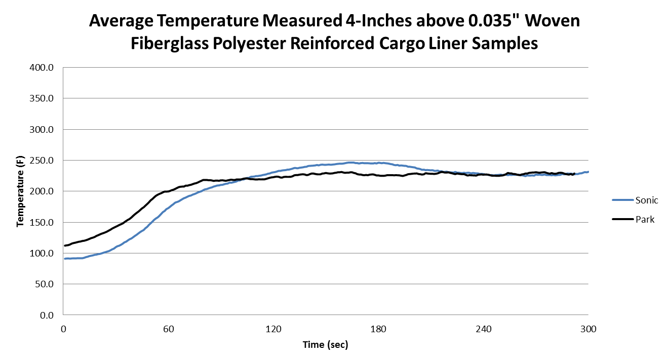
Implementing NexGen (Sonic) Burner Into Required Flammability Tests
Sonic and Park Burner Comparison
Park Burner
NexGen Burner

Slide 18
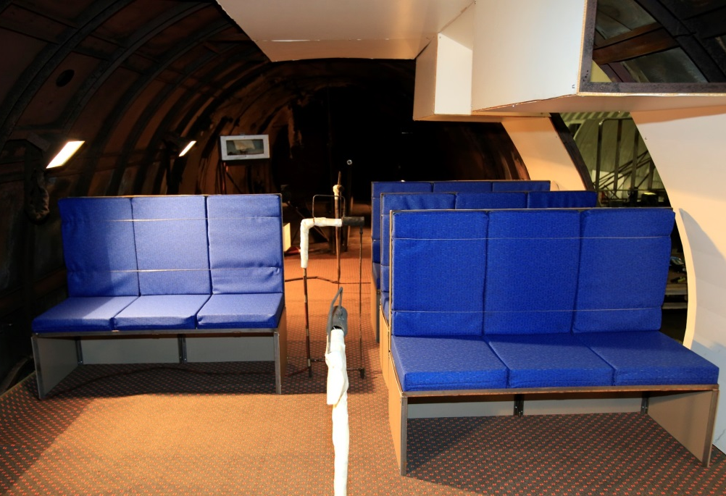
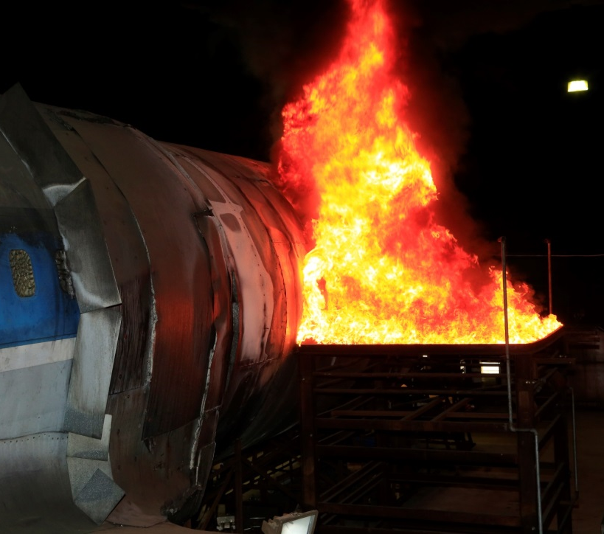
Evaluated the Impact of Non-Low Heat Release Panels on Postcrash Fire Survivability

Slide 19
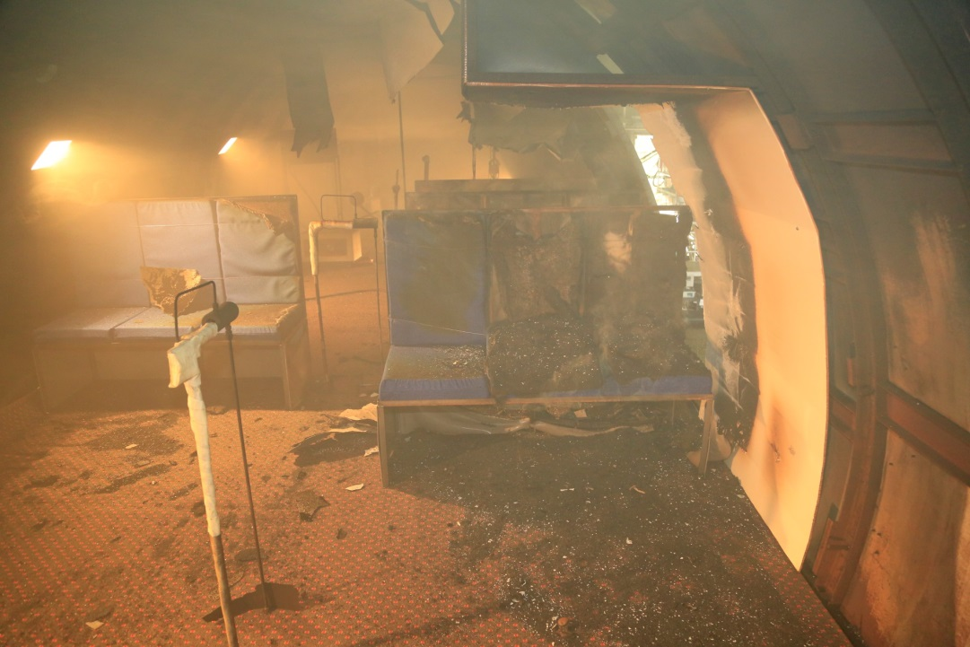
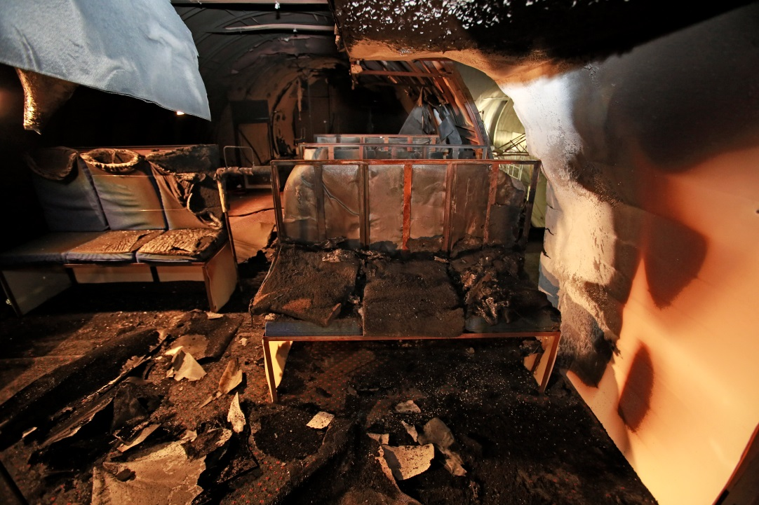
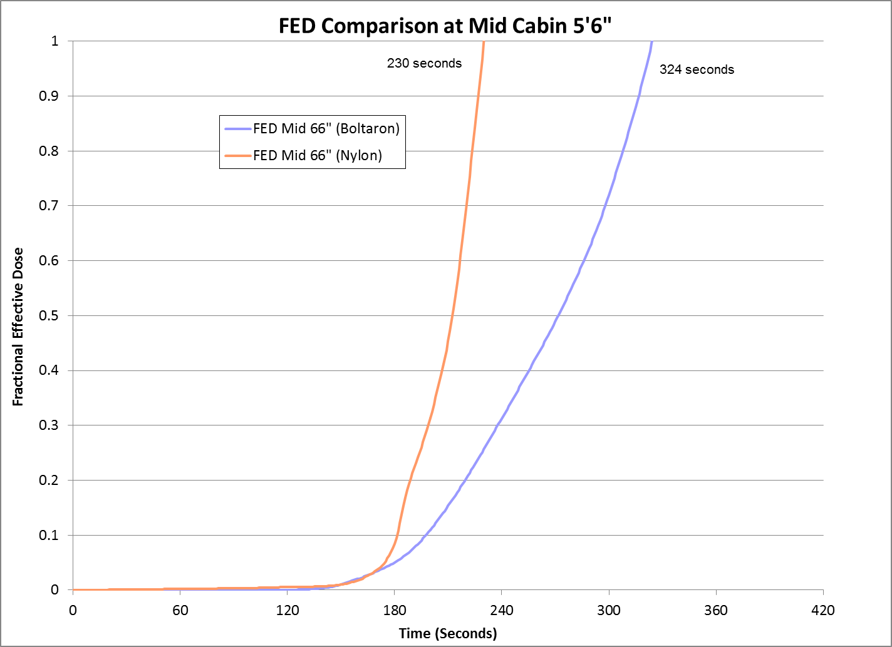
OSU-Compliant Materials
non-OSU-Compliant Materials

Slide 20
Systems Fire Protection:
Lithium Batteries
Cargo Compartment Fire Protection
Halon Replacement
Fuel Cells

Slide 21
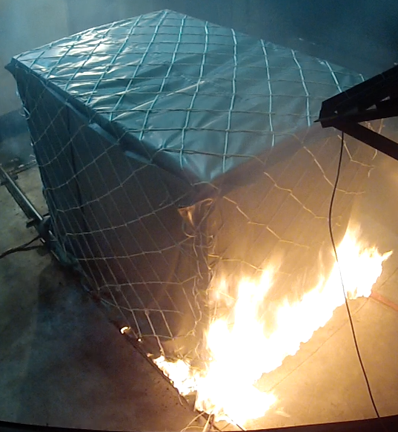
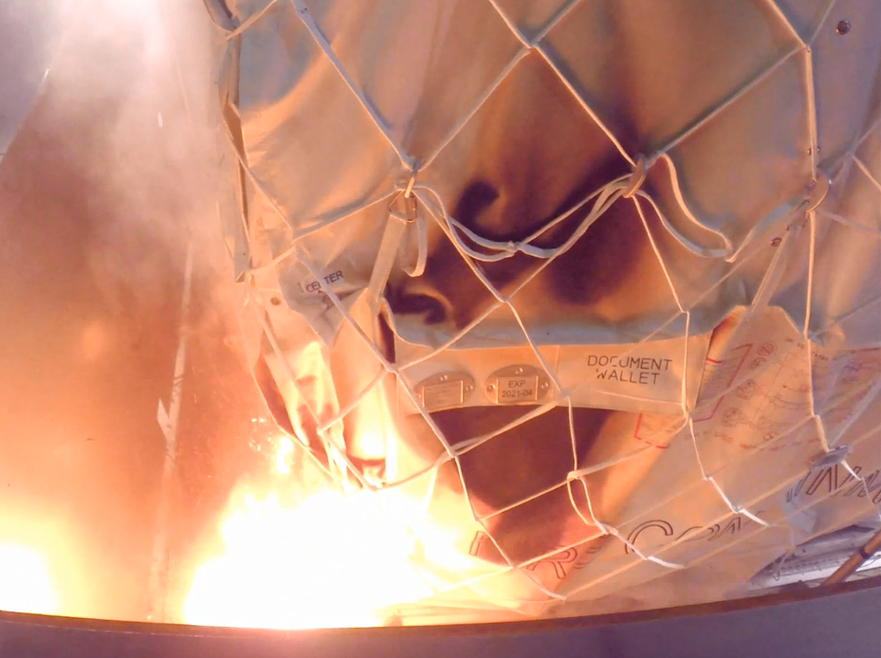
Evaluated Fire Containment Covers (FCCs) Against Lithium Battery Fires
4800 Li Metal Cells
1000 Lithium-ion Cells

Slide 22
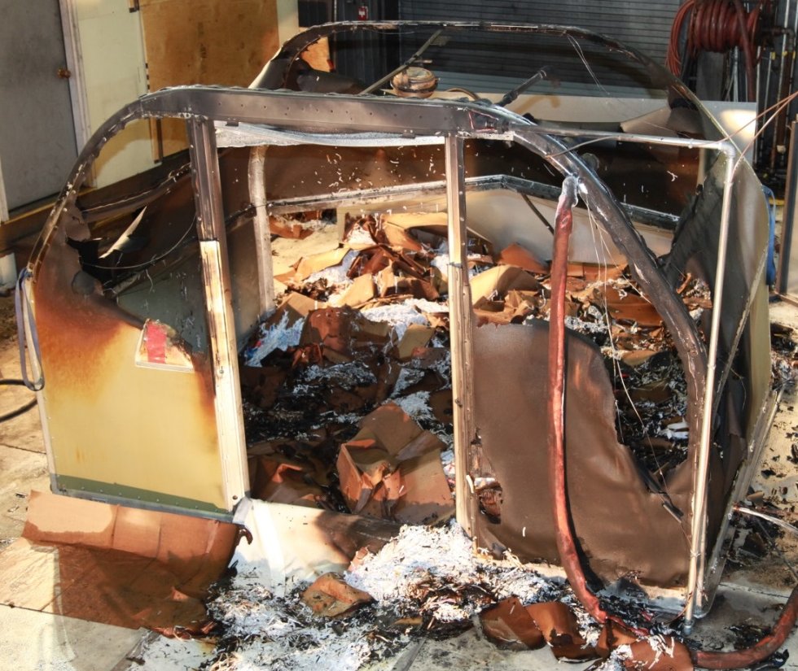
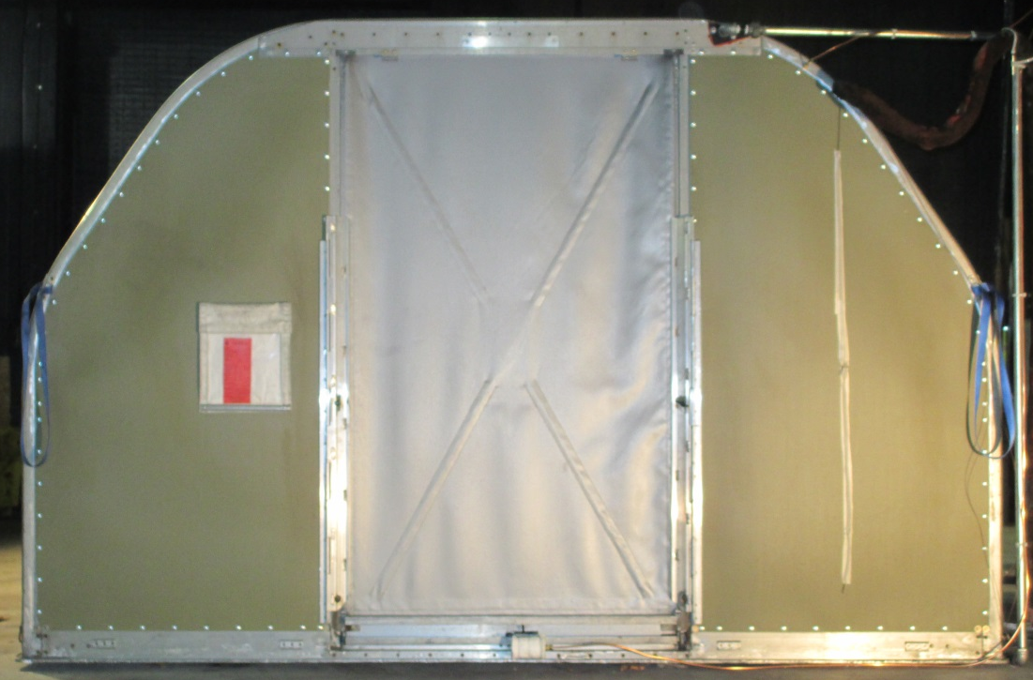
Evaluated Fire Resistant Containers (FRCs) Against Lithium Battery Fires

Slide 23
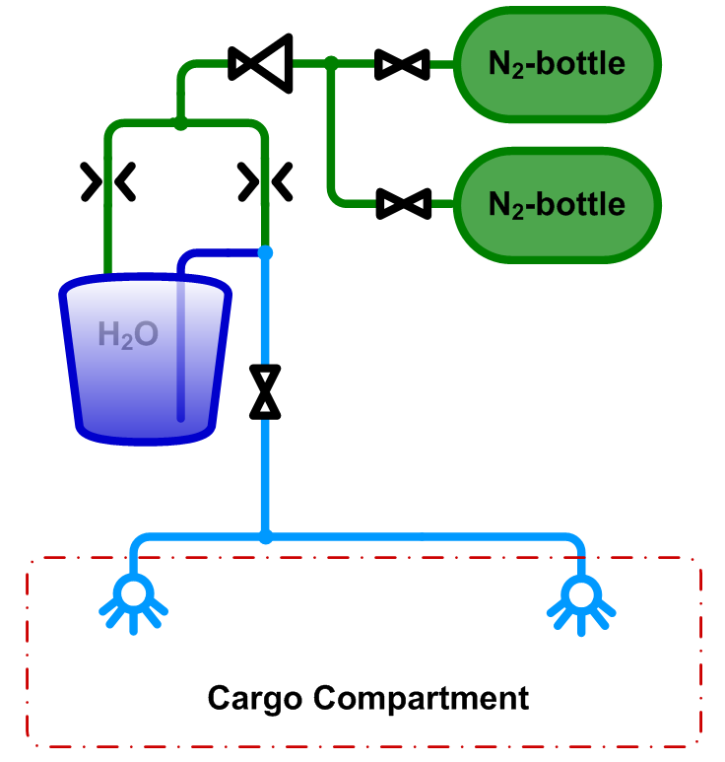
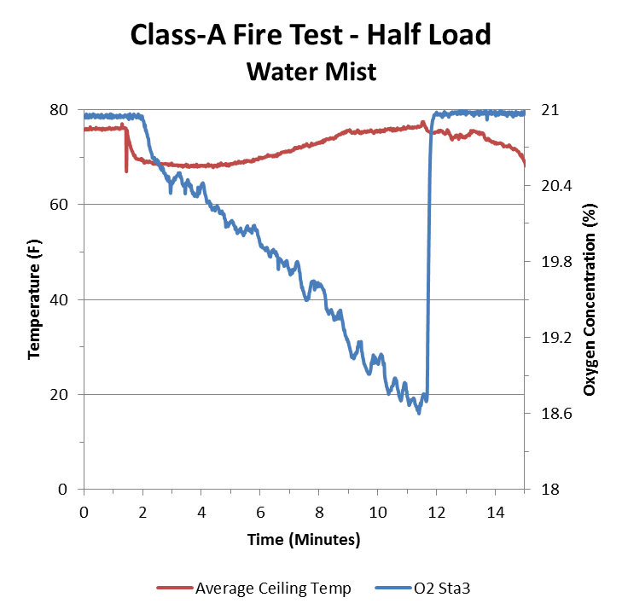
Evaluated Water Mist System for Class-E Cargo Compartment Fire Protection
~84 Liters of water used
~34 Kg of nitrogen used

Slide 24
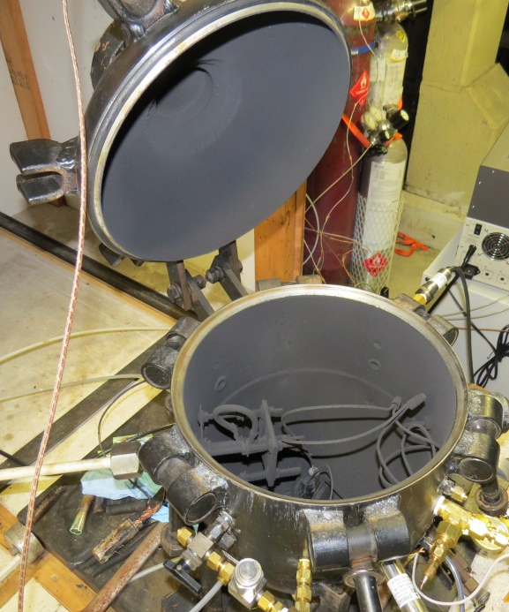
Measured Flammable Gasses Vented by Lithium Batteries in Thermal Runaway

Slide 25
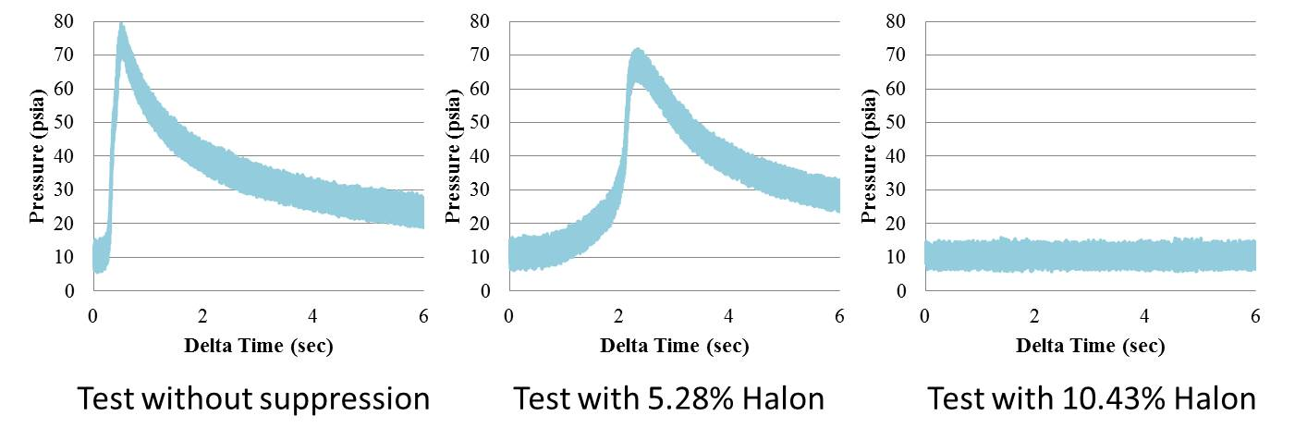

Measured Effectiveness of Halon 1301 in Preventing the Explosion of Lithium Battery Vented Flammable Gasses

Slide 26





Measured Pressure Rise from Ignition of Battery Gasses and Number of Batteries Required to Activate Pressure Relief Panels

Slide 27

Measured the Minimum Inerting Concentration (MIC) of Halon 1301 for a Vented Lithium Battery Flammable Gas Mixture
Test Setup

Slide 28


Characterized the Fire Hazards of Numerous Lithium Battery Chemistries and Sizes 45 in Thermal Runaway
Thermocouples
Li-Ion Propagation
Heater
Thermocouples
Heater

Slide 29
Quantified the Energy Release of Lithium Ion Batteries in Thermal Runaway Under Anaerobic Conditions

Slide 30



Examined the Potential Fire Hazard of E-Tablets Stored in a Galley Cart (Simulated In-Flight Entertainment System)

Slide 31


Determined Certification Criteria for Blended Gas
Halon Replacement Agent in Nacelle Fire Simulator
NACELLE FIRE SIMULATOR
/ | MPSHRe Outcome (%v/v)
CF3I | 7.1
HFC-125 | 17.6
FK-5-1-12 | 6.1
MSSI Blend A | 30.6
halon 1301 | 6 ( per FAA AC 20-100, not the MPSHRe )
Fire
Extinguishing
Agent
EXHAUST
TEST SECTION
FIRE EXTINGUISHER
INLET
TEST SECTION
FIRE EXTINGUISHING AGENT INJECTION
POOL FIRE THREAT
SPRAY FIRE THREAT
sta551
sta453

Slide 32
Measured the Flammability Envelope of Hydrogen, Air and Halon 1301 Mixtures

Slide 33

Examined the Flammability of Materials in a Low-Concentration Hydrogen Environment (<LFL)
Test sample
Igniters
Bunsen Burner
Camera
Blow-out panels
H₂ Analyzer
Burner Actuator

Slide 34

Conducted Destructive Testing of Fuel Cells to Determine Consequences of Failure Modes

Slide 35



Examined the Oxygen Depleted Air (ODA) By-Product from a Fuel Cell for Cargo Compartment Fire Suppression in a 737

Slide 36

www.fire.tc.faa.gov

