Slide 1
Flammability of Hydrogen at Sub-Atmospheric Pressures and Reduced Oxygen Concentrations

Slide 2
Hydrogen Properties
Gas at room temperature, can displace air
Very wide flammability limits (~4-76% at sea level)
Very low ignition energy needed (<0.1mJ)
In a closed container, explosion pressure rises up to 8 times initial pressure in as little as 10ms
Adiabatic flame temperature of 4010°F (2210°C)

Slide 3
Objective
Test flammability of hydrogen in air at atmospheric and sub-atmospheric pressures
Pressures replicating elevations of 0, 15,000, 30,000, and 40,000 feet (14.7, 8.29, 4.36, and 2.71 PSI, respectively)
Find flammability limits and verify with previous data
Test flammability properties and in oxygen-depleted air at these pressures (added nitrogen)
Find the limiting oxygen concentration

Slide 4
Concept
Nitrogen can be added to air to lower the oxygen concentration, effectively inerting the H₂-air mixture
Similar to inerting the empty space in jet fuel tank
Allowable oxygen concentration vs. altitude according to AC 25-981-2A

Slide 5
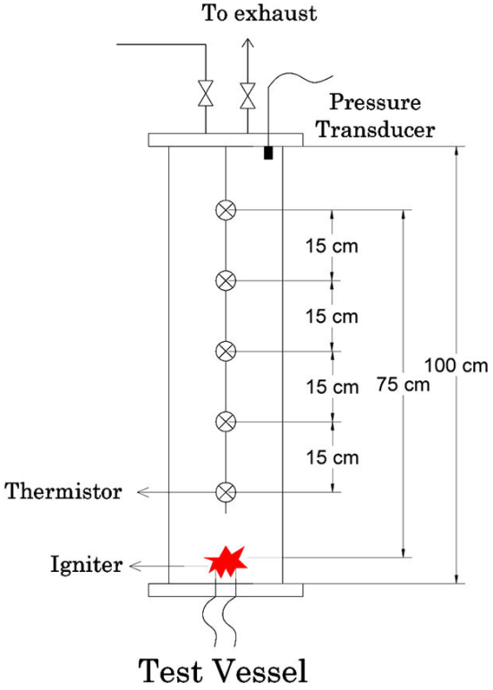
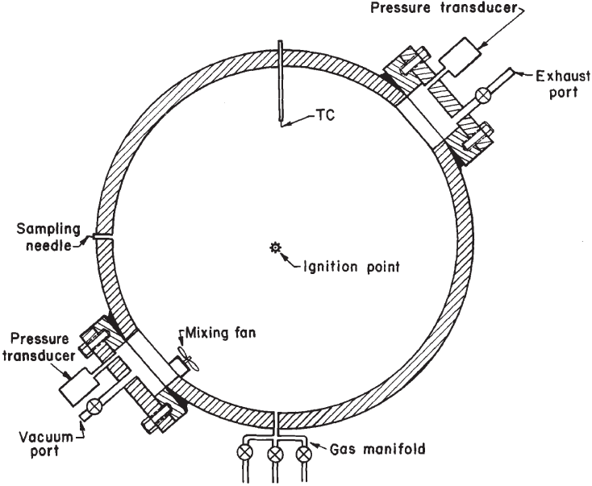
Common Experimental Methods
Variables:
Vessel type
Vessel size
Ignitor type
Ignition energy
Flammability criterion
From Upper Flammability Limits of Hydrogen and Light Hydrocarbons in
Air at Subatmospheric Pressures, Hai Le, et al. 2012
From Flammability of Methane, Propane, and Hydrogen gases, Kenneth L. Cashdollar, et al. 2000

Slide 6
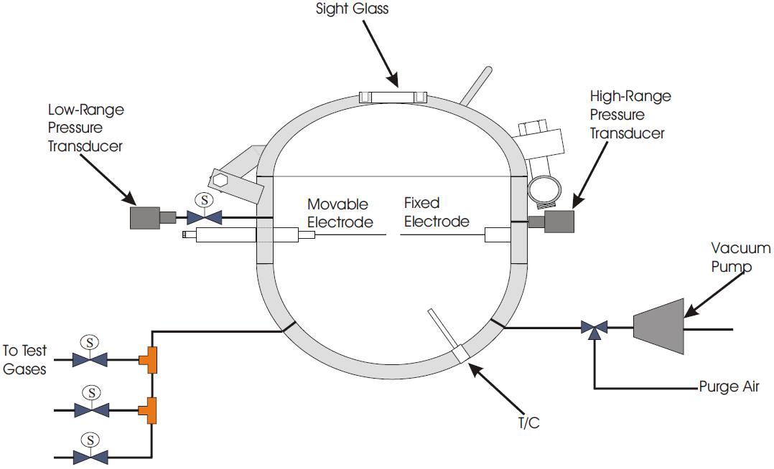
Experimental Setup

Slide 7
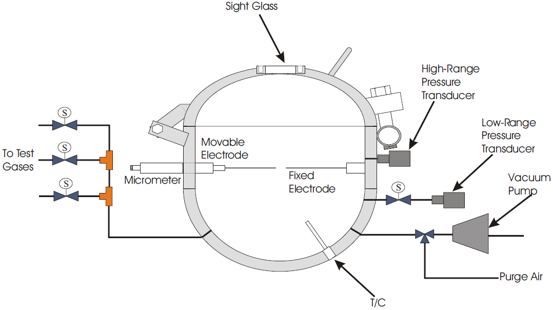
Experimental Setup
Based on ASTM standards
20L, ½” thick steel chamber, 300 PSI max
Chamber evacuated, then filled by partial pressures
Can mix hydrogen, nitrogen, and air at any ratio
Initial pressure varied from 2.71 to 14.7 PSI
Initial temperature 72°F (22°C)
Ignited with 15,000V, 30mA continuous spark, 0.5s duration
Considered flammable if pressure rise 3% over initial pressure

Slide 8
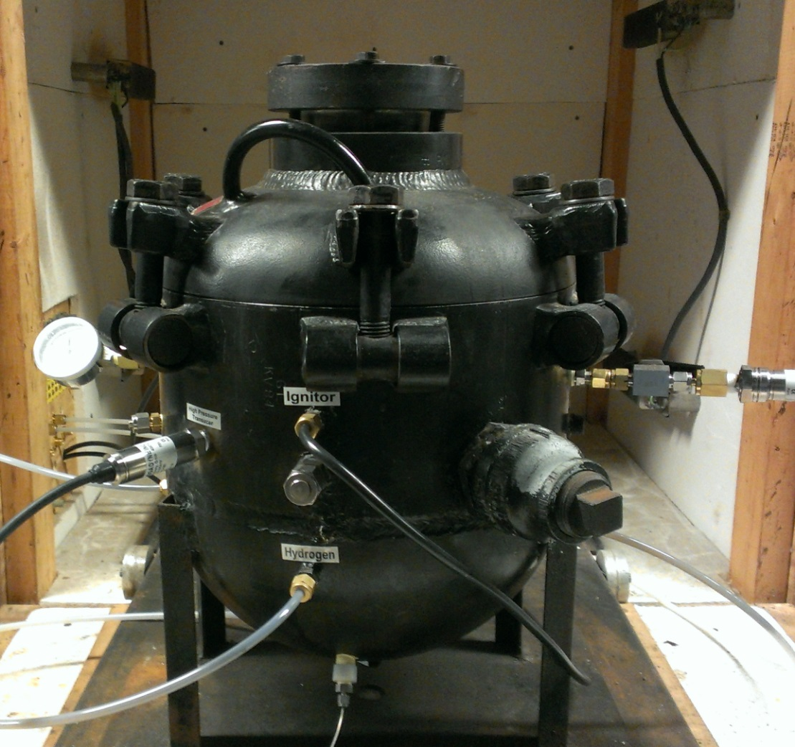
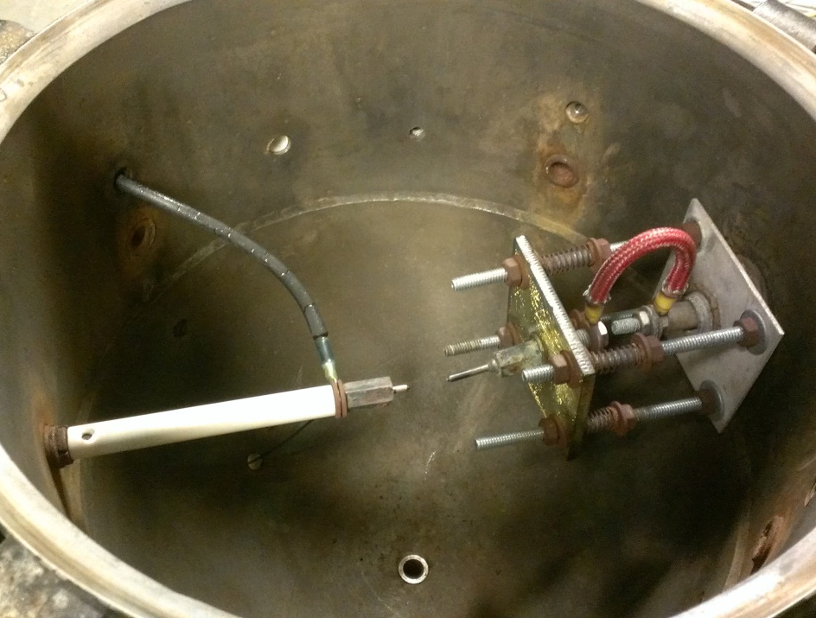
Experimental Setup
High Pressure Transducer
Thermocouple
Electrodes
Picture of explosibility chamber outside and inside

Slide 9
Gap (in.) | Avg. Energy (J)
0.186 | 1.09
0.3125 | 1.24
0.625 | 1.65
0.75 | 1.88

Slide 10
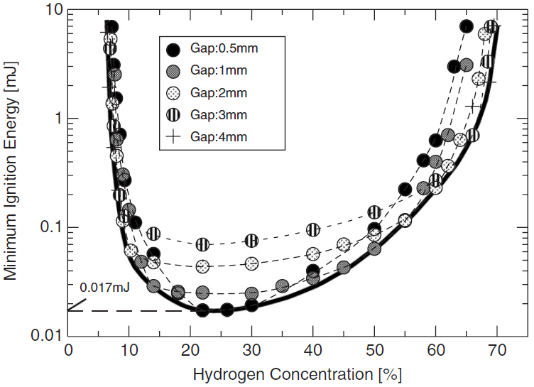
From Literature
From Minimum ignition energy of hydrogen–air mixture: Effects of humidity and spark duration, Ryo Ono, et. al, University of Tokyo, 2007.
Flammability limits are wider with larger spark gap
Final Configuration: 0.65” gap, 0.5s duration, 12.4J average energy

Slide 11
Example of Single Test Pressure Data
3.62% Pressure Rise, 823 ms Rise Time

Slide 12
Example of Single Test Pressure Data
686% Pressure Rise, 12ms Rise Time

Slide 13
LFL decreased as the altitude increased

Slide 14
Much larger change in pressure rise as H₂ concentration changed

Slide 16
Not Enough Spark Energy at Low Pressure Upper Flammability Limits

Slide 17
Altitude (ft.) | Lower Limit
0 | 4.70%
15,000 | 4.41%
30,000 | 4.07%
40,000 | 3.89%
Altitude (ft.) | Upper Limit
0 | 78.18%
15000 | 78.87%
30000 | 77.86%
40000 | 76.87%
As altitude increased, flammability limits widened except where limited by spark energy

Slide 18
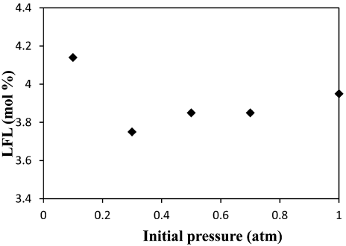
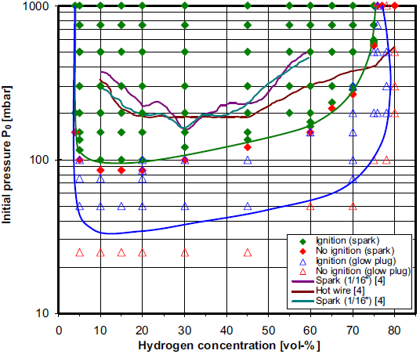
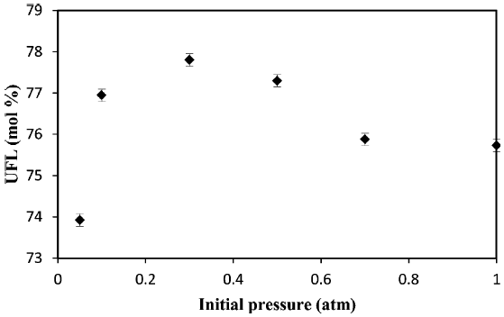
Previous Experimental Data
Pressure (atm) | Altitude (ft.)
1 | 0
0.7 | 9,500
0.5 | 18,000
0.3 | 30,000
0.1 | 52,000
From Flammability limits and laminar flame speed of hydrogen-air mixtures at sub-atmospheric pressures, M. Kuznetsov, et al., 2012
From Lower and Upper Flammability Limits of Hydrogen and Light Hydrocarbons in Air at Subatmospheric Pressures, Hai Le, et al., 2012
Measured flame propagation in 10cm diameter tube
Pressure rise 10× igniter alone in 25cm diameter sphere

Slide 19
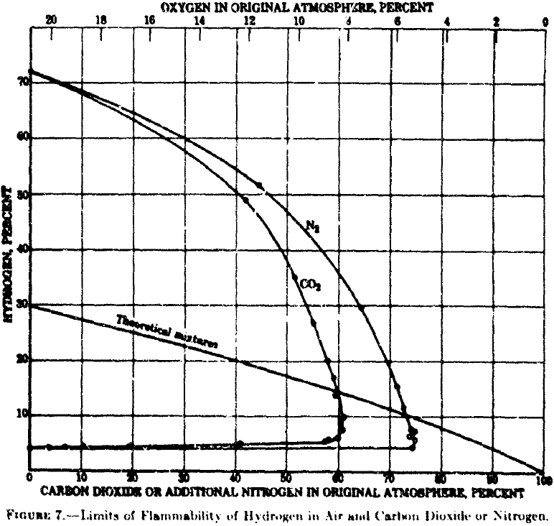
Inerting with Nitrogen in Literature
From Limits of Flammability of Gases and Vapors, H. F. Coward and G. W. Jones, Bureau of Mines, 1952.
Tested in a 6 ft by 2 in diameter tube at atmospheric pressure
Flame did not propagate below 4.9% oxygen concentration

Slide 24
As altitude increased, limits widened but peak pressure decreased

Slide 25
Less oxygen was needed to ignite at high altitudes

Slide 26
Elevation | Limiting O₂ %
0 | 4.21%
15000 | 3.89%
30000 | 3.61%
40000 | 3.49%
Limiting oxygen concentration decreased as altitude increased

Slide 27
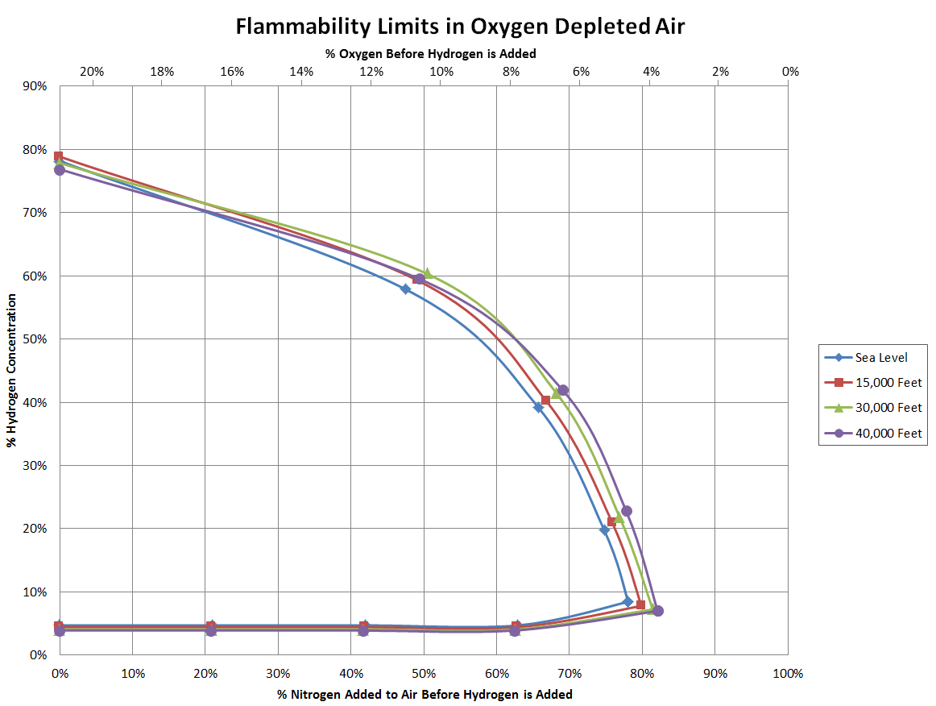
Limits of flammability widen as altitude increases

Slide 28
Conclusion and Future Work
H₂ flammability limits widen at high altitude
H₂ requires less O₂ to ignite at high altitudes, so more N₂ is required to inert it
Less powerful explosions at high altitude
Higher spark energy may be needed near upper flammability limits at high altitude

