Slide 1
Cargo Fire Suppression Using Oxygen Depleted Air from a Hydrogen Fuel Cell
The 8th Triennial Int’l Fire & Cabin
Safety Research Conference
Atlantic City, NJ
October 24-27, 2016
Shane Nicholson
Parker Hannifin Corporation
Aerospace Group
Steve Summer
Federal Aviation Administration
Fire Safety Branch
http://www.fire.tc.faa.gov

Slide 2
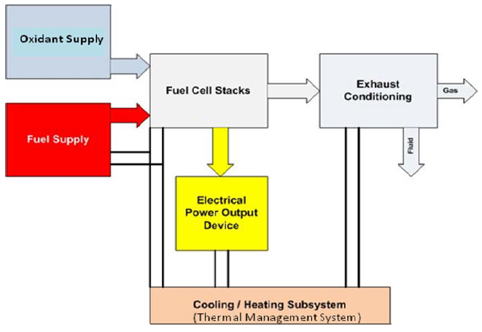
Background
Aviation industry is pursuing efforts to install Hydrogen Fuel Cells on aircraft for a number of potential operations, such as the main battery, ram air turbine, APU, galley power, etc.
In addition, the byproducts of a Fuel Cell System
are being looked at to supply water onboard as well as Oxygen Depleted Air (ODA) for fuel tank inerting or cargo fire suppression

Slide 3
Objective
Key objective of this research activity was to evaluate the effectiveness of ODA from a Hydrogen Fuel Cell system at maintaining fire suppression O₂ levels following an initial nitrogen knockdown in an aircraft cargo compartment.
This testing was conducted in conjunction with Parker Aerospace, Airbus and Ballard Power Systems on board the FAA Fire Safety Branch’s 737 test aircraft

Slide 4
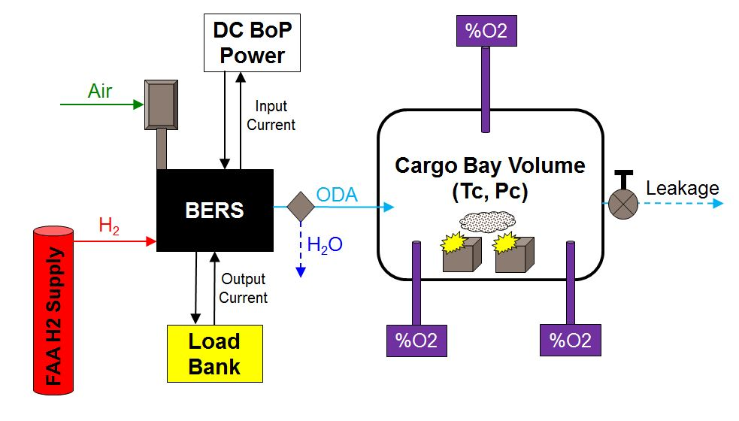
Test Concept

Slide 5
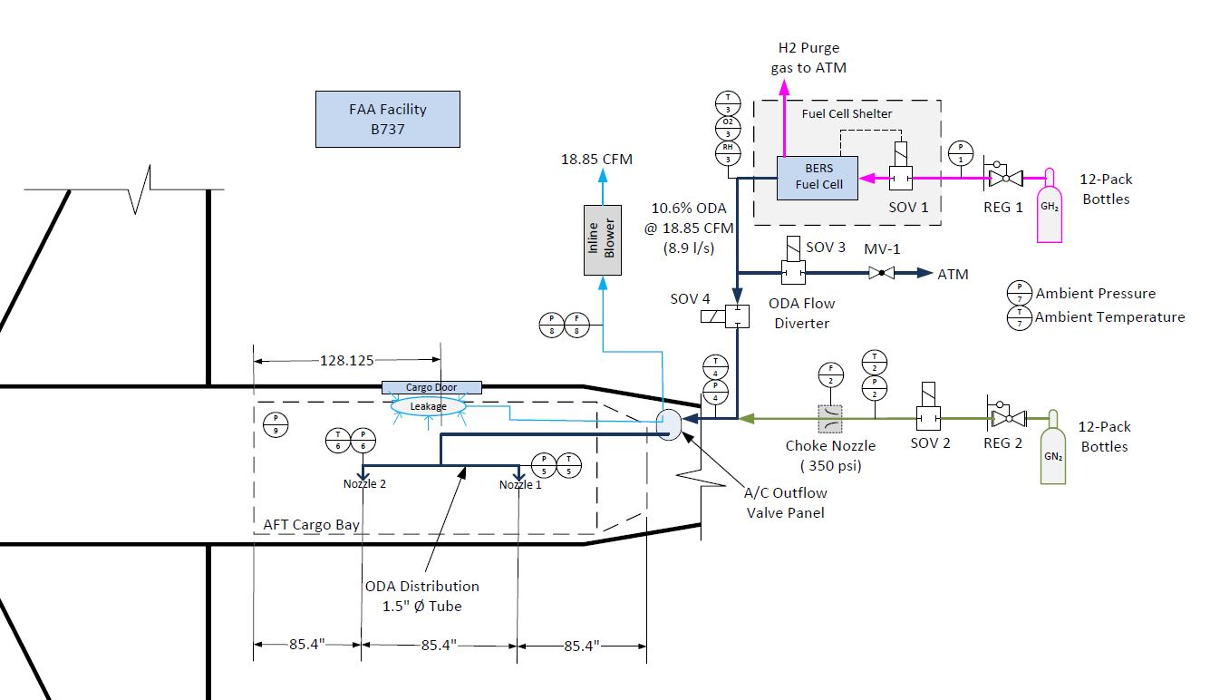
Test Setup

Slide 6
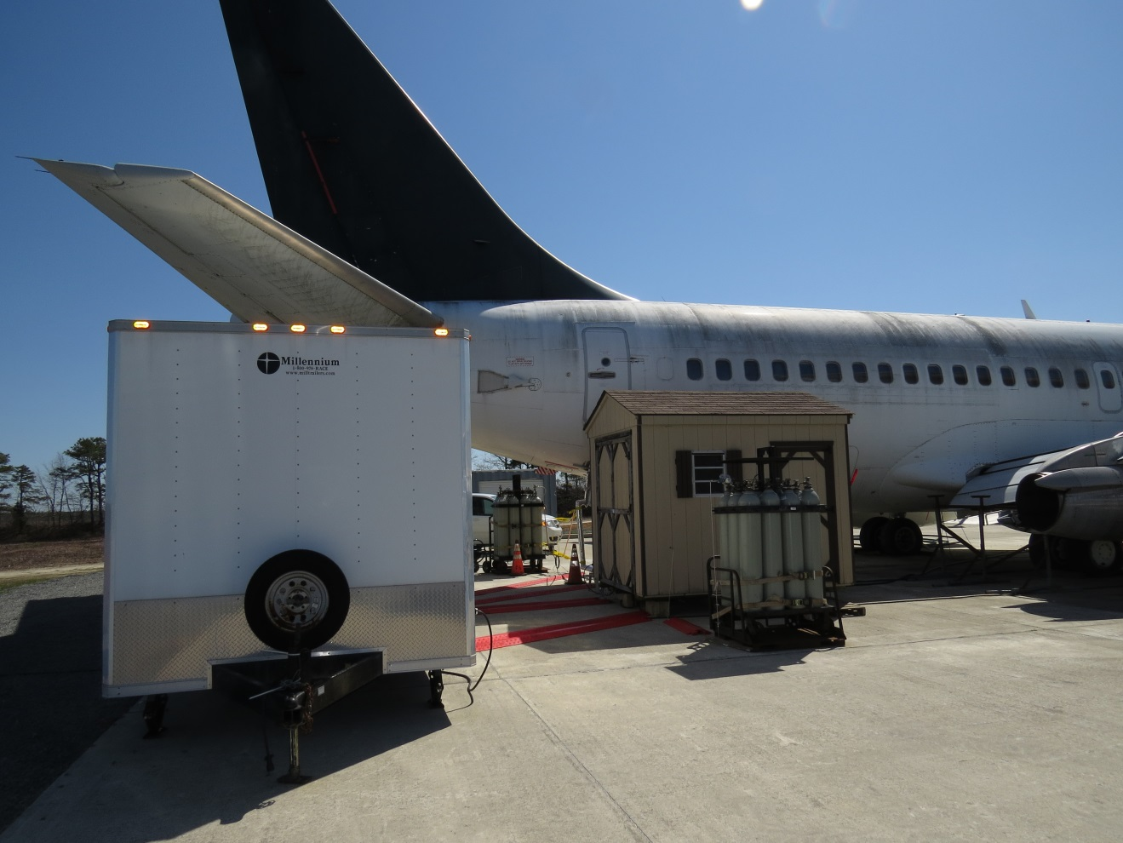
Shelter Housing Fuel Cell System
Nitrogen Bottle Bank
Instrumentation Trailer
Hydrogen Bottle Bank

Slide 7
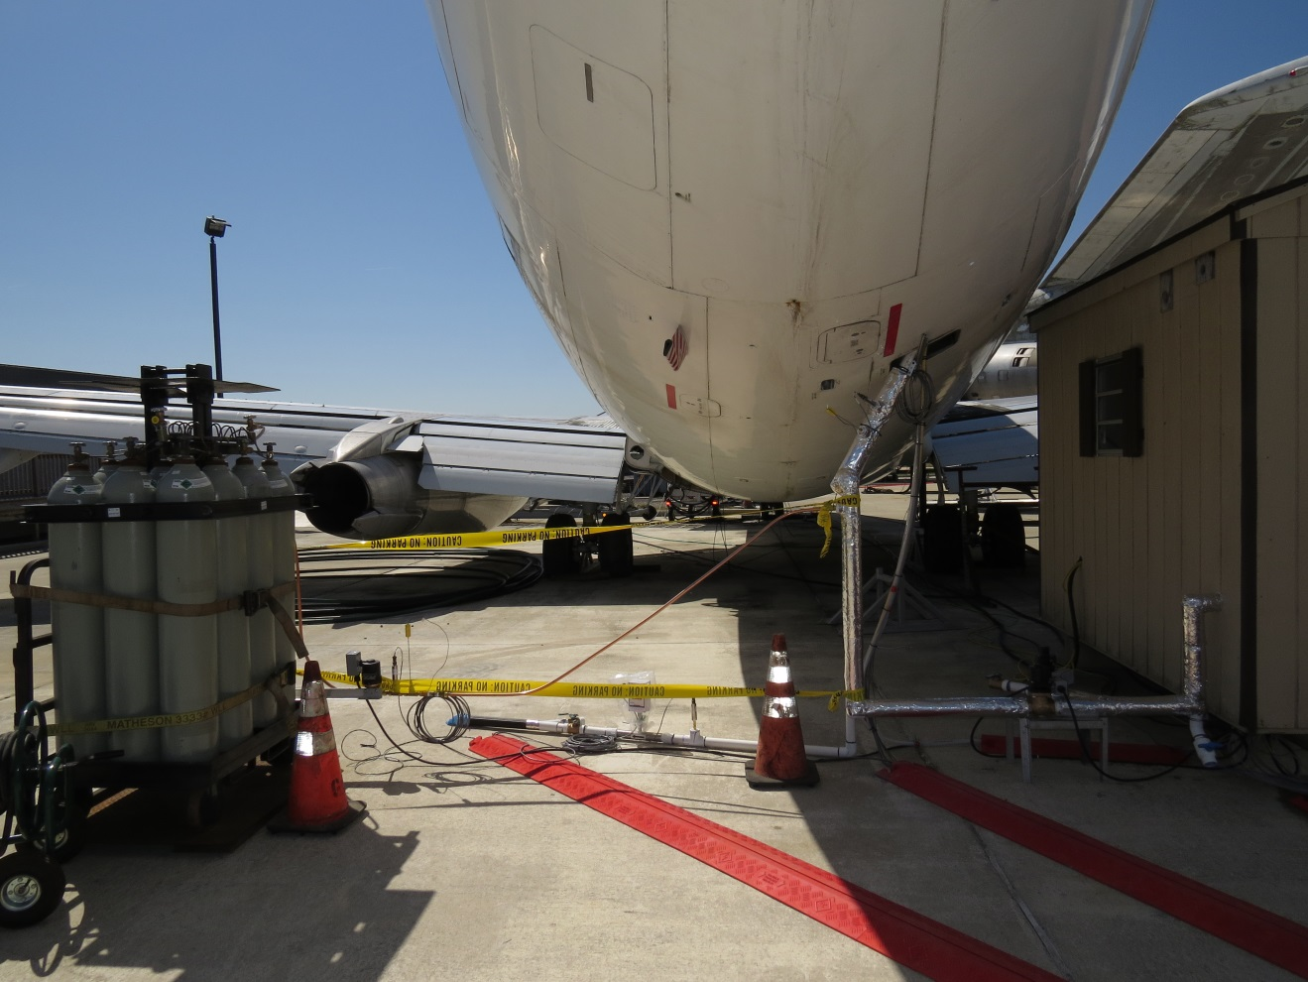
Nitrogen Bottle Bank
Leakage Flow Control/Meter
Sonic Choke (N2 Inlet to Bay)
ODA Bypass Control
ODA Inlet to Cargo Bay

Slide 8
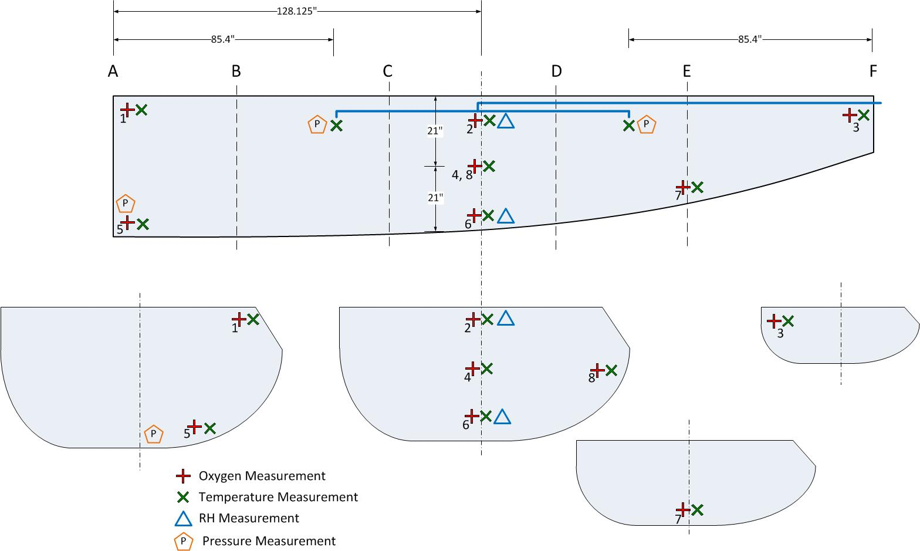
Cargo Bay Instrumentation

Slide 9
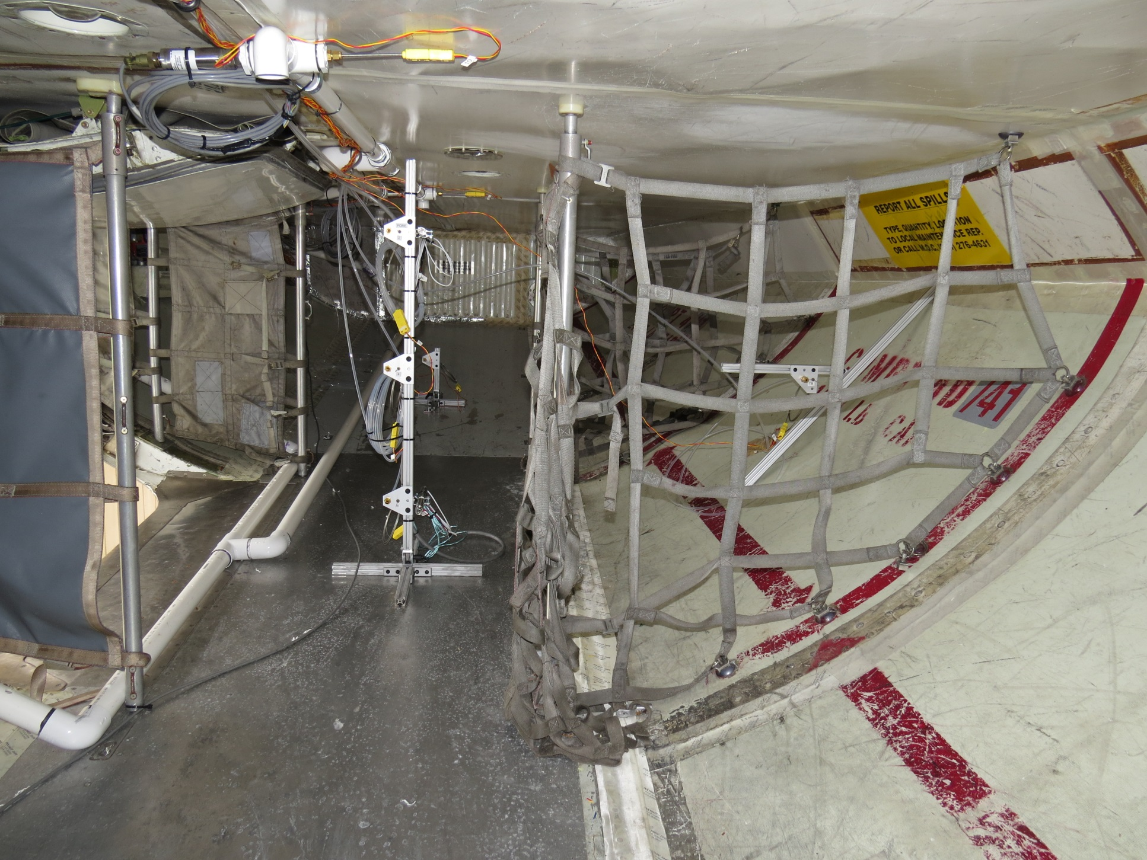
N2/ODA distribution manifold
Instrumentation access panel leading to outflow valve
Instrumentation Tree
Leakage flow source
Cargo Bay Instrumentation – View looking Aft

Slide 10
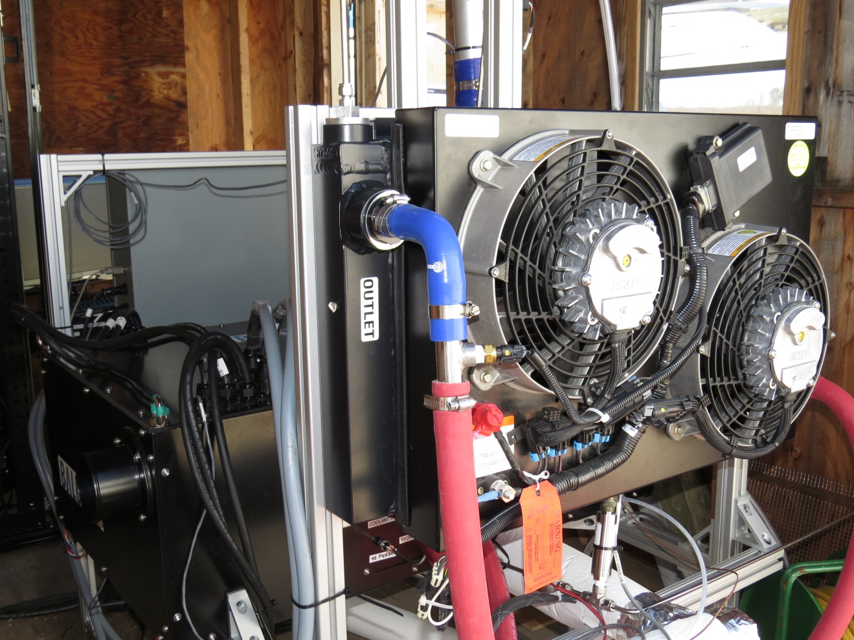
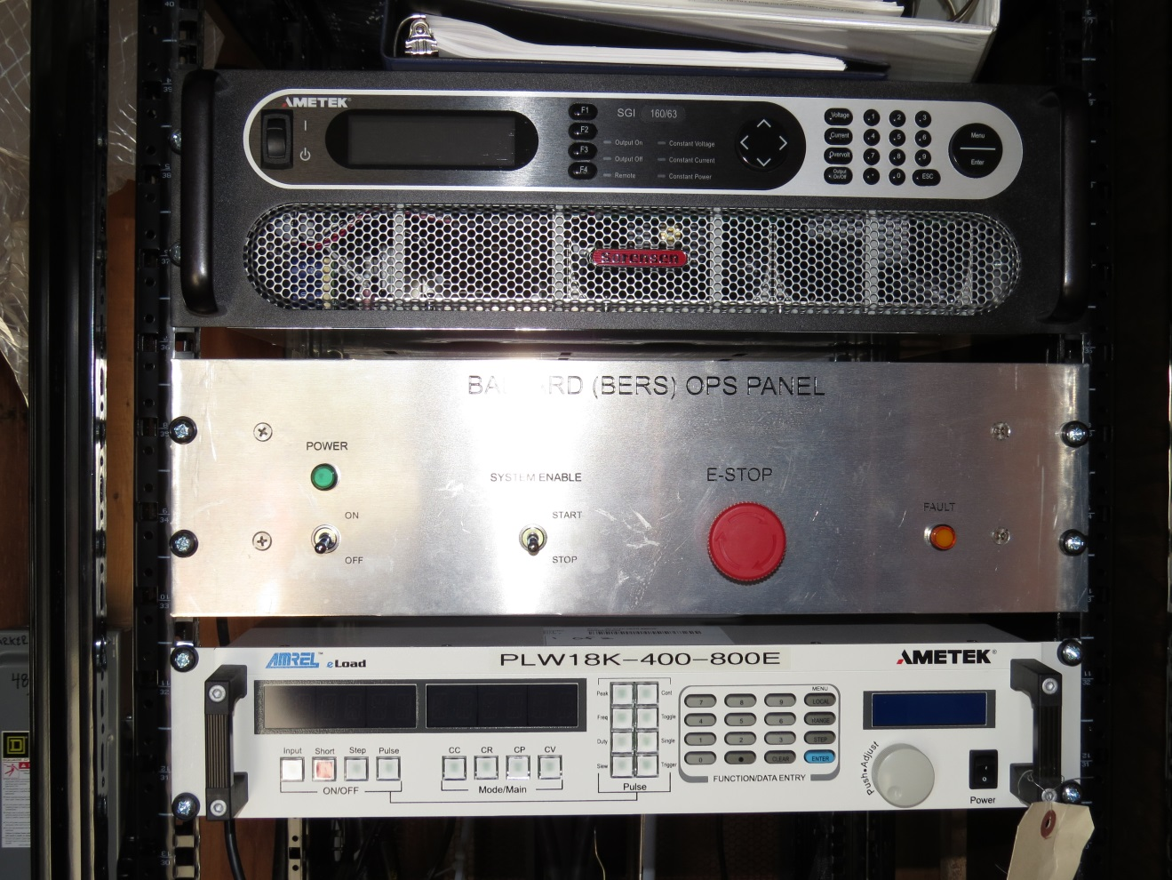
Hydrogen Fuel Cell System – Ballard Engineering Reference System (BERS)
System Power Supply
System Control Panel
Load Bank

Slide 11
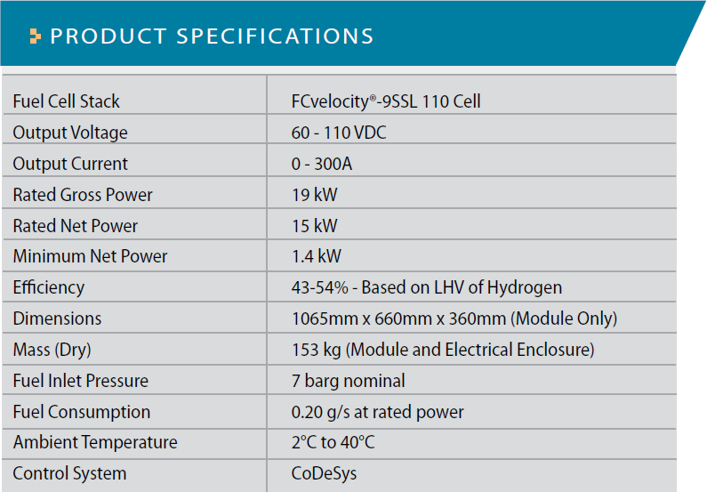
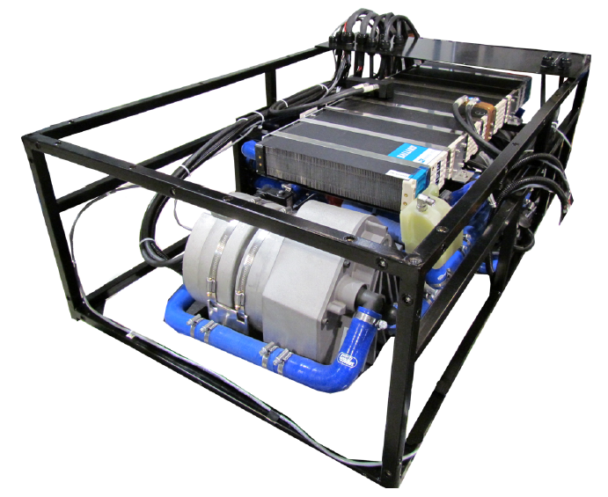
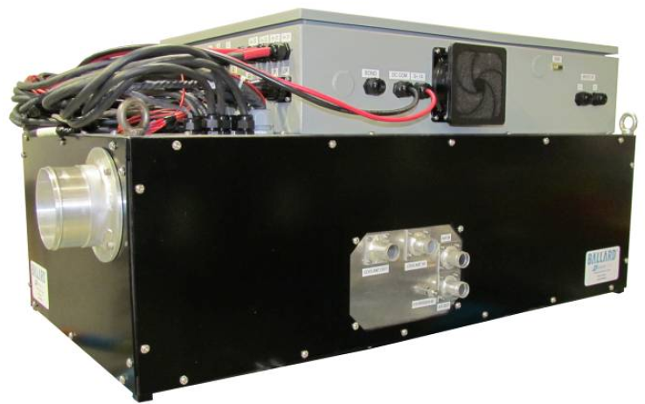
Ballard ERS Features (FCvelocity®-9SSL)
Self-Contained Fuel Cell System Developed as an Engineering Design & Integration Tool

Slide 12
Test Plan
Conduct initial N₂ knockdown to ~11% O₂, followed by ODA to evaluate capability of maintaining the inert environment
Once target suppression achieved vary flows to evaluate sensitivity
Conduct three tests to evaluate repeatability of results
Analytical calculations of cargo bay O₂ concentrations based on known flowrates and concentrations of ODA, leakage flow and N₂ flow used for further validation of results

Slide 13
Test Procedures
Initiate leakage flow (initial flowrate of ~18.85 scfm)
Initiate ODA flow to ambient (@ BERS initial conditions of 1.8 stoich, 18.85 scfm, 10.6 %O₂)
Perform initial N2 knockdown (~160 cfm for approximately 2 minutes)
Switch ODA flow to Cargo Bay
Allow for stabilization of Cargo Bay O₂ concentrations
Modify leakage and BERS conditions based on test plan
After each change of condition, allow time for stabilization of Cargo Bay O₂ concentrations

Slide 14
ODA Quality 10.6% with SR_{air}=1.8
% Oxygen in ODA

Slide 15
Stack Current Setting 189 Amps
BERS ODA discharge flow set by load current to meet 18.85 scfm leakage plus gas supply and bay sampling extraction of 0.5 scfm
Total
ODA
Vol
Flow

Slide 16
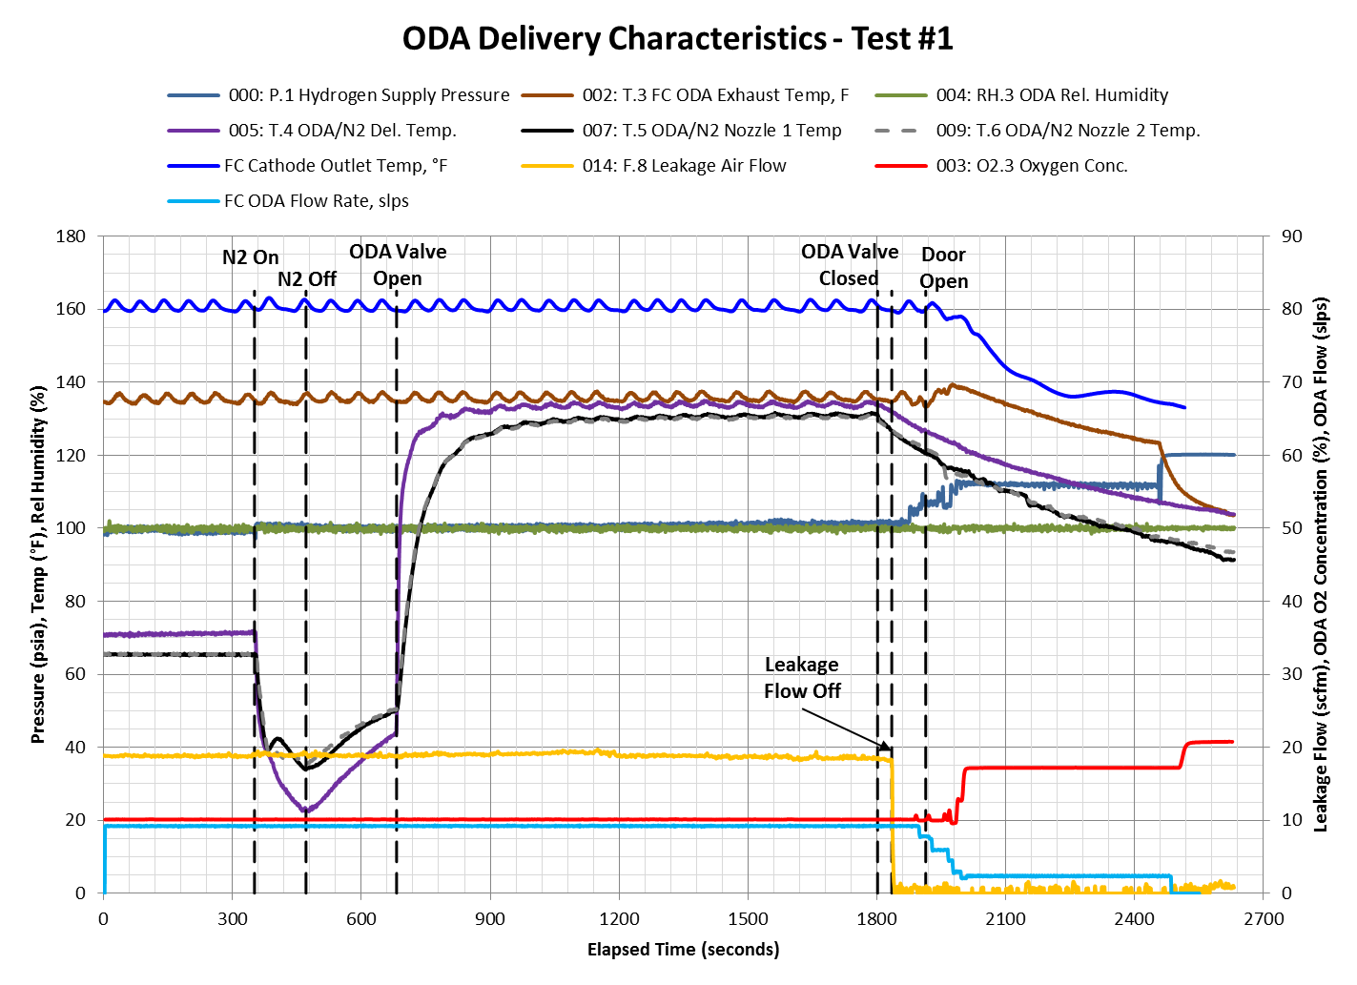

Slide 17
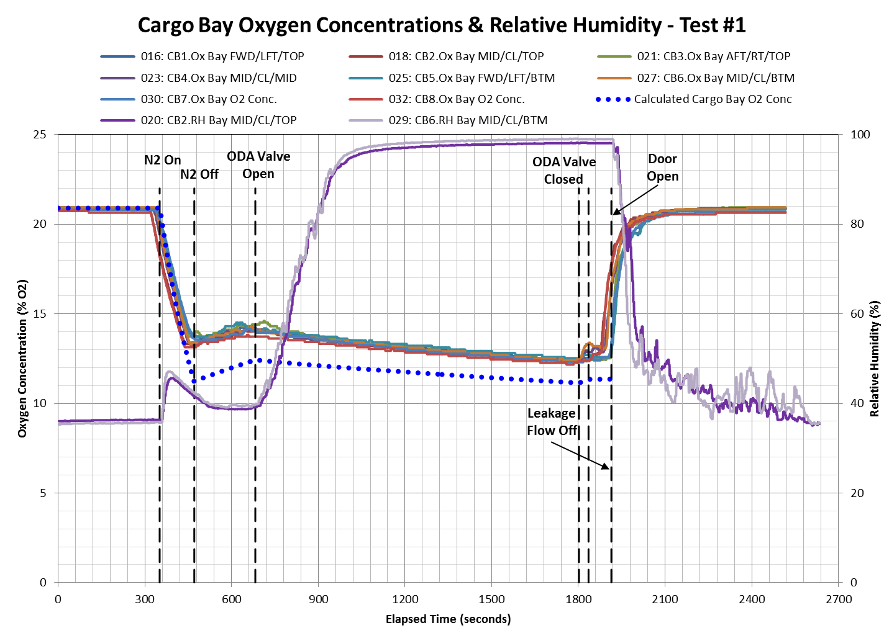
Leak in ODA bypass valving led to incomplete N2 knockdown of cargo bay

Slide 18
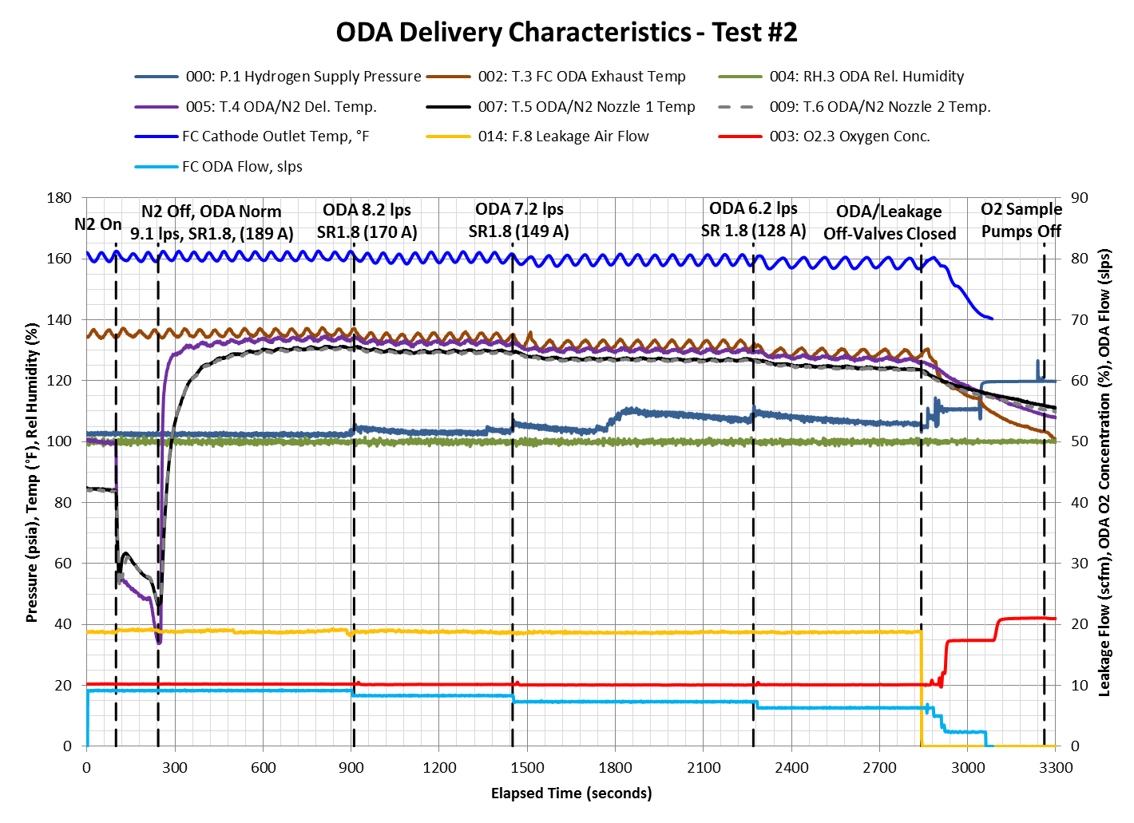

Slide 19
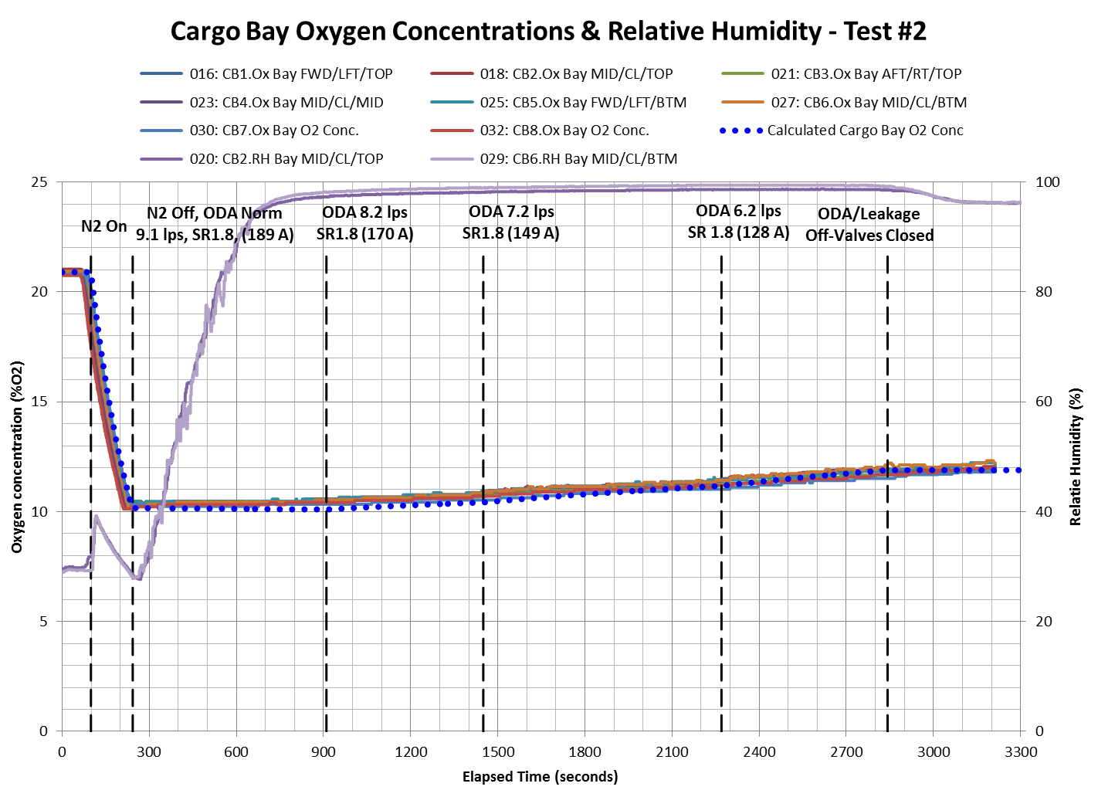

Slide 20
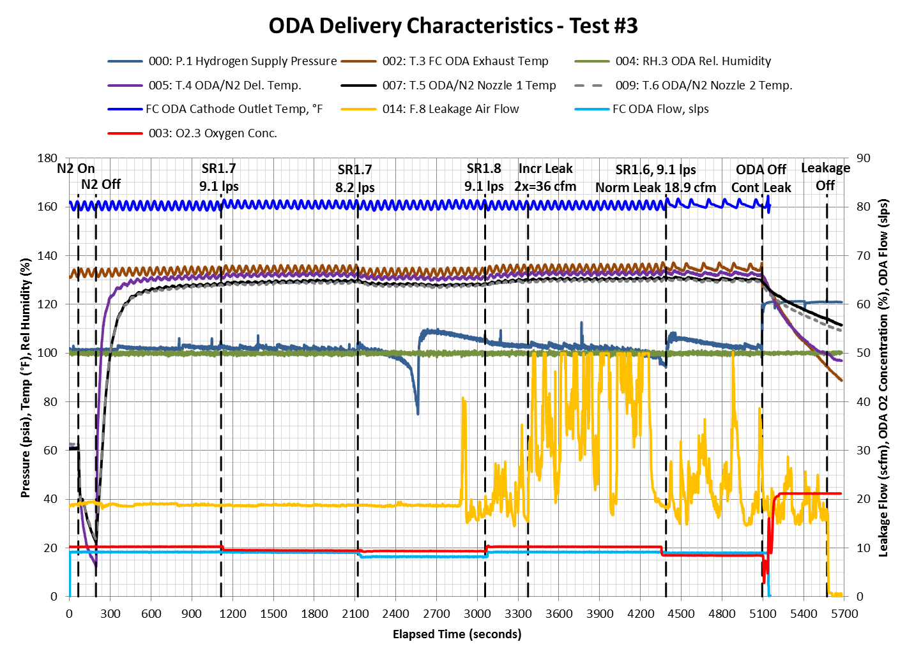
Water content begins to affect leakage readings

Slide 21
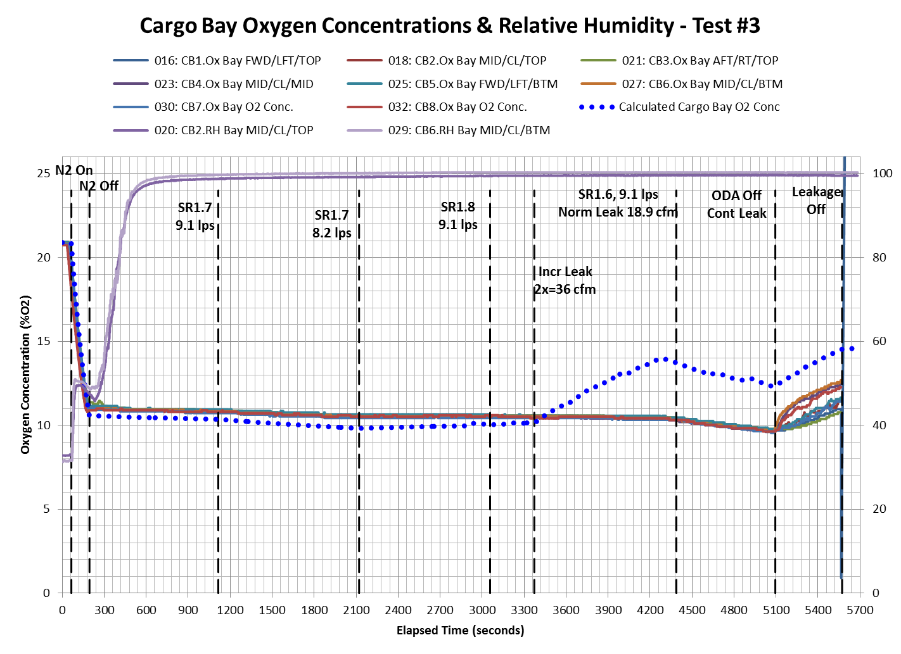
Increased leakage flow appears to have not been achieved due to water content

Slide 22
Summary
ODA from the fuel cell system exhibited potential to maintain an oxygen deprived environment under a variety of operating conditions.
Results with increased leakage flow raise questions, as expected increase in O2 concentration was not observed.
  Cause is attributed to incorrect leakage flow readings caused by increased water content (increased leakage flow never actually achieved)

Slide 23
Next Steps
Final report will be developed and published on www.fire.tc.faa.gov
Further data is needed on actual O2 concentration required to suppress a cargo fire, particularly with increased humidity resulting from ODA flow

